Slide 1


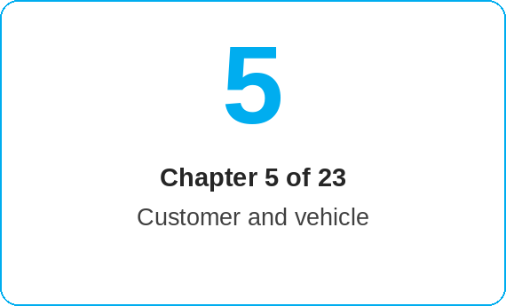

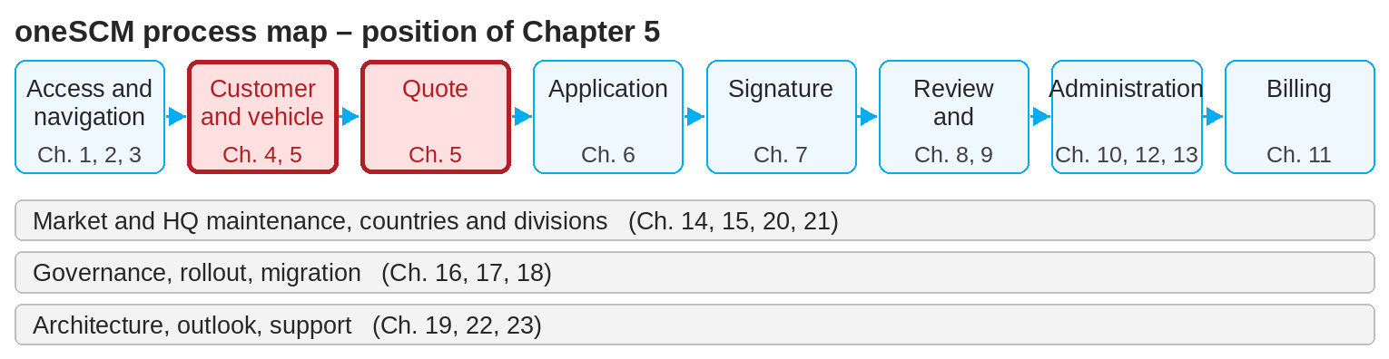
oneSCM – Preparing Vehicle, Product and Quote
oneSCM
for Cars
Purpose and benefit
You select the contract type and entry point, load vehicle data, select product and scope of services, configure term, mileage and options and create a quote with campaigns and discounts (Chapter 5.1 to 5.8).
References to handbook chapters and systems are highlighted; e-mail addresses are provided as links.
How to proceed
Topics at a glance
Click "Create contract" and select the contract type (5.1).
Depending on the phase, enter the appropriate entry point to load the vehicle data (5.2):
  For a price indication: model series
  From quote: OTR deal ID
  From order: order number from GO
  From production: VIN
Add first registration, current mileage or license plate (5.3). If these are not yet known, activate the toggle.
Select the service/maintenance package (5.4) and configure payment interval, term, annual mileage and, if applicable, industry (5.5).
5.1 – 5.3 Vehicle
Contract types and entry points
Vehicle and case identifiers
Vehicle data, mandatory fields and validation rules
5.4 – 5.6 Product and price
Selecting products and scope of services
Configuring term, mileage and options
Prices, campaigns and discounts in the quote
5.7 – 5.8 Quote
Quote validity and changes
Handover to application creation
!
As soon as you click "Create application", you jump to customer data entry and can only edit the contract again later. Check product, term and mileage beforehand.
Note: This Quick Guide summarizes Chapter 5 of the oneSCM handbook. Details, screenshots and evidence can be found in the handbook.
AS OF: 2026-10-11 | 1/2

Slide 2
oneSCM – Preparing Vehicle, Product and Quote
oneSCM
for Cars
Roles and prerequisites
How to proceed (continued)
Roles involved
Dealer: create and hand over quote
Market: provide products, prices and campaigns (Chapter 14)
MO: review for special approvals
Prerequisites
Customer is created or assigned (Chapter 4)
Vehicle identifier is available: model series, OTR deal ID, GO order number or VIN
Permitted products for market and division are known
If available, add technical options and additional services and select active campaigns or your own dealer discounts (5.6). Check eligibility against the campaign description.
Check the contract details in the payment plan and generate the "Price information" preview (PDF) for quote purposes. Note the quote validity (5.7).
With "Create application" you hand over the quote to application creation (5.8, Chapter 6).
Frequently asked questions and answers
Which identifier do I use before the order? The model series for a price indication; from quote the OTR deal ID, from order the order number from GO.
Can I change a quote later? Yes, until application creation; after that the change rules from Chapter 5.7 and 10.2 apply.
How long is a quote valid? Validity depends on market requirements and price version (Chapter 5.7 and 14.9).
Checklist before completion
☐ Entry point selected to match the phase
☐ Vehicle data loaded and mandatory fields checked
☐ Product, term and mileage match the customer's wishes
☐ Campaign permitted, price information generated
Important links and contacts
OTR – Order and vehicle reference (Chapter 19.5).
MIC – Vehicle data API (Chapter 19.8).
oneSCM handbook – Complete chapters with screenshots, role, status and scope matrices (Appendix D).
Support and escalation – Report a support case with reference number, market, division and screenshot (Chapter 23.4 and 23.5).
Notes and pitfalls
The payment intervals "one-time" and "monthly" are always available; other intervals depend on customer segment and term.
Model series with six, seven and eight digits are accepted; contingent products (sales logic "FRD Not Related") are found via the model series, not via the VIN (5.4).
If the identifier returns no products, check the first registration date and mileage: vehicles above the product's maximum age or maximum mileage receive no results (5.3).
Demonstrator and company cars count as used vehicles; only a pure maintenance package is possible for them.
Note: This Quick Guide summarizes Chapter 5 of the oneSCM handbook. Details, screenshots and evidence can be found in the handbook.
AS OF: 2026-10-11 | 2/2

