Slide 1


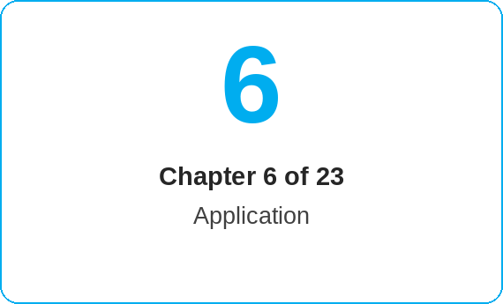

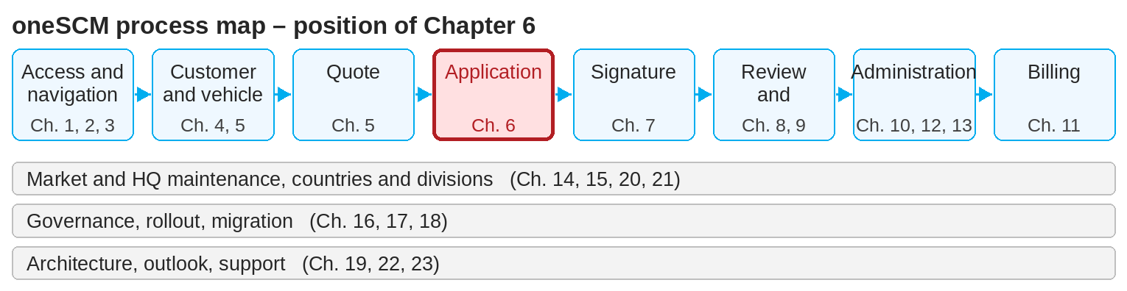
oneSCM – Creating a Service Contract and Completing the Application
oneSCM
for Cars
Purpose and benefit
You check prerequisites and contract type, enter contract data and mandatory fields, check customer, vehicle and product assignment, understand validation rules and save the application with a reference number (Chapter 6.1 to 6.7).
References to handbook chapters and systems are highlighted; e-mail addresses are provided as links.
How to proceed
Topics at a glance
Check contract type and prerequisites (6.1): vehicle, product and customer group must match the contract type.
Enter the contract data (6.2): mandatory fields are marked with an asterisk; missing entries block saving.
In the payment plan section, check the assignment of customer, vehicle and product (6.3) and use the application preview (PDF).
Read validation messages (6.4): red messages must be resolved; yellow notes allow you to continue.
6.1 – 6.3 Entering
Checking prerequisites and contract type
Entering contract data and mandatory fields
Checking customer, vehicle and product assignment
6.4 – 6.7 Checking and saving
Validation rules and error messages
Identifying special approvals in the standard process
Overview and final check
Saving the application and checking the reference
!
The payment interval can later only be changed to "one-time"; other changes require a new contract.
Identify special approvals (6.5): deviating conditions or customer groups trigger an MO review (Chapter 9 and 12.4).
Carry out the final check in the overview (6.6) and click the check mark to proceed to signing.
Save the application and note the reference number (6.7); it is the key for Application Management and support.
Note: This Quick Guide summarizes Chapter 6 of the oneSCM handbook. Details, screenshots and evidence can be found in the handbook.
AS OF: 2026-10-11 | 1/2

Slide 2
oneSCM – Creating a Service Contract and Completing the Application
oneSCM
for Cars
Roles and prerequisites
Frequently asked questions and answers
Can I change the application after saving? To a limited extent: first registration, license plate and documents via "Update" (Chapter 8.3); conditions require a new contract.
What does a special approval mean? The application deviates from the standard and is reviewed by the MO before it can be activated (Chapter 9 and 12.4).
Where can I see the reference number? In the overview after saving and in the first column of Application Management.
Roles involved
Dealer: enter, check and save application
MO: special approvals and review (Chapter 9)
Market: validation rules per market
Prerequisites
Quote is prepared (Chapter 5)
Customer is assigned (Chapter 4)
Role for application creation is activated (Chapter 2)
Important links and contacts
Transition module T6-7 – From saved application to payment data and signature.
oneSCM handbook – Complete chapters with screenshots, role, status and scope matrices (Appendix D).
FAQ and troubleshooting – Chapter 23 with questions per process phase and known errors per market and release.
Support and escalation – Report a support case with reference number, market, division and screenshot (Chapter 23.4 and 23.5).
Checklist before completion
☐ Contract type and prerequisites checked
☐ Mandatory fields complete, no red messages
☐ Customer, vehicle and product assigned correctly
☐ Application saved, reference number noted
Notes and pitfalls
In the handbook example, an application is submitted for a business customer; deviations for private customers and KAM-managed key accounts are marked.
You activate a collective invoice during the customer data check via the toggle at the bottom of the page.
Saved applications can be found under Application Management (Chapter 8.1).
Note: This Quick Guide summarizes Chapter 6 of the oneSCM handbook. Details, screenshots and evidence can be found in the handbook.
AS OF: 2026-10-11 | 2/2

