Slide 1


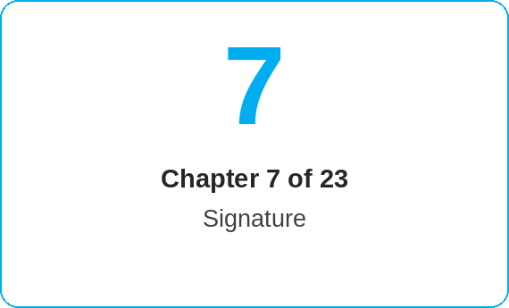
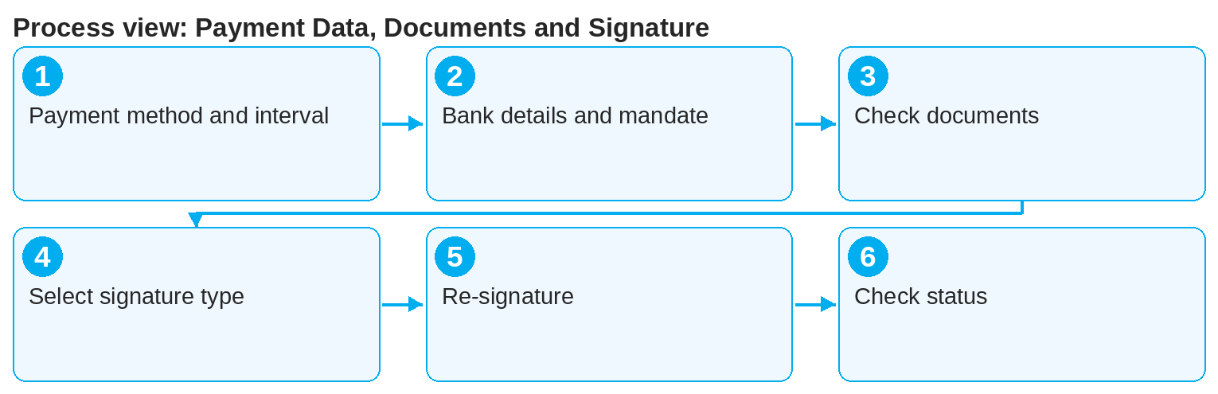
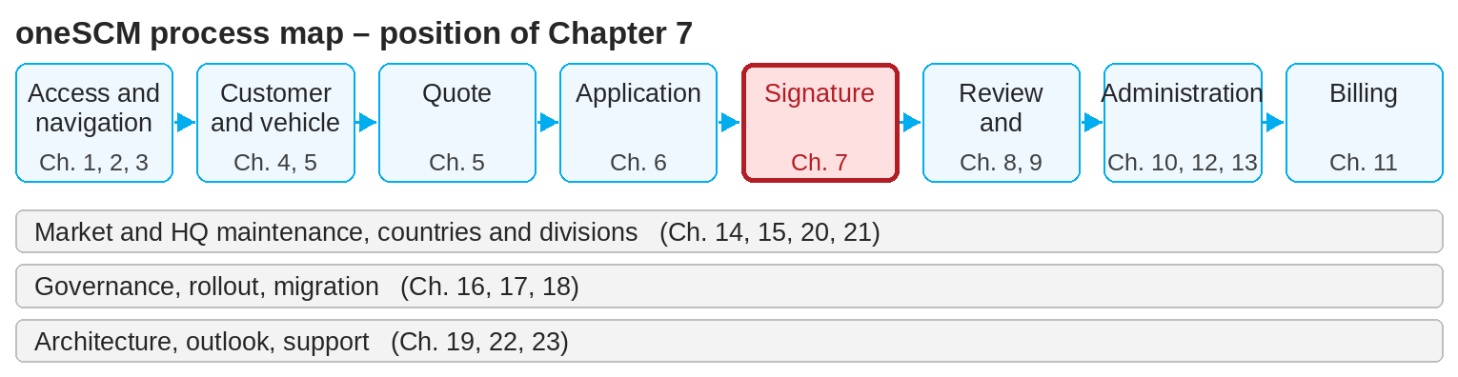
oneSCM – Payment Data, Documents and Signature
oneSCM
for Cars
Purpose and benefit
You enter payment method and payment interval, payer and invoice recipient, bank details and mandates, generate the contract documents in the correct language and obtain the signature digitally or manually (Chapter 7.1 to 7.8).
References to handbook chapters and systems are highlighted; e-mail addresses are provided as links.
How to proceed
Topics at a glance
Select payment method and payment interval (7.1) and define payer and invoice recipient (7.2).
Enter bank details and generate the SEPA mandate (7.3); for a collective invoice, activate the toggle.
Generate the application preview (PDF) and check the language variant of the documents (7.4).
7.1 – 7.3 Payment
Payment methods and payment intervals
Contract payer and invoice recipient
Bank details and mandates
7.4 – 7.6 Documents and signature
Contract documents and language variants
Digital signature
Manual signature and document upload
7.7 – 7.8 Checking
Multiple signatures and re-signature
Checking signature, document and application status
!
For contract review and activation, first registration, license plate and a copy of the ZB II must be available. For the print variant, contract documents and SEPA mandate must be uploaded separately.
Select the signature type (7.5 and 7.6):
  E-signature (QR code): customer scans the code, signs on mobile; filed automatically.
  Signature by e-mail: link by e-mail, access with 4-digit SMS code; filed automatically.
  Print document: handwritten signature, then scan and "Upload application".
For multiple signatories or changes, obtain the signature again (7.7).
Check signature, document and application status (7.8) before moving on to the activation check (Chapter 8).
Note: This Quick Guide summarizes Chapter 7 of the oneSCM handbook. Details, screenshots and evidence can be found in the handbook.
AS OF: 2026-10-11 | 1/2

Slide 2
oneSCM – Payment Data, Documents and Signature
oneSCM
for Cars
Roles and prerequisites
Frequently asked questions and answers
The customer has no mobile number on file. What now? The e-mail variant requires SMS verification; use the e-signature via QR code or the print variant.
Can a document be uploaded later? Yes, via Application Management › Update › Communication (Chapter 8.3).
What happens with a re-signature? The previous document is replaced; the signature status starts over (Chapter 7.7).
Roles involved
Dealer: enter payment data, obtain signature, upload documents
Customer: signing via QR code, e-mail or on paper
MO: review of signature and document status
Prerequisites
Application is saved (Chapter 6)
Customer e-mail and mobile number are stored in the customer master
Payer's bank details are available
Important links and contacts
Transition module T7-8 – From documents and signature to the activation check.
MPay – Payment integration (Chapter 19.15).
oneSCM handbook – Complete chapters with screenshots, role, status and scope matrices (Appendix D).
Support and escalation – Report a support case with reference number, market, division and screenshot (Chapter 23.4 and 23.5).
Checklist before completion
☐ Payment method, interval, payer and invoice recipient entered
☐ SEPA mandate generated or uploaded
☐ Documents in the correct language variant
☐ Signature status "signed" checked
Notes and pitfalls
With digital signing, the contract is sent to the customer automatically.
The print variant is suitable when several signatures are required or when no digital signature is possible.
Alternatively, the contract document can be opened on a computer via the link.
Note: This Quick Guide summarizes Chapter 7 of the oneSCM handbook. Details, screenshots and evidence can be found in the handbook.
AS OF: 2026-10-11 | 2/2

