Slide 1


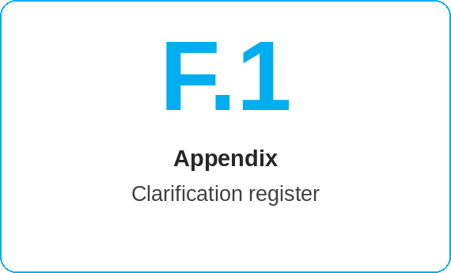
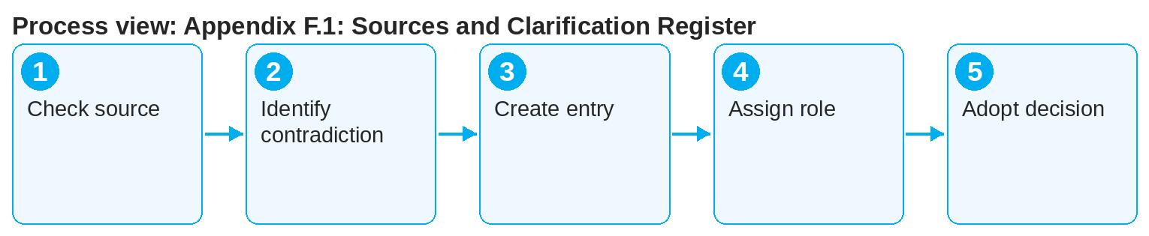
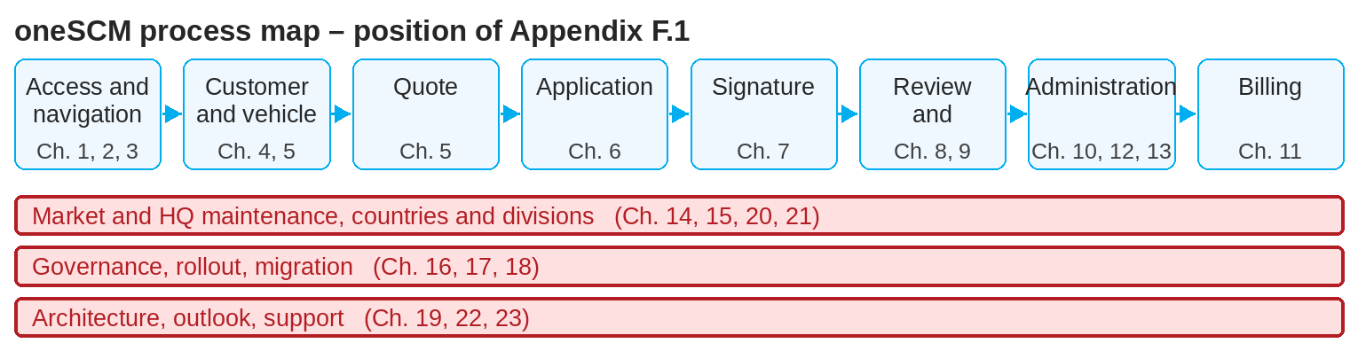
oneSCM – Appendix F.1: Sources and Clarification Register
oneSCM
for Cars
Purpose and benefit
The source index substantiates every handbook statement; the clarification register collects contradictions, gaps and open questions with status and owners. This guide shows how to use both and create entries.
How to proceed
References to handbook chapters and systems are highlighted; e-mail addresses are provided as links.
For a statement, check the source in the source index and its evidence status.
If you find a contradiction or a gap, create an entry in the clarification register: chapter, statement, observation, source.
Assign the entry to the responsible role (Market, HQ, MO) and set the status to "open".
Contents at a glance
Sources
Source type: system documentation, ticket, business decision, test
Evidence status: confirmed, open, contradictory
Version reference (Chapter 16.6)
Clarification register
Entry: chapter, statement, contradiction or gap
Status: open, under clarification, decided
Responsible role and due date
!
No change to the handbook without a source. Statements without confirmed evidence are marked as open and must not be used in training (Chapter 16.4).
Track the decision; the result is adopted into the chapter and the source is updated.
Before releases, check the chapter's open entries (Chapter 22).
Note: This Quick Guide summarizes Appendix F.1 of the oneSCM handbook. Details, screenshots and evidence can be found in the handbook.
AS OF: 2026-10-11 | 1/2

Slide 2
oneSCM – Appendix F.1: Sources and Clarification Register
oneSCM
for Cars
Roles and prerequisites
Frequently asked questions and answers
What is the difference between a source and a ticket? The source substantiates a statement; the ticket describes a change or an error. Both are referenced.
Who decides a clarification? The responsible role; for Blueprint questions, HQ (Chapter 15.4).
How long does an entry stay open? Until the decision; open entries are reviewed before each release.
Roles involved
All roles: report contradictions and gaps
Editorial team: keep register, maintain sources
HQ/Market: decide clarifications
Prerequisites
Chapter and statement concerned
Source or ticket reference, if available
Access to the register
Important links and contacts
Sources and clarification register – Appendix F.1.
Ticket-to-chapter mapping – Appendix E.1.
oneSCM Handbook – Complete chapters with screenshots, role, status and scope matrices (Appendix D).
Support and escalation – Report a support case with reference number, market, division and screenshot (Chapters 23.4 and 23.5).
Checklist before completion
☐ Source and evidence status checked
☐ Entry created in full
☐ Responsible role set
☐ Decision adopted into chapter
Notes and pitfalls
The register is required reading before releases and training.
Data protection: no personal data in entries (Chapter 16.1).
Ticket references link the register and the mapping (Appendix E).
Note: This Quick Guide summarizes Appendix F.1 of the oneSCM handbook. Details, screenshots and evidence can be found in the handbook.
AS OF: 2026-10-11 | 2/2

