Slide 1


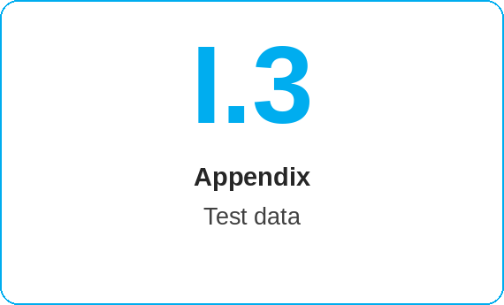
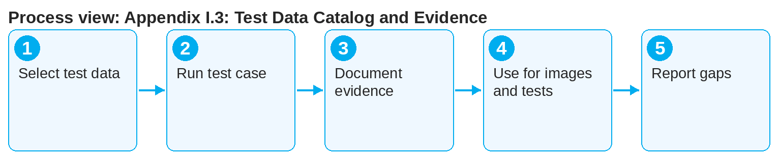
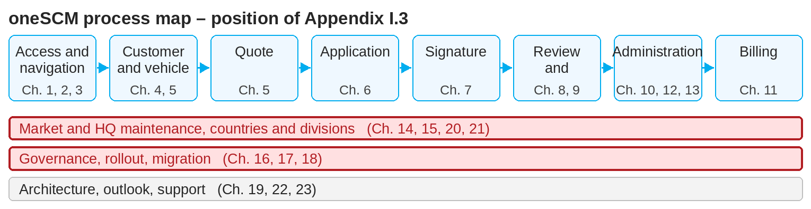
oneSCM – Appendix I.3: Test Data Catalog and Evidence
oneSCM
for Cars
Purpose and benefit
The test data catalog provides safe sample customers, vehicles, products and payment data for training, tests and screenshots and documents the evidence per test case. This guide shows how to select test data and file evidence.
How to proceed
Select the customer, vehicle and product from the catalog to match the test case or practical example.
Run the test case in the test or training system; use only test accounts for bank details.
Document the evidence: test case, date, release, environment, result.
References to handbook chapters and systems are highlighted; e-mail addresses are provided as links.
Contents at a glance
Catalog
Test customers: private, business, KAM
Test vehicles per division with VIN, model series, OTR deal ID
Test products, campaigns, bank details (test accounts)
Evidence
Test case, date, release, environment
Result and deviation
Reference to ticket and chapter (Appendix E)
!
Real customer, vehicle or bank data are not test data. Test data come exclusively from the catalog; production data are not permitted in tests and images (Chapter 16.1).
Also use test data for screenshots (Appendix G) and Product Testing (Chapter 14.12).
Report unusable or missing test data to the editorial team (Appendix F).
Note: This Quick Guide summarizes Appendix I.3 of the oneSCM handbook. Details, screenshots and evidence can be found in the handbook.
AS OF: 2026-10-11 | 1/2

Slide 2
oneSCM – Appendix I.3: Test Data Catalog and Evidence
oneSCM
for Cars
Roles and prerequisites
Frequently asked questions and answers
May I create a real vehicle in the training system? No, only test vehicles from the catalog.
Where do I file the evidence? In the evidence register of the catalog with reference to test case and release.
Are there test data for tyre contracts? Yes, test products with tyre type and tyre size (Chapter 13).
Roles involved
Trainer/tester: use test data
Market: Product Testing (Chapter 14.12)
Editorial team: maintain catalog and evidence
Prerequisites
Training or test system
Test case or practical example (Appendix I.1)
Data protection rules (Chapter 16.1)
Important links and contacts
Test data catalog and evidence – Appendix I.3.
Product Testing – Chapter 14.12.
oneSCM Handbook – Complete chapters with screenshots, role, status and scope matrices (Appendix D).
Support and escalation – Report a support case with reference number, market, division and screenshot (Chapters 23.4 and 23.5).
Checklist before completion
☐ Test data selected from the catalog
☐ Test case run in the test system
☐ Evidence fully documented
☐ Missing test data reported
Notes and pitfalls
Test vehicles are available per division with matching identifiers (Chapter 21.2).
Evidence is a prerequisite for the productive functional baseline (Chapter 16.4).
The catalog is updated with each release (Chapter 22).
Note: This Quick Guide summarizes Appendix I.3 of the oneSCM handbook. Details, screenshots and evidence can be found in the handbook.
AS OF: 2026-10-11 | 2/2

