Slide 1


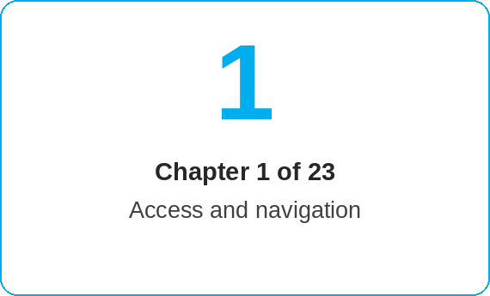
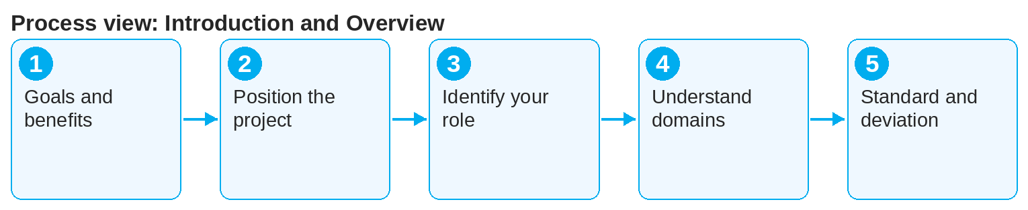

oneSCM – Introduction and Overview
oneSCM
for Vans
Purpose and benefit
oneSCM is the central system for service contract and maintenance products. This guide shows what oneSCM is used for, which roles work together and how the global standard interacts with local variants per market (Chapter 1.1 to 1.6).
How to proceed
Read Goals and benefits (1.1): oneSCM combines price information, quote, application, contract and management in one system.
Position the project (1.2): oneSCM replaces legacy systems and maps the contract process for Cars and Vans uniformly.
Identify your role (1.3 and 1.4) and the related chapters:
  Dealer: Chapters 4 to 8 and 10
  MO: Chapters 9 and 10
  Market: Chapter 14
  HQ: Chapter 15
References to handbook chapters and systems are highlighted; e-mail addresses are provided as links.
Topics at a glance
1.1 – 1.3 Goals and roles
Goals and benefits of oneSCM
Project background and context
Roles involved and tasks
1.4 – 1.6 Ecosystem and standard
Roles in the oneSCM ecosystem
Business domains and collaboration
Global standard and local variants
!
Country-specific deviations from the Blueprint are only valid if they are documented and approved in the country deviation register (Chapter 20.6).
Understand the business domains (1.5): customer, vehicle, product, contract, payment and document are interlinked.
Note standard and deviation (1.6): The Blueprint applies globally; country deviations are documented in the register (Chapter 20).
Note: This Quick Guide summarizes Chapter 1 of the oneSCM handbook. Details, screenshots and evidence can be found in the handbook.
AS OF: 2026-10-11 | 1/2

Slide 2
oneSCM – Introduction and Overview
oneSCM
for Vans
Roles and prerequisites
Frequently asked questions and answers
What does oneSCM stand for? For central Service Contract Management: quote, application, contract and management of service and maintenance products.
Does the handbook apply to Cars and Vans? Yes. Division differences are described in Chapter 21, country differences in Chapter 20.
Where do I start as a new user? With Chapter 2 (access) and Chapter 3 (navigation), then with the process chapter for your role.
Roles involved
Dealer (dealership): quote, application, Application Management
MO (Market Operation): business review and activation
Market: product, price and campaign maintenance, administration
HQ: Blueprint, global standards, central master data
Prerequisites
Access to oneSCM via RetailPortal or direct link (Chapter 2)
Knowledge of your own market, division and dealership context
Handbook Chapter 1 as an entry point before all process chapters
Important links and contacts
oneSCM handbook – Complete chapters with screenshots, role, status and scope matrices (Appendix D).
oneSCM RetailPortal – System news and training material.
Glossary – Appendix A with terms and abbreviations.
Support and escalation – Report a support case with reference number, market, division and screenshot (Chapter 23.4 and 23.5).
Checklist before completion
☐ Own role and market are known
☐ Relevant handbook chapters are identified
☐ Access to oneSCM is requested or available
☐ Glossary and process map are known
Notes and pitfalls
Terms and abbreviations (MO, HQ, OTR, VIN, ZB I) can be found in the glossary (Appendix A).
The process map (Chapter 3.4) shows the order of the process chapters.
Reading paths per role are in the preface (V.2).
Note: This Quick Guide summarizes Chapter 1 of the oneSCM handbook. Details, screenshots and evidence can be found in the handbook.
AS OF: 2026-10-11 | 2/2

