Slide 1


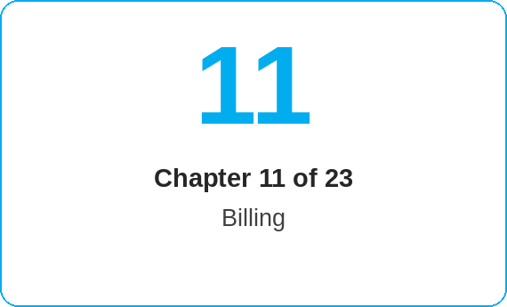
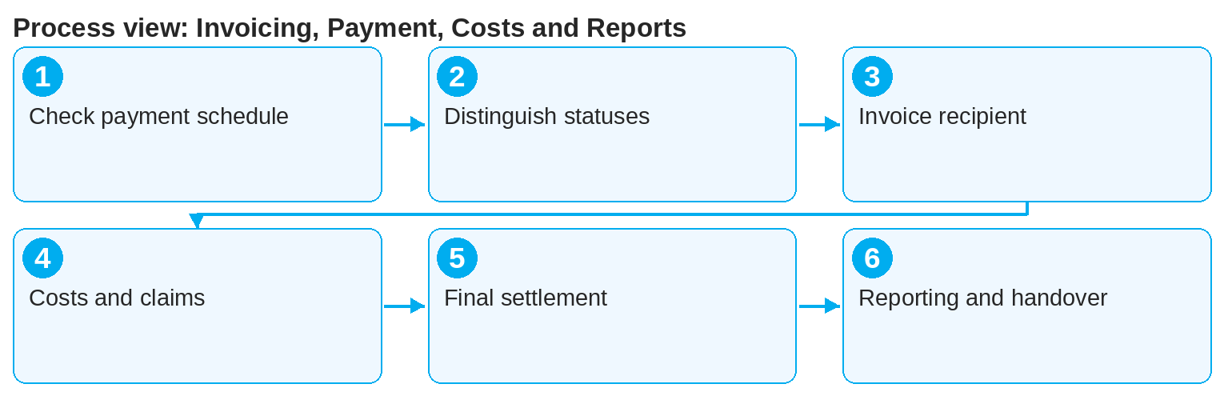
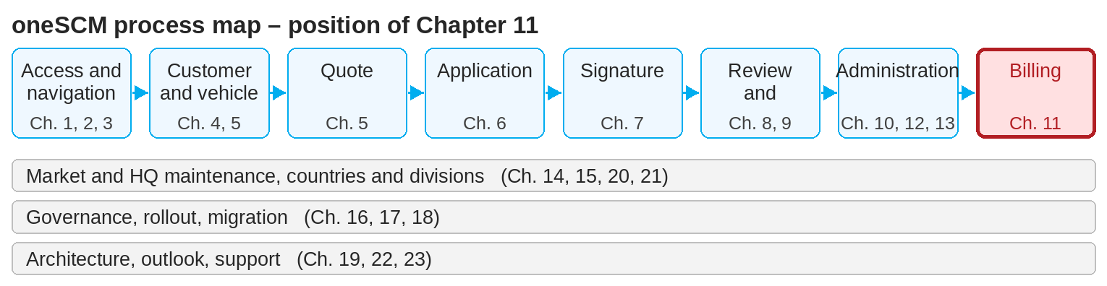
oneSCM – Invoicing, Payment, Costs and Reports
oneSCM
for Vans
Purpose and benefit
You understand invoicing and payment schedules, distinguish invoice and payment status, handle different invoice recipients and collective invoices, know cost management and claims, final settlement and corrections and use reporting and exports (Chapter 11.1 to 11.8).
References to handbook chapters and systems are highlighted; e-mail addresses are provided as links.
How to proceed
Check the contract's payment schedule (11.1): interval, amounts and due dates.
Distinguish invoice status (issued, cancelled) and payment status (open, paid, overdue) (11.2).
For a different invoice recipient or collective invoice, check the assignment from Chapter 7.2 (11.3).
Topics at a glance
11.1 – 11.4 Invoice and costs
Invoicing and payment schedules
Distinguishing invoice status and payment status
Different invoice recipients and collective invoice
Cost management and claims
11.5 – 11.8 Settlement and reporting
Workshop and supplier references
Final settlement, refund and corrections
Reporting, filters and exports
Handing over deviations to the department or support
!
Invoice and payment status are separate values. An issued invoice is not paid, and an incoming payment does not automatically change the contract status.
Track costs and claims per contract (11.4) and the workshop and supplier references (11.5).
On closure, the final settlement takes place with refund or correction (11.6).
Use reporting, filters and exports for analyses (11.7) and hand over deviations to the department or support (11.8).
Note: This Quick Guide summarizes Chapter 11 of the oneSCM handbook. Details, screenshots and evidence can be found in the handbook.
AS OF: 2026-10-11 | 1/2

Slide 2
oneSCM – Invoicing, Payment, Costs and Reports
oneSCM
for Vans
Roles and prerequisites
Frequently asked questions and answers
Why is the contract "paid" but the invoice "open"? Both statuses come from different systems and are updated at different times (11.2).
Who corrects an incorrect invoice? The Finance department via the correction process; you hand over the case with the reference number (11.6 and 11.8).
Can I export reports? Yes, via Reporting with filters and export (11.7), depending on your role.
Roles involved
Dealer: check invoice and payment status, workshop reference
Finance department: payment schedules, corrections, refunds
Market/HQ: reporting and analyses
Prerequisites
Contract is active and payment data is entered (Chapter 7)
Access to invoice and payment information
Knowledge of the interfaces to oneERP, NEMESIS and MPay (Chapter 19)
Important links and contacts
NEMESIS – Accounting processing (Chapter 19.14).
MPay – Payment integration (Chapter 19.15).
oneSCM handbook – Complete chapters with screenshots, role, status and scope matrices (Appendix D).
Support and escalation – Report a support case with reference number, market, division and screenshot (Chapter 23.4 and 23.5).
Checklist before completion
☐ Payment schedule and due dates checked
☐ Invoice and payment status read correctly
☐ Invoice recipient and collective invoice appropriate
☐ Deviation handed over with reference number
Notes and pitfalls
Accounting processing takes place in NEMESIS, payments via MPay, customer data via oneERP (Chapter 19.11 to 19.15).
When a workshop invoice is accepted, the system transfers the mileage into the contract's mileage history (10.9, 11.5).
Calculation examples for refunds are in Appendix I.2.
Note: This Quick Guide summarizes Chapter 11 of the oneSCM handbook. Details, screenshots and evidence can be found in the handbook.
AS OF: 2026-10-11 | 2/2

