Slide 1


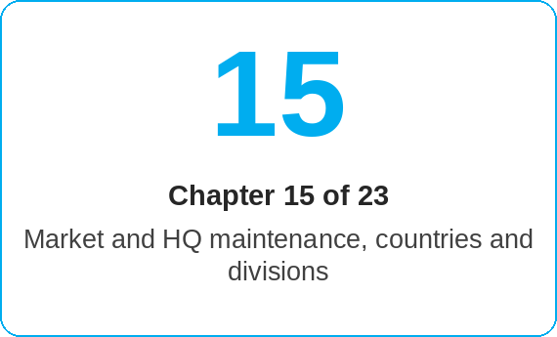
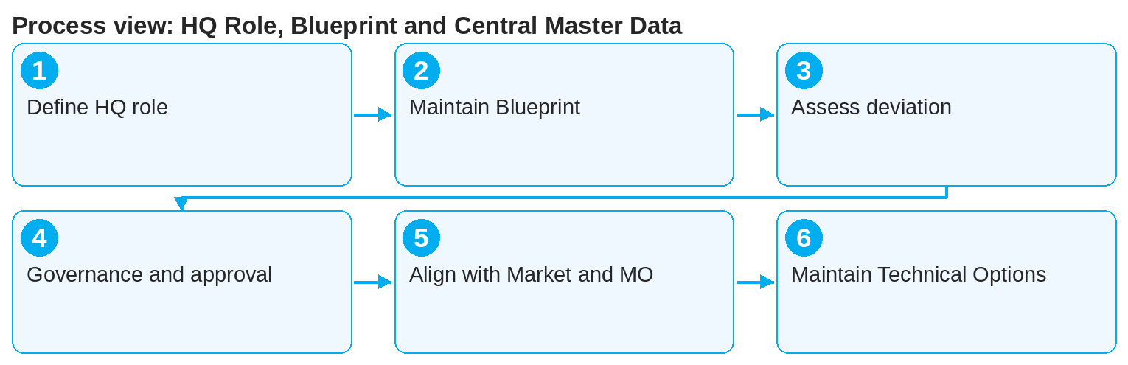

oneSCM – HQ Role, Blueprint and Central Master Data
oneSCM
for Vans
Purpose and benefit
You know the tasks and scope of the HQ role, maintain the Blueprint and global standards, handle country deviations, steer governance and approvals, work together with Market and MO and are responsible for Technical Options, SA matching and coverage codes (Chapter 15.1 to 15.7).
References to handbook chapters and systems are highlighted; e-mail addresses are provided as links.
How to proceed
Distinguish the HQ role from Market and MO (15.1).
Maintain the Blueprint and the global standards as the binding basis for all markets (15.2).
Assess country deviations and approve or reject them (15.3); record the result in the register (Chapter 20.6).
Topics at a glance
15.1 – 15.4 Blueprint and governance
Tasks and scope of the HQ role
Blueprint maintenance and global standards
Handling country deviations
Governance and approvals at HQ level
15.5 – 15.7 Collaboration and master data
Collaboration with Market and MO
Task description versus documented navigation
Technical options, SA matching, coverage and industry codes
!
Changes to coverage codes and SA matching affect all markets and divisions. They are published only after approval and with test evidence (Chapter 16.4).
Steer governance and approvals at HQ level (15.4) following the approval workflow from Chapter 16.3.
Align with Market and MO (15.5); distinguish between task description and documented navigation in the system (15.6).
Maintain technical options, SA matching, coverage and industry codes centrally (15.7); they control product assignment and claiming of services. Markets appear in the language of the market settings.
Note: This Quick Guide summarizes Chapter 15 of the oneSCM handbook. Details, screenshots and evidence can be found in the handbook.
AS OF: 2026-10-11 | 1/2

Slide 2
oneSCM – HQ Role, Blueprint and Central Master Data
oneSCM
for Vans
Roles and prerequisites
Frequently asked questions and answers
What is the Blueprint? The global standard process with products, rules and master data from which markets may deviate only in a documented way (15.2).
Who maintains coverage codes? HQ centrally; markets use them in product definition and claiming of services (15.7).
How do HQ and Market proceed in case of conflicts? Via the clarification register and the governance approval (15.4 and 16.7).
Roles involved
HQ: Blueprint, global standards, central master data
Market: local configuration and feedback (Chapter 14)
MO: check rules and quality feedback (Chapter 9)
Prerequisites
HQ role with central maintenance rights
Governance process and approval levels known (Chapter 16)
Country deviation register accessible (Chapter 20.6)
Important links and contacts
Transition module T15-14 – Handing over central foundations to market maintenance.
Transition module T15-16 – From the maintenance decision to governance evidence.
oneSCM handbook – Complete chapters with screenshots, role, status and scope matrices (Appendix D).
Support and escalation – Report a support case with reference number, market, division and screenshot (Chapters 23.4 and 23.5).
Checklist before completion
☐ Blueprint change justified and approved
☐ Country deviation assessed and in the register
☐ Technical Options and coverage codes tested
☐ Market and MO informed
Notes and pitfalls
The Blueprint is the reference for training and handbook; deviations are documented per country (Chapter 20).
Group names of technical options are unique per division; the Blueprint wizard ends with the step "Overview & Confirmation" (15.2, 15.7).
Transition modules T15-14 and T15-16 connect HQ maintenance with Market and governance.
Note: This Quick Guide summarizes Chapter 15 of the oneSCM handbook. Details, screenshots and evidence can be found in the handbook.
AS OF: 2026-10-11 | 2/2

