Slide 1


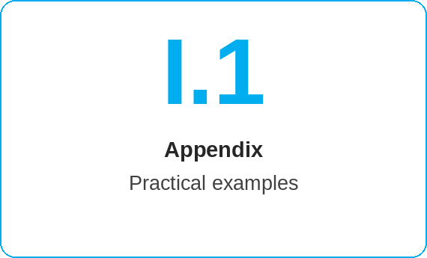
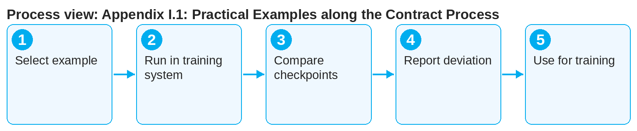
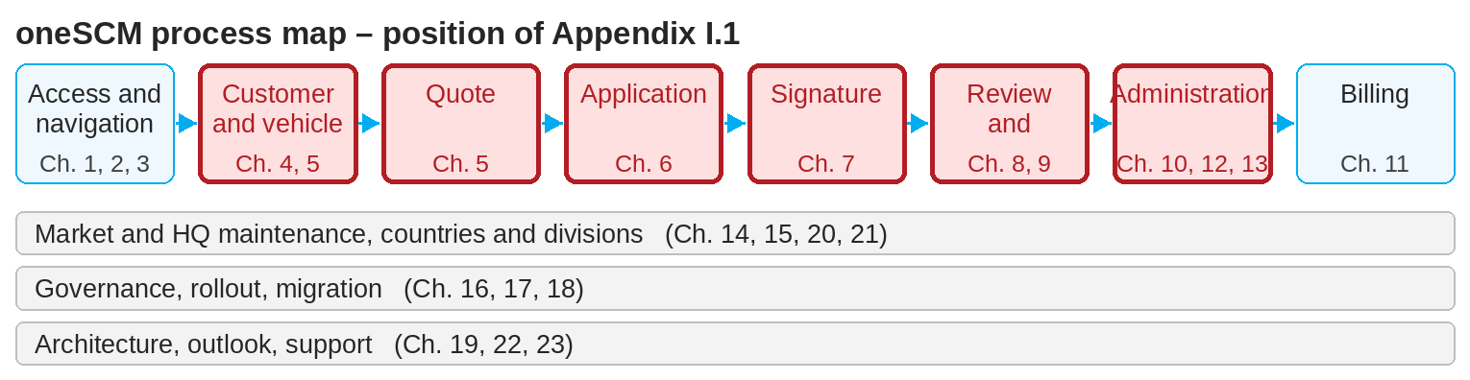
oneSCM – Appendix I.1: Practical Examples along the Contract Process
oneSCM
for Vans
Purpose and benefit
The practical examples walk through end-to-end cases from quote to termination: business customer with collective invoice, private customer with e-signature, KAM-managed key account with special case, tyre contract. This guide shows how to follow the examples and use them in training.
How to proceed
Select the example that matches your role and customer group.
Carry out the steps in the training system with the specified test data (Appendix I.3).
At each checkpoint, compare your status with the status documented in the example.
References to handbook chapters and systems are highlighted; e-mail addresses are provided as links.
Contents at a glance
Examples
Example 1: Business customer, collective invoice, signature by e-mail
Example 2: Private customer, e-signature via QR code
Example 3: KAM-managed key account with special case request
Example 4: Tyre contract (Chapter 13)
End-to-end phases
Quote and application (Chapters 5 and 6)
Payment and signature (Chapter 7)
Review and activation (Chapters 8 and 9)
Change and termination (Chapter 10)
!
Run practical examples only in the training or test system. In the production system, real applications are created and reviewed by Customer Management.
In case of deviations, check the chapter and clarification register; report new deviations (Appendix F).
Use the examples for knowledge checks (Appendix H) and calculation examples (Appendix I.2).
Note: This Quick Guide summarizes Appendix I.1 of the oneSCM handbook. Details, screenshots and evidence can be found in the handbook.
AS OF: 2026-10-11 | 1/2

Slide 2
oneSCM – Appendix I.1: Practical Examples along the Contract Process
oneSCM
for Vans
Roles and prerequisites
Frequently asked questions and answers
Which example suits Vans dealers? Example 1 (business customer) and Example 2 (private customer), both with Vans identifiers.
Are there examples of rejections? Yes, Example 3 contains a special case request with rejection and resubmission.
Where does the test data come from? From the test data catalog in Appendix I.3.
Roles involved
Dealer: examples for quote, application, signature
MO: examples for review and rejection
Trainers: examples as practice cases
Prerequisites
Test environment or training system
Test data from Appendix I.3
Chapters 4 to 10 read
Important links and contacts
Practical examples – Appendix I.1.
Test data catalog – Appendix I.3.
Calculation examples – Appendix I.2.
oneSCM Handbook – Complete chapters with screenshots, role, status and scope matrices (Appendix D).
Checklist before completion
☐ Appropriate example selected
☐ Run with test data in the training system
☐ Status compared at checkpoints
☐ Deviations reported
Notes and pitfalls
Example 1 corresponds to the case in the Vans template "Application creation and management".
Division differences are marked in the examples (Chapter 21).
Checkpoints correspond to the checklists in Appendix B.
Note: This Quick Guide summarizes Appendix I.1 of the oneSCM handbook. Details, screenshots and evidence can be found in the handbook.
AS OF: 2026-10-11 | 2/2

