Slide 1
Unsupervised Extreme Learning Machines ( US-ELM )

Slide 2
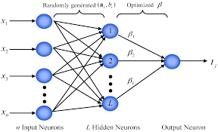
Extreme Learning Machines
Extreme learning machines are feedforward neural network used for classification , regression, clustering and feature extraction.
ELM was first introduced by Huang in 2010 which was for the supervised task.
ELM was extended to perform unsupervised task in 2014 by Gao Huang.
ELM consists of only one hidden layer where the weights between the input layer and the hidden layer are randomly generated and the weights between the hidden layer and the output layer are computed.
ELM only updates the weights between the hidden layer and the output layer

Slide 3
Why is ELM required ?
ELM outperforms SVM in classification and regression problems.
ELM is able to learn thousands of times faster than networks trained using backpropagation.
ELM finds the global minima faster than all the known gradient based algorithms for feature extraction thereby minimizing the error at a faster rate.

Slide 4
Supervised ELMs
Consider a supervised learning problem where we have a training set with N samples : {X,Y} , where X is the input and Y is the corresponding label.
ELM training involves 2 stages :
Stage 1 :
Construct the hidden layer using a fixed number of randomly generated mapping neurons, which can be any nonlinear piecewise continuous functions, such as the Sigmoid function.
Let H be the hidden layer activations where
Let be the weights between the hidden layer and the output layer where
The outputs of the network is given by
where X is the input.
Notes:
β

Slide 5



Stage 2 :
In the second stage, ELMs aim to solve the output weights by minimizing the sum of the squared losses of the prediction errors, which leads to the following formulation:
where the first term in the objective function is a regularization term against over-fitting, e is the error vector and C is a penalty coefficient
on the training errors.
By substituting the constraints into the objective function, we obtain the following equivalent unconstrained optimization problem:
By differentiating the above equation, w.r.t to , we get :

Slide 6

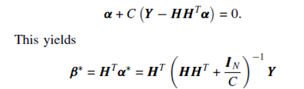
If H has more rows than columns and is of full column rank, which is usually the case where the number of training patterns is larger than the number of the hidden neurons, the above equation is overdetermined ( i.e. more equations than unknowns or an inconsistent system ) , then we have a closed form solution for as :
If the no of training patterns is smaller than the number of hidden neurons, then H will have more columns than rows, which often leads to an undetermined least squares problem. In this case, will have infinite no of solutions. To handle this problem, we restrict to be a linear combination of the rows of H :
Notice that when H has more columns than rows and is of full row rank , is invertible.
Multiplying the gradient equation , by we get :
In short, where is the pseudo-inverse of the matrix H.

Slide 7

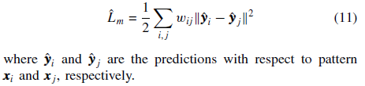
Manifold Regularization Framework
Semi-supervised learning is built on the following two assumptions:
both the labeled data Xl and the unlabeled data Xu are drawn from the same marginal distribution PX
(2) if two points x1 and x2 are close to each other, then the conditional probabilities P(y|x1) and P(y|x2) should be similar as well.
The cost function is given by :
Where is the pairwise similarity between the points xi and xj.
The conditional probability is difficult to compute. Hence, we approximate the above equation to :
Finding the pairwise similarity between the points xi and xj :
The non-zero weights are computed using the Gaussian function :

Slide 8


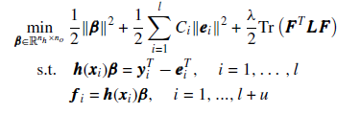
The equation (11) can be written in matrix form as :
Where Tr(.) denotes the trace of a matrix.
is known as the graph Laplacian.
D is the diagonal matrix having its diagonal elements as
The objective function of semi-supervised ELM by modifying the objective function of supervised ELM is given by :
Where is the hidden to output weights.
is the tradeoff parameter
F is the output matrix of the network
e is the error

Slide 9
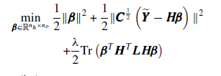



We substitute the constraints into the objective function, and rewrite the above formulation in a matrix form
Where is the augmented training target with first rows is equal to and rest of the rows is 0.
Again, we compute the gradient of the objective function with respect to , we get :
Then, we compute the output weights , which is given by :

Slide 10
Unsupervised ELM

Slide 11


Unsupervised ELM
In unsupervised setting, the entire training data X = {x_{i}} where i = 1 to N are unlabeled (N is the number of training patterns) and our target is to find the underlying structure of the original data.
The formulation of US-ELM follows from the formulation of SS-ELM. When there is no labeled data, SS-ELM Cost function is reduced to
Eq(1)
Note that the above formulation always attains its minimum at β = 0. we have to introduce additional constraints to avoid a degenerated solution. Specifically, the formulation of US-ELM is given by
Eq(2)

Slide 12

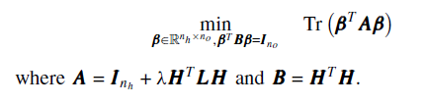
An optimal solution to (2) is given by choosing β as the matrix whose columns are the eigenvectors (normalized to satisfy the constraint) corresponding to the first no smallest eigenvalues of the generalized eigenvalue problem.
eq(3)
The eq(2) can rewritten as
The above trace minimization problem attains its optimum if and only if the column span of β is the minimum span of the eigenspace corresponding to the smallest no eigenvalues of eq(3). Therefore, by stacking the normalized eigenvectors of corresponding to the smallest no generalized eigenvalues,we obtain an optimal solution to eq(3).

Slide 13




Let γ₁, γ₂, . . . , γ_{no+1} (γ₁ ≤ γ₂ ≤ · · · ≤ γ_{no+1}) be the (n_{o} +1) smallest eigenvalues of eq(3) and v₁,v₂, . . . ,v_{no+1} be their corresponding eigenvectors. Then, the solution to the output weights β is given by
Where , i = 2,…n_{o}+1 are the normalized eigen vectors.
If the number of labeled data is smaller than the number of hidden neurons then ,then the alternate formulation is given by
eq(4)
Again, let u₁,u₂, . . . ,u_{no+1} be generalized eigenvectors corresponding to the (n_{o} + 1) smallest eigenvalues of eq(4), then the final solution is given by
where , , i = 2,…n_{o}+1 are the normalized eigen vectors.

Slide 14
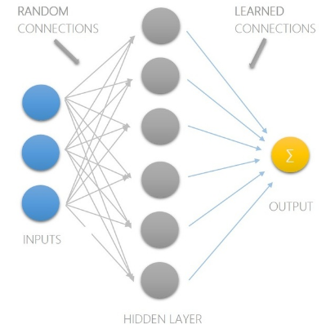
Unsupervised ELM Algorithm
Let X be the input, W be the weights between input and hidden neurons , be the weights between the hidden and the output neurons.
Step 1: Randomly initialize bias b, weights W connecting between input and hidden layer.
Step 2: Compute H matrix as where where,
no of rows = no of training samples
no of columns = no of hidden neurons
Step 3: Compute graph laplacian matrix where W is the similarity matrix and D is the diagonal matrix
Step 4: Compute
Step 5: Compute Matrix A given by
Step 6: Compute the Eigen vectors of matrix A.
7. Choose smallest n_{o} Eigen vectors corresponding to smallest eigen vectors.
8. Normalize the eigen vectors
9. Calculate embedded matrix E = Hβ.
10. Apply SOM/K-means to embedded matrix.

Slide 15
Step 7: Choose smallest n_{o} Eigen vectors corresponding to smallest eigen vectors.
Step 8: Normalize the eigen vectors
Step 9: Calculate embedded matrix
Step 10: Apply SOM/K-means to embedded matrix.

Slide 16
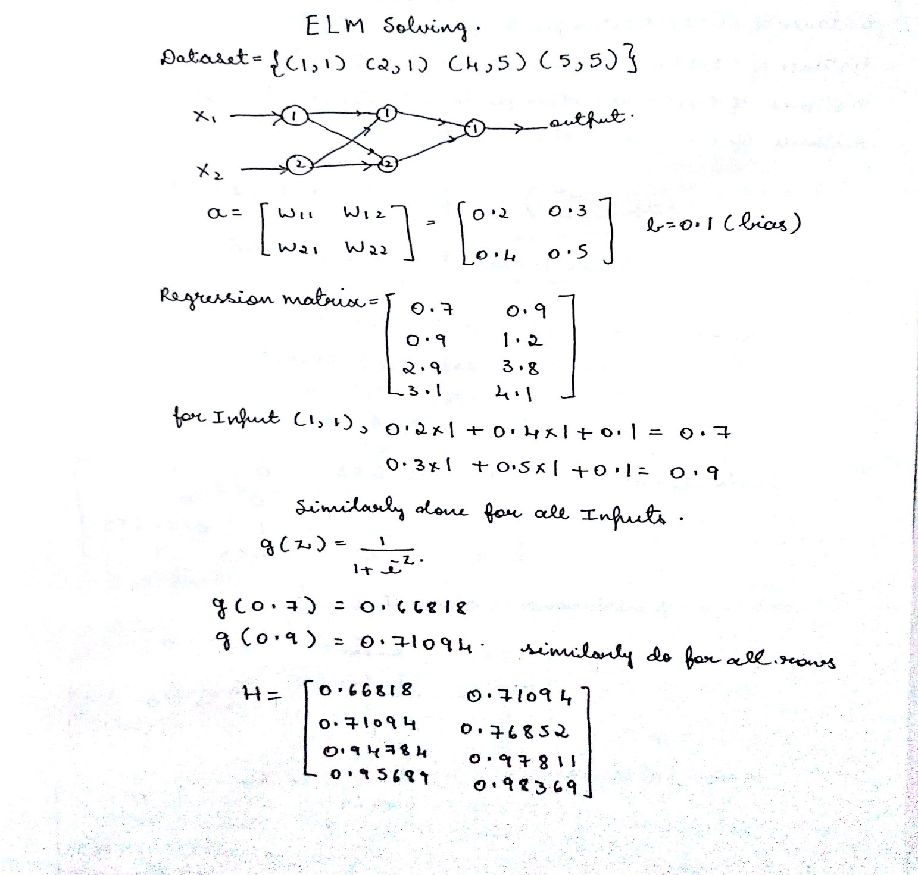
Manually Solved Example

Slide 17
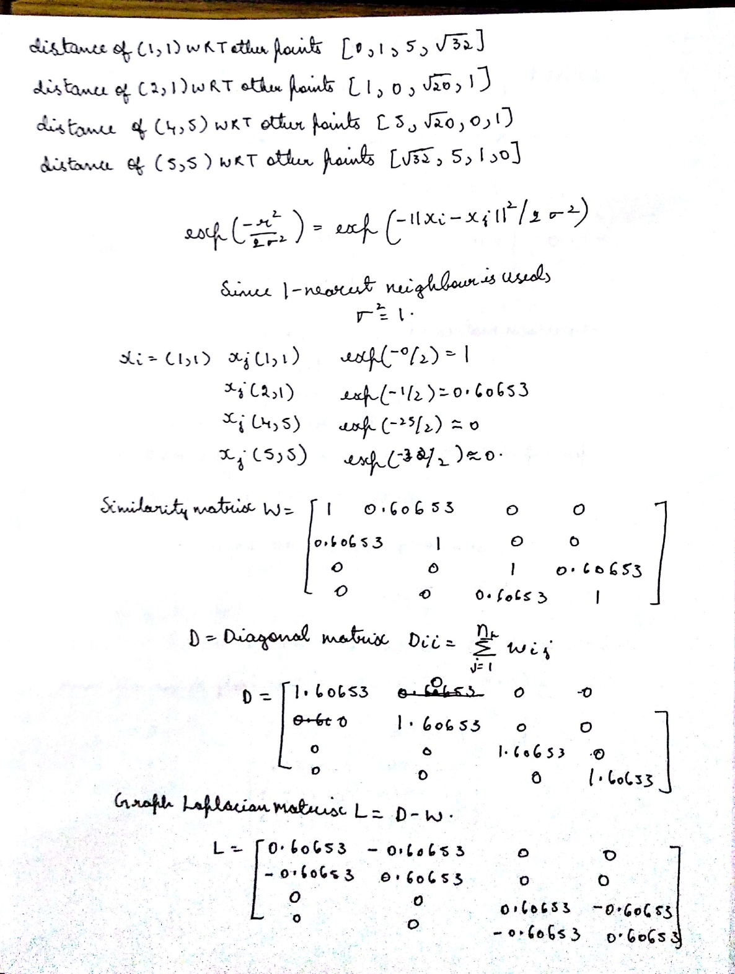

Slide 18
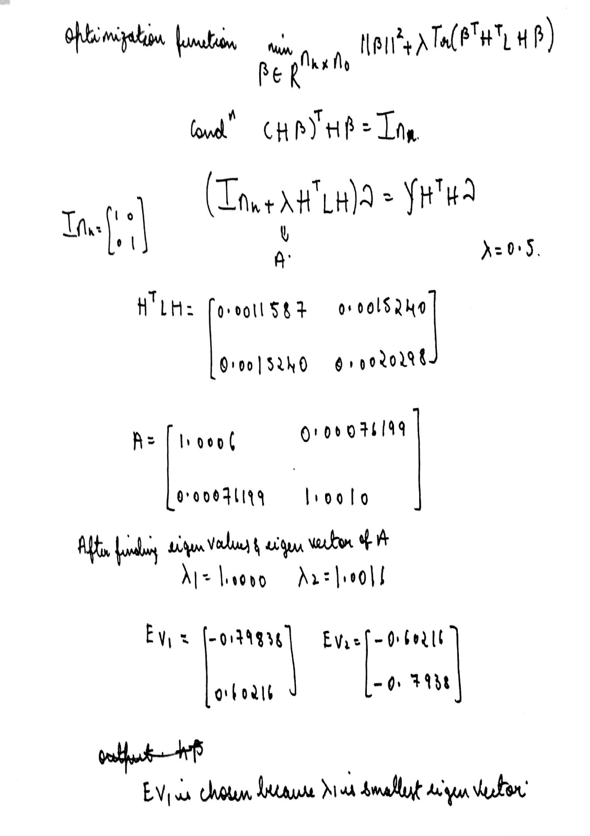

Slide 19
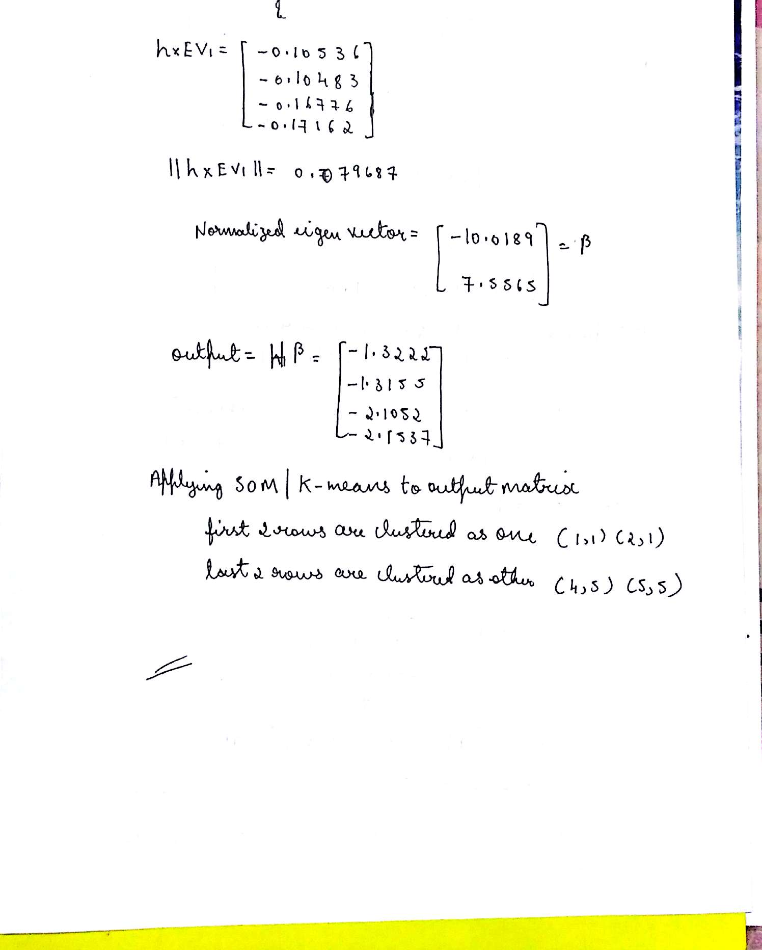

Slide 20
References
Semi-Supervised and Unsupervised Extreme Learning Machines Gao Huang, Shiji Song, Jatinder N. D. Gupta, and Cheng Wu.

