Slide 1
Achieving Multiple Tool and Technology Build Automation Success
Tom Canova
http://www.dell.com/us/enterprise

Slide 2
Agenda
The Multiple Tool Technology Challenge
The Ultimate Automation Goal
Automation Tips and Techniques
Gradle Techniques

Slide 3
Speaker Background
Co-op student on Space Shuttle verification team in 80’s
Started java development in the 90’s while working at a major oil company
Developed balance transfer internet application at major bank in 2000
Development Lead/Manager, Build Team Manager, Architect, SW Eng in 2000s
Build Automation Engineer @ Dell supporting new product development

Slide 4
The Multiple Tool Technology Challenge
Single vendor paradise …
The right tool for the right job
Legacy/inherited tools/technologies
Some technologies in our build technology stack
ant
maven
Jenkins
Microsoft TFS
subversion
Findbugs and Security Static Analysis Tools
OpenSuse Build Services (OBS)
various VMWare products
linux shell scripts, yum, etc…
gradle

Slide 5
The ultimate automation goal
Increase productivity and quality in the product being developed
limit manual tasks to the creative tasks involved in creating the product
provide timely and effective communication
support quality thru repeatability, automated testing, automated code analysis

Slide 6
Automation Tips and Techniques
Test First
Jenkins Plugins
Taking Jenkins further with Groovy
Loosely coupled jobs
Effective Communication
Reusability and Maintainability Tips

Slide 7
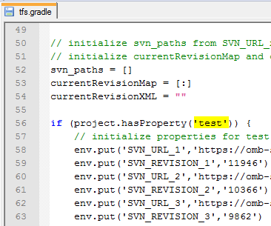
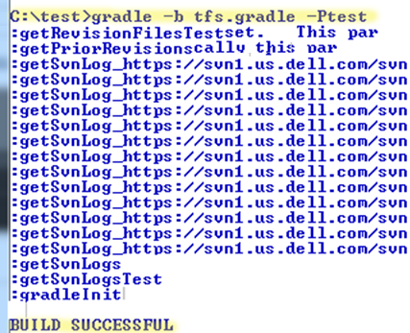
Test First
Test outside of Jenkins

Slide 8
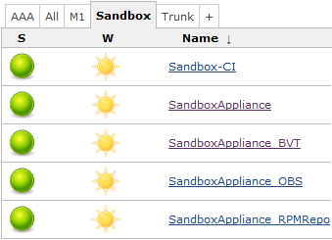
Test First
Jenkins Test Environment Options
Sandbox Jobs to test Jenkins changes without impacting execution of live jobs

Slide 9
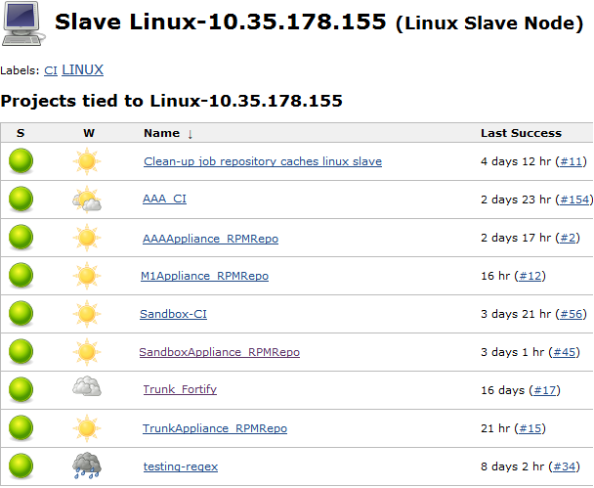
Test First
Use a Slave to isolate test load so automation changes that are being tested don’t have an adverse impact on your live jobs

Slide 10
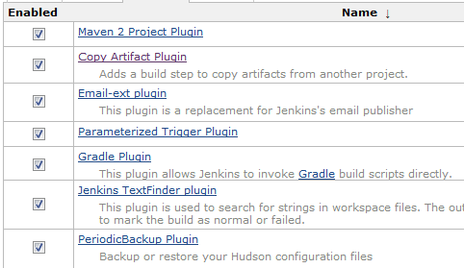
Plugins
Some plugins we are using to tie our multiple technologies together

Slide 11

Taking Jenkins further with
When existing plugins won’t do it all
Leverage a powerful language like groovy or ruby that works well with Jenkins
Why Groovy
Java ecosystem
Java expertise
Gradle, a Groovy DSL (alternative to Mvn+Ant)
Jenkins API

Slide 12
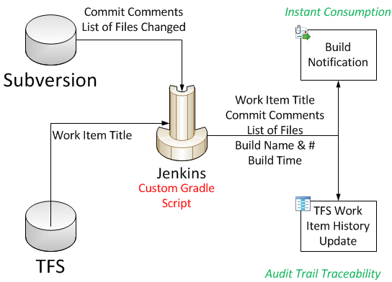
Taking Jenkins further with
Traceability & TFS, Subversion, Jenkins

Slide 13
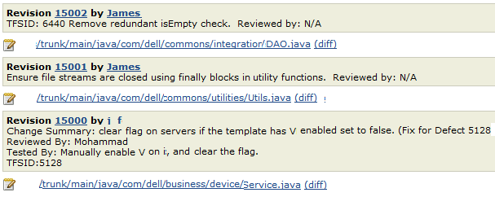
Taking Jenkins further with
Subversion Commit Comments

Slide 14
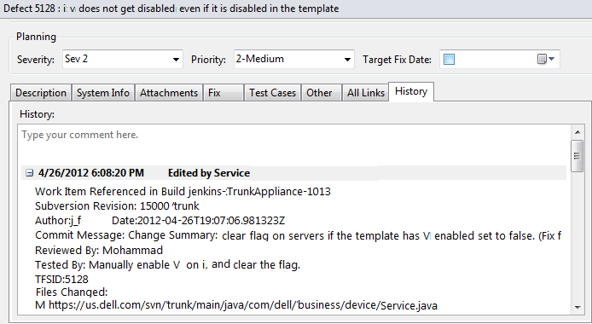
Taking Jenkins further with
TFS History

Slide 15
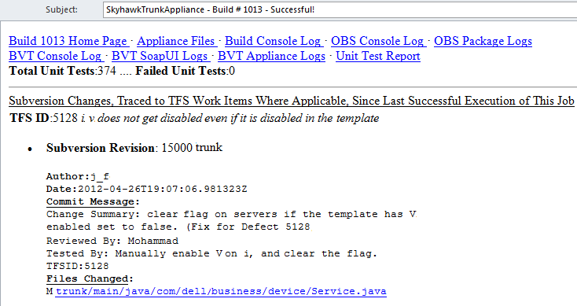
Taking Jenkins further with
Email

Slide 16
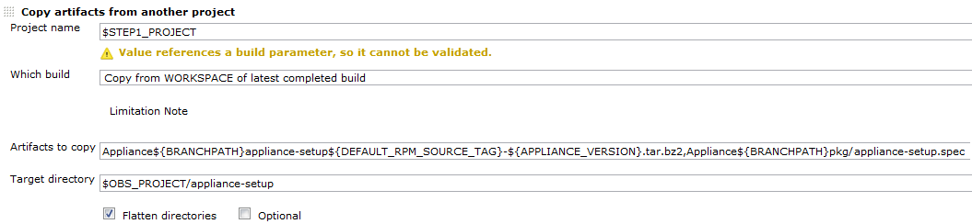
Loosely Coupled Jobs and Scripts
Use Plugins – don’t hardcode a script to point to a related jobs workspace to get artifacts
Allow parallelism across nodes
Divide/refactor large jobs along natural functional/technology boundaries
Loose Coupling Fosters Reuse

Slide 17
Effective Communication
Jenkins is nice, but …
Timely information delivery
Consumable information

Slide 18


Reusability and Maintainability Tips
Target Multiple platform types

Slide 19
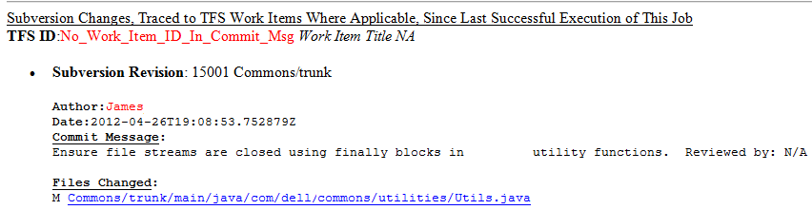
Reusability and Maintainability Tips
Help another team to leverage
sensitivity to code quality and documentation
more people know and support/contribute
consider a Jenkins plugin

Slide 20
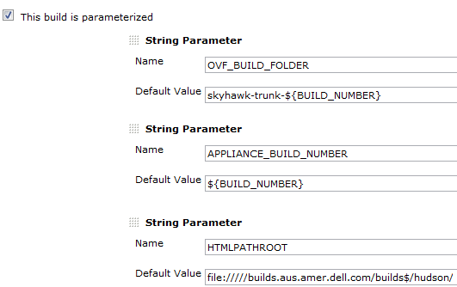
Reusability and Maintainability Tips
Refactor and Iterate
Paramaterize

Slide 21
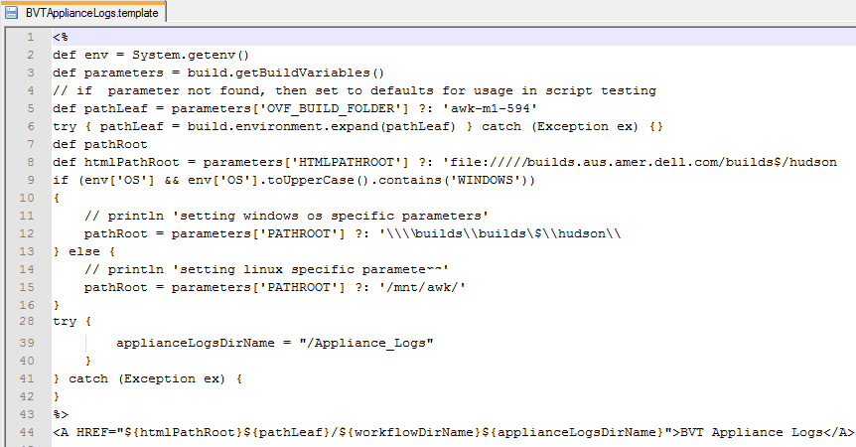
Reusability and Maintainability Tips
Refactor and Iterate
Leverage new plugins and technologies

Slide 22

Gradle Features
Tasks – ‘Public’ api for your script
Task dependency management
Library dependency management
Use Groovy
Tasks vs Methods
Configuration Phase/Execution Phase
Embedded ANT
Plugins

Slide 23
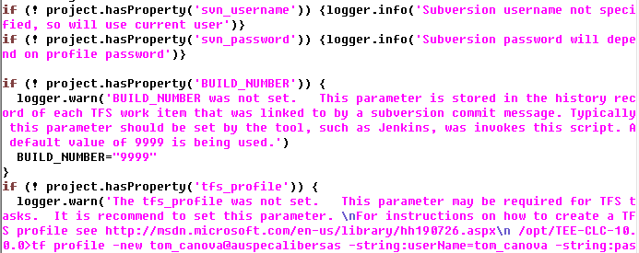
Gradle Techniques
Self Documenting Configuration

Slide 24

Gradle Techniques
Assertions Project Level Configuration Task Level Configuration Method Level Configuration Test Results Confirmation

Slide 25

Gradle Techniques
When and How To Fail Quietly

Slide 26

Gradle Techniques
Leverage Groovy

Slide 27


Gradle Techniques
Tasks of type Exec
Good when:
# Calls Known at Scripting Time
# Calls Known at Configuration Time

Slide 28
More Information
Gradle http://gradle.org/
Subversion http://subversion.apache.org/
Jenkins http://jenkins-ci.org/
Microsoft TFS Team Explorer Everywhere http://www.microsoft.com/en-us/download/details.aspx?id=4240

Slide 29

Questions

