Slide 1
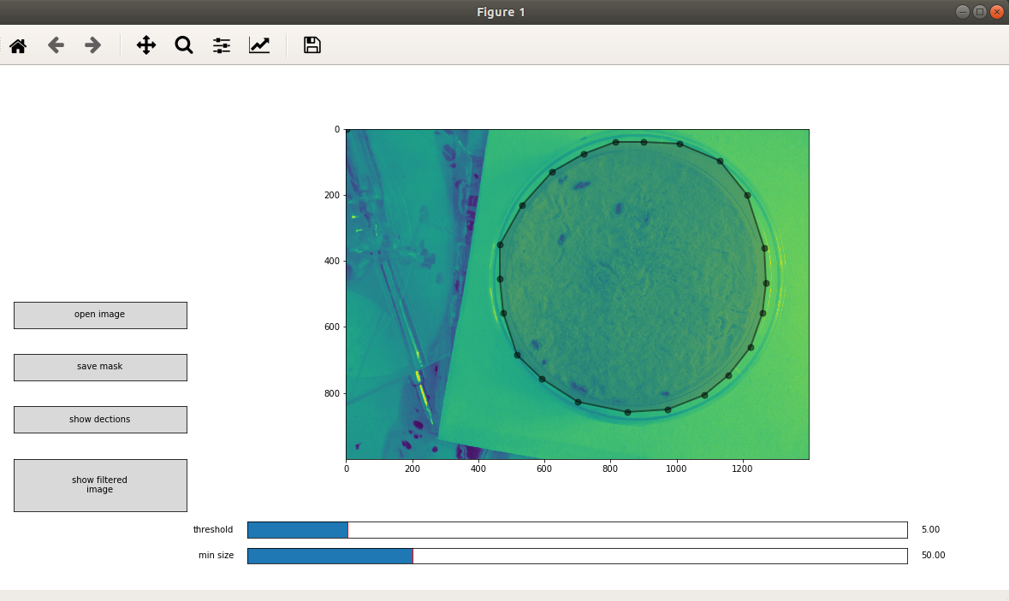
View of the image after conversion to greyscale. Note that all further calculations also use grey scale images
Draw a circle by clicking on the image.
Open and browse for image files
Save the mask when you are done

Slide 2
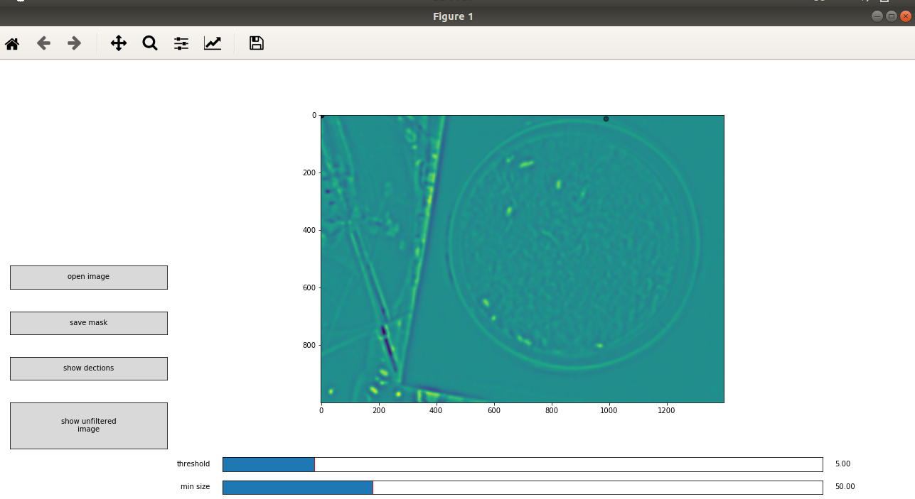
Filtered image as it should look like
Switch between unfiltered and filtered images

Slide 3
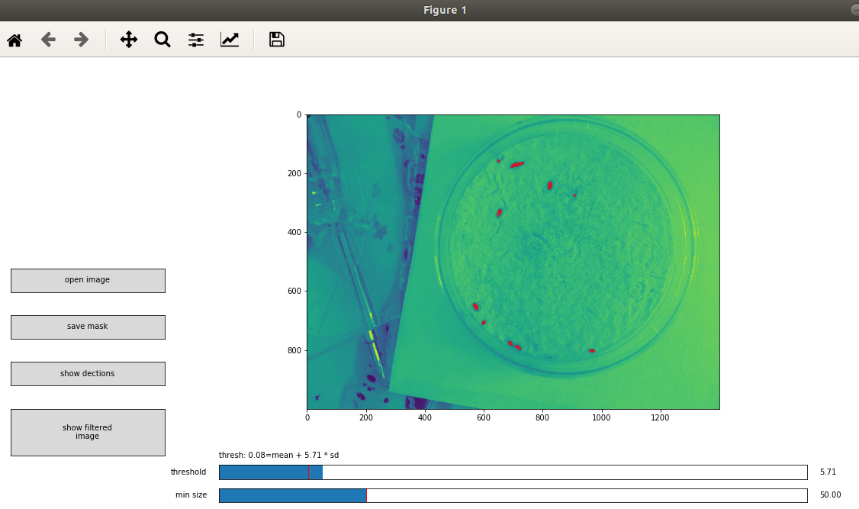
Red areas show where the script finds bugs
Actual value of the threshold. Any pixel in the filtered image, above this value will be marked with the red mask.
Select a threshold for segmentation by clicking on this slider. Once you clicked here red areas will show were bugs are detected.
Press here to display where the script finds an individual bug. This takes into account both segmentation and the min_size parameter
Select a minimal size for an area to be recognized as a bug. Once you used this slider the location of each bug will be shown as a point.

