Slide 1
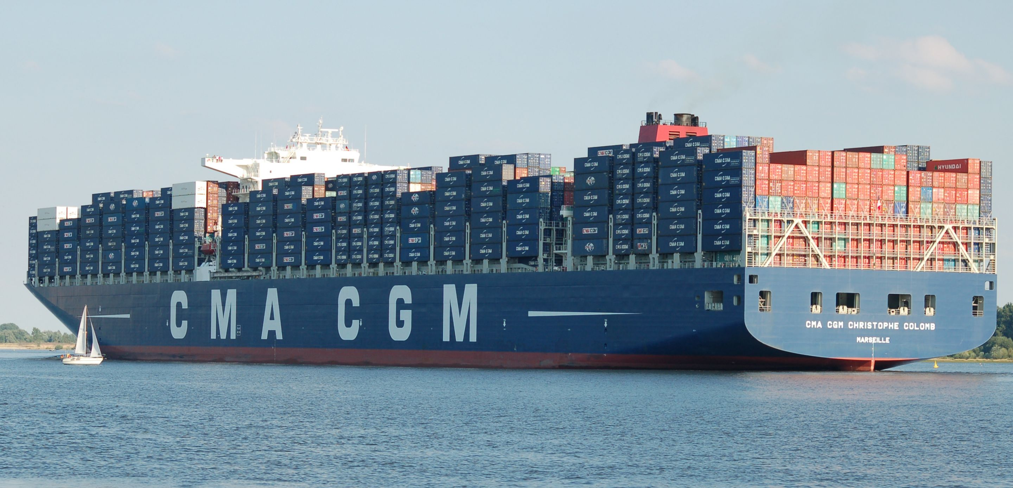
Containerization

Slide 2
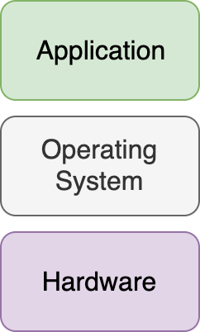
Old School Physical Servers
Applications run directly on the physical server’s host OS
The application is tightly coupled to the setup of the servers it’s running on
No sandbox between applications

Slide 3
How can we get a more well defined and efficient environment to run our applications in?

Slide 4
Let’s virtualize our servers!

Slide 5
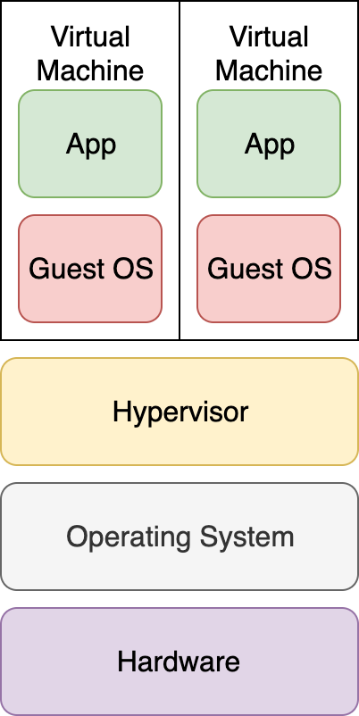
Virtualization
Virtualize the machines that the application run on
Enables pre- and well defined machine images
Applications are still tightly coupled to the host setup
Applications are not sandboxed unless they have their own virtual machine

Slide 6
Containerization
What do we want then?
Build an application once, run it anywhere in a predictable fashion

Slide 7
Containerization
How?
We create an lightweight encapsulation of our application in a container with its own operating system

Slide 8
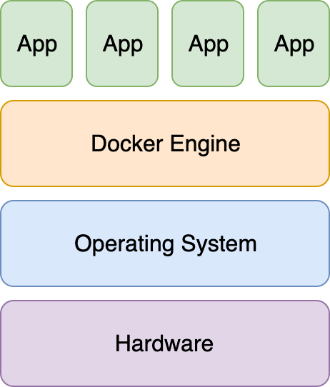
Containerization
Docker is an engine that runs application containers in a sandbox
Build once, run anywhere. Laptop, physical server, virtual machine, cloud
The container is independent of the host and of other containers running in parallel

