Slide 1
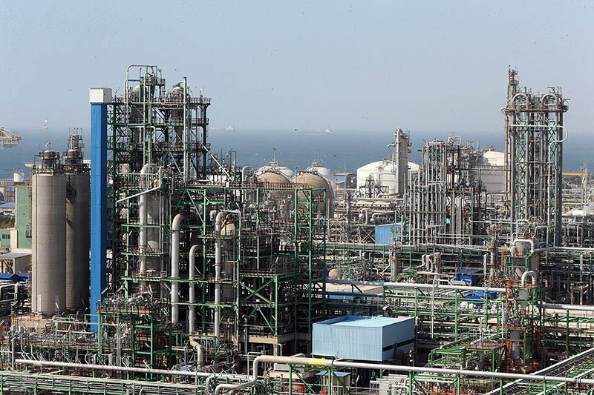
What is a pipeline?
What is a
pipeline?

Slide 2
Compile, Test, Package and Run
No matter the process or infrastructure all applications have to be at least packaged, transferred to a production environment and then run
Preferably testing will be performed before release

Slide 3
Compile, Test, Package and Run
The process from code to production can be fully manual, partially automated or fully automated
The cadence can be from yearly releases to releases several times a day and everything in between

Slide 4
Compile, Test, Package and Run
We aim for:
Full automatization from committed code to production
Deliveries in small batches whenever they’re ready

Slide 5
Compile, Test, Package and Run
The steps needed to compile, test, package, deploy etc will be automatized and chained together in pipelines

Slide 6
Compile, Test, Package and Run
By using two principles:
Continuous Integration (CI)
Continuous Deployment (CD)

Slide 7
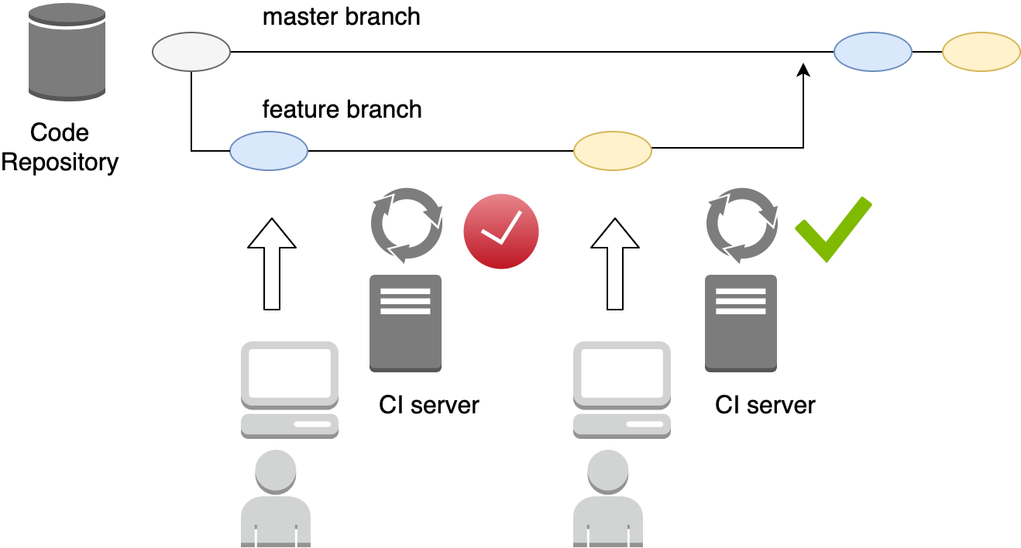
Continuous Integration

Slide 8
Continuous Integration
All code that goes to the master branch has passed the test suite
The master branch is always ready for release

Slide 9
Continuous Deployment
Through Continuous Integration we know that:
All code that goes to the master branch has passed the test suite
The master branch is always ready for release
Enables us to:
Deploy every new batch of commits on the master branch to production

Slide 10
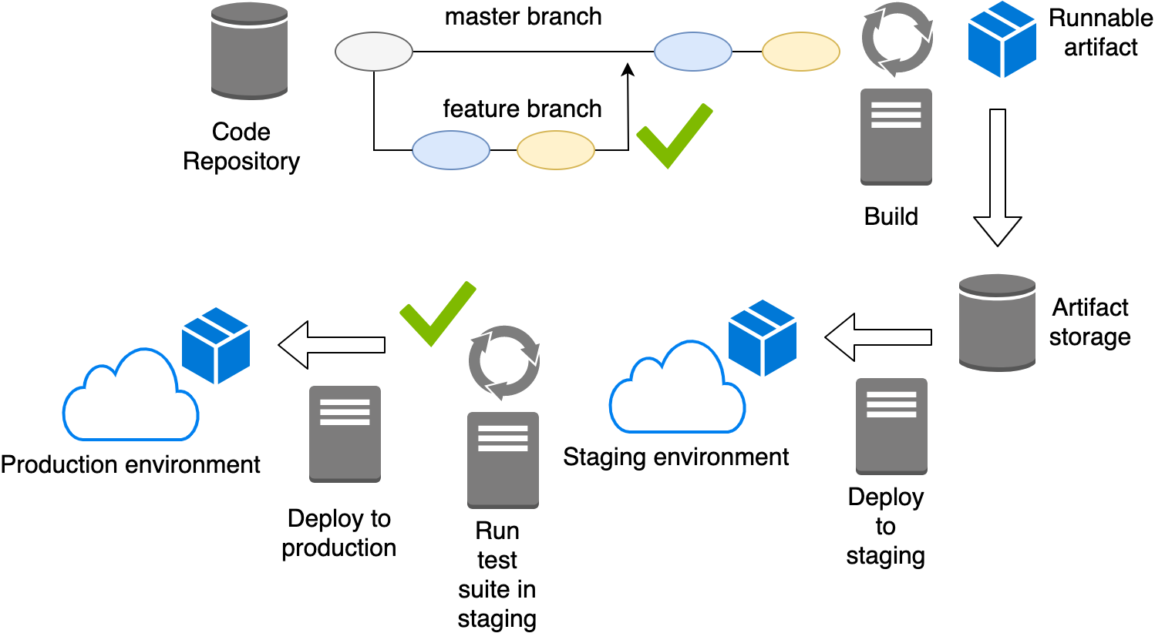
Continuous Deployment

Slide 11
Continuous Deployment
Fully automatized process from build to production deployment
The same environment agnostic artefact is deployed to all environments
All commits will be deployed to production automatically if they pass the test suite

