Slide 1
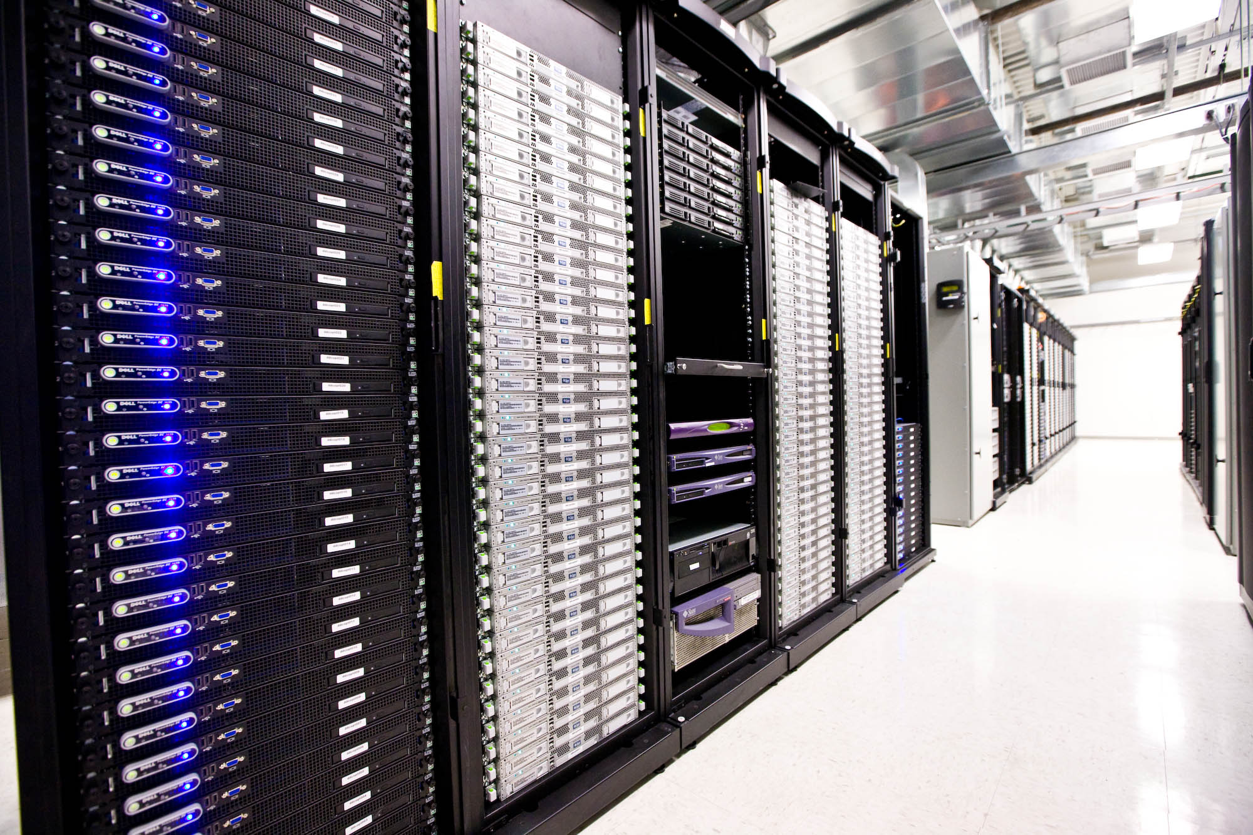
Container
Cluster

Slide 2
What do we need for our consumers to be able to access our application?

Slide 3
We need to run our application container in the cloud and make it accessible from the internet

Slide 4
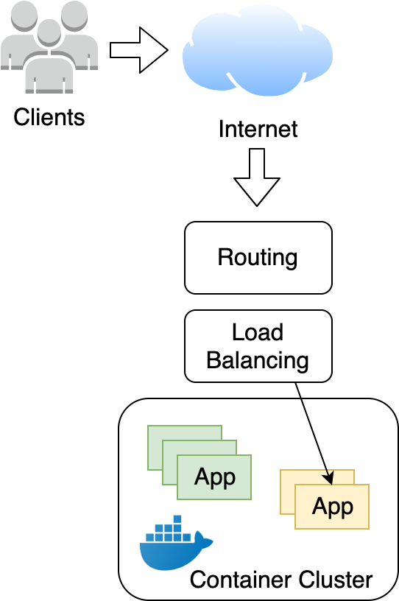
We need something like this

Slide 5
What do we need from AWS to achieve this?

Slide 6
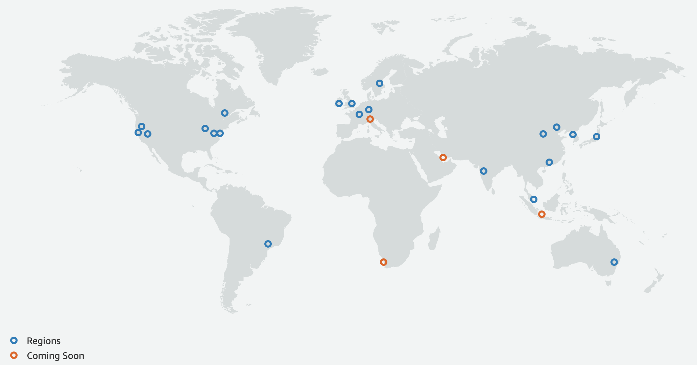
AWS Regions

Slide 7
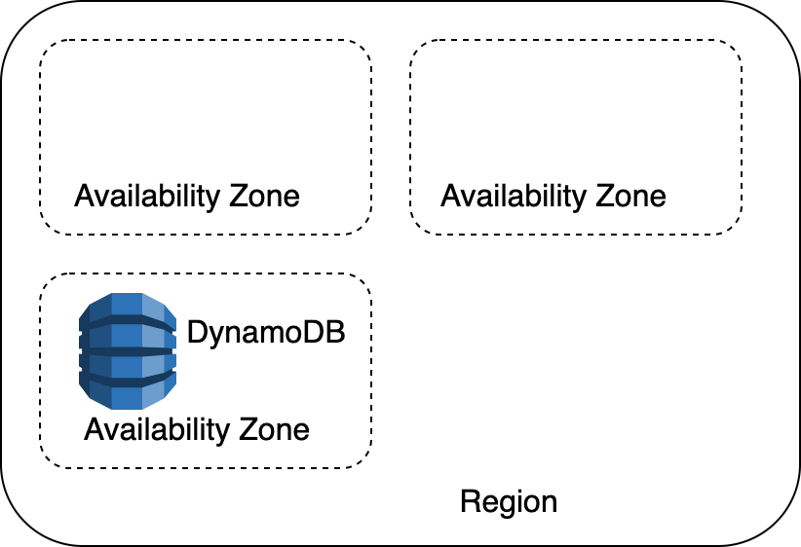
AWS Regions and Availability Zones

Slide 8
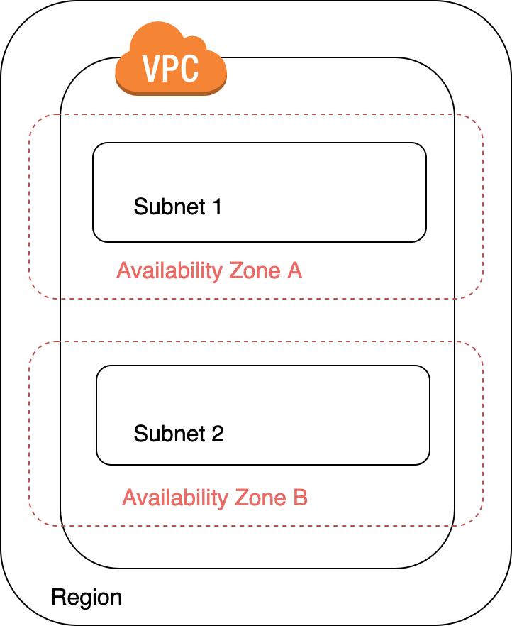
AWS Regions, Availability Zones and Networking

Slide 9
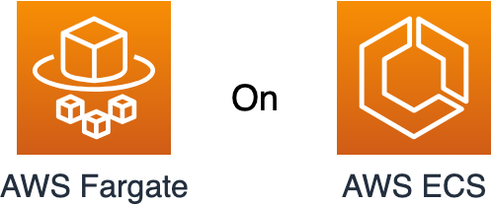
Where to run our containers?
We now have regions, availability zones, VPCs and subnets in our toolbox. But where can we run our containers?

Slide 10
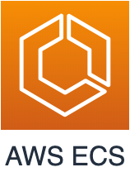
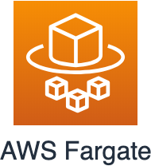
AWS ECS and Fargate
Amazon Elastic Container Service (Amazon ECS) is a highly scalable, high-performance container orchestration service that supports Docker containers and allows you to easily run and scale containerized applications on AWS.
AWS Fargate is a compute engine for Amazon ECS that allows you to run containers without having to manage servers or clusters.

Slide 11
With our newly expanded AWS toolbox, how can we achieve this in AWS?

Slide 12
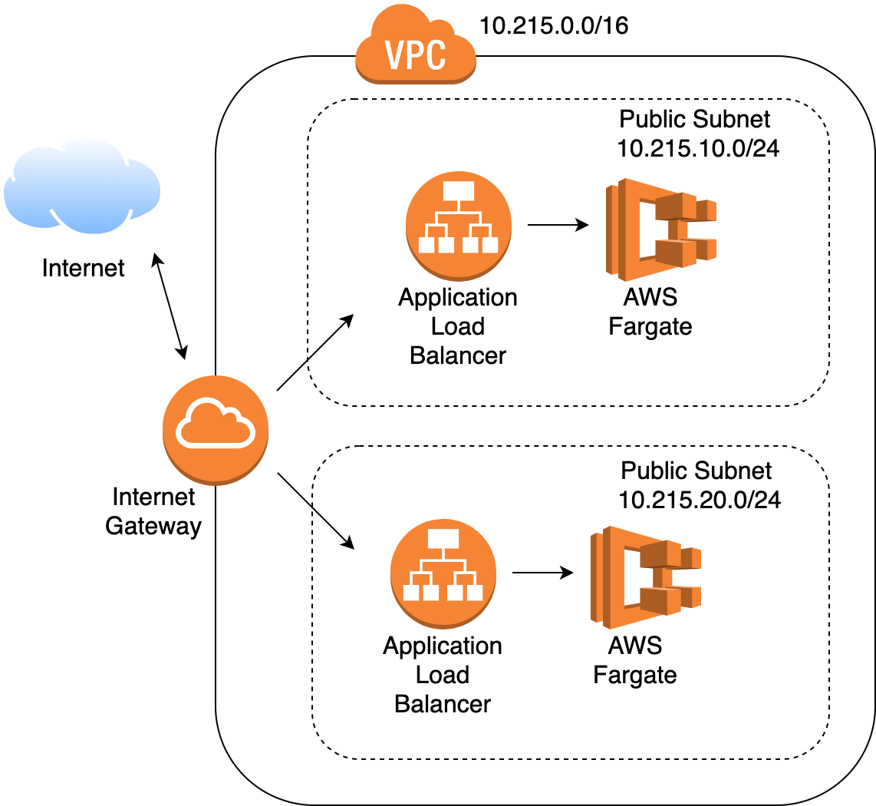
Our Container Cluster in AWS

Slide 13
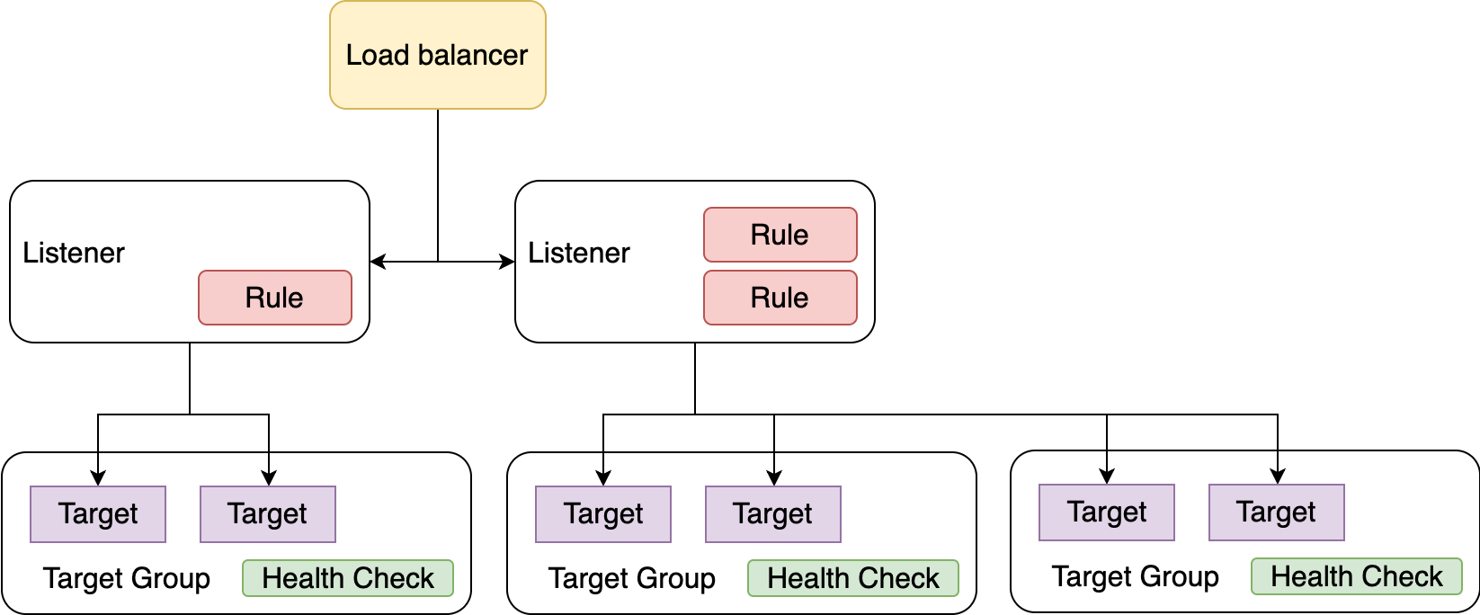
The Load Balancer in Detail

Slide 14
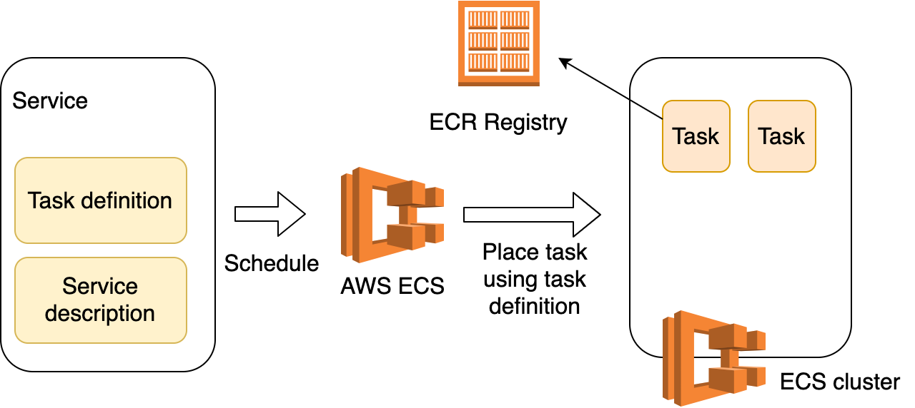
Service, Task and Task Definition

