Slide 1
Parallel and Distributed Software Systems
(Parallelle en gedistribueerde software systemen)
Universiteit Gent
Faculteit Ingenieurswetenschappen en Architectuur
1ste master computerwetenschappen
2de master elektrotechniek : ICT
Academiejaar 2014 - 2015
Filip DE TURCK
Jan FOSTIER

Slide 2
Course Objectives
1. Learn and thoroughly understand concepts regarding the different aspects of the design and implementation of distributed software.
2. A state-of-the-art overview of parallel and cloud computing systems, design of parallel algorithms, software engineering specifically for these applications, and management of high performance and cloud-based systems.
Remarks:
1) The emphasis is on the software side and on the different programming models.
2) Hardware/architecture aspects are covered in other courses and are only used to the extent necessary to understand the impact on the software performance.

Slide 3
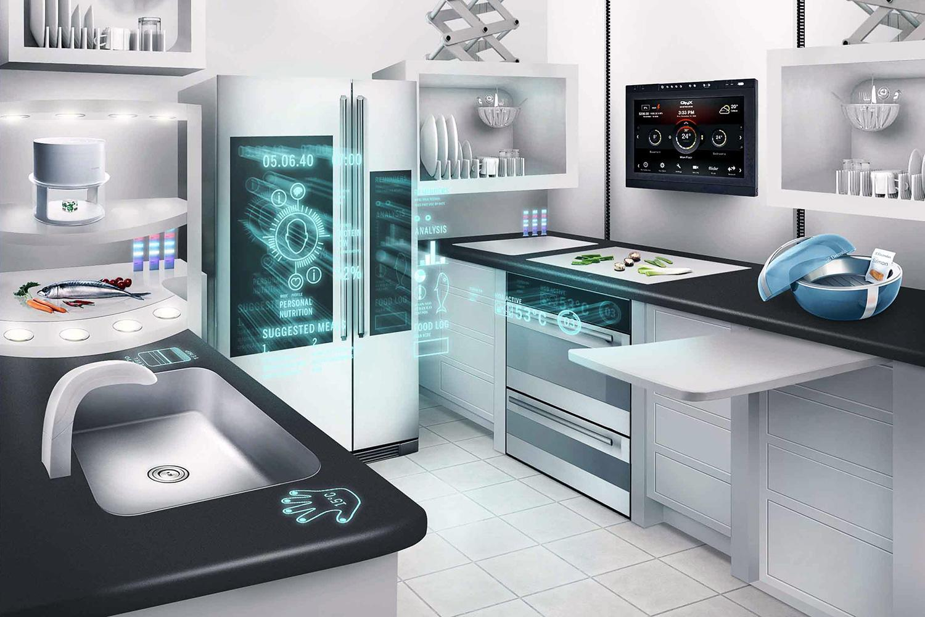

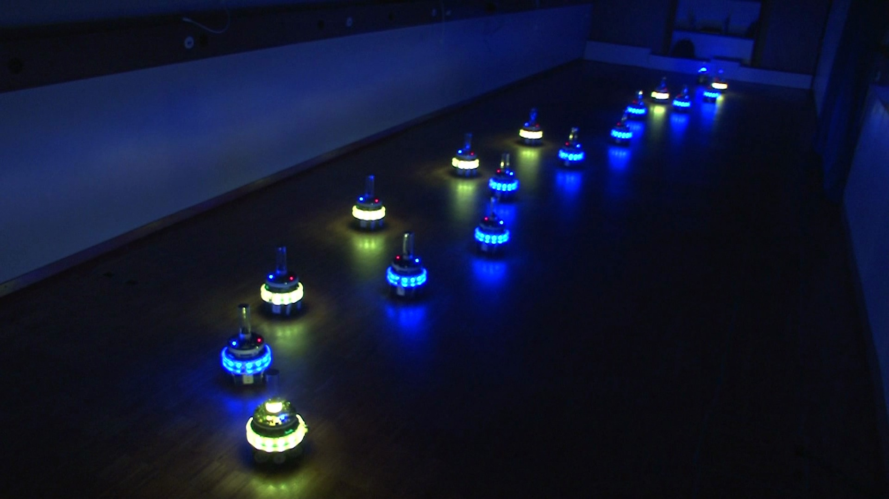

Distributed Software
Communication between software components on different machines
1. to enable resource sharing
2. to improve scalability
3. to provide fault tolerance

Slide 4
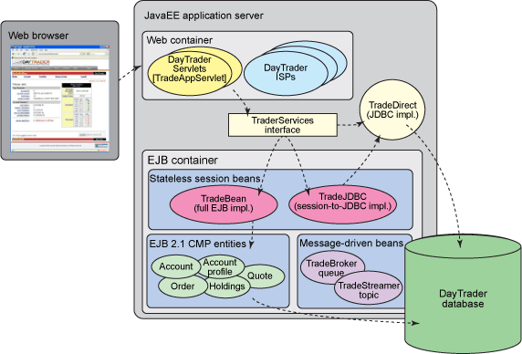
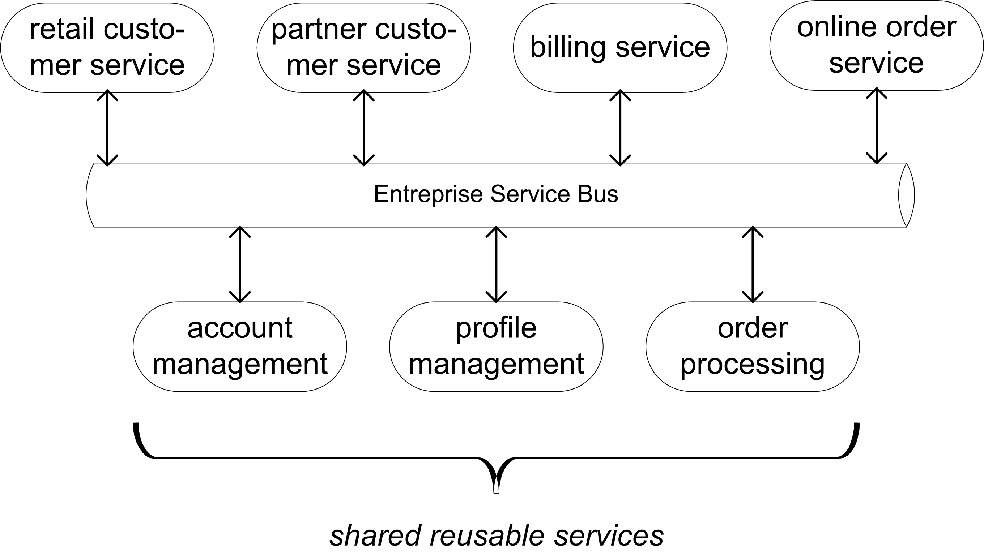
Distributed Software

Slide 5
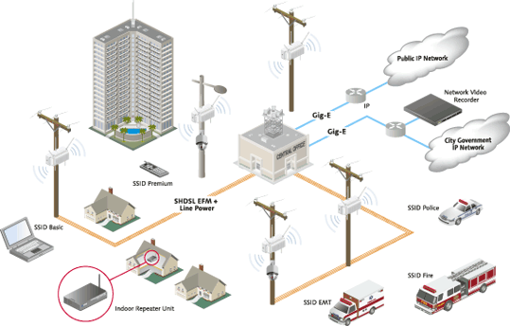
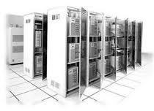
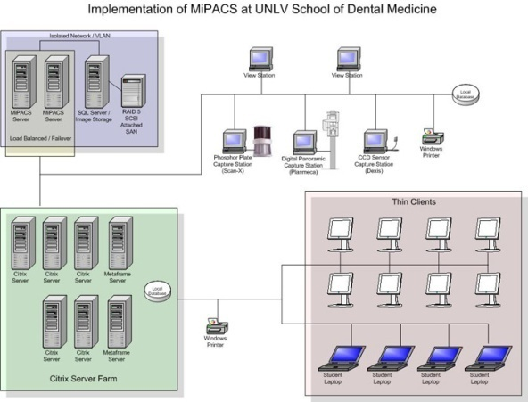

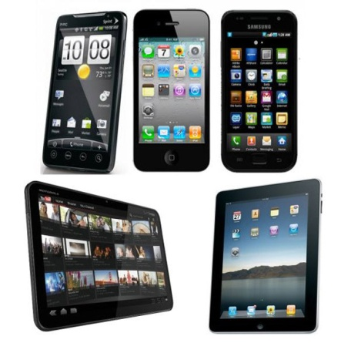
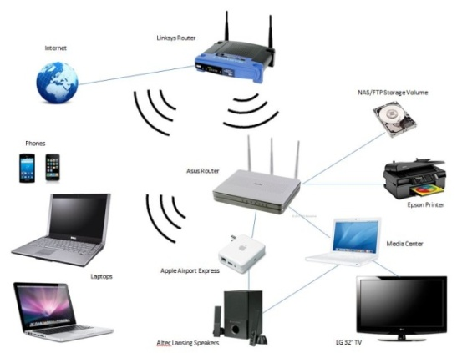
Distributed Software
Software
Software
sensor networks
datacenters
hospital networks
Software
Software
smart phones - tablets
home / enterprise networks
Notes:
Welke software componenten beschouwen we in mijn team:
software in datacenters, dankzij de recente opkomst van cloud computing wordt meer en meer software in datacenters uitgevoerd
op smart phones en tablets
ook software in thuis- en bedrijfsnetwerken, bijvoorbeeld op een home gateway of set top box voor digitale TV (in bedrijfsnetwerken: software voor kennisbeheer – knowledge management)
software in hospitaalnetwerken, bijv. op de schermen aan het bed van de patienten en op computers van de artsen en verplegend personeel om hen te ondersteunen in hun beslissingen
software in sensornetwerken (bijv smart cities) om snel data te kunnen aggregeren, verwerken en doorgeven
De sterkte en unieke van mijn team is dat we ook het netwerk in rekening brengen in de software componenten en ook het netwerk intelligenter maken door extra software componenten in het netwerk zelf.

Slide 6
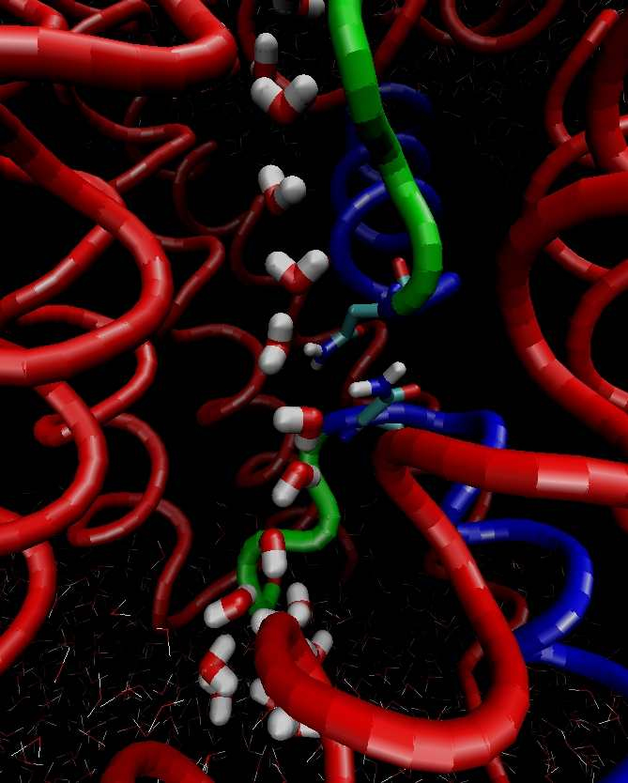


Parallel Software
Optimize algorithms by spreading over different threads, cores and machines:
1. to improve algorithm execution times
2. avoid bottlenecks in the algorithm execution

Slide 7
When ? Where ? Who ? What ?
Lectures
Tuesday, 10.00 – 12.45, Hoveniersberg, Aud. VII (Vaerenbergh)
Tuesday, 14.30 – 17.15, Plateau, Aud. D0.21A
Lab sessions
Tuesday, Zuiderpoort (3rd floor)
Lab 1 : Enterprise Applications (November 18)
group A: 10.00 AM – 13.00 PM
group B: 14.00 PM – 17.00 PM
Lab 2 : Resource Allocation (December 2)
group A: 10.00 AM – 13.00 PM
group B: 14.00 PM – 17.00 PM
Who ?
Lecturers: Filip De Turck, Jan Fostier
Exercises/lab sessions: Femke De Backere
Course material
Syllabus : will be distributed by VTK
Minerva: slides, code examples, exercise info, etc.

Slide 8
Grading
Practicals (2 lab sessions + 3 exercises) 20 %
Home work assignments 5 %
Exam (written) 75%
closed book, theory (syllabus) (1/3)
open book, exercise (on algorithms) (2/3)
NOTE:
NO 2ND CHANCE FOR LAB SESSIONS/HOMEWORK IN 2ND EXAM PERIOD

Slide 9
Lab sessions
Topics
session 1 : Enterprise Applications
session 2 : Resource Allocation
The concept
MANDATORY, marks are given
in groups of 2 persons
each session has 3 parts :
part 1 : preparatory (@home)
tutorial on Minerva (1 week before session)
part 2 : in-lab working under supervision
part 3 : hand in your report, at the end of the lab session

Slide 10
Questions
before/during/after course lesson or lab session
minerva forum
email: pds@intec.ugent.be

Slide 11
Timing - Calendar
 | 10:00-12:45 | 14:30-17:15
Di 23 sept | Introduction
Di 30 sept | Modern Processors + HWA1
Di 7 okt | Middleware | MPI
Di 14 okt | MPI + HWA2 | Timing + Coordination
Do 23 okt | Exercise 1 MPI
Di 28 okt | Coordination + P2P + HWA3 | Multithreading
Di 4 nov | Cloud computing | Exercise 2 Multithreading
Di 11 nov | Holiday
Di 18 nov | Lab 1 Enterprise Applications | Lab 1 Enterprise Applications
Di 25 nov | MapReduce + HWA4 | Resource Allocation
Di 2 dec | Lab 2 Resource Allocation | Lab 2 Resource Allocation
Di 9 dec | GPU
Di 16 dec | Extra slot
Also on Minerva

