Slide 1
Chapter 2: Distributed-memory programming using the Message Passing Interface (MPI)

Slide 2
Chapter 2: outline
Distributed-memory architecture: general considerations
Programming model: Message Passing Interface (MPI)
Point-to-point communication
Blocking communication
Point to point network performance
Non-blocking communication
Collective communication
Collective communication algorithms
Global network performance
Parallel program performance evaluation
Amdahl’s law
Gustafson’s law
Parallel program development: case studies

Slide 3
Chapter 2: outline
Distributed-memory architecture: general considerations
Programming model: Message Passing Interface (MPI)
Point-to-point communication
Blocking communication
Point to point network performance
Non-blocking communication
Collective communication
Collective communication algorithms
Global network performance
Parallel program performance evaluation
Amdahl’s law
Gustafson’s law
Parallel program development: case studies

Slide 4
Motivation for parallel computing
Want to run the same program faster
Depends on the application what is considered an acceptable runtime
SETI@Home, Folding@Home, GIMPS: years may be acceptable
For R&D applications: days or even weeks are acceptable
CFD, CEM, Bioinformatics, Cheminformatics, and many more
Prediction of tomorrow’s weather should take less than a day of computation time.
Some applications require real-time behavior
Computer games, algorithmic trading
Want to run bigger datasets
Want to reduce financial cost and/or power consumption
Notes:
SETI @ home = Search for Extraterrestrial Intelligence
Folding @ home = Predict protein folding
GIMPS = Great Internet Mersenne Prime Search (Mersenne prime = prime of the form 2^{p} – 1)
R&D = Research & Development
CFD = Computational Fluid Dynamics
CEM = Computational Electromagnetics
Algorithmic trading = buying and selling of financial stock by computers.

Slide 5
Terminology
Computer program = passive collection of instructions.
Process = instance of a computer program that is being executed.
Multitasking = running multiple processes on a CPU.
Thread = smallest stream of instructions that can be managed by an OS scheduler (= light-weight process).
Distributed memory system = multi-processor systems where each processor has fast access to its own private memory and relies on inter-processor communication to access another processor’s memory.
Notes:
A computer program is what comes out a compiler. It is a static collection of instructions that defines a particular implementation (example: Word that is installed on a Windows PC).
A process is an actual instance of a computer program (example: a Word process that is running). Note that several instances of the same program can be active at the same time.
Threads are the subject of a separate chapter.

Slide 6
Distributed-memory architecture
CPU
CPU
CPU
CPU
…
Memory
Memory
Memory
Memory
NI
NI
NI
NI
Machine
Machine
Machine
Machine
Interconnection network (e.g. Gigabit Ethernet, Infiniband, Myrinet, …)
Notes:
In the next chapters, we will focus our attention on parallel computing. We start by considering distributed-memory systems, consisting of a number of machines connected by an interconnection network. In its most simple form, each machine runs a single process. This process has direct access only to the local memory of that machine. In order to access data stored in the memory of another machine, the data must be communicated through the interconnection network using message-passing. For this, each machine has at least one network interface (NI) or network interface controller (NIC) (these are the same things).
In High Performance Computing, the de facto standard for message-passing is the Message Passing Interface (MPI).

Slide 7
Flynn’s taxonomy
Instruction pool
Instruction pool
Data pool
PU
Data pool
PU
PU
SISD
MISD
Instruction pool
Instruction pool
PU
PU
PU
Data pool
Data pool
PU
PU
PU
SIMD
MIMD
Illustrations from Wikipedia
Notes:
In Flynn’s taxonomy, distributed memory systems are recognized as MIMD architectures.

Slide 8
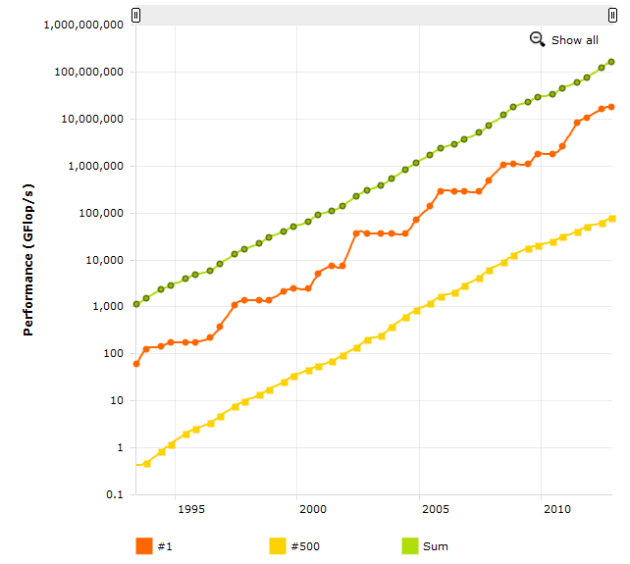
Evolution of top 500 supercomputers over time
= 17.6 PFlops/s
(# 1 ranked)
= 76 TFlops/s
(# 500 ranked)
Exponential increase of supercomputer
peak performance over time
Image taken from www.top500.org
Notes:
In past 15 years, we’ve seen an exponential growth in the performance of high performance computing systems. For example, the Titan – Cray XK7 was ranked the number 1 supercomputer in the world (list of November 2012, see www.top500.org for more recent updates) and has a measured Linpack (linear algebra package) peak performance of 17,59 PFlops/s. The system contains 560640 cores; a combination of 16-core AMD Opteron 6274 CPUs and Nvidia Tesla K20x GPUs.

Slide 9
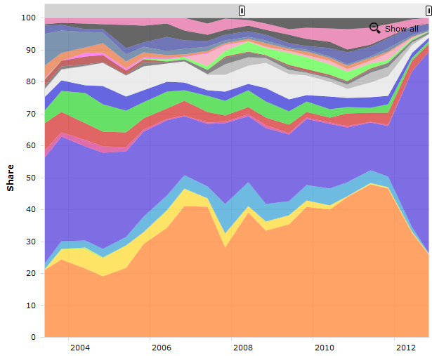
Application area – performance share
“unknown”
Image taken from www.top500.org
“research”
Notes:
The different colors represent different application areas over time. A big portion of the supercomputers are used for scientific research. Other application areas are weather and climate simulation, financial models, aerospace, geophysics, etc. Note that in the last update in November 2012, it was unknown for over 60% over the top 500 supercomputers for what kind of purpose they are intended.

Slide 10
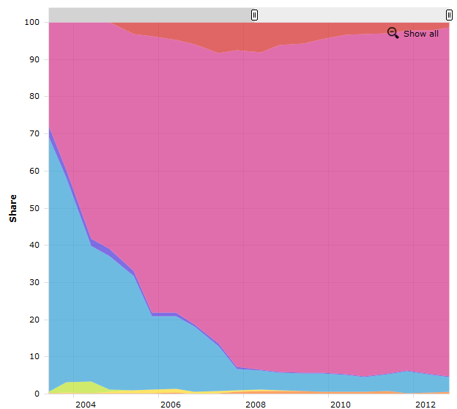
Operating system family
“Mixed”
“Linux”
“Unix”
Notes:
Note that the use of the Linux operating system is dominant on the High Performance Computing market.
Other interesting evolutions can be observed at www.top500.org. For instance, there is recent trend to create hybrid CPU / GPU systems (roughly 10% of the current performance is delivered by incorporating GPUs). Also, Infiniband interconnect technology is predominantly used as in interconnect (~ 45%), next to Gigabit Ethernet (~38%).

Slide 11



Stevin Supercomputer @ UGent
Tier 1 “Stevin” supercomputer @ Ghent University
528 nodes, each containing:
Two 8-core Intel Xeon E5-2670 @ 2.6 GHz
64 GB of RAM (4 GB / core)
8448 cores in total: 152.8 TFLOPS/s
33 TB RAM in total
FDR Infiniband Mellanox interconnect
Ranked 163 on www.top500.org (Nov. 2012)
Ranked 239 on www.top500.org (June 2013)

Slide 12
Chapter 2: outline
Distributed-memory architecture: general considerations
Programming model: Message Passing Interface (MPI)
Point-to-point communication
Blocking communication
Point to point network performance
Non-blocking communication
Collective communication
Collective communication algorithms
Global network performance
Parallel program performance evaluation
Amdahl’s law
Gustafson’s law
Parallel program development: case studies

Slide 13
Message Passing Interface (MPI)
MPI = library specification, not an implementation
Most important open implementation (GPL):
Open MPI (http://www.open-mpi.org, MPI-2 standard)
Other important vendor-specific implementations:
Qlogic MPI
Intel MPI
Specifies routines for (among others)
Point-to-point communication (between 2 processes)
Collective communication (> 2 processes)
Topology setup
Parallel I/O
Bindings for C/C++ and Fortran
Notes:
Note that MPI does not provide bindings for Java. This is because the MPI routines rely on the use of pointers to refer to memory buffer in which data can be written / from which data can be read. Pointers are not natively supported by Java.

Slide 14


MPI reference works
MPI standards: http://www.mpi-forum.org/docs/
MPI: The Complete Reference (M. Snir, S. Otto, S Huss-Lederman, D. Walker, J. Dongarra) Available from http://switzernet.com/people/emin-gabrielyan/060708-thesis-ref/papers/Snir96.pdf
Using MPI: Portable Parallel Programming with the Message Passing Interface, 2nd ed. (W. Gropp, E. Lusk, A. Skjellum).
Notes:
Even though “MPI: The Complete Reference” might appear to be just a listing of all MPI routines, it is in fact a very readable book with lots of examples.
The book by Gropp is probably too superfluous. The current lecture notes are more in-depth.

Slide 15
MPI standard
Started in 1992 (Workshop on Standards for Message-Passing in a Distributed Memory Environment)
Support from over 40 vendors (IBM, Intel, Cray, ...), library writers and academia
MPI version 1.0 (May 1994)
Final pre-draft in 1993 (Supercomputing ‘93 conference)
Final version June 1994
MPI version 2.0 (July 1997)
Support for one-sided communication
Support for process management
Support for parallel I/O
MPI version 3.0 (September 2012)
Support for non-blocking collective communication
Fortran 2008 bindings
New one-sided communication routines

Slide 16
Hello world example in MPI
#include <mpi.h>
#include <iostream>
#include <cstdlib>
using namespace std;
int main(int argc, char* argv[]) {
int rank, size;
MPI_Init( &argc, &argv );
MPI_Comm_rank( MPI_COMM_WORLD, &rank );
MPI_Comm_size( MPI_COMM_WORLD, &size );
cout << “Hello World from process” << rank << “/” << size << endl;
MPI_Finalize();
return EXIT_SUCCESS;
}
john@doe ~]$ mpirun –np 4 ./helloWorld
Hello World from process 2/4
Hello World from process 3/4
Hello World from process 0/4
Hello World from process 1/4
Output order is
random
Notes:
Source code “helloworld.cpp” can be obtained on Minerva.

Slide 17
Basic MPI routines
int MPI_Init(int *argc, char ***argc)
Initialization: all processes must call this prior to any other MPI routine.
Strips of (possible) arguments provided by “mpirun”.
int MPI_Finalize(void)
Cleanup: all processes must call this routine at the end of the program.
All pending communication should have finished before calling this.
int MPI_Comm_size(MPI_Comm comm, int *size);
Returns the size of the “Communicator” associated with “comm”
Communicator = user defined subset of processes
MPI_COMM_WORLD = communicator that involves all processes
int MPI_Comm_rank(MPI_Comm comm, int *rank);
Return the rank of the process in the Communicator
Range: [0 ... size – 1]
Notes:
MPI standard:
MPI programs require that library routines that are part of the basic language environment (such as printf and malloc in ISO C) and are executed after MPI_Init and before MPI_Finalize. All MPI programs must contain exactly one call to an MPI initialization routine (MPI_Init).
MPI_Finalize cleans up all MPI state. If an MPI program terminates normally (i.e., not due to a call to MPI_ABORT or an unrecoverable error) then each process must call MPI_Finalize before it exits. Before an MPI process invokes MPI_Finalize, the process must perform all MPI calls needed to complete its involvement in MPI communications.

Slide 18
Message Passing Interface Mechanisms
P processes (or instances) of the “Hello World” program
“Hello World”
“Hello World”
“Hello World”
“Hello World”
Hello World process
Hello World
process
Hello World
process
Hello World
process
Stack variables:
rank = 0
size = P
Stack variables:
rank = 1
size = P
Stack variables:
rank = 2
size = P
…
Stack variables:
rank = P-1
size = P
Machine
Machine
Machine
Machine
Interconnection network (e.g. Gigabit Ethernet, Infiniband, Myrinet, …)
mpirun launches P independent processes across the different machines
Each process is a instance of the same program

Slide 19
Message Passing Interface (MPI)
MPI mechanisms (depends on implementation)
Compiling an MPI program from source
mpicc -O3 main.cpp -o main
gcc -O3 main.cpp -o main -L<IncludeDir> -l<mpiLibs>
Also mpic++ (or mpicxx), mpif77, mpif90, etc.
Running MPI applications
mpirun -np <number of program instances> <your program>
List of worker nodes specified in some config file.
Using MPI on the Ugent HPC cluster
Load appropriate module first, e.g.
module load ictce
Compiling an MPI program from source
mpigcc (uses the GNU “gcc” C compiler)
mpiicc (uses the Intel “icc” C compiler)
mpigxx (uses the GNU “g++” C++ compiler)
mpiicpc (uses the Intel “icpc” C++ compiler)
Submit job using a jobscript (see project assignment)
C
mpicc / mpic++
defaults to gcc
C++

Slide 20
Basic MPI point-to-point communication
...
int rank, size, count;
char b[40];
MPI_Status status;
... // init MPI and rank and size variables
if (rank != 0) {
MPI_Send(“Hello World”, 12, MPI_CHAR, 0, 123, MPI_COMM_WORLD);
} else {
for (int i = 1; i < size; i++) {
MPI_Recv(b, 40, MPI_CHAR, i, MPI_ANY_TAG, MPI_COMM_WORLD, &status);
MPI_Get_count(&status, MPI_CHAR, &count);
printf(“I received %s from process %d with size %d and tag %d\n”,
b, status.MPI_SOURCE, cout, status.MPI_TAG);
}
}
...
branching on rank
john@doe ~]$ mpirun –np 4 ./ptpcomm
I received Hello World from process 1 with size 12 and tag 123
I received Hello World from process 2 with size 12 and tag 123
I received Hello World from process 3 with size 12 and tag 123
Notes:
Source code “ptpcomm.cpp” on Minerva.

Slide 21
Message Passing Interface Mechanisms
P processes (or instances) of the “Hello World” program
“Hello World”
“Hello World”
“Hello World”
Hello World process
Hello World
process
Hello World
process
Hello World
process
rank = 0
Recv 3x
rank = 1
Send
rank = 2
Send
…
rank = P-1
Send
Machine
Machine
Machine
Machine
“Hello World”
“Hello World”
“Hello World”
Interconnection network (e.g. Gigabit Ethernet, Infiniband, Myrinet, …)
mpirun launches P independent processes across the different machines
Each process is a instance of the same program

Slide 22
Blocking send and receive
int MPI_Send(void *buf, int count, MPI_Datatype datatype,
int dest, int tag, MPI_Comm comm)
buf: pointer to the message to send
count: number of items to send
datatype: datatype of each item
number of bytes sent: count * sizeof(datatype)
dest: rank of destination process
tag: value to identify the message [0 ... at least (32 767) ]
comm: communicator specification (e.g. MPI_COMM_WORLD)
int MPI_Recv(void *buf, int count, MPI_Datatype datatype,
int source, int tag, MPI_Comm comm,
MPI_Status *status)
buf: pointer to the buffer to store received data
count: upper bound (!) of the number of items to receive
datatype: datatype of each item
source: rank of source process (or MPI_ANY_SOURCE)
tag: value to identify the message (or MPI_ANY_TAG)
comm: communicator specification (e.g. MPI_COMM_WORLD)
status: structure that contains { MPI_SOURCE, MPI_TAG, MPI_ERROR }
Notes:
MPI Standard: The send buffer specified by the MPI_Send operation consists of count successive entries of the type indicated by datatype, starting with the entry at address buf. Note that we specify the message length in terms of number of elements, not number of bytes. Note that count may be zero, in which case the data part of the message is empty.
In addition to the data part, messages carry information that can be used to distinguish messages and selectively receive them. This information consists of a fixed number of fields, which we collectively call the message envelope. These fields are
source
destination
tag
communicator
The message source is implicitly determined by the identity of the message sender. The other fields are specified by arguments in the send operation. The message destination is specified by the dest argument. The integer-valued message tag is specified by the tag argument. This integer can be used by the program to distinguish different types of messages.
The receive buffer consists of the storage containing count consecutive elements of the type specified by datatype, starting at address buf. The length of the received message must be less than or equal to the length of the receive buffer. An overflow error occurs if all incoming data does not fit, without truncation, into the receive buffer. If a message that is shorter than the receive buffer arrives, then only those locations corresponding to the (shorter) message are modified.
The selection of a message by a receive operation is governed by the value of the message envelope. A message can be received by a receive operation if its envelope matches the source, tag and comm values specified by the receive operation. The receiver may specify a wildcard MPI_ANY_SOURCE value for source, and/or a wildcard MPI_ANY_TAG value for tag, indicating that any source and/or tag are acceptable. It cannot specify a wildcard value for comm. Thus, a message can be received by a receive operation only if it is addressed to the receiving process, has a matching communicator, has matching source unless source=MPI_ANY_SOURCE in the pattern, and has a matching tag unless tag=MPI_ANY_TAG in the pattern. The message tag is specified by the tag argument of the receive operation. The argument source, if different from MPI_ANY_SOURCE, is specified as a rank within the process group associated with that same communicator (remote process group, for intercommunicators).
Note the asymmetry between send and receive operations: A receive operation may accept messages from an arbitrary sender, on the other hand, a send operation must specify a unique receiver. This matches a push communication mechanism, where data transfer is effected by the sender (rather than a pull mechanism, where data transfer is effected by the receiver).

Slide 23
Sending and receiving
Two-sided communication:
Both the sender and receiver involved in data transfer
As opposed to one-sided communication
Posted send must match receive
When do MPI_Send and MPI_Recv match ?
1. Rank of receiver process
2. Rank of sending process
3. Tag
- custom value to distinguish messages from same sender
4. Communicator
Rationale for Communicators
Used to create subsets of processes
Transparent use of tags
modules can be written in isolation
communication within module through own Communicator
communication between modules through shared Communicator
Notes:
MPI Standard:
One can think of message transfer as consisting of the following three phases.
1. Data is pulled out of the send buffer and a message is assembled.
2. A message is transferred from sender to receiver.
3. Data is pulled from the incoming message and disassembled into the receive buer.
Type matching has to be observed at each of these three phases: (1) The type of each variable in the sender buffer has to match the type specified for that entry by the send operation; (2) the type specified by the send operation has to match the type specified by the receive operation; (3) and the type of each variable in the receive buffer has to match the type specified for that entry by the receive operation. A program that fails to observe these three rules is erroneous.
One of the goals of MPI is to support parallel computations across heterogeneous environments. Communication in a heterogeneous environment may require data conversions. MPI requires that a representation conversion be performed when a typed value is transferred across environments that use different representations for the datatype of this value. MPI does not specify rules for representation conversion. Such conversion is expected to preserve integer, logical and character values, and to convert a floating point value to the nearest value that can be represented on the target system.

Slide 24
MPI Datatypes
MPI_Datatype | C datatype
MPI_CHAR | signed char
MPI_SHORT | signed short int
MPI_INT | signed int
MPI_LONG | signed long in
MPI_UNSIGNED_CHAR | unsigned char
MPI_UNSIGNED_SHORT | unsigned short int
MPI_UNSIGNED | unsigned int
MPI_UNSIGNED_LONG | unsigned long int
MPI_FLOAT | float
MPI_DOUBLE | double
MPI_LONG_DOUBLE | long double
MPI_BYTE | no conversion, bitpattern transferred as is
MPI_PACKED | grouped messages

Slide 25
Querying for information
MPI_Status
Stores information about the MPI_Recv operation
typedef struct MPI_Status {
int MPI_SOURCE;
int MPI_TAG;
int MPI_ERROR;
}
Does not contain the size of the received message
int MPI_Get_count (MPI_Status *status, MPI_Datatype
datatype, int *count)
returns the number of data items received in the count variable
not directly accessible from status variable
Notes:
MPI Standard: The source or tag of a received message may not be known if wildcard values were used in the receive operation. Also, if multiple requests are completed by a single MPI function, a distinct error code may need to be returned for each request. The information is returned by the status argument of MPI_RECV. The type of status is MPI-defined. Status variables need to be explicitly allocated by the user, that is, they are not system objects.
In C, status is a structure that contains three fields named MPI_SOURCE, MPI_TAG, and MPI_ERROR; the structure may contain additional fields. Thus, status.MPI_SOURCE, status.MPI_TAG and status.MPI_ERROR contain the source, tag, and error code, respectively, of the received message.
MPI_Get_count returns the number of entries received. (Again, we count entries, each of type datatype, not bytes.) The datatype argument should match the argument provided by the receive call that set the status variable.

Slide 26
Blocking send and receive
send
req to send
recv
req to send
req to send
ok to send
recv
send
ok to send
recv
send
ok to send
data
data
data
time
sender comes first, idling at sender (no buffering of message)
sending/receiving at about the same time, idling minimized
receiver comes first, idling at receiver
Slide reproduced from slides by John Mellor - Crummey
Notes:
MPI Standard: The send call described before is blocking: it does not return until the message data and envelope have been safely stored away so that the sender is free to modify the send buffer. The message might be copied directly into the matching receive buffer, or it might be copied into a temporary system buffer. In standard mode, it is up to MPI to decide whether outgoing messages will be buffered. MPI may buffer outgoing messages. In such a case, the send call may complete before a matching receive is invoked. On the other hand, buffer space may be unavailable, or MPI may choose not to buffer outgoing messages, for performance reasons. In this case, the send call will not complete until a matching receive has been posted, and the data has been moved to the receiver. (end of standard citation) This corresponds to (a) in the slide.
In case the send and receive operation are posted (almost) simultaneous, idling is guaranteed to be minimized (b).
In case a (blocking) receive operation is posted before a matching send is posted (c), the receiver side will block until the message is received.

Slide 27
Deadlocks
int a[10], b[10], myRank;
MPI_Status s1, s2;
MPI_Comm_rank( MPI_COMM_WORLD, &myRank);
if ( myRank == 0 ) {
MPI_Send( a, 10, MPI_INT, 1, 1, MPI_COMM_WORLD );
MPI_Send( b, 10, MPI_INT, 1, 2, MPI_COMM_WORLD );
}
else if ( myRank == 1 ) {
MPI_Recv( b, 10, MPI_INT, 0, 2, MPI_COMM_WORLD, &s1 );
MPI_Recv( a, 10, MPI_INT, 0, 1, MPI_COMM_WORLD, &s2 );
}
If MPI_Send is blocking (handshake protocol), this program will deadlock
If 'eager' protocol is used, it may run
Depends on message size
Slide credit: John Mellor - Crummey
Notes:
See deadlock.cpp example on Minerva.

Slide 28
Chapter 2: outline
Distributed-memory architecture: general considerations
Programming model: Message Passing Interface (MPI)
Point-to-point communication
Blocking communication
Point to point network performance
Non-blocking communication
Collective communication
Collective communication algorithms
Global network performance
Parallel program performance evaluation
Amdahl’s law
Gustafson’s law
Parallel program development: case studies

Slide 29
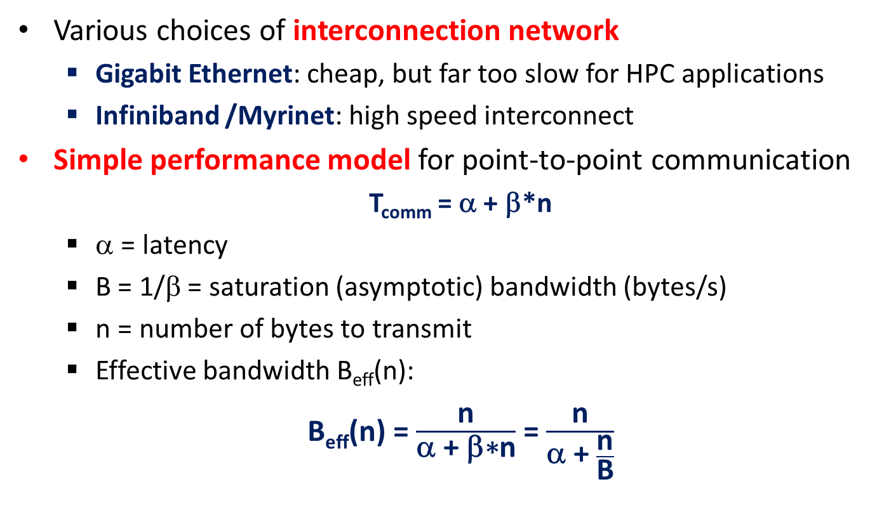
Network cost modeling
Various choices of interconnection network
Gigabit Ethernet: cheap, but far too slow for HPC applications
Infiniband /Myrinet: high speed interconnect
Simple performance model for point-to-point communication
T_{comm} = α + β*n
α = latency
B = 1/β = saturation (asymptotic) bandwidth (bytes/s)
n = number of bytes to transmit
Effective bandwidth B_{eff}(n):
B_{eff}(n) = $\frac{\text{n}}{\text{a}\text{ + }\text{b}\text{∗}\text{n}}$ = $\frac{\text{n}}{\text{a}\text{ + }\frac{\text{n}}{\text{B}}}$
Notes:
Note that in the most general case, αλπηα and beta depend on the message size n.
In case alpha and beta are constant (this is the most simple model), the effective bandwidth is only a function of the message size n. Note that when the latency -> 0 or n -> infinity, the effective bandwidth is equal to the saturation bandwidth B.

Slide 30
The case of Gengar (UGent cluster)
Bandwidth and latency
to the 193 other machines
~20 Gbit/s
~1μs
Non-blocking Infiniband (switched fabric)
16 GByte of RAM
~100 Gbit/s
50ns
6 MByte of L2 cache
6 Mbyte of L2 cache
core 1 &
L1 cache
core 2 &
L1 cache
core 1 &
L1 cache
core 2 &
L1 cache
6 Mbyte of L2 cache
6 Mbyte of L2 cache
2ns
core 3 &
L1 cache
core 4 &
L1 cache
core 3 &
L1 cache
core 4 &
L1 cache
CPU 1
CPU 2
Bandwidth
Latency
Notes:
A Gengar machine consists of two quad-core CPUs (Intel Xeon L5420), hence 8 cores in total. Each core has 32 Kbyte L1 cache memory; 6 Mbyte of L2 cache is shared by two cores only. In fact, this is one the earliest quad-core models that was introduced by Intel, and in fact consists of two dual-core CPUs that are packed together. Because e.g. core 1 and core 3 inside a single CPU do not share any cache memory, the exchange of data will always occur by reading / writing to the main memory. On the other hand, core 1 and core 2 share L2 cache, therefore, exchange of data between these cores can happen at a faster rate, by reading / writing to the shared L2 cache.
Each machine has 16 GByte of RAM (2 GByte / core). The machines are connected by a high-speed Infiniband network (fully non-blocking, see further). Additionally, the machines are connected by a Gigabit Ethernet network (not shown on the slide). This network is used for console login and non-HPC related access (e.g. maintenance).

Slide 31
Measure effective bandwidth: ringtest
Idea: send a single message of size N in a circle
Increase the message N size exponentially
1 byte, 2 bytes, 4 bytes, ... 1024 bytes, 2048 bytes, 4096 bytes
Benchmark the results (measure wall clock time T), …
Bandwidth = N * P / T
P-1
...
0
3
1
2

Slide 32
Ringtest in MPI
void sendRing( char *buffer, int length ) {
/* send message in a ring here */
}
int main( int argc, char * argv[] )
{
...
char buffer = (char*) calloc ( 1048576, sizeof(char) );
int msgLen = 8;
for (int i = 0; i < 18; i++, msgLen *= 2) {
double startTime = MPI_Wtime();
sendRing( buffer, msgLen );
double stopTime = MPI_Wtime();
double elapsedSec = stopTime - startTime;
if (rank == 0)
printf( "Bandwidth for size %d is : %f\", ... );
}
...
}
Notes:
Example can be downloaded from Minerva

Slide 33
Ringtest in MPI
void sendRing( char *buffer, int msgLen )
{
int myRank, numProc;
MPI_Comm_rank( MPI_COMM_WORLD, &myRank );
MPI_Comm_size( MPI_COMM_WORLD, &numProc );
MPI_Status status;
int prevR = (myRank - 1 + numProc) % numProc;
int nextR = (myRank + 1 ) % numProc;
if (myRank == 0) { // send first, then receive
MPI_Send( buffer, msgLen, MPI_CHAR, nextR, 0, MPI_COMM_WORLD);
MPI_Recv( buffer, msgLen, MPI_CHAR, prevR, 0, MPI_COMM_WORLD,
&status );
} else { // receive first, then send
MPI_Recv( buffer, msgLen, MPI_CHAR, prevR, 0, MPI_COMM_WORLD,
&status );
MPI_Send( buffer, msgLen, MPI_CHAR, nextR, 0, MPI_COMM_WORLD);
}
}
Notes:
Example can be downloaded from Minerva

Slide 34
Basic MPI routines
Timing routines in MPI
double MPI_Wtime( void )
returns the time in seconds relative to “some time” in the past
“some time” in the past is fixed during process
double MPI_Wtick( void )
Returns the resolution of MPI_Wtime() in seconds
e.g. 10⁻³ = millisecond resolution
Notes:
MPI standard
MPI_Wtime returns a floating-point number of seconds, representing elapsed wall-clock time since some time in the past. The "time in the past" is guaranteed not to change during the life of the process. The user is responsible for converting large numbers of seconds to other units if they are preferred. The times returned are local to the node that called them. There is no requirement that different nodes return "the same time.“
MPI_Wtick returns the resolution of MPI_Wtime in seconds. That is, it returns, as a double precision value, the number of seconds between successive clock ticks. For example, if the clock is implemented by the hardware as a counter that is incremented every millisecond, the value returned by MPI_Wtick should be 10e-3.

Slide 35
Bandwidth on Gengar (Ugent cluster)
Effective BW increases for larger messages
Infiniband
Effective Bandwidth B_{eff} (MByte/s)
Gigabit
Ethernet
Message size (byte)
Notes:
Measured effective bandwidth (unidirectional) using the ringtest example for both the Gigabit Ethernet network and Infiniband network. Measurements were done on the Gengar cluster (each machine has both an Infiniband and a Gigabit Ethernet interface). The effective bandwidth increases for larger message size, in both cases, consistent with the formulas from earlier slides.

Slide 36
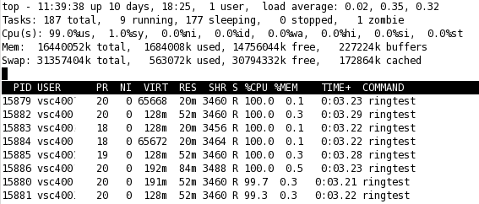
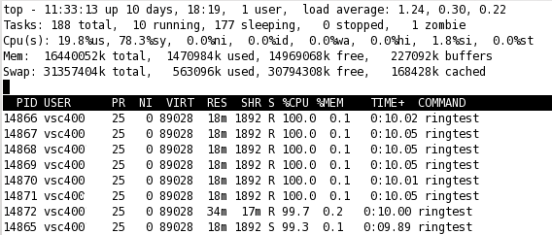
Benchmark results
Comparison of CPU load
Infiniband
Gigabit
Ethernet
Notes:
We observed a big difference in available bandwidth between the two networks (previous slide). A second major difference is the fact that the Gigabit Ethernet requires quite a lot of CPU cycles when communication at full speed. These CPU cycles are needed to constantly pack small portions of data into packets and copy them across memory locations (tcp/ip stack protocol overhead). These CPU instructions are encoded in the Gigabit Ethernet device driver. The CPU is constantly signaled by means of interrupt requests to prepare the next portion of data to send or receive. This gives rise to a combined fraction of over 80% of the CPU cycles that are spent in “system time (= device driver)” (sy: 78,3%) and handling software interrupt requests (si: 1,8%). Only 19.8% of the cycles can be spent in user space (actual program).
The Infiniband network on the other hand can transmit at full speed, with very little CPU interaction, leaving 99% of the CPU cycles to the user space. Therefore, Infiniband networks are much more suited to overlap computations and communications (see further: non-blocking send / receive + asynchronous progress).

Slide 37
Exchanging messages in MPI
int MPI_Sendrecv( void *sendbuf, int sendcount, MPI_Datatype
sendtype, int dest, int sendtag, void *recvbuf,
int recvcount, MPI_Datatype recvtype, int source,
int recvtag, MPI_Comm comm, MPI_Status *status )
sendbuf: pointer to the message to send
sendcount: number of elements to transmit
sendtype: datatype of the items to send
dest: rank of destination process
sendtag: identifier for the message
recvbuf: pointer to the buffer to store the message (disjoint with sendbuf)
recvcount: upper bound (!) to the number of elements to receive
recvtype: datatype of the items to receive
source: rank of the source process (or MPI_ANY_SOURCE)
recvtag: value to identify the message (or MPI_ANY_TAG)
comm: communicator specification (e.g. MPI_COMM_WORLD)
status: structure that contains { MPI_SOURCE, MPI_TAG, MPI_ERROR }
sendbuf: pointer to the buffer to send
int MPI_Sendrecv_replace( ... )
Buffer is replace by received data
Notes:
MPI standard:
Execute a blocking send and receive operation. Both send and receive use the same communicator, but possibly different tags. The send buffer and receive buffers must be disjoint, and may have different lengths and datatypes.

Slide 38
Basic MPI routines
2
Sendrecv example
const int len = 10000;
int a[len], b[len];
if ( myRank == 0 ) {
MPI_Send( a, len, MPI_INT, 1, 0, MPI_COMM_WORLD );
MPI_Recv( b, len, MPI_INT, 2, 2, MPI_COMM_WORLD, &status );
} else if ( myRank == 1 ) {
MPI_Sendrecv( a, len, MPI_INT, 2, 1, b, len, MPI_INT, 0,
0, MPI_COMM_WORLD, &status );
} else if ( myRank == 2) {
MPI_Sendrecv( a, len, MPI_INT, 0, 2, b, len, MPI_INT, 1,
1, MPI_COMM_WORLD, &status );
}
Compatibility between Sendrecv and 'normal' send and recv
Sendrecv can help to prevent deadlocks
2
1
0
1
0
safe to exchange !
Notes:
MPI_Sendrecv can help prevent deadlocks, because from a programmer’s point of view, the send and receive operation are posted simultaneously. It is safe to mix MPI_Send and MPI_Recv on one process with MPI_Sendrecv on another process.

Slide 39
Chapter 2: outline
Distributed-memory architecture: general considerations
Programming model: Message Passing Interface (MPI)
Point-to-point communication
Blocking communication
Point to point network performance
Non-blocking communication
Collective communication
Collective communication algorithms
Global network performance
Parallel program performance evaluation
Amdahl’s law
Gustafson’s law
Parallel program development: case studies

Slide 40
Non-blocking communication
Idea:
Do something useful while waiting for communications to finish
Try to overlap communications and computations
How?
Replace blocking communication by non-blocking variants
MPI_Send(...) MPI_Isend(..., MPI_Request *request)
MPI_Recv(...) MPI_Irecv(..., status, MPI_Request *request)
I = intermediate functions
MPI_Isend and MPI_Irecv routines return immediately
Need polling routines to verify progress
request handle is used to identify communications
status field moved to polling routines (see further)
Notes:
MPI Standard: One can improve performance on many systems by overlapping communication and computation. This is especially true on systems where communication can be executed autonomously by an intelligent communication controller. Light-weight threads are one mechanism for achieving such overlap. An alternative mechanism that often leads to better performance is to use non-blocking communication. A non-blocking send start call initiates the send operation, but does not complete it. The send start call can return before the message was copied out of the send buffer. A separate send complete call is needed to complete the communication, i.e., to verify that the data has been copied out of the send buffer. With suitable hardware, the transfer of data out of the sender memory may proceed concurrently with computations done at the sender after the send was initiated and before it completed. Similarly, a non-blocking receive start call initiates the receive operation, but does not complete it. The call can return before a message is stored into the receive buffer. A separate receive complete call is needed to complete the receive operation and verify that the data has been received into the receive buffer. With suitable hardware, the transfer of data into the receiver memory may proceed concurrently with computations done after the receive was initiated and before it completed. The use of non-blocking receives may also avoid system buffering and memory-to-memory copying, as information is provided early on the location of the receive buffer.

Slide 41
Non-blocking communications
Asynchronous progress
= ability to progress communications while performing calculations
Depends on hardware
Gigabit Ethernet = very limited
Infiniband = much more possibilities
Depends on MPI implementation
Multithreaded implementations of MPI (e.g. Open MPI)
Daemon for asynchronous progress (e.g. LAM MPI)
Depends on protocol
Eager protocol
Handshake protocol
Still the subject of ongoing research
Notes:
Asynchronous progress is the ability of a parallel architecture to overlap communications and calculations. When performing data transfer over a Gigabit Ethernet network, the CPU is actively involved in copying memory from the source buffer to the buffers that can be directly accessed by the network interface (NIC). This is handled by the device driver software of the network (usually a module of the OS kernel) . At high data transfer rates (i.e. close to the maximum bandwidth of one Gigabit per second), the CPU is flooded with interrupt requests, in order to copy a new segment of data into the buffer. This means that the CPU has relatively few cycles left to perform actual computations and the abilities for asynchronous progress are very limited.
Inifiniband on the other hand, implements a so-called zero-copy protocol, in which the Inifiniband hardware can directly access a certain memory block (direct memory access or DMA). This greatly improves performance, as the CPU is greatly offloaded by this protocol. Nowadays, Open MPI has very good support for Infiniband. On the UGent HPC, vendor-specific implementations are used, e.g. the Intel MPI and Qlogic MPI implementations of MPI. These have full support for all hardware features available.
The eager protocol is a data transfer protocol where the data is immediately transmitted to the receiver side, without any prior acknowledgement from the receiver side that it is ready to receive this data. This protocol is only used for very small messages for which the sending side assumes that there is sufficient buffer capacity on the receiving side to store the data. The eager protocol therefore has very limited overhead.
The handshake protocol is a data transfer protocol where the sending side first transmits a request to transmit to the receiving party. If the receiving party is ready to receive the data, it sends an acknowledgement back to the sending side, and the data can actually be transmitted. The handshake protocol is typically used for larger messages.

Slide 42
Non-blocking sending and receiving
Isend
req to send
Isend
req to send
ok to send
ok to send
Irecv
Irecv
data
data
time
network interface supports overlapping computations and communications
network interface has no such support
Slide reproduced from slides by John Mellor - Crummey
Notes:
Left: Gray boxes denote useful computations. Almost no CPU cycles are needed to transfer a message between two nodes. The network interface uses e.g. direct memory access (DMA) to access the send/receive buffers, largely bypassing the CPU.
Right: Blue means that the CPU is actively involved in the data transfer (e.g. by copying data from memory to the network interface). CPU cycles that are spent during communications cannot be used for asynchronous progress. Therefore, overlapping communications and computations possibilities are very limited in this case.

Slide 43
Non-blocking communications
Polling / waiting routines
int MPI_Wait( MPI_Request *request, MPI_Status *status )
request: handle to identify communication
status: status information (cfr. 'normal' MPI_Recv)
int MPI_Test( MPI_Request *request, int *flag, MPI_Status *status )
Returns immediately. Sets flag = true if communication completed
int MPI_Waitany( int count, MPI_Request *array_of_requests,
int *index, MPI_Status *status )
Waits for exactly one communication to complete
If more than one communication has completed, it picks a random one
index returns the index of completed communication
int MPI_Testany( int count, MPI_Request *array_of_requests,
int *index, int *flag, MPI_Status *status )
Returns immediately. Sets flag = true if at least one communication completed
If more than one communication has completed, it picks a random one
index returns the index of completed communication
If flag = false, index returns MPI_UNDEFINED
Notes:
MPI Standard: Non-blocking communications use opaque request objects to identify communication operations and match the operation that initiates the communication with the operation that terminates it. These are system objects that are accessed via a handle. A request object identifies various properties of a communication operation, such as the send mode, the communication buffer that is associated with it, its context, the tag and destination arguments to be used for a send, or the tag and source arguments to be used for a receive. In addition, this object stores information about the status of the pending communication operation.
The functions MPI_Wait and MPI_Test are used to complete a non-blocking communication. The completion of a send operation indicates that the sender is now free to update the locations in the send buffer (the send operation itself leaves the content of the send buffer unchanged). It does not indicate that the message has been received, rather, it may have been buffered by the communication subsystem. The completion of a receive operation indicates that the receive buffer contains the received message, the receiver is now free to access it, and that the status object is set. It does not indicate that the matching send operation has completed (but indicates, of course, that the send was initiated).
It is convenient to be able to wait for the completion of any, some, or all the operations in a list, rather than having to wait for a specific message. A call to MPI_Waitany or MPI_Testany can be used to wait for the completion of one out of several operations.

Slide 44
Example: client-server code
if ( rank != 0 ) { // client code
while ( true ) { // generate requests and send to the server
generate_request( data, &size );
MPI_Send( data, size, MPI_CHAR, 0, tag, MPI_COMM_WORLD );
}
} else { // server code (rank == 0)
MPI_Request *reqList = new MPI_Request[nProc-1];
for ( int i = 0; i < nProc - 1; i++ )
MPI_Irecv( buffer[i].data, MAX_LEN, MPI_CHAR, i+1, tag,
MPI_COMM_WORLD, &reqList[i] );
while ( true ) { // main consumer loop
MPI_Status status;
int reqIndex, recvSize;
MPI_Waitany( nProc–1, reqList, &reqIndex, &status );
MPI_Get_count ( &status, MPI_CHAR, &recvSize );
do_service( buffer[reqIndex].data, recvSize );
MPI_Irecv( buffer[reqIndex].data, MAX_LEN, MPI_CHAR,
status.MPI_SOURCE, tag, MPI_COMM_WORLD,
&reqList[reqIndex] );
}
}
Notes:
Source code “clientserver2.cpp” is available on Minerva.
In this simple example, all processes produce data of some sort (assume producing data is time-consuming). In a simple while(true) loop, data is produced and sent to the process with rank 0.
A single process (rank == 0) collects all the data and consumes it (assume consuming this data is fast). This process should be able to receive data from any (other) process. This could be implemented using e.g. a blocking receive operation with the MPI_ANY_SOURCE specification, however, in this example, we choose to use non-blocking receive operations. We post a non-blocking receive operation for each of the other processes. These non-blocking receive operations return immediately (before data is actually received). Next, in a while(true) loop, the root process accepts waits for exactly one message to be received. This data is then consumed and a new receive operation is posted for that process. The root process knows which of the pending receive requests was satisfied by the i-index. In this simple example, this index corresponds to the source rank. However, this rank can also be retrieved from the status structure (status.MPI_SOURCE).
A problem with this example is that MPI_Waitany does not guarantee fairness. Because MPI_Waitany waits for exactly one request to be received, MPI_Waitany can in fact repeatedly satisfy a request from the same client process (assume that do_service takes more time than generate_request). The other processes are not served and are hence idling.

Slide 45
Non-blocking communications
Polling / waiting routines (cont'd)
int MPI_Waitall( int count, MPI_Request *array_of_requests,
MPI_Status *array_of_statuses )
Waits for all communications to complete
int MPI_Testall ( int count, MPI_Request *array_of_requests,
int *flag, MPI_Status *array_of_statuses )
Returns immediately. Sets flag = true if all communications have completed
int MPI_Waitsome ( int incount, MPI_Request * array_of_requests,
int *outcount, int *array_of_indices,
MPI_Status *array_of_statuses )
Waits for at least one communications to complete
outcount contains the number of communications that have completed
Completed requests are set to MPI_REQUEST_NULL
int MPI_Testsome ( int incount, MPI_Request * array_of_requests,
int *outcount, int *array_of_indices,
MPI_Status *array_of_statuses )
Same as Waitsome, but returns immediately.
flag field no longer needed, returns outcount = 0 if no completed communications
Notes:
MPI_Waitall blocks until all communication operations associated with active handles in the list complete, and returns the status of all these operations (this includes the case where no handle in the list is active). MPI_Testall returns flag = true if all communications associated with active handles in the array have completed.
MPI_Waitsome waits until at least one of the operations associated with active handles in the list have completed. Returns in outcount the number of requests from the list array_of_requests that have completed. Returns in the first outcount locations of the array array_of_indices the indices of these operations.

Slide 46
Example: improved client-server code
if ( rank != 0 ) { // same client code
...
} else { // server code (rank == 0)
MPI_Request *reqList = new MPI_Request[nProc-1];
MPI_Status *status = new MPI_Status[nProc-1];
int *reqIndex = new MPI_Request[nProc];
for ( int i = 0; i < nProc - 1; i++ )
MPI_Irecv( buffer[i].data, MAX_LEN, MPI_CHAR, i+1, tag,
MPI_COMM_WORLD, &reqList[i] );
while ( true ) { // main consumer loop
int numMsg;
MPI_Waitsome( nProc–1, reqList, &numMsg, reqIndex, status );
for ( int i = 0; i < numMsg; i++ ) {
MPI_Get_count ( &status[i], MPI_CHAR, &recvSize );
do_service( buffer[reqIndex[i]].data, recvSize);
MPI_Irecv( buffer[reqIndex[i]].data, MAX_SIZE, MPI_CHAR,
status[i].MPI_SOURCE, tag, MPI_COMM_WORLD,
&reqList[reqIndex[i]] );
}
}
}
Notes:
Source code “clientserver3.cpp” is available on Minerva.
Same client-server example. This time however, MPI_Waitsome is used instead of MPI_Waitany. This guarantees that every client will eventually be provided by the server side (fairness).

Slide 47
Chapter 2: outline
Distributed-memory architecture: general considerations
Programming model: Message Passing Interface (MPI)
Point-to-point communication
Blocking communication
Point to point network performance
Non-blocking communication
Collective communication
Collective communication algorithms
Global network performance
Parallel program performance evaluation
Amdahl’s law
Gustafson’s law
Parallel program development: case studies

Slide 48
Barrier synchronization
MPI_Barrier(MPI_Comm comm)
This function does not return until all processes in comm have called it.
process rank
Computations
Idle time
Call to MPI_Barrier
Barrier Synchronization
Waiting time
(process dependent)
time
Notes:
Blocks the caller until all processes in the communicator have called it; that is, the call returns at any process only after all members of the communicator have entered the call.

Slide 49
Broadcast
MPI_Bcast(void *buffer, int count, MPI_Datatype datatype,
int root, MPI_Comm comm)
MPI_Bcast broadcasts count elements of type datatype stored in buffer at the root process to all other processes in comm where this data is stored in buffer.
buffer at non-root process (contents will be overwritten)
count elements
count elements
p₀
data
p₁
data
p₂
MPI_Bcast
data
buffer at all processes
now contain same data
p₃
data
data
p₄
data
process rank
process rank
buffer at root process (contains useful data)
Notes:
MPI_Bcast broadcasts “count” elements of type “datatype” from root to all other processes in comm. All processes in comm have to call this function (both root and non-root processes). Before calling the function, the buffer at the root process must contain useful data. Hence, at the root process, this buffer acts as a send buffer. This data will be transmitted to the other processes and will remain unchanged. The buffers at the other processes acts as a receive buffer; it needs to be pre-allocated, any contents will be overwritten by the data at the root process.

Slide 50
Broadcast example
...
int rank, size;
... // init MPI and rank and size variables
int root = 0;
char buffer[12];
if (rank == root)
sprintf(buffer, “Hello world”);
MPI_Bcast(buffer, 12, MPI_CHAR, root, MPI_COMM_WORLD);
printf(“Process %d has %s stored in the buffer.\n”, buffer, rank);
...
fill the buffer at the root process only
all processes must call MPI_Bcast
john@doe ~]$ mpirun –np 4 ./broadcast
Process 1 has Hello World stored in the buffer.
Process 0 has Hello World stored in the buffer.
Process 3 has Hello World stored in the buffer.
Process 2 has Hello World stored in the buffer.

Slide 51
Broadcast algorithm
Linear algorithm, subsequent sending of n bytes from root process to P-1 other processes takes (α + βn) (P- 1) time.
Binary tree algorithm takes only (α + βn) ⎡log₂P⎤ time.
p₀
data (n bytes)
n bytes
n bytes
p₁
n bytes
p₂
p₃
p₄
p₅
p₆
p₇
process rank
Notes:
MPI_Bcast broadcasts a message from the process with rank root to all processes of the group. It is called by all members of group using the same arguments for comm and root. On return, the contents of root's communication buffer has been copied to all processes.
General, derived datatypes are allowed for datatype. The type signature of count, datatype on any process must be equal to the type signature of count, datatype at the root. This implies that the amount of data sent must be equal to the amount received, pairwise between each process and the root. MPI_Bcast and all other data-movement collective routines make this restriction. Distinct type maps between sender and receiver are still allowed.

Slide 52
Scatter
MPI_Scatter(void *sendbuf, int sendcount, MPI_Datatype sendType,
void *recvbuf, int recvcount, MPI_Datatype recvType,
int root, MPI_Comm comm)
MPI_Scatter partitions a sendbuf at the root process into P equal parts of size sendcount and sends each process in comm (including root) a portion in rank order.
send buffer (only matters at root process)
root = p₁
recvcount elements
p₀
d₀
p₁
d₀
d₁
d₂
d₃
d₄
d₁
d₀
d₁
d₂
d₃
d₄
p₂
sendcount elements
MPI_Scatter
d₂
p₃
d₃
p₄
d₄
process rank
process rank
receive buffer
Notes:
MPI_Scatter is the inverse operation to MPI_Gather.
The outcome is as if the root executed n send operations:
MPI_Send(sendbuf + i * sendcount * extent(sendType), sendcount, sendType, i, …)
and each process executed a receive:
MPI_Recv(recvbuf, recvcount, recvType, i, …)
The send buffer is ignored for all non-root processes.
The type signature associated with sendcount, sendtype at the root must be equal to the type signature associated with recvcount, recvtype at all processes (however, the type maps may be different). This implies that the amount of data sent must be equal to the amount of data received, pairwise between each process and the root. Distinct type maps between sender and receiver are still allowed.
All arguments to the function are significant on process root, while on other processes, only arguments recvbuf, recvcount, recvtype, root, comm are significant. The arguments root and comm must have identical values on all processes.

Slide 53
Scatter example
int root = 0;
char recvBuf[7];
if (rank == root) {
char sendBuf[25];
sprintf(sendBuf, “This is the source data.”);
MPI_Scatter(sendBuf, 6, MPI_CHAR, recvBuf, 6, MPI_CHAR,
root, MPI_COMM_WORLD);
} else {
MPI_Scatter(NULL, 0, MPI_CHAR, recvBuf, 6, MPI_CHAR,
root, MPI_COMM_WORLD);
}
recvBuf[6] = ’\0’;
printf(“Process %d has %s in receive buffer\n”, rank, recvBuf);
...
fill the send buffer at the root process only
first three parameters are ignored on non-root processes
john@doe ~]$ mpirun –np 4 ./scatter
Process 1 has s the stored in the buffer.
Process 0 has This i stored in the buffer.
Process 3 has data. stored in the buffer.
Process 2 has source stored in the buffer.
Notes:
See scatter.cpp on Minerva.
The code shown in this slide is a simplification of scatter.cpp and will fail when running it with more than 4 processes, because the send buffer is too small. The example on Minerva is more generic in that sense.

Slide 54
Scatter algorithm
Linear algorithm, subsequent sending of n bytes from root process to P-1 other processes takes (α + βn) (P- 1) time.
Binary algorithm takes only α ⎡log₂P⎤ + βn(P-1) time (reduced number of communication rounds!)
p₀
p₁
4n bytes
p₂
p₃
p₄
2n bytes
p₅
p₆
n bytes
p₇
process rank
one block = n bytes
Notes:
Note that the binary algorithm does not reduce the amount of data sent from the root process, compared to the linear algorithm. It does however, reduce the number of communication rounds from (P-1) to log₂P. Note however that certain data need to be buffered by certain non-root processes. This buffer is not provided by the used and must therefore be allocated by the MPI implementation itself.

Slide 55
Scatter (vector variant)
MPI_Scatterv(void *sendbuf, int *sendcnts, int *displs,
MPI_Datatype sendType, void *recvbuf, int recvcnt,
MPI_Datatype recvType, int root, MPI_Comm comm)
Partitions of sendbuf don’t need to be of equal size and are specified per receiving process: the first index by the displs array, their size by the sendcnts array.
send buffer (only matters at root process)
root = p₁
recvcount elements
p₀
p₁
p₂
displs[i]
sendcnts[i]
elements
MPI_Scatterv
p₃
p₄
process rank
process rank
receive buffer
Notes:
MPI_Scatterv extends the functionality of MPI_Scatter by allowing a varying count of data to be sent to each process, since sendcnts is now an array. It also allows more flexibility as to where the data is taken from on the root, by providing the new argument, displs.
The outcome is as if the root executed P send operations
MPI_Send(sendbuf + displs[i] * extent(sendType), sendcnts[i], sendType, i, …)
and each process executed a receive
MPI_Recv(recvbuf, recvcnt, recvType, i, …)
The send buffer is ignored for all non-root processes.
The type signature implied by sendcnt[i], sendType at the root must be equal to the type signature implied by recvcnt, recvType at process i (however, the type maps may be different). This implies that the amount of data sent must be equal to the amount of data received, pairwise between each process and the root. Distinct type maps between sender and receiver are still allowed.
All arguments to the function are significant on process root, while on other processes, only arguments recvbuf, recvcnt, recvtype, root, comm are significant. The arguments root and comm must have identical values on all processes.

Slide 56
Gather
MPI_Gather(void *sendbuf, int sendcount, MPI_Datatype sendType,
void *recvbuf, int recvcount, MPI_Datatype recvType,
int root, MPI_Comm comm)
MPI_Gather gathers equal partitions of size recvcount from each of the P processes in comm (including root) and stores them in recvbuf at the root process in rank order.
Gather is the opposite of Scatter
receive buffer (only matters at root process)
sendcount elements
root = p₁
p₀
d₀
d₀
p₁
d₁
d₁
d₀
d₁
d₂
d₃
d₄
p₂
d₂
MPI_Gather
d₂
recvcount elements
p₃
d₃
d₃
p₄
d₄
send buffer
d₄
process rank
process rank
A vector variant, MPI_Gatherv, exists, a similar generalization as MPI_Scatterv
Notes:
Each process (root process included) sends the contents of its send buffer to the root process. The root process receives the messages and stores them in rank order. The outcome is as if each of the P processes in the group (including the root process) had executed a call to
MPI_Send(sendbuf, sendcount, sendtype, root, …)
and the root had executed P calls to
MPI_Recv(recvbuf + i * recvcount * extent(recvType), recvcount, recvType, i, …)
where extent(recvType) is the type extent obtained from a call to MPI_Type_extent().
The receive buffer is ignored for all non-root processes.
General, derived datatypes are allowed for both sendtype and recvtype. The type signature of sendcnt, sendtype on process i must be equal to the type signature of recvcnt, recvtype at the root. This implies that the amount of data sent must be equal to the amount of data received, pairwise between each process and the root. Distinct type maps between sender and receiver are still allowed. All arguments to the function are significant on process root, while on other processes, only arguments sendbuf, sendcnt, sendtype, root, comm are significant. The arguments root and comm must have identical values on all processes. The specification of counts and types should not cause any location on the root to be written more than once. Such a call is erroneous.
Note that the recvcnt argument at the root indicates the number of items it receives from each process, not the total number of items it receives.

Slide 57
Gather example
int root = 0;
int sendBuf = rank;
if (rank == root) {
int *recvBuf = new int[size];
MPI_Gather(&sendBuf, 1, MPI_INT, recvBuf, 1, MPI_INT,
root, MPI_COMM_WORLD);
cout << “Receive buffer at root process: ” << endl;
for (size_t i = 0; i < size; i++)
cout << recvBuf[i] << “ ”;
cout << endl;
delete [] recvBuf;
} else {
MPI_Gather(&sendBuf, 1, MPI_INT, NULL, 1, MPI_INT,
root, MPI_COMM_WORLD);
}
receive buffer exists at the root process only
receive parameters are ignored on non-root processes
john@doe ~]$ mpirun –np 4 ./gather
Receive buffer at root process:
0 1 2 3
Notes:
See gather.cpp on Minerva.

Slide 58
Gather algorithm
Linear algorithm, subsequent sending of n bytes from P-1 processes to root takes (α + βn) (P- 1) time.
Binary algorithm takes only α ⎡log₂P⎤ + βn(P-1) time (reduced number of communication rounds!)
p₀
p₁
4n bytes
p₂
p₃
p₄
2n bytes
p₅
p₆
n bytes
p₇
process rank
one block = n bytes
Notes:
Note that the binary algorithm does not reduce the amount of data sent to the root process (this is dominant for large messages). It does however, reduce the number of communication rounds from (P-1) to log₂P. Note however that certain data need to be buffered by certain non-root processes. This buffer is not provided by the used and must therefore be allocated by the MPI implementation itself.

Slide 59
AllGather
MPI_Allgather(void *sendbuf, int sendcnt, MPI_Datatype sendType,
void *recvbuf, int recvcnt, MPI_Datatype recvType,
MPI_Comm comm)
MPI_Allgather is a generalization of MPI_Gather, in that sense that the data is gathered by all processed, instead of just the root process.
sendcount
elements
receive buffer
receive buffer
p₀
p₁
p₂
MPI_Allgather
p₃
p₄
process rank
process rank
recvcount elements
send buffer
Notes:
MPI_Allgather can be thought of as MPI_Gather, but where all processes receive the result, instead of just the root. The j^{th} block of data sent from each process is received by every process and placed in the j^{th} block of the buffer recvbuf.
The type signature associated with sendcount, sendtype, at a process must be equal to the type signature associated with recvcount, recvtype at any other process.
The outcome of a call to MPI_Allgather(...) is as if all processes executed P calls to
MPI_Gather(sendbuf, sendcnt, sendtype, recvbuf, recvcnt, recvtype, root, comm)
for root = 0, …, P – 1.
The rules for correct usage of MPI_Allgather are easily found from the corresponding rules for MPI_Gather.

Slide 60
Allgather algorithm
P calls to gather takes P[α ⎡log₂P⎤ + βn(P-1)] time (using the best gather algorithm)
Gather followed by broadcast takes 2α ⎡log₂P⎤ + βn(P⎡log₂P⎤ + P-1) time.
“Butterfly” algorithm takes only α log₂P + βn(P-1) time (in case P is a power of two)
p₀
n bytes
2n bytes
4n bytes
p₁
p₂
p₃
p₄
p₅
p₆
p₇
process rank
one block = n bytes
Notes:
There are several ways to implement an allgather algorithm. A naïve solution would be to call the gather routine P times, each time with a different process as root. This is very inefficient as this leads to a dominant term of n*P*P.
An improvement is to perform a single gather operation, followed by a broadcast from the root. This lead to a dominant term of n*P*log P.
However, a dedicated algorithm, based on a butterfly communication pattern leads to a domination term of only n*P.

Slide 61
All to all communication
MPI_Alltoall(void *sendbuf, int sendcnt, MPI_Datatype sendType,
void *recvbuf, int recvcnt, MPI_Datatype recvType,
MPI_Comm comm)
Using MPI_Alltoall, every process sends a distinct message to every other process.
send buffer
receive buffer
p₀
a₀
a₁
a₂
a₃
a₄
a₀
b₀
c₀
d₀
e₀
p₁
b₀
b₁
b₂
b₃
b₄
a₁
b₁
c₁
d₁
e₁
p₂
c₀
c₁
c₂
c₃
c₄
MPI_Alltoall
a₂
b₂
c₂
d₂
e₂
p₃
d₀
d₁
d₂
d₃
d₄
a₃
b₃
c₃
d₃
e₃
p₄
e₀
e₁
e₂
e₃
e₄
a₄
b₄
c₄
d₄
e₄
process rank
sendcount elements
process rank
recvcount elements
A vector variant, MPI_Alltoallv, exists, allowing for different sizes for each process
Notes:
MPI_Alltoall is an extension of MPI_Allgather to the case where each process sends distinct data to each of the receivers. The j^{th} block sent from process i is received by process j and is placed in the i^{th} block of recvbuf.
The type signature associated with sendcount, sendtype, at a process must be equal to the type signature associated with recvcount, recvtype at any other process. This implies that the amount of data sent must be equal to the amount of data received, pairwise between every pair of processes. As usual, however, the type maps may be different.
The outcome is as if each process executed a send to each process (itself included) with a call to
MPI_Send(sendbuf + i * sendcnt * extent (sendType), sendcnt, sendType, i, …)
and a receive from every other process with a call to
MPI_Recv(recvbuf + i * recvcnt * extent (recvType), recvcnt, recvType, i, …)
All arguments on all processes are significant. The argument comm must have identical values on all processes.

Slide 62
Reduce
MPI_Reduce(void *sendbuf, void *recvbuf, int count, MPI_Datatype
dataType, MPI_Op op, int root, MPI_Comm comm)
The reduce operation aggregates (“reduces”) scattered data at the root process
send buffer
receive buffer
p₀
d₀
d₀◊ d₁ ◊ d₂ ◊ d₃ ◊ d₄
p₁
d₁
count elements
p₂
d₂
MPI_Reduce
p₃
d₃
root = p₀
p₄
d₄
process rank
count elements
process rank
◊ = operation, like sum, product, maximum, etc.
Notes:
MPI_Reduce combines the elements provided in the input buffer of each process in the group, using the operation op, and returns the combined value in the output buffer of the process with rank root. The input buffer is defined by the arguments sendbuf, count and datatype; the output buffer is defined by the arguments recvbuf, count and datatype; both have the same number of elements, with the same type.
The routine is called by all group members using the same arguments for count, datatype, op, root and comm. Thus, all processes provide input buffers and output buffers of the same length, with elements of the same type. Each process can provide one element, or a sequence of elements, in which case the combine operation is executed element-wise on each entry of the sequence. For example, if the operation is MPI_MAX and the send buffer contains two elements that are floating point numbers ( count = 2 and datatype = MPI_FLOAT), then
recvbuf[0] = global_maximum(sendbuf[0])
and
recvbuf[1] = global_maximum(sendbuf[1])
The operation op is always assumed to be associative. All predefined operations are also assumed to be commutative. Users may define operations that are assumed to be associative, but not commutative. The "canonical" evaluation order of a reduction is determined by the ranks of the processes in the group. However, the implementation can take advantage of associativity, or associativity and commutativity in order to change the order of evaluation. This may change the result of the reduction for operations that are not strictly associative and commutative, such as floating point addition.

Slide 63
Reduce operations
Available reduce operations (associative and commutative)
User defined operations are also possible
MPI_MAX | maximum
MPI_MIN | minimum
MPI_SUM | sum
MPI_PROD | product
MPI_LAND | logical AND
MPI_BAND | bitwise AND
MPI_LOR | logical OR
MPI_BOR | bitwise OR
MPI_LXOR | logical exclusive OR
MPI_BXOR | bitwise exclusive OR
MPI_MAXLOC | maximum and its location
MPI_MINLOC | maximum and its location

Slide 64
Allreduce operation
MPI_Allreduce(void *sendbuf, void *recvbuf, int count,
MPI_Datatype dataType, MPI_Op op, MPI_Comm comm)
Similar to the reduce operation, but the result is available on every process.
send buffer
receive buffer
p₀
d₀
d₀◊ d₁ ◊ d₂ ◊ d₃ ◊ d₄
p₁
d₁
d₀◊ d₁ ◊ d₂ ◊ d₃ ◊ d₄
p₂
d₂
MPI_Allreduce
d₀◊ d₁ ◊ d₂ ◊ d₃ ◊ d₄
p₃
d₃
d₀◊ d₁ ◊ d₂ ◊ d₃ ◊ d₄
p₄
d₄
d₀◊ d₁ ◊ d₂ ◊ d₃ ◊ d₄
process rank
count elements
process rank
Notes:
Same as MPI_Reduce except that the result appears in the receive buffer of all the group members.

Slide 65
Scan operation
MPI_Scan(void *sendbuf, void *recvbuf, int count,
MPI_Datatype dataType, MPI_Op op, MPI_Comm comm)
A scan performs a partial reduction of data, every process has a distinct result
send buffer
receive buffer
p₀
d₀
d₀
p₁
d₁
d₀ ◊ d₁
p₂
d₂
MPI_Scan
d₀ ◊ d₁ ◊ d₂
p₃
d₃
d₀ ◊ d₁ ◊ d₂ ◊ d₃
p₄
d₄
d₀ ◊ d₁ ◊ d₂ ◊ d₃ ◊ d₄
process rank
count elements
process rank
Notes:
MPI_SCAN is used to perform a prefix reduction on data distributed across the group. The operation returns, in the receive buffer of the process with rank i, the reduction of the values in the send buffers of processes with ranks [0,...,i]. The type of operations supported, their semantics, and the constraints on send and receive buffers are as for MPI_REDUCE.

Slide 66
Chapter 2: outline
Distributed-memory architecture: general considerations
Programming model: Message Passing Interface (MPI)
Point-to-point communication
Blocking communication
Point to point network performance
Non-blocking communication
Collective communication
Collective communication algorithms
Global network performance
Parallel program performance evaluation
Amdahl’s law
Gustafson’s law
Parallel program development: case studies

Slide 67
Network cost modeling
Simple performance model for multiple communications
Bisection bandwidth: sum of the bandwidths of the (average number of) links to cut to partition the network in two halves.
Diameter: maximum number of hops to connect any two devices
bisection
Network
(second half)
Network
(first half)
Notes:
We have created simple model for point-to-point communication bandwidth in earlier slides. However, this model is not always valid in case several devices are communication mutually. For example, consider 4 machines and two scenarios:
Machine 0 is communicating with machine 1, while machine 2 and 3 are not communicating.
Machine 0 is communicating with machine 1, and simultaneously, machine 2 is communicating with machine 3.
In scenario a), machine 0 and 1 can communicate at their full (effective) bandwidth. However, in scenario b), this bandwidth might be lower, because two communications are occurring simultaneously, and they might share a common communication path in the network. Therefore, we need to study and understand the network topology which is connecting the different machines. Note that not only the bandwidth might be influenced by the network, also the latency depends on the network, as a different number of “hops” might be required, depending on which two machines are communicating. Therefore, two measurements are important:
Bisection bandwidth: Given an interconnection network connecting N machines represented as a graph, the bisection bandwidth is defined as the sum of the bandwidths corresponding to the minimum number of edges (i.e. communication links) that have to be removed in order to split the graph (or the network) into two equally sized unconnected parts.
Diameter: Maximum number of hops to connect any two devices.

Slide 68
Bus topology
Bus = communication channel that is shared by all connected devices
No more than two devices can communicate at any given time
Hardware controls which devices have access
High risk of contention when multiple devices try to access the bus simultaneously. Bus is a “blocking” interconnect.
bus
bisection
Bus network properties
Bisection bandwidth = point-to-point bandwidth (independent of # devices)
Diameter = 1 (single hop)

Slide 69
Crossbar switch
input devices
switch
i₁
i₂
i₃
i₄
o₁
o₂
output devices
o₃
Crossbar switch can connect
any combination of input/output pairs at full bandwidth = fully non-blocking
o₄
Notes:
A crossbar switch divides the communicating devices into two groups: “input devices” and “output devices”, even though in the general case, the links are bidirectional and communication can flow in both directions between any “input” / “output” pair. For example, suppose that the input devices are processors, and the output devices are memory modules. Each processor can then have bidirectional communication with any memory module. Note that using this topology, processors cannot mutually communicate. The same is true for the memory modules.
An important property of the crossbar switch is that, as long as an output device is not accessed by two processors simultaneously, any input device can communicate at full speed with any output device, regardless of other ongoing communication. This is a very beneficial property of a network. The network is said to be fully non-blocking. The bisection bandwidth is then BP/2, where B is the point-to-point saturation bandwidth and P is the number of connected devices.

Slide 70
Static routing in crossbar switch
input devices
Input – output pairings
i₁
i₂
i₃
i₄
Input | Output
i₁ | o₂
i₂ | o₄
i₃ | o₁
i₄ | o₃
o₁
o₂
state A
state B
output devices
o₃
Switches at crossing of input/output should be in state B. Other switches should be in state A.
Path selection is fixed = static routing
o₄
Notes:
In a crossbar switch, the routing process is static, that is, a given input / output communication is always routed over the same physical wires, regardless of the other communicating processes.

Slide 71
Crossbar switch for distributed memory systems
Usually implemented
in a switch
M₁
M₁
4 port
non-blocking
switch
M₂
M₂
M₃
M₃
M₄
M₄
Crossbar implementation of a switch with P = 4 machines.
Fully non-blocking
Expensive: P² switches and O(P²) wires
Notes:
In a distributed memory environment, the separation of devices into “input” and “output” devices is not desirable. A crossbar switching network however, can easily be modified. Note that the directed arrows now denote unidirectional communication links. The network is again fully non-blocking. Note that in reality, the switching network is usually contained in a so-called switch. The switch then has a number of ports (typically 24 to 96) to which machines can be connected by means of a cable interconnect (copper or optical cable).
Note that even though a crossbar switch has attractive properties, because P² switches are required (and the same order of magnitude of cables connecting these switches) crossbar switches are not directly used when dealing with a high number of devices. They do however serve as building blocks for other, fully non-blocking switching networks (see next slide).

Slide 72
Clos switching networks
n inputs
n outputs
4x4 CB
4x4 CB
4x4 CB
Built in three stages, using crossbar switches as components.
Every output of an input stage switch is connected a different middle stage switch.
Every input can be connected to every output, using any one of the middle stage switches.
All input / output pairs can communicate simultaneously (non-blocking)
Requires far less wiring than conventional CB switches.
4x4 CB
4x4 CB
4x4 CB
4x4 CB
4x4 CB
4x4 CB
4x4 CB
4x4 CB
4x4 CB
input stage
middle stage
output stage
Notes:
Clos networks have three stages: the input stage, middle stage, and the output stage. Each stage is made up of a number of crossbar switches (see diagram below), often just called crossbars. Each call entering an ingress crossbar switch can be routed through any of the available middle stage crossbar switches, to the relevant egress crossbar switch. A middle stage crossbar is available for a particular new call if both the link connecting the ingress switch to the middle stage switch, and the link connecting the middle stage switch to the egress switch, are free.

Slide 73
Clos switching networks
n inputs
n outputs
4x4 CB
4x4 CB
4x4 CB
Built in three stages, using crossbar switches as components.
Every output of an input stage switch is connected a different middle stage switch.
Every input can be connected to every output, using any one of the middle stage switches.
All input / output pairs can communicate simultaneously (non-blocking)
Requires far less wiring than conventional CB switches.
4x4 CB
4x4 CB
4x4 CB
4x4 CB
4x4 CB
4x4 CB
4x4 CB
4x4 CB
4x4 CB
input stage
middle stage
output stage

Slide 74
Clos switching networks
n inputs
n outputs
4x4 CB
4x4 CB
4x4 CB
Built in three stages, using crossbar switches as components.
Every output of an input stage switch is connected a different middle stage switch.
Every input can be connected to every output, using any one of the middle stage switches.
All input / output pairs can communicate simultaneously (non-blocking)
Requires far less wiring than conventional CB switches.
4x4 CB
4x4 CB
4x4 CB
4x4 CB
4x4 CB
4x4 CB
4x4 CB
4x4 CB
4x4 CB
input stage
middle stage
output stage

Slide 75
Clos switching networks
A
B
E
4x4 CB
4x4 CB
4x4 CB
Built in three stages, using crossbar switches as components.
Every output of an input stage switch is connected a different middle stage switch.
Every input can be connected to every output, using any one of the middle stage switches.
All input / output pairs can communicate simultaneously (non-blocking)
Requires far less wiring than conventional CB switches.
Adaptive routing may be necessary: can not find a connection for E !
D
C
4x4 CB
4x4 CB
4x4 CB
E
4x4 CB
4x4 CB
4x4 CB
C
D
4x4 CB
4x4 CB
4x4 CB
A
B
input stage
middle stage
output stage

Slide 76
Clos switching networks
A
B
E
4x4 CB
4x4 CB
4x4 CB
Built in three stages, using crossbar switches as components.
Every output of an input stage switch is connected a different middle stage switch.
Every input can be connected to every output, using any one of the middle stage switches.
All input / output pairs can communicate simultaneously (non-blocking)
Requires far less wiring than conventional CB switches.
Adaptive routing may be necessary: reroute an existing path
D
C
4x4 CB
4x4 CB
4x4 CB
E
4x4 CB
4x4 CB
4x4 CB
C
D
4x4 CB
4x4 CB
4x4 CB
A
B
input stage
middle stage
output stage

Slide 77
Clos switching networks
A
B
E
4x4 CB
4x4 CB
4x4 CB
Built in three stages, using crossbar switches as components.
Every output of an input stage switch is connected a different middle stage switch.
Every input can be connected to every output, using any one of the middle stage switches.
All input / output pairs can communicate simultaneously (non-blocking)
Requires far less wiring than conventional CB switches.
Adaptive routing may be necessary: E can now be connected
D
C
4x4 CB
4x4 CB
4x4 CB
E
4x4 CB
4x4 CB
4x4 CB
C
D
4x4 CB
4x4 CB
4x4 CB
A
B
input stage
middle stage
output stage

Slide 78
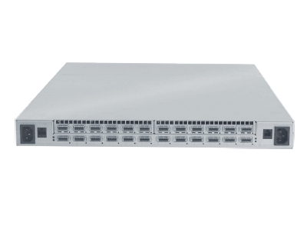
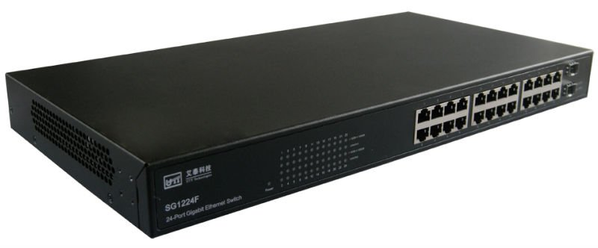

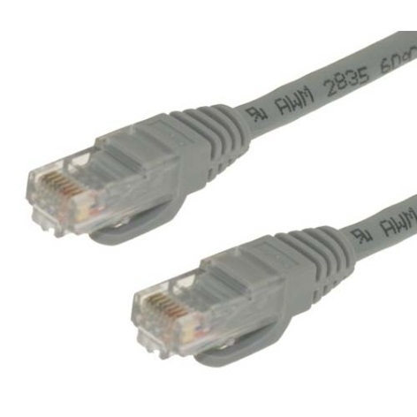
Switch examples
Infiniband switch (24 ports)
Gigabit Ethernet switch (24 ports)
non-blocking switches

Slide 79
Mesh networks
bisection

Slide 80
Chapter 2: outline
Distributed-memory architecture: general considerations
Programming model: Message Passing Interface (MPI)
Point-to-point communication
Blocking communication
Point to point network performance
Non-blocking communication
Collective communication
Collective communication algorithms
Global network performance
Parallel program performance evaluation
Amdahl’s law
Gustafson’s law
Parallel program development: case studies

Slide 81
Basic performance terminology
Runtime (“How long does it take to run my program”)
In practice, only wall clock time matters
Depends on the number of parallel processes P
T_{P} = runtime using P processes
Speedup (“How much faster does my program run in parallel”)
S_{P} = T₁ / T_{P}
In the ideal case, S_{P} = P
Super linear speedup are usually due to cache effects
Parallel efficiency (“How well is the parallel infrastructure used”)
η_{P} = S_{P} / P (0 ≤ η_{P} ≤ 1)
In the ideal case, η_{P} = 1 = 100%
Depends on the application what is considered acceptable efficiency

Slide 82
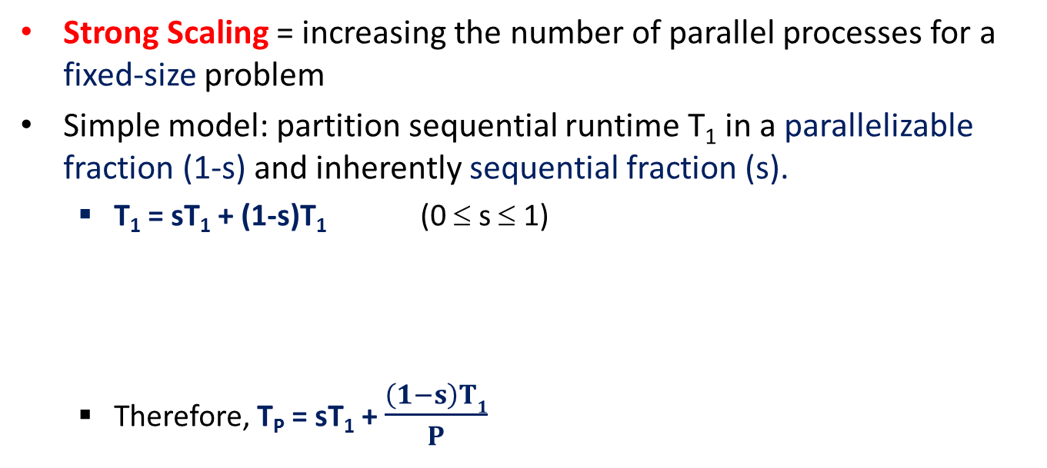
Strong scaling: Amdahl’s law
Strong Scaling = increasing the number of parallel processes for a fixed-size problem
Simple model: partition sequential runtime T₁ in a parallelizable fraction (1-s) and inherently sequential fraction (s).
T₁ = sT₁ + (1-s)T₁ (0 ≤ s ≤ 1)
Therefore, T_{P} = sT₁ + $\frac{\left(1−s\right)T1}{P}$
T₁ =
sequential
parallelizable
sT₁
(1-s)T₁
T₂ =
sequential
parallel
T₃ =
sequential
parallel
T₄ =
sequential
parallel
…
T∞ =
sequential

Slide 83
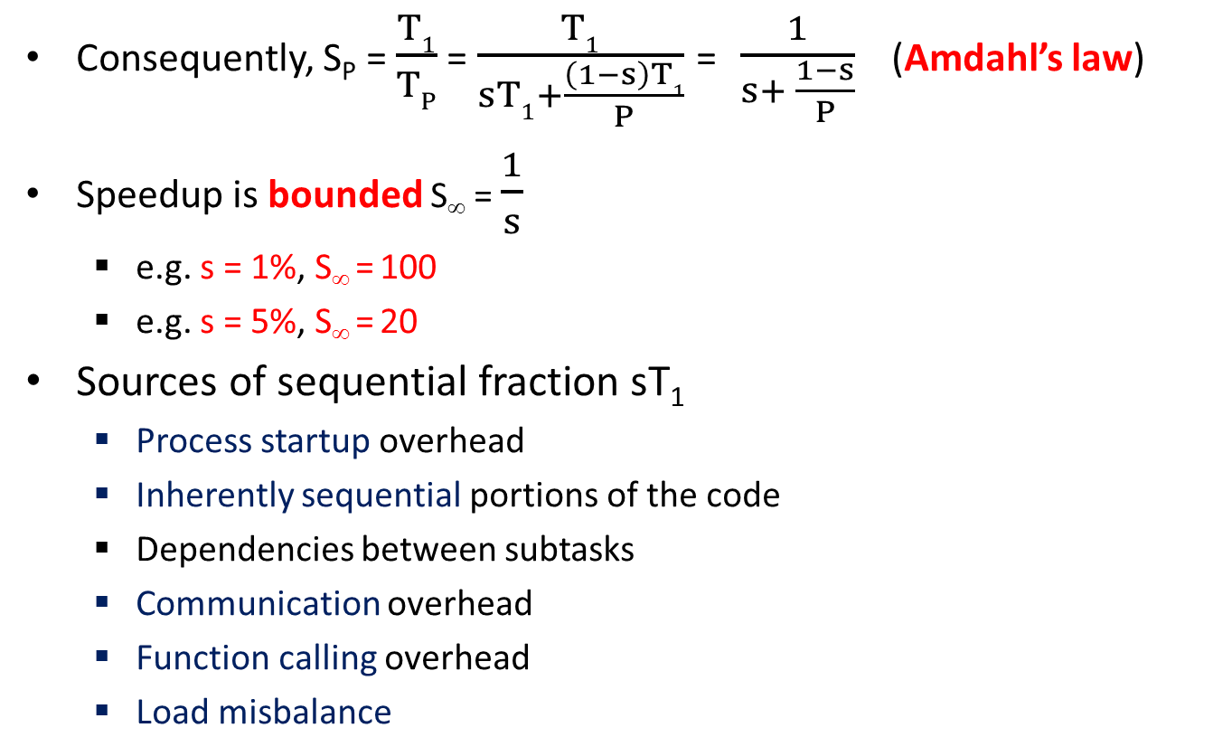
Strong scaling: Amdahl’s law
Consequently, S_{P} = $\frac{T1}{TP}$ = $\frac{T1}{sT1+\frac{\left(1−s\right)T1}{P}}$ = $\frac{1}{s+ \frac{1−s}{P}}$ (Amdahl’s law)
Speedup is bounded S∞ = $\frac{1}{s}$
e.g. s = 1%, S∞ = 100
e.g. s = 5%, S∞ = 20
Sources of sequential fraction sT₁
Process startup overhead
Inherently sequential portions of the code
Dependencies between subtasks
Communication overhead
Function calling overhead
Load misbalance

Slide 84
Amdahl’s law
linear speedup
For small P, close to linear speedup

Slide 85

Amdahl’s law
Same graph as on previous slide, but logarithmic x-as
S∞ = $\frac{1}{s}$

Slide 86
Amdahl’s law
Same graph as on previous slide, but expressed as parallel efficiency

Slide 87
Weak scaling: Gustafson’s law
Weak scaling: increasing both the number of parallel processes P and the problem size N.
Simple model: assume that the sequential part is constant, and that the parallelizable part is proportional to N.
T₁(N) = T₁(1)[ s + (1-s)N ] (0 ≤ s ≤ 1)
sT₁(1)
(1-s)T₁(1)
T₁(1) =
sequential
parallelizable
T₁(2) =
sequential
parallelizable
parallelizable
T₁(3) =
sequential
parallelizable
parallelizable
parallelizable
T₁(4) =
sequential
parallelizable
parallelizable
parallelizable
parallelizable

Slide 88
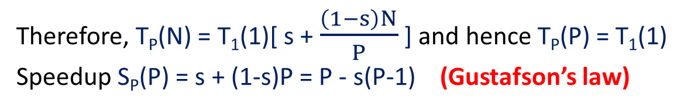
Gustafson’s law
Solve increasingly larger problems using a proportionally higher number of processes (N = P).
sT₁(1)
(1-s)T₁(1)
T₁(1) =
sequential
parallelizable
T₂(2) =
sequential
parallelizable
T₃(3) =
sequential
parallelizable
T₄(4) =
sequential
parallelizable
Therefore, T_{P}(N) = T₁(1)[ s + $\frac{\left(1−s\right)N}{P}$ ] and hence T_{P}(P) = T₁(1)
Speedup S_{P}(P) = s + (1-s)P = P - s(P-1) (Gustafson’s law)

Slide 89
Gustafson’s law

Slide 90
Gustafson’s law
Same graph as on previous slide, but expressed as parallel efficiency and log scale
η∞ = 1-s

Slide 91
Chapter 2: outline
Distributed-memory architecture: general considerations
Programming model: Message Passing Interface (MPI)
Point-to-point communication
Blocking communication
Point to point network performance
Non-blocking communication
Collective communication
Collective communication algorithms
Global network performance
Parallel program performance evaluation
Amdahl’s law
Gustafson’s law
Parallel program development: case studies

Slide 92
Case Study 1: Parallel matrix-matrix product

Slide 93
Case study: parallel matrix multiplication
Matrix-matrix multiplication: C = α*A*B + β*C (BLAS xgemm)
Assume C = m x n; A = m x k; B = k x n matrix.
α, β = scalars; assume α = β = 1 in what follows, i.e. C = C + A*B
Initially, matrix elements are distributed among P processes
We will review different partitioning schemes (1D, 2D, block cyclic)
Assume same scheme for each matrix A, B and C
Each process computes values for C that are local to that process
Required data from A and B that is not local needs to be communicated
Performance modeling assuming the α, β, γ model
α = latency
β = per element transfer time
γ = time for single floating point computation
Case study reproduced from J. Demmel
Notes:
Do not confuse the alpha and beta from the matrix-matrix multiplication formula with the alpha and beta from the communication cost model (latency and time per element).

Slide 94
Case study: parallel matrix-matrix product
First approach: one dimensional partitioning
Partition columns into P (roughly) equal slices of dimensions m x n/P (matrix C); m x k/P (matrix A); k x n/P (matrix B)
X(I) refers to slice I, held by process p_{i} (X = {A, B, C})
B(J, I) refers to block J, i.e. rows [J*k/P … (J+1)*k/P[ of slice B(I)
This “block” scheme is only introduced for notation purposes
n/P
n
0
k/P
p₀ | p₁ | … | p_{i} | … | p_{P-1}
e.g. matrix B
1
…
k
B(I)= slice I
Case study reproduced from J. Demmel
J
B(J, I)
…
P-1
P processes
Notes:
Capitalized indices denote slice / block indices, e.g. A(I) = slice I (I = 0… P-1) from matrix A.

Slide 95

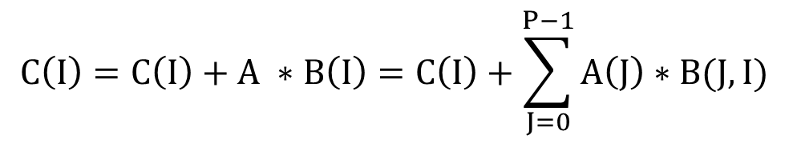
Case study: parallel matrix-matrix product
First approach: one dimensional partitioning
Process p_{i} needs to compute C(I):
do this in parallel
$$C\left(I\right)=C\left(I\right)+A ∗B\left(I\right)=C\left(I\right)+\sum_{J=0}^{P−1}{A\left(J\right)∗B(J,I)}$$
$∀ I=0…$P-1
m x k/P slice
k/P x n/P block
data that needs to be
communicated to p_{i}
data not
needed by p_{i}
data local in p_{i}
 |  | C(I)
 |  | A(I)
 |  | B(I)
+=
Case study reproduced from J. Demmel
*
C
A
B

Slide 96
Case study: parallel matrix-matrix product
First approach: one dimensional partitioning
Very naive algorithm:
Use MPI_Allgather to collect complete matrix A in all P processes. Cost: αlog₂P + β(km/P)(P-1)
Compute C(I) using formula on previous slide for all C(I) in parallel. Cost: 2nkmγ/P
Sequential algorithm cost T₁ = 2nkmγ
Parallel efficiency η_{P} = 1 / (1 + (α/γ)Plog₂P /(2nkm) + (β/γ) (P-1)/(2n) )
Disregard the contribution of the log term (grows slowly)
Isoefficiency when n and P increase proportionally (approx.)
Major disadvantage:
Need temporary memory to store mk elements of matrix A
This goes against philosophy to keep data distributed
Solution: modified allgather operation
Case study reproduced from J. Demmel
Notes:
The allgather cost may be higher if the network is not fully non-blocking.

Slide 97
Case study: parallel matrix-matrix product
First approach: one dimensional partitioning
Modified allreduce scheme in P-1 steps (as seen from process p₁)
P-1 communication rounds (cyclic left shift of slices of matrix A)
Big advantage: need to store only one slice of A at a time
Cyclic left shift of slices
Cyclic left shift of slices
Initial A
A(0) | A(1) | A(2)
A(1) | A(2) | A(0)
A(2) | A(0) | A(1)
matrix A
C(1) += A(1) * B(1,1) + A(2)*B(2,1) + A(0) * B(0,2)
Case study reproduced from J. Demmel

Slide 98
Case study: parallel matrix-matrix product
First approach: one dimensional partitioning
Parallel algorithm pseudocode:
Assume all slices of A are of equal size and fit in Tmp
nextRank = (myRank + 1) mod P;
prevRank = (myRank – 1) mod P;
Tmp = A(myRank)
C(myRank) = C(myRank) + Tmp * B(myRank, myRank)
for j = 1 to P-1
send Tmp to process prevRank
receive Tmp from process nextRank
C(myRank) = C(myRank) + Tmp * B((myRank + j) mod P, myRank)
endfor
Perform this product using Level-3 BLAS
Case study reproduced from J. Demmel

Slide 99
Case study: parallel matrix-matrix product
First approach: 1 dimensional partitioning
Time for one inner loop: T_{inner} = 2(α + (km/P)β)+2γnkm/P²
We assume sending and receiving operations are not concurrent because they involve different processes
T_{total} = 2γnmk/P² + (P-1)T_{inner} = 2(P-1)α+2kmβ(P-1)/P+2γnkm/P
Every process communicates only to left / right neighbors
Algorithm is suitable even for simple ring topology networks
Parallel efficiency η_{P} = 2nkmγ / ( P T_{total} )
= 1 / (1 + (α/γ)P(P-1)/(nkm) + (β/γ)(P-1)/n) )
Isoefficiency when (n, m and P) or (n, k and P) grow proportionally
Grows to 1 as α/γ and β/γ decrease (faster network)
Case study reproduced from J. Demmel
Notes:
Note the additional factor of two in the amount of communication required (need to receive AND send each slice of A)
Note that the log P factor in the latency has been replaced by (P-1).

Slide 100
Case study: parallel matrix-matrix product
Second approach: two dimensional partitioning
Partition matrices in 2D in an r x c mesh (P = r*c)
X(I, J) refers to block (I, J) of matrix X (X = {A, B, C})
Process p_{n} is also denoted by p_{i,j} (n = i*c + j) and holds X(I,J)
n
p_{0,0} | p_{0,1} | p_{0,2} | … | p_{0,c-1}
p_{1,0} | …
 |  | p_{i,j}
p_{r-1,0} |  |  |  | p_{r-1,c-1}
e.g. matrix B
B(I, J)
k
Case study reproduced from J. Demmel
r processes
c processes

Slide 101
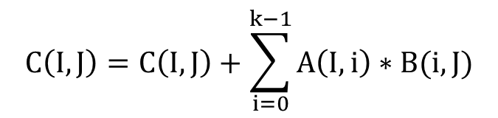
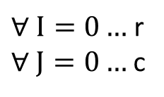
Case study: parallel matrix-matrix product
Second approach: two dimensional partitioning (SUMMA)
Process p_{i,j} needs to compute C(I, J):
do this in parallel
$$C\left(I,J\right)=C\left(I,J\right)+\sum_{i=0}^{k−1}{A\left(I,i\right)∗B(i, J)}$$
$∀ I=0…$ r
$∀ J=0…$ c
index i refers to a single column of A or single row of B
data that needs to be
communicated to p_{i,j}
data not
needed by p_{i,j}
data local in p_{i,j}
 |  | C(I,J)
 |  | A(I,J)
 |  | B(I,J)
*
Case study reproduced from J. Demmel
+=
B
B(i,J)
k elements
A(I,i)
C
A
Notes:
Note that when r is not equal to c (as in this case: r = 3; c = 4), the summation has to be performed over individual elements, rather than over blocks (blocks of A and B are incompatible in general).

Slide 102
Case study: parallel matrix-matrix product
Second approach: two dimensional partitioning
SUMMA algorithm (all I and J in parallel)
Cost for inner loop (executed k times):
log₂c (α + β(m/r)) + log₂r (α + β(n/c)) + 2mnγ/P
Total T_{P} = 2kmnγ/P + kα(log₂c + log₂r) + kβ((m/r)log₂c) + (n/c)log₂r)
For n = m = k and r = c = sqrt(P) we find:
Parallel efficiency η_{P} = 1 / (1 + (α/γ)(Plog₂P)/(2n²) + (β/γ)√P logP/n)
Isoefficiency when n grows as √P (constant memory per node!)
for i = 0 to k–1
broadcast A(I, i) within process row
broadcast B(i, J) within process column
C(I,J) += A(I, i) * B(i, J)
endfor
Case study reproduced from J. Demmel
Notes:
We again ignore the contribution of the log factor in the isoefficiency discussion.

Slide 103
Case study: parallel matrix-matrix product
Even more efficient: use “blocking” algorithm
SUMMA algorithm is implemented in PBLAS = Parallel BLAS
Algorithm can be extended to block-cyclic layout (see further)
for i = 0 to k–1 step b
end = min(i+b-1, k-1)
broadcast A(I, i:end) within process row
broadcast B(i:end, J) within process column
C(I,J) += A(I, i:end) * B(i:end, J)
endfor
Perform this product using Level-3 BLAS

Slide 104
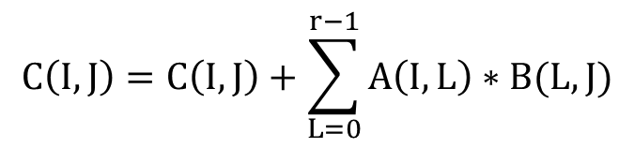
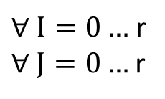
Case study: parallel matrix-matrix product
Special case when c = r = √P AND n = k = m (Cannon's algorithm)
Process p_{i,j} needs to compute C(I, J):
do this in parallel
$$C\left(I,J\right)=C\left(I,J\right)+\sum_{L=0}^{r−1}{A\left(I,L\right)∗B(L, J)}$$
$∀ I=0…$ r
$∀ J=0…$ r
n/√P x n/√P block
data that needs to be
communicated to p_{i,j}
data not
needed by p_{i,j}
data local in p_{i,j}
 |  | C(I,J)
 |  | A(I,J)
 |  | B(I,J)
=
Case study reproduced from J. Demmel
*
C
A
B
Notes:
When c = r, the summation can be performed over blocks

Slide 105
Case study: parallel matrix-matrix product
Special case c = r = √P
Cannon’s algorithm (seen from process that holds block (1,2) )
0,0 | 0,1 | 0,2
1,0 | 1,1 | 1,2
2,0 | 2,1 | 2,2
0,0 | 0,1 | 0,2
1,1 | 1,2 | 1,0
2,2 | 2,0 | 2,1
0,1 | 0,2 | 0,0
1,2 | 1,0 | 1,1
2,0 | 2,1 | 2,2
0,2 | 0,0 | 0,1
1,0 | 1,1 | 1,2
2,1 | 2,2 | 2,0
matrix A
0,0 | 0,1 | 0,2
1,0 | 1,1 | 1,2
2,0 | 2,1 | 2,2
0,0 | 1,1 | 2,2
1,0 | 2,1 | 0,2
2,0 | 0,1 | 1,2
1,0 | 2,1 | 0,2
2,0 | 0,1 | 1,2
0,0 | 1,1 | 2,2
2,0 | 0,1 | 1,2
0,0 | 1,1 | 2,2
1,0 | 2,1 | 0,2
matrix B
Initial A, B
Initial shifting
After shift k = 0
After shift k = 1
C(1,2) += A(1,0) * B(0,2) + A(1,1)*B(1,2) + A(1,2) * B(2,2)
Case study reproduced from J. Demmel
Notes:
Initially, row I of matrix A is left-cyclic-shifted by I blocks; column J of matrix B is up-cyclic-shifted by J blocks.
In each next step, each row of A is left-cyclic-shifted by one block; each column of B is up-cyclic-shifted by one block.

Slide 106
Case study: parallel matrix-matrix product
Second approach: two dimensional partitioning
Cannon’s algorithm pseudocode (seen from process p_{i,j})
TmpA = A(I,J);
TmpB = B(I,J);
// left-circular-shift row i of matrix A by i blocks
send TmpA to process p_{i,(j-i) mod r}
receive TmpA from process p_{i, (j+i) mod r}
// up-circular-shift column j of matrix B by j blocks
send TmpB to process p_{(i-j) mod r, j}
receive TmpB from process p_{(i+j) mod r, j}
for k = 0 to s-2
C(I,J) = C(I,J) + TmpA * TmpB
send TmpA to process p_{i,(j-1) mod r}
receive TmpA from process p_{i, (j+1) mod r}
send TmpB to process p_{(i-1) mod r, j}
receive TmpB from process p_{(i+1) mod r, j}
endfor
C(I,J) = C(I,J) + TmpA * TmpB
Perform this product using Level-3 BLAS
Case study reproduced from J. Demmel

Slide 107
Case study: parallel matrix-matrix product
Second approach: two dimensional partitioning
Time for inner loop: T_{inner} = 4*(α + (n²/P)*β) + 2*(n/s)³*γ
We assume sending and receiving operations are not concurrent
Assume non-blocking network between processes on same row/column
Total time ≈ 4*s*α + 4*(n²/s)*β + 2*(n³/P)*γ
Parallel efficiency η_{P} = 2*n³*γ / ( P * T_{total} )
= 1 / (1 + 2*(α/γ)*(s/n)³ + 2*(β/γ)*s/n )
= 1 / ( 1 + O(√P/n) )
Grows to 1 as O(n/ √P) increases or as α/γ and β/γ decrease
Difficult to generalize when P ≠ s² or A, B and C are not square
Rarely used in practice, even though it is optimal!
Case study reproduced from J. Demmel

Slide 108
Case Study 2: Parallel Gaussian Elimination

Slide 109
Case study: parallel Gaussian Elimination
Linear system of equations:
In matrix form: A x = b
A: n x n matrix, b: size-n vector (known), x: size-n vector (unknown)
Goal: find x
Gaussian Elimination (GE): make A upper triangular: U x = c
Solve for x by using backward substitution
Closely related to the LU decomposition
a₁₁ x₁ + a₁₂ x₂ + … + a_{1n} x_{n} = b₁
a₂₁ x₁ + a₂₂ x₂ + … + a_{2n} x_{n} = b₂
…
a_{n1} x₁ + a_{n2} x₂ + … + a_{nn} x_{n} = b_{n}
Case study reproduced from J. Demmel

Slide 110
Case study: parallel Gaussian Elimination
Algorithm (cfr. 1st Bachelor)
for i = 1 … n-1
for row j = i+1 … n
for col k = i … n // add multiple of row i to row j
A(j,k) = A(j,k) – A(j,i)/A(i,i) * A(i,k)
multiplier m fixed within inner loop
i
upper triangular
(white): finished
A(i, i)
i
strict lower triangular
(white): all zeros
Case study reproduced from J. Demmel
green = updated
in two inner loops
j
A(j, i)
Notes:
The multiplier m = A(j, i) / A(i, i) is chosen such that element A(j, i) will be made zero.
The updates are also applied to the right hand-size vector B during the gaussian elimination (not shown)
Note that in this pseudo-code we start counting from index 1 (and not from 0 as in C code).

Slide 111
Case study: parallel Gaussian Elimination
Initial version 1
for i = 1 … n-1
for row j = i+1 … n
for col k = i … n // add multiple of row i to row j
A(j,k) = A(j,k) – A(j,i)/A(i,i) * A(i,k)
Do not recompute multiplier in inner loop
for i = 1 … n-1
for row j = i+1 … n
m = A(j,i)/A(i,i)
for col k = i … n // add multiple of row i to row j
A(j,k) = A(j,k) – m * A(i,k)
Case study reproduced from J. Demmel

Slide 112
Case study: parallel Gaussian Elimination
Current version 2
for i = 1 … n-1
for row j = i+1 … n
m = A(j,i)/A(i,i)
for col k = i … n
A(j,k) = A(j,k) – m * A(i,k)
Don’t compute what we already know: A(j, i) will be zero
for i = 1 … n-1
for row j = i+1 … n
m = A(j,i)/A(i,i)
for col k = i+1 … n
A(j,k) = A(j,k) – m * A(i,k)
Case study reproduced from J. Demmel

Slide 113
Case study: parallel Gaussian Elimination
Current version 3
for i = 1 … n-1
for row j = i+1 … n
m = A(j,i)/A(i,i)
for col k = i+1 … n
A(j,k) = A(j,k) – m * A(i,k)
Store multipliers m below diagonal in zeroed entries
We will use them later on
for i = 1 … n-1
for row j = i+1 … n
A(j,i) = A(j,i)/A(i,i)
for col k = i+1 … n
A(j,k) = A(j,k) – A(j,i) * A(i,k)
Case study reproduced from J. Demmel

Slide 114
Case study: parallel Gaussian Elimination
Current version 4
for i = 1 … n-1
for row j = i+1 … n
A(j,i) = A(j,i)/A(i,i)
for col k = i+1 … n
A(j,k) = A(j,k) – A(j,i) * A(i,k)
Split middle loop
for i = 1 … n-1
for row j = i+1 … n
A(j,i) = A(j,i)/A(i,i)
for row j = i+1 … n
for col k = i+1 … n
A(j,k) = A(j,k) – A(j,i) * A(i,k)
Case study reproduced from J. Demmel

Slide 115
Case study: parallel Gaussian Elimination
Last version
for i = 1 … n-1
for row j = i+1 … n
A(j,i) = A(j,i)/A(i,i)
for row j = i+1 … n
for col k = i+1 … n
A(j,k) = A(j,k) – A(j,i) * A(i,k)
i
A(i, i)
i
A(i+1:n, i) = A(i+1:n, i)*(1/A(i,i))
BLAS level 1 xscal: x = α x
Case study reproducted from J. Demmel
A(i+1:n, i+1:n) = A(i+1:n, i+1:n)
- A(i+1:n, i) * A(i, i+1:n)
BLAS level 2 xger: A = A + αxy^{T}
j
A(j, i)
Notes:
What we did up until now:
We reformulated the algorithm so that the use of BLAS level 1 and level 2 become apparent. Remember: BLAS routines are provided by CPU vendors in highly optimized libraries. Using BLAS routines in your code will therefore significantly boost your implementation performance.
We’ve stored the multipliers m instead of putting zeros. This allows us to decouple some of the operations in the middle loop.
The use of level 1 (vector operations) and level 2 (matrix-vector operations) BLAS routines is a good thing, however, the level 3 BLAS routines (matrix – matrix operations) is where the performance gain is truly significant (because of the ability to exploit both the temporal and spatial locality the in the cache hierarchy – see Chapter 1). Therefore, we will now further modify our algorithm so that it can make use of level 3 BLAS routines.
xscal = scale a vector
xger = general rank-1 update
x = {s = single precision, d = double precision, c = complex single, z = complex double}

Slide 116
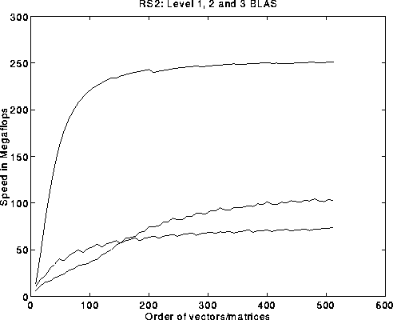
Case study: parallel Gaussian Elimination
What we really want: use BLAS level 3 operations
Peak FLOPS/s
BLAS level 3
BLAS level 2
BLAS level 1
How?
Blocking: see matrix as b x b blocks and treat blocks as atomic entities
Save updates to the lower right “trailing submatrix”
Apply several level 2 BLAS calls into a single level 3 BLAS call
Image taken from J. Demmel
Notes:
The block size b should be:
Small enough so that several b x b blocks fit the cache
Large enough to enable temporal locality in the cache (i.e., make level 3 BLAS fast)

Slide 117
Case study: parallel Gaussian Elimination
level 3 BLAS matrix-matrix products!
Blocked version
for ib = 1 … n-1 step b
end = min(ib+b-1,n)
use BLAS-2 GE algorithm to get A(ib:n, ib:end)
A(ib:end, end+1:n) = LL⁻¹ * A(ib:end, end+1:n)
A(end+1:n, end+1:n) = A(end+1:n, end+1:n)
- A(end+1:n, ib:end) * A(ib:end, end+1:n)
b
ib
end
LL = strict lower triangular part of
A(ib:end, ib:end) + I
LL = b x b matrix
A(ib:end, ib:end)
ib
b
LL
A(ib:end, end+1:n)
end
Case study reproducted from J. Demmel
A(end+1:n, ib:end)
A(end+1:n, end+1:n)
Notes:
For proof of correctness: see http://www.cs.berkeley.edu/~demmel/cs267/lecture12/lecture12.html

Slide 118
Case study: parallel Gaussian Elimination
What about (distributed-memory) parallelization ?
Need to discuss matrix decomposition
0 | 1 | 2 | 3
0 | 1
2 | 3
Poor load balance:
p₀ idle after n/4 steps
Poor load balance:
p₀ idle after n/2 steps
1) 1D column blocked
2) 2D row and column blocked
0 | 1 | 2 | 3 | 0 | 1 | 2 | 3 | 0 | 1 | 2 | 3 | 0 | 1 | 2 | 3
0 | 1 | 2 | 3 | 0 | 1 | 2 | 3
Cannot use
level-3 BLAS
Work per column is
not parallel
2) 1D column cyclic
4) 1D column block cyclic
Case study reproducted from J. Demmel
0 | 1 | 2 | 3
1 | 2 | 3 | 0
2 | 3 | 0 | 1
3 | 0 | 1 | 2
0 | 1 | 0 | 1 | 0 | 1
2 | 3 | 2 | 3 | 2 | 3
0 | 1 | 0 | 1 | 0 | 1
2 | 3 | 2 | 3 | 2 | 3
0 | 1 | 0 | 1 | 0 | 1
2 | 3 | 2 | 3 | 2 | 3
Complicated addressing
Poor load balance
Best option
5) Block skewed layout
6) 2D row and column block cyclic
Notes:
1D column blocked layout: partition columns in P blocks of size m x n/P (assume an m x n matrix).
2D row and column blocked layout: partition both rows and columns in an r x c grid of processes (P = rc)
1D column cyclic: assign column i to process i mod P
1D column block cyclic: assign column i to process i/b mod, with b the block size
Block skewed layout: partition matrix in a P x P grid, and assign blocks to processes such that each process appears once on each row and each column
2D row and column block cyclic layout: see next slide

Slide 119
Case study: parallel Gaussian Elimination
c
Block cyclic layout
Processes are arranged in an r x c grid
Partition m x n matrix in blocks of size MB x NB
Map process grid in block cyclic manner
p₀ | p₁ | p₂
p₃ | p₄ | p₅
r
n
p₀ | p₁ | p₂ | p₀ | p₁
p₃ | p₄ | p₅ | p₃ | p₄
p₀ | p₁ | p₂ | p₀ | p₁
p₃ | p₄ | p₅ | p₃ | p₄
p₀ | p₁ | p₂ | p₀ | p₁
p₃ | p₄ | p₅ | p₃ | p₄
p₀ | p₁ | p₂ | p₀ | p₁
NB
MB
m
final row/column blocks may be smaller if n mod NB ≠ 0 or m mod MB ≠ 0

Slide 120
Case study: parallel Gaussian Elimination
Block cyclic layout
r-fold parallelism in each column
c-fold parallelism in each row
Load is balanced if MB * r << m and NB * c << n
Typical values for MB x NB: 64 x 64
Use of blocks allows for local calls to BLAS level 3 routines
Used as a general-purpose layout in
PBLAS = Parallel BLAS (distributed-memory)
ScaLapack = Parallel LAPACK (distributed-memory)
Easy to modify SUMMA algorithm (matrix-matrix product)
From 2D row and column blocked (as seen in previous slides) …
…to block cyclic layout (do this as an exercise)

Slide 121
Case study: parallel Gaussian Elimination
for ib = 1 … n-1 step b
end = min(ib+b-1,n)
for i = ib to end
(1) column broadcast elements A(i, i:end)
(2) A(i+1:n,i) /= A(i,i)
(3) A(i+1:n,i+1:end) -= A(i+1:n,i)*A(i,i+1:end)
end for
… (see next slide)
end for
(1)
(2)
(2)
(3)
Case study reproducted from J. Demmel

Slide 122
Case study: parallel Gaussian Elimination
(4+5)
for ib = 1 … n-1 step b
end = min(ib+b-1,n)
for i = ib to end
… (see previous slide)
end for
(4) Broadcast LL⁻¹ right
(5) A(ib:end, end+1:n) = LL⁻¹ * A(ib:end, end+1:n)
(6) broadcast A(ib:end, end+1:n) down
(7) broadcast A(end+1:n, ib:end) right
(8) update A(end+1:n, end+1:n)
end for
LL
(6+7)
(8)
Case study reproducted from J. Demmel

Slide 123
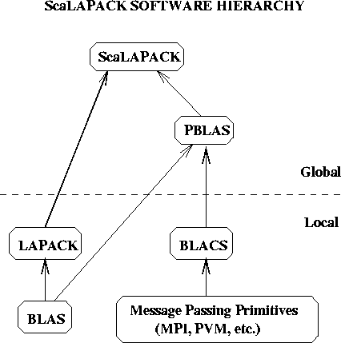
Case study: parallel Gaussian Elimination
Image take from J. Demmel

Slide 124

Case Study 3: Parallel Sorting

Slide 125
Case study: parallel sorting algorithm
Sequential sorting of n keys (1st Bachelor)
Bubblesort: O(n²)
Mergesort: O(n log n), even in worst-case
Quicksort: O(n log n) expected, O(n²) worst-case, fast in practice
Parallel sorting of n keys, using P processes
Initially, each process holds n/P keys (unsorted)
Eventually, each process holds n/P keys (sorted)
Keys per process are sorted
If q < r, each key assigned to process q is less than or equal to every key assigned to process r (sort keys in rank order)

Slide 126
Case study: parallel sorting algorithm
Bubblesort algorithm: O(n²)
void Bubble_sort(int *a, int n) {
for (int listLen = n; listLen >= 2; listLen--)
for (int i = 0; i < listLen-1; i++)
if (a[i] > a[i+1]) {
temp = a[i];
a[i] = a[i+1]
a[i+1] = temp;
}
}
“Compare-swap” operation
Example:
5 2 4 8 1 → 2 4 5 1 8
→ 2 4 1 5 8
→ 2 1 4 5 8
→ 1 2 4 5 8
after iteration 1
after iteration 2
after iteration 3
after iteration 4
Algorithm reproduced from P. Pacheco

Slide 127
Case study: parallel sorting algorithm
Bubblesort
Result of current step (a[i] > a[i+1]) depends on previous step
Value of a[i] is determined by previous step
Algorithm is “inherently serial”
Not much point in trying to parallelize this algorithm
Odd-even transposition sort
Decouple algorithm in two phases: even and odd
Even phase: compare-swap on following elements:
(a[0], a[1]), (a[2], a[3]), (a[4], a[5]), …
Odd phase: compare-swap operations on following elements:
(a[1], a[2]), (a[3], a[4]), (a[5], a[6]), …

Slide 128
Case study: parallel sorting algorithm
Even-odd transposition sort algorithm: O(n²)
void Even_odd_sort(int *a, int n) {
for (int phase = 0; phase < n; phase++)
if (phase % 2 == 0) { // even phase
for (int i = 0; i < n-1; i += 2)
if (a[i] > a[i+1]) {
temp = a[i];
a[i] = a[i+1]
a[i+1] = temp;
}
} else { // odd phase
for (int i = 1; i < n-1; i += 2)
if (a[i] > a[i+1]) {
temp = a[i];
a[i] = a[i+1]
a[i+1] = temp;
}
}
}
“Compare-swap” operation
“Compare-swap” operation
Algorithm reproduced from P. Pacheco

Slide 129
Case study: parallel sorting algorithm
Even-odd transposition sort algorithm: O(n²)
Example:
5 2 4 8 1 → 2 5 4 8 1
→ 2 4 5 1 8
→ 2 4 1 5 8
→ 2 1 4 5 8
→ 1 2 4 5 8
even phase
odd phase
even phase
odd phase
even phase
Parallelism within each even or odd phase is now obvious:
Compare-swap between (a[i], a[i+1]) independent from (a[i+2], a[i+3])

Slide 130
Case study: parallel sorting algorithm
execute in parallel during phase j
Parallel algorithm
First, assume P == n (one element per process)
a[i-2]
a[i-1]
a[i]
a[i+1]
phase j
a[i-2]
a[i-1]
a[i]
a[i+1]
phase j+1
execute in parallel during phase j+1
Communicate value with neighbor
Right process (highest rank) keeps largest value
Left process (lowest rank) keeps smallest value
Image reproduced from P. Pacheco
Notes:
After P == n phases, all elements are sorted

Slide 131
Case study: parallel sorting algorithm
Parallel algorithm
Now, assume n/P >> 1 (as is typically the case)
Example: P = 4; n = 16
process 0
process 1
process 2
process 3
initial values
15,11,9,16
3,14,8,7
4,6,12,10
5,2,13,1
local sorting
9,11,15,16
3,7,8,14
4,6,10,12
1,2,5,13
phase 0 (even)
3,7,8,9
11,14,15,16
1,2,4,5
6,10,12,13
phase 1 (odd)
3,7,8,9
1,2,4,5
11,14,15,16
6,10,12,13
phase 2 (even)
1,2,3,4
5,7,8,9
6,10,11,12
13,14,15,16
phase 3 (odd)
1,2,3,4
5,6,7,8
9,10,11,12
13,14,15,16
Algorithm reproduced from P. Pacheco

Slide 132
Case study: parallel sorting algorithm
Theorem: Parallel odd-even transposition sort algorithm will sort the input
list after P (= number of processes) phases.
Parallel even-odd transposition sort pseudocode
sort local keys
for (int phase = 0; phase < P; phase++) {
neighbor = computeNeighbor(phase, myRank);
if (I’m not idle) { // first and/or last process may be idle
send all my keys to neighbor
receive all keys from neighbor
if (myRank < neighbor)
keep smaller keys
else
keep larger keys
}
}
Algorithm reproduced from P. Pacheco

Slide 133
Case study: parallel sorting algorithm
Implementation of computeNeighbor (MPI)
int computeNeighbor(int phase, int myRank) {
int neighbor;
if (phase % 2 == 0) {
if (myRank % 2 == 0)
neighbor = myRank + 1;
else
neighbor = myRank - 1;
} else {
if (myRank % 2 == 0)
neighbor = myRank – 1;
else
neighbor = myRank + 1;
}
if (neighbor == -1 || neighbor == P-1)
neighbor = MPI_PROC_NULL;
return neigbor;
}
When used as destination or source rank in MPI_Send
or MPI_Recv, no communication takes place
Algorithm reproduced from P. Pacheco

Slide 134
Case study: parallel sorting algorithm
Implementation of data exchange in MPI
Be careful of deadlocks
In both even and odd phases, communication always takes place between a process with even, and a process with odd rank
if (myRank % 2 == 0) {
MPI_Send(...)
MPI_Recv(...)
} else {
MPI_Recv(...)
MPI_Send(...)
}
Exchange order to prevent deadlocks !
OR
MPI_Sendrecv(...)
Algorithm reproduced from P. Pacheco

Slide 135
Case study: parallel sorting algorithm
Parallel odd-even transposition sort algorithm analysis
Initial sorting: O(n/P log(n/P) ) time
Use an efficient sequential sorting algorithm, e.g. quicksort or mergesort
Per phase: 2(α + n/P β) + γn/P
Total runtime T_{P}(n) = O(n/P log(n/P) + 2(αP + nβ) + γn
= 1/P O(n log n) + O(n)
Linear speedup when P is small and n is large
However, bad asymptotic behaviour
When n and P increase proportionally, runtime per process is O(n)
What we really want: O(log n)
Difficult! (but possible!)
Algorithm reproduced from P. Pacheco

Slide 136
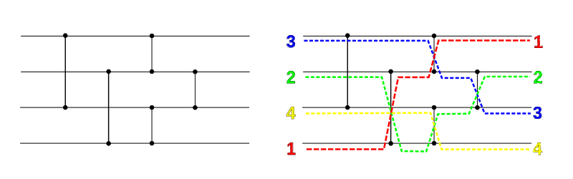
Case study: parallel sorting algorithm
Sorting networks ( = graphical depiction of sorting algorithms)
Number of horizontal “wires” ( = elements to sort)
Connected by vertical “comparators” ( = compare and swap)
x
min(x, y)
y
max(x, y)
Example (4 elements to sort)
elements to sort (n)
time
Notes:
Note that sorting networks can only be used for sorting algorithms for which the order of comparisons is fixed and set in advance.

Slide 137
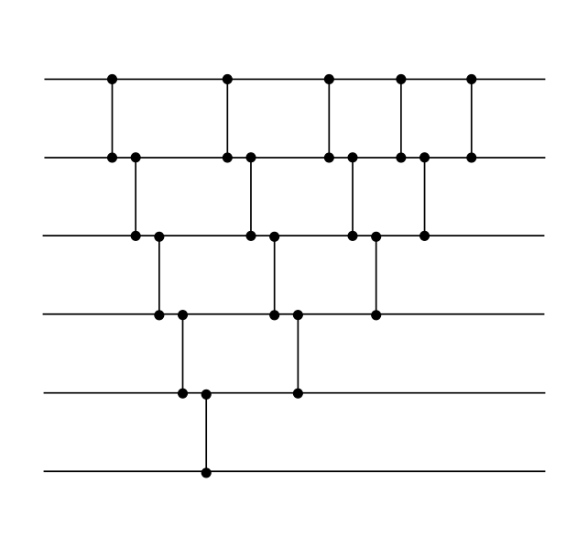
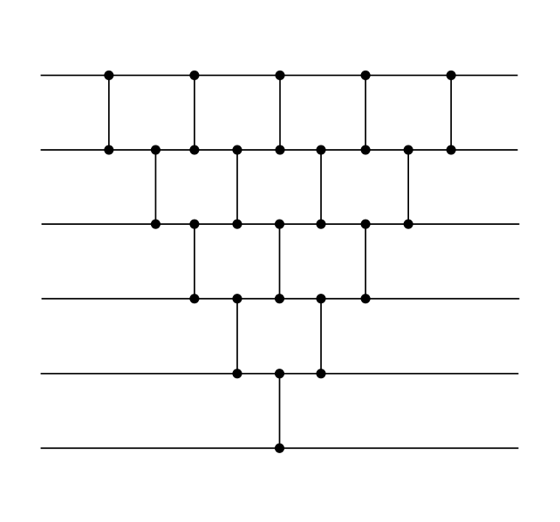
Case study: parallel sorting algorithm
Bubblesort algorithm (sequential)
Same bubblesort algorithm (parallel)
Sequential runtime
= number of comparators
= “size of the sorting network”
= n * (n – 1) / 2
Parallel runtime
(assume P == n processes)
= “depth of sorting network”
= 2n – 3
Notes:
For the parallel runtime, we assume that comparators can be indepently

Slide 138
Case study: parallel sorting algorithm
Definition: depth of a sorting network (= parallel runtime)
Zero at the inputs or each wire
For a comparator with inputs with depth d₁ and d₂, the depth of its output is 1 + max(d₁, d₂)
Depth of the sorting network = maximum depth of each output
0
1
3
5
7
9
0
1
2
3
4
5
6
7
8
9
0
2
3
4
5
6
7
8
0
3
4
5
6
7
0
4
5
6
0
5

Slide 139
Case study: parallel sorting algorithm
Sorting network of odd-even transposition sort
Parallel runtime = “depth of sorting network” = n
… or P (we assume n == P)

Slide 140
Case study: parallel sorting algorithm
Can we do better?
Sequential sorting algorithms are O(n log n)
Ideally, P and n can scale proportionally: P = O(n)
That means that we want to sort n numbers in O(log n) time
This is possible (!), however, big constant pre-factor
We will describe an algorithm that can sort n numbers in O(log² n) parallel time (using P = O(n) processes)
This algorithm has best performance in practice
… unless n becomes huge (n > 2²⁰⁰⁰)
Nobody wants to sort that many numbers

Slide 141
Case study: parallel sorting algorithm
Theorem (zero-one principle): If a sorting network with n inputs sorts all 2^{n} binary strings of length n correctly, then it sorts all sequences correctly (proof: see references).
1
0
Example
0
0
0
0
1
1
0
1
1
1
We will design an algorithm that can sort binary sequences in O(log₂²n) time

Slide 142
Case study: parallel sorting algorithm
Step 1: create a sorting network that sorts bitonic sequences
Definition: A bitonic sequence is a sequence which is first increasing and then decreasing, or can be circularly shifted to become so.
(1, 2, 3, 3.14, 5, 4, 3, 2, 1) is bitonic
(4, 5, 4, 3, 2, 1, 1, 2, 3) is bitonic
(1, 2, 1, 2) is not bitonic
Over zeros and ones, a bitonic sequence is of the form
0^{i}1^{j}0^{k} or 1^{i}0^{j}1^{k} (with e.g. 0^{i} = 0000…0 = i consecutive zeros)
i, j or k can be zero

Slide 143
Case study: parallel sorting algorithm
Now, let’s create a sorting network that sorts a bitonic sequence.
A half-cleaner network connects line i with line i + n/2
If the input is a binary bitonic sequence then for the output
Elements in the top half are at least as small as the corresponding elements in the bottom half, i.e. halves are relatively sorted.
Bottom and top half are bitonic.
One of the halves of the output consists of only zeros or ones (i.e. is “clean”).
Half-cleaner
example (n=8)
Notes:
Proof. See notes.

Slide 144
Case study: parallel sorting algorithm
Example of a half-cleaner[n] network
0
0
0
0
upper half
is “clean”
1
0
input =
bitonic
sequence
1
0
upper half
is smaller than
lower half
1
1
0
0
lower half
is bitonic
0
1
0
1
Notes:
A half-cleaner[n] network transforms a bitonic input sequence of size n into two bitonic sequences of size[n/2]. Both halves are relatively sorted: all elements in the upper half are smaller than (or equal to) the elements of the lower half. This means that we can apply the half-cleaner network recursively to sort a bitonic input sequence.

Slide 145
Case study: parallel sorting algorithm
Therefore, a bitonic sorter[n] (i.e. network that sorts a bitonic sequence of length n) is easily obtained by recursion:
Half-cleaner[n]
Bitonic-sorter[n/2]
Bitonic-sorter[n/2]
A bitonic sorter sorts a bitonic sequence of length n = 2^{k} using
size = nk/2 = n/2 log₂n comparators (= sequential time)
depth = k = log₂n (= parallel time)

Slide 146
Case study: parallel sorting algorithm
Step 2: Build a network merger[n] that merges two sorted sequences of length n/2 so that the output is sorted
Flip second sequence and concatenate first and flipped second
Concatenated sequence is bitonic, sort using step 1
Conceptually
0
0
Bitonic sorter[n]
sorted
sequence 1
0
0
1
1
1
1
0
1
sorted
sequence 2
1
1
1
1
1
0
Notes:
This scheme represents a conceptual respresentation of the merger[n] network. We will further transform and simplify this conceptual scheme in the next slides.

Slide 147
Case study: parallel sorting algorithm
Merger[n] scheme
Same scheme as in previous slide
0
Bitonic sorter[n/2]
sorted
sequence 1
0
1
1
0
Bitonic sorter[n/2]
sorted
sequence 2
1
1
1
half-cleaner[n]
Notes:
This is still the merger[n] scheme. The only modification is that bitonic sorter[n] is decomposed in its three building blocks (one half-cleaner[n] + 2 bitonic sorter[n/2] blocks).

Slide 148
Case study: parallel sorting algorithm
Merger[n] scheme
Same scheme as in previous slide (only drawn differently)
0
Bitonic sorter[n/2]
sorted
sequence 1
0
1
1
0
Bitonic sorter[n/2]
sorted
sequence 2
1
1
1
flip-cleaner[n]
Notes:
This is again the merger[n] scheme, but drawn differently: the lower half of the lines are flipped. Convince yourself that this is still the exact same scheme is in the previous slides (exact same functionality).

Slide 149
Case study: parallel sorting algorithm
Merger[n] scheme
Flipping a bitonic sequence is again a bitonic sequence
0
Bitonic sorter[n/2]
sorted
sequence 1
0
1
1
0
Bitonic sorter[n/2]
sorted
sequence 2
1
1
1
flip-cleaner[n]
Notes:
In this scheme, we simply omit the flipping of the lower bitonic sequence. We know that the result is again a bitonic sequence and that bitonic sorter will correctly sort this.

Slide 150
Case study: parallel sorting algorithm
Step 3: Build a sorter[n] network that sorts arbitrary sequences
Do this recursively from merger[n] building blocks
Depth: D(1) = 0 and D(n) = D(n/2) + log₂n = O(log₂²n)
sorter[n/2]
merger[n]
(from Step 2)
sorter[n/2]

Slide 151
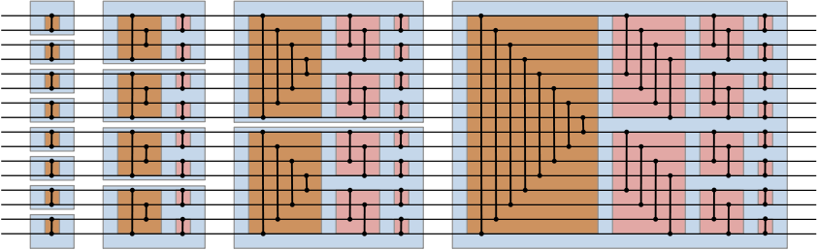
Case study: parallel sorting algorithm
Example: sorter[16]
flip-cleaner[16]
merger[8]
half-cleaner[8]
merger[2]
merger[4]
merger[16]

Slide 152
Case study: parallel sorting algorithm
Further reading of bitonic networks:
http://valis.cs.uiuc.edu/~sariel/teach/2004/b/ webpage/lec/14_sortnet_notes.pdf
In case n is not a power of two:
http://www.iti.fh-flensburg.de/lang/algorithmen/ sortieren/bitonic/oddn.htm

Slide 153

Notes:
The end

