Slide 1
Chapter 4: Data-intensive processing using MapReduce

Slide 2
Chapter 4: outline
Introduction
Motivation
Big ideas
MapReduce
Programming model
Framework
Design patterns for MapReduce
In-mapper combining
Pairs versus stripes
Order reversal
Value-to-key conversion

Slide 3
Chapter 4: outline
Introduction
Motivation
Big ideas
MapReduce
Programming model
Framework
Design patterns for MapReduce
In-mapper combining
Pairs versus stripes
Order reversal
Value-to-key conversion

Slide 4
Introduction
MapReduce is a programming model and execution framework
Used for processing massive amounts of data (“web-scale”)…
… in a distributed way
Originally developed by Google
Hadoop: open-source implementation (Java)
What is “big data” ?
Google processes 100 Tbytes/day (2004) – 20 Pbytes/day (2008)
Ebay keeps track of 170 trillion records (~ 6.5 Pbytes)
Facebook analyses 2.5 Pbytes of user data (grows with 15 Tbyte/day)
Large Hadron Collider (Cern): 15 Pbytes / year.
EMBL: DNA sequencing database: 5 Pbytes (2009)
Material reproduced from Lin and Dyer

Slide 5
Motivation (why ?)
Improvements in capacity are outpacing bandwidth
Capacity: has improved order of magnitude of the past decades
Bandwidth of commodity networks: 50x
Latency of commodity networks: 2x
Why such large amounts of data
Successfully retrieving information from data depends on
Algorithms
Features
Data itself
Growing evidence that having more data and simple models outperforms complex features/algorithms with less data
This is called “Data-driven philosophy”
Material reproduced from Lin and Dyer

Slide 6
Motivation (how ?)
Related to “cloud” computing
Cloud = the current buzz-word
Includes web-based apps that store user-generated data
Major idea (1): “Utility computing” (like water, gas, electricity, …)
Frees users from upfront investments
Elasticity (computer power on demand, when needed)
Major idea (2): “Everything as a service”
Infrastructure (IaaS)
Platform (PaaS), e.g. Google App Engine
Software (SaaS)
Link to MapReduce:
Just as “clouds”, MapReduce tries to represent the right level of abstraction: separate the “what” from the “how”
Material reproduced from Lin and Dyer

Slide 7
Chapter 4: outline
Introduction
Motivation
Big ideas
MapReduce
Programming model
Framework
Design patterns for MapReduce
In-mapper combining
Pairs versus stripes
Order reversal
Value-to-key conversion

Slide 8
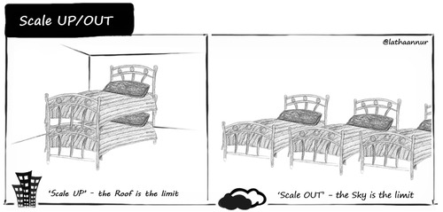
Big ideas of MapReduce (1)
Scale “out”, not “up”
Prefer a larger number of low-end workstations over a smaller number of high-end workstations (for big-data problems)
Buying low-end workstations (“desktop-like machines”) is 4-12x as cost efficient as buying high-end workstations (“high-memory SMP machines with a high number of CPUs / cores”).
Idea is also valid for network interconnects
E.g. Infiniband versus “commodity” Gigabit Ethernet
True HPC applications do require fast networks though…
Material reproduced from Lin and Dyer

Slide 9
Target cluster
“many machines”
CPU
CPU
CPU
HD
RAM
HD
RAM
HD
RAM
machine (cheap)
network (cheap)

Slide 10

Big ideas of MapReduce (2)
Assume failures are common
Example: 10,000-server cluster, MTBF = 1000 days
Expected value of 10 failures a day
Restarting a large-scale job every time a node fails? NO
Ideas:
In case of node failure,
only the work attributed to that node should be recomputed
remaining work should be redistributed among other nodes
In case a node is repaired/replaced
node should be able to rejoin an existing job
Material reproduced from Lin and Dyer
Notes:
MTBF = Mean time before failure

Slide 11
Big ideas of MapReduce (3)
“Move processing to the data”
In a supercomputer
“compute nodes” are typically linked to “storage nodes” through a high-capacity interconnect
In big data problems
moving this data itself becomes a bottleneck
MapReduce assumes a system where storage and processing power are co-located
In MapReduce: data is located on the local disc of the compute node (requires a distributed file system – see further)
Try to assign computations to the nodes that contain all necessary data
Material reproduced from Lin and Dyer

Slide 12
Big ideas of MapReduce (4)
Process data sequentially and avoid random access
Example: 1 terabyte database: 10¹⁰ 100-byte records
Disc latency: ~10 ms
Disc throughput: ~100 Mbyte /s
Updating 1% using random access
10⁸ x 10⁻² (latency only) = 10⁶ seconds
Reading and rewriting the entire database
2 x 10¹² x 10⁻⁸ = 2.10⁴ seconds
Material reproduced from Lin and Dyer

Slide 13
Big ideas of MapReduce (5)
Hide system-level details from the application developer
Parallel programming is difficult
Code runs in unpredictable order
Race conditions, deadlocks, livelocks, …
Main idea is to be able to program the “what” (i.e. the functionality of the code) and hide the “how” (i.e. the low-level details)
What
How
Responsibility
of the programmer
Responsibility
of the framework
Material reproduced from Lin and Dyer

Slide 14
Big ideas of MapReduce (6)
Scalability of the framework
Ideal algorithm:
Given twice the amount of data, the runtime should be (at most) twice as high (algorithm has linear complexity)
Doubling the number of resources, the runtime should be roughly halved
For complex algorithms, this is usually unobtainable
Require true HPC computing environments to get reasonable speedups
For data-driven problems, MapReduce will effectively scale to very large volumes / very large number of CPUs
Material reproduced from Lin and Dyer

Slide 15
Chapter 4: outline
Introduction
Motivation
Big ideas
MapReduce
Programming model
Framework
Design patterns for MapReduce
In-mapper combining
Pairs versus stripes
Order reversal
Value-to-key conversion

Slide 16
MapReduce basics
MapReduce programming model
Divide & conquer strategy
divide: partition dataset into smaller, independent chunks to be processed in parallel ( = “map”)
conquer: combine, merge or otherwise aggregate the results from the previous step (= “reduce”)
Roots in functional programming (e.g. Lisp)
Operates on <key, value> pairs
Web-based example: key = URL ; value = webpage
Graph-based example: key = nodes ; value = adjacency list
Users specifies two functions:
map: ( k₁, v₁ ) → list[k₂, v₂]
reduce: ( k₂, list[v₂] ) → list[k₃, v₃]
Sorting of intermediate keys between map and reduce phase
Material reproduced from Lin and Dyer

Slide 17
MapReduce framework
input
<key,value>
pairs
A
α
B
β
C
γ
D
δ
E
ε
mapper
mapper
mapper
mapper
intermediate
<key,value>
pairs
a
1
b
2
c
3
c
6
a
5
c
2
b
7
c
8
Shuffle and Sort: aggregate values by keys
sorted
intermediate
<key,value>
pairs
a
1
5
b
2
7
c
2
3
8
6
reducer
reducer
reducer
output
<key,value>
pairs
a
6
b
9
c
19
Material reproduced from Lin and Dyer

Slide 18
MapReduce basics
Mappers and reducers
objects that implement “map” and “reduce” methods
one mapper object per map “task”
map task processes a subset of the input <key, value> pairs
one reduce object per reduce “task”
reduce task processes a subset of the intermediate pairs
map function
Operates on a single input pair
Outputs a list of intermediate pairs
reduce function
Operates on a single key and all of its values
Outputs of list of resulting <key, value> pairs

Slide 19
Example: k-mers in DNA
Problem: given a number of DNA sequences, count the occurences of all “words” of length k (= k-mers).
Example (with k = 3):
AACACA
AACTG
AACTGA
Now, assume that we have lots of input sequences
output
input
AAC, 3x
ACA, 2x
ACT, 2x
CTG, 2x
CAC, 1x
TGA, 1x

Slide 20
Distributed k-mer count
How would we implement this using e.g. MPI ?
“count
k-mers”
split 0
counts
Very big data
Result
“count
k-mers”
counts
split 1
“count
k-mers”
“merge”
split 2
counts
…
“count
k-mers”
split n
counts
partial results

Slide 21
MapReduce Framework
MapReduce
split 0
MAP
Sort key/value pairs by key
REDUCE
Very big data
Result
split 1
split 2
…
split n
map (k₁, v₁) list[k₂, v₂]
Accepts an input key/value pair
Emits intermediate key/value pair(s)
reduce (k₂, list[v₂]) list[k₃, v₃]
Accepts intermediate key and all its associated values
Emits output value(s)
Notes:
Map, written by the user, takes an input key/value pair and produces a set of intermediate output key/value pairs.
MapReduce library groups together all intermediate with the same intermediate key and passes them to the reduce function
Reduce, also written by the user, merges together.

Slide 22
k-mer count problem revisited
MapReduce
<AAC, 1>
Sort key/value pairs by key
<AAC, 1>
<ACA, 1>
<AAC, 1>
AACACA
<CAC, 1>
<AAC, 1>
AACACA
AACTG
AACTGA
<ACA, 1>
AAC, 3
ACA, 2
ACT, 2
CAC, 1
CTG, 2
TGA, 1
<ACA, 1>
<ACA, 1>
<AAC, 1>
AACTG
<ACT, 1>
<ACT, 1>
<CTG, 1>
<ACT, 1>
<CAC, 1>
<AAC, 1>
<ACT, 1>
<CTG, 1>
AACTGA
<CTG, 1>
<CTG, 1>
<TGA, 1>
<TGA, 1>
Notes:
Map, written by the user, takes an input key/value pair and produces a set of intermediate output key/value pairs.
MapReduce library groups together all intermediate with the same intermediate key and passes them to the reduce function
Reduce, also written by the user, merges together.

Slide 23
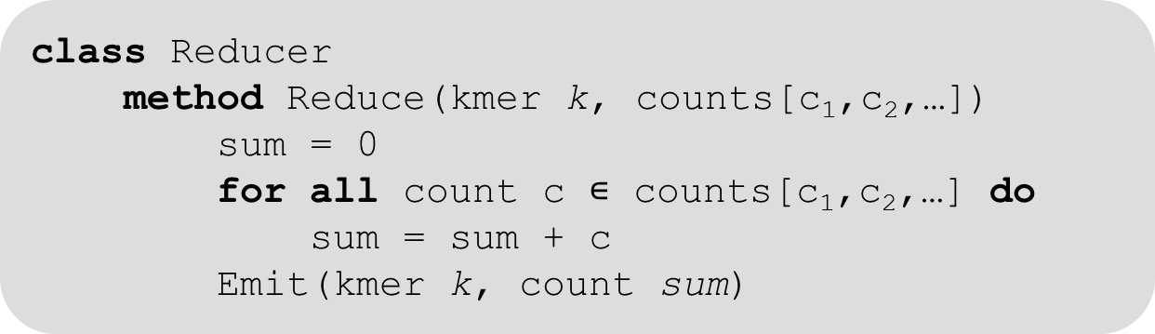
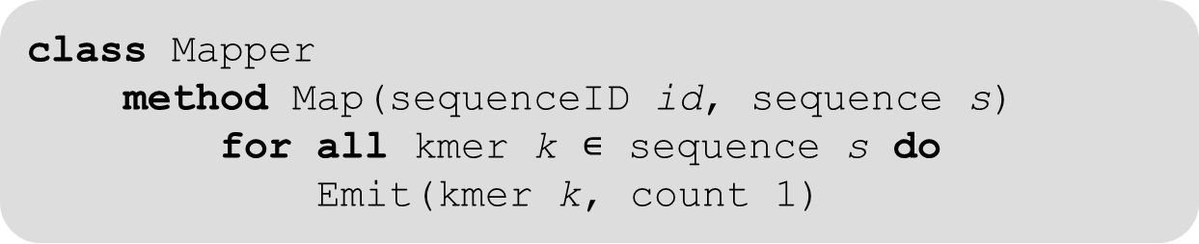
k-mer count in DNA
Pseudocode (basic implementation)
class Mapper
method Map(sequenceID id, sequence s)
for all kmer k $∊$ sequence s do
Emit(kmer k, count 1)
class Reducer
method Reduce(kmer k, counts[c₁,c₂,…])
sum = 0
for all count c $∊$ counts[c₁,c₂,…] do
sum = sum + c
Emit(kmer k, count sum)

Slide 24
Chapter 4: outline
Introduction
Motivation
Big ideas
MapReduce
Programming model
Framework
Design patterns for MapReduce
In-mapper combining
Pairs versus stripes
Order reversal
Value-to-key conversion

Slide 25
MapReduce Basics
OpenMP / Pthread / MPI: lower-level constructs
Manually break up problems into smaller subtasks
Explicitly assign tasks to workers
Ensure that workers get the input data they require
Explicitly synchronize these tasks
Explicitly communicate (partial) results
Not really any support for fault tolerance
MapReduce framework
Handles the above points “automatically”
Material reproduced from Lin and Dyer

Slide 26
MapReduce framework
Scheduling: “map tasks” = blocks of input <key, value> pairs
#map tasks >> #worker nodes (typically)
MapReduce automatically assigns map tasks to worker nodes
MapReduce automatically assigns reduce tasks to worker nodes
Load balance by keeping track of which tasks are finished
Stragglers (tasks that take excessively long) can be difficult to achieve good load balance
Data / code co-localization
Move code to data: schedule tasks such that few data movements are required
Otherwise: copy data between worker nodes (slow)
Synchronization / communication
Barrier between map and reduce phase
Efficient sorting of intermediate <key, value> pairs
Error handling through job resubmission
Material reproduced from Lin and Dyer

Slide 27
Distributed file system
HDFS: Hadoop Distributed File System
Master-slave concept
Master = namenode (keeps track of file names and where data is stored)
Slaves = data nodes = contain piece of the actual data
Data nodes are also the worker nodes that process map and reduce routines!
Redundancy concept
Each block of data is present in multiple (default=3) data nodes
Allows to recover from failures
Increases possibilities for improved data locality
Material reproduced from Lin and Dyer

Slide 28
Distributed execution overview
user
program
fork
fork
fork
master
assign
map
assign
reduce
Input data
worker
output file 0
worker
split 0
local
write
split 1
worker
split 2
output file 1
worker
worker
sort,
remote read

Slide 29
Chapter 4: outline
Introduction
Motivation
Big ideas
Programming model: map - reduce
Basic functionality
Framework
Design patterns for MapReduce
In-mapper combining
Pairs versus stripes
Order reversal
Value-to-key conversion

Slide 30
MapReduce design patterns
Responsibilities of the user
Prepare the data
Implement the mapper/reducer (+ combiner/partitioner – see further)
Rest is handled through the framework (no user control!)
What “extras” can be done by the user?
Complex, user defined data types in <key, value> pairs
User-specific initialization code in mapper/reducer
Ability to preserve state across multiple inputs
Determine the sort order of intermediate terms
Control the partitioning of the intermediate key space
Material reproduced from Lin and Dyer

Slide 31
MapReduce design patterns
Many complex algorithms
Cannot be cast in a single MapReduce jobs
Rather, a sequence of jobs might be required
… or even, a hierarchy (a mapper calling a new MapReduce job)
external (sequential) program (“driver”) can control and launch MapReduce jobs
Goals of design patterns
Provide optimizations applicable to many algorithms
Ultimate goal: scalability
If data x 2 -> time x 2
If P x 2 -> time / 2
Material reproduced from Lin and Dyer

Slide 32
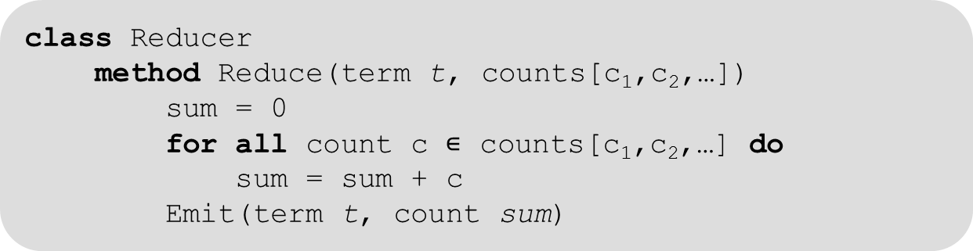

Local aggregation
Word count problem (basic implementation)
class Mapper
method Map(docid a, doc d)
for all term t $∊$ doc d do
Emit(term t, count 1)
class Reducer
method Reduce(term t, counts[c₁,c₂,…])
sum = 0
for all count c $∊$ counts[c₁,c₂,…] do
sum = sum + c
Emit(term t, count sum)
Material reproduced from Lin and Dyer
Correct code, however, number of emitted <k, v> pairs is equal to
the total number of terms in all documents (= huge)

Slide 33
Local aggregation
Local aggregation: reduce amount of intermediate <k,v> pairs
While not altering the final results
Reduces the amount of network traffic
Reduces the amount of disc I/O (pairs are streamed to disc)
Alleviates effect of “stragglers”
How ?
1) MapReduce combiners
method than can optionally be implemented by user
2) “In-mapper combining”
relies on the ability to preserve state in mapper
Material reproduced from Lin and Dyer

Slide 34
MapReduce Combiners
A
α
B
β
C
γ
D
δ
E
ε
mapper
mapper
mapper
mapper
a
1
b
2
c
3
c
6
a
5
c
2
b
7
c
8
combiner
combiner
combiner
combiner
a
1
b
2
c
9
a
5
c
2
b
7
c
8
Shuffle and Sort: aggregate values by keys
Material reproduced from Lin and Dyer
a
1
5
b
2
7
c
2
9
8
reducer
reducer
reducer
a
6
b
9
c
19

Slide 35
MapReduce Combiners
Combiners
Can be provided to the framework as optimization
Can be thought of a “mini-reducers” prior to sorting phase
Work on the output of a single mapper (locally)
Used at the discretion of the framework
User cannot force the use of combiners
Can sometimes be identical to reducers
In the general case, they can be different
Alternative: “in-mapper combining”
Material reproduced from Lin and Dyer

Slide 36

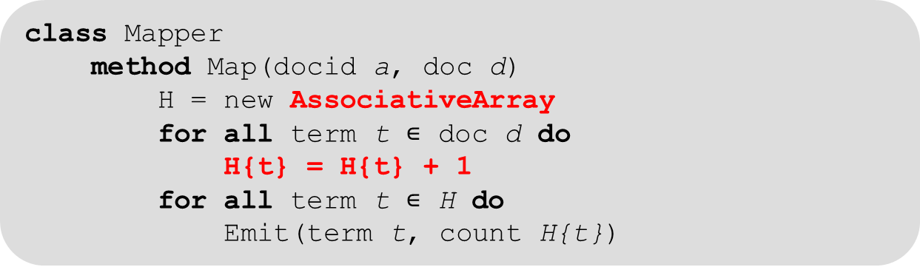
In-mapper combining
“In-mapper combining” within a document
class Mapper
method Map(docid a, doc d)
H = new AssociativeArray
for all term t $∊$ doc d do
H{t} = H{t} + 1
for all term t $∊$ H do
Emit(term t, count H{t})
class Reducer
method Reduce(term t, counts[c₁,c₂,…])
sum = 0
for all count c $∊$ counts[c₁,c₂,…] do
sum = sum + c
Emit(term t, count sum)
Material reproduced from Lin and Dyer
The total number of emitted <k, v> pairs equals
the number of unique terms in each document

Slide 37
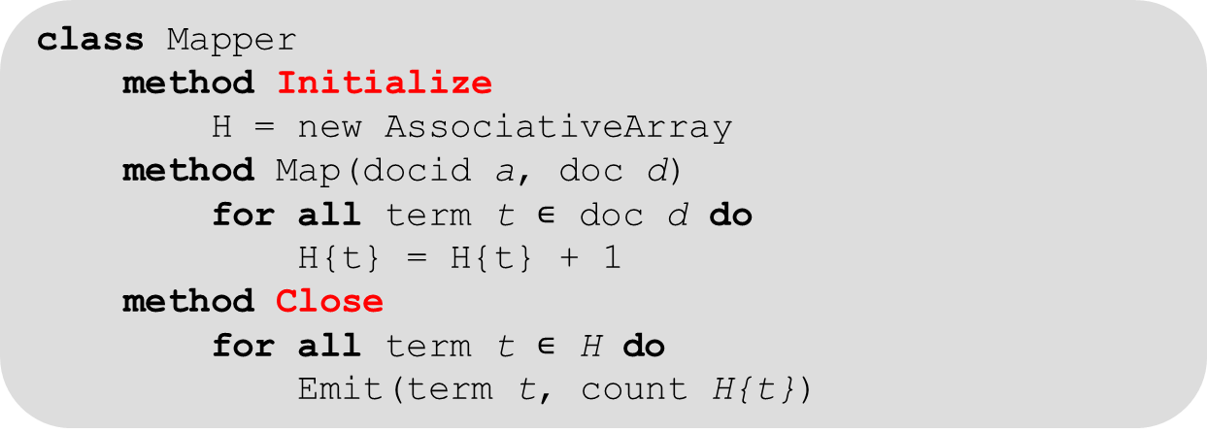
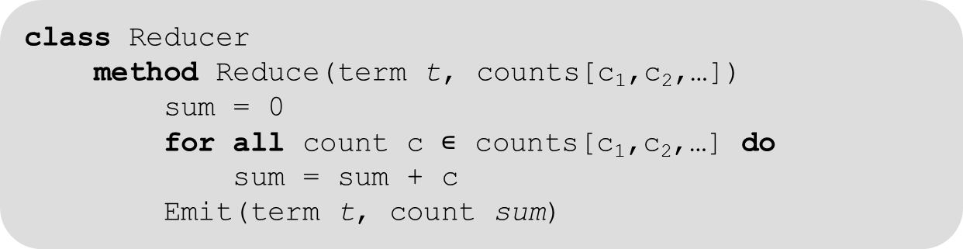
In-mapper combining
In-mapper combining within a mapper, across documents
class Mapper
method Initialize
H = new AssociativeArray
method Map(docid a, doc d)
for all term t $∊$ doc d do
H{t} = H{t} + 1
method Close
for all term t $∊$ H do
Emit(term t, count H{t})
class Reducer
method Reduce(term t, counts[c₁,c₂,…])
sum = 0
for all count c $∊$ counts[c₁,c₂,…] do
sum = sum + c
Emit(term t, count sum)
Material reproduced from Lin and Dyer
The total number of emitted <k, v> pairs equals
the number of unique terms encountered in a mapper

Slide 38
In-mapper combining
Advantage over using combiners:
Programmer forces combining <k,v> pairs
Reduces number of emitted <k,v> pairs by mappers
Reduced overhead from creation, deletion, disc I/O, serialization, etc.
Disadvantage over using combiners:
Memory constraints of a single node
AssociativeArray needs to be emptied from time to time
Every so many elements
Or when memory requirements exceed node capacity
Combiners do not necessarily perform same operations as reducers
See next example
Material reproduced from Lin and Dyer

Slide 39
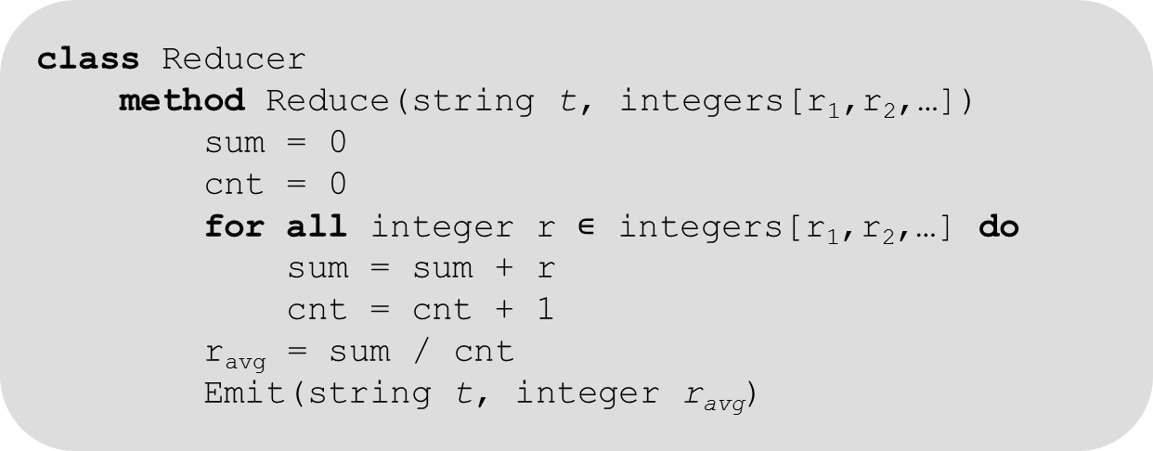
Local aggregation correctness
Compute the mean of values associated with the same key
class Mapper
method Map(string t, integer r)
Emit(string t, integer r)
class Reducer
method Reduce(string t, integers[r₁,r₂,…])
sum = 0
cnt = 0
for all integer r $∊$ integers[r₁,r₂,…] do
sum = sum + r
cnt = cnt + 1
r_{avg} = sum / cnt
Emit(string t, integer r_{avg})
Material reproduced from Lin and Dyer
Cannot use reducer as combiner:
mean(1,2,3,4,5) ≠ mean(mean(1,2), mean(3,4,5))

Slide 40


Local aggregation correctness
First try at the use of a combiner …
class Combiner
method Combine(string t, integers[r₁,r₂,…])
sum = 0
cnt = 0
for all integer r $∊$ integers[r₁,r₂,…] do
sum = sum + r
cnt = cnt + 1
Emit(string t, pair(sum, cnt))
class Reducer
method Reduce(string t, pairs[(s₁,c₁),(s₂,c₂),…])
sum = 0
cnt = 0
for all pair(s,c) $∊$ pairs[(s₁,c₁),(s₂,c₂),…] do
sum = sum + s
cnt = cnt + c
r_{avg} = sum / cnt
Emit(string t, integer r_{avg})
Material reproduced from Lin and Dyer
mismatch between Map output type and Combiner input type

Slide 41
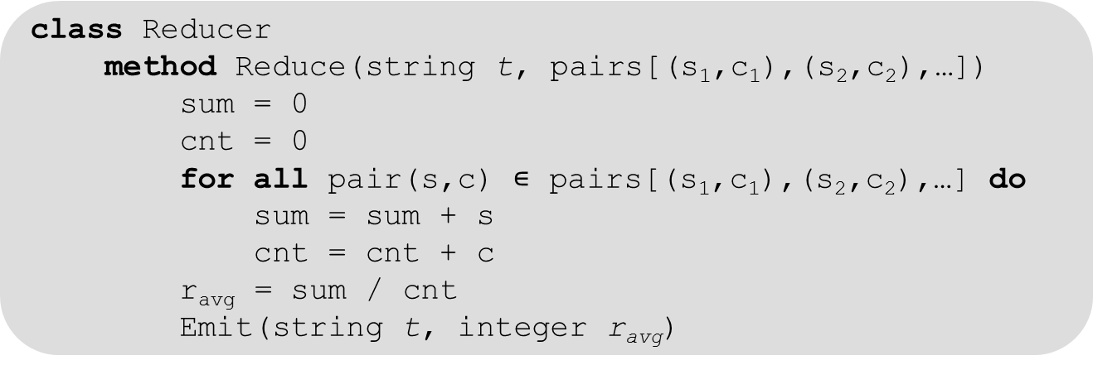
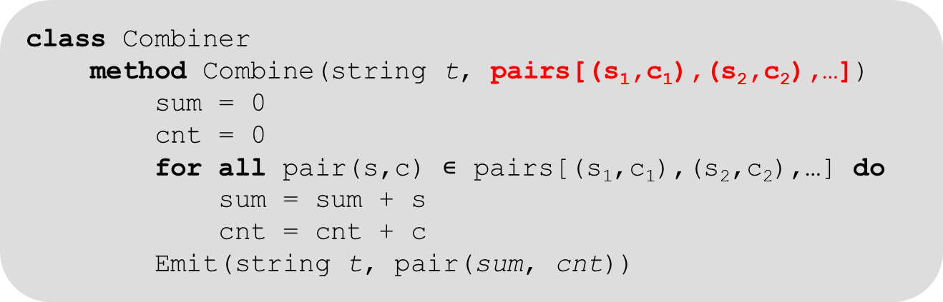
Local aggregation correctness
class Mapper
method Map(string t, integer r)
Emit(term t, pair(r,1))
class Combiner
method Combine(string t, pairs[(s₁,c₁),(s₂,c₂),…])
sum = 0
cnt = 0
for all pair(s,c) $∊$ pairs[(s₁,c₁),(s₂,c₂),…] do
sum = sum + s
cnt = cnt + c
Emit(string t, pair(sum, cnt))
class Reducer
method Reduce(string t, pairs[(s₁,c₁),(s₂,c₂),…])
sum = 0
cnt = 0
for all pair(s,c) $∊$ pairs[(s₁,c₁),(s₂,c₂),…] do
sum = sum + s
cnt = cnt + c
r_{avg} = sum / cnt
Emit(string t, integer r_{avg})
Material reproduced from Lin and Dyer
Correct!

Slide 42
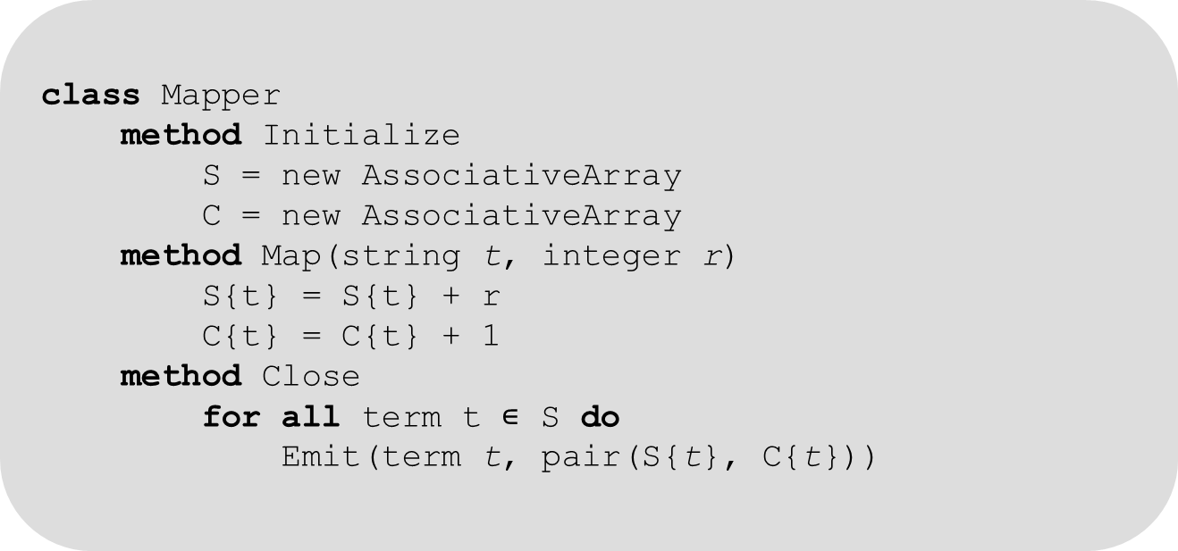
In-mapper combining
Alternative: use in-mapper combining …
class Mapper
method Initialize
S = new AssociativeArray
C = new AssociativeArray
method Map(string t, integer r)
S{t} = S{t} + r
C{t} = C{t} + 1
method Close
for all term t $∊$ S do
Emit(term t, pair(S{t}, C{t}))

Slide 43
Design pattern 2: “pairs” vs. “stripes”
Example: Build a co-occurrence matrix
Given n words in a text
Construct n x n matrix N, where N_{ij} denotes the number of co-occurences of words w_{i} and w_{j} (e.g. w_{j} followed by w_{i})
“Pairs” method (= naïve approach)
Map routine emits <w_{i}, w_{j}> pairs and 1 as value
Reduce count the co-occurrences for each <w_{i}, w_{j}> pair
“Stripes” method (= improved approach)
Map routine emits “stripes” of word counts of w_{j} associated to w_{i}

Slide 44
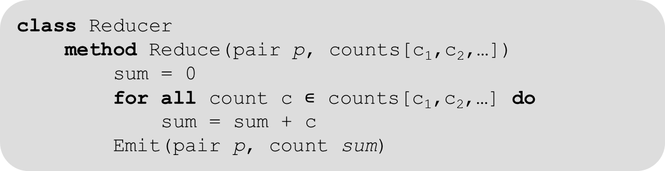
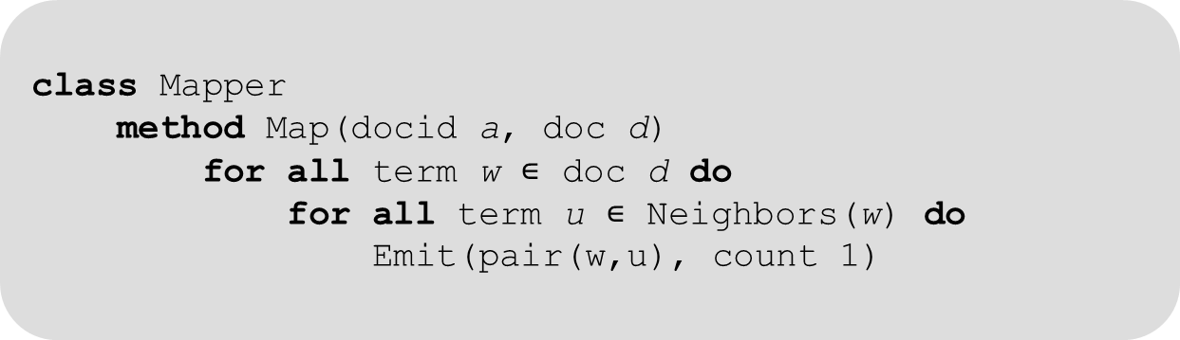
“Pairs” approach
“Pairs” implementation
class Mapper
method Map(docid a, doc d)
for all term w $∊$ doc d do
for all term u $∊$ Neighbors(w) do
Emit(pair(w,u), count 1)
class Reducer
method Reduce(pair p, counts[c₁,c₂,…])
sum = 0
for all count c $∊$ counts[c₁,c₂,…] do
sum = sum + c
Emit(pair p, count sum)
code can be optimized using in-mapper combining

Slide 45
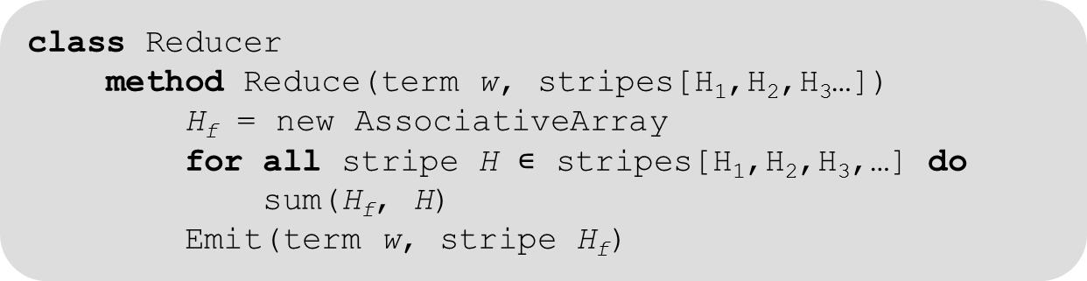
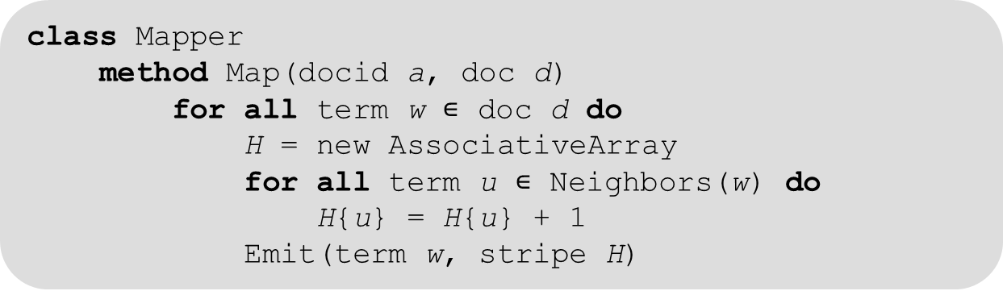
“Stripes” approach
class Mapper
method Map(docid a, doc d)
for all term w $∊$ doc d do
H = new AssociativeArray
for all term u $∊$ Neighbors(w) do
H{u} = H{u} + 1
Emit(term w, stripe H)
class Reducer
method Reduce(term w, stripes[H₁,H₂,H₃…])
H_{f} = new AssociativeArray
for all stripe H $∊$ stripes[H₁,H₂,H₃,…] do
sum(H_{f}, H)
Emit(term w, stripe H_{f})
Potential memory bottleneck as stripes can be very big

Slide 46
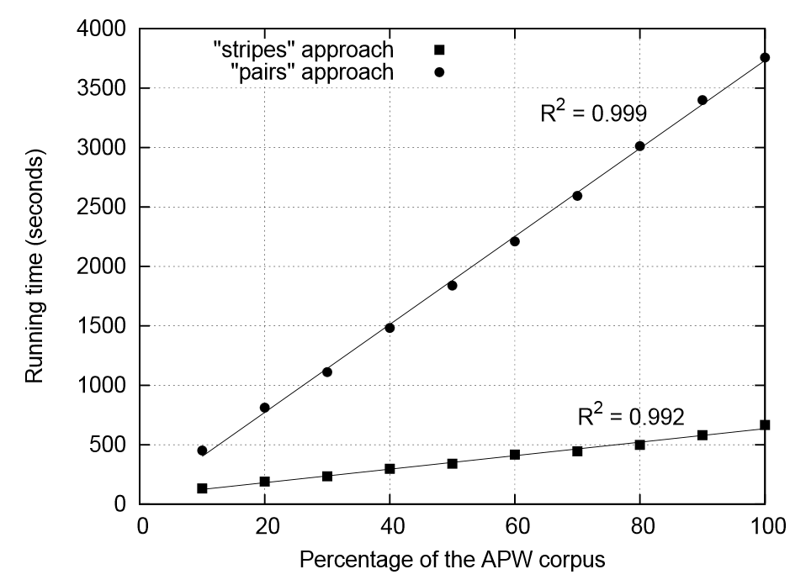
“pairs” versus “stripes”

Slide 47
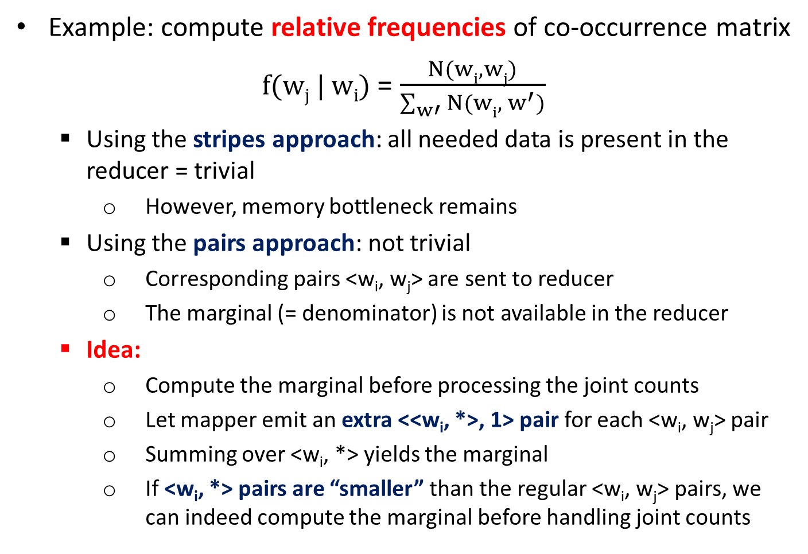
Order inversion
Example: compute relative frequencies of co-occurrence matrix
f(w_{j} | w_{i}) = $\frac{N(wi, wj)}{\sum_{w′}{N(wi, { w}^{′})}}$
Using the stripes approach: all needed data is present in the reducer = trivial
However, memory bottleneck remains
Using the pairs approach: not trivial
Corresponding pairs <w_{i}, w_{j}> are sent to reducer
The marginal (= denominator) is not available in the reducer
Idea:
Compute the marginal before processing the joint counts
Let mapper emit an extra <<w_{i}, *>, 1> pair for each <w_{i}, w_{j}> pair
Summing over <w_{i}, *> yields the marginal
If <w_{i}, *> pairs are “smaller” than the regular <w_{i}, w_{j}> pairs, we can indeed compute the marginal before handling joint counts

Slide 48
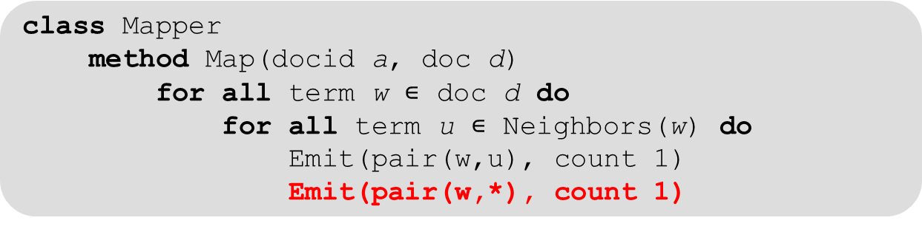
Order inversion
Mapper code:
class Mapper
method Map(docid a, doc d)
for all term w $∊$ doc d do
for all term u $∊$ Neighbors(w) do
Emit(pair(w,u), count 1) Emit(pair(w,*), count 1)
<w, * > is always smaller than any other <w, u>
Optimizations (not shown):
In-mapper combining
OR
MapReduce combiners

Slide 49
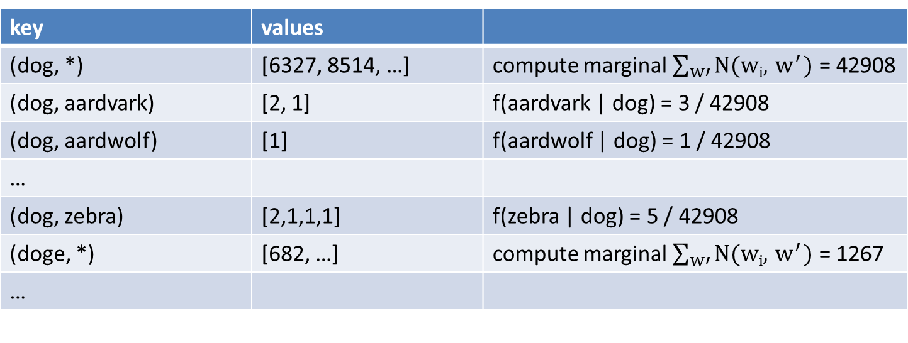
Order inversion
Reducer view
key | values
(dog, *) | [6327, 8514, …] | compute marginal $\sum_{w′}{N(wi, { w}^{′})}$ = 42908
(dog, aardvark) | [2, 1] | f(aardvark | dog) = 3 / 42908
(dog, aardwolf) | [1] | f(aardwolf | dog) = 1 / 42908
…
(dog, zebra) | [2,1,1,1] | f(zebra | dog) = 5 / 42908
(doge, *) | [682, …] | compute marginal $\sum_{w′}{N(wi, { w}^{′})}$ = 1267
…
Need to be sent to same reducer !!
Not guaranteed by default: only equal keys are sent to the same reducer

Slide 50
Design patterns: Order inversion
Partitioner determines to which reducer intermediate pairs are sent
Default implementation:
Compute a hash value for each intermediate key and send to reducer i
i = h modulo #reducers
Override this implementation:
Such that hash value only depends upon w_{i} for each <w_{i}, w_{j}> pair
Thus, all <w_{i}, w_{j}> pairs will be sent to the same reducer

Slide 51
Complete MapReduce framework
A
α
B
β
C
γ
D
δ
E
ε
mapper
mapper
mapper
mapper
a
1
b
2
c
3
c
6
a
5
c
2
b
7
c
8
combiner
combiner
combiner
combiner
a
1
b
2
c
9
a
5
c
2
b
7
c
8
partitioner
partitioner
partitioner
partitioner
Shuffle and Sort: aggregate values by keys
Material reproduced from Lin and Dyer
a
1
5
b
2
7
c
2
9
8
reducer
reducer
reducer
a
6
b
9
c
19

Slide 52
Design patterns: value-to-key conversion
Example: sensor data
Large number of sensors s₁, s₂, s₃…
Each collect values (raw data) r_{x}
During a large number of time intervals t₁, t₂, …
Example log:
(t₁, s₁, r₈₀₅₂₁)
(t₁, s₂, r₁₄₂₀₉)
(t₁, s₃, r₇₆₀₄₂)
…
(t₂, s₁, r₂₁₈₂₃)
(t₂, s₂, r₆₆₅₀₈)
(t₂, s₃, r₉₈₃₄₇)
…
Goal: restructure data per sensor over time (ordered)
s₁ : {[t₁, r₈₀₅₂₁], [t₂, r₂₁₈₂₃], …}

Slide 53
Design patterns: value-to-key-conversion
Simply:
emit <s, pair<t, r> >
will only sort on key (sensor), but not on time
Solution 1:
Perform “secondary” sorting of values by reducer
Suffers from scalability bottlenecks
Solution 2:
emit <pair<s, t> , r>
Will sort both on sensor and time
Requires a “partitioner” to assign same sensors to the same reducer

Slide 54
Conclusions
MapReduce
Simple programming model for processing large datasets on a large computer cluster.
Focus on the problem, let the library deal with the (messy) details.
References
Jeffrey Dean and Sanjay Ghemawat, “MapReduce: Simplified Data Processing on Large Clusters”, proceedings of the OSDI 2004. http://labs.google.com/papers/mapreduce-osdi04.pdf
Jimmy Lin and Chris Dyer, “Data-intensive text processing using MapReduce”

Slide 55

Notes:
The end

