Slide 1
Chapter 1
Distributed Software: Introduction
1. Definitions and Terminology
2. Developing distributed applications
3. Architecture
4. Design: middleware and services
5. Classes of distributed systems
6. Important architectures and platforms
7. Scalability and high availability
8. The Java family
9. The .NET family
10. This course

Slide 2
Chapter 1
Distributed Software: Introduction
Definitions and Terminology
Introduction
Examples
Definitions
Need for distributed systems
Why are distributed systems different ?
2. Developing distributed applications
3. Architecture
4. Design: middleware and services
5. Classes of distributed systems
...

Slide 3
Why this course ?
Definitions and terminology
Introduction
A loose definition
distributed system =
collection of interacting processes
appearing as single application to the end user
“The network is the computer”
- search portals for huge information stores
- grid computing
- cloud management systems
- P2P applications
- communication tools
- online gaming
- Internet of Things applications
Technology = standard programming tools + sockets ?
- specific, recurring problems due to distributed nature
- solve once, use many times
- middleware solves these problems in a generic way

Slide 4
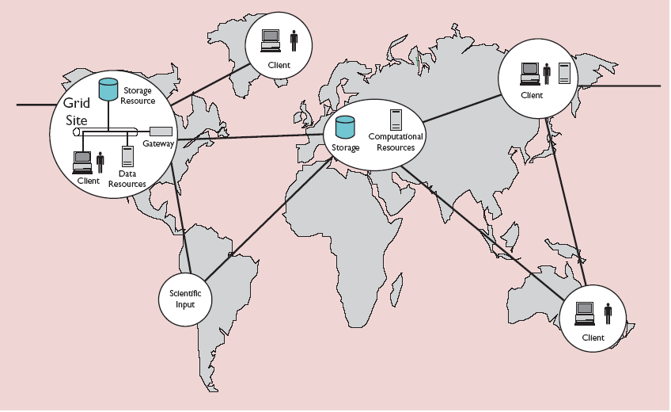
Grid computing
Definitions and terminology
2. Examples
“A computational grid is a hardware and software infrastructure
that provides dependable, consistent, pervasive, and inexpensive
access to high-end computational capabilities.”
[Kesselman & Foster, 1998]
Geographically spread resources
Resource heterogeneity
No single entity of control (no big boss)

Slide 5
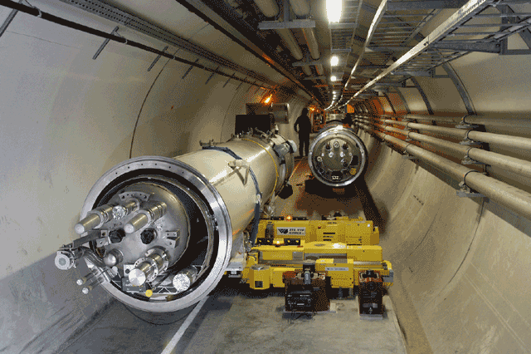
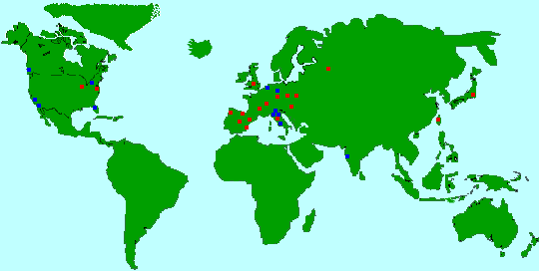

Grid computing
Definitions and terminology
2. Examples
Large Hadron Collider (LHC)
Computing Grid Project LCG
Requirements
> 6000 users
20 Pbyte/year [20 10⁶ CDs]
> 70 000 GFLOP

Slide 6
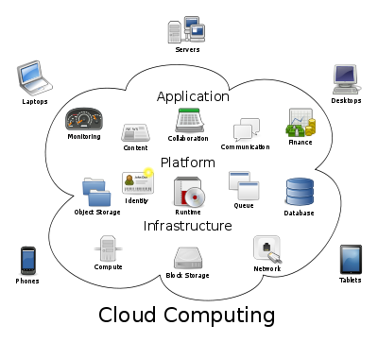
Cloud computing
Definitions and terminology
2. Examples
Roughly defined
Cloud computing = Grid computing
+ virtualization
+ elasticity
+ business model
The NIST Definition
“Cloud computing is a model for enabling ubiquitous, convenient, on-demand network access to a shared pool of configurable computing resources (e.g., networks, servers, storage, applications, and services) that can be rapidly provisioned and released with minimal management effort or service provider interaction. This cloud model is composed of five essential characteristics, three service models, and four deployment models.”

Slide 7
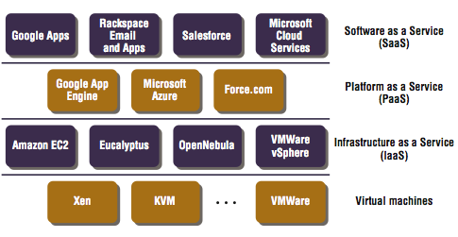
Cloud computing
Definitions and terminology
2. Examples
Essential Characteristics
on demand self-service
broadband access
resource pooling
-rapid elasticity
-measured service
Service Models
Software-as-a-Service (SaaS)
-Platform-as-a-Service (PaaS)
-Infrastructure-as-a-Service (IaaS)
Deployment models
Private Cloud
Community Cloud
Public Cloud
-Hybrid Cloud

Slide 8

File sharing
Definitions and terminology
2. Examples
Some facts
Origin : sharing (often illegal) content (KazaA, BitTorrent, eMule, ...)
Huge user base
P2P internet traffic estimated at 70% of total traffic
New applications
Voice over IP (Skype)
sharing computational power “desktop grids” (Folding@home)
Benefits
resources grow with number of users
better scaling behaviour
better robustness (no central servers)

Slide 9
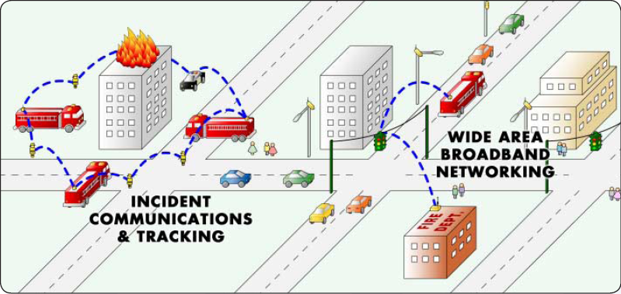
Mobile and ubiquitous computing
Definitions and terminology
2. Examples
Nomadic scenarios
access guaranteed on other locations
(e.g. traveller accessing remote content, using local peripherals)
Mobile scenarios
mobility (=moving user) support for applications
(e.g. taking location into account)
Ubiquitous computing scenarios
application fed with sensor info, steers actuators
(e.g. cleaning robot)
Ad-hoc scenarios
rapid deployment of infrastructure
(often emergency/military scenarios)

Slide 10
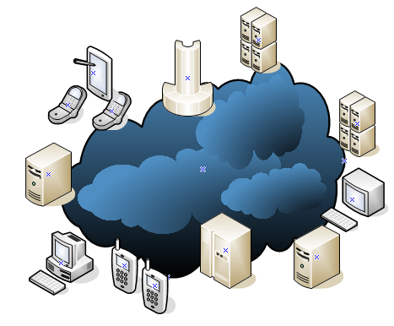
Distributed system =
Definitions and terminology
3. Definitions
A distributed system = a system where
hardware and software components are located at networked computers
components communicate and coordinate their actions ONLY by passing messages
Consequences
no limit on spatial extent
no global time notion
almost always concurrent execution
(partial) failures likely to happen

Slide 11
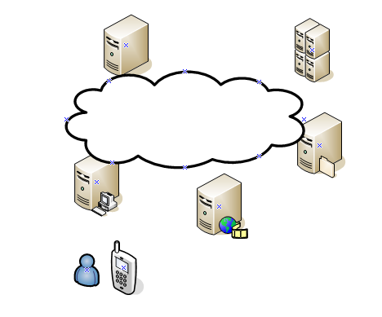
Service =
Definitions and terminology
3. Definitions
A service = part of a computer system managing a collection of related resources, presenting their functionality to users and applications
Examples
storage service
print service
streaming service
connectivity service
transcoding service
Streaming content to mobile clients
User
management
Transcoding
service
Storage
service
Network
service
Streaming
service

Slide 12


Client - Server
Definitions and terminology
3. Definitions
A server = running process on networked computer
accepting requests to perform a service
responding appropriately
request
server
response
A client = running process on networked computer sending service requests to servers
request
client
response

Slide 13
Remote invocation =
Definitions and terminology
3. Definitions
A remote invocation = complete interaction between client
and server to process a single request
request
client
server
response
remote interaction
request 1
request 2
server
client
server
client
response 1
response 2
remote
interaction #1
remote
interaction #2

Slide 14
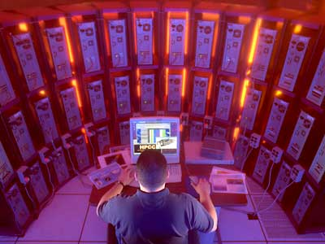
Why distributed systems ?
Definitions and terminology
4. Need for distr. syst.
Many problems
no limit on spatial extent, difficult to manage
no global time notion
almost always concurrent execution
(partial) failures likely to happen
Many advantages
resource sharing
information resources
hardware resources
scalability
“easy” to adapt to larger user base
fault tolerance
“easy” to cope with failures

Slide 15
Distributed system vs. standalone system
Definitions and terminology
5. Why different ?
Standalone system | Distributed system
Communication between processes possible through shared memory. | Communication between processes only through the network.
Global state possible through shared memory. | No global state.
Local operating system can be used to get a shared time value. | No global notion of time.
Local operating system offers primitives to safely share resources. | Synchonisation between processes through network communication only.
Failing processes easy to detect (communication is reliable). | (Partial) failures difficult to detect (because of unreliable communication).
Infrastructure known beforehand. | Infrastructure can vary dynamically (new servers/nodes can become available).
Components are located on the standalone machine. | Location of components can vary dynamically.
Local operating system enforces security. | Security threat due to distributed nature (possibly vulnerable communication link).

Slide 16
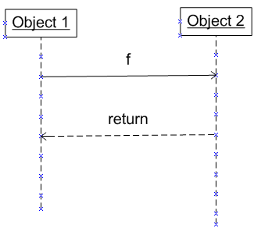
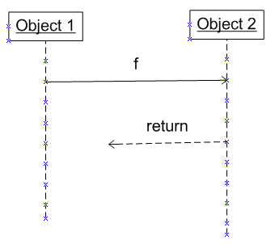
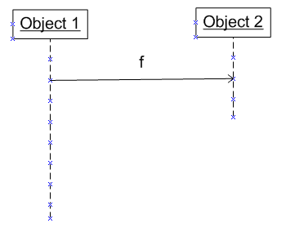
Faulty communication or faulty process ?
Definitions and terminology
5. Why different ?
Normal
scenario
state update
of Object 2
Failure
scenario’s
state update
of Object 2
NO state update
of Object 2
communcation
failure [1]
process
failure [2]
How can Object 1 distinguish between [1] and [2] ?

Slide 17
Chapter 1
Introduction
Definitions and Terminology
2. Developing distributed applications
The development process
System models
Challenges for developing distributed app’s
3. Architecture
4. Design: middleware and services
5. Classes of distributed systems
6. Important architectures and platforms
...

Slide 18
Developing standalone applications
2. Developing distributed app’s
Development process
Requirements analysis phase
required functions
non-functional constraints
WHAT ?
[OOA]
Architectural phase
Formalised requirements
UML-diagrams capturing requirements
Design phase
HOW ?
High level architecture
subsystems and interfaces
Detailed design
(in parallel for each subsystem)
Implementation phase
Code + documentation (in parallel)
Integration phase
Combine realised subsystem code

Slide 19
Developing distributed applications
2. Developing distributed app’s
Development process
Requirements analysis phase
required functions
non-functional constraints
Middleware Services
Architectural phase
Formalised requirements
UML-diagrams capturing requirements
Design phase
High level architecture
subsystems and interfaces
Middleware Platform
+
Functional architecture
Logical architecture
how will the subsystems interact
(e.g. eventing, through remote method call, data base, ...)
System architecture
client-server or P2P ?
System models
non-functional constraints relating to distributed nature

Slide 20

System models
2. Developing distributed app’s
2. System models
System models
-> capture non-functionals of the requirements
related to distributed nature
-> Interaction model
can we give time guarantees on network
communication/process execution ?
-> Failure model
which failures should the application cope with ?
how will we detect failures ?
what will we do in case of failures ?
-> Security model
who can do what in the system ?

Slide 21

Interaction model
2. Developing distributed app’s
2. System models
A synchronous system is a system where
1. The time to execute each process step has
a known lower and upper bound
2. Each message is received within a known bounded time
3. Each process controlled by local clock with
known bound for drift rate w.r.t. real time
An asynchronous system is a system where one of the
above mentioned conditions does not hold.
Asynchronous system
needs special algorithms
to detect event order

Slide 22
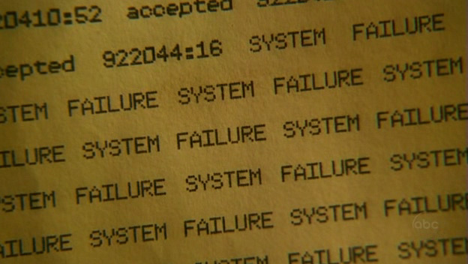
Failure model
2. Developing distributed app’s
2. System models
Omission failures
a component fails to perform an action
Process omission : a process does not fulfill a request
Channel omission: a communication link fails to deliver a message
Byzanthine failures
arbitrary behavior (e.g. a process giving the wrong result)
Timing failures
a synchronous system is violating one (or more)
of its timing constraints
Detection mechanisms
heartbeat
timout

Slide 23

Security model
2. Developing distributed app’s
2. System models
Security threats
Process
server : enemy can use intercepted credentials
client : enemy can pretend to be server
Channels
copy,change,replay, create messages
Privacy issues
Solution
Authentication/Authorization infrastructure
+ Crytographic solutions
(shared secret, asymmetric keys, ...)

Slide 24
Challenges for developing distributed app’s
2. Developing distributed app’s
3. Challenges
Challenge Solution
Heterogeneity
physical/L2 network Common (standard) protocols
hardware Virtualization
operating system Virtual machins
programming languages Middleware
Security
privacy (e.g. financial/medical data) cryptographic infrastructure
secure accounting authorization/authentication
prove identity virus scanning
viruses firewall, VPN
(distributed) denial of service attacks sandboxing
mobile code
Scalability
scaling of infrastructure cost clever design physical cost = O(#users) automatic replication of components
performance scaling
scaling of logical resources
performance bottlenecks

Slide 25
Challenges for developing distributed app’s
2. Developing distributed app’s
3. Challenges
Challenge Solution
Failures
failure detection polling, heart beat, checksum,…
failure handling masking : retransmit messages,
fail over
tolerate : inform user of
(partial) failure
recover : roll back to ensure
consistency
high availability redundancy and replication
Concurrency
resource access conflicts lock mechanisms synchronization primitives

Slide 26

Challenges for developing distributed app’s
2. Developing distributed app’s
3. Challenges
Challenge Solution
Transparency Middleware
Access transparency
identical operations to access local and remote resources
Location transparency
access of resources without location knowledge
Concurrency transparency
provide safe resource sharing amongst concurrent processes
Replication transparency
replicated resources are used implicitly
Failure transparency
hide hardware/software failure
Mobility transparency
resources/clients can move without affecting system operation
Performance transparency
system can be reconfigured according to load conditions
Scaling transparency
system can expand without changing structure and algorithms

Slide 27
Chapter 1
Distributed Software: Introduction
Definitions and Terminology
2. Developing distributed applications
3. Architecture
1. Logical architecture
2. System architecture
4. Design: middleware and services
5. Classes of distributed systems
6. Important architectures and platforms
...

Slide 28
Logical architecture
3. Architecture
1. Logical architecture
= architecture capturing how subsystems will interact
also referred to as “architectural style”
Layered architecture
layer only interacts with neighbour
+ reduced number of interfaces, dependencies
+ easy replacement of a layer
- possible duplication of functionality
Layer 1
Component 1
1.
4.
Component 2
Layer
violation
Layer 2
2.
3.
Layer 3
Component 3

Slide 29
Logical architecture
3. Architecture
1. Logical architecture
Interacting objects
no predefined interaction pattern
+ highly flexible
- complex to manage and maintain
Component 1
Component 2
10.
1.
4.
5.
9.
6.
8.
2.
7.
Component 3
3.

Slide 30
Logical architecture
3. Architecture
1. Logical architecture
Event based interaction
“publish-subscribe” style
+ loose coupling of components
related: message based interaction (also decoupling in time)
often used to integrate legacy systems
Component 3
1:subscribe
4:event delivery
Event system
5:event
delivery
2:subscribe
3:publish
Component 1
Component 2

Slide 31
Logical architecture
3. Architecture
1. Logical architecture
Data centric architecture
only interaction through shared data base
+ loose coupling of components
- possibly slow (central bottleneck, locking, ...)
Component 1
1:publish data
Component 2
2: query
data

Slide 32
System architecture
3. Architecture
2. System architecture
How to map logical components to actually deployed components
(replicated ?, P2P, pure client server, ...)
Client-server architectures
“simple” client-server
1. request
client
server
2. reply
client- multiserver
(explicit server lookup)
e.g. DNS based load balancing
server
3. request
server
4. reply
server
1. get server
client
2. serverID

Slide 33
System architecture
3. Architecture
2. System architecture
client- multiserver
(implicit server lookup)
server
server
3. reply
server
1. request
2. forward
request
client
proxy server
server
2. forward
request
server
1. request
client
proxy
3. reply
server
4. forward
reply

Slide 34
P2P architectures
3. Architecture
2. System architecture
servent = process issueing requests + fulfilling requests
peering components use logical network (overlay) to interact
Unstructured P2P :
- links have no other meaning than communication
- unstructured search (e.g. flooding) : resource consuming
Structured :
- logical link has relation to service offered
- structured search much more efficient
important data structure : Distributed Hash Table (DHT)
Why P2P ?
scalability (10000 – 100000 users not exceptional)
gradual scaling (“organic growth”)
robustness

Slide 35

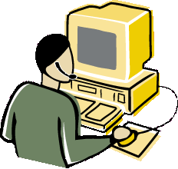
P2P : file sharing
3. Architecture
2. System architecture
Unstructured
Mediated P2P
Pure P2P
Hybrid P2P
Napster
Audiogalaxy
Early Gnutella
FreeNet
KazaA
control traffic (index, lookup)
data traffic (download, upload)

Slide 36
P2P : file sharing
3. Architecture
2. System architecture
Structured
hash(itemName)
key
f(key)
content
item
key
nodeID
Chord
each node has integer nodeID
e.g. consider 5 node network {nodeID}={3,7,10,12,15}
{key}={0 .. 15}
{14,15}
15
12
3
{0,1,2,3}
{11,12}
see chapter “P2P” for
more details
10
{8,9,10}
7
{4,5,6,7}

Slide 37
Chapter 1
Distributed Software: Introduction
Definitions and Terminology
2. Developing distributed applications
3. Architecture
4. Design: middleware and services
5. Classes of distributed systems
6. Important architectures and platforms
...

Slide 38
Role of middleware
4. Design : MW and services
1) Abstract hardware/software platform
operating system
implementation language
...
2) Realize transparency – focus on location transparency
Distributed Application
Distributed Application
Logical interaction
Remote invocation
Middleware
Remote invocation
Operating system A
Socket
Socket
Operating system B
Hardware
A
Hardware
B
NIC
NIC
Host A
Host B

Slide 39
Role of middleware
4. Design : MW and services
3) Provide generic services
Naming service
associate logical names to remote entities
Discovery and registration service
easy service lookup and registration
Transaction service
support distributed (database) transactions
Security service
support to authenticate and authorize users
Event service
distributed notification of events
Data replication
offer the same data at different locations to optimize data access
Persistence service
to transparently offer data persistence
(i.e. data is automatically stored in a persistent medium)
Life cycle service
managing service components
(start up of services, shut down, etc.)

Slide 40
Middleware Layer
4. Design : MW and services
Applications and services
Middleware
Streaming
Transaction service
Remote procedure call
Remote method invocation
Security
Inter-process communication
Event notification
Naming service
Data replication
Discovery/registration service
Persistent storage
Operating system
Platform
Computer/network hardware

Slide 41
Chapter 1
Introduction
Definitions and Terminology
2. Developing distributed applications
3. Architecture
4. Design: middleware and services
5. Classes of distributed systems
6. Important architectures and platforms
...

Slide 42
Taxonomy
5. Classes of distr. syst.
Responsiveness
E-health monitoring systems (e.g. monitoring of life-critical functions in a hospital)
Hard real time
Infrastructure Management (e.g. VoIP system)
Multimedia grids
Soft real time
Service grids
Business Applications (e.g. web shop, banking, …)
Off-line monitoring systems (e.g. national pollution measurement network)
E-science grids/clusters
Do not care
Computation Storage
Transactional
Data collection
Functionality

Slide 43
Chapter 1
Distributed Software: Introduction
Definitions and Terminology
2. Developing distributed applications
3. Architecture
4. Design: middleware and services
5. Classes of distributed systems
6. Important architectures and platforms
1. Thin versus thick ?
2. Grid and cluster systems
3. Transactional systems
4. Integration
7. Scalability and high availability
...

Slide 44
How thick is the client ?
Architectures and Platforms
Client think/thin
Thin client
+ cheaper and many devices involved -> overall cheaper
+ cheaper to update (controlled by server), and less updates needed
- some functions more natural to support on client
- permanent network connection needed
Technologies
web browser
+ ubiquitous and uniform client
+ no network blockages (firewalls) for HTTP (port 80)
+ huge user base
+ browser functionality can be extended
remote desktop clients
(cf. Athena) “screen scrapers”

Slide 45
Clusters and grids
Architectures and Platforms
2. Grids and clusters
Cluster middleware
job scheduling
cluster monitoring
user administration
matchmaking
job submission
Important technologies: Oracle Fusion, Mosix
Grid middleware
meta-schedulling
abstraction of heterogeneity
information service
Important technologies :
Globus (and descendents), gLite (used in EGEE(+))
interacting jobs : Message Passing Interface (MPI)

Slide 46
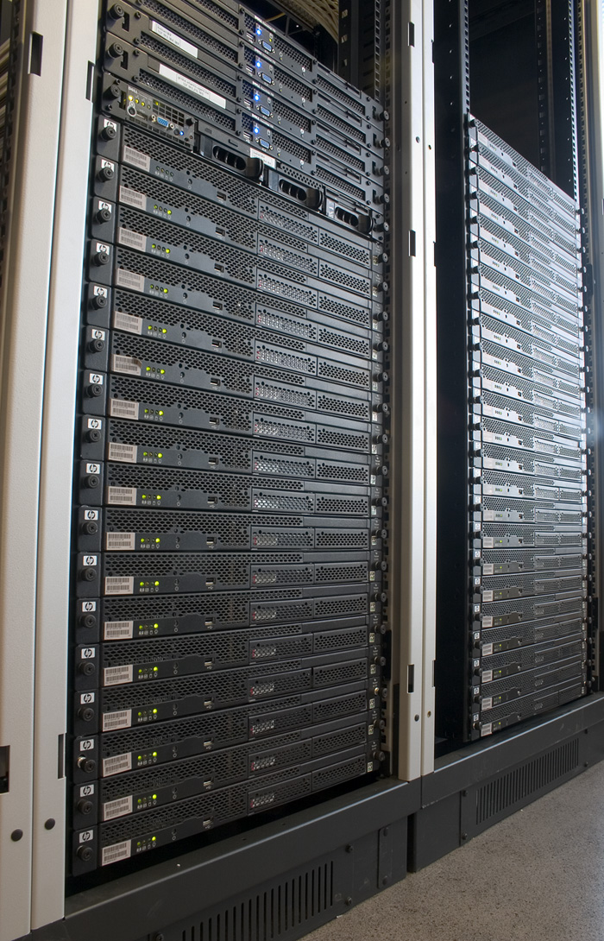
Grid@UGent
Architectures and Platforms
2. Grids and clusters

Slide 47
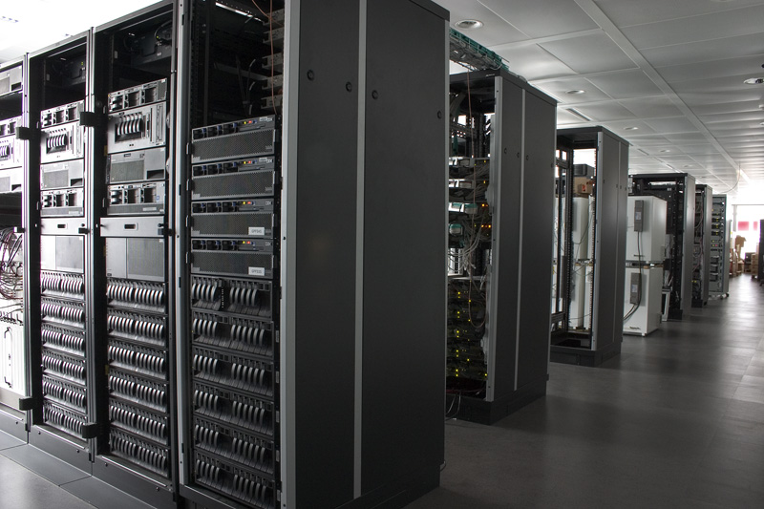
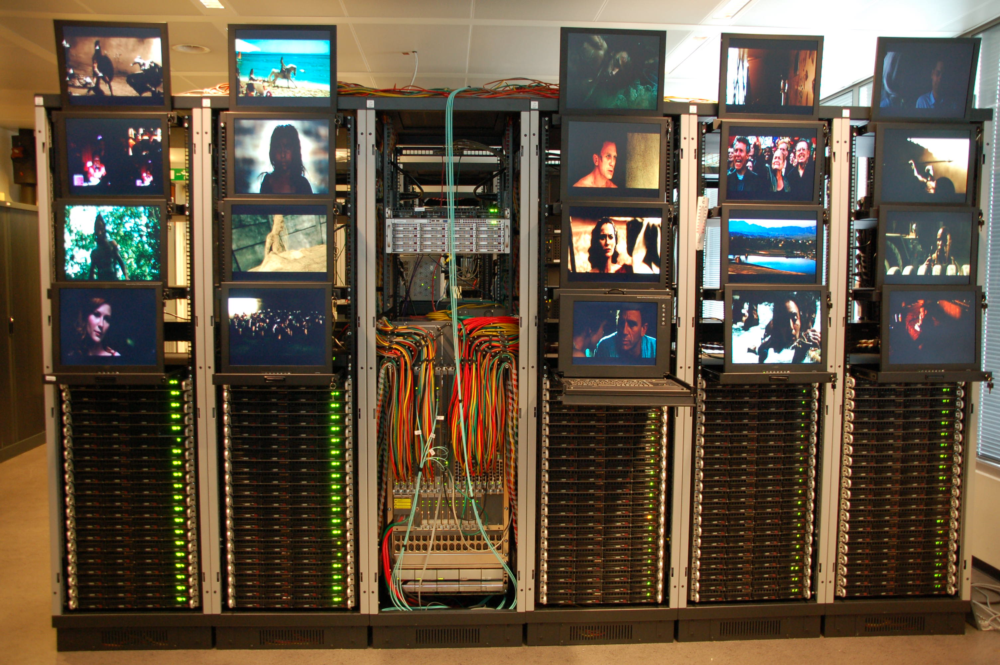
Cloud@IBCN.INTEC
Architectures and Platforms
2. Grids and clusters

Slide 48
3-tier architecture
Architectures and Platforms
3. Transactional systems
Thin client (web, screenscraper)
Thick client
Relational DB
Object relational mapping
Custom solution
Web components (UI, webservices)
non web components
plain old objects
User interface
Business Logic Layer
Persistent Data Storage
Presentation Layer
Client
Server
3-tier business architecture
layered architecture
rationale : separiation of concerns

Slide 49
Integration through bus
Architectures and Platforms
4. Integration
Application 3
Integration solution
Application 1
Application 2
Integration solutions :
- Enterprise service bus (SOAP based)
- Message Oriented Middleware

Slide 50
Chapter 1
Distributed Software: Introduction
…
3. Architecture
4. Design: middleware and services
5. Classes of distributed systems
6. Important architectures and platforms
1. Thin versus thick ?
2. Grid and cluster systems
3. Transactional systems
4. Integration
7. Scalability and high availability
8. The Java technology family
...

Slide 51
Scalability
7. Scalability and High Availability
= the system ability to handle gracefully a growing amount of requests
two types of scalability:
- horizontal scalability
- vertical scalability

Slide 52
Vertical Scalability
7. Scalability and High Availability
adding more resources to a single computational node
improve existing code to handle more requests
Techniques:
adding memory or disks, or more powerful CPU
improving the I/O and concurrency models
using non-blocking and/or asynchronous I/O,
using the most appropriate thread model (i.e single, pool, per-connection),
using synchronous or asynchronous invocations.
Distribution of processes over available processor cores

Slide 53
Horizontal Scalability
7. Scalability and High Availability
adding more computational nodes to distributed system
Techniques:
Master/slave techniques
Partitioning of data on the available nodes (e.g. Distributed Hash Tables)
NoSQL-based systems in particular allow for horizontal scaling

Slide 54
High Availability
7. Scalability and High Availability
the property of a distributed system to handle hardware and software failures
Techniques:
Redundancy: software components are available on several locations,
Failover : when a software component or resource fails, automatic failover to the redundant components
Replicas: multiple copies of the same data are available.
Very often the source of performance problems!

Slide 55
CAP theorem
7. Scalability and High Availability
A distributed computer system can NOT simultaneously provide all three of the following guarantees:
Consistency: all read/write operations must result in a global consistent state,
Availability: all requests on non-failed components must get a response,
Partition Tolerance: the system continues to operate when nodes are not able to communicate with each other.
In practice:
- the Availability and Consistency guarantees are the most important
- Partition Tolerance or effects of network failures are often neglected.

Slide 56
Chapter 1
Distributed Software: Introduction
...
4. Design: middleware and services
5. Classes of distributed systems
6. Important architectures and platforms
7. Scalability and high availability
8. The Java technology family
1. General architecture
2. Client tier
3. Web tier
4. Business tier
5. Web services
...

Slide 57
Java Enterprise Edition (JEE)
8. The Java family
1. General architecture
Web Tier
Business
Tier
thin client
Browser
Enterprise Information System
HTTP
JSP
EJB
Entities
Application Client
Servlet
RMI
CORBA
thick client
Client
Server
Presentation
Business logic
Persistent data storage

Slide 58
The container concept
8. The Java family
1. General architecture
high level
“programmers” view
on the interaction
a client
a component
mediated interaction
by container to
implement services
(e.g. security checks, load balancing, ...)

Slide 59
The container concept
8. The Java family
2. Client tier
Thin client
Container = browser
runs HTTP protocol
services
install plug-ins
run security checks
sandboxing
Thick client
Container = appclient
runs RMI/CORBA/... protocol
middleware services:
naming and lookup
security checking
...

Slide 60
Servlet
8. The Java family
3. Web tier
= server side plug-in
= base technology for all Java web tier components
Basic operation
browser sends request to URL referring to a Servlet instance
HTTP request contains parameters, HTTP headers, ...
Servlet gets HTTPRequest object from web server
Servlet analyzes request
Servlet prints HTML output to HTTPResponse object
HTTPResponse is sent to webserver
Webserver sends HTML to client

Slide 61
Servlet
8. The Java family
3. Web tier
Container services
Servlet life cycle management
Servlet pooling
Session tracking
Providing access to other resources (e.g. a database)
Providing access to other components (other Servlets, EJBs, …)
HTTP POST
Webserver
webclient
HTTP REPLY
init()
service(HTTTRequest,
HTTPResponse)
INVOKE
Servlet
webclient
Database
Servlet
Container

Slide 62
Java Server Pages (JSP)
8. The Java family
3. Web tier
Servlet disadvantage
pages contain static + dynamic data
static data created dynamically -> not optimal
Solution
mix static and dynamic code in single webpage
compile webpage to extract servlets and static portions
configure webserver to
automatically invoke servlets to create dynamic content
merge dynamic and static content to response to client
JSP : Java Server Page
HTML
code
passive
JSP
compiler
active
passive
Servlet class

Slide 63
Beans and entities
8. The Java family
4. Business tier
JSP
EJB
Entities
Servlet
Web container
EJBcontainer
Persistence
provider
Java EE container
External resources
Relational Database

Slide 64
Beans and entities
8. The Java family
4. Business tier
EJB container services
component life cycling management,
transaction processing,
security handling,
persistence
remotability
timer
state management
resource pooling
messaging
Persistence provider services
store/retrieve from DB
optimization through caching

Slide 65
Beans and entities
8. The Java family
4. Business tier
Session Beans
Message Beans
Entities
session related object
always associated to one single client at most
types
stateful :
“conversational state”
stateless
singleton
asynchronous message handling
connected to JMS
compliant message
queue
new since J2EE 1.3
“real life” object
mostly associated to “row in database”
persistent
NEW since EJB3.0
[replace (very) complex EntityBeans]
- NOT managed by EJB container
synchronous
asynchronous

Slide 66
Web services
8. The Java family
5. Web services
What ?
= “interface” technology
specifies how to access remote objects through the web
typically : SOAP (Simple Object Access Protocol) or
REST (Representational State Transfer) over HTTP
Pro – con ?
+ language and platform neutral
+ often uses HTTP as underlying protocol (no network discontinuities)
- performance (large messages, complex parsing)
- only stateless invocations
JEE and web services
Pojo’s and session beans can be exposed as webservice

Slide 67
Chapter 1
Distributed Software: Introduction
...
4. Design: middleware and services
5. Classes of distributed systems
6. Important architectures and platforms
7. Scalability and high availability
8. The Java technology family
9. The .NET technology family
...

Slide 68
.NET
9. The .NET family
Very similar functions as in JEE
Web tier
web service (SOAP / REST) heavily used
ASP is counterpart for JSP
.NET framework for web tier development : ASP.NET
Business tier
COM+ component model ported to .NET
“.NET enterprise services”
resource pooling
eventing
security
transaction support
synchronization

Slide 69
Chapter 1
Distributed Software: Introduction
...
4. Design: middleware and services
5. Classes of distributed systems
6. Important architectures and platforms
7. Scalability and high availability
8. The Java technology family
9. The .NET technology family
10. This course

Slide 70
Outline
10. This course
Chapter 1: Introduction
Chapter 2: Middleware
Chapter 3: Enterprise Applications
Chapter 4: Global State and Time
Chapter 5: Coordination
Chapter 6: P2P systems
Chapter 7: Cloud Computing
Chapter 8: Resource Allocation

