Slide 1

Chapter 3
Enterprise applications

Slide 2
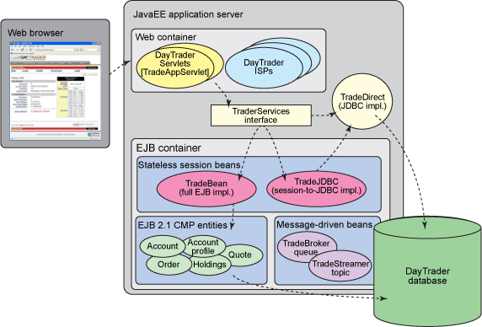
Overview
1. JEE-based applications

Slide 3
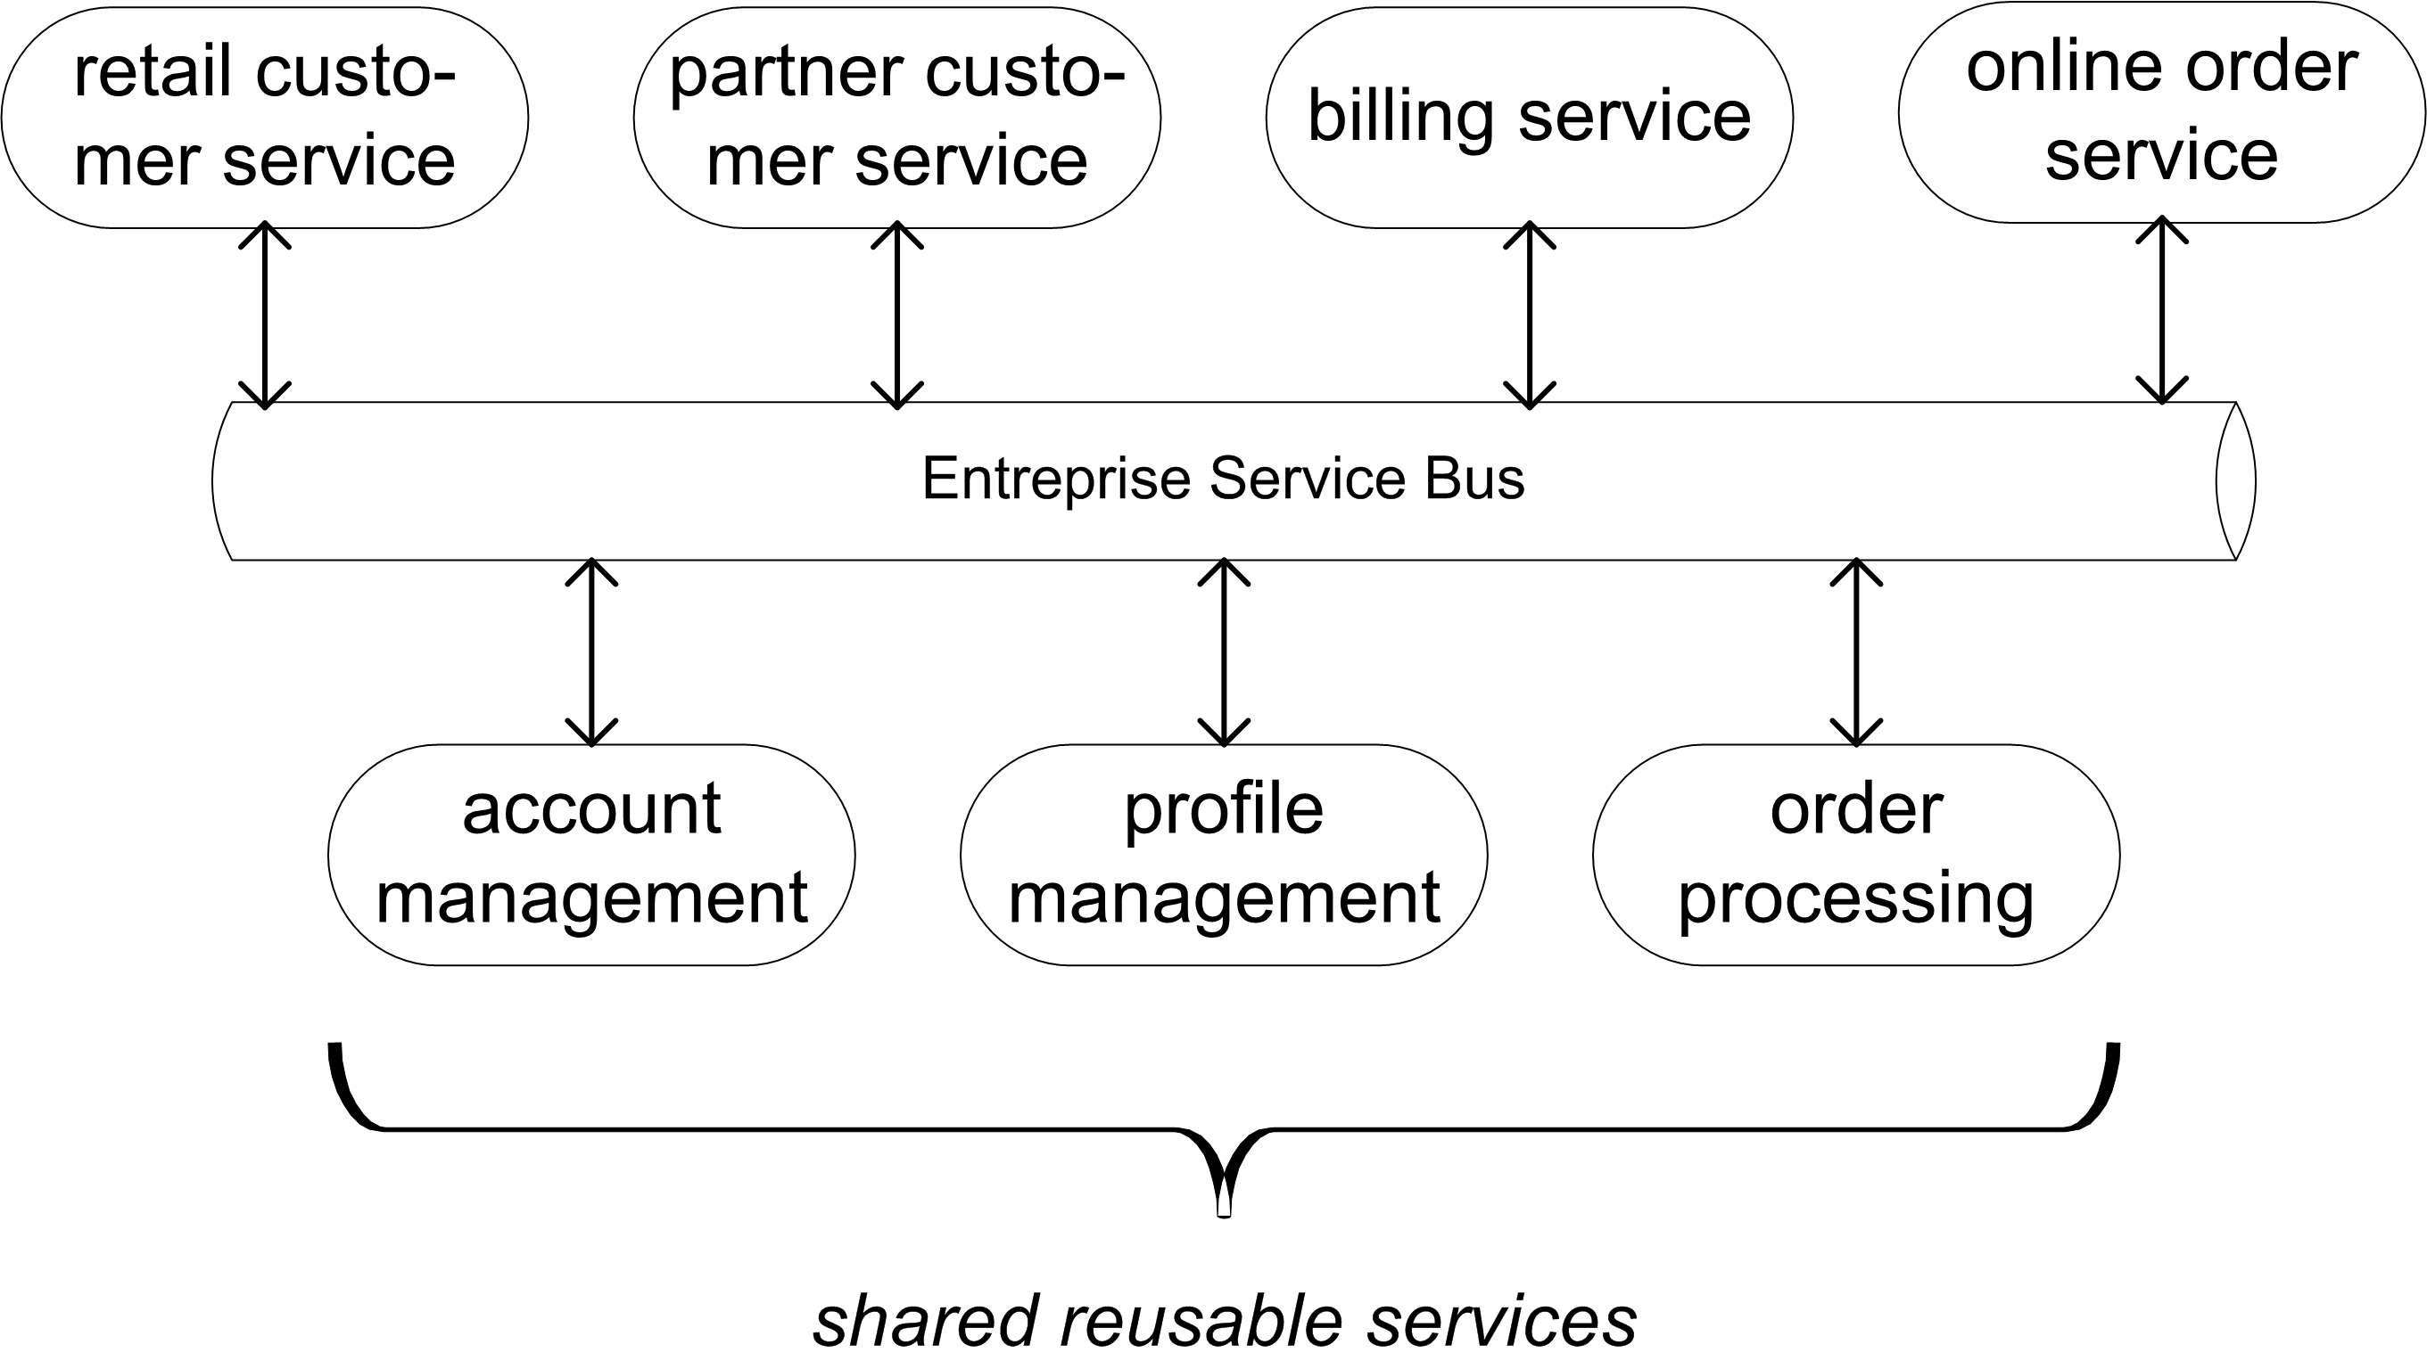
Overview
2. Service-oriented applications
for B2B applications

Slide 4
Outline (1)
Overview of Java Enterprise Edition (JEE) architecture
  Server side architecture
  Benefits
Servlets and Java Server Pages (JSP)
Deployment and annotations
Entities and Persistence
  Managing entities
  Primary keys
  Object relational mappings
  Example code
Enterprise Java Beans (EJBs)
  EJB views
  Stateless session beans
  Stateful session beans
  Message driven beans
JEE Design Patterns
  Session Façade, Proxy and Command pattern
Transaction and 8. Security Service
  Attributes and annotations
Notes:
After an overview of the basic concepts (programming language generations and compilation versus interpretation), the following programming paradigms are detailed: procedural, functional, object oriented and declarative. Moreover, scripting languages will be explained. The next three sections focus on an overview of Java, C/C++ and C# and their important concepts.

Slide 5
Outline (2)
9. Introduction : Service Oriented Architectures
10.Technology building blocks
- SOAP
- WSDL
- WS-* standards
11. Java Web Services
12 Web Service Orchestration and Choreography
13. Software Integration
  - eTOM, ITIL

Slide 6
Architecture
Overview of JEE architecture
  Architecture
Client
Webserver
Application Server
Database system
Web container
browser
webserver
applet
applet
EJB container
Servlet
JEE client
JSP
EJB
Web container services:
component life cycle management
handle communication with
webserver HTTP <-> servlet
session tracking
EJB container services:
component life cycle management
transaction service
security handling
resource pooling
Notes:
The main JEE architecture is shown in this figure. Clients are used to connect through a browser or standalone application. The webserver layer allows the clients to connect to the application (Servlet and JSP technology is used here, i.e. two technologies explained in the previous lesson). The Servlet and JSP components are run inside the webcontainer. Besides the Web container, there is also an EJB container, which runs the EJBs (Enterprise Java Beans). These are the bundled Java-components, which can be exchanged between different application servers.
The services offered by the two different containers are explained, and also detailed on the next pages.

Slide 7
Architecture
Overview of JEE architecture
  Architecture
container hosted on application server
java beans interactions mediated by container
interactions :
- with other beans
locally (same container)
remotely (different container)
- with other JEE components (servlets, jsp, ...)
- with client
- with other resources (e.g. database)
EJB
EJB
EJB
EJB-container
Notes:
The EJB-container concept is detailed here, together with an overview of the possible interactions.
Popular EJB-containers are: JBoss, Sun GlassFish, IBM Websphere and BEA Weblogic.

Slide 8
Architecture
Overview of JEE architecture
  Architecture
architecture provides non-functional features:
    component life cycle management,
    transaction processing,
    security handling,
    persistence ,
    remotability,
    timer,
    state management,
    resource pooling,
    messaging.
Inversion of Control (IoC) principle:
- decisions taken at server side, not client side
- container provides transparant features
Notes:
The following features are provided by the EJB container (non-functional because they don’t influence the functionality of an application but ease the effort for the programmer and improve the performance of the applications):
component life cycle management: starting the components when they are needed and shutting them down when no longer required
transaction processing: making sure a set of operations are executed within the context of a transaction, with no significant effort from the programmer (transactions are detailed in section 5 of this chapter)
security handling: making sure that certain method calls can only be executed when the caller of the method has the right permission (also detailed in section 5 of this chapter)
persistence: automatically storing and retrieving data from the database, without the need of the programmers to write the database query and insertion code (detailed in section 3 of this chapter)
remotability: making sure components can be accessed from remote locations, without the need of writing the code to transfer method calls and data over the network
timer: allows to schedule operations
state management: maintaining the values of variables even when the components are not active
resource pooling: sharing resources over multiple requests, to make sure the resources (CPU and Memory) are used in an efficient way
messaging: providing the means to publish data and allow clients to subscribe to data they are interested in

Slide 9
Server side architecture
Overview of JEE architecture
  Architecture
persistent
application data [POJO]
business logic
Web container
EJB container
Persistence
provider
Java EE container
Servlet
JSP
External
Resource
persistent
application data
[RDBMS]
EJB
Entity
Notes:
The concept of an entity is explained here: is a Plain Old Java Object (POJO), which means it is regular Java object (not an EJB) which is run within the container of a persistence provider. A popular example of such a persistence container is Hibernate.
The remote data is stored and made accessable by a Remote Database Management System (RDBMS).
Other examples of external resources are files (local files or on a remote file system).

Slide 10
Benefits
Overview of JEE architecture
  2. Benefits
1. Simplify the development of large, distributed applications:
  the EJB container provides system-level services to enterprise beans,
  the bean developer can concentrate on solving business problems.
  the EJB container--not the bean developer--is responsible for system-level services such as transaction management and security authorization.
Notes:
The three main benefits of using the architecture with web containers and EJB containers are listed on this page and the next page.

Slide 11
Benefits (2)
Overview of JEE architecture
  2. Benefits
2. the client developer can focus on the presentation of the client:
  because the beans--and not the clients--contain the application's business logic,
  the clients are thinner (important for clients that run on small devices)
3. enterprise beans are portable/reusable components:
  the application assembler can build new applications from existing beans.
  these applications can run on any compliant J2EE server.

Slide 12
Outline
Overview of Java Enterprise Edition (JEE) architecture
Presentation Layer
  Addressing resources and HTML forms
  Servlets (redirection, collaboration)
  Session Management
  Java Server Pages
3. Deployment and annotations
4. Entities and Persistence
5. Enterprise Java Beans (EJBs)
6. JEE Design Patterns
7. Transaction and Security Service
Notes:
After an overview of the basic concepts (programming language generations and compilation versus interpretation), the following programming paradigms are detailed: procedural, functional, object oriented and declarative. Moreover, scripting languages will be explained. The next three sections focus on an overview of Java, C/C++ and C# and their important concepts.

Slide 13
Addressing resources : URL
2. Presentation Layer
  1. Addressing resources and HTML forms
<protocol>://<hostname>:<port>/<fully qualified pathname>?<parameters>
<protocol> : http, https, ftp, telnet, …
<hostname> : IP-address or DNS-name
<port> : port for webserver (default : http : 80, https: 343)
<fully qualified pathname> : directory + file name (default index.html)
<parameters> : normally used to specify (name, value)-pairs
? : separates resource name from parameters
+ : represents space
& : separate (name,value) pairs
= : binds value to name
% : escape character
followed by 2 hex-symbols representing ASCII value
e.g. http://www.spy.cia.com:80/reports/interest?subject=elections%21
elections!

Slide 14
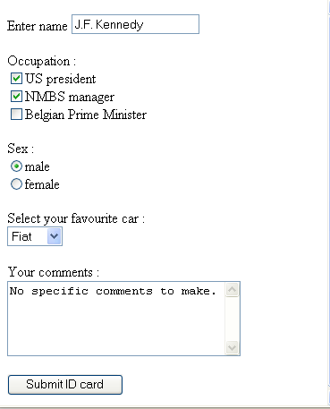
HTML Web Form: example
2. Presentation Layer
  1. Addressing resources and HTML forms

Slide 15
HTML Web Form: source
2. Presentation Layer
  1. Addressing resources and HTML forms
<html><head><title> Personal ID </title></head>
<body>
<FORM METHOD="GET" ACTION="http://localhost:8080/process/input">
<P>Enter name <INPUT TYPE="text" NAME="name" SIZE=20></INPUT></P>
<P>Occupation :<BR>
<INPUT TYPE="checkbox" NAME="USpres">US president<BR>
<INPUT TYPE="checkbox" NAME="NMBS">NMBS manager<BR>
<INPUT TYPE="checkbox" NAME="prime">Belgian Prime Minister<BR>
</P>
<P>Sex : <BR>
<INPUT TYPE="radio" NAME="sex" VALUE="male" CHECKED>male<BR>
<INPUT TYPE="radio" NAME="sex" VALUE="female">female<BR>
<P>Select your favourite car : <BR>
<SELECT NAME="cars">
<OPTION VALUE="volvo">Volvo
<OPTION VALUE="saab">Saab
<OPTION VALUE="fiat">Fiat
<OPTION VALUE="audi">Audi
</select>
</P>
<P>Your comments :<BR>
<TEXTAREA NAME="comments" ROWS="5" COLS="30">
</TEXTAREA>
</P>
<INPUT TYPE="submit" VALUE="Submit ID card">
</FORM>
</body>
</html>

Slide 16
Servlets and JSP
2. Presentation Layer
  2. Servlets
Plug-in object at server side
Runs separate thread per request
Shares resources with other servlets
Servlet life cycle managed by container process
(single process, single JVM) :
Created/destroyed/activated/passivated
HTTP POST
webclient
webserver
HTTP REPLY
INVOKE
webclient
Servlet
Container

Slide 17
Servlet life cycle
2. Presentation Layer
  2. Servlets
If webcontainer receives request for non-instantiated servlet :
  Load Servlet class
  Instantiate object of Servlet class
  Initialize Servlet
  -> call init() method
  Invoke service()-method to handle request
  Handle any new requests by invoking service()
  If idle-time > timeout or request by admin
    Remove servlet from webcontainer
    -> call destroy()method (clean up)

Slide 18
Servlet types
2. Presentation Layer
  2. Servlets
GenericServlet
abstract public void service(ServletRequest req,ServletResponse res)
throws ServletException, IOException
method called for each request
method not synchronized by default !
HttpServlet
Inherits from GenericServlet
Overrides service-method
- automatically dispatches to HTTP-message related methods
public void doGet(HttpServetRequest req,HttpServletResponse res)
throws ServletException, IOException
public void doPost(HttpServetRequest req,HttpServletResponse res)
throws ServletException, IOException

Slide 19
Servlet framework methods
2. Presentation Layer
  2. Servlets
Automatically called methods
public void init(ServletConfig config)
    called by container when Servlet is loaded
    if overriden : first statement should be super.init(config)
    calls init() method
    (better to override init() !)
public void init()
    called by init(ServletConfig)
    code non-standard initialization here (e.g. Open database connection)
public void destroy()
    called by container when Servlet unloaded or timeout
    locate clean-up code here
    (close file handles, database connections, sockets, etc.)
    DANGER : make this method thread-safe !!!
public abstract void service(ServletRequest req, ServletResponse res)
    called when request received
    overriden in HttpServlet class to dispatch to HTTP-related methods
Convenience method
public void log(String log)
    write (error)message to container specific log file

Slide 20
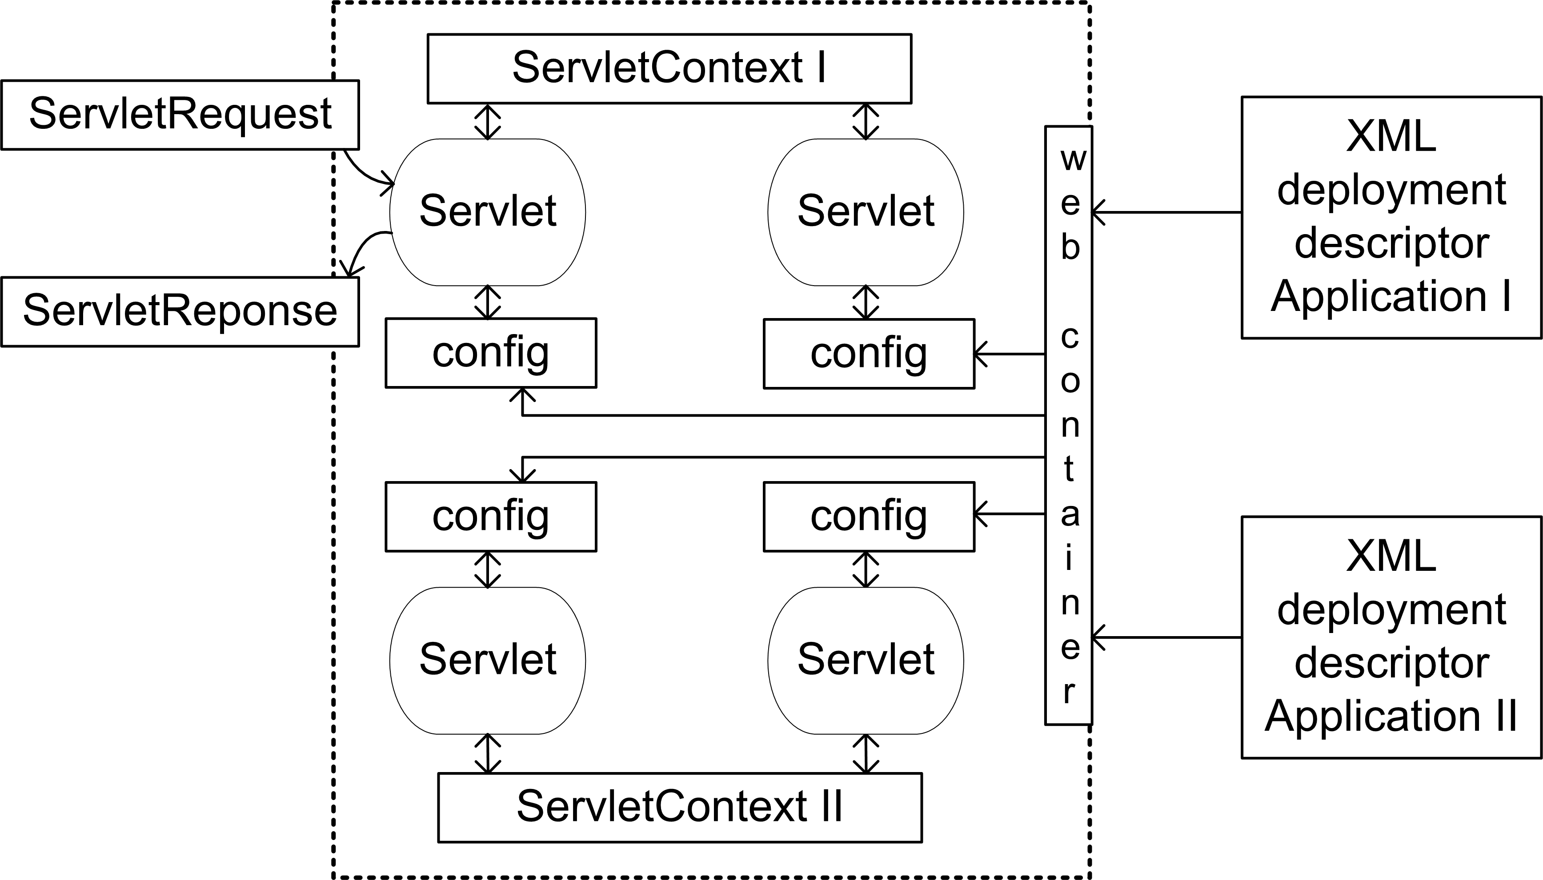
Servlet environment
2. Presentation Layer
  2. Servlets

Slide 21
Servlet Example
2. Presentation Layer
  2. Servlets
import java.io.*;
import javax.servlet.*;
import javax.servlet.http.*;
public class ProcessInput extends HttpServlet {
public void doGet(HttpServletRequest req,HttpServletResponse res)
throws ServletException,IOException {
res.setContentType("text/html");
PrintWriter out=res.getWriter();
out.println("<HTML><HEAD><TITLE>Echo back to confirm.</TITLE></HEAD>");
out.println("<BODY>");
out.println("You have entered following data :<BR>");
out.println("Your name : "+req.getParameter("name")+"<BR>");
out.print("Your occupations : ");
if(req.getParameter("USpres")!=null) out.print("US president ");
if(req.getParameter("NMBS")!=null) out.print("NMBS manager ");
if(req.getParameter("prime")!=null) out.print("Belgian Prime Minister ");
out.println("<BR>");
out.println("Your sex : "+req.getParameter("sex")+"<BR>");
out.println("Your favourite car : "+req.getParameter("cars")+"<BR>");
out.println("Your comments : "+req.getParameter("comments")+"<BR>");
out.println("</BODY>");
out.println("</HTML>");
out.close();
}
}

Slide 22
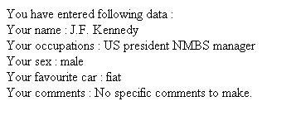
Servlet Example: output
2. Presentation Layer
  2. Servlets
Browser output :

Slide 23
Servlet redirection
2. Presentation Layer
  2. Servlets
HttpServletResponse :
public sendRedirect(String url)
e.g. sendRedirect(http://newhost/index.html)
Allows distributing requests over the available servlets on different servers

Slide 24
Servlet collaboration
2. Presentation Layer
  2. Servlets
Sharing data
Within same application : use ServletContext attributes
With another application/context ON SAME SERVER :
  use database
  use external object (on same or different server)
  use ServletContext of other application
ServletContext ownContext=getServletContext();
ServletContext otherContext=
ownContext.getContext(“/otherapp/index.html”);
Object parameter=otherContext.getAttribute(“foreignAttribute”);
Sharing control
Use RequestDispatcher to forward/include to component contents

Slide 25
Servlet chaining / forwarding
2. Presentation Layer
  2. Servlets
make sure all headers are set appropriately before forwarding requests !
Use getRequestDispatcher()-methods
forward(ServletRequest request, ServletResponse response)
-> forward request to other resource, hand off control
-> response NOT committed to client !
include(ServletRequest request, ServletResponse response)
-> include contents to response of this servlet,
original servlet stays in control
// …
String destination=“/servlet/NewServlet”;
RequestDispatcher dispatcher=req.getRequestDispatcher(destination);
dispatcher.forward(req,res);
// …

Slide 26
Servlet forwarding : example
2. Presentation Layer
  2. Servlets
Check credentials
Process input text
ValidServlet
forward
valid
ProcessServlet
invalid
HTML-input form
Fields : name, password, text
Known to webserver
as “valid”
Known to webserver
as “process”
Web application “forward” contains :
HTML-input form “index.html”
Servlet “valid” instance of class ValidServlet.class
Servlet “process” instance of class ProcessServlet.class
forward.war

Slide 27
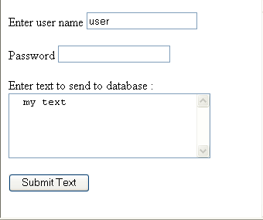
Servlet forwarding : example
2. Presentation Layer
  2. Servlets
index.html
<html>
<head>
<title> Forward </title>
</head>
<body>
<FORM METHOD="GET" ACTION="http://localhost:8080/forward/valid">
<P>Enter user name <INPUT TYPE="text" NAME="user" SIZE=20></INPUT></P>
<P>Password <INPUT TYPE="password" NAME="pass" SIZE=20></INPUT></P>
<P>Enter text to send to database :<BR>
<TEXTAREA NAME="text" ROWS="5" COLS="30">
</TEXTAREA>
</P>
<INPUT TYPE="submit" VALUE="Submit Text">
</FORM>
</body>
</html>

Slide 28
Servlet forwarding : example
2. Presentation Layer
  2. Servlets
ValidServlet.java
public class ValidServlet extends HttpServlet {
public void doGet(HttpServletRequest req,HttpServletResponse res)throws ServletException,IOException {
String user=req.getParameter("user");
String pass=req.getParameter("pass");
if(user.equals("user")&&pass.equals("secret")) {
RequestDispatcher dispatcher=req.getRequestDispatcher("process");
dispatcher.forward(req,res);
} else {
res.setContentType("text/html");
PrintWriter out=res.getWriter();
out.println("<HTML><HEAD><TITLE>Answer from ValidServlet.</TITLE></HEAD>");
out.println("<BODY>");
out.println("You failed to supply valid credentials.<BR>");
out.println("</BODY>");
out.println("</HTML>");
out.close();
}
}
public void doPost(HttpServletRequest req,HttpServletResponse res) throws ServletException,IOException {
doGet(req,res);
}
}

Slide 29
Servlet forwarding : example
2. Presentation Layer
  2. Servlets
ProcessServlet.java
public class ProcessServlet extends HttpServlet {
public void doGet(HttpServletRequest req,HttpServletResponse res)throws ServletException,IOException {
String text=req.getParameter("text");
res.setContentType("text/html");
PrintWriter out=res.getWriter();
out.println("<HTML><HEAD><TITLE>Answer from ProcessServlet.</TITLE></HEAD>");
out.println("<BODY>");
out.println("Following text has been submitted :<BR>"+text);
out.println("</BODY>");
out.println("</HTML>");
out.close();
}
public void doPost(HttpServletRequest req,
HttpServletResponse res)throws ServletException,IOException {
doGet(req,res);
}
}

Slide 30
Session Management
2. Presentation Layer
  3. Session Management
HTTP session-less protocol
Approaches:
  1) Cookies
  2) URL re-writing
  3) Exchange of security certificates
Servlets:
- automatic session management by the container
- use HTTPSession interface !

Slide 31
Servlets and JSP
2. Presentation Layer
  4. Java Server Pages
Servlet disadvantage :
  pages contain static + dynamic data
  static data created dynamically -> not optimal
Solution
  mix static and dynamic code in single webpage
  compile webpage to extract servlets and static portions
  configure webserver to
    automatically invoke servlets to create dynamic content
    merge dynamic and static content to response to client
passive
JSP
compiler
HTML
code
active
passive
Servlet class
JSP : Java Server Page
Actually : JSP = Servlet

Slide 32
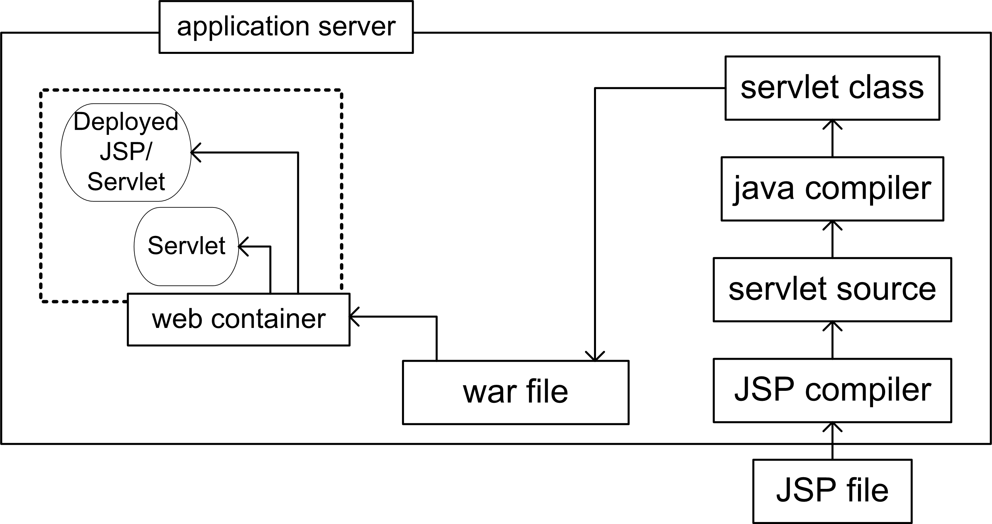
Java Server Pages: deployment
2. Presentation Layer
  4. Java Server Pages

Slide 33
JSP vs Servlet: Example
2. Presentation Layer
  4. Java Server Pages
Servlet version
import java.io.*;
import javax.servlet.*;
public class RandomGenericServlet extends GenericServlet {
public void service(ServletRequest req,ServletResponse res)
throws ServletException,IOException {
res.setContentType("text/html");
PrintWriter out=res.getWriter();
out.println("<HTML><HEAD><TITLE>Servlet Output
</TITLE></HEAD>");
out.println("<BODY> Your random number is : "+
((int)(Math.random()*10))+"</BODY>");
out.println("</HTML>");
out.close();
}
}
JSP-version
<%@page contentType="text/html"%>
<html>
<head><title>JSP output</title></head>
<body>
Your random number is : <%=((int)(Math.random()*10))%>
</body>
</html>

Slide 34
Outline
Overview of Java Enterprise Edition (JEE) architecture
Presentation Layer
Deployment and annotations
- deployment
- annotations
4. Entities and Persistence
5. Enterprise Java Beans (EJBs)
6. JEE Design Patterns
7. Transaction and Security Service
Notes:
After an overview of the basic concepts (programming language generations and compilation versus interpretation), the following programming paradigms are detailed: procedural, functional, object oriented and declarative. Moreover, scripting languages will be explained. The next three sections focus on an overview of Java, C/C++ and C# and their important concepts.

Slide 35
Deployment
3. Deployment and annotations
  1. Deployment
JEE-application
enterprise bean class (bytecode) [IDE/programmer]
interfaces [IDE]
  local/remote
helper classes (utilities/exceptions/...) [programmer]
deployment descriptor (XML) [IDE/deploytool]
EJB JAR-file
EJB JAR-file
EAR-file
WAR-file
deployable units to
application server
EAR: Enterprise Archive-file
WAR: Web Archive-file

Slide 36
Deployment descriptor:
Annotations
3. Deployment and annotations
  2. Annotations
essentially contains meta-data of application/component
cumbersome to construct/maintain
alternative : Annotations
BUT : deployment descriptor can still override annotations
@
+
=
JEE
component
POJO

Slide 37
Annotations
3. Deployment and annotations
  2. Annotations
package java.lang :
• @Deprecated
• @Override
• @SuppressWarning
own annotations can be defined
http://download.oracle.com/javase/1.5.0/docs/guide/language/annotations.html
In JEE applications, annotations are used to specify:
- mapping of attributes to database tables
- type of Enterprise Java Bean
- transaction parameters
- security parameters
- lifecycle management of entities, session beans

Slide 38
Outline
Overview of Java Enterprise Edition (JEE) architecture
Servlets and Java Server Pages (JSP)
Deployment and annotations
Entities and Persistence – interfacing with Database Layer
  Managing entities
  Primary keys
  Object relational mappings
  Example code
  Lifecycle management
Enterprise Java Beans (EJBs)
JEE Design Patterns
Transaction and Security Service
Notes:
After an overview of the basic concepts (programming language generations and compilation versus interpretation), the following programming paradigms are detailed: procedural, functional, object oriented and declarative. Moreover, scripting languages will be explained. The next three sections focus on an overview of Java, C/C++ and C# and their important concepts.

Slide 39
Introduction
4. Entities and Persistence
  1. Introduction
Entity = persistent object
persistent state realised through persistent fields/properties
object/relational annotations used to map to relational data in data store
Entity class = any Java class but
annotated with @Entity
public/protected no-arg constructor
not final class, no persistent final fields, no final methods
if passed by value, must implement Serializable
persistent instance variables NOT public
Field is persistent, unless annotated @Transient
Primary key annotated with
- simple primary key @Id
- composite primary key @EmbeddedId, @IdClass
Notes:
An definition of entity is given here. It is important to note that an entity can be any Java class (no need for instance to derive from an Entity base class or implement an entity interface) and that annotations are used to indicate the mapping of the class attributes to the tables in the data store. Annotations are indicated in source code and start with the @-sign.
From the different attributes of an entity, one needs to be selected as the primary key (i.e. a unique identifier for each particular entity instance).

Slide 40
Entities
4. Entities and Persistence
  1. Introduction
Object-oriented view of entities stored in persistent storage
  Normally, each entity represents a row in a relational DB table
Persistence code generated through ORM-tool
(Object-Relational Mapping, e.g. Hibernate, TopLink)
A single instance (on the server) can be accessed by multiple clients
Each instance must be uniquely identifiable by means of a primary key.

Slide 41
Primary Key
4. Entities and Persistence
  2. Primary Keys
Primary Key class
must be public
properties public
public default constructor
must implements hashCode() and equals()
must be Serializable
composite primary key : related to
- multiple fields/properties of the entity class
- embeddable class
Same names of fields/properties as in entity class
Notes:
Some specific details a primary key class has to fulfill.

Slide 42
Managing Entities
4. Entities and Persistence
  3. Managing Entities
EntityManager
- find entities
- query entities
- life cycle funtions on entities (create, remove, persist)
PersistentContext
associated to data store
associated to its own EntityManager
  Container Managed :
    changes in PersistentContext automatically propagated by container
    EntityManager obtained by @PersistenceContext annotation
    (through injection)
    @PersistenceContext
    EntityManager theManager;
Notes:
When using entities, the EntityManager class plays an important role. The programmer can create an instance of this class to manage the available entities.
Through the @PersistenceContext annotation, an EntityManager is associated with a specific datastore (database type, host name, IP address and port).

Slide 43
Building Java EE 6 Apps with Entities
4. Entities and Persistence
  3. Managing Entities
Entity objects = simple Java classes
  entity classes can be created directly inside a web application
Two options:
  Option 1 : Start with Entity code
  Generate Database tables, columns and Database synchronization code based on attributes of entities
  Option 2 : Start with Database structure (tables, columns)
  Generate Entity code and Datebase synchronization code
Notes:
Two options exist for building applications with entities. One is to start with the entity code, indicate the attributes to be persisted and at deployment time, the database tables are created automatically together with the database synchronization code.
The other option is to start with an existing database (structure and available data) and let an IDE generate the entity code from it. This generated code can then be adapted by the programmer when new functionality is required.

Slide 44
Creating the Entity Classes
4. Entities and Persistence
  4. Object Relational Mapping
Relations :
@OneToOne
@OneToMany
@ManyToOne
@ManyToMany
Every association has a direction :
Unidirectional
Bidirectional

Slide 45
Creating the Entity Classes
4. Entities and Persistence
  4. Object Relational Mapping
@OneToOne (unidirectional) 1-1
@Entity
public class Person implements Serializable {
private static final long serialVersionUID = 1L;
@Id
@GeneratedValue(strategy = GenerationType.AUTO)
private Long id;
private String firstname;
private String lastname;
@OneToOne
private Address address;
…
}
@Entity
public class Address implements Serializable {
private static final long serialVersionUID = 1L;
@Id
@GeneratedValue(strategy = GenerationType.AUTO)
private Long id;
private String street;
private String zipcode;
private String city;
}
ID | Firstname | Lastname | Address_ID
ID | Street | Zipcode | City

Slide 46
Creating the Entity Classes
4. Entities and Persistence
  4. Object Relational Mapping
@OneToOne (bidirectional) 1-1
@Entity
public class Person implements Serializable {
private static final long serialVersionUID = 1L;
@Id
@GeneratedValue(strategy = GenerationType.AUTO)
private Long id;
private String firstname;
private String lastname;
@OneToOne
private Address address;
…
}
@Entity
public class Address implements Serializable {
@OneToOne(mappedBy = "address")
private Person person;
private static final long serialVersionUID = 1L;
@Id
@GeneratedValue(strategy = GenerationType.AUTO)
private Long id;
private String street;
private String zipcode;
private String city;
}
Owning side: Person
ID | Firstname | Lastname | Address_ID
ID | Street | Zipcode | City

Slide 47
Creating the Entity Classes
4. Entities and Persistence
  4. Object Relational Mapping
@OneToOne (bidirectional) 1-1
@Entity
public class Person implements Serializable {
private static final long serialVersionUID = 1L;
@Id
@GeneratedValue(strategy = GenerationType.AUTO)
private Long id;
private String firstname;
private String lastname;
@OneToOne(mappedBy = "person")
private Address address;
…
}
@Entity
public class Address implements Serializable {
@OneToOne
private Person person;
private static final long serialVersionUID = 1L;
@Id
@GeneratedValue(strategy = GenerationType.AUTO)
private Long id;
private String street;
private String zipcode;
private String city;
}
Owning side: Address
ID | Firstname | Lastname
ID | Street | Zipcode | City | Person_ID

Slide 48
Creating the Entity Classes
4. Entities and Persistence
  4. Object Relational Mapping
@OneToMany (unidirectional) 1-n
@Entity
public class Pavilion implements Serializable {
private static final long serialVersionUID = 1L;
@Id
@GeneratedValue(strategy = GenerationType.AUTO)
private Long id;
private String name;
private String location;
@OneToMany
private Collection<Animal> animals;
@Entity
public class Animal implements Serializable {
private static final long serialVersionUID = 1L;
@Id
@GeneratedValue(strategy = GenerationType.AUTO)
private Long id;
private String name;
private String kind;
private String weight;
}
ID | Name | Location
PAVILION_ID | ANIMAL_ID
ID | Name | Kind | Weight

Slide 49
Creating the Entity Classes
4. Entities and Persistence
  4. Object Relational Mapping
@OneToMany (bidirectional) 1-n @ManyToOne n-1
@Entity
public class Pavilion implements Serializable {
private static final long serialVersionUID = 1L;
@Id
@GeneratedValue(strategy = GenerationType.AUTO)
private Long id;
private String name;
private String location;
@OneToMany(mappedBy = "pavilion")
private Collection<Animal> animals;
@Entity
public class Animal implements Serializable {
@ManyToOne
private Pavilion pavilion;
private static final long serialVersionUID = 1L;
@Id
@GeneratedValue(strategy = GenerationType.AUTO)
private Long id;
private String name;
private String kind;
private String weight;
}
ID | Name | Location
ID | Name | Kind | Weight | PAVILION_ID

Slide 50
Creating the Entity Classes
4. Entities and Persistence
  4. Object Relational Mapping
@ManyToMany (bidirectional) n-m
@Entity
public class Student implements Serializable {
private static final long serialVersionUID = 1L;
@Id
@GeneratedValue(strategy = GenerationType.AUTO)
private Long id;
private String firstname;
private String lastname;
private int studentcode;
@ManyToMany
private Collection<Subject> subjects;
@Entity
public class Subject implements Serializable {
@ManyToMany(mappedBy = "subjects")
private List<Student> students;
private static final long serialVersionUID = 1L;
@Id
@GeneratedValue(strategy = GenerationType.AUTO)
private Long id;
private String subjectname;
ID | Studentcode | Firstname | Lastname
ID | Subjectname
Students_ID | Subjects_ID

Slide 51
Entity Lifecycle Management
4. Entities and Persistence
  6. Lifecycle Management
@PrePersist
Marks a method in the entity class as a pre-persist callback (executed before an entity is persisted).
@PostPersist
Marks a method in the entity class as a postpersist callback (executed after an entity is persisted).
@PreUpdate
Marks a method in the entity class as a preupdate callback (executed before entity data is updated in the database).
@PostUpdate
Marks a method in the entity class as a postupdate callback (executed after entity data is updated in the database).
@PreRemove
Marks a method in the entity class as a preremove callback (executed before an entity is removed from the database).
@PostRemove
Marks a method in the entity class as a postremove callback (executed after an entity is removed from the database).
@PostLoad
Marks a method in the entity class as a postload callback (executed before an entity is loaded from the database).

Slide 52
Outline
Overview of Java Enterprise Edition (JEE) architecture
Servlets and Java Server Pages (JSP)
Deployment and annotations
Entities and Persistence
Enterprise Java Beans (EJBs) – Business Layer
  EJB views
  EJB types
  Stateless session beans
  Stateful session beans
  Message driven beans
JEE Design Patterns
Transaction and Security Service
Notes:
After an overview of the basic concepts (programming language generations and compilation versus interpretation), the following programming paradigms are detailed: procedural, functional, object oriented and declarative. Moreover, scripting languages will be explained. The next three sections focus on an overview of Java, C/C++ and C# and their important concepts.

Slide 53
Types of EJBs: overview
5. Enterprise Java Beans
  2. EJB types
EJBs
Session Beans
Message Beans
Entities
session related object
always associated to
one single client at
most
types
Stateful :
“conversational
state”
Stateless
Singleton
instantiated once/app
asynchronous
message handling
new since J2EE 1.3
“real life” object
mostly associated
to “row in database”
persistent
NEW since EJB3.0
[replace (very) complex
EntityBeans]
- NOT managed by
EJB container
synchronous
asynchronous

Slide 54
Session EJBs
5. Enterprise Java Beans
  2. EJB types
A session bean instance is:
  A non-persistent object
  Implements some business logic
  (“procedural component”)
  Runs on the server
Not shared among multiple clients
Notes:
Since this communication via a network, finding the server means determining the servers network address.

Slide 55
Stateless Session EJBs
5. Enterprise Java Beans
  2. EJB types
Conceptually, the same as stateful session EJBs
No state
  http-style request – reply interaction
  Can have fields, but they are not unique to any client
Basically, it’s an optimization trick:
Since the container knows the bean has no state, it can:
  Use a single bean instance (While each client thinks it has its own copy)
  Destroy/re-instantiate on the fly
  Redirect requests to different instances (load balancing)
Example: CurrencyConversionBean

Slide 56
Stateful Session EJBs
5. Enterprise Java Beans
  2. EJB types
A stateful session bean maintains a state
  values of its instance variables
  also called : conversational state
The state is relevant only for a single client
  cannot be seen by other clients
The state is not persistent
  does not survive a server shutdown
  when the client removes the bean or terminates, the session ends and the state disappears
Canonical example: ShoppingCart

Slide 57
Singleton Session EJBs
5. Enterprise Java Beans
  2. EJB types
Instantiated once per application
and exists for the lifecycle of the application.
Use: single enterprise bean instance shared across and concurrently accessed by clients

Slide 58
Message Driven Beans (MDBs)
5. Enterprise Java Beans
  2. EJB types
process messages asynchronously
messages originate from JMS (Java Messaging Service)-compliant system
message can be sent by any source
  other EJB
  other JEE component (e.g. web component)
  any other (legacy) component
indirectly accessed by clients
  no interface, use message instead
similar to stateless session bean
  all beans are equivalent (pooling !) – no client specific state
  no conversational state maintained
  can handle requests from multiple clients
JMS queue
Client
MDB

Slide 59
Stateless Session Bean usage
5. Enterprise Java Beans
  3. Stateless session beans
Client 1
Bean Pool
Client 2
Instance 1
Client 3
Instance 2
Client 4
EJB container

Slide 60
JEE standard example Currency Converter
5. Enterprise Java Beans
  3. Stateless session beans
CurrencyConverterBean.java
package converter;
import java.math.BigDecimal;
import javax.ejb.Stateless;
@Stateless
public class CurrencyConverterBean implements CurrencyConverterRemote {
BigDecimal yenRate = new BigDecimal("121.6000");
BigDecimal euroRate = new BigDecimal("0.0077");
public CurrencyConverterBean() {
}
public BigDecimal dollarToYen(BigDecimal dollars) {
BigDecimal result = dollars.multiply(yenRate);
return result.setScale(2, BigDecimal.ROUND_UP);
}
public BigDecimal yenToEuro(BigDecimal yens) {
BigDecimal result = yens.multiply(euroRate);
return result.setScale(2, BigDecimal.ROUND_UP);
}
}

Slide 61
Currency Converter : remote interface
5. Enterprise Java Beans
  3. Stateless session beans
package converter;
import java.math.BigDecimal;
import javax.ejb.Remote;
@Remote
public interface CurrencyConverterRemote {
BigDecimal dollarToYen(BigDecimal dollars);
BigDecimal yenToEuro(BigDecimal yens);
}
CurrencyConverterRemote.java

Slide 62
Application Client
5. Enterprise Java Beans
  3. Stateless session beans
package currencyconverterclient;
import converter.CurrencyConverterRemote;
import java.math.BigDecimal;
import javax.ejb.EJB;
public class Main {
@EJB
private static CurrencyConverterRemote currencyConverterBean;
public Main() {
}
public static void main(String[] args) {
BigDecimal param = new BigDecimal("100.00");
BigDecimal amount = currencyConverterBean.dollarToYen(param); System.out.println(amount);
amount = currencyConverterBean.yenToEuro(param);
System.out.println(amount);
}
}
Main.java

Slide 63
Stateful Session Bean usage
5. Enterprise Java Beans
  4. Stateful session beans
Client 1
Client 2
State 1
Instance 1
State 2
Instance 2
Client 3
State 3
Instance 3
State 4
Instance 4
Client 4
EJB container
typical usage : multi-step workflows

Slide 64
Activation and Passivation
5. Enterprise Java Beans
  4. Stateful session beans
During the bean’s lifecycle, the container may decide to passivate it
Normally done to free up memory and other resources
Bean is notified immediately before passivation by lifecycle method @PrePassivate
In this method, the bean should:
  Release any heavy-duty resources it might be holding
    Open files, database connections, etc.
  Nullify fields that should not be serialized (cache, etc.)
  Copy state into Serializable variables
If the bean is referenced by client while passivated, the container activates it.
Bean is notified by @PostActivate immediately after de-serialization
  Its chance to restore all field values, resources, etc.

Slide 65
Stateful Session Beans: Programming Rules
5. Enterprise Java Beans
4. Stateful session beans
Additional Rules:
- @Stateful (instead of @Stateless)
identical (except for name) as @Stateless
- instance variables must be primitive/Serializable
- @Remove for “friendliness”
- provide additional methods (wrt stateless beans) :
  @PostActivate
  @PrePassivate

Slide 66
Simple Example : a random bean
5. Enterprise Java Beans
  4. Stateful session beans
business methods:
  random() : give a random int number between 0 and 10
  random(int n) : idem between 0 and n
  getSum() : get sum of all values produced in this session
  getUser() : get user of this session
  setUser() : set user of this session

Slide 67
Random State Bean : remote interface
5. Enterprise Java Beans
  4. Stateful session beans
RandomStateRemote.java
package randomstate;
import javax.ejb.Remote;
import javax.ejb.Remove;
@Remote
public interface RandomStateRemote {
int random(int n);
int random();
void setUser(String name);
String getUser();
int getSum();
@Remove
void remove();
}

Slide 68
Random State Bean : Bean Class
5. Enterprise Java Beans
  4. Stateful session beans
RandomStateBean.java
package randomstate;
import javax.ejb.Remove;
import javax.ejb.Stateful;
@Stateful
public class RandomStateBean implements RandomStateRemote {
private String userName;
private int sum=0;
public RandomStateBean() {}
public int random(int n) {
int r=(int)(n*Math.random());
sum+=r;
return r;
}
public int random() {return random(10);}
public void setUser(String name) {userName=name;}
public String getUser() {return userName;}
public int getSum() {return sum;}
@Remove
public void remove() {userName=null;sum=0;}
}
session related state variables
friendly removal

Slide 69
Random State Bean : multisession client
5. Enterprise Java Beans
  4. Stateful session beans
Main.java
package twosessionclient;
import javax.ejb.EJB;
import randomstate.RandomStateRemote;
public class Main {
@EJB
private static RandomStateRemote george;
@EJB
private static RandomStateRemote john;
public Main() {}
public static void main(String[] args) {
george.setUser("George");
john.setUser("John");
for(int i=0;i<5;i++)
System.out.println("1:"+george.random(10)+
"\t2:"+john.random(100));
System.out.println(george.getUser()+" : "+george.getSum());
System.out.println(john.getUser()+" : "+john.getSum());
george.remove();
john.remove();
}
}
1:5 2:8
1:0 2:25
1:6 2:43
1:3 2:34
1:1 2:1
George:15
John:111
sample run

Slide 70
Outline
Overview of Java Enterprise Edition (JEE) architecture
Servlets and Java Server Pages (JSP)
Deployment and annotations
Entities and Persistence
Enterprise Java Beans (EJBs)
JEE Design Patterns
  Session Façade, Proxy and Command pattern
Transaction
Security Service
Notes:
After an overview of the basic concepts (programming language generations and compilation versus interpretation), the following programming paradigms are detailed: procedural, functional, object oriented and declarative. Moreover, scripting languages will be explained. The next three sections focus on an overview of Java, C/C++ and C# and their important concepts.

Slide 71
EJB Design Patterns
6. Design Patterns
  Overview
Client
Proxy pattern
abstracts the server to the client
proxy
Facade pattern
session bean
presents API to clients
Facade
Command pattern
reduce the complexity in the communication
decouple client - server
Controller
Entity 1
Entity 3
Entity 2
Notes:
Three JEE-specific design patterns are detailed in this section: the façade pattern, proxy pattern and command pattern.

Slide 72
The Session Facade Pattern
6. Design Patterns
  1. Session Façade Pattern
Used for minimizing
  Client/entity bean coupling
  Risk of client using unapproved business methods
    Or using approved business methods in unapproved ways
  Network delays
  Points of change if high-level business operations are modified
The idea: create a Session EJB that provides high-level business methods
  Client should only work with the session bean(s)
  Entity EJBs provide (possibly only) a local interface
    Session EJB accesses entity EJBs locally
Notes:
The definition and advantages of the façade pattern are described.

Slide 73
The Session Facade Pattern
6. Design Patterns
  1. Session Façade Pattern
No Facade
Client
Client
Client
Application Server
Notes:
Illustration of the communication between the clients and entities when no façade session bean is used.

Slide 74
The Session Facade Pattern
6. Design Patterns
  1. Session Façade Pattern
With Facade
Client
Client
Client
Application Server
Notes:
Similar illustration of the communication between the clients and entities, in this case a façade session bean is used.

Slide 75
Session Facade Example
6. Design Patterns
  1. Session Façade Pattern
Client code without the facade:
  Find Account home
  Find accounts a1, a2 by primary keys k1, k2
  a1.setBalance(a1.getBalance() - amount);
  a2.setBalance(a2.getBalance() + amount);
Client code with the facade:
  Find TransferBean home, create TransferBean t1
  t1.transfer(k1, k2, amount);
Notes:
Illustration of the usefulness of a façade session bean for a specific example.

Slide 76
Resulting Benefits
6. Design Patterns
  1. Session Façade Pattern
Faster operation
  1 JNDI lookup, 1 remote object lookup and 1 remote business method vs. 1 JNDI lookup, 2 remote object lookups and 4 remote business methods in the old code
Easier maintenance
  If we have two different clients (servlet, application) and we wish to change the transfer semantics (e.g., add logging), there's only one place to change
Easier transaction management
  can be started at the facade
Increased security
  Client can't invoke Account.setBalance directly, since Account has no remote component interface
Notes:
List of benefits when using the façade session bean design pattern.

Slide 77
Example Façade Session
6. Design Patterns
  1. Session Façade Pattern
package ods.ejb;
import java.util.List;
import javax.ejb.Stateless;
import javax.persistence.EntityManager;
import javax.persistence.NoResultException;
import javax.persistence.PersistenceContext;
@Stateless
public class AccountFacade implements AccountFacadeLocal {
@PersistenceContext
private EntityManager em;
public AccountFacade() {
}
public boolean isValidAccount(String username, String password){
Account account = findByUsername(username);
boolean valid = false;
If(account != null)
if(account.getPassword().equals(password))
valid = true;
return valid;
}
public Account addAccount(String username,
String password, boolean isAdmin)
throws IllegalArgumentException{
Account existing = findByUsername(username);
if(existing != null)
throw new IllegalArgumentException("username allready exists");
else{
Account account = new Account(username, password, isAdmin);
create(account);
return account;
}
}
public Account findByUsername(String username){
try {
Account account = (Account) em.createNamedQuery("findAccountByUsername")
.setParameter("username", username).getSingleResult();
return account;
} catch (NoResultException e) { }
return null;
}
public void create(Account account) {
em.persist(account);
}
public void edit(Account account) {
em.merge(account);
}
public void destroy(Account account) {
em.remove(em.merge(account));
}
public Account find(Object pk) {
return (Account) em.find(Account.class, pk);
}
public List findAll() {
return em.createQuery("select object(o) from Account as o").getResultList();
}
}

Slide 78
Proxy Pattern
6. Design Patterns
  2. Proxy Pattern
Class at client side
Proxy can contain JNDI name – Bean class mapping
Can serve as cache for object references
Allows cleaner coding style
Performance benefit : cache object references
ClientNoProxy
ClientProxy
Application Server
Notes:
Explanatory figure to illustrate the Proxy design pattern for JEE applications.

Slide 79
Command Pattern
6. Design Patterns
  3. Command Pattern
Command pattern
  = Class, transmitted from one object to another
  Client constructs commands, facade forwards them to right controller
Example code
public interface BasicCommandInterface{
public String getCommandTarget();
public String getCommandInstruction();
public HashMap getCommandData();
public void setCommandData(String key,Object value);
public void setCommandTarget(String aTarget);
public void setCommandInstruction(String anInstruction);
public execute();
public void getCommandData(HashMap aData);
}
Applications can be modified dynamically
Facade doesn’t need to provide all interface methods
Notes:
When the command pattern is used, an object is transmitted between the client and session bean. This object contains the command information in a textual format. This approach is more flexible than the approach that for each possible command a separate method is available (since adding or changing a command requires to change the session bean interface and implementation).
In the case of the command design pattern, the client constructs the commands and the facade forwards them to right controller, where the commands are interpreted and forwarded.

Slide 80
Command Pattern
6. Design Patterns
  3. Command Pattern
Command Routing
(could be proxy)
Command Processor
(stateless SB)
Controller
(stateful SB)
Client
Commands
decoupling client – server
single network transaction
Notes:
Illustration of the communication between the clients, the session beans and the entities when the command pattern is used.

Slide 81
Other Recommended Practices
6. Design Patterns
  3. Command Pattern
Avoid calling EJB methods directly from JSP
  The need to catch remote exceptions would complicate the JSP code
Avoid hard-coding JNDI resource names
Avoid fine grain data transfers
Notes:
To conclude this section, some extra recommended practices are listed.

Slide 82
Outline
Overview of Java Enterprise Edition (JEE) architecture
Servlets and Java Server Pages (JSP)
Deployment and annotations
Entities and Persistence
Enterprise Java Beans (EJBs)
6. JEE Design Patterns
7. Transaction and 8. Security Service
  Introduction
  Transaction attributes
  Transaction rollback
  Transaction annotations
  Security terminology
  Declarative security
  Programmatic security
Notes:
After an overview of the basic concepts (programming language generations and compilation versus interpretation), the following programming paradigms are detailed: procedural, functional, object oriented and declarative. Moreover, scripting languages will be explained. The next three sections focus on an overview of Java, C/C++ and C# and their important concepts.

Slide 83
Introduction
7. Transactions and security service
  1. Introduction
Account 1
Facade
Account 2
Log
Set of operations need to move data from one consistent state to another (example shown: transfer money from one account to another and log that the transfer is done)
The set of operations should be indivisible
If one or more operations fail, the entire set should be undone
Notes:
The

Slide 84
Possible Approach
7. Transactions and security service
  1. Introduction
If one or more operations fail, the entire set should be undone:
By means of exception handling:
  Catch all possible exceptions of involved methods
  In case of exceptions: undo already finished operation
Drawbacks:
  Code spread across many exception handlers
        Less readable
        Less maintainable
  In case of network failures
    Has the operation been completed or not ?
    Remote object should roll back automatically if the network becomes unavailable
=> Use of transactions

Slide 85
What is a Transaction?
7. Transactions and security service
  1. Introduction
A transaction is a set of operations that moves data from one consistent state to another
If one or more operations fail, the entire set is undone
  Success: the transaction "commits"
  Failure: the transaction "rolls back"
For example:
begin transaction
debit checking account
credit savings account
update history log
commit transaction

Slide 86
Transaction Definitions
7. Transactions and security service
  1. Introduction
Transactional Object: An object which is used (methods invoked) within a transaction
  Can only be associated with one transaction at a time
  EJBs can be transactional objects
Transactional Client: A program which invokes methods on transactional objects
Transaction Manager: A program that coordinates transaction processing

Slide 87
The Transaction Context
7. Transactions and security service
  1. Introduction
A single transaction can involve multiple objects and operations
A transaction context represents the transaction shared by all these participants
By default, it is automatically propagated between transactional objects (EJBs).

Slide 88
Java APIs for Transactions
7. Transactions and security service
  1. Introduction
The Java Transaction API (JTA) is used by application developers
  Specifies the interface between the transaction manager and all involved objects
  Main class: the UserTransaction interface.
The Java Transaction Service (JTS) is used by developers of transaction managers
  Developers of application servers, EJB containers, etc.
  Not used by application developers

Slide 89
Container Managed Transactions
7. Transactions and security service
  1. Introduction
Can be used with both session beans and entities.
The container begins a transaction immediately before an enterprise bean method starts (if declared to be transactional).
The transaction is committed before the method exits
Not all methods should be associated with transactions
=> Use of transaction attributes
at deployment time

Slide 90
Transaction Attribute Values
7. Transactions and security service
  2. Transaction attributtes
When using CMT, beans (or specific methods within beans) have a transaction attribute
Attribute controls scope of transaction
One of six possible values:
  Required
  RequiresNew
  Mandatory
  Never
  NotSupported
  Supports

Slide 91
Transaction Attributes
7. Transactions and security service
  2. Transaction attributtes
Bean1
Bean2
.
.
methodA() {
.
.
Bean2.methodB();
.
}
.
.
methodB() {
.
.
.
}
TX1
TX?
methodB() part of TX1 ?
(dependent on transaction attribute,
associated with methodB
detailed on next 6 slides !)

Slide 92
Required
7. Transactions and security service
  2. Transaction attributtes
Required
  If the invoker has a transaction context, it is propagated to the bean
  If not, the container creates a new transaction context
  I.e., the method always executes within a transaction context, but does not create a new transaction needlessly
  This is the default value
Bean1 methodA() Bean2 methodB()
Transactional TX1 TX1
Context None TX2

Slide 93
RequiresNew
7. Transactions and security service
  2. Transaction attributtes
RequiresNew
  If the invoker has a transaction context, it is suspended for the duration of this method's execution
  Either way, a new transaction context is created
  Use when you want the method to execute within a transaction, but you do not want failure to roll back the whole transaction
Bean1 methodA() Bean2 methodB()
Transactional TX1 TX2
Context None TX2

Slide 94
Mandatory
7. Transactions and security service
  2. Transaction attributtes
Mandatory
  If the invoker has a transaction context, it is propagated to the bean
  Otherwise, an exception is thrown
    TransactionRequiredException
  Use when you want the invoker to provide the transaction
    Does not necessarily imply BMT or client managed transactions: the invoker can be a different method in the same EJB
Bean1 methodA() Bean2 methodB()
Transactional TX1 TX1
Context None EXCEPTION

Slide 95
Never
7. Transactions and security service
  2. Transaction attributtes
Never
  If the invoker has a transaction context, an exception is thrown
    RemoteException or EJBException
  Otherwise, the method proceeds normally, without a context
  Used for non-transactional resources
Bean1 methodA() Bean2 methodB()
Transactional TX1 EXCEPTION
Context None None

Slide 96
NotSupported
7. Transactions and security service
  2. Transaction attributtes
NotSupported
  If the invoker has a transaction context, it is suspended for the duration of this method's execution
  If not, no transaction context is used
  Either way, the method executes without transaction context
  For performance optimization
Bean1 methodA() Bean2 methodB()
Transactional TX1 TX1 suspended
Context None None

Slide 97
Supports
7. Transactions and security service
  2. Transaction attributtes
Supports
  If the invoker (client, or a different method) has a transaction context, it is propagated to the bean
  If not, no transaction context is used
  Use this for "don't care" situations
Bean1 methodA() Bean2 methodB()
Transactional TX1 TX1
Context None None

Slide 98
Transaction Attribute Values: Summary
7. Transactions and security service
  2. Transaction attributtes
 | Invoker's transaction context | Method's action
Supports | T₁ | Use T₁
 | None | Work with no transaction context
NotSupported | T₁ | T₁ suspended
 | None | Work with no transaction context
Required | T₁ | Use T₁
 | None | Create and use T₂
RequiresNew | T₁ | T₁ suspended, create and use T₂
 | None | Create and use T₂
Mandatory | T₁ | Use T₁
 | None | Throw exception
Never | T₁ | Throw exception
 | None | Work with no transaction context

Slide 99
Recommended Practices
7. Transactions and security service
  2. Transaction attributtes
Always prefer container managed transactions.
Prefer Required, RequiresNew and Mandatory over other options
  Supports, NotSupported and Never are not implemented by all containers - compromises portability

Slide 100
Exceptions and Transactions
7. Transactions and security service
  3. Transaction rollback
An application exception does not abort the transaction
  However, note that if the exception causes the method that initiated the transaction to end, then the transaction will be stopped
  If the client invokes m₁, m₁ initiates the transaction (due to its Requires attribute) and invokes m₂, and m₂ throws an application exception, then m₁ can try to continue the transaction
  If m₁ throws (or does not catch) an application exception, the transaction will roll back
A system exception aborts the transaction
  The container will log the error and mark the transaction "rollback only"
  Any attempt to proceed with the transaction would be futile

Slide 101
Rolling back a Transaction
7. Transactions and security service
  3. Transaction rollback
1. By the container: if a system exception is thrown
2. The bean method can instruct the container to roll back a transaction
  By invoking setRollBackOnly on its EJB context object
  Usually done before throwing an application exception

Slide 102
Roll back example
7. Transactions and security service
  3. Transaction rollback
public void transferToSaving(double amount) throws
InsufficientBalanceException {
checkingBalance -= amount;
savingBalance += amount;
try {
updateChecking(checkingBalance);
if (checkingBalance < 0.00) {
context.setRollbackOnly();
throw new InsufficientBalanceException();
}
updateSaving(savingBalance);
} catch (SQLException ex) {
throw new EJBException
("Transaction failed due to SQLException: "+ ex.getMessage());
}
}
Application exception :
explicit roll back
System exception :
automatic roll back

Slide 103
Java 5 Annotations Example
7. Transactions and security service
  4. Transaction annotations
@Stateless
@TransactionManagement(TransactionManagementType.CONTAINER)
public class OrderManagerBean {
@Resource
private SessionContext context;
...
@TransactionAttribute(TransactionAttributeType.REQUIRED)
public void placeOrder(Item item, Customer customer){
try {
if (!bidsExisting(item)){
validateCredit(customer);
chargeCustomer(customer, item);
removeItemFromBidding(item);
}
} catch (CreditValidationException cve) {
context.setRollbackOnly();
} catch (CreditProcessingException cpe){
context.setRollbackOnly();
} catch (DatabaseException de) {
context.setRollbackOnly();
}
}
}

Slide 104
@ApplicationException
7. Transactions and security service
  4. Transaction annotations
public void placeOrder(Item item, Customer customer) throws CreditValidationException,
CreditProcessingException, DatabaseException {
if (!bidsExisting(item)){
validateCredit(customer);
chargeCustomer(customer, item);
removeItemFromBidding(item);
}
}
...
@ApplicationException(rollback=true)
public class CreditValidationException extends Exception {
...
@ApplicationException(rollback=true)
public class CreditProcessingException extends Exception {
...
@ApplicationException(rollback=false)
public class DatabaseException extends RuntimeException {
...

Slide 105
J2EE Security Terminology (1)
7. Transactions and security service
  5. Security terminology
A principal is “something” that can be authenticated
  For example, a user or a server
Each principal has an associated set of security attributes
  Used to identify which resources the principal can access
A principal is identified using credentials
  A credential contains or references security attributes
  Credentials are acquired via authentication
  Credentials can also be acquired through delegation from another principal

Slide 106
J2EE Security Terminology (2)
7. Transactions and security service
  5. Security terminology
Group: A set of authenticated users, defined in the Application Server.
Role: An abstract name for the permission to access a particular set of resources in an application.
  A role can be compared to a key that can open a lock.
  Many people might have a copy of the key. The lock doesn’t care who you are, only that you have the right key.

Slide 107
Two possible ways
7. Transactions and security service
  5. Security terminology
Declarative security: defined using deployment descriptors
  Includes definition of security roles, access control rules and authentication requirements
  Mapped by the application deployer to the specific runtime environment
Programmatic security: explicit use of security APIs by application code
  Provides increased flexibility
    e.g., the same method can function differently for different principals
  Key methods: getCallerPrincipal and isCallerInRole, defined in EJBContext.

Slide 108
Declarative example
7. Transactions and security service
  6. Declarative security
@DeclareRoles("BIDDER", "CSR", "ADMIN")
@Stateless
public class BidManagerBean implements BidManager {
@RolesAllowed("CSR, ADMIN")
public void cancelBid(Bid bid, Item item) {...}
@PermitAll
public List<Bid> getBids(Item item) {...}
}

Slide 109
Programmatic example
7. Transactions and security service
  7. Programmatic security
@Stateless
public class BidManagerBean implements BidManager {
@Resource SessionContext context;
...
public void cancelBid(Bid bid, Item item) {
if (!context.isCallerInRole("CSR")) {
throw new SecurityException("No permissions to cancel bid");
}
...
}
...
}

Slide 110
Service Oriented Architectures

Slide 111
Outline
9. Introduction : Service Oriented Architectures
10.Technology building blocks
- SOAP
- WSDL
- WS-* standards
11. Java Web Services
12. Web Service Orchestration and Choreography
13. Software Integration
  - eTOM, ITIL

Slide 112
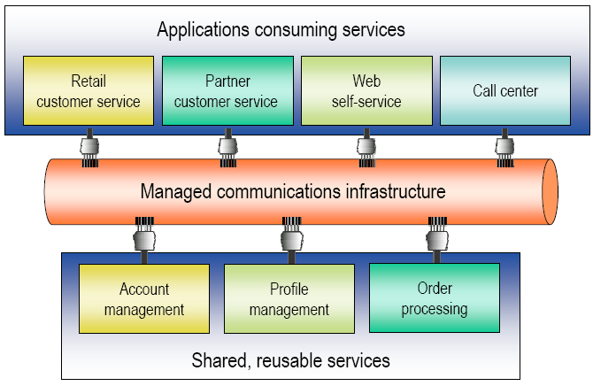
What is an SOA?
9. Introduction
Shared, reusable, loosely coupled services
Notes:
One of the key features of an SOA is the ability to support shared, cross-application reusable services. Application designers can use the functionality they need from a variety of loosely-coupled service building blocks and hence rapidly and robustly create new applications or application features.

Slide 113
What is an SOA?
9. Introduction
Service oriented architecture
  Architecture = style of design
    Enterprise architectural style
  Service-oriented: the core unit of design is a service
    Implementing a capability so that it can be easily consumed
  An approach to designing systems, a set of design principles
  A way of thinking about a problem, a mindset
From a technical perspective
  An architecture for designing systems
    A “service”’ exposes a discrete capability
    Any application that needs the capability uses the service
  A service exposes its capability via an interface
    Standards-compliance improve usability
  Compare against an application-centric design perspective
    Monolithic application silos
    Duplication of functionality
Notes:
A SOA (Service Oriented Architecture) is first and foremost an architecture, which means it is a design style tuned for enterprises. The other key ingredient of an SOA is the fact that it is service oriented: the core building block of an SOA design is a service. These service building blocks implement capabilities that can be easily (automically) consumed.
Generalised we can state that the SOA idea is an approach to designing enterprise systems, it gives the designer a set of design principles by which a problem can be solved.
Seen from a technical perspective, SOA is, as stated, an architecture for designing systems, in which the service building blocks expose certain capabilities. Any application that wants to use those capabilities can ask the service to deliver them. Services themselves expose their capabilities via a service interface (which is standards-compliant to improve interoperability).
When compared against application-centric design, the application-centric approach leads to monolithic applications with a lot of duplicated functionality.

Slide 114
SOA benefits
9. Introduction
Measurable benefits
  Improvement of the quality of applications
    Outsourcing non-business functionality to knowledgeable service creators
    Increase productivity, efficiency, effectiveness, satisfaction
  Reduction of time-to-market
    Deliver new features, new capabilities faster
  Increase of ease of doing business
    Make it easier to integrate with customers, partners and suppliers
  Reduction of costs
Notes:
There are plenty of benefits of employing a SOA model:
First and foremost SOA can improve the quality of applications: by combining modular service block functionality, businesses can focus on the functionality they are specialised in, and leave other functionality to be implemented by specialised service builders.
SOA can reduce the time to market a new application, as certain (more trivial) service building blocks can either be reused from existing applications or bought from other service developers.
SOA also increases the ease of doing business, as due to the adoption of standards it becomes easy to integrate suppliers’ services in products (i.e. less time spent figuring out interworking mechanics), or to deliver services yourself to customers.
Due to outsourcing / service-provider competition, the development and maintenance costs of business-needed functionality can be lowered. An additional benefit is that new applications do not have to be developed from a clean slate, but can instead count on a toolbox of existing services from which development can be started.

Slide 115
SOA risks
9. Introduction
Risks
  SOA is hard
  Disruptive to the status quo
    Fundamental changes required
  Requires a long term commitment
    Modest return in the near term
    Significant return in the long term
  Many SOA initiatives will fail spectacularly
    Derailed by cultural issues, not technology
      Deliver on time
      Cost containment
  Systems may become more brittle and inflexible than before
Notes:
Along with the benefits come plenty of risks though. One of these risks is that SOA is a difficult concept to execute in a good way: fundamental changes are required in the application development cycle, concerning viewing applications no longer as individual-standing containers, but instead as a collection of self-containing services with the core ‘application-glue’ welded between these services.
For businesses SOA requires a long term commitment, as the return in the near term will be modest at best, but in the long term, if done right, significant investment returns can be expected.
A lot of SOA initiatives are bound to fail, mostly due to cultural issues, and not due to the state of SOA technology. Projects nowadays are expected to be delivered on-time, within a certain cost-frame. Mostly these limitations do not take into account the fact that if projects are built up in a SOA way, the hence developed services could be reused in future projects (lowering those projects’ development time and focusing more on innovative features).
If SOA is not done in a correct fashion then there is a profound risk of making systems even more brittle than before, as, when for instance relying on external parties’ services, any wrongful (i.e. non-announced functionality breaking change) change to this external service can leave the whole system in distress.

Slide 116
SOA requires changes
9. Introduction
Fundamental changes required
  Design-wise
    Different design focus (service rather than application)
    Designing reusable services takes more time
    Requires much more collaboration
  Accounting
    Who pays for initial service development?
    How does one re-gain those expenses?
  Control issues
    Hard dependencies on services that you do not control
  Operations issues
    New applications may impact performance of existing apps
Notes:
From looking at the risks it has already become clear that, in order to have SOA succeed, some changes are required.
One of these changes is that design needs to focus more on the individual services rather than on the whole application. This design of reusable service building blocks requires more time and much more collaboration (the to-be-developed service building block needs to be able to work ‘on its own’ and provide its’ functionality to a variety of service consumers).
Cost-wise a business needs to look at how the initial (and rather time-consuming) service developments will be budgetted and how it will be able to regain those expences.
Using external (i.e. not under company control) services also requires hard dependencies to be negotiated regarding the functionality and behavior that those services will exhibit (and will keep exhibiting over time).
Special care also has to be taken when deploying new applications that make use of existing services, as the added load on those existing services can lead to worse performance for existing applications.

Slide 117
SOA planning and governance
9. Introduction
SOA requires planning and governance
  Where do you start?
  How do you build services?
  Do you build the right services?
  Are your services reusable?
  Can people find the services?
  Who is using the services?
  Can you find the root cause of a problem?
  Who will be affected if you make this change?
Notes:
Moving to SOA mainly involves a big deal of careful planning and governance. How will one make the good choices regarding which functionality will be contained in services (so that they are not trivial on the one side and not bloated on the other)? How will services be made reusable across applications, whether it be in-company or outsourced? Are people able to find the repository of already existing services? Who is using your services? What if problems occur, can one easily backtrace to the root of a problem? If you make changes to existing services, how will it affect existing applications that make use of that particular service.

Slide 118
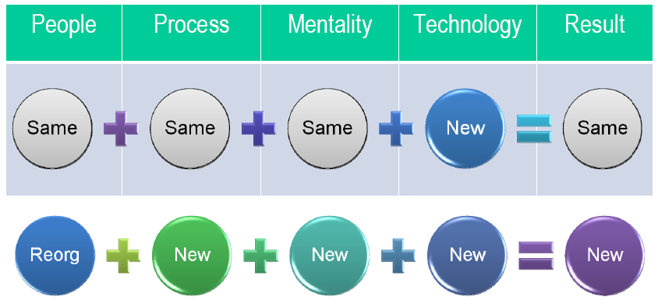
New technology != change
9. Introduction
Notes:
A new technology alone is not sufficient to provide inherent change, instead, as was mentioned, both the process and mentality behind developing IT projects should change. The service oriented process / mentality and coupled technology can make it possible to achieve new results.

Slide 119
SOA enabling technologies
9. Introduction
SOA is about design not technology
  Any technology can be used to build a service
    WS-*, CORBA, COM, etc
  Technology will influence the power, flexibility, manageability and resilience of a SOA system
  Pervasive standards-based technology = wider reach
    Standard data formats (e.g. XML)
    Standard protocols (e.g. HTTP, SOAP)
    Standard description languages (e.g. XML Schema, WSDL)
  Isn’t WS-* required?
    SOA is about system design, not technology
    10 years from now, WS-* may be like CORBA
    Today: one of the best options available
      Pervasive: widely adopted
      Good tooling and frameworks
      Good interoperability
Notes:
SOA is not about a specific technology but rather about a design view. The chosen technology will however influence how powerful, flexible, manageable and resilient to changes a SOA-based system will be.
The choice for a standards-based technology will allow SOA developers to have a wider reach (making it easier to reuse their services for other applications).
For SOA, it is not needed to use the various WS-* standards, but today the WS-* standards are one of the best options for creating SOA, as they have been widely adopted and have good tooling available.

Slide 120
Service-Oriented Architectures
9. Introduction
Vision
Services should be dynamically discoverable,
Separation between service description and implementation
Assemble application “ad hoc” based on discovered services
“Service-oriented architectures”
owner of the service
runs the service remotely
offers XML-description of service
provider
requestor
registry
broker
discovers and invokes service
can be person/application/service
manages info repository on providers and services
  white pages : business info on provider
  (name , description, …)
  green pages : info how to use the service
  (policies, software bindings, …)
  yellow pages :
  key-word based search engine for services

Slide 121
Outline
9. Introduction : Service Oriented Architectures
10.Technology building blocks
- SOAP
- WSDL
- WS-* standards
11. Java Web Services
12. Web Service Orchestration and Choreography
13. Software Integration
  - eTOM, ITIL

Slide 122
Web Service
10. Introduction
“A Web service is a software application identified by a URI whose interfaces
and binding are capable of being defined, described, and discovered by XML artifacts,
and supports direct interactions with other software applications using
XML-based messages via Internet-based protocols.”
Service implementation :
any application
  any programming language
  any platform
remotely available through
web service provider
Service definition/interface :
defines the service
in XML-syntax
not necessarily on same machine as
service implementation
includes :
  data types involved
  supported method calls
  network location
XML-
message
Service interface
Service implementation
WEB SERVICE

Slide 123
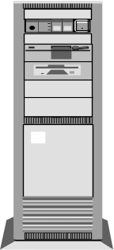

Service-Oriented Architectures
10. Introduction
retrieve service description
(how to access service ?)
    default : from provider
    alternative : from broker
access the service
provider
requestor
3 : bind
2 : find
1 : publish
Dynamic publishing
Query public/private registry
Specifies service type
Can include QoS requirements
Alternative : no registry
- direct publishing :
offline mechanism to locate service
- use HTTP GET request on service provider
webserver
registry

Slide 124

Web Service Technologies
10. Web service technology
SOAP
WSDL
“Simple Object Access Protocol”
RPC-protocol for web services
used to access remote service
“Web Services Description Language”
description of how to access web service
used to access remote service
UDDI
“Universal Description, Discovery, and Integration”
protocol to publish/find web service
through registry
XML

Slide 125
Web Service Technology
10. Web service technology
HTTP
Servlet
JSP/ASP
text protocol
not object oriented
SOAP over
HTTP/SMTP
Web service
text protocol
object oriented
IIOP
CORBA
RMI
binary protocol
object oriented

Slide 126
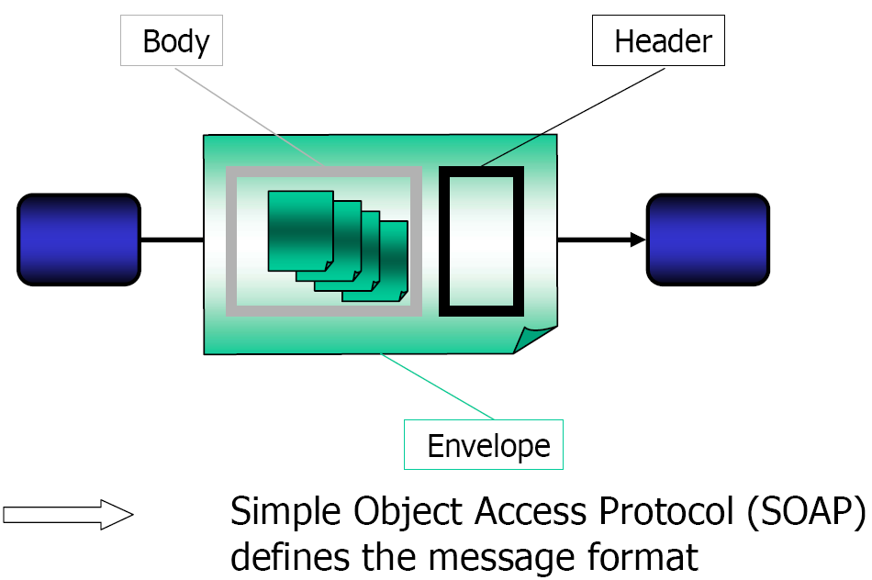
Interaction Protocol
10. Web service technology
Notes:
XML being the data format of choice for web service data exchanges, we still need an interaction protocol between client / service. This interaction protocol has been defined to be SOAP (Simple Object Access Protocol), which defines the message format, consisting of a SOAP envelope containing a header and message body. Note that other interaction protocols exist.

Slide 127
SOAP messages
10. Web service technology
SOAP envelope
Container for SOAP message
Defines relevant xml namespaces, encodings
SOAP header
SOAP block
Directives to SOAP-processor
Not always forwarded by intermediary SOAP-nodes
Header content standardized by SOAP
…
SOAP block
SOAP body
SOAP block
Payload, message data
To be processed by ultimate receiver
…
SOAP block
SOAP-processor = environment receiving/processing/forwarding SOAP-message
(e.g. J2EE application server, .NET server, …)

Slide 128
SOAP message : request example
10. Web service technology
SOAP RPC request
POST /InStock HTTP/1.1
Host: www.stock.org
Content-Type: application/soap+xml; charset=utf-8
Content-Length: nnn
<?xml version="1.0"?>
<soap:Envelope
xmlns:soap="http://www.w3.org/2001/12/soap-envelope"
soap:encodingStyle="http://www.w3.org/2001/12/soap-encoding">
<soap:Body xmlns:m="http://www.stock.org/stock">
<m:GetStockPrice>
<m:StockName>IBM</m:StockName>
</m:GetStockPrice>
</soap:Body>
</soap:Envelope>
HTTP protocol
binding
Specify namespaces
And encoding rules
RPC-specification
stock.GetStockPrice(“IBM”)

Slide 129
SOAP message : reply example
10. Web service technology
SOAP RPC reply
HTTP/1.1 200 OK
Content-Type: application/soap; charset=utf-8
Content-Length: nnn
<?xml version="1.0"?>
<soap:Envelope xmlns:soap="http://www.w3.org/2001/12/soap-envelope"
soap:encodingStyle="http://www.w3.org/2001/12/soap-encoding">
<soap:Body xmlns:m="http://www.stock.org/stock">
<m:GetStockPriceResponse>
<m:Price>34.5</m:Price>
</m:GetStockPriceResponse>
</soap:Body>
</soap:Envelope>
“return 34.5”

Slide 130
WSDL1.1
10. Web service technology
Web Services Description Language
XML grammar to specify collection of “access end points”
(1 URL specifies a single access end point)
designed to automate application-to-application interaction (or B2B interaction)
defines the communication protocol to be used at runtime
  message format
  methods to be invoked
  parameter lists, return types
  …
WSDL descriptions can be automatically generated for existing code
stub classes can be generated from WSDL descriptions

Slide 131
WSDL1.1 : document structure
10. Web service technology
<definitions>
<import>*
<types>
<schema></schema>*
</types>
<message>*
<part></part>*
</message>
<portType>*
<operation>*
<input></input>
<output></output>
<fault></fault>*
</operation>
</portType>
<binding>*
<operation>*
<input></input>
<output></output>
</operation>
</binding>
<service>*
<port></port>*
</service>
</definitions>
<definitions>
  container for service description
  global declaration of
  document scope namespaces
<import>
  similar to java-import
  (modularization of WSDL docs)
  include of namespaces (not file itself !)
<types>
  contains definition of all datatypes used in
  messages
  currently : XSD (XML Schema Definitions)
<message>
  defines message structure
  (for each part : type and name are defined)
<portType>
  specifies legal operations for web service
  endpoint (=group of actions)
  <operation> : method definition specifies
    method name
    input message
    output message
    error message

Slide 132
WSDL1.1 : document structure
10. Web service technology
<definitions>
<import>*
<types>
<schema></schema>*
</types>
<message>*
<part></part>*
</message>
<PortType>*
<operation>*
<input></input>
<output></output>
<fault></fault>*
</operation>
</PortType>
<binding>*
<operation>*
<input></input>
<output></output>
</operation>
<binding>
<service>*
<port></port>*
</service>
</definitions>
<binding>
  concrete protocol & data format spec for portType
  standard soap-bindings available
<service>
  defines URL for service endpoint
  <port> = single access point for webservice
  each port specifies
    name
    binding info
    URL of webservice (<soap:address> element)

Slide 133
WSDL1.1 : supported interactions
10. Web service technology
<operation>
Request – response
<input> before <output>
1
client
server
2
Solicit - response
<output> before <input>
1
client
server
2
One-way (asynchronous)
only <input>
client
1
server
Notification
only <output>
client
server
1

Slide 134
WSDL1.1: different styles
10. Web service technology
RPC/encoded
RPC/literal
Document/encoded (not used)
Document/literal

Slide 135
RPC/encoded
10. Web service technology
public void myMethod(int x, float y);
<soap:envelope>
<soap:body>
<myMethod>
<x xsi:type="xsd:int">5</x>
<y xsi:type="xsd:float">5.0</y>
</myMethod>
</soap:body>
</soap:envelope>
<message name="myMethodRequest">
<part name="x" type="xsd:int"/>
<part name="y" type="xsd:float"/>
</message>
<message name="empty"/>
<portType name="PT">
<operation name="myMethod">
<input message="myMethodRequest"/>
<output message="empty"/>
</operation>
</portType>
<binding .../>
<!-- ... -->
XSI types usually overhead
no easy validation
not WS-I compliant (WS-I defines interoperability rules)

Slide 136
RPC/literal
10. Web service technology
public void myMethod(int x, float y);
<message name="myMethodRequest">
<part name="x" type="xsd:int"/>
<part name="y" type="xsd:float"/>;
</message>
<message name="empty"/>
<portType name="PT">
<operation name="myMethod">
<input message="myMethodRequest"/>
<output message="empty"/>
</operation>
</portType>
<binding .../>
<!-- ... -->
<soap:envelope>
<soap:body>
<myMethod>
<x>5</x>
<y>5.0</y>
</myMethod>
</soap:body>
</soap:envelope>
no overhead from XSI types
still no easy validation
WS-I compliant

Slide 137
Document/literal
10. Web service technology
public void myMethod(int x, float y);
<types>
<schema>
<element name="xElement" type="xsd:int"/>
<element name="yElement" type="xsd:float"/>
</schema>
</types>
<message name="myMethodRequest">
<part name="x" element="xElement"/>
<part name="y" element="yElement"/>
</message>
<message name="empty"/>
<portType name="PT">
<operation name="myMethod">
<input message="myMethodRequest"/>
<output message="empty"/>
</operation>
</portType>
<binding .../>
<!-- ... -->
<soap:envelope>
<soap:body>
<xElement>5</xElement>
<yElement>5.0</yElement>
</soap:body>
</soap:envelope>
no operation name (difficult dispatching)
easy validation (soap:body can be defined in a schema)
not WS-I compliant

Slide 138
Document/literal wrapped
10. Web service technology
public void myMethod(int x, float y);
<types>
<schema>
<element name="myMethod">
<complexType>
<sequence>
<element name="x" type="xsd:int"/>
<element name="y" type="xsd:float"/>
</sequence>
</complexType>
</element>
<element name="myMethodResponse">
<complexType/>
</element>
</schema>
</types>
<message name="myMethodRequest">
<part name="parameters" element="myMethod"/>
</message>
<message name="empty">
<part name="parameters" element="myMethodResponse"/>
</message>
<portType name="PT">
<operation name="myMethod">
<input message="myMethodRequest"/>
<output message="empty"/>
</operation>
</portType>
<binding .../>
<!-- ... -->
<soap:envelope>
<soap:body>
<myMethod>
<x>5</x>
<y>5.0</y>
</myMethod>
</soap:body>
</soap:envelope>
operation name is available
easy validation (soap:body can be defined in a schema)
WS-I compliant

Slide 139
Summary WSDL styles
10. Web service technology
Use document/literal wrapped
  except: when overloaded operations
  then: use document/literal unwrapped
  however: when several methods have same signature
  then: use RPC/literal
  in case of data graphs (e.g. binary trees), literal style is not an option, prefer RPC/encoded
Ref: http://www.ibm.com/developerworks/webservices/library/ws-whichwsdl/
public void myMethod(int x, float y);
public void myMethod(int x);
public void myMethod(int x, float y);
public void myMethod(int x);
public void myOtherMethod(int x, float y);

Slide 140
UDDI
10. Web service technology
Universal Description, Discovery, and Integration
= standardized method to publish and discover information about web services
DNS-like functionality (and organization)
currently not very popular
UBR [ UDDI Business Registry]
Public operator
node
Private operator
node
replication
Public node answers
  same info
  same QoS
For all nodes
Public operator
node
Public operator
node

Slide 141
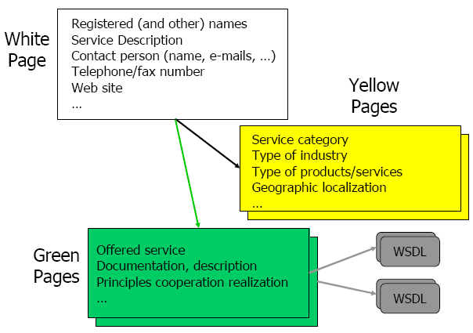
How to offer and find services?
10. Web service technology
Universal Description, Discovery and Integration (UDDI)
Standardized publishing, advertisement
Extended name server, describing interface and properties
XML Descriptor
  White page: service name, description, contact information
  Yellow page: semantics (based on standard taxonomy)
  Green page: technical specification (URL, WSDL, etc.)
Logically central, physically distributed database
Notes:
How can we now offer our web services to the world and / or find web services that deliver us the functionality that we need? The answer lies in the UDDI standard: a standardized way of publishing / advertising web services. UDDI can be seen as an extended name server that XML-describes web service interfaces and properties. The descriptor consists of three parts: the white pages, yellow pages and green pages.
The white pages hold basic contact information regarding the web service (who develops it, what is the name, how can we contact the developers, etc.). The yellow pages cover the semantics of the web service and the green pages cover the technical aspects: the URL, interface (WSDL), documentation etc. This service information repository can be seen as a logically central but physically distributed data base.

Slide 142
UDDI: the reality
10. Web service technology
UDDI is, due to non-common usage, slowly becoming an outdated standard
Web Services are increasingly being used in Business-2-Business (B2B) / Enterprise Application Integration (EAI) scenarios
  Trusted environments
  “Certainty” about service support
No widespread ‘service’ market
Not so great as a public database (Microsoft, IBM, SAP closed their test UDDI databases)
Notes:
The reality of the UDDI standard is that it is slowly becoming outdated, due to in effect almost never being used. Currently the general business public has no need for a widespread ‘service’ market, but instead opts for trusted Business-2-Business web service use scenarios, where parties trust and know each other.
Microsoft, IBM and SAP even closed their UDDI test databases.

Slide 143
Alternative to UDDI?
10. Web service technology
UDDI provides discovery for services that are always connected to the network.
  need a discovery system for sometimes connected services.
UDDI has to handle with out-of-date service entry information
  Need a discovery system for dynamically updated entries.
UDDI provides discovery for only registered services
  Need a discovery for services not exist in any central registry.
UDDI provides a central registry
  Need a discovery system which performs on distributed registries on ad hoc and managed networks
Notes:
With the downsides of UDDI in-mind, is there an alternative to this standard?
More specifically we would like to find a technology that can discover services that are only connected from time-to-time, that dynamically updates service information and that finds services that aren’t registered to a central repository.

Slide 144
WS-Discovery
10. Web service technology
Defines a multicast protocol to locate services
allows dynamic discovery of services in ad-hoc and managed networks
  discovery of temporarily-connected services providing interface to portable devices such as hand-helds, pocket pc, etc…
enables discovery of services by type and within scope
scales to a large number of endpoints, by defining a multicast suppression behavior if a service registry (discovery proxy) is available on the network
Supported by Microsoft, BEA, Intel, Canon
No internet-scale discovery, aimed at local networks
Notes:
This alternative exists under the WS-Discovery standard. WS-Discovery defines a multicast protocol to locate services. This multicast protocol is able to dynamically discover services in both ad-hoc and managed networks. It allows discovery of services by type (i.e. can specify what the services must adhere to, after which only services matching those specifications will be searched). The multicast protocol used can scale to a large number of endpoints as it automatically suppresses multicasting when a service registry is available on a network.
WS-Discovery is supported by a large number of high-profile vendors. It does not allow internet-scale discovery of services.

Slide 145
WS-Addressing
10. Web service technology
WS-Addressing defines standard ways to route a message over multiple transports or direct a response to a third party.
  Without WS-Addressing: a standard SOAP request is sent over HTTP, the URI of the HTTP request serves as the message's destination. The message response is packaged in the HTTP response and received by the client over the HTTP connection.
For example, a client application might send a request over JMS and ask to receive the response through e-mail or SMS.
To enable these kinds of applications, WS-Addressing incorporates delivery, reply-to, and fault handler addressing information into a SOAP envelope.

Slide 146
WS-Addressing example
10. Web service technology
<S:Envelope xmlns:S="http://www.w3.org/2003/05/soap-envelope"
xmlns:wsa="http://www.w3.org/2004/12/addressing">
<S:Header>
<wsa:MessageID>
http://...
</wsa:MessageID>
<wsa:ReplyTo>
<wsa:Address>http://…</wsa:Address>
</wsa:ReplyTo>
<wsa:FaultTo>
<wsa:Address>http://…</wsa:Address>
</wsa:FaultTo>
<wsa:To>http://…</wsa:To>
<wsa:Action>http://…</wsa:Action>
</S:Header>
<S:Body>
<!-- The message body of the SOAP request -->
</S:Body>
</S:Envelope>

Slide 147
WS-Addressing Endpoint references
10. Web service technology
10. Technology
<wsa:EndpointReference xmlns:wsa="..." xmlns:example="...">
<wsa:Address>http://example.com/weather</wsa:Address>
<wsa:ReferenceProperties>
<example:ServiceLevel>Basic</example:ServiceLevel>
</wsa:ReferenceProperties>
<wsa:ReferenceParameters>
<example:CityCode>NYC</example:CityCode>
</wsa:ReferenceParameters>
</wsa:EndpointReference>

Slide 148
WSDL2.0
10. Web service technology
W3C working draft since 2004, recommendation since july 2007
rarely used for the moment: WSDL 1.1 still widely used
Main differences with WSDL1.0
- support for WS-Addressing
- interface type instead of port type
- no operation overloading allowed

Slide 149
Outline
9. Introduction : Service Oriented Architectures
10.Technology building blocks
- SOAP
- WSDL
- WS-* standards
11. Java Web Services
12. Web Service Orchestration and Choreography
13. Software Integration
  - eTOM, ITIL

Slide 150
JAX WS
11. Java Web Services
Java EE 5 provides a robust platform on which web services can be built and deployed
Web service can be built either as:
  Option 1: regular Java class
  Option 2: EJB 3 stateless session bean
Option 2 allows for use of declarative transactions and security.
Advantage Option 1: can be run in a web container, no need for application container.
Both options can use annotations, definition of life cycle methods.
Option 1 requires annotation processing in an external Annotation Processing Tool (APT)
Ref: http://jax-ws.dev.java.net/jax-ws-ea3/docs/annotations.html

Slide 151
EJB as a Web Service example
11. Java Web Services
@WebService
@SOAPBinding(style = SOAPBinding.Style.DOCUMENT)
@Stateless
public class eBayBean implements eBayInterface {
@PersistenceContext private EntityManager em;
public eBayBean() {
}
@WebMethod
@WebResult(name = "bidNumber")
public Long addBid(
@WebParam(name = "User") String userId,
@WebParam(name = "Item") Long itemId,
@WebParam(name = "Price") Double bidPrice) {
return persistBid(userId, itemId, bidPrice);
}
private Long persistBid(String userId, Long itemId, Double bidPrice)
{
}
}

Slide 152
@WebService annotation options
11. Java Web Services
@ WebService {
String name() default "";
String targetNamespace() default "";
String serviceName() default "";
String wsdlLocation() default "";
String endpointInterface() default "";
String portName() default "";
};

Slide 153
@SOAPBinding annotation options
11. Java Web Services
@ SOAPBinding {
public enum Style {
DOCUMENT,
RPC
};
public enum Use {
LITERAL,
ENCODED
};
public enum ParameterStyle {
BARE,
WRAPPED
};
Style style() default Style.DOCUMENT;
Use use() default Use.LITERAL;
ParameterStyle parameterStyle() default ParameterStyle.WRAPPED;
}

Slide 154
@WebMethod annotation
11. Java Web Services
@WebService
@Stateless
public class eBayBean {
public Long addBid(..) {
}
@WebMethod(exclude = "true")
public Long persistBid(..) {
}
}

Slide 155
@WebMethod annotation options
11. Java Web Services
@WebMethod {
String operationName() default "";
String action() default "" ;
boolean exclude() default false;
};

Slide 156
@WebParam annotation
11. Java Web Services
@WebMethod
public Long addBid(
@WebParam(name = "user", mode = WebParam.Mode.IN)
String userId, ...) {
...
}

Slide 157
@WebParam annotation options
11. Java Web Services
@WebParam {
public enum Mode { IN, OUT, INOUT };
String name() default "";
String targetNamespace() default "";
Mode mode() default Mode.IN;
boolean header() default false;
String partName() default "";
};

Slide 158
@WebResult annotation + options
11. Java Web Services
@WebMethod
@WebResult(name = "bidNumber")
public Long addBid(...){}
Options:
@WebResult {
String name() default "return";
String targetNamespace() default "";
boolean header() default false;
String partName() default "";
};

Slide 159
Accessing a web service from an EJB
11. Java Web Services
import javax.xml.ws.WebServiceRef ;
@WebServiceRef(wsdlLocation=
"http://localhost:8080/eBayService/eBayBean?WSDL")
private static eBayService ebs;
public static void main(String [] args) {
try {
eBayBean ebay = ebs.geteBayBeanPort();
System.out.println("Bid Successful, BidId Received is:“
+ebay.addBid(“test", 1001, 185,0 ));
} catch (Exception ex) {
ex.printStackTrace();
}
}

Slide 160
EJB as a web service client
11. Java Web Services
@Stateless
public class AmazonOrderBean implements AmazonOrder {
@WebServiceRef(AmazonDeliveryService.class)
private AmazonDeliverySEI deliveryService;
public String checkOrderDeliverStatus(String shipId) {
...
String deliveryStatus =
deliveryService.checkDeliveryStatus(shipId);
...
}
}
NetBeans support for JAX-WS:
http://www.netbeans.org/kb/docs/websvc/jax-ws.html

Slide 161
Outline
9. Introduction : Service Oriented Architectures
10. Technology building blocks
- SOAP
- WSDL
- WS-* standards
11. Java Web Services
12. Web Service Orchestration and Choreography
13. Software Integration
  - eTOM - ITIL

Slide 162
What is the problem?
12. Orchestration and Choreography
Web service composition
  Bringing together existing web services to build more complex ones
  Orchestration e.g. WS-BPEL
Consistency of composition
  Guaranteeing consistency between behaviour delivered by Web Services and expected composition
  Choreography e.g. WS-CDL
Notes:
In this section we focus on how to build (multi-partner) business processes using different (multi-partner distributed) web services.
One of the methods used to do so can be web service orchestration (by means of for instance WS-BPEL), which aims to build complex new services by using existing web services in a controlled workflow (and coordinated by a single coordinator).
Another technology, web service choreography (by means of the WS-CDL standard) aims to look at the consistency of composing web services from multiple independent parties into a business process (with no central coordinator).

Slide 163


Choreography versus Orchestration
12. Orchestration and Choreography
Choreography | Orchestration
Distributed environment | Centralized environment
All participants are active and independent | 1 active & multiple passive participants
Collaboration | Composition
Interaction based (observable behavior) | Action based
Notes:
The differences between a web service choreography and a web service orchestration can be seen on this slide:
A web service choreography operates in a fully distributed environment, with no central coordinator, while an orchestration needs a central coordinator to control the workflow execution. In a choreography all participants are active and behaving independently from each other, while in an orchestration there is one active participant, controlling the total workflow behavior, and multiple passive participants, waiting for instructions by the active party.
Also, like in a dance, a choreograpy is fully interaction based (what matters is the total system behavior), while in an orchestration what matters is the actions undertaken as directed to by the coordinator of the orchestration.

Slide 164
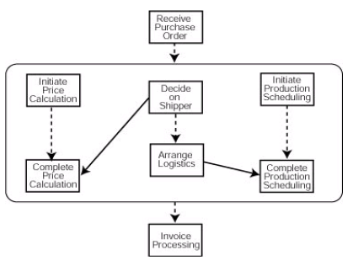
Business Process Execution Language
12. Orchestration and Choreography
Workflow definition language for describing business processes
WS-BPEL now, before BPEL4WS
Convergence of XLANG (Microsoft) and WSFL (IBM)
1st version released by IBM, Microsoft and BEA in august 2002
Version 2.0 standard since April 2007
Example workflow
Notes:
BPEL is the standard worflow definition language for describing business processes (or so called workflows) with web services. Before it was called BPEL4WS, but now, to be better aligned with the other WS-* standards, it has been renamed to WS-BPEL.
In the example we see a business workflow stating that when a purchase order is recieved, three activities need to be started: initiating a price calculation, deciding on shipper and initiating a production schedule. Once the shipper has been decided the price calculation can be completed, and logicstics can be arranged. When price calculation and production scheduling activities are finished, invoice processing can begin.

Slide 165
WS-BPEL
12. Orchestration and Choreography
Is an XML based specification language
Relates to basic Web Services via their WSDLs
BPEL itself defines a Web Service (WSDL document)
WS-BPEL process specification contains:
  Definition and role of business process participants (my process, services I rely on, client processes)
  Data / state used within the process
  Properties that enable asynchronous interaction (correlations)
  Exception handling
  Error recovery – undoing actions
  Event handlers concurrent with process itself
  Business process workflow - activities
Notes:
BPEL is an XML-based specification language that uses Web Services’ WSDL to compose new business workflows. The BPEL workflow as a whole can itself be seen as a (new) Web Service (exposing a WSDL document).
The WS-BPEL specification contains a.o.:
The definition and role of business process participants (the actual business process, the web services that are needed to implement this business process, client processes), the data (and associated state) of the process, properties that enable asynchronous calls (so called correlations).
Exception handling, error recovery and event handlers are all possible in BPEL, as are general business process workflow activities (joins, branches, etc.)

Slide 166
BPEL scenario structure
12. Orchestration and Choreography
<process>
<!– Definition and roles of process participants -->
<partnerLinks> ... </partnerLinks>
<!- Data/state used within the process -->
<variables> ... </variables>
<!- Properties that enable asynchronous interaction -->
<correlationSets> ... </correlationSets>
<!- Exception handling -->
<faultHandlers> ... </faultHandlers>
<!- Error recovery – undoing actions -->
<compensationHandlers> ... </compensationHandlers>
<!- Concurrent events with process itself -->
<eventHandlers> ... </eventHandlers>
<!- Business process flow -->
(activities)*
</process>
Notes:
The pictured XML shows the structure of a BPEL.

Slide 167
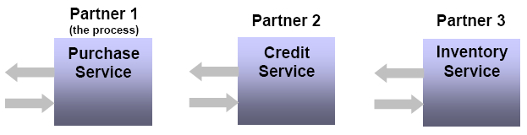
BPEL PartnerLink
12. Orchestration and Choreography
All parties the BPEL interacts with are defined by partner links
  Links to all the different WSDL-defined Web Services that a BPEL process instance interacts with
  Invoked partner links: BPEL process invokes Web Service
  Client partner link: WSDL-defined Web Services that can invoke a BPEL process
    At least one (start client)
  A Web Service can have both roles (WS-invokes BPEL and BPEL-invokes-WS)
Notes:
In the partner link section of the BPEL the different partner links are declared. Partners in this case are either web services that are invoked by the BPEL process, or links to web services which can invoke the BPEL process. The latter can be the start-client of the BPEL process, or callbacks from Web Services that have been called by the BPEL in an asynchronous way.

Slide 168
PartnerLinkType, Role, PortType
12. Orchestration and Choreography
PartnerLinkType defines the conversational relationship between two WSDL-defined partners by defining the roles played by each of the services (invoker or client) in the conversation and specifying the portType (interface) provided by each service to receive / transmit messages within the context of the conversation.
  Each partnerLinkType has one or two roles (two roles in case of asynchronous callback), and each role has one portType
  In the case of BPEL, one of the WSDL partners in the conversation will always be the central coordinator (i.e. the BPEL process!)
PartnerLinkType, roles and portType are defined in WSDL through the extensibility mechanism (out of scope)
PortType has been renamed to Interface in BPEL2.0
  BPEL2.0 not widely adopted yet (out of scope)
Notes:
A partnerLinkType characterizes the conversational relationship between two services by defining the roles played by each of the services in the conversation and specifying the portType provided by each service to receive messages within the context of the conversation. Each <role> specifies exactly one WSDL portType.

Slide 169
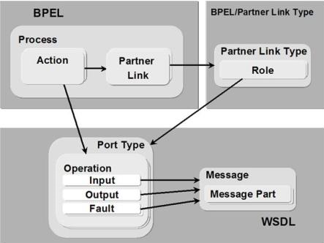
Key BPEL concepts
12. Orchestration and Choreography
Notes:
Here we show an overview of these BPEL concepts and how they relate to each other. BPEL models a business process that performs actions on partner links. The actions on these partner links (web services) are defined by partner link types and roles (invoker or client), with each role defined by a port type (which defines the method, input message, output message to be used)
Actions and partner links are defined in the BPEL, while partner link types, roles and port types are defined in the WSDL.

Slide 170
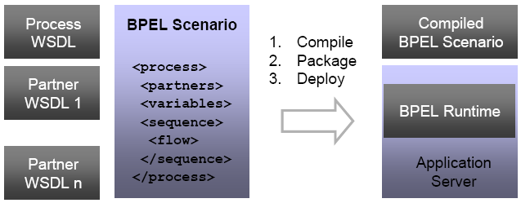
How is it executed
12. Orchestration and Choreography
Notes:
Now that we have seen some of the major features of BPEL, we show how this is executed: On the lefthand side we have the process WSDL itself and the various partner WSDLs. The BPEL scenario then describes the actual bussiness process workflow.
These are then compiled, packaged and deployed on an application server, on which the BPEL runtime takes care of executing the compiled BPEL scenario.

Slide 171
Orchestration
12. Orchestration and Choreography
BPEL: business process execution language
First version developed in 2002
Standardized through OASIS (Organisation for the Advancement of Structured Information Standards)
Used to standardize enterprise application integration
Also support in Netbeans

Slide 172
WS-Choreography
12. Orchestration and Choreography
Working group in W3C, that is tasked with defining a language for describing peer to peer interactions of services from a neutral perspective
Based on a formalized description of external observable behavior across domains
Current status
  Requirements document (published March 2004)
  Model Overview document (published April 2004),
  1st Working Draft of the WS-CDL specification (published April 2004)
  Last Call Working Draft published Dec 2004.
  Candidate Recommendation Sep 2005.
Notes:
Now that we have discussed orchestration (i.e. business process started and executed by one controlling party), we will have a look at web service choreographies.
The W3C has a working group that defines a language for describing peer to peer interactions of services when there is no central coördinator of the business workflow. A web service choreography tries to formally describe the external observable behavior, as it is exactly this overall observable behavior that defines the business process.
Currently the WS-CDL (Web Service – Choreography Description Language) specification is not yet a standard, but is still in the candidate recommendation state.

Slide 173
Orchestration vs. Choreography
12. Orchestration and Choreography
Orchestration
  Recursive Web Service Composition
  An executible business process describing a flow from the perspective and under control of a single endpoint
  Executable language (interpreted / compiled to executable) implies a centralized control mechanism
  Requires Web services
Choreography
  Establishes a global behavioral contract
  The observable public exhange of messages, rules of interaction and agreements between two or more business process endpoints
  Description language
  Choreography has no centralized control. Instead control is shared between domains
  Does not need Web Services but is targeted to deliver over them
Notes:
As a rehash of what we have seen regarding orchestration versus choreography, an orchestration is an executible business process under the control of a single endpoint. An orchestration is defined in an executable language (BPEL) that gets compiled and can be run by a BPEL runtime on an application server. Furthermore, orchestrations require the use of web services to implement endpoint activities.
A choreography on the other hand establishes a global behavioral contract. This contract specifies (in a description language: WS-CDL) the observable public exchange of messages, rules of interaction and agreements between two or more business endpoints in the choreography. Choreographies have no centralized control (otherwise it would be an orchestration) and do not require web services but are targeted to work with them.

Slide 174
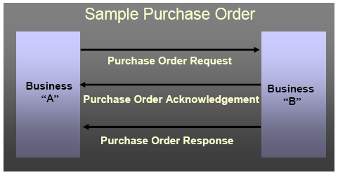
Sample Business Process
12. Orchestration and Choreography
Notes:
To give an example of a possible choreography we look at a purchase process between a business A and a business B. Business A initiates a purchase order, after which business B acknowledges that it has received the request. After processing the request Business B then passes a purchase order response message to business A.

Slide 175
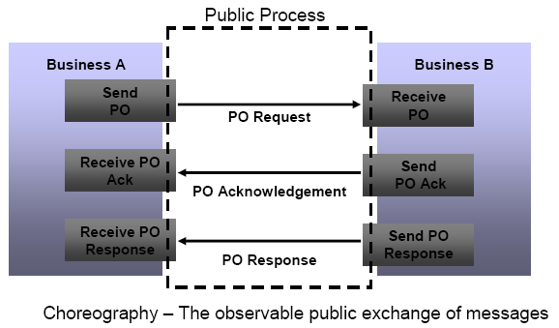
From a choreography perspective
12. Orchestration and Choreography
Notes:
If we look at this from a choreography perspective, the choreography is interested in the public observable behavior, i.e. the public exhange of messages between these two participants that leads to a global ‘state’

Slide 176
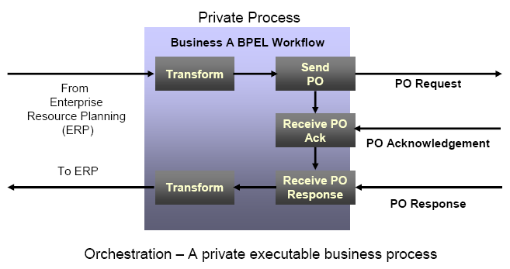
From an orchestration perspective
12. Orchestration and Choreography
Notes:
Both of the businesses in this example are internally modelled as an orchestration, in that they both execute a private business process. Note that this can still mean that the the internals of business A a BPEL workflow is executed relying on external web services, but Business A has centralized control over all processes in this workflow.

Slide 177
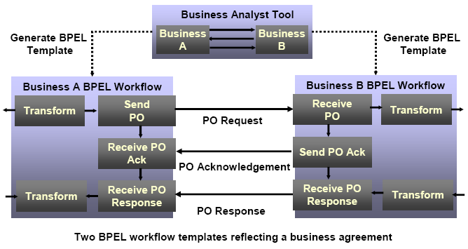
Orchestration and choreography together
Notes:
If we now look at the global picture of our example again, we see that the top layer reflects the actual business agreement between the two participants in the choreography. This business agreement is modelled as a choreography by a business analyst tool, which in turn can generate BPEL templates for both Business A and Business B. Business A and B can implement these BPEL templates (as they see fit and without having to consult each other), and, if done correctly, they can execute the choreography (i.e. if both parties adhere to the BPEL template generated by the choreography / business analyst tool).

Slide 178
Conclusion
12. Orchestration and Choreography
Orchestration and choreography are used to specify business processes
What is the benefit?
  XML specification guarantees platform independence
  Reuse of existing functionality
  Offers high-level business process view / more distinction between business process and actual implementation
  Distributed deployment
What is the problem
  Product incompatibilities
    Improving over time
  Lack of choreography tooling
    Construction of WS-CDL and automated extraction of different partner’s BPEL templates is still in research
Notes:
To conclude we can say that orchestration and choreography are used to specify complex business processes. The benefit of these technologies is that due to the fact that both are specified in XML they can be platform independent. Both give a high-level view of the business process, allowing business flow designers to focus more on the business flow and less on the service implementation details.
The problem with orchestration and choreographies is that in reality a lot of products are proving to be incompatible (i.e. Web Services that cannot communicate with each other due to being developed by different tools). Web service choreographies also suffer from a lack of good tooling i.e. atm a designer cannot automatically extract BPEL templates from a WS-CDL definition.

Slide 179
Outline
9. Introduction : Service Oriented Architectures
10.Technology building blocks
- SOAP
- WSDL
- WS-* standards
11. Java Web Services
12. Web Service Orchestration and Choreography
13. Software Integration
  - eTOM, ITIL

Slide 180
eTOM - ITIL
13. Software Integration
The eTOM (enhanced Telecom Operations Map) is a guidebook, the most widely used and accepted standard for business processes in the telecommunications industry.
Describes how to model telecom business process information and data
The eTOM model describes the full scope of business processes required by an operator, supplier, service provider, system and defines key elements and how they interact.
A common vocabulary that creates a bridge between the telecom business and IT, which then simplifies the integration of IT systems.
ITIL is an analogous standard or framework for best practices in information technology.
eTOM is an example of the effort
- common terminology
- compatible information exchange formats
required by the involved parties when defining web services for integration of their applications.
Notes:
A summary of eTOM is presented here. It describes how to model telecom business process information and data.
It is an example of the effort (common terminology and compatible information exchange formats) required by the involved parties when defining web services for integration of their applications.
ITIL (Information Technology Infrastructure Library) is an analogous initiative originating from IT industry, detailing IT business processes and common vocabulary.

