Slide 1

Chapter 4
Global state and timing
1. Physical clock synchronization
1. Hardware clocks
2. Skew and drift
3. Time standards
4. Clock synchronization
2. Logical clocks
1. Events and temporal ordering
2. Lamport clock
3. Vector clock
3. Performance metrics
1. Response time
2. Throughput

Slide 2
Why synchronization ?
Physical clock syncrhonization
  Hardware clocks
NO global state notion in a distributed system
-> no global time notion
-> how to be sure about event ordering ?
The origin of the problem
- concurrency
- inter-process communication with uncertain delay
- impossible to distinguish between failing process
and failing network link
Two flavours of time
- physical time
= real time, related to solar time
- important when connection to “real” time is needed
- logical time
= not related to solar time
- value only important for event ordering
- easier to realize (no specific hardware needed)

Slide 3
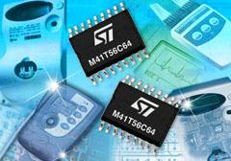
From crystal to time ...
Physical clock syncrhonization
  Hardware clocks
Crystal with stable
oscillating frequency f
interrupt
when counter==0
6
8
7
5
5
2
0
1
clock
tick
Digital counter
interupt frequency
H=60/s
8
7
7
4
4
2
1
7
interupt service
routine
Digital counter
Start value
Clock
chip
100987650100019
incrementing counter
clock value in memory
= #ms elapsed after b
-> C(t)

Slide 4
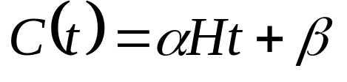
From chrystal to time ...
Physical clock syncrhonization
  Hardware clocks
Real time ?
“real” time = t
ideally : C(t) = t
C(t) can be computed from H,t and b
Clock is updated H times a second,
-> smallest measurable time interval = 1/H
= clock resolution
How to adjust clocks ?
- jumps in time dangerous (especially going back !)
- continuous adjustments preferred
- by changing α

Slide 5
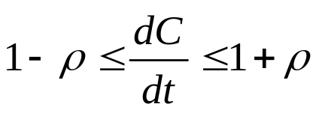
Drift : clocks get out of pace ...
Physical clock syncrhonization
  2. Skew and drift
Crystal oscillation frequency NOT stable
ambient temperature
fabrication tolerances
packaging issues (strain on the crystal)
remaining battery power
-> changing oscillation frequency
-> changing interupt frequency
ΔH/H ≈ 10⁻⁵
Drift rate = rate clock C(t) looses track with t
1+ρ_{C} = dC/dt
drift rate specification (ρ≥0)

Slide 6
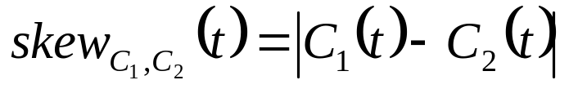
Skew : clocks keep different times ...
Physical clock syncrhonization
  2. Skew and drift
Drift rate values
“Ordinary” quartz clock : 1 s in 11-12 days -> ρ=10⁻⁶ s/s
“High precision” quartz clock: ρ=10⁻⁷ a 10⁻⁸ s/s
Clock skew
= difference in time reading between two clocks
skew
C₁(t)
C₂(t)

Slide 7

Correct clock ...
Physical clock syncrhonization
  2. Skew and drift
Correctness condition
alternatives:
bounded drift rate
monotonicity condition
Faulty clock
either
stopped ticking (crashed)
still ticks, but does not obey correctness condition

Slide 8
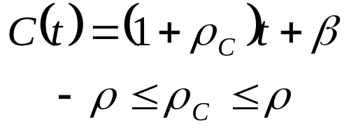
Correct clock : bounded drift rate
Physical clock syncrhonization
  2. Skew and drift
(i) Correctness condition : bounded drift rate
max drift rate = ρ
actual drift rate = ρ_{C}
Error made when measuring intervals ?
(1+ρ)(T*-T)
C(t)
(1+ρ)t+β
t
C(T*)
(1-ρ)t+β
(1+ρ_{C})(T*-T)
C(T)
(1-ρ)(T*-T)
T
T*
t

Slide 9

Correct clock
Physical clock syncrhonization
  2. Skew and drift
(i) Correctness condition : bounded drift rate
        NO jumps in clock
(ii) Monotonicity condition
=> do NOT go backward in time !
weaker than bounded drift rate condition
(iii) Hybrid condition
= monotonicity + forward jumps at sync. points

Slide 10
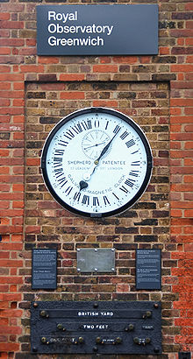
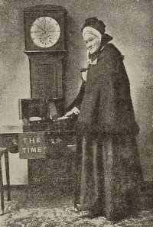
The origin of time
Physical clock syncrhonization
  3. Time standards
Historically : time used to organize everday’s life
-> time related to sun apparent movement
-> 24h = time elapsed between 2 solar culmination points
-> timekeeping by astronomers (Greenwich Mean Time)
Ruth Belville

Slide 11
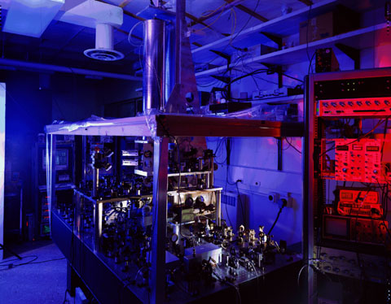
The origin of time
Physical clock syncrhonization
  3. Time standards
Take-over by physicists
-> measure oscillations of excited Ce-133 atom
-> far less cumbersome than solar measurements
-> IAT : International Atomic Time
NIST-F1 Cesium Fountain Atomic Clock
The Primary Time and Frequency Standard for the United States

Slide 12
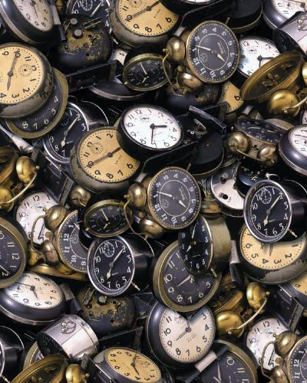
The origin of time
Physical clock syncrhonization
  3. Time standards
BUT: physicists’ time gets out of pace with astronomers’ time
-> irregularities in earth’s orbit
-> slow down of earth’s rotation
-> Need for small adjustments to keep sync. with “real” time
-> leap seconds introduced
-> when ? if skew(IAT,astronomical time) > 800 ms
UTC : Universal Coordinated Time
33 seconds
= Number of seconds that International Atomic Time (IAT) has diverged from Coordinated Universal Time (UTC) since IAT was established in 1972.

Slide 13
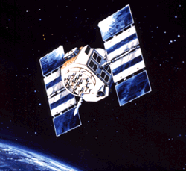
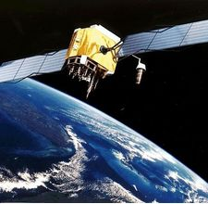
The origin of time
Physical clock syncrhonization
  3. Time standards
UTC = “real” time
How to get hold of it ?
source accuracy
land based stations 0.1 – 10 ms
satellite 1 ms
Cheap UTC chips commercially available
GPS
Galileo

Slide 14
Chapter 4
Global state and timing
1. Physical clock synchronization
1. Hardware clocks
2. Skew and drift
3. Time standards
4. Clock synchronization
A. External-Internal synchronization
B. Client-Server algorithms
1. Synchronous system
2. Asynchronous system (Christian’s algorithm)
C. Peering algorithms
1. Network Time Protocol
2. Berkeley algorithm
2. Logical clocks
3. Performance metrics

Slide 15
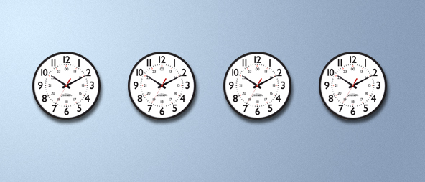
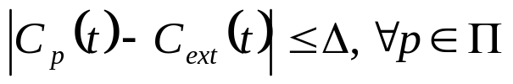
External vs. internal synchronization
Physical clock syncrhonization
  4. Clock synchronization
set of interacting processes Π
process p -> clock C_{p}(t)
External synchronization
external “authoritative”
process clock C_{ext}(t)
p_{ext}
≤Δ
Π
p₁
p₃
≤Δ
≤Δ
p₂
p₄
is externally synchronized
  ↔ All C_{p}(t) have bound skew Δ w.r.t. C_{ext}(t)

Slide 16

External vs. internal synchronization
Physical clock syncrhonization
  4. Clock synchronization
Internal synchronization
Π
p₁
≤Δ
p₃
p₂
p₄
is internally synchronized
  ↔ Skew between any 2 clocks in Π is bounded

Slide 17
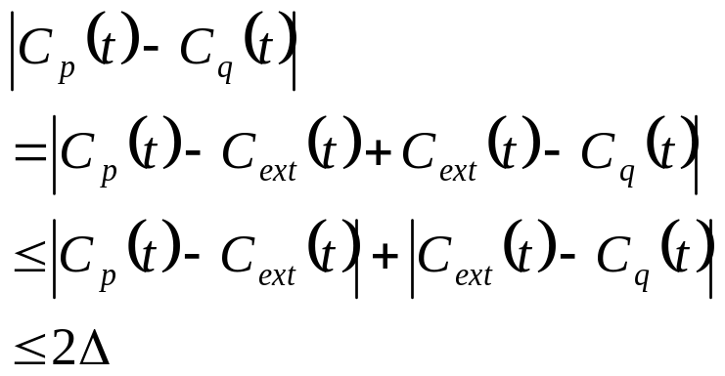
External vs. internal synchronization
Physical clock syncrhonization
  4. Clock synchronization
(Obvious) property
if Π is externally synchronized with skew Δ,
then it is internally synchronized with skew 2Δ
p_{ext}
≤Δ
Π
p
≤Δ
≤2Δ
q

Slide 18
Client-server algorithm
Physical clock syncrhonization
  4. Clock synchronization
Meaning of “client-server”
asymmetric, i.e. one process (p) has
better clock than the other (q)
Goal of synchronization
minimize |C_{p}-C_{q}|
Problem
p sends its current time reading
BUT: when arriving at q, unknown amount of time has elapsed
-> δ
Synchronous system
bounds of network delay known, i.e. δ_{max}, δ_{min}
-> puts limit on uncertainty of p send time
Asynchronous system
No info known on δ, BUT, of course δ ≤ RTT
Estimate δ≈RTT/2

Slide 19
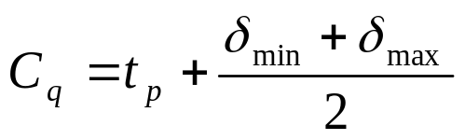
Synchronous system
Physical clock syncrhonization
  4. Clock synchronization
C_{q} <- t_{p}+δ
q
m(t_{p})
C_{p} and C_{q} should be synchronized.
p
δ ?
t_{p}
t_{p}+δ
t
δ_{min} ≤ δ ≤ δ_{max}
-> t_{p}+δ_{min} ≤ t_{p}+δ ≤ t_{p}+δ_{max}
estimate : t_{p}+δ = t_{p} + (δ_{min}+δ_{max})/2

Slide 20

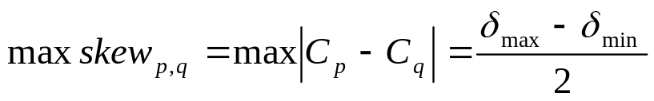
Synchronous system
Physical clock syncrhonization
  4. Clock synchronization
Synchronization error ?
C_{q} <- t_{p}+δ_{est}
δ_{est}=(δ_{min}+δ_{max})/2
q
m(t_{p})
p
δ_{min}
δ_{max}
t_{p}
t_{p}+δ
t
skew(C_{p},C_{q}) =|t_{p}+δ_{est}-(t_{p}+δ)|
= |δ_{est} – δ|
worst case occurs at the edges, i.e. for
δ=δ_{min}
δ=δ_{max}

Slide 21

Asynchronous system : Cristian’s algoritm
Physical clock syncrhonization
  4. Clock synchronization
No upper bound for one way delay δ
Suppose we have a lower bound δ_{min} (possibly 0)
Two messages involved:
- request (r)
- reply (a) : contains timestamp by time server
(1951-1999)
T_{r}
T_{a}
C_{q} <- t_{p} + δ ?
T_{a}-T_{r}
q
r
a(t_{p})
C_{p} and C_{q} should be synchronized.
p
δ ?
t_{p}
t_{p}+δ
t

Slide 22
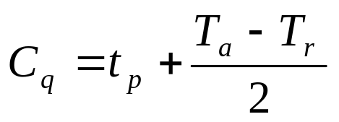
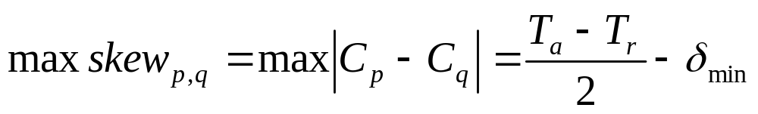
Asynchronous system : Cristian’s algoritm
Physical clock syncrhonization
  4. Clock synchronization
T_{r}
T_{a}
C_{q}= t_{p} + δ_{est} ?
T_{a}-T_{r}
q
r
a(t_{p})
p
δ_{min}
δ_{min}
t_{p}
t_{p}+δ
t
δ_{min} ≤ δ ≤ T_{a}-T_{r}-δ_{min}
δ_{est} = (T_{a}-T_{r})/2
skew=|C_{q}-C_{p}| = |t_{p}+δ_{est}-(t_{p}+δ)|
= |δ_{est}-δ|
max skew for extreme values of δ

Slide 23

Peering algorithms : NTP
Physical clock syncrhonization
  4. Clock synchronization
Network Time Protocol : asynchronous system
Clock skew between p and q : C_{q} = C_{p} + o
Two messages exchanged between p and q
request (r)
reply (a)
Time stamp info embedded in a and r
T_{i-3}
T_{i}
C_{q} <- C_{q} – o ?
q
T_{i-2}
T_{i-1}
C_{p} and C_{q} should be synchronized.
r(T_{i-3})
a(T_{i-1})
p
δ_{r} ?
δ_{a} ?
t_{p}+δ
t
total delay δ = δ_{r} + δ_{a}

Slide 24


Peering algorithms : NTP
Physical clock syncrhonization
  4. Clock synchronization
T_{i-3}
C_{q} = C_{p} + o
T_{i-3}+δ_{r}
q
r(T_{i-3})
p
T_{i}
δ_{r} ?
T_{i-2}
q
t
T_{i-1}
a(T_{i-1})
T_{i-1}+δ_{a}
p
δ_{a} ?
t_{p}+δ
t

Slide 25
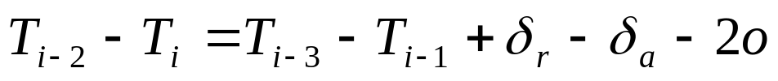
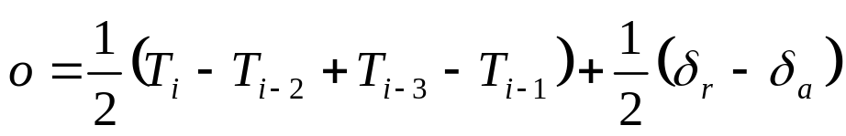
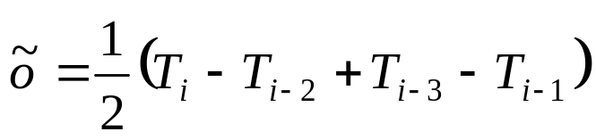
Peering algorithms : NTP
Physical clock syncrhonization
  4. Clock synchronization
some math ...
-
or
estimate o : suppose network is symmetric (δ_{r}=δ_{a})

Slide 26


Peering algorithms : NTP
Physical clock syncrhonization
  4. Clock synchronization
some more math ...
+
or

Slide 27
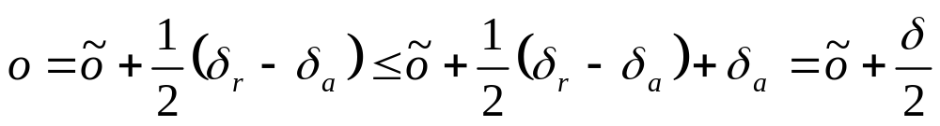
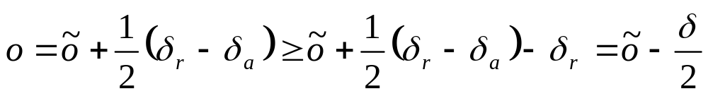
Peering algorithms : NTP
Physical clock syncrhonization
  4. Clock synchronization
synchronization error ?
maximum error = δ/2
if <o,δ> pairs are stored, o-values with lowest δ’s are most accurate

Slide 28
Peering algorithms : NTP hierarchy
Physical clock syncrhonization
  4. Clock synchronization
Primary servers are connected to UTC sources
Stratum n servers synchronized by stratum (n-1) servers
(unless unreachable ...)
Synchronization subnet
  = lowest level servers in users’ computers LAN
Stratum 1
1
Stratum 2
2
2
Stratum 3
3
3
3
Reliability through redundant paths
Scalable
Authenticates time sources

Slide 29
Peering algorithms : NTP modes
Physical clock syncrhonization
  4. Clock synchronization
Multicast
    used in high speed (low delay) LAN environment
    server multicasts time to clients
    clients assume some average delay
Procedure call
    cf. Christian’s algorithm
    better accuracy obtained
Symmetric
    Peering servers execute P2P algorithm
    collect 8 <o,δ> pairs
    optimal o based on minimal δ
    Used to achieve high accuracy
NTP accuracy : 1 - 50 ms

Slide 30
Peering algorithms : Berkeley algorithm
Physical clock syncrhonization
  4. Clock synchronization
Peering processes elect time server
Server (master) actively polls its clients (slaves)
poll for slave time t_{slave},
using Christian’s algorithm, measure RTT_{slave}
compute average time value, but
      neglect slaves with RTT_{slave} > RTT_{max}
      if |t_{avg} – t_{slave}| > ε -> remove t_{slave} from set
      send adjustment (t_{slave} – t_{avg}) to slave
      (removes uncertainty of sending new time message)
    elect new master if old one fails

Slide 31
Chapter 4
Global state and timing
1. Physical clock synchronization
1. Hardware clocks
2. Skew and drift
3. Time standards
4. Clock synchronization
2. Logical clocks
1. Events and temporal ordering
2. Lamport clock
3. Vector clock
3. Performance metrics

Slide 32
Event ordering
2. Logical clocks
  1. Events and temporal ordering
Logical clock
goal : given two events p and q, happening in different processes
which one happened first ?
Distributed system Π={p₁, ... , p_{N}}
Event is
  change state in one of Π’s processes
  send message to process
  receive message from process
change
send
receive
p₂
p₁
p₀
t

Slide 33
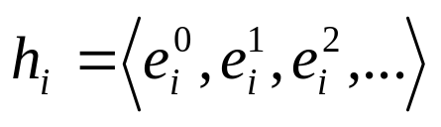
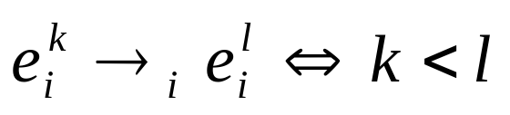
Event ordering within one process
2. Logical clocks
  1. Events and temporal ordering
... is easy !
local clock can time stamp events
Define “→_{i}” as process local happened-before relation
for events happening in p_{i}
Define h_{i} event history of process p_{i}
process local
logical clock
h₂
e₂⁰
e₂¹
e₂²
p₂
e₁⁰
e₁¹
e₁²
e₁³
e₁⁴
e₁⁵
p₁
e₀⁰
e₀¹
e₀²
e₀³
e₀⁴
e₀⁵
p₀
t

Slide 34
Towards global event ordering
2. Logical clocks
  1. Events and temporal ordering
events happened before real time T
events in Π
h₂
e₂⁰
e₂¹
→₂
→_{i} only ordering in h_{i}
global ordering “→” ?
e₂²
h₁
e₁¹
?
e₁⁰
e₁⁴
e₁²
h₀
e₁⁵
e₁³
e₀¹
e₀⁰
e₀²
e₀⁴
e₀³

Slide 35
Towards global event ordering
2. Logical clocks
  1. Events and temporal ordering
Common sense for →
if both events belong to same process
global ordering coincides with local ordering
a →_{i} b => a → b
2. sending a message (s) happens before receiving (r)
  s → r
→ is transitive
(a → b) AND (b → c) => (a → c)
“p → q” if connected through a chain of events

Slide 36
Towards global event ordering
2. Logical clocks
  1. Events and temporal ordering
e₂⁰
e₂¹
e₂²
p₂
e₁⁰
e₁¹
e₁²
e₁³
e₁⁴
e₁⁵
p₁
e₀⁰
e₀¹
e₀²
e₀³
e₀⁴
p₀
t
e₀⁰ → e₂²
e₂⁰ → e₀⁵

Slide 37
Towards global event ordering
2. Logical clocks
  1. Events and temporal ordering
Concurrent events
if no chain of events links e and e’
e || e’
⬄ NOT(e → e’) AND NOT(e’ → e)
“e and e’ happen concurrently”
Causality ?
e → e’ ≠> e causes e’
e → e’ => e’ DOES NOT cause e
“→“ : potential causal ordering
How to easily determine if a chain of events connects e and e’ ?
we need a clock ...

Slide 38
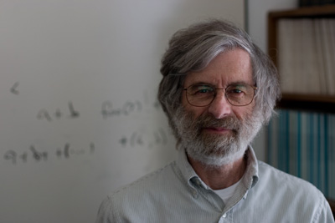
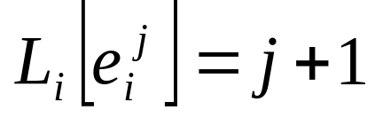
A scalar clock : Lamport clock
2. Logical clocks
  2. Lamport clock
Each process p_{i} maintains a scalar L_{i}, initial value 0
L_{i} increases monotonically
L_{i} updated just before event is timestamped
if NO communication between processes
L_{i} is incremented at each event occurence
L₂
1
2
3
p₂
e₂⁰
e₂¹
e₂²
L₁
1
2
3
4
5
6
p₁
e₁⁰
e₁¹
e₁²
e₁³
e₁⁴
e₁⁵
L₀
1
2
3
4
5
6
p₀
e₀⁰
e₀¹
e₀²
e₀³
e₀⁴
e₀⁵
t

Slide 39

Communicating processes
2. Logical clocks
  2. Lamport clock
In case of communication
L_{q}
L_{q}[e]
L_{q}[r] ?
L_{q}[r]+1
q
e
r
p
s
L_{p}
L_{p}[s]-1
L_{p}[s]
L_{p}[s]+1
t
e → r => L_{q}[r] > L_{q}[e]
s → r => L_{q}[r] > L_{p}[s]

Slide 40
Algorithm
2. Logical clocks
  2. Lamport clock
Algorithm : Lamport Clock
Initialize all L_{p} to 0
Increment L_{p} just before each event is handled in process p
When message is sent from process p,
send event is time stamped using 2.,
time stamp L_{p}[s] is sent along with the message.
When a message is received at process q:
new local clock is computed: L_{q} ← max(L_{p}[s], L_{q})+1
receive event is time stamped using this clock value

Slide 41
Example
2. Logical clocks
  2. Lamport clock
L₂
1
2
5
6
p₂
e₂⁰
e₂¹
e₂²
e₂³
L₁
1
2
3
4
5
6
p₁
e₁⁰
e₁¹
e₁²
e₁³
e₁⁴
e₁⁵
L₀
1
2
3
4
7
p₀
e₀⁰
e₀¹
e₀²
e₀³
e₀⁵
t

Slide 42


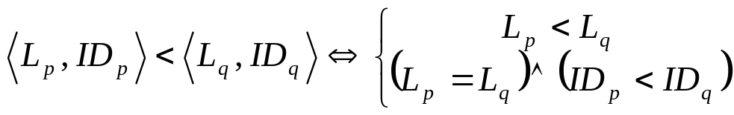
Interpretation
2. Logical clocks
  2. Lamport clock
No guarantee for potential causal ordering !
But
No total ordering on simple Lamport clock
(clock values can be equal for different events)
Relation R is total iff
i) R is antisymmetric: aRb AND bRa => a=b
ii) R is transitive : aRb AND bRc => aRc
iii) R is total : aRb OR bRa
Possible extension :
allocate (numeric) ID to each process
define ordering on <L,ID>

Slide 43
Interpretation
2. Logical clocks
  2. Lamport clock
Lamport clock just keeps track of the maximum number of events
seen at a process from any process in Π
events in Π
h₂
happened
before e₁²
L=5
e₂⁰
e₂¹
e₂²
h₁
e₁¹
e₁⁰
e₁⁴
e₁²
h₀
e₁⁵
e₁³
e₀¹
e₀⁰
e₀²
e₀⁴
e₀³
happened
before e₀⁴
L=6
The events seen before e₀⁴ are not necessarily a superset
of those seen by e₁² !!!
e₁² || e₀⁴

Slide 44
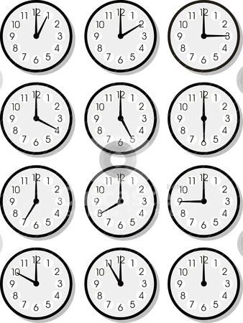
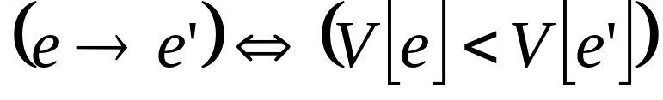
Vector clocks
2. Logical clocks
  3. Vector clock
Goal
provide guarantee for potential causal ordering
based on clock value
How ?
Keep track of the number of events seen from
each process individually
-> Each process has a vector V_{p} of N elements
Interpretation
If an event (e’) has a clock value, indicating that is has seen
more events from every process than another event (e)
THEN we are sure that e → e’

Slide 45
Algorithm
2. Logical clocks
  3. Vector clock
Algorithm : Vector Clock
1. Intialize V_{p}=0
2. Increment V_{p}[p] just before event is time stamped in
process p:
V_{p}[p] ←V_{p}[p]+1
3. When process p sends message, p sends complete vector
4. When process q receives a message
V_{q}[i] ← max(V_{q}[i],V_{p}[i])
Increment V_{q} according to 2.
Timestamp the receive event with V_{q}

Slide 46
Example
2. Logical clocks
  3. Vector clock
V₂
<0,0,1>
<0,0,2>
<1,4,3>
<1,4,4>
p₂
e₂⁰
e₂¹
e₂²
e₂³
V₁
<0,1,0>
<0,2,0>
<1,3,0>
<1,4,0>
<1,5,0>
<1,6,0>
p₁
e₁⁰
e₁¹
e₁²
e₁³
e₁⁴
e₁⁵
V₀
<1,0,0>
<2,0,0>
<3,0,0>
<4,0,0>
<5,4,4>
p₀
e₀⁰
e₀¹
e₀²
e₀³
e₀⁵
t

Slide 47
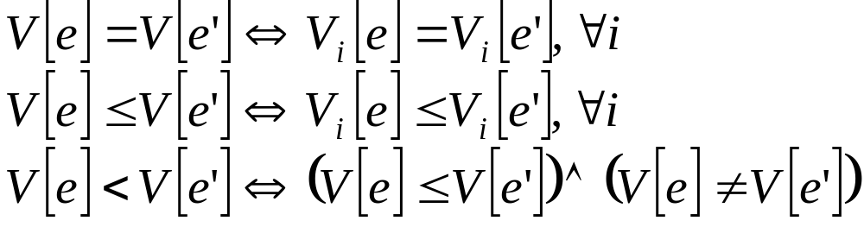
Remarks
2. Logical clocks
  3. Vector clock
< ???
Drawbacks
  more data exchanged
  number of processes needs to be known

Slide 48
Chapter 4
Global state and timing
1. Physical clock synchronization
2. Logical clocks
3. Performance Metrics
3.1 Response time
3.2 Throughput

Slide 49


Performance Metrics
3. Performance Metrics
Process n₁
Process 2
Process 1
Process n₂
Process 2
Process 1
Request
Response
Process n₄
Process 2
Process n₃
Process 1
Process 2
Process 1
Response Times
Throughput

Slide 50
Performance Metrics
3. Performance Metrics
Response Time
  as a function of the number of simultaneous requests
Throughput
  =max number of simultaneous requests per second
Average
Variance
Worst case
Best case

Slide 51
Throughput
3. Performance Metrics
Average
Response
Time
Maximum
response time
throughput
Offset response time
Number of simultaneous requests

Slide 52
Response Time
3. Performance Metrics
client
server
Composed of :
Tsubm : submission time (+ marshalling)
Tforw : forward transmission time
Twait : time spent in queue before a serving thread can be created
Tproc, invoc : dispatch request + create thread from thread pool + demarshalling
Tproc : server processing time
Tproc, ret : return processing times (marshalling)
Tbackw: backward transmission time
Trec : reception time (+ demarshalling)
1 client / 1 server

Slide 53
Response Time
3. Performance Metrics
r = Object.invoke (…);
Tsubm
Tforw
Twait
Tproc, invoc
response time
Tproc
Tproc, ret
Tbackw
Trec
client
server

Slide 54

Tforw, Tbackw
3. Performance Metrics
Is the required time for sending all packets or frames to the destination host
Packet/frame delay is the sum of delays on each subnetwork link traversed by the packet/frame
link delay
packet delay

Slide 55
Link Delay
3. Performance Metrics
To:
Via:
Y
Output 3
Z
Output 2
Z
Propagation delay
Y
Transmission delay
Processing delay
  Queuing delay

Slide 56
Link Delay Components
3. Performance Metrics
Processing delay
  Delay between the time the packet/frame is correctly received at the head node of the link and the time the packet is assigned to an outgoing link queue for transmission
Queuing delay
  Delay between the time the packet/frame is assigned to a queue for transmission and the time it starts being transmitted
Transmission delay
  Delay between the times that the first and last bits of the packet/frame are transmitted
Propagation delay
  Delay between the time the last bit is transmitted at the head node of the link and the time the last bit is received at the tail node

Slide 57
Twait
3. Performance Metrics
Server
Process
Tproc, invoc + Tproc + Tproc, ret
Twait = time spent in queue before a serving thread can be created
Cfr modelling packet queuing and transmission time
Important term in the response time

