Slide 1
Chapter 2: Middleware
1. Situating Middleware
2. Communication between distributed objects
3. Remote procedure call
4. Java RMI
5. CORBA RMI
6. Middleware Services

Slide 2
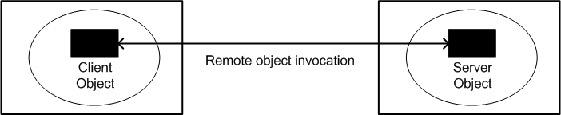
Remote invocation

Slide 3
Remote invocation: requires …
creating sockets
converting arguments to bit stream
interpreting received bit stream
interpreting received bit stream
converting return values, exceptions to bit stream
fault tolerance measures
multi-threading
closing sockets
client
server

Slide 4
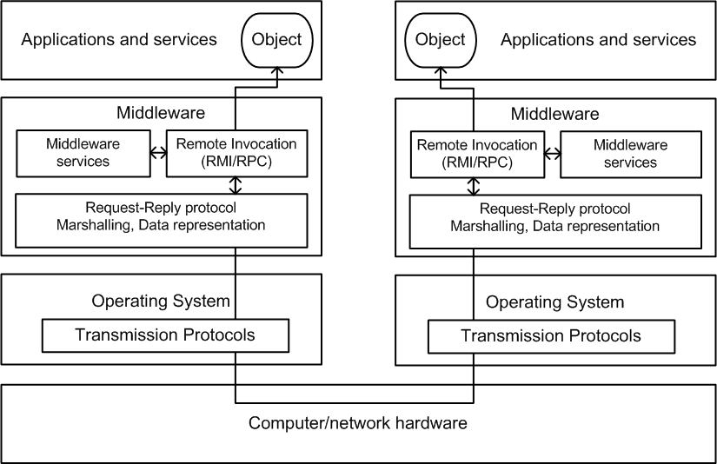
Middleware: positioning

Slide 5
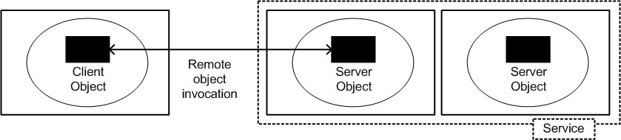
Remote (service) invocation

Slide 6
Local and remote invocations
A
B
C
D
E
remote invocation
local invocation
Local invocation Remote invocation
Use Object Reference Use Remote Object Reference
Any public method Limited access, remote interface

Slide 7
Invocation: syntax
The transparency argument
Make invocation syntax similar to local invocation, hiding:
locate/contact remote object
marshalling
fault tolerance measures
communication details (sockets)
But ...
Not everything should be hidden ...
programmer should know object is remote (network latency !) !
Typical approach
same invocation syntax (but catch exceptions ...)
object interface reflects remoteness

Slide 8
Remote interface : Java RMI example
import java.rmi.*;
public interface UpperServerInterface extends Remote {
String toUpper(String s) throws RemoteException;
String getServerName() throws RemoteException;
}
UpperServerInterface.java

Slide 9
Remote object references
purpose : unique ID for objects in distributed system
uniqueness over time
uniqueness over space
Remote
object
Host : Internet Address
Process : Port number + process creation time
Object : object number
Object type : remote interface
IP-address
Port number
Creation time
Object number
Interface
32
32
32
32
?

Slide 10
Interface Definition Language (IDL)
Some facts ...
purpose : specify remote interfaces in a language neutral way
standardized in 1990
uses C++-like syntax (C++ has no interface construct ...)
heavily used in CORBA (Common Object Request Broker Architecture)
Syntax
keyword usage
interface -> specifies interface name
attribute -> automatically make getters/setters
in -> input parameter (read)
out -> output parameter (out)
inout -> input & output
raises -> throwing exceptions
Object -> supertype of all IDL types
any -> anything can be passed (void*)
readonly -> no setter, only getter for this attribute
module -> groups interfaces and types in own name space (use with :: operator)

Slide 11
IDL type system
built-in types
short unsigned short
long unsigned long
float double
char
boolean octet
any
use typedef-construct to extend IDL-types
inheritance supported on interface level
C++ syntax
support for multiple inheritance

Slide 12
IDL example
#ifndef __ECHO_IDL__
#define __ECHO_IDL__
interface echo {
string echoString(in string mesg);
long times_called();
};
#endif
echo.idl

Slide 13
More advanced IDL example
Whiteboard.idl
struct Rectangle{ long width;
long height;
long x;
long y;
};
struct GraphicalObject {
string type;
Rectangle enclosing;
boolean isFilled;
};
interface Shape {
long getVersion() ;
GraphicalObject getAllState() ; // returns state of the GraphicalObject
};
typedef sequence <Shape, 100> All;
interface ShapeList {
exception FullException{ };
Shape newShape(in GraphicalObject g) raises (FullException);
All allShapes(); // returns sequence of remote object references
long getVersion() ;
};
Notes:
differs from Java in that Java has classes but IDL does not.
CORBA must define anything that will be passed as argument or returned as result.
in Java the argument types are classes which can be defined in the language.

Slide 14
IDL module
Modules allow interfaces and associated definitions to be grouped.
A module defines a naming scope.
module Whiteboard {
struct Rectangle{
...} ;
struct GraphicalObject {
...};
interface Shape {
...};
typedef sequence <Shape, 100> All;
interface ShapeList {
...};
};

Slide 15
Chapter 2: Middleware
1. Middleware situation
2. Communication between distributed objects
1. Invocation semantics
2. RMI-architecture
3. Request-Reply protocol
4. Marshalling
3. Remote procedure call
4. Java RMI
5. CORBA RMI
6. Middleware Services
15

Slide 16
Fault tolerance
Techniques:
1. Retry-request message
2. Duplicate request filtering
3. Retransmission of results
3.1 Re-execute call
3.2 History table of results - Retransmit reply
determines
Invocation semantics:
1. Maybe
2. At-least-once
3. At-most-once
( Java RMI : at-most-once, CORBA : at-most-once or maybe Sun RPC : at-least-once )

Slide 17
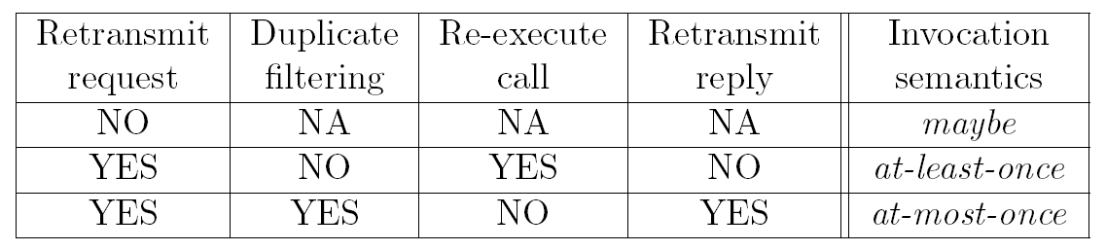
Invocation semantics
( Java RMI : at-most-once,
CORBA : at-most-once or maybe,
Sun RPC : at-least-once )

Slide 18
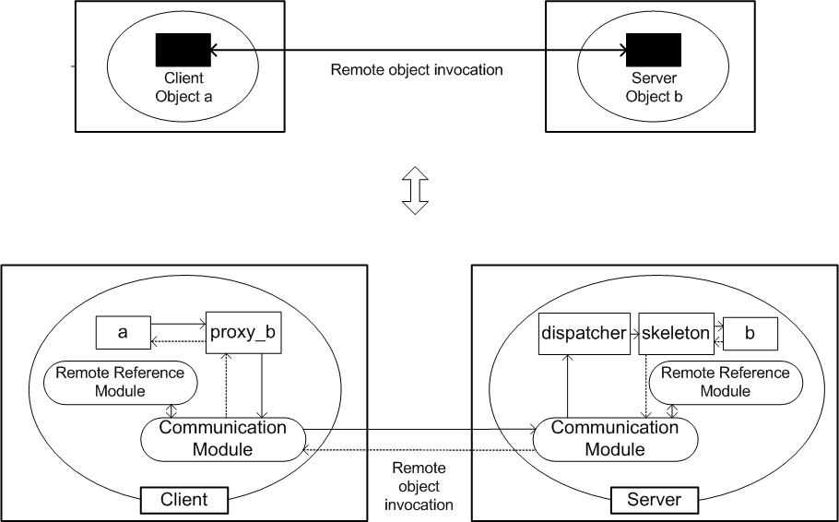
RMI architecture

Slide 19
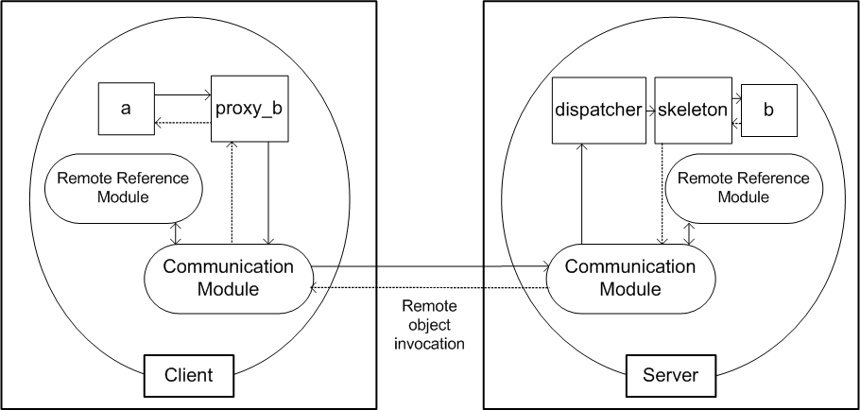
RMI architecture

Slide 20
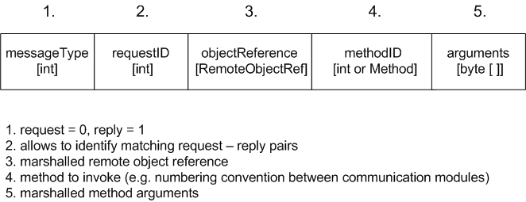
Request-Reply protocol
Runs in the communication module
Purpose
send message to server object
send back return value or exception info to requestor
enforce appropriate invocation semantics
Message format:

Slide 21
RR protocol: Duplicate filtering algorithm
if duplicate request arrives (check client + requestID)
discard if request handling still in process
if request already executed
re-execute (idempotent operations)
retransmit reply (keep history)
scaling of history table ?
- timeout (FIFO)
- interpret new request from same client
as acknowledgement

Slide 22
Marshalling
= transform object in memory to bitstream
Object-to-object communication
RMI software
proxy
skeleton
Byte-oriented communication
Options
marshalling using external standard = External Data Representation e.g. CORBA’s common data representation (CDR) Java serialization
marshalling using sender standard AND send this standard along

Slide 23
Java standard serialization
class implements Serializable interface
writing create ObjectOutputStream (out)
call out.writeObject(<object>)
reading
create ObjectInputStream (in)
call in.readObject()
cast to specific class (result is of type Object)
BUT : class file must be reachable by virtual machine !
Notes:
Standard serialization is very simple (the mechanism is quite powerful and well designed !). It suffices to implement the interface Serializable, creating appropriate input/output streams (ObjectInputStream and ObjectOutputStream respectively) and calling the read/write methods (readObject() and writeObject).
Implementing the Serializable interface literally involves nothing : the interface is empty and only serves as a marker for serializability.
When reading a serialized object, one must ensure that the “class”-file is reachable by the JVM (this is logical : only data is serialized – methods are found in the class file).

Slide 24
Java Serialization
Special care when:
1. static attributes
2. attribute contains reference to object of another class
3. attribute marked by transient keyword
4. update of serialized object and serialize again to same stream

Slide 25
RMI: Binding service
disadvantages of remote object references
no logical meaning
direct reference to physical location
server might crash -> automatic failover to other server ?
object might migrate ?
load balancing through replication not possible
binding service =
registry of remote objects reference
<-> textual name mappings
Server registers remote objects [1]
Client performs lookup [2]
Binding service
2
1
a
3
b
client
server

Slide 26
Chapter 2: Middleware
1. Situating middleware
2. Communication between distributed objects
3. Remote procedure call
1. RPC architecture
2. SUN RPC details
3. Example : date service
4. Java RMI
5. CORBA RMI
6. Middleware Services
26

Slide 27
RPC History
= non OO version of RMI
“RMI for C programs”
“invented” in 1976 (!), IETF RFC 707
popular implementation “SUN RPC”
(official name : ONC RPC (Open Network Computing)
competing implementations not always compatible !
programming language : mostly C
used to implement Network File System (NFS)

Slide 28
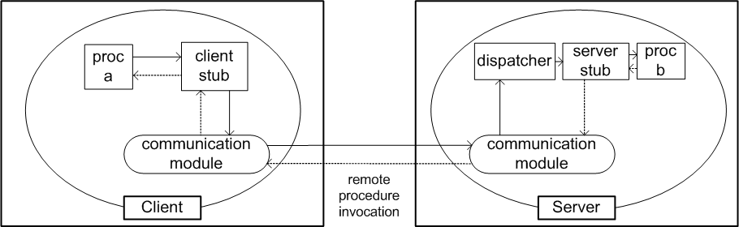
SUN RPC Architecture
no remote reference module
dispatcher selects function stub at server side
client procedure stub = RMI proxy
server procedure stub = RMI skeleton
stubs can be generated from service interface definition

Slide 29
Details
marshalling : external data representation (XDR, RFC 1832)
interface compiler : rpcgen
binding service : portmapper
Steps for developing RPC-program
Interface definition (XDR)
procedures have only 1 argument -> use C-structs
additional keywords:
program logical grouping of procedures
version version control
2. Compile XDR-file with rpcgen
-> client stub procedure
-> server main procedure, dispatcher, server proc stubs
-> XDR marshalling and unmarshalling procedures
Implement application logic (client and server proc’s)
perform RPC in client code
clnt_create(hostname,program,version) returns handle
clnt_destry(handle) matching closing procedure
5. compile + run

Slide 30
Date example
(credits: Unix Networking, Stevens)
date.x
/*
* date.x Specification of the remote date and time server
*/
/*
* Define two procedures
* bin_date_1() returns the binary date and time (no arguments)
* str_date_1() takes a binary time and returns a string
*
*/
program DATE_PROG {
version DATE_VERS {
long BIN_DATE(void) = 1; /* procedure number = 1 */
string STR_DATE(long) = 2; /* procedure number = 2 */
} = 1; /* version number = 1 */
} = 0x31234567; /* program number = 0x31234567 */
Start numbering procedures at 1 (procedure 0 is always the ``null procedure''.)
Program number is defined by the user. Use range 0x20000000 to 0x3fffffff.
Provide a prototype for each function.

Slide 31
Date example : server side
dateproc.c
/*dateproc.c remote procedures; called by server stub */
#include <rpc/rpc.h> /* standard RPC include file */
#include "date.h" /* this file is generated by rpcgen */
/*Return the binary date and time*/
long *bin_date_1()
{
static long timeval; /* must be static */
timeval = time((long *) 0);
return(&timeval);
}
/*Convert a binary time and return a human readable string*/
char **str_date_1(long *bintime)
{
static char *ptr; /* must be static */
ptr = ctime(bintime); /* convert to local time */
return(&ptr);
}
No main() routine in server code.
Extra level of indirection. bin_date() does not return a long, but long*.
return variable needs to be declared static

Slide 32
Date example : client side
rdate.c
/* rdate.c client program for remote date program */
#include <stdio.h>
#include <rpc/rpc.h>
/* standard RPC include file */
#include "date.h" /* this file is generated by rpcgen */
main(int argc, char *argv[]) {
CLIENT *cl; /* RPC handle */
char *server;
long *lresult; /* return value from bin_date_1() */
char **sresult; /* return value from str_date_1() */
if (argc != 2) {
fprintf(stderr, "usage: %s hostname\n", argv[0]); exit(1);
}
server = argv[1];
/* Create client handle */
if ((cl = clnt_create(server, DATE_PROG, DATE_VERS, "udp")) == NULL) {
/*can't establish connection with server */
clnt_pcreateerror(server);
exit(2);
}
/*... */
}

Slide 33
Date example : client side
rdate.c
/* ... */
/* First call the remote procedure "bin_date". */
if ( (lresult = bin_date_1(NULL, cl)) == NULL) {
clnt_perror(cl, server); exit(3);
}
printf("time on host %s = %ld\n",server, *lresult);
/* Now call the remote procedure str_date */
if ( (sresult = str_date_1(lresult, cl)) == NULL) {
clnt_perror(cl, server);
exit(4);
}
printf("time on host %s = %s", server, *sresult);
clnt_destroy(cl); /* done with the handle */
exit(0);
}
client calls client stubs (_1) suffix
close handle after use !

Slide 34
Chapter 2: Middleware
1. Situating middleware
2. Communication between distributed objects
3. Remote procedure call
4. Java RMI
1. Philosophy and design choices
2. Example
5. CORBA RMI
6. Middleware Services
34

Slide 35
Java RMI : philosophy
Java-only technology
alternatives : CORBA, SOAP
Remote invocation semantics identical to local ones BUT :
client knows invocation is remote (MUST catch RemoteException)
server object MUST implement Remote interface
Terminology
client-side RMI-component (proxy) : stub
server-side RMI-component : skeleton
no dispatcher per class (single generic dispatcher)
binder : RMIregistry (1 instance on every server computer)
stubs and skeletons automatically generated by RMI-compiler rmic

Slide 36
Java RMI : Code download
Automatic code download !
1 : b:B ?
a
b:B
4
2
B_stub : Class
B_stub : Class
b_stub : B_stub
3
server
client
Easy to keep clients and servers synchronized (same version)
Security risk
Specialized security limitations for downloaded classes
Implemented in RMISecurityManager()

Slide 37
Java RMI : Parameter passing
local invocation
pass by reference
remote invocation
remote objects : pass by reference
(remote object reference)
non-remote objects : pass by value
make object COPY (MUST be serializable)
send copy to other side

Slide 38
Java RMI : Remote interface
extends java.rmi.Remote
all methods throw java.rmi.RemoteException
has public visibility
import java.rmi.*;
public interface MyRemoteInterface extends Remote {
int getData() throws RemoteException;
MyRemoteInterface getNewObject() throws RemoteException;
String getMessage(int n) throws RemoteException;
}

Slide 39
Java RMI : Remote objects
extend
java.rmi.server.UnicastRemoteObject
or java.rmi.server.Activatable
implement desired remote interface
import java.rmi.*;
Import java.rmi.server.UnicastRemoteObject;
public class MyServer extends UnicastRemoteObject implements MyRemoteInterface {
// …
public int getData() throws RemoteException {/* … */}
public MyRemoteInterface getNewObject() throws RemoteException {/* … */}
public String getMessage(int n) throws RemoteException {/* … */}
}

Slide 40
Java RMI : Registry
RMI registry must run on every server computer maps String <-> remote object reference String : //computerName:port/objectName accessed through the class java.rmi.Naming
server methods (registration of objects)
public void bind(String name, Remote obj)
public void unbind(String name, Remote obj)
public void rebind(String name, Remote obj)
client methods (lookup of server objects)
public Remote lookup(String name)
public String[ ] list()
(returns all names bound in registry)

Slide 41
Server Remote Interface
put String to upper case remotely
import java.rmi.*;
public interface UpperServerInterface extends Remote {
String toUpper(String s) throws RemoteException;
String getServerName() throws RemoteException;
}

Slide 42
Example : Server Object
import java.rmi.*;
import java.rmi.server.*;
public class UpperServer extends UnicastRemoteObject
implements UpperServerInterface {
private String name;
public UpperServer(String n) throws RemoteException {
name=n;
}
public String toUpper(String s) {
return "Server : "+name+" : "+s.toUpperCase();
}
public String getServerName() {
return name;
}
}

Slide 43
Example : Server program
import java.rmi.*;
import java.rmi.server.*;
import java.net.*;
public class UpperServerProgram {
public static void main(String[] args) {
if(System.getSecurityManager()==null)
System.setSecurityManager(new RMISecurityManager());
for(int i=0;i<args.length;i++)
registerServer(args[i]);
}
public static void registerServer(String s) {
try {
UpperServer server=new UpperServer(s);
Naming.rebind(s,server);
System.out.println("Server <"+s+"> running ...");
} catch(Exception e) {
System.err.println("Failing starting server : "+s+e);
}
}
}

Slide 44
Example : Client program
import java.rmi.*;
import java.rmi.server.*;
public class UpperClient {
public static void main(String[] args) {
System.setSecurityManager(new RMISecurityManager());
UpperServerInterface server=null;
try {
server = (UpperServerInterface)
Naming.lookup("rmi://localhost/"+args[1]);
System.out.println("Reply from server : "+
server.toUpper(args[0]));
} catch(RemoteException e) {System.err.println("Remote exception : "+e);
} catch(Exception ee) {System.err.println(ee);
}
}
}

Slide 45
Java RMI : a Client recipe
Create and install RMISecurityManager
Lookup remote object
(specify host, port number, textual representation of server object)
3. Perform remote invocations, catching remote exceptions

Slide 46
Java RMI : a Server recipe
Remote interface
Must be public
Must extend java.rmi.Remote
Each method must throw java.rmi.RemoteException
Remote objects type : use interface type
Remote Server object
Implement Remote interface
Extend java.rmi.server.UnicastRemoteObject
Constructor must throw RemoteException
Remote Server program
Create and install RMISecurityManager
Create server object
Register at least one server object

Slide 47
Chapter 2: Middleware
1. Situating Middleware
2. Communication between distributed objects
3. Remote procedure call
4. Java RMI
5. CORBA RMI
1. CORBA architecture
2. Designing a CORBA application
6. Middleware Services
47

Slide 48
Situating CORBA
Socket Interface:
no concept of methods, objects
no services
support for multiple programming languages
JAVA RMI/ C RPC
concept of methods, objects
services:
Binding service
Activation Service
single programming language
Notes:
In 1989, the need was generally recognized in industry for a middleware that allows applications to communicate irrespective of their programming language and that offers all required middleware services. Designing distributed application based on low level socket handling indeed also for support of multiple programming languages (client and server can be written in a totally different programming language). However, distributed application design through sockets is not very flexible as no middleware services are available for the developer. In the case of RPC or Java RMI, there is only support for a single programming language and the support for middleware services is limited (for instance, Java RMI offers a Binding service, Activation Service, and a “light” Persistent object storage service).

Slide 49
CORBA: Basic Idea
Need for middleware that allows applications to communicate irrespective of their programming language and that offers all required services
Recognized by OMG in 1989
OMG = Object Management Group
Industry Group of over 800 participants
Their goal : design middleware that allows applications to communicate irrespective of (i) their programming language, (ii) their hardware and software platforms and (iii) the networks they communicate over.
Notes:
The OMG (Object Management Group) is an industry Group of over 800 participants, including the most important software vendors. In 1989, the recognized the need for a middleware that allows applications to communicate irrespective of (i) their programming language, (ii) their hardware and software platforms and (iii) the networks they communicate over. Their goal was to develop a common standard to be used by all participating companies.

Slide 50
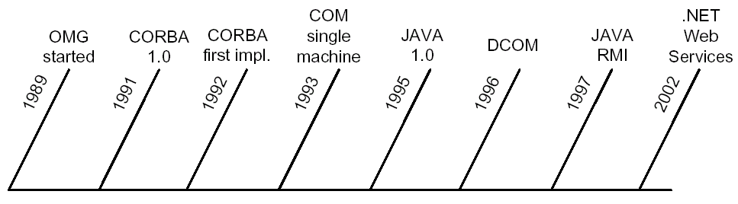
CORBA ORB
OMG introduced ORB
ORB = Object Request Broker
Software component which helps a client to invoke a method on an object
Timeline :
Notes:
The OMG introduced the concept of an ORB (Object Request Broker), which is a software component that helps a client to invoke a method on a remote object. This ORB plays a central role in the CORBA architecture. A broker is an often used concept in distributed software (Dutch: makelaar): it offers a service to the interested clients by hiding the complexity of the underlying objects or components.
Due to the fact that CORBA was developed in the early 90ties and the fact that a lot of CORBA-based applications and tools were developed since then, CORBA is now generally considered as a mature software technology.

Slide 51
CORBA framework components
IDL = Interface Definition Language
CORBA Architecture
ORB Core, Object Adapter, Skeletons, Client stubs/proxies, Implementation repository, Interface repository, Dynamic Invocation Interface, Dynamic Skeleton Interface
GIOP = General Inter-Orb protocol
CDR = Common Data Representation
Object Reference Definition
IOR = Interoperable Object Reference
CORBA Services
Naming, Event, Notification, Security, Transaction, Concurrency, Trading
Notes:
CORBA stands for Common Object Request Broker Architecture. There are five main parts in the CORBA framework:
- IDL (Interface Definition Language): for defining the interfaces of the CORBA objects.
- CORBA Architecture: similar to the already detailed RMI architecture. The main components are: the ORB Core, Object Adapter, Skeletons, Client stubs/proxies, Implementation repository, Interface repository, Dynamic Invocation Interface, Dynamic Skeleton Interface.
- GIOP (General Inter-Orb protocol): the request-reply protocol for communication between the ORBs, CDR (Common Data Representation) is used for marshalling.
- Object Reference Definition: remote references of CORBA objects are referred to as IORs (Interoperable Object References), which are similar to the remote references, described in Section 1.
- CORBA Services: extra services for the applications developers, e.g Naming, Event, Notification, Security, Transaction, Concurrency, Trading.

Slide 52
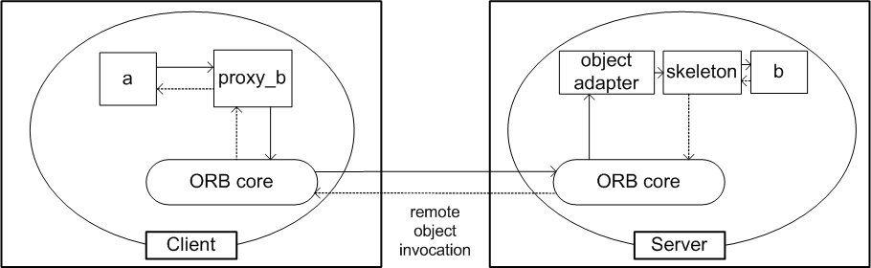
CORBA architecture
ORB Core
cfr Communication Module
Provides interface:
start/stop ORB
convert between remote objects and strings
provide argument lists for requests using dynamic invocation
Object Adapter
Remote Ref + Dispatcher
creates remote object references for CORBA objects
dispatches each invocation to the appropriate servant
activates objects
Portable Object Adapters = POAs
Notes:
The figure above shows the CORBA RMI architecture. In comparison to the general RMI architecture of lecture II.1, following new parts can be distinguished:
ORB Core: has comparable functionality to the Communication Module and provides an application interface to (i) start/stop the ORB, (ii) convert between remote objects and strings and (iii) provide argument lists for requests using dynamic invocation.
Object Adapter: provides the functionality of the Remote Reference and Dispatcher module, i.e. it creates remote object references for CORBA objects and dispatches each invocation to the appropriate servant.
Servant: the object implementing the business logic of the server object
(enumeration continued on next page)

Slide 53
Portable Object Adapter
object adapter : connects a request using an object reference with the proper code to service that request
Object Adapter
skeleton
b
ORB Core
server
Portable Object Adapter (POA):
Allow programmers to construct object implementations that are portable between different ORB products.
Allow a single servant to support multiple object identities simultaneously.
Notes:
Overview of the advantages of the POA approach.

Slide 54
CORBA architecture (2)
Skeletons
generated by IDL compiler
remote method invocations are dispatched via appropriate skeleton to a particular servant
unmarshals the arguments
marshals exceptions and results
Client Stubs/proxies
generated by IDL compiler
marshals the arguments
unmarhals exceptions and results
Notes:
Skeletons: are generated by the IDL compiler and makes sure that remote method invocations are dispatched via appropriate skeleton to a particular servant. The skeleton unmarshals the arguments and marshals exceptions and results.
Client stubs/proxies: are generated by the IDL compiler, marshals the arguments and unmarshals exceptions and results

Slide 55
CORBA : pseudo objects
CORBA implementations provide some interfaces to the functionality of the ORB
pseudo objects:
Cannot be passed as arguments
IDL interface
Implemented as libraries
Example: ORB interface
represents the functionality that programmers need to access:
init method : to initialize the ORB
connect method : to register CORBA objects with the ORB
shutdown method : to stop CORBA objects
conversion between remote object references and strings
Notes:
There is also the concept of pseudo objects, which have following properties:
- they cannot be passed as arguments
- implement an IDL interface
- are implemented as libraries
Depending on the CORBA implementation, there are some interfaces to the functionality of the ORB
An important example of a pseudo object is the ORB interface, which depending on the particular CORBA implementation can allow for following the functionality to the programmers:
- init method : to initialize the ORB
- connect method : to register CORBA objects with the ORB
- shutdown method : to stop CORBA objects
- conversion between remote object references and strings
The CORBA - IOR format is similar to the general RMI remote object reference.

Slide 56
CORBA IDL interface example
#ifndef __ECHO_IDL__
#define __ECHO_IDL__
/**
* The Echo interface which is basically an interface that contains an echo operation and an accompanying operation.
* @author AT&T omniORB, adapted by Filip De Turck
* @version $Revision: 1.6 $, $Date: 2001/06/26 00:26:46 $
**/
interface echo {
/**
* Echoes the string received
* @param mesg The received string which has to be echoed
* @return The echoed string, which has to be <U>freed by the caller</U>
**/
string echoString(in string mesg);
/**
* @return The number of times the <code> echoString </code> operation is called
**/
long times_called();
};
#endif
echo.idl :

Slide 57
CORBA : IDL
CORBA IDL
IDL interface specifies a name and a set of methods that clients can request
Parameters and results: in, out, inout keywords
Passing CORBA objects, primitive and constructed types
Type Object: common supertype of all IDL interface types
Exceptions: defined in interfaces and thrown by their methods
Invocation semantics: at-most-once

Slide 58
CORBA client and server example
Java Interface files
echo.java
IDL compiler :
Server Skeletons
_echoImplBase.java
echoPOA.java
IDL compiler
(idlj)
*.idl files
Proxy Classes or Client Stubs
_echoStub.java
Java classes for structs
echo.idl
Helper and Holder classes
$ idlj -fall –oldImplBase echo.idl
$ idlj -fall echo.idl
echoHelper.java
Notes:
When writing a CORBA client server application, the following 6 steps need to be taken (detailed on this and the subsequent pages):
1. Specification of an IDL interface of the involved objects
2. Compilation of the IDL interfaces, which generates the stub code, the skeleton code and the header files (in case of C/C++ programming language) or interface files (in case of Java programming language)

Slide 59
Java interface file
/**
* echo.java .
* Generated by the IDL-to-Java compiler
* from echo.idl
*/
public interface echo extends org.omg.CORBA.Object
{
public String echoString(String mesg);
public int times_called();
} // interface Echo

Slide 60
Servant Class Implementation
import org.omg.CORBA.*;
class echoServant extends _echoImplBase {
private ORB theORB;
private int counter;
public echoServant(ORB orb) {
theOrb = orb;
counter = 0;
}
public String echoString(String mesg) {
counter++;
String p = mesg;
return p;
}
public int times_called() {
return counter;
}
}
Notes:
3. Implementation of the Servant class: there are two options
extending the corresponding skeleton class, often referred to as the BOA (Basic Object Adapter) approach: in this case the servant class implements the interface methods and uses exactly the method signatures defined in the equivalent Java interface, an ORB private attribute is used to connect new CORBA objects to the ORB (connect method) or shutdown objects (shutdown method)
using a Portable Object Adapter (POA): allows programmers to construct object implementations that are portable between different ORB products and allows a single servant to support multiple object identities simultaneously.
The source code above details the BOA approach, more details on the POA approach are provided on the one but next slide.

Slide 61
Servant Classes
Extends the corresponding skeleton class
Implements the interface methods
Uses the method signatures defined in the equivalent Java interface
ORB private attribute: to connect new CORBA objects to the ORB (connect method) or shutdown objects (shutdown method)
Notes:
Summary of the BOA approach, detailed on the previous page.

Slide 62
Server Class Implementation
import org.omg.CORBA.*;
public class echoServer
{
public static void main(String args[]) throws org.omg.CORBA.UserException {
try{
java.util.Properties props = System.getProperties();
ORB orb = ORB.init(args, props);
echoServant echoRef = new echoServant(orb);
orb.connect(echoRef);
System.out.println(“echoServer ready and waiting ...");
orb.run();
} catch (Exception e) {
System.err.println("ERROR: " + e);
e.printStackTrace(System.out);
}
System.out.println(“Echo Server Exiting...");
} //main
} // class
Notes:
4. Implementation of the Server program: contains the main method (in case of C/C++/Java programs), depending on the servant implementation choice, two options for the code in the main method can be distinguished:
BOA approach: the ORB needs to be created and initialized, an instance of the Servant class is created and registered to the ORB (through the connect method), and subsequently waits for incoming client requests
POA approach: the rootPOA object is created first, next a POA object is created, the POAManager is activated, the servants are activated and the object references are created from the POA

Slide 63
CORBA server
Java class with Main method
Creates and initializes the ORB
Creates an instance of Servant class
Registers it to the ORB (through the connect method)
Waits for incoming client requests
Notes:
Summary of the implementation of the Server program in the BOA approach, as detailed on the previous page.

Slide 64
Client Implementation
import org.omg.CORBA.*;
public class echoClient
{
public static void main(String args[])
java.util.Properties props = System.getProperties();
org.omg.CORBA.ORB orb = org.omg.CORBA.ORB.init(args, props);
if (args.length == 0) {
System.err.println("usage: java echoClient <object reference>\n"); System.exit(1);}
try {
org.omg.CORBA.Object obj = orb.string_to_object(args[0]);
if (obj==null) {
System.err.println("Got a nil reference.\n"); System.exit(1);}
Echo echoRef = echoHelper.narrow(obj);
String src = "Hello!";
String answer = echoRef.echoString(src);
System.out.println("I said:\""+src+"\"."+
" The Object said:\""+answer+"\“.");
System.out.println("The function echoString on the object is called already "+
echoRef.times_called()+" time(s)");
} catch(Exception ex) {
System.err.println("Caught an exception!!.\n");
}
orb.destroy();
System.exit(0);
} //main
} // class
Notes:
5. Client program implementation: contains a main method, in which the following takes place: creation and initialization of the ORB, invocation of the narrow method to cast an Object to particular required type, invocation of the remote methods, catching of CORBA System exceptions

Slide 65
Client Program
Creates and initializes the ORB
Narrow method to cast Object to particular required type
Invokes the methods
Catch CORBA System exceptions
Objects cannot be passed by value in CORBA
Notes:
Summary of the implementation of the client program, as detailed on the previous page.

Slide 66
Running the server and client
Start orbd :
UNIX command shell : $ orbd
MS-DOS system prompt : start orbd
Start the Echo server :
UNIX command shell : $ java echoServer
MS-DOS system prompt :
start java echoServer
Result: echoServer ready and waiting ...
Run the client application :
$ java echoClient ior_server
ResuIt: I said: “Hello!“. The Object said: “Hello!“.
Notes:
6. Running the server and client: the orb daemon needs to be started on the involved machines (typical name: orbd, can differ from one vendor to another), next the CORBA server can be started on a certain machine. When it is started, the unique IOR of the server can be determined (and for instance printed to file). Next the client application can be started: in order to identify the remote server object, the IOR is required, and can be provided for instance as a command line argument. An alternative for using the IORs to identify the server objects, is by using the CORBA Naming Service (detailed further in this section).

Slide 67
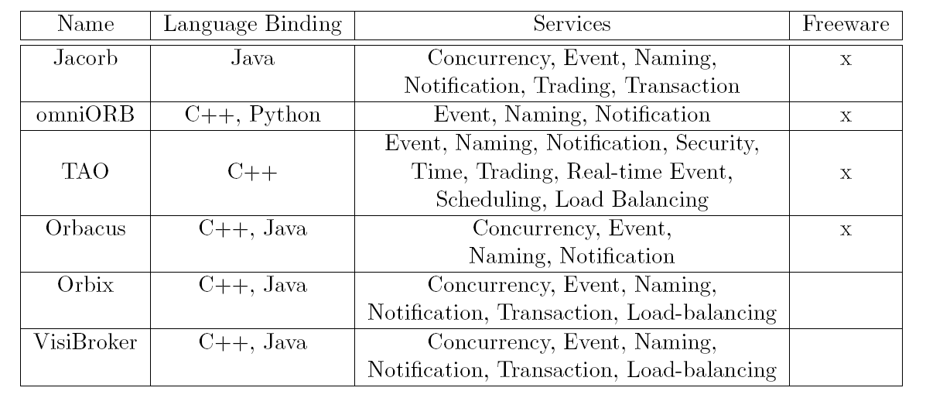
CORBA implementations
Notes:
Some interesting URLs with links to:
Commercial CORBA products
Open Source freely available CORBA products
SUN Java implementation of CORBA

Slide 68
Chapter 2: Middleware
1. Situating middleware
2. Communication between distributed objects
3. Remote procedure call
4. Java RMI
5. CORBA RMI
6. Middleware Services
1. Trading service
2. Event Service
3. Notification Service
4. Activation Service
5. Dynamic Invocation Service
68

Slide 69
Overview Of Middleware Services
Naming Service
Event and Notification Service
Messaging Service
Persistence Service
Transaction Service
Activation Service
Loadbalancing Service
Dynamic Invocation Service
Security Service
Session Tracking
Notes:
For developing applications it is important that middleware services are available to the software developer. For instance, (i) a naming service helps to register and lookup remote object references by a textual name instead of dealing directly with the remote object references, (ii) an event service helps clients to register for certain events instead of having to program callbacks to all interested clients, (iii) a session tracking service can help tracking user sessions without having to manually program it, (iv) transaction service for implementing transactions, without the need for manually programming the two-phase commit protocol and (v) persistence service for automatically storing and retrieving the state of objects, without having to program the manual SQL statements. 10 middleware services exist and are listed above.
The following middleware services will be detailed here:
Naming Service
Event and Notification Service
Activation Service
Dynamic Invocation Service

Slide 70
CORBA Naming Service
Naming service
2
1
a
3
b
server
client
Registration of Object References
Names are structured in a hierarchy
cfr directories in file system
files and directories can be assigned a “Kind” id
Notes:
In the case of CORBA, the naming service has an IDL interface which provides following methods:
bind: for servers to register the remote object references of CORBA objects by name (e.g. bind (path, Object)), an exception is generated when the name is already bound
rebind: same as bind, except that when the name is already bound, the remote object reference is overwritten
resolve: for clients to look up the remote object references by name (e.g. Object = resolve(path))
These methods belong to an interface called NamingContext. The CORBA names are structured in a hierarchy (cfr directories in a file system). Files and Directories can be assigned a kind id. A path is defined as an array of NameComponents (a struct containing a name). The path starts from an initial context provided by CORBA.

Slide 71
CORBA server
Java class with Main method
Creates and initializes the ORB
Creates an instance of Servant class
Registers it to the ORB (through the connect method)
Gets a reference for the Naming Service
Registers the server to the Naming Service
Waits for incoming client requests
Notes:
When using the CORBA naming service, the following extra steps are required in the implementation, detailed in the previous chapter:
CORBA server implementation: i.e. the class with the main method, after an instance of the servant class is created, a reference to the Naming Service has to be obtained, and the server has to be registered to the naming service
Client implementation: a reference to the Naming Service has to be obtained and a resolve has to be invoked on this reference, from the returned result the remote object reference can be created.

Slide 72
Running server and client with NS
1. Naming Service
Start orbd :
UNIX command shell : $ orbd -ORBInitialPort 1050 -ORBInitialHost nameserverhost &
MS-DOS system prompt : start orbd -ORBInitialPort 1050 -ORBInitialHost nameserverhost
Start the Echo server :
UNIX command shell : $ java echoServer -ORBInitialPort 1050 -ORBInitialHost nameserverhost &
MS-DOS system prompt :
start java echoServer -ORBInitialPort 1050 -ORBInitialHost nameserverhost
Result: echoServer ready and waiting ...
Run the client application :
$ java echoClient -ORBInitialPort 1050 -ORBInitialHost localhost
Result: I said, “Hello!“. The Object said, “Hello!"
1050 = port on which Naming Service listens
Notes:
When running the server and client: the name and port of the naming server has to provided either as command line arguments or in configuration file.

Slide 73
CORBA Trading Service
Trading Service:
Comparable to Naming Service
Allows objects to be located by attribute : directory service
Database: service types and attributes -> remote object references
Clients specify :
Constraints on the values of attributes
Preferences for the order in which to receive matching offers
Notes:
The Trading Service is comparable to the Naming Service. It is a directory service, which allows objects to be located by one or multiple attributes. Clients can specify constraints on the values of the attributes and preferences for the order in which to receive matching offers. Multiple trading services can be federated, i.e. can refer to each other and form virtually one trading service.

Slide 74
Architecture for distributed event notification
Event service
object of interest
subscriber
1.
notification
object of interest
observer
subscriber
2.
notification
notification
object of interest
observer
subscriber
3.
notification
Notification : object that contains information about event
Observer : decouple the object of interest from its subscribers (forwarding, filtering, patterns of events, notification mailbox)
Notes:
The above figure shows 3 options for distributed event notification. The third option is the most flexible one and is referred to as the observer pattern: the observer object decouples the object of interest from its subscribers. The observer object can take care of following tasks:
- Forwarding of the events to the subscribers,
- Filtering of the events based on the specified criteria,
- Detection of patterns in the events,
- Notification mailbox functionality, i.e store the events until they can be delivered or retrieved

Slide 75
CORBA Event Service
Defines interfaces for:
Suppliers
Consumers
Push (by supplier to consumer)
PushConsumer interface {push (...);}
Consumer register their object references
Pull (by consumer from supplier)
PullSupplier interface { pull (...); }
Suppliers register their object references
Notes:
CORBA provides an Event Service, based on the publish-subscribe principle. A CORBA Event Service defines IDL interfaces for the suppliers, i.e the objects of interest (cfr Figure 3.1) and the consumers, i.e. the subscribers. Following methods are available:
Push : invoked by the suppliers on the PushConsumer interface, consumers register their object references with suppliers
Pull: invoked by the consumer on the PullSupplier interface, in this model suppliers register their object references with consumers

Slide 76
Corba Event Service (2)
Event Channels
Allow multiple suppliers to communicate with multiple consumers
Buffer between suppliers and consumers
EventChannel interface
implemented by objects in event server
Chains of event channels
Notes:
Event channels are used for complying with the observer pattern. They allow multiple suppliers to communicate with multiple consumers and are a buffer between the suppliers and consumers. The push-pull model to the event channels is followed: suppliers push events to the channel and consumers either pull events from it or get events pushed from it. Chains of event channels can also be constructed.

Slide 77
Notification Service
Extends Event Service with filters
Notifications have datatype ( <-> any )
Event Consumers may use filters
Specify events they are interested in
Proxies forward notifications to consumers according to constraints specified in filters
Event Suppliers can discover the events the consumer are interested in
Event Consumers can discover a set of event types (subscribe to new event)
Configure properties of Event Channel
Reliability, priority of events, required ordering, policy for discarding stored events
Event type repository
Notes:
The Notification Service extends the Event Service. Besides the event service functionality, it allows to use filters. Notifications have a datatype (in contrast to the any datatype of the Event Service). Event consumers can use the filters to specify the events they are interested in. Proxies forward the notifications to consumers according to constraints specified in filters. Event suppliers can discover the events the consumer are interested in and event consumers can discover a set of event types (subscribe to new events).
The Notification Service allows to configure the properties of the event channel, in terms of:
- reliability
- priority of events
- required ordering
- policy for discarding stored events
A structured event type consists of an event header and an event body. The event header specifies the domain type, the event type, the event name, and the requirements. The event body consists of <name, value> pairs.

Slide 78
Corba Event service (1)
Push event delivery model

Slide 79
Corba Event service (2)
Pull event delivery model

Slide 80
Corba Event service (3)

Slide 81
Corba Event service (4)
Hybrid Push/Pull event delivery model

Slide 82
Corba Event service (5)
Event Channel Interfaces

Slide 83
Corba Event service (6)
Chaining of event channels (federation)

Slide 84
Corba Transaction service (1)
Transaction scenario – part I

Slide 85
Corba Transaction service (2)
Transaction scenario – part II

Slide 86
Corba Transaction service (3)
Transaction scenario – part III

Slide 87
Corba Transaction service (4)
Transaction scenario – part IV

Slide 88
Persistence service
Automated storing and retrieving data to/from databases
-> next chapter

Slide 89
Activation Service
Activation service
Activation
= on demand execution of services to reduce server processes/threads
activate objects when requests arrive
passivate objects if in consistent state
Activator
keeps table of passive (activatable) objects
start server processes on demand
create active server objects from passive state (e.g. serialized state)
keeps table of activated objects and their location
In practice ...
CORBA : activator service
Java RMI : 1 activator on each server computer

Slide 90
Implementation Repository
Responsible for
activating registered servers on demand
locating servers that are currently running
Object Adapter name is used for registration and activation
Implementation Repository entry: Object Adapter Name Pathname of Object Implementation Host name and port number of server
Extra information : access control information
Notes:
The CORBA Object Adapter name is used for registration and activation. An implementation repository is a database, containing for each registered Object Adapter Name: (i) the pathname of the object implementation binary and (ii) the host name and port number of the computer, which can run the object. Access control rights for each object can be stored as well.

Slide 91
Implementation Repository
On ImR machine: start ImR
$ imr –p 2446 –f /etc/imr.db –i /etc/imr/ior_file
On participating hosts: startup daemon
$ imr_ssd
Register a program:
$ imr_mg add “echoServer” –c “java echoServer”
$ imr_mg add “echoServer” –c “xterm –e java echoServer”
Automatic creation of new entries when activating objects:
$ imr –p 2446 –f /etc/imr.db –i /etc/imr/ior_file –a
Notes:
When using the Implementation Repository service, the repository binary is started on one selected computer. On each participating host of the distributed system, a daemon needs to be started. When registering a binary on a participating host, this information is passed to the Implementation Repository and the object startup information is known in the entire distributed system. Some CORBA products also allow the automatic creation of new implementation repository entries when activating objects (i.e. without the need for manual registration of the binaries).

Slide 92
Loadbalancing service
Automatic distribution of load between different servers
Often a broker is used:
same interface as servers
forwards load to “most appropriate” server
(either prediction of load or retrieving load information)
Often in combination with Naming service

Slide 93
Dynamic Invocation service
Allowing the invocation of objects, whose interface is not known at compile time, but discovered at run time
Java: Reflection API
CORBA: Interface repository

Slide 94
CORBA Interface Repository
Provide information about registered IDL interfaces
Can supply
the names of the methods
the corresponding names and types of arguments and exceptions
Reflection facility
Useful when client has no proxy for object
Not required when static invocation with client stubs and IDL skeletons
Notes:
The CORBA Interface Repository provides information about registered IDL interfaces and can supply:
- the names of the methods
- the corresponding names and types of arguments and exceptions
It offers the reflection facility, which is available in Java. This is useful when a client has no proxy for a remote object. It is not required for static invocation with client stubs and IDL skeletons.
At compile time, the Dynamic Invocation Interface is used to obtain from the interface repository the necessary information, construct an invocation with the required arguments and sent it to the server. The Dynamic Skeleton Interface at server side allows to accept invocations on an interface for which there is no skeleton. It inspects the request, discovers the target object and invokes the target.

Slide 95
Other services
Security
Session tracking
-> next chapter

