Slide 1

Chapter 5
Coordination
Failure detection
Distributed mutual exclusion
Election
Ordered multicast

Slide 2
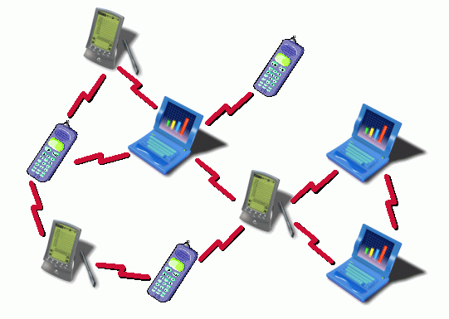
General Problem
1. Introduction
Given a set of processes Π={p_{i}}, distributed over multiple hosts
  how to coordinate actions ?
  agree on contents of shared variables (“global state”) ?
Example problems
control access to common database (locking)
elect central node in ad hoc network
elect time server in network
avoid static master-slave relations to enhance robustness

Slide 3
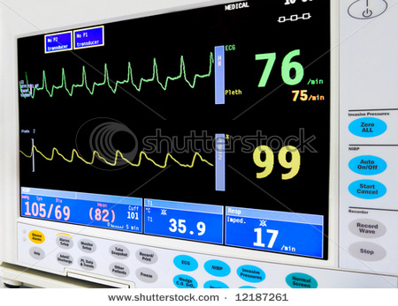
Chapter 6
Coordination
Failure detection
  Problem statement
  Algorithm
Distributed mutual exclusion
Election
Ordered multicast

Slide 4
Detecting failures
Failure detection
  Problem statement
Process p still running ?
Terminology
Unreliable failure detector : only hints
possible states assigned to p
suspected : the process p is probably crashed
unsuspected : the process p is probably alive
Reliable failure detector : SURE about crashing
possible states
failed : the process p has definitely crashed
unsuspected : the process is probably still alive

Slide 5
Algorithms
Failure detection
  Problem statement
Two mechanisms
- heart beat from p
- server polls p
Heart beat
p sends message m to q, periodicity T
q measures inter arrival time of m : Δm
Δm
perfect world
Δm = cst.
q
m
m
m
m
m
p
T
Δm
t
real network
Δm ?
q
m
m
m
m
m
m
m
p
t

Slide 6
Algorithms
Failure detection
  Problem statement
Synchronous system
- bounded network delay δ < Δ
- message is delivered
Δm
δ₁
δ₂
q
T₁^{q}
T₂^{q}
clock offset o
C_{q} = C_{p} + o
m
m
p
T
t
T₁^{p}
T₂^{p}
T₂^{q}=T₂^{p}+δ₂+o
T₁^{q}=T₁^{p}+δ₁+o
Δm=T₂^{q}-T₁^{q}=T₂^{p}-T₁^{p}+δ₂-δ₁
-

Slide 7
Algorithms
Failure detection
  Problem statement
Synchronous system
Δm = T₂^{q}-T₁^{q}
= T₂^{p}-T₁^{p}+δ₂-δ₁
= T + δ₂-δ₁
|Δm| = |T+δ₂-δ₁|
≤ T + |δ₂-δ₁|
≤ T + Δ
Δm > T + Δ -> p has crashed
Δm ≤ T + Δ -> p WAS alive,
but MIGHT have crashed since
Δm OK
q
m
m
p
T
Δm ≤T+Δ
Δm >T+Δ
failed
unsuspected
Reliable failure detector

Slide 8
Algorithms
Failure detection
  Problem statement
Asynchronous system
No assumption on network delay
Only suspicion if Δm becomes exceedingly large
-> Limit Δ on Δm
Δm ≤T+Δ
no message received
Δm > T+Δ
suspected
unsuspected
message received
Unreliable failure detector
Δ ?
Δ >> too many unsuspected
Δ << too many suspected
sensible choice : set Δ in relation to network delay
- adapt dynamically
- e.g. Δ = 1.2 δ

Slide 9
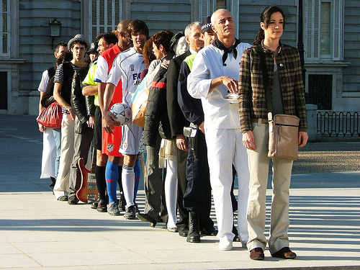
Chapter 6
Coordination
Failure detection
Distributed mutual exclusion
  Problem statement
  Evaluation metrics
  Centralized approach
  Ring approach
  Multicast approach
    Ricart-Agrawala
    Maekawa voting
Election
Ordered multicast

Slide 10
Critical sections
2. Mutual Exclusion
  Problem statement
Goal
Coordinate process access to shared resources
Accesses common resource
No other process should access same resource
Critical section
Distributed mutual exclusion
  no shared variables between processes
  no support from common coordinating OS kernel
  only rely on message passing

Slide 11
Problem statement
2. Mutual Exclusion
  Problem statement
Consider
  N processes {p₁, … , p_{N}}, NO shared variables
  access common resources in a critical section
  asynchronous system
  processes CAN communicate (know each other)
  Failure model
      reliable channel (each message delivered, exactly once)
      no process failures
      processes are well-behaved
      (leave critical section eventually)
p₂
p₃
p₁
p₅
“dangerous”
resource
p₄
p_{N}

Slide 12
A good solution should ...
2. Mutual Exclusion
  Problem statement
1. safety [REQUIRED]
At most ONE process may execute in critical section
at any time
2. liveness [REQUIRED]
Requests to enter/leave critical sections eventually
succeed
-> deadlock-free algorithm
-> no starvation
3. fairness [BONUS]
Access to critical section is granted using “happened
- before” relation
-> use logical clock to order access requests

Slide 13
Critical section access API
2. Mutual Exclusion
  Problem statement
Application level primitives
enter() enter critical section, block if necessary
resourceAccess() access the shared resource (in critical section)
exit() leave critical section – make free for other processes
enter()
p₅
Critical
section
resourceAccess()
exit()

Slide 14

How to quantify solution quality ?
2. Mutual Exclusion
  2. Evaluation Metrics
Evaluation metrics
bandwidth consumption
= number of messages sent to enter/leave critical section
client delay
  = time needed to enter/leave critical section
  measured in UNLOADED system

Slide 15
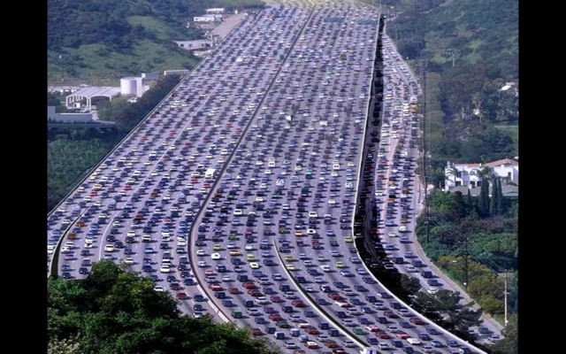
How to quantify solution quality ?
2. Mutual Exclusion
  2. Evaluation Metrics
system throughput
  how many processes can access critical section in given time period ?
  depends on resourceAccess()-time
  derived measure: synchronization delay =
average (time process (i+1) enters – time process (i) leaves)
LOADED system
p₁ enters
p₁ leaves
p₂ enters
p₂ leaves
p₁
busy
p₂
busy
time
synchronization
delay
= LOST time

Slide 16

Central server
2. Mutual Exclusion
  3. Centralized approach
Centralized algorithms (one server)
easy
but typically poor scaling
server
client
client
client
client
Messages
Client -> Server : Request
Client -> Server : Leave
Server -> Client : Grant

Slide 17
Central server algorithm
2. Mutual Exclusion
  3. Centralized approach
token variable
== process ID currently active
== -1 if critical section not taken
message queue Q
stores pending requests
token
server
Q
t=-1
Q={}
t=1
Q={}
t=1
Q={2}
t=2
Q={}
server
R
G
L
R
p₁
G
p₂

Slide 18
Central algorithm
2. Mutual Exclusion
  3. Centralized approach
client side
1. enter()
send Request message to server
wait until Grant received
2. accessResource()
perform any application specific logic
3. leave()
send Leave message to server
When receiving Request
if (token == -1) {
send Grant to requesting process
token=sender(Request)
} else
enqueue Request in Q
When receiving Leave
1. dequeue oldest message m from Q
2. token=sender(m)
2. send Grant to sender(m)
server side

Slide 19
Algorithm OK ?
2. Mutual Exclusion
  3. Centralized approach
Safety
guarded by token variable
Liveness
Request to enter
all processes eventually leave
each leave dequeues a message from Q
if oldest Request dequeued
=> every Request eventually handled
Request to leave
no permission needed from server
Fairness
Order Q according to “happened-before”

Slide 20
Algorithm efficient ?
2. Mutual Exclusion
  3. Centralized approach
Bandwidth
enter()
leave()
client
server
Request
=> 2 messages/enter
Grant
client
server
Leave
=> 1 message/leave

Slide 21
Algorithm efficient ?
2. Mutual Exclusion
  3. Centralized approach
Client delay (unloaded system)
δ=time needed for 1 communication
RTT = 2δ
enter()
leave()
client
server
δ
=> 2δ
Request
δ
Grant
client
server
Leave
no blocking
=> 0δ

Slide 22
Algorithm efficient ?
2. Mutual Exclusion
  3. Centralized approach
Synchronization delay (loaded system)
client 1
server
client 2
Request
p₁ starts CS
Grant
Request
p₁ leaves CS
Leave
sync. delay
2δ
Grant
p₂ starts CS

Slide 23
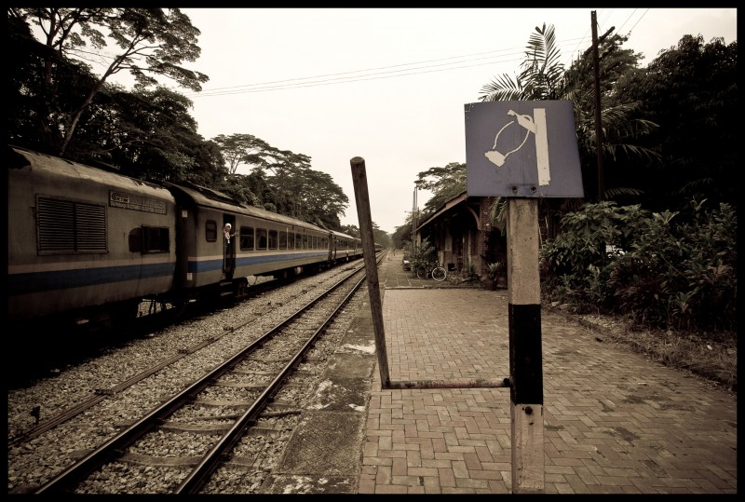
Ring-based algorithm
2. Mutual Exclusion
  4. Ring approach
Processes {p₀, ..., p_{N-1}} arranged in logical ring
Process p_{i} has one unidirectional communication channel to p_{(i+1) mod N}
token = message passed along ring
Only one process has token
Symmetric algorithm
(no “special” process)
Message : Token
p₃
…
p₂
p₁
p₀
p_{N-1}

Slide 24
Ring-based algorithm
2. Mutual Exclusion
  4. Ring approach
p₃
p₂
p₁
Token
p₀
time
process wants critical section
process executes critical section
process leaves critical section

Slide 25
Algorithm OK ?
2. Mutual Exclusion
  4. Ring approach
each process p
When process p receives “Token”
if (p wants access) {
execute logic in critical section
leave()
} else send(Token) to next process
Safety
process can only send Token if it has received Token
Liveness
process eventually leave
=> Token circulates in the ring
(p not allowed new access !)
=> No starvation
Fairness
not guaranteed : processes need luck for early access
access order not based “happened before” of requests

Slide 26
Algorithm efficient ?
2. Mutual Exclusion
  4. Ring approach
Bandwidth
enter
leave : included in enter
BUT : algorithm always consumes bandwidth !
worst case
best case
p_{N-1}
p₂
p₁
Token
Token
p₀
N messages
1 message
time
average : (N+1)/2 messages

Slide 27
Algorithm efficient ?
2. Mutual Exclusion
  4. Ring approach
Client delay (unloaded system)
enter()
leave() : no blocking for process to leave critical section
0δ
worst case
best case
p_{N-1}
p₂
p₁
Token
Token
p₀
Nδ
0δ
time
average client delay : Nδ/2

Slide 28
Algorithm efficient ?
2. Mutual Exclusion
  4. Ring approach
Synchronization delay (loaded system)
worst case
best case
p_{N-1}
p_{N-1}
p₂
p₂
p₁
p₁
Token
p₀
p₀
time
time
lost
time
lost
time
Nδ
δ
average sync. delay : (N+1)δ/2

Slide 29

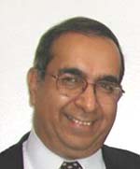
Multicast : Ricart-Agrawala algorithm
2. Mutual Exclusion
  5. Multicast approach
Filosophy
Use multicast to reduce bandwidth
Use logical clock (Lamport clock) to realize fairness
Basic mechanism to enter CS :
multicast request and enter if all others agree
Each process p_{i}
Has state variable
  Released : outside critical section
  Wanted : wants to enter
  Held : inside critical section
Lamport clock
Queue Q to store pending Requests
Lamport clock
state
T
Q
p_{i}
Organization of Q ?
Lamport-clock based happened-before
Total ordering implemented to ensure consistency
<p₁,T₁> < <p₂,T₂>
⬄ (T₁<T₂) or ((T₁==T₂) and (p₁<p₂))
pending requests

Slide 30
Ricart-Agrawala algorithm
2. Mutual Exclusion
  5. Multicast approach
Messages
Request(p_{i},T_{i}),
Reply
each process p_{i}
Initialization
state = Released
enter()
state = Wanted
multicast Request(p_{i},T_{i}) to all processes
store T=T_{i} of Request message
wait until (N-1) Reply messages received
state = Held
leave()
state = Released
send Reply to all pending Requests in Q
when receiving Request(p_{j},T_{j}) at p_{i} (i≠j)
if (state == Held) or ((state==Wanted) and (T,p_{i})<(T_{j},p_{j})) {
enqueue Request in Q
// do NOT reply
} else send Reply to p_{j}

Slide 31
Examples
2. Mutual Exclusion
  5. Multicast approach
Process p requests entry, all others in RELEASED-state
-> all (N-1) other processes reply immediately
-> p can enter CS
(2) Process p requests entry, one process q in HELD-state,
all others in RELEASED-state
-> (N-2) other processes reply immediately
-> p waits until q has left CS
-> p can enter CS

Slide 32
Examples
2. Mutual Exclusion
  5. Multicast approach
(3) Processes p₁ and p₂ request entry, p₃ not
RELEASED
WANTED
p₃
HELD
R<2,5>
reply
T=5
p₂
reply
reply
R<1,10>
reply
p₁
T=10
0
time

Slide 33
Algorithm OK ?
2. Mutual Exclusion
  5. Multicast approach
Safety : a proof
  Suppose p and q simultaneously executing critical section
  => both p and q received (N-1) Reply-messages
  => p sent Reply to q AND q sent Reply to p
  => condition (state_{i} == Held) or ((state_{i}==Wanted) and (T,p_{i})<(T_{j},p_{j}))
  DOES NOT hold for
  (p_{j}=q),(p_{i}=p) (a)
  AND (p_{j}=p),(p_{i}=q) (b)
  some logic for (a)
  => ![(state_{p} == Held) or ((state_{p}==Wanted) and (T_{p},p)<(T_{q},q)) ]
  => (state_{p}!=Held) AND [(state_{p}!=Wanted) or (T_{q},q)<(T_{p},p)]
  => [(state_{p} != Held) and (state_{p}!=Wanted)]
  or [(state_{p} != Held) and (T_{q},q)<(T_{p},p)]
  => (state_{p}==Released) or [(state_{p} != Held) and (T_{q},q)<(T_{p},p)]
  p can NOT be in state Released (because now in CS)
  => [(state_{p} != Held) and (T_{q},q)<(T_{p},p)]

Slide 34
Algorithm OK ?
2. Mutual Exclusion
  5. Multicast approach
Safety
  ...
  (a) => [(state_{p} != Held) and (T_{p},p)>(T_{q},q)]
  (b) => [(state_{q} != Held) and (T_{q},q)>(T_{p},p)]
  CAN NOT hold simultaneously
  => p and q can NOT be executing simultaneously in critical section
(2) Liveness
Every Request eventually granted
- immediately
- after dequeueing from Q
=> every process will eventually receive (N-1) answers
(3) Fairness
Requests replied in happened-before order

Slide 35
Algorithm efficient ?
2. Mutual Exclusion
  5. Multicast approach
Bandwidth
enter()
leave() no messages needed for leaving
p₀
p₁
p₂
p_{N-1}
N Request messages
(N-1) Reply messages
if multicast supported
1 Request message only !

Slide 36
Algorithm efficient ?
2. Mutual Exclusion
  5. Multicast approach
(2) Client delay (unloaded system)
enter()
p₀
p₁
p₂
p_{N-1}
-> 2δ
leave()
-> 0δ
Reply to pending Request
does not block p₀

Slide 37
Algorithm efficient ?
2. Mutual Exclusion
  5. Multicast approach
(3) Synchronisation delay (loaded system)
p₀
p₁
p₂
lost
time
-> 1δ

Slide 38
Maekawa Voting
2. Mutual Exclusion
  5. Multicast approach
Filosophy
Drawback of Ricart-Agrawala : all processes need to agree
Maekawa voting : only SUBSET of processes involved
Basic idea : “vote on behalf of others”
Candidate process must collect sufficient votes before entering
Voting set for each process p_{i} : V_{i}
  V_{i} ⊆ {p₁, …, p_{N}}, satisfying (Required)
  p_{i} ∈ V_{i} (Required)
  V_{i} ∩ V_{j} ≠∅ (Required)
  |V_{i}| = K (fairness) (Bonus)
  p_{j} contained in M voting sets (Bonus)
Algorithm
process q ∈ (V_{i} ∩ V_{j} )
q votes for 1 process only
-> q makes sure p_{i} and p_{j} are not
simulataneously executing critical section
-> safety condition met
Additional state needed per process : voted

Slide 39
Constructing voting sets
2. Mutual Exclusion
  5. Multicast approach
Choosing parameters
  Theoretical result : optimal solution (minimal K)
      K ≈ N^{1/2}
      M = K
  In practice : difficult to calculate optimal V_{i}
      Sub-optimal solution
      K ≈ 2N^{1/2}
      M = K
Practical algorithm (for N=S²)
for S=3
C₁
C₂
C₃
V₁ = R₁ ∪ C₁
V₂ = R₁ ∪ C₂
V₃ = R₁ ∪ C₃
V₄ = R₂ ∪ C₁
V₅ = R₂ ∪ C₂
V₆ = R₂ ∪ C₃
V₇ = R₃ ∪ C₁
V₈ = R₃ ∪ C₂
V₉ = R₃ ∪ C₃
R₁
p₁
p₂
p₃
R₂
p₄
p₅
p₆
R₃
p₇
p₈
p₉

Slide 40
Constructing voting sets
2. Mutual Exclusion
  5. Multicast approach
In general
Construct SxS matrix A, consisting of all processes
    i is row where p is found
    j is column where q is found
    R_{i} = i-th row of A
    C_{j} = j-th column of A
    Voting set V_{p} = R_{i} ∪ C_{j}
Checking this V_{p} ...
    p ∈ R_{i}, p ∈ C_{j} => p ∈ V_{p}
    V_{p}=R_{i} ∪ C_{j}
    V_{q}=R_{s} ∪ C_{t}
    => V_{p} ∩ V_{q} = (R_{i} ∪ C_{j}) ∩ (R_{s} ∪ C_{t})
    = (R_{i} ∩ R_{s}) ∪ (R_{i} ∩ C_{t}) ∪ (C_{j} ∩ R_{s}) ∪ (C_{j} ∩ C_{t})
    BUT R_{k} ∩ C_{l} ≠ F (for any k,l) (s_{kl} ∈ R_{k} and s_{kl} ∈ C_{l})
    => V_{p} ∩ V_{q} ≠ F
K = 2S -1
K = M

Slide 41
The algorithm
2. Mutual Exclusion
  5. Multicast approach
Differences w.r.t. Ricart-Agrawala
additional state variable per process needed (voted or not)
multicast request to enter to voting set only
explicit leave needed (so voting processes can vote for other process)
Messages
Request
Reply
Release

Slide 42
The algorithm
2. Mutual Exclusion
  5. Multicast approach
when receiving Request(p_{j}) at p_{i}
if (state == Held) or (voted = True) {
enqueue Request in Q
// do NOT reply
} else {
send Reply to p_{j}
voted = True
}
when receiving Release(p_{j}) at p_{i}
if (Q != empty) {
dequeue pending Request m from Q
send Reply to sender(m)
voted = True
} else {
voted = False
}
Initialization
state = Released
voted = False
enter()
state = Wanted
multicast Request(p_{i}) to voting set V_{i}
wait until K Reply messages received
state = Held
leave()
state = Released
multicast Release to voting set V_{i}
each process p

Slide 43
Example
2. Mutual Exclusion
  5. Multicast approach
Processes p₁ and p₃ request entry, p₂ and p₄ not
C₁
C₂
RELEASED
NOT voted
V₁={p₁,p₂,p₃}
V₂={p₁,p₂,p₄}
V₃={p₁,p₃,p₄}
V₄={p₂,p₃,p₄}
K=3
voted
R₁
p₁
p₂
WANTED
R₂
p₃
p₄
HELD
1 : request
2 : reply
3 : release
p₄
1
2
3
2
3
p₃
1
1
3
2
3
2
p₂
1
1
2
3
p₁
1
2
3
0
time

Slide 44
Algorithm OK ?
2. Mutual Exclusion
  5. Multicast approach
Safety
Suppose p and q simultaneously active
=> all processes in V_{p} and V_{q} voted for p AND q
=> process t in V_{p} ∩ V_{q} ≠ F voted for p AND q
impossible :
voted_{t}=True immediately after voting for 1 process
(2) Liveness
deadlock prone !!!
P
p₁
p₄
p₃
V₇
p₀
p₇
V₀
p₅
p₂
p₆
V₀ ∩ V₇ = {p₃,p₄}
should vote consistently !!!

Slide 45
Algorithm NOT OK !
2. Mutual Exclusion
  5. Multicast approach
Release
Q₄={}
Q₄={7}
Q₄={7,0}
p₄
Q₃={}
Q₃={0}
Q₄={0,7}
p₃
Reply
p₇
Reply
p₀
0
p₇ and p₀ will NEVER
receive Reply from complete
voting set !

Slide 46
Algorithm OK ?
2. Mutual Exclusion
  5. Multicast approach
(2) Liveness
Solution : organise Q according to Lamport clock !
(3) Fairness
OK by adaptation !

Slide 47
Algorithm efficient ?
2. Mutual Exclusion
  5. Multicast approach
Bandwidth
enter()
same as Ricart-Agrawala, but message sent to
voting set only !
-> K Request messages
-> K Reply messages
leave()
explicit Leave message now needed
-> K Release messages
(2) Client delay
idem as Ricart-Agrawala
enter() : 2δ
leave() : 0δ

Slide 48
Algorithm efficient ?
2. Mutual Exclusion
  5. Multicast approach
(3) Synchronization delay
p₀
p₁
p₂
V₀ ∩ V₂={p₁}
Reply
Release
Reply
lost
time
-> 2δ

Slide 49
Summary on efficiency
2. Mutual Exclusion
  Summary
Bandwidth Client delay Synchronization delay
enter() leave() enter() leave()
Central server 2M 1M 2δ 0δ 2δ
Ring algorithm constant Nδ/2 (N+1)δ/2
Ricart-Agrawala (2N-1)M 0M 2δ 0δ 1δ
Maekawa voting 2KM KM 2δ 0δ 2δ

Slide 50

Chapter 6
Coordination
Failure detection
Distributed mutual exclusion
Election
  Problem statement
  Evaluation metrics
  Ring algorithm
  Multicast algorithm
Ordered multicast

Slide 51
The problem with elections
3. Elections
  1. Problem statement
Consider
  N processes {p₁, … , p_{N}}
    NO shared variables
    knowing each other (can communicate)
  select ONE process to play special role (e.g. coordinator)
  every process p_{i} should have same coordinator
  if elected process fails : do new election round
p₂
ID₂
each process has unique ID
elect process with largest ID
each process has state
  elected_{i} = ID of elected process
elected_{i} should be independent of i
elected₂=ID₃
p₁
ID₁
elected₁=ID₃
p₃
p_{N}
ID₃
Coordinator
ID_{N}
elected₃=ID₃
elected_{N}=ID₃

Slide 52
Some terms
3. Elections
  1. Problem statement
Terminology
  request election : a process “calls the election”
  at most 1 election initiated per process
  possibly N elections running simultaneously
  at any time, a process is either
    participant : currently engaged in some election
    non-participant : currently not engaged in any election
p₅
C
p₄
Election 1
p₃
Election 2
p₂
p₁
time

Slide 53

Good elections
3. Elections
  2. Metrics
Correctness requirements
(1) safety (REQUIRED)
each participant process p_{i} has :
elected_{i} = ?
OR elected_{i} = P
(P is elected process,
non-crashed with largest ID)
(2) liveness (REQUIRED)
        all processes p_{i} participate
        eventually set elected_{i} ≠ ? or crash
Evaluation metrics
  bandwidth
  # messages needed to do election process
  turnaround time
  time needed for election round

Slide 54
Ring algorithm: Chang – Roberts
3. Elections
  3. Ring algorithm
processes organized in ring
non-identical IDs (how to make IDs unique ?)
processes know how to communicate
50
p₄
100
p₃
p₂
7
p₁
p_{N}
Failure model
  No failures :
  reliable channels
  no process crashes
Asynchronous system
20
10

Slide 55
Ring algorithm: Chang – Roberts
3. Elections
  3. Ring algorithm
Messages
Election(i,ID)
i = initiator of election
ID = current max ID
Elected(i)
process p_{i} has been elected
Each process has
state : participant_{i} (True/False)
elected_{i} (ID of elected process, or ?)

Slide 56
Algorithm
3. Elections
  3. Ring algorithm
Receipt of Election(i,ID)-message at p_{j}
if(ID>ID_{j}) {
forward Election(i,ID)
participant_{j} = TRUE
}
if((ID≤ID_{j})and(i≠j)) {
if(participant_{j} = FALSE) {
send Election(j,ID_{j})
participant_{j}=TRUE
}
}
if(i==j) {
participant_{j}=FALSE
elected_{j} = j
send Elected(j)
}
Initialization
participant_{i} = FALSE for all i
Start election process p_{i}
participant_{i} = TRUE
send message Election(i,ID_{i})
Receipt of Elected(i)-message at p_{j}
if(i≠j) {
participant_{j} = FALSE
elected_{j} = i
forward Elected(i)
}
each process p

Slide 57
Example
3. Elections
  3. Ring algorithm
p₃ calls the election
p₄ (5)
<3,15>
<2,50>
<2>
p₃ (15)
<2,50>
<2>
<3,15>
p₂ (50)
<2,50>
<2,50>
<0,20>
<2>
p₁ (10)
<0,20>
<2,50>
<2>
p₀ (20)
Election(i,ID)
time
Elected(i)

Slide 58
Algorithm OK ?
3. Elections
  3. Ring algorithm
Safety
Elected message only sent if Election-message with own ID received
Suppose p and q both elected
=> p received Elected(p)
q received Elected(q)
BUT IDs are unique
(ID_{p}<ID_{q}) => q will NOT forward Elected(p,ID_{p})
(ID_{p}>ID_{q}) => p will NOT forward Elected(q,ID_{q})
=> impossible for BOTH messages to visit complete ring
=> impossible p AND q to be elected
(2) Liveness
No failures
=> messages allowed to circulate
=> circulation stops (through participant state variable)

Slide 59
Algorithm efficient ?
3. Elections
  3. Ring algorithm
3 phases
  ID in Election message grows
  do complete round with constant ID
  let the Elected message circulate
Worst case : process with max ID is last process visited
p₄ (5)
<3,15>
<2,50>
<2>
N messages
(N-1) messages
N messages
p₃ (15)
<2,50>
<2>
<3,15>
p₂ (50)
<2,50>
<2,50>
<0,20>
<2>
p₁ (10)
<0,20>
<2,50>
<2>
p₀ (20)
time

Slide 60
Algorithm efficient ?
3. Elections
  3. Ring algorithm
Best case : process with max ID is process calling election
p₄ (5)
<3,50>
<3>
p₃ (50)
<3,50>
<3,50>
<3>
p₂ (15)
1 message
(N-1) messages
N messages
<3>
<3,50>
<3>
p₁ (10)
<3,50>
<3>
p₀ (20)
time
min max average
bandwidth 2NM (3N-1)M (5N-1)M/2
turnaround time 2Nδ (3N-1)δ (5N-1)δ/2

Slide 61


Bully algorithm (Garcia – Molina)
3. Elections
  4. Multicast algorithm
Context
Failure model
process crashes dealt with
System model
Synchronous system (uses time-outs to detect failure)
A-priori knowledge
process knows all processes with larger ID
Philosophy
Election starts when current coordinator fails
Failure discovery :
- by timeouts
- election possibly by several processes
Each process has
set L of candidate coordinators (set of processes with larger ID)
set S of other processes (smaller IDs)
Upper bound for answering : T

Slide 62
Communication
3. Elections
  4. Multicast algorithm
Messages involved
election announce election round
answer reply to election message
coordinator announce ID of elected coordinator
L₅
P
p₄
50
p₂
7
20
p₅
p₁
10
p₃
100
S₅

Slide 63
Algorithm
3. Elections
  4. Multicast algorithm
Call the election process p_{i}
if {L=∅} then {
elected=i
send coordinator(i) to S
} else {
send election(i) to L
if no answer-message in period T then {
elected=i;
send coordinator(i) to S
} else {
if no coordinator-message in T’ then call election again
}
}
Receipt coordinator(j) at p_{i}
elected_{i} = j
Receipt of election(j)-message at p_{i}
if(no elections initiated by p_{i}) {
send answer-message to p_{j}
p_{i} calls election
}
If new process started
with highest ID
-> will become
coordinator (bully !)

Slide 64
Example
3. Elections
  4. Multicast algorithm
Election called by p₁, after crash of p₄
current coordinator
e[lection]
a[nswer]
c[oordinator]
crash
p₄
e
e
p₃
T
e
a
c
p₂
e
a
a
c
p₁
0
time

Slide 65
Algorithm OK ?
3. Elections
  4. Multicast algorithm
safety
OK IF NO PROCESS REPLACEMENT
IF PROCESS REPLACEMENT OCCURS
If new process has highest ID
-> announces coordinator
-> can conflict with other announcement (if election running)
liveness
messages delivered reliably (no communication faults)
either
      answer from L
      process is coordinator itself
      -> in any case coordinator identified !

Slide 66

Chapter 6
Coordination
Failure detection
Distributed mutual exclusion
Election
Ordered multicast

Slide 67
Multicast
4. Multicast
Processes can be part of multiple multicast-groups
Basic operations
multicast(g,m) send message m to all members of group g
deliver(m) deliver received message m to the application
Each message carries
sender(m)
group(m)
payload(m)
closed group : members only
open group : process not part of group g can multicast to g

Slide 68
Basic-Multicast
4. Multicast
B-multicast over reliable message delivery
send(p,m) reliable send m to p
receive(m) put message in input queue of p
B-multicast(g,m) : for each process p in g, send(p,m)
On receive(m) at p : B-deliver(m) at p
Issues
  problem of ack-implosion (for large number of processes)
  inefficient usage of network bandwidth (causing delay)
Extentions to B-multicast
  provide reliability (guaranteed delivery, exactly once)
  implementation over IP-multicast
  guarantee message ordering

Slide 69
Ordering
4. Multicast
FIFO-ordering
if a correct process issues
multicast(g,m)
multicast(g,m’)
then every correct process delivering m’ will deliver m before m’
Causal ordering
if multicast(g,m) “happened before” multicast(g,m’),
every correct process that delivers m’ will deliver m before m’
Total ordering
if a correct process delivers m before delivering m’,
then every correct process that delivers m’ will deliver m before m’
Reliability NOT implied
Total ordering does NOT imply FIFO- or causal ordering
-> FIFO-total ordering
-> causal-total ordering

