Slide 1
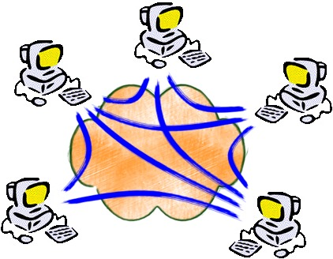
Chapter 7
Peer-to-Peer systems
Introduction
Overlays
Distributed Hash Tables

Slide 2

Chapter 7
Peer-to-Peer systems
Introduction
  Why P2P systems ?
  P2P generations
Overlays
Distributed Hash Tables

Slide 3
The rationale for P2P
Introduction
  Why P2P ?
Scaling and cost of client server systems
popular services need large server infrastructures
-> high investment and operational cost
total cost
System (HW/SW)
upgrade
#users
Observation
performance of edge devices grows (gap client – server closes)
performance only occasionally fully used

Slide 4
The rationale for P2P
Introduction
  Why P2P ?
“How to unleash the power of Internet’s dark matter ?”
P2P philosophy
make heavily use of edge resources
(CPU, storage, I/O devices, Information, ...)
#users ~ #edge devices
-> infrastructure grows together
(automatically) with user base
Need for software systems that can survive without central servers.

Slide 5

Some numbers
Introduction
  Why P2P ?
Edge resource estimation
In total
  #hosts : 10⁹
  processor performance : 2 GFLOPs
  disk space : 500 GB
Available
  1% connected hosts
  50% CPU power
  10% disk space
-> “P2P supercomputer”
    10⁴ PFLOPs CPU power
    5 10⁵ PB disk space
A “real” supercomputer
Nov 2012 :
1. Sequoia IBM (20 PFLOPs, 8 MW) @DoE
K Computer Fujitsu (11 PFLOPs, 12 MW) @Riken

Slide 6
Why is P2P difficult ?
Introduction
  Why P2P ?
Nodes
  large number of nodes
  unstable
  under control of end users
Interconnection infrastructure
  slow
  unreliable
No central control
  more complex managment
  (control infrastructure can fail)
decentralized control
self-organization
  handling failing nodes
  spreading load dynamically
=>

Slide 7
Characteristics of P2P systems
Introduction
  Why P2P ?
Shared characteristics
Users contribute to the total pool of available resources
(avoid free-riding)
All nodes in principle equal
System operation independent of centralized control
Application areas
file sharing
collaboration tools (Groove)
communication (VoIP P2P [Skype], chatting [Jabber])
CPU scavenging (SETI@Home, Folding@Home, ...)
Important problems
data placement and lookup
routing (use the network bandwidth efficiently)
provide anonymity
self-organization (self-management)

Slide 8

The history of P2P
Introduction
  2. P2P generations
Generation I : File sharing with centralized control
index maintained in a centralized infrastructure
download purely P2P
-> poor scalability
-> vulnerable to attacks
Generation II : File sharing with decentralized control
self-organization through overlay construction
two variants:
  pure P2P (all nodes identical)
  hybrid P2P (hierarchical structuring)
scalable and robust
Generation III : P2P middleware
middleware services offered:
  data placement
  data lookup
  automatic replication/caching
  authentication/security
applications built on top of P2P middleware

Slide 9
P2P-architectures
Introduction
  2. P2P generations
mediated
pure
hybrid
data traffic
P2P
P2P
P2P
control traffic
client-server
P2P
local : client-server
on distance : P2P
efficiency
+ efficient search
+ efficient control
- inefficient search
- BW consuming
+/-
scalability
- control hot spot
(mirrors needed ?)
- BW needed
grows rapidly
good compromise
robustness
- single point of failure
- easy to attack
+ graceful degradation
+ difficult to attack
?
accountability
easy
difficult
difficult
Generation I
Generation II

Slide 10




Generation I : Rise and fall of Napster
Introduction
  2. P2P generations
Aug ‘99
Shawn Fanning releases Napster on the Internet
Recording Industry Association of America sues Napster for copyright infringement
Oct ‘99
Dec ‘99
College campuses block Napster
Feb ‘00
5 million Napster users
Metallica sues Napster
300,000 users blocked
$
Apr ‘00
$15mio investment Hummer Winblad
Jun ‘00
Senate hearing on digital music and copyright
©
20 million Napster users
Aug ‘00
Oct ‘00
32 million Napster users
Bertelsmann drops lawsuit, provides loan to develop subscription service
Dec ‘00
$
2.7 billion songs downloaded in Feb01
Feb ‘01
Napster offers $1billion to record companies
Apr ‘01
On court order, Napster adds filters to block copyrighted content
Jun ‘01
90% of songs are blocked
Napster goes offline
Aug ‘01

Slide 11


Generation I : SETI@Home
Introduction
  2. P2P generations
SETI
=“Search for extraterrestrial Intelligence”
started in 1998 as a 2 year project
4 M users signed up
Radio telescope data sent to clients for digital signal analysis
Nodes process data when cycles are available
(works as screen saver)
Using resources to allow better signal analysis
35 GB/tape
16 hours recorded data
10 tapes/week, 350 GB
≈10 000 0.3 MB work units

Slide 12


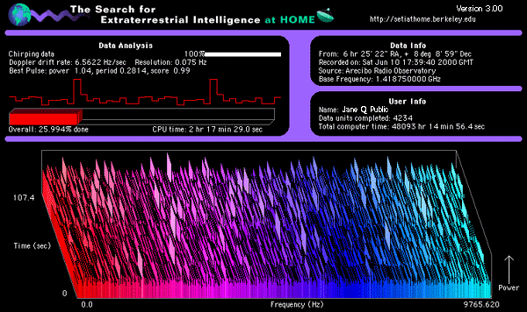
SETI : How it works
Introduction
  2. P2P generations
process
work unit
work unit
download client software
work unit
results
integrity check
store in data base

Slide 13
SETI : Some numbers
Introduction
  2. P2P generations
computations per work unit 3.1x10¹² FP-operations
work unit throughput 700 000/day
22x10¹⁷ FLOP/day
>25 TFLOPS
SETI@home
ASCI White@DoE
Processing
25 TFLOPS
12.3 TFLOPS
Cost
1 M USD
110 M USD

Slide 14
Generation III : P2P middleware
Introduction
  2. P2P generations
Requirements
add/find/remove distributed resources transparently
globally scalable
load balancing
exploitation of locality
dynamic adaptations (dynamic hosts/resources)
security of data
anonymity
Important platforms
Pastry, Tapestry, CAN, Chord, Kademlia

Slide 15
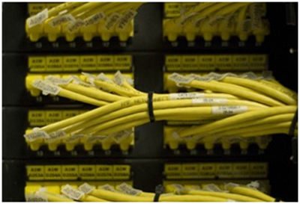
Chapter 7
Peer-to-Peer systems
Introduction
Overlays
Distributed Hash Tables

Slide 16
Overlay routing
2. Overlays
A
Full mesh overlay topology
scales badly !
dest. next hop
H B
E E
H
Overlay
B
E
B
dest. next hop
H E
E
A
dest. next hop
H H
a
c
e
h
dest. next
h c
e c
dest. next
h f
e d
b
d
c
g
f
g
a
dest. next
h g
dest. next
h h
f
IP layer
d
b
dest. next
e e
dest. next
e c

Slide 17

Overlay routing
2. Overlays
IP packet
IP header
IP payload
overlay packet
overlay
header
overlay
payload
IP source address
IP destination address
overlay source address (edge node ID)
overlay destination address (edge node ID)
IP layer and overlay layer have own
addressing scheme
routing protocol

Slide 18
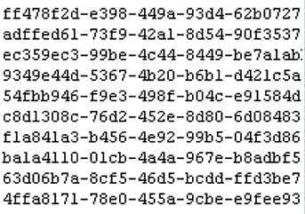
Content based routing
2. Overlays
Use ID of object to manipulate instead of node ID
-> overlay can redirect to closest replica
-> overlay can optimize placement and #replicas
Globally Unique ID (GUID)
constructed through hash of object state
  content itself
  object description
overlay = distributed hash table (DHT)
Responsibilities of DHT
find object given GUID (route requests)
  > map GUID to node ID
announce GUIDs of new objects
remove GUIDs of old objects
manage with nodes becoming unavailable

Slide 19
DHT routing vs. IP routing
2. Overlays
IP routing DHT routing
Size IPv4 : 2³² nodes > 2¹²⁸ GUIDs
IPv6 : 2¹²⁸ nodes flat
but: hierarchical structured
Load balancing routes determined by topology any algorithm can be used
(e.g. OSPF routes) objects can be relocated
to optimize routing
Dynamics static (time constant 1h) can be dynamic
asynchronous w.r.t. application synchronous or asynchronous
Resilience built in ensured through replication of objects
Target IP destination maps to 1 node GUID can map to different replicas

Slide 20
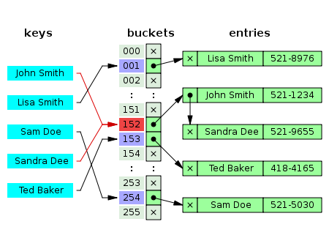
Chapter 7
Peer-to-Peer systems
Introduction
Overlays
Distributed Hash Tables
  Introduction
  Circular routing (1D)
  Pastry (1D)
  Chord (1D)
  CAN (nD)

Slide 21
Data management APIs
3. Distributed Hash Tables
1. Introduction
Distributed Hash Table [DHT] API
put(GUID,data)
remove(GUID)
value = get(GUID)
DHT takes care of:
      finding good location
      number of replicas needed
Distributed Object Location and Routing [DOLR] API
publish(GUID)
unpublish(GUID)
sendToObj(message,GUID,[#])
node made explicitely responsible for GUID

Slide 22
Bootstrapping
3. Distributed Hash Tables
1. Introduction
The bootstrapping problem
how to find a network node ?
Approaches
- pre-configured static addresses of stable nodes
- should have fixed IP address
- should always be on
- DNS-service
domain name resolves to nodes
Configuration info made available
- routing table bootstrap info
- GUID space the node is responsible for
- protocol information

Slide 23
DHT : GUID routing
3. Distributed Hash Tables
1. Introduction
Concept
hash
function
Content
Item
Node is responsible
for range of GUIDs it
belongs to
GUID
e.g. Node
Public key
Nodes are responsible for part of GUID space
{GUID}
Node1
Node2
GUIDs in intersection
are replicated
Node3

Slide 24
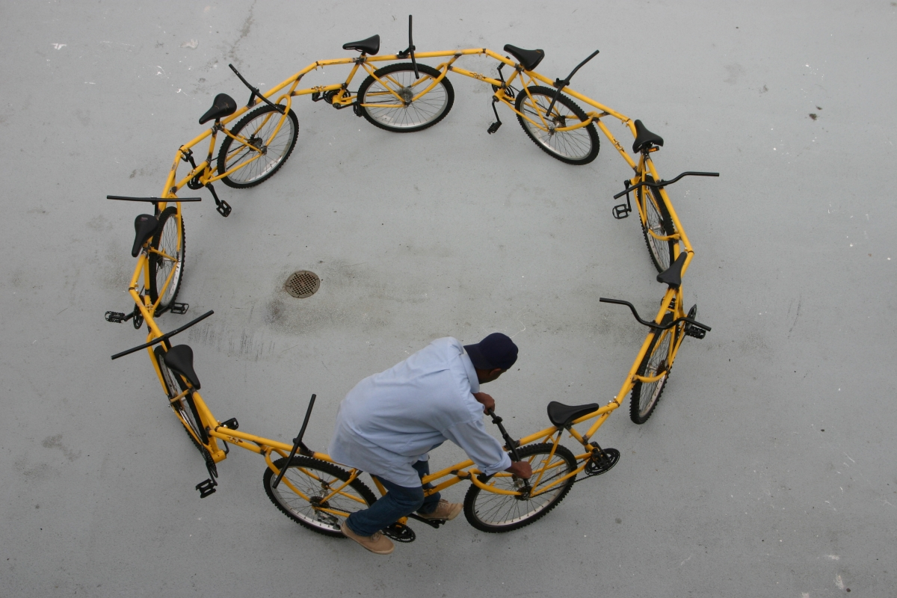
Circular routing
3. Distributed Hash Tables
2. Circular routing
Suppose : GUID consists of 4 hex symbols
0
FFFF
Active node 2
Active node 1
l=4
Active node has Leaf set (size 2l)
= Table (GUID,IP) of neighbours

Slide 25
Circular routing
3. Distributed Hash Tables
2. Circular routing
0
FFFF
l
k=Destination
l=4
j
i
Source
a
h
b
GUID IP
i IPi
j IPj
k IPk
l IPl
GUID IP
a IPa
b IPb
c IPc
d IPd
c
g
d
e
f
GUID IP
e IPe
f IPf
g IPg
h IPh
N active nodes
leaf set size = 2l
worst case
N/2l hops
=>

Slide 26
Prefix routing
3. Distributed Hash Tables
3. Pastry
Optimize routing efficiency
allow for longer jumps
without increasing leaf set
=> need for additional “jump” mechanism
0
FFFF
leaf set

Slide 27
Prefix routing
3. Distributed Hash Tables
3. Pastry
Routing table structure @active node
n-bit GUID -> n/4 routing table rows
(16 bit -> 4 rows)
p = longest prefix match
Routing table of node with GUID 53AF
[GUID,IP] of next hop for message
destinated for 5Cxx
p
0 1 2 3 4 5 6 7 8 9 A B C D E F
0 x x x x x x x x x x x x x x x
1 x x x x x x x x x x x x x x x
2 x x x x x x x x x x x x x x x
3 x x x x x x x x x x x x x x x
[GUID,IP] of next hop for message
destinated for 53A3 (=closest active node to 53A3)

Slide 28
Prefix Routing
3. Distributed Hash Tables
3. Pastry
Message m from S(ource) to D(estination) arrives in C(urrent) node
Leaf set : size 2l (L_{-l} -> L_{l})
R : routing matrix
if (L_{-l} ≤ D ≤ L_{l}) {
forward m
- to GUID_{i} found in leaf set
- to current node C
} else {
find longest prefix match p of D and C
c = symbol (p+1) of D
if(R_{pc} ≠ null) forward m to R_{pc}
else {
find GUID_{i} in L or R with |GUID_{i} – D|<|GUID_{i}-C|
forward m to GUID_{i}
}
}
Observation:
correct routing possible with empty routing table

Slide 29
Node dynamics : Joining
3. Distributed Hash Tables
3. Pastry
X
X wants to join
how to construct R_{X}, L_{X} ?
how to adapt R of all other nodes ?
Special “nearest neighbour” discovery
algorithm to find a nearby active node B
X sends join(X,GUID_{X}) to B
DHT routes join the usual way
to node F
min |GUID_{F}-GUID_{X}|
3. All nodes on routing path
send info to X to construct R_{X},L_{X}
Join
0
FFFF
R_{D},L_{D}
R_{F},L_{F}
R_{C},L_{C}
F
Join
R_{B},L_{B}
Join
D
Join
B
C

Slide 30
Node dynamics : Joining
3. Distributed Hash Tables
3. Pastry
Constructing R_{X}
{B₀,B₁,B₂, ... ,B_{N-1}} = set of physical nodes visited by Join message
B₀=B
B_{N-1}=F
Row 0 :
- used to route GUID with no common prefix
- bootstrap node B₀ (very) close to X
=> R_{X}[0]=R_{B0}[0]
Row 1 :
- used to route GUID with common prefix 1
- prefix(GUID_{B1},GUID_{X})≥1
=> R_{X}[1]=R_{B1}[1]
...
Row i : => R_{X}[i]=R_{Bi}[i]
Constructing L_{X}
X should be neighbour of F
initial choice : L_{X}=L_{F}

Slide 31
Node dynamics : Leaving
3. Distributed Hash Tables
3. Pastry
Only leaf sets are repaired
l=4
L_{D}
GUID(D₋₄) IP(D₋₄)
GUID(D₋₃) IP(D₋₃)
GUID(D₋₂) IP(D₋₂)
GUID(D₋₁) IP(D₋₁)
GUID(D₁) IP(D₁)
GUID(D₂) IP(D₂)
GUID(D₃) IP(D₃)
GUID(D₄) IP(D₄)
0
FFFF
L_{D2}
Failing node X
D₄
D₃
D finds node close to GUID_{X}
-> D₂
Get L_{D2}
Adapt L_{D} based on
-> Remove D₃
-> Add D₅
4. Propagate to neighbours
unreachable
D₂
Detecting node D
D₁
D₋₁
D₋₂
D₋₃
D₋₄
L_{D}

Slide 32
Chord
3. Distributed Hash Tables
4. Chord
Basic Chord API
lookup(key) : maps key -> IP address of node responsible for the key
Application built on top on Chord
- uses lookup(key)
- gets informed by Chord when key-set of current node changes
- is responsible for (if desired)
- authentication
- caching and replication
Sample applications
- cooperative mirroring (multiple servers cooperate to store content)
- time shared storage (ensuring data availability, even if server off-line)
- distributed indexes (content sharing)
- large-scale combinatorial search (e.g. code breaking)

Slide 33
Consistent hashing
3. Distributed Hash Tables
4. Chord
Hash function (SHA-1) produces m-bit identifiers
hash(nodeIP)
hash(key)
Identifiers mapped to identifier circle modulo 2^{m}
Key k -> hash(k) -> node(hash(k)) = successor(k)
= node with smallest identifier ≥ hash(k)
K=62
K=53
n1
n56
n12
K=10
m = 6
8 nodes
5 keys stored
n48
n24
K=48
n28
K=26
n36
n32

Slide 34
Joining and Leaving
3. Distributed Hash Tables
4. Chord
X Leaving
keys associated with X -> reassigned to successor(X)
X Joining
X gets some of the keys assigned to successor(X)
K=62
K=53
n1
n56
n12
K=10
n54
n48
n24
K=48
n28
K=26
n36
n32

Slide 35
Simple Routing
3. Distributed Hash Tables
4. Chord
Request lookup(id) arrives at node n
Node n knows id of its successor
n.findSuccessor(id) {
if id in (n,successor] return successor
else return successor.findSuccessor(id)
}
K=62
K=53
n1
n56
lookup(53)
n12
(a,b]
Clockwise interval
Excluding a, including b
n48
n24
K=48
n28
K=26
n36
n32

Slide 36
Skiplist routing
3. Distributed Hash Tables
4. Chord
Each node has finger table
≈ leaf set with non-equidistant node intervals
Finger table (m entries)
Distance ID IP
1
2
4
8
…
Routing to GUID
send message to successor GUID
= highest ID in finger table
with ID≤ GUID
O(log N) hops needed
Robustness
node keeps track of n successors
= circular routing in case finger table
not valid

Slide 37
Skiplist routing
3. Distributed Hash Tables
4. Chord
Finger table
Distance ID IP
1
2
4
More formally
row i in finger table is node at distance larger than 2^{i-1}
finger[i] =successor(n+2^{i-1} ) (i≥1)
n1
Finger table (m=6)
n12+1 n24
n12+2 n24
n12+4 n24
n12+8 n24
n12+16 n28
n12+32 n48
n56
n12
Finger table (m=6)
n48+1 n56
n48+2 n56
n48+4 n56
n48+8 n56
n48+16 n1
n48+32 n24
n48
n24
n28
n36
n32

Slide 38
Skiplist routing
3. Distributed Hash Tables
4. Chord
Routing : take largest jump possible !
lookup(53)
K=53
n1
Finger table (m=6)
n12+1 n24
n12+2 n24
n12+4 n24
n12+8 n24
n12+16 n28
n12+32 n48
n56
Finger table (m=6)
n48+1 n56
n48+2 n56
n48+4 n56
n48+8 n56
n48+16 n1
n48+32 n24
n12
n48
n24
n28
n36
n32

Slide 39
Skiplist routing
3. Distributed Hash Tables
4. Chord
Routing : take largest jump possible !
n.findSuccessor(id) {
if id in (n,successor] return successor
else {
n’=closestPreceedingNode(id)
return n’.findSuccessor(id)
}
}
n.closestPreceedingNode(id) {
for i=m downto 1
if finger[i] in (n,id] return finger[i]
return n
}

Slide 40
Node dynamics : Joining
3. Distributed Hash Tables
4. Chord
Bootstrapping (create a new ring)
n.create() {
predecessor=null
successor=n
}
Joining a ring (containing n’)
n.join(n’) {
predecessor=null
successor=n’.findSuccessor(n)
}

Slide 41
Node dynamics : Stability
3. Distributed Hash Tables
4. Chord
Stabilizing the ring
Runs periodically
Informs nodes about newly joined nodes
Fix finger tables
Fix predecessors
n.stabilize() {
x=successor.predecessor
if x in (n,successor]
successor = x // better successor found
successor.notify(n) // adapt predecessor of successor
}
n.notify(n’) { //n’ thinks it is the predecessor of n
if (predecessor==null) OR (n’ in (predecessor,n[)
predecessor = n’ // better predecessor found
}

Slide 42
Node dynamics : Stability
3. Distributed Hash Tables
4. Chord
n.stabilize() {
x=successor.predecessor
if x in (n,successor] successor = x // better successor found
successor.notify(n) // adapt predecessor of successor
}
n.notify(n’) { //n’ thinks it is the predecessor of n
if (predecessor==null) OR (n’ in (predecessor,n[)
predecessor = n’ // better predecessor found
}
Steady-State : no changes !
P.stabilize()
- adapts successor @P (s_{P})
- adapts predecessor @Q (p_{Q})
If successor and predecessor @P and Q correct,
i.e. s_{P} = Q, p_{Q} = P
x=successor.predecessor=(s_{P}).predecessor=p_{(sP)}=p_{Q}=P
-> x in (P,Q] ? -> FALSE
-> Q.notify(P)
P in (p_{Q},Q[ ? -> P in (P,Q[ ? -> FALSE
NO UPDATES
P(s_{P},p_{P})
Q(s_{Q},p_{Q})

Slide 43
Node dynamics : Join
3. Distributed Hash Tables
4. Chord
P(s_{P}=Q,p_{P}=?)
X(s_{X}=null,p_{X}=null)
X joins, P<X<Q
Ring stable
Q(s_{Q}=?,p_{Q}=P)
X.join(Q)
-> p_{X}=null
-> s_{X}=Q.findSuccessor(X)=Q
P(s_{P}=Q,p_{P}=?)
X(s_{X}=Q,p_{X}=null)
Q(s_{Q}=?,p_{Q}=P)

Slide 44
Node dynamics : Join
3. Distributed Hash Tables
4. Chord
P(s_{P}=Q,p_{P}=?)
X(s_{X}=Q,p_{X}=null)
Q(s_{Q}=?,p_{Q}=P)
X.stabilize()
-> x=successor.predecessor=(s_{X}).predecessor=p_{(sX)}=p_{Q}=P
-> P in (X,Q] -> FALSE
-> Q.notify(X)
Q.notify(X)
-> X in (p_{Q},Q[ = (P,Q[ -> TRUE -> p_{Q}=X
P(s_{P}=Q,p_{P}=?)
X(s_{X}=Q,p_{X}=null)
Q(s_{Q}=?,p_{Q}=X)

Slide 45
Node dynamics : Join
3. Distributed Hash Tables
4. Chord
P(s_{P}=Q,p_{P}=?)
X(s_{X}=Q,p_{X}=null)
Q(s_{Q}=?,p_{Q}=X)
P.stabilize()
-> x=successor.predecessor=(s_{P}).predecessor=p_{(sP)}=p_{Q}=X
-> X in (P,Q] -> TRUE -> s_{P}=X
-> X.notify(P)
X.notify(P)
-> p_{X} == null -> p_{X}=P
P(s_{P}=X,p_{P}=?)
X(s_{X}=Q,p_{X}=P)
Q(s_{Q}=?,p_{Q}=X)

Slide 46
Node dynamics : Join example
3. Distributed Hash Tables
4. Chord
N100 {K85,K93,K99}
N200 {K125,K135, K175}
N150 JOINS
N100 {K85,K93,K99}
N150 {}
N200 {K125,K135, K175}
N150 COPIES KEYS FROM N200

Slide 47
Node dynamics : Join example
3. Distributed Hash Tables
4. Chord
N100 {K85,K93,K99}
N150 {K125,K135}
N200 {K125,K135, K175}
N100, N150 and N200 stabilize
N100 {K85,K93,K99}
N150 {K125,K135}
N200 {K175}

Slide 48
Node dynamics : Stability
3. Distributed Hash Tables
4. Chord
n.fixFingers() {
next++ // f[next] will be fixed
if (next>m) next = 1
finger[next]=findSuccessor(n+2^{next-1})
}
n.checkPredecessors() { // allows active predecessor to enter
if (predecessor failed) predecessor = null
}

Slide 49
Node dynamics : Failures
3. Distributed Hash Tables
4. Chord
As long as each node knows successor -> correct operation of lookup
Consider finger table @P
P+1 Na
P+2 Nb
P+4 Nc
P+8 Nd
P+16 Ne
P+32 Nf
Suppose
- lookup(id) is launched @P, Nd<id<Ne
- nodes Na, Nb, Nc, Nd and Ne fail simultaneously
-> successor(id)=Nf (instead of Ne)
-> ERROR
Robustness ?
- each node has list of r first successors
- to corrupt ring -> r nodes have to fail simultaneously
- changes needed to stabilization and lookup code

Slide 50
Node dynamics : Failures (pseudo code)
3. Distributed Hash Tables
4. Chord
n.findSuccessor(id) {
if id in (n,successor] return successor
else {
try {
n’=closestPreceedingNode(id)
return n’.findSuccessor(id)
} catch(TimeoutException e) {
invalidate n’ from finger
and successor table
return n.findSuccessor(id)
}
}
}
n.closestPreceedingNode(id) {
for i=m downto 1
if finger[i] in (n,id] return finger[i]
for i=r downto 1
if successor[i] in (n,id] return successor[i]
return n
}

Slide 51
Multi-dimensional routing
3. Distributed Hash Tables
5. CAN
CAN : Content addressable network
Basic idea
use d-dimensional space to map keys
node is responsible for d-dimensional hypercube
- Cartesian coordinates used
- space is d-torus
Example 2D
(0,1)
(1,1)
[0.0->0.5,0.5->1.0]
[0.5->1.0,0.5->1.0]
[0.5->0.75,
0.25->0.5]
[0.0->0.5,0.0->0.5]
[0.75->1.0,
0.0->0.5]
[0.5->0.75,
0.0->0.25]
(0,0)
(1,0)

Slide 52
Multi-dimensional routing
3. Distributed Hash Tables
5. CAN
Mapping content to node
- Key-Value pair <K,V> mapped to point P in Cartesian space
P=hash(K)
- P belongs to region owned by node N
- N stores <K,V>
Retrieving entry for key K
- compute P=hash(K)
- if P not owned by requester or neighbours
-> route request in the CAN network
Self-organizing routing
node learns and stores set of neighbours
neighbour : shares hyperplane of dimension (d-1)
-> in (d-1) dimension, intervals overlap
info stored per neighbour n
IP(n), zone(n)
A
E
IP(A), zone(A)
IP(B), zone(B)
…
B
D
C
F

Slide 53
Multi-dimensional routing
3. Distributed Hash Tables
5. CAN
Neighbour nodes : examples
Suppose equally partitioned zones (regular d-dimensional grid)
Number of neighbours : 2d
Average routing path length = (d n ^{1/d})/4

Slide 54
Multi-dimensional routing
3. Distributed Hash Tables
5. CAN
Routing in d dimensions
Follow straight line from source to destination
(0,1)
(1,1)
(0.8,0.9)
lookup(0.8,0.9)
(0,0)
(1,0)

Slide 55
Multi-dimensional routing
3. Distributed Hash Tables
5. CAN
Routing in d dimensions
Forward to closest neighbour (greedy forwarding)
-> each node keeps track of at least d neighbours
-> space complexity O(d)
-> lookup cost O(dN^{1/d}) (N number of nodes)
(0,1)
(1,1)
(0.8,0.9)
lookup(0.8,0.9)
(0,0)
(1,0)

Slide 56
Node dynamics : Joining the CAN
3. Distributed Hash Tables
5. CAN
1. Find an active node in the CAN (Bootstrapping)
- CAN has DNS name
- DNS resolves to IP address of bootstrapping node
- each bootstrap node has list of probably active nodes
- nodes that joined before
- nodes can notify before they leave
- nodes supposed to reply to ping-messages from bootstrap
- bootstrap node replies to “join” by random selection from the
active node list
- essential to minimize activity of the bootstrap node
2. Find a zone to care for
3. Publish new node to neighours

Slide 57
Node dynamics : Joining the CAN
3. Distributed Hash Tables
5. CAN
1. Find an active node in the CAN (Bootstrapping)
2. Find a zone to care for
- X selects random point P
- X sends JOIN(P) -> arrives at node N currently responsible for P
- N splits zone in 2
- N sends to X
- range of keys X will be responsible for
- <Key,Value> pairs X will handle
3. Publish new node to neighbours
N
N
X
X -> JOIN(P)

Slide 58
Node dynamics : Joining the CAN
3. Distributed Hash Tables
5. CAN
Joining : example
C
B
C
A
B
A
D
X
D
F
F
E
E
H
H
G
G
neighbour’(B) = {A,C,G,X}
neighbour’(X) = {A,D,F,B}
neighbour(B) = {A,C,D,F,G}

Slide 59
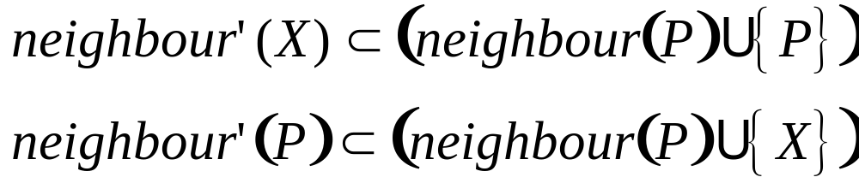
Node dynamics : Joining the CAN
3. Distributed Hash Tables
5. CAN
1. Find an active node in the CAN (Bootstrapping)
2. Find a zone to care for
3. Publish new node to neighbours
- X and P update neighbour set
- X and P send immediate update on zone(X) and zone(P) to
neighbour(P) and neighbour(P’)
- every node sends periodic refreshes (soft-state updates)
- n + zone(n)
- for each neighbour : ID + zone
Joining is a LOCAL operation
-> only neighbours are affected
-> O(d)

Slide 60
Node dynamics : Leaving the CAN
3. Distributed Hash Tables
5. CAN
Normal exit
- X checks if zone(X) can be merged with zone(n)
- if so, zone(X) is handed to n
- if not, a neighbour zone will take care of multiple zones
- which neighbour ?
minimize maximum zone size of neighbours
Unexpected departure (failure)-> Immediate take-over
Failure detected through absence of update messages
When node N detects X has departed (probably multiple Ns !)
- start take over timer
timeout = C zoneSize(N)
when time-out {
N sends TAKEOVER(zoneSize(N)) to neighbour(X)
update zone(N) info
}
- on receipt of TAKEOVER(zoneSize(Y)) at node N
if(zoneSize(Y)<zoneSize(N)) {
cancel timer @ N
update neighbour info
}
else send TAKEOVER(zoneSize(N)) to neighbour(X)

Slide 61
Node dynamics: Leaving the CAN
3. Distributed Hash Tables
5. CAN
Unexpected departure (failure)
Immediate take-over algorithm OK to handle single node failures
If less than 50% of neighbour(X) nodes reachable
-> locate active neighbours through expanding ring search
prior to take-over
Expanded ring search @ node N
TTL = 1
do {
broadcast request for info to neighbours(N)
TTL++
} while neighbourInfo incomplete
Avoid too much fragmentation
background zone-reassignment process

Slide 62
Advanced CAN
3. Distributed Hash Tables
5. CAN
Increase d
  - reduces hop count and latency
  - increases node state
2. Use multiple “realities”
- as if separate instances of CAN are running on same node infrastructure
- in each reality, node is responsible for different zone
-> improved data availability, robustness
-> reduced latency
RTT based routing metrics
- use RTT weighted distances when forwarding
-> favours low latency paths
-> lower latency
Overloading coordinate zones
- multiple nodes are responsible for same zone (“peers”)
- reduces number of zones
-> reduced path length
-> reduced latency
-> improved fault tolerance

Slide 63
Advanced CAN
3. Distributed Hash Tables
5. CAN
Multiple hash functions
- k different hash functions map same value to k nodes
- queries are sent to k nodes
-> improved latency
-> improved data availability
- cost : larger node state, increased query traffic
- instead of launching parallel queries: start with query to closest node
Organize coordinate space based on physical network layout
Uniform coordinate partitioning
prior to splitting zone, check whether neighbour could be split
(i.e. has larger zone)
-> better load balancing
Caching and replication to manage hot spots
- cache recently accessed data in node, and check cache before forwarding
- replicate frequently accessed data in neighbouring nodes

Slide 64
Research challenges
3. Distributed Hash Tables
5. CAN
Appropriate distance function
Keep system structure simple under frequent joins/leaves
Fault tolerance measures
Concurrent changes
Proximity routing (adapt logical routing to physical topology)
Cope with malicious nodes
Indexing and keyword search (instead of ID’s)

