Slide 1
ASP.NET Identity - Database
© 2014 Edument AB. All Rights Reserved

Slide 2
ASP.NET Identity - Database
ASP.NET has its own default database structure for the purpose of handling user information.
AspNetUserRoles
AspNetUsers
AspNetUserClaims
AspNetRoles
AspNetUserLogins
_MigrationHistory

Slide 3
ASP.NET Identity - Database
AspNetUsers
Column | Description
Id | A generated GUID value
Username | Email value by default
Email | Users email
PhoneNumber | Users phone number
PasswordHash | Hashed password
SecurityStamp | A generated GUID value
EmailConfirmed | Confirmation for email
PhoneNumberConfirmed | Confirmation for phone number
TwoFactorEnabled | Enables email / phone confirmation
LockOutEnabled | Enables lock out
LockOutEndDateUtc | Sets the lock out time
AccessFailedCount | Number of failed logins attempts
User information

Slide 4
ASP.NET Identity - Database
Specific content of table AspNetUsers:
Id is the primary key and is generated as a GUID
PasswordHash is generated hash of 68 characters
UserName is stored without any serialization and is the value as the email

Slide 5
ASP.NET Identity - Database
Globally Unique Identifier (GUID)
As seen before the Id and security stamp property
Måste använda guid?

Slide 6
ASP.NET Identity - Database
Password hasher in ASP.NET Identity
ASP.NET Identity uses Password based key Derivation Function 2.
Används per default går att ändra
The password is salted and hashed….

Slide 7
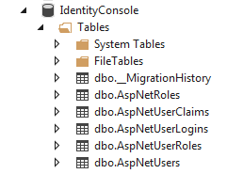
ASP.NET Identity
When we run the application the IdentityDbContext will create tables in our database

Slide 8
ASP.NET Identity
dbo.AspNetUsers contains all the users
dbo.AspNetRoles contains all the roles
dbo.AspNetUserRoles contains the relations between users and roles
dbo.AspNetUserClaims contains all the claims which belong to a specific user
dbo.AspNetUserLogins contains all the users who login using an external login
dbo.MigrationHistory contains all the performed database migrations
?? Höra med tore

Slide 9
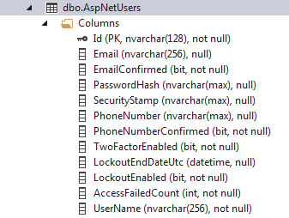
ASP.NET Identity
The table AspNetUsers contains several columns to handle a user
?? Fråga Tore

