Slide 1
ASP.NET Identity External Login Providers
© 2014 Edument AB. All Rights Reserved

Slide 2
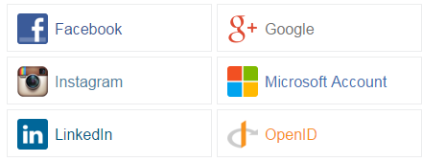
ASP.NET Identity
What is External Login Providers
An alternative to handle user authentication using OAuth

Slide 3
ASP.NET Identity
Benefits of External Login Providers
Delegates the responsibility of user authentication
Takes advantage of already safe implemented authentication
Removes the need for user registration
No need for storing user credentials
Application
Authentication
Facebook

Slide 4
ASP.NET Identity
Use Case scenario
Let us say that we have an application for public use, which will handle a lot of users
Then it would be wise to implement external login providers to offer an easy way to authenticate

Slide 5
ASP.NET Identity
Disadvantages with External login providers
The external login provider could crash / shut down
Users may not trust the service
Might be affected if the external login provider has a security breach

