Slide 1
ASP.NET Identity
© 2014 Edument AB. All Rights Reserved

Slide 2
ASP.NET Identity
Setting up a database using ASP.NET Identity

Slide 3
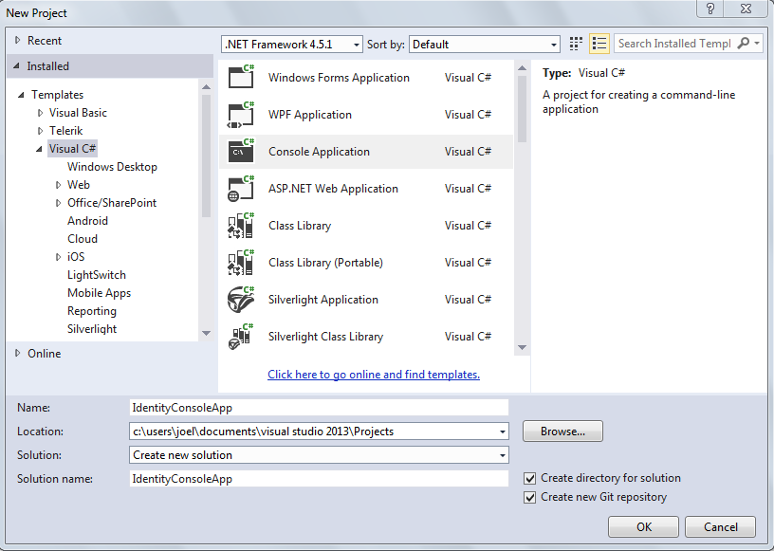
ASP.NET Identity
We will start by creating a new console application. We will call it “IdentityConsoleApp”

Slide 4
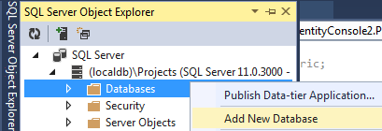
ASP.NET Identity
Open the SQL Server Object Explorer and create a new database to your localdb

Slide 5
ASP.NET Identity
Then we add the connectionstring to our app.config file.
<connectionStrings>
<add name="DefaultConnection"
connectionString=“Data Source=(localdb)\Projects;Initial
Catalog=IdentityConsole;Integrated Security=True;
Connect Timeout=30;Encrypt=False;TrustServerCertificate=False"
providerName="System.Data.SqlClient" />
</connectionStrings>
Please note that the connection string has to be on a single line!

Slide 6

ASP.NET Identity
We will have to add ASP.NET Identity
Open the Package Manager Console and type:
PM> Install-Package Microsoft.AspNet.Identity.EntityFramework
Or open the NuGet package manager by right clicking your project and choose Manage NuGet Packages

Slide 7
ASP.NET Identity
Now we initialize the database by making an instance of IdentityDbContext, and calling the Initialize method
Bool value which determines:
If true = run always
If false = run only if context has not been run before
static void Main(string[] args)
{
new IdentityDbContext<IdentityUser>().Database.Initialize(true);
}

Slide 8
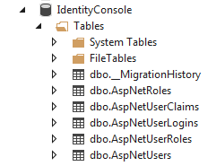
ASP.NET Identity
When we run the application the IdentityDbContext will create the following tables in our database

Slide 9
ASP.NET Identity
dbo.AspNetUsers contains all the users
dbo.AspNetRoles contains all the roles
dbo.AspNetUserRoles contains the relations between users and roles
dbo.AspNetUserClaims contains all the claims which belong to a specific user
dbo.AspNetUserLogins contains all the users who login using an external login
dbo.MigrationHistory contains all the performed database migrations
?? Höra med tore

Slide 10
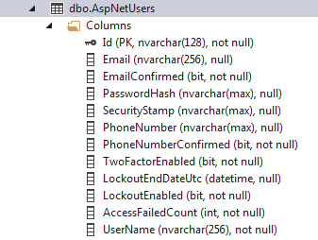
ASP.NET Identity
The table AspNetUsers contains several columns to handle a user
?? Fråga Tore

Slide 11
ASP.NET Identity
We will now add logic to seed the database, which we do by creating a class that we will call ApplicationDbInitializer which:
inherits from the generic DropCreateDatabaseAlways class
will contain the seed method.
public class ApplicationDbInitializer : DropCreateDatabaseAlways<IdentityDbContext<IdentityUser>>
Notes:
DropCreateDatabaseAlways<IdentityDbContext<IdentityUser>>() = An implementation of IDatabaseInitializer that will always recreate and optionally re-seed the database the first time that a context is used in the app domain. To seed the database, create a derived class and override the Seed method.

Slide 12
ASP.NET Identity
We override the seed method and use the class Usermanager to create 10 new users in the database
protected override void Seed(IdentityDbContext<IdentityUser> context)
{
var usermanager = new UserManager<IdentityUser>(
new UserStore<IdentityUser>(new IdentityDbContext<IdentityUser>()));
using (usermanager)
{
for (int i = 0; i < 10; i++)
{
var email = "user" + (i * 3) + "@example.com";
string phone = "12345678" + (i * 100 + i);
var tempuser = new IdentityUser()
{ UserName = email, Email = email, PhoneNumber = phone };
usermanager.Create(tempuser, "ASP+Rocks4U");
}
var appstore = new UserStore<IdentityUser>();
appstore.Context.SaveChanges();
base.Seed(context);
}
}
Notes:
UserManager<IdentityUser> = handles the IdentityUser, CRUD
UserStore<IdentityUser> = commits changes to the database

Slide 13
ASP.NET Identity
In the main method we set the initializer to initialize the ApplicationDbInitializer, which will run the seed method
static void Main(string[] args)
{
Database.SetInitializer(new ApplicationDbInitializer());
new IdentityDbContext< IdentityUser>().Database.Initialize(true);
}

Slide 14
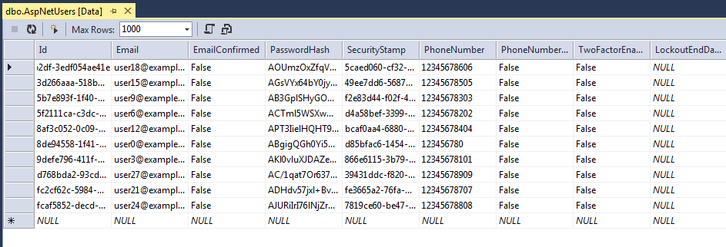
ASP.NET Identity
If we run the application now, the application will populate the database with 10 users

Slide 15
ASP.NET Identity
Adding additional properties
public class ApplicationUser : IdentityUser
{
public string Address { get; set; }
public string Country { get; set; }
public DateTime Created { get; set; }
}
Replace all the declarations of IdentityUser with ApplicationUser

Slide 16
ASP.NET Identity
Summary
In this module we have:
Created a database that uses ASP.NET Identity structure
Created a seed method to populate the database every time you run the application

