Slide 1
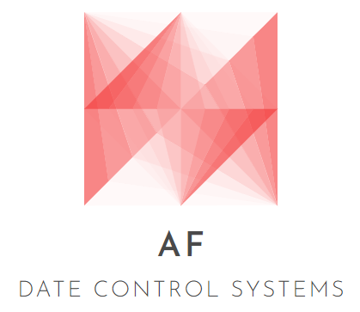

Andreas Fahey G00346830
APPLIED PROJECT AND MINOR DISSERTATION

Slide 2









Background
What is the project idea ?
How did the idea come about ?
What is the purpose of developing this application ?
Target Audience ?

Slide 3

Technologies
Used Ionic Firebase To develop the application.
Why Ionic Firebase ?

Slide 4

Technologies
Used GitHub for project development.
Used Visual Studio Code as a Software Editor for the software development.
Used Overleaf LaTeX Editor for project dissertation.

Slide 5

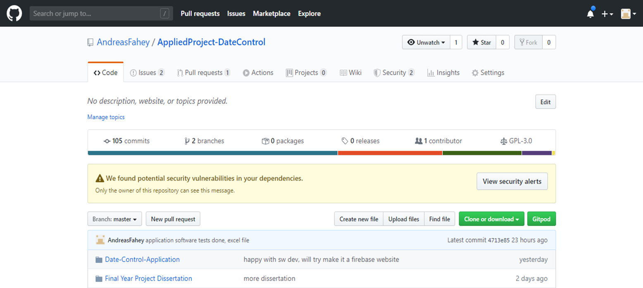
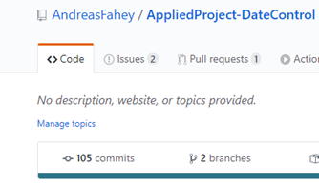
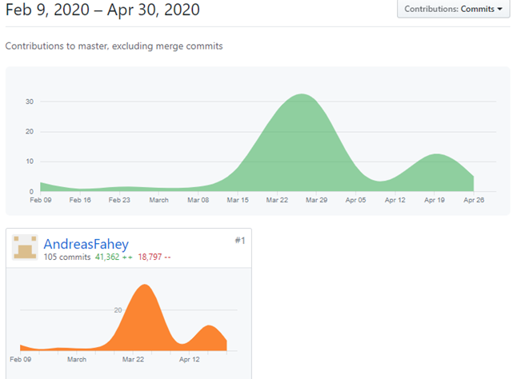
GitHub
Project Repo Screenshots below.
Repository Home, Commits & Insights.
Shows Project Development for software and dissertation.

Slide 6

Conclusion
Learning Outcomes
CBE Contact Made
Project Demo

