Slide 1

Web Development Team 3
Collaborative Math Game
Math Collab
Andreas Glaser
Andreas Khouri
Christa Strauß
Dzianis Brysiuk
Noah Lehmann
Tina Amann

Slide 2
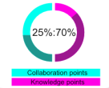
Rules of Collaboration
Rule Set #1
How Knowledge and Collaboration gets you to the next Level
Earn Points through:
Knowledge
Collaboration
Scoreboard
Levels | Collaboration Points | Knowledge Points
Beginner | 25% | 75%
Intermediate | 50% | 50%
Pro | 65% | 35%

Slide 3
Rules of Collaboration
Rule Set #2
How and when an artificial Intelligence needs to help students collaborate
Two basic Problems with Collaboration between most students:
Problem | Possible Solution
1. Nobody can or want‘s to answer your questions or help you with your problems | AI scans question for keywords to find the topic and generate answers or at least useful advice or wikis
2. Others are faster than you, you don‘t have the chance to help anybody | AI produces fake problems, visible only for students in need for collaboration points

Slide 4
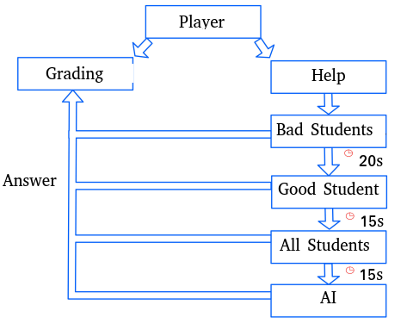
Rules of Collaboration
Rule Set #3
With the first two rules in mind, how a fair distribution of collaborative points is guaranteed
Problem: Faster students always grab the collaboration points before anybody else can, only artificial questioning is not the key to a collaborative environment!
Bad Students | <60% Knowledge
Good Students | Average
Overambitious | Detected answering too much!

Slide 5
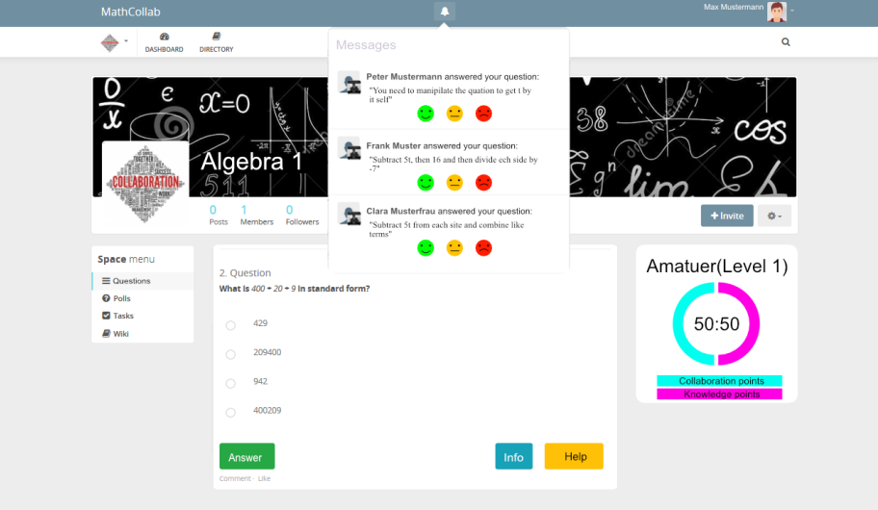
Wireframe
(based on HumHub)
Grade the
Answers on your
questions
AI Functionality
Scoreboard

