Slide 1
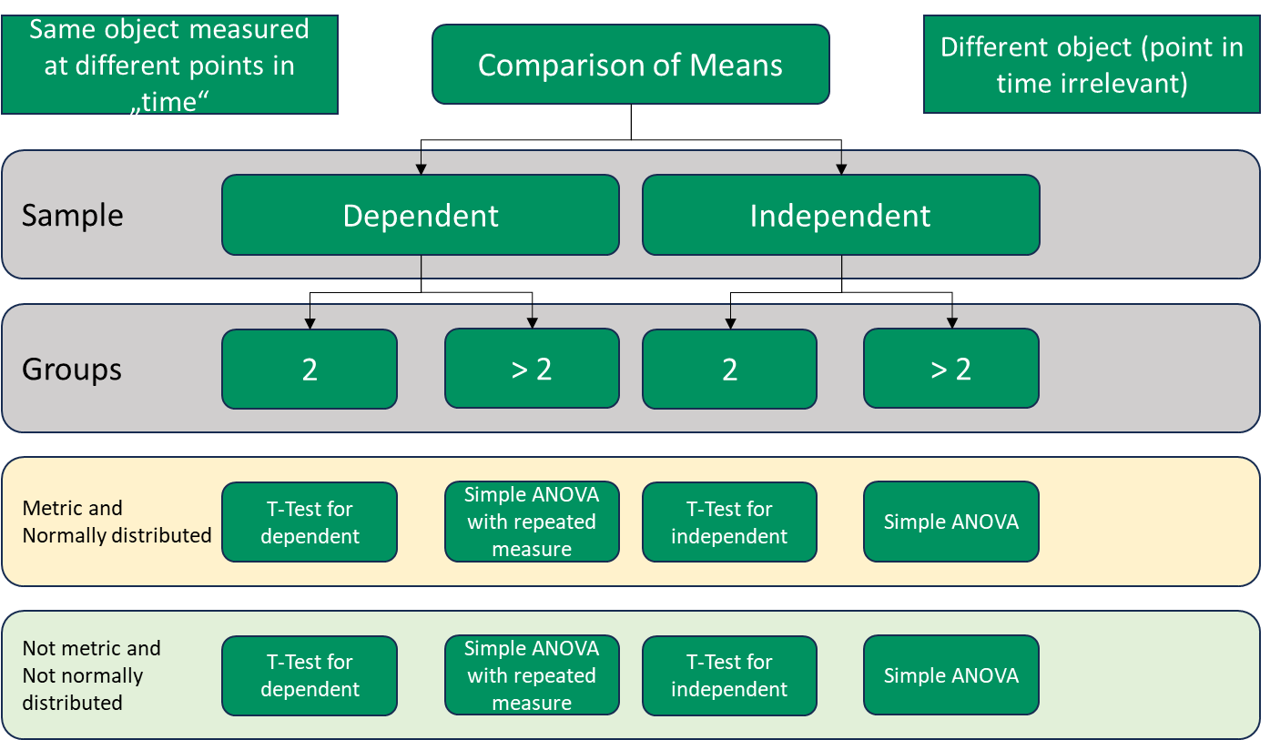
Signed-Rank-Test
Friedman-Test
Mann-Whitney-Test
Kruska-Wallis-Test

Slide 2
