Slide 1
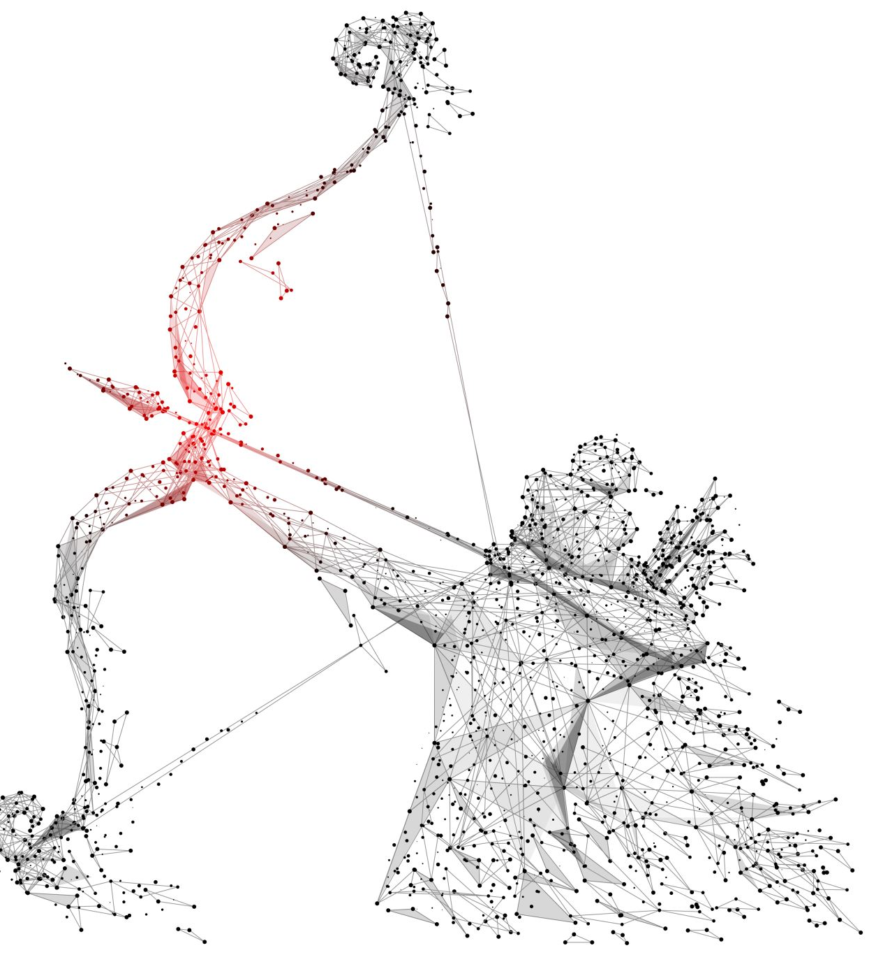
Hermes
DNN Inference Propagation under Thermal Constraints Violation

Slide 2
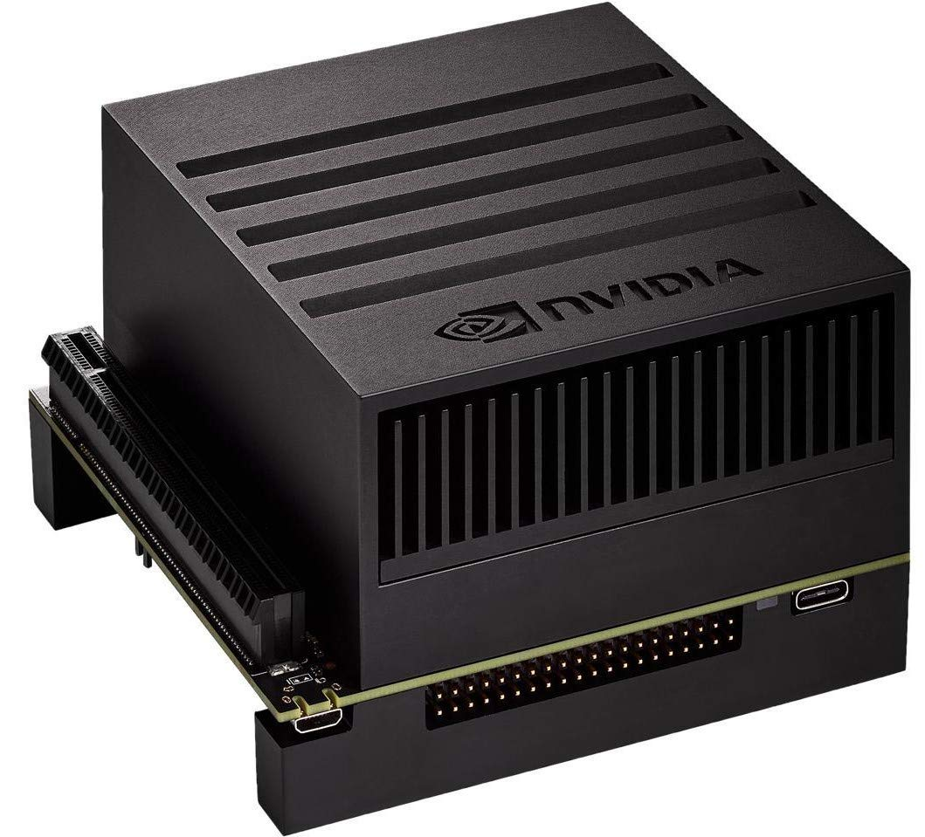
Edge
Jetson AGX Xavier
CPU: 8-core NVIDIA Carmel Armv8.2 64-bit
8MB L2
4MB L3
GPU: NVIDIA Volta™ architecture
512 NVIDIA CUDA® cores
64 Tensor cores
22 TOPS (INT8)
Deep Learning Accelerators: 2x NVDLA
10 TOPS (INT8)
RAM: 64 GB 256-bit LPDDR4x

Slide 3
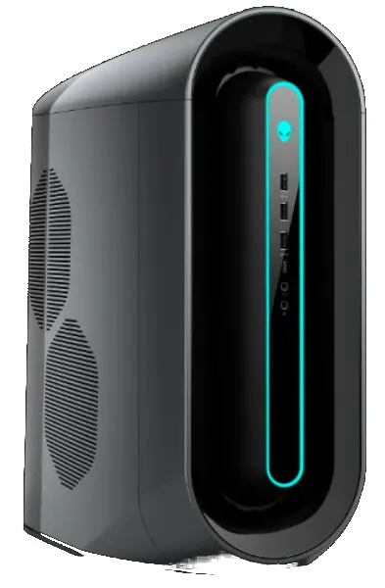
Cloud
Alienware Aurora R9, a high-end gaming desktop computer
CPU: Intel® Core™ i7-9700 Processor:
8 cores @ 4.70 GHz
GPU: x2 NVIDIA GeForce RTX 2070 SUPER
2560 NVIDIA CUDA® Cores
Boost Clock @ 1.77 GHz
8 GB GDDR6 Memory
RAM: 64 GB DDR4

Slide 4
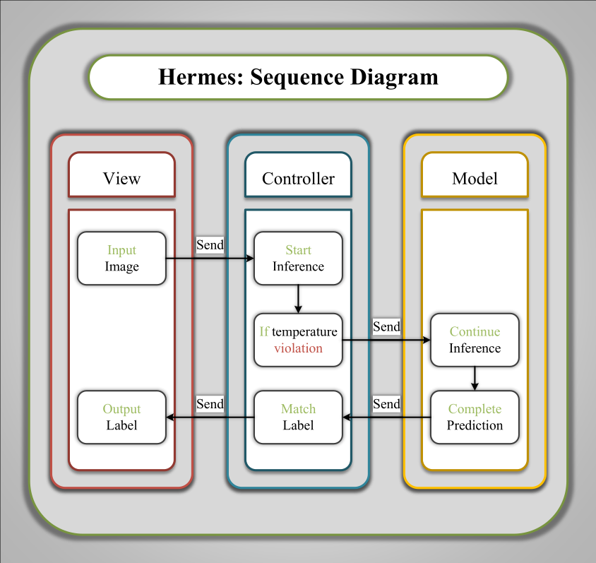
Hermes

