Slide 1
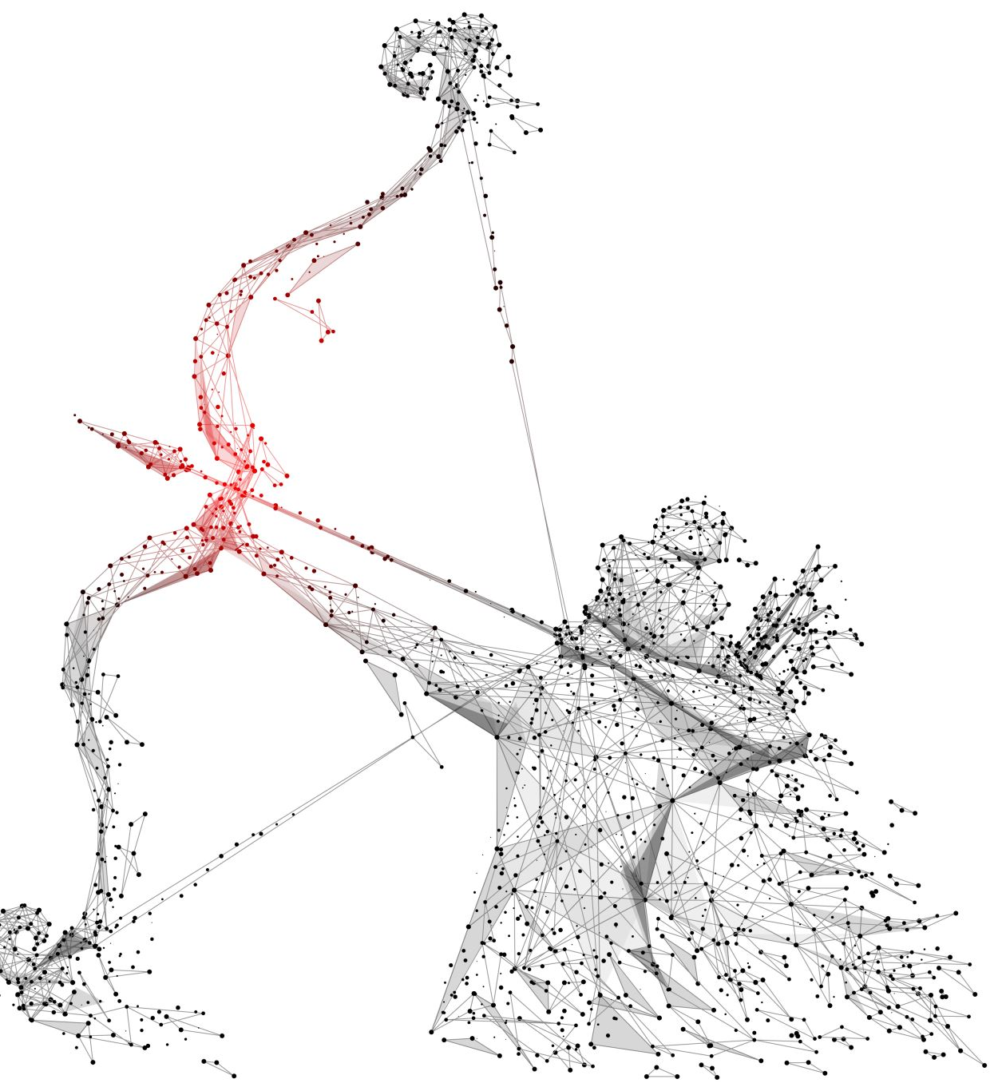
Hermes
DNN Inference Propagation under Thermal Constraints Violation

Slide 2
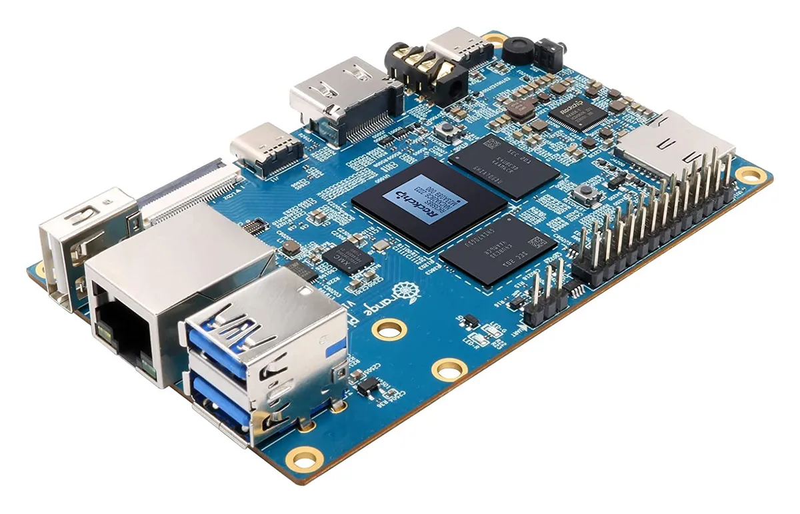
Edge
Orange Pi 5
CPU: 8-core x64 architecture:
4 Cortex-A76 @ 2.4GHz
4 Cortex-A55 @ 1.8GHz
GPU: ARM Mali-G610:
Mid-range GPU for smartphones and other mobile devices
4 graphics processing cores
NPU: 6 Tops AI computing power, empowering various AI scenarios
RAM: 16 GB

Slide 3
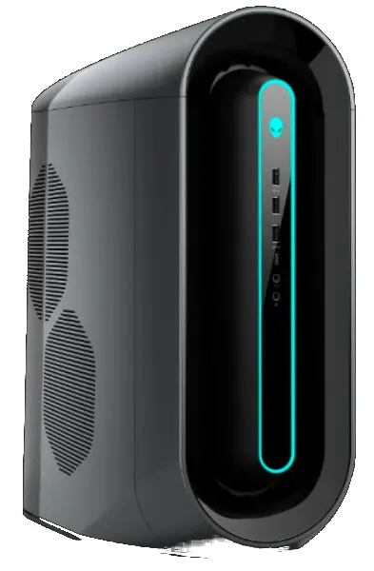
Cloud
Alienware Aurora R9, a high-end gaming desktop computer
CPU: Intel® Core™ i7-9700 Processor:
8 cores @ 4.70 GHz
GPU: x2 NVIDIA GeForce RTX 2070 SUPER
2560 NVIDIA CUDA® Cores
Boost Clock @ 1.77 GHz
8 GB GDDR6 Memory
RAM: 64 GB DDR4

Slide 4
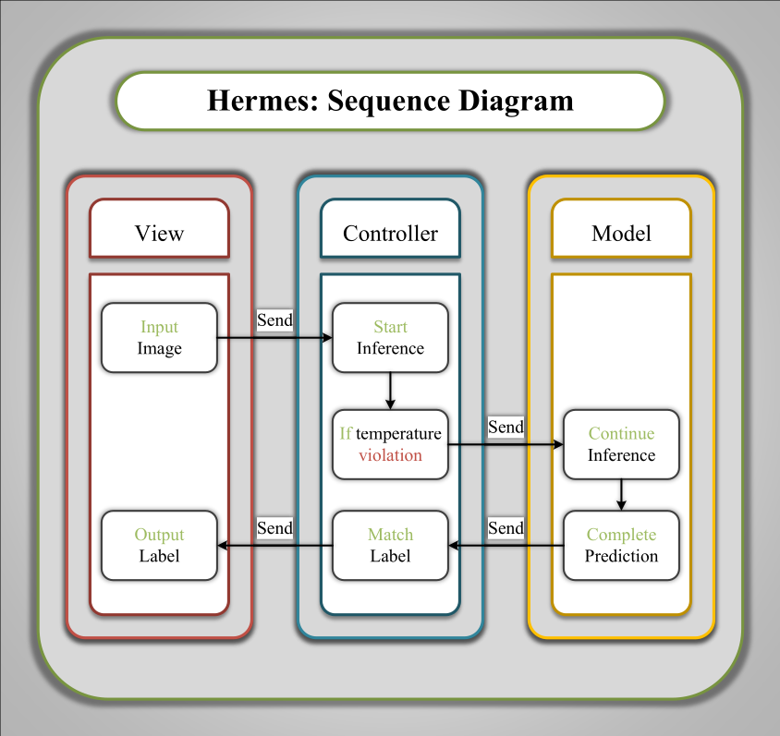
Hermes

