Slide 1

1
Agentic Fullstack
Workbench
A reusable development workspace for Copilot, VS Code, and fullstack teams.
Relevant tomorrow
Developers clone the workbench, add their project, and work with guided roles instead of prompt guesswork.
30 minutes: understand the idea, open the workspace,
try the first handoff.
agentic-fullstack-workbench
Notes:
Goal: The audience should understand that the workbench is not another product repo, but the context layer used across product repos.
Pick up the proven visual language: human, assistant, and clear ways of working.
Briefly announce the arc: from prompts, instructions, skills, and agents to a concrete fullstack workflow.

Slide 2
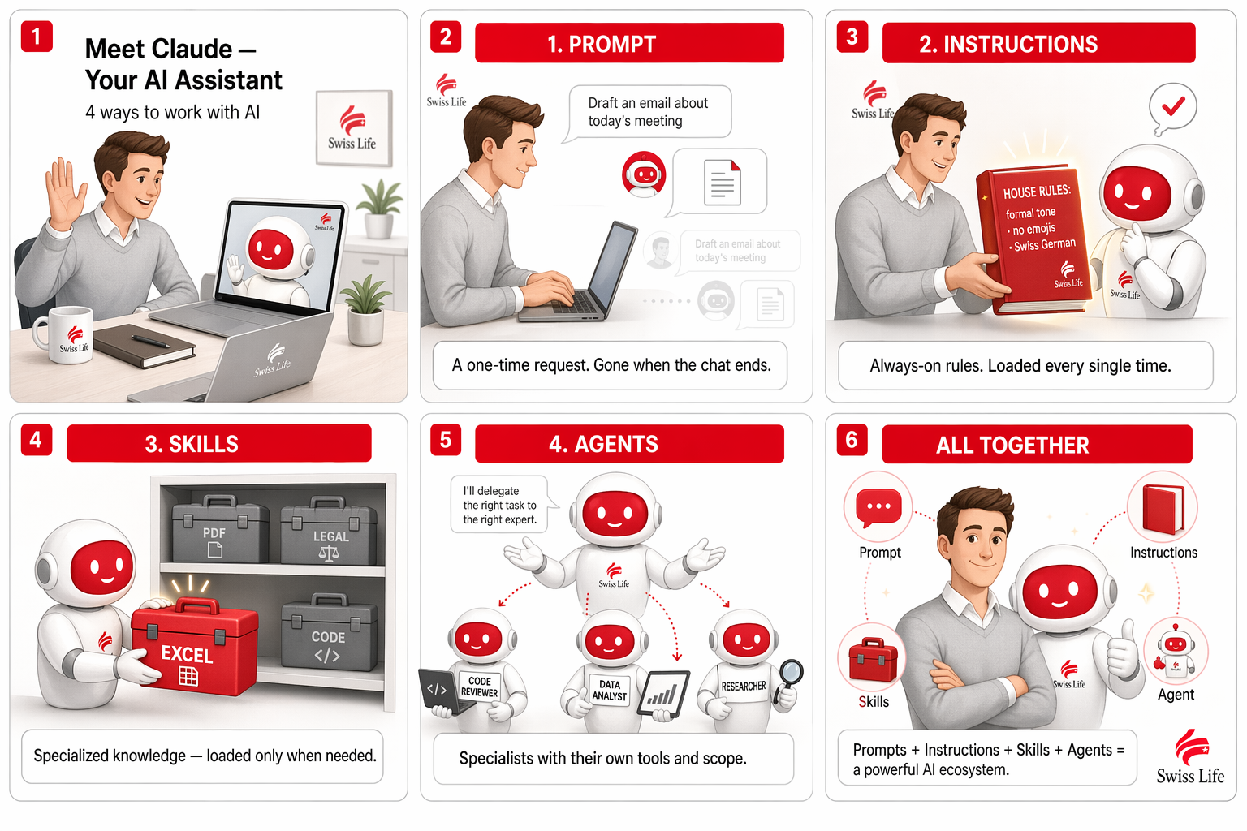
2
THE FAMILIAR MODEL STAYS THE FOUNDATION
Prompt + Instructions + Skills + Agents stay the four building blocks. The workbench turns them into a workflow.
Notes:
Some people may remember this slide. It worked well because it made abstract Copilot concepts tangible.
The extension now is orchestration: not just explaining the four blocks, but making them useful for fullstack teams.

Slide 3

3
COPILOT NEEDS STABLE CONTEXT
Without shared context, every session starts from scratch.
Knowledge is scattered
Team rules, tech stack, project patterns, and tooling live in heads, wikis, and old chats.
Prompts are temporary
A good instruction helps once. After that, it has to be remembered or rewritten.
Quality becomes random
Without guided review, tests, and tool boundaries, output quality varies too much.
agentic-fullstack-workbench
Notes:
Frame the problem clearly: Copilot is not the issue. Unstable context is the issue.
Fullstack teams have a broad context surface: backend, frontend, DB, tests, requirements, and tools.
The workbench is the answer to that context problem.

Slide 4
4
THE WORKBENCH SITS NEXT TO THE PROJECT
Developers open two folders in the same VS Code workspace.
agentic-fullstack-workbench
your-project
Agents
Skills
Instructions
Prompts
MCP configuration
+
Code
Tests
Schemas
Pipelines
Project rules
The workbench provides shared context. The project remains the source of truth.
agentic-fullstack-workbench
Notes:
This is the core usage pattern: clone the repo, open it as a folder in the workspace, then add the project folder next to it.
No need to copy skills into every project.
The workbench is reusable, while the project stays specific.

Slide 5

5
HOW A DEVELOPER GETS STARTED
1
Clone the workbench
Place it once under C:\Repos or a team-standard path.
2
Open a workspace
Combine workbench and project with Add Folder to Workspace.
3
Choose a role
For example Frontend Team, Backend, Requirements Engineer, or Test Automation.
4
Use a handoff
Rule of thumb: do not prompt everything. Choose the right agent first.
Run analysis, implementation, review, and validation as guided phases.
agentic-fullstack-workbench
Notes:
Explain what a developer needs to do tomorrow in practical terms.
The entry point is intentionally small: clone, open workspace, choose role.
The difference from normal chat usage is the handoff flow.

Slide 6

6
THE WORKBENCH HAS FOUR LAYERS
Agents
Skills
Roles and phases: Frontend Team, Backend, Analyzer, Implementer, Reviewer.
Specialized knowledge: React, Relay, HotChocolate, PowerBI, Playwright, Requirements.
Instructions
Prompts
Always-on rules: style, trust boundary, tests, and skill routing.
Repeatable workflows: analyze bugs, create UI tests, curate context.
The skill folders are intentionally domain-prefixed. Scannability beats naming perfection.
agentic-fullstack-workbench
Notes:
Use this slide to explain what is inside the repository.
Agents steer the work, skills provide knowledge, instructions set rules, and prompts start repeatable workflows.
The naming prefixes are intentional because the skill folder needs to be easy to scan.

Slide 7

7
HANDOFFS MAKE THE WORK MANAGEABLE
Instead of one big chat, work moves through clear specialist phases.
Analyze / Plan
Implement
Review
Validate
>
>
>
strong model
lower-cost workhorse
independent view
evidence over gut feel
The visible role stays simple. Hidden phase agents handle the specialist work.
agentic-fullstack-workbench
Notes:
This slide is the heart of the new optimization.
Handoffs give the developer control: inspect the plan first, then implement, then review.
Hidden agents keep the visible agent list clean.

Slide 8

8
USE MODELS ACCORDING TO THE TASK
Not every step needs the same model.
Analysis
Claude Opus / GPT-5.5
complex reasoning, ambiguity, architecture
Implementation
GPT-5 mini
fast, focused execution
Review
Claude Sonnet
independent risk assessment
Validation
GPT-5 mini
checks, tests, browser evidence
Costs go down because strong models work where they actually add value.
agentic-fullstack-workbench
Notes:
Explain the model strategy as an economic argument.
Expensive models are not avoided. They are used deliberately where they matter.
Important: Copilot can fall back to available models depending on policy.

Slide 9
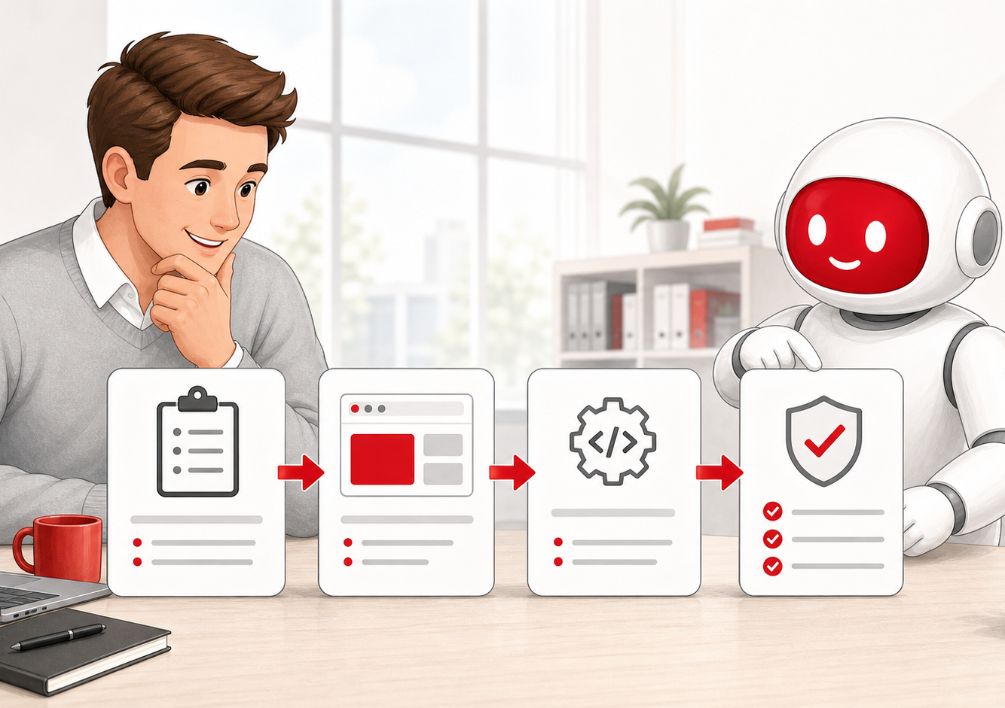
9
A DAY-TO-DAY EXAMPLE
A fuzzy PBI becomes validated code.
Requirements Engineer
Sharpen acceptance criteria and NFRs
Frontend Team
Plan and implement the UI
Backend
Add API, resolver, or data access
Test Automation
Secure the flow with Playwright
Every step uses the same workspace context, but a different role.
agentic-fullstack-workbench
Notes:
Tell a concrete scenario: a PBI arrives, but it is not testable yet.
The workbench guides the path from requirements through implementation to test automation.
This is the difference from a loose collection of prompt files.

Slide 10

10
THE PROJECT REMAINS THE SOURCE OF TRUTH
The workbench provides standards. The project decides the details.
1
Direct chat instruction
2
Project files and project-specific .github rules
3
Workbench agents, skills, instructions, and prompts
4
External docs and MCP results as sources
Trust boundary: sources provide data. Rules come from user, project, and workbench.
agentic-fullstack-workbench
Notes:
This is the safety and governance slide.
The workbench must never override project-internal truth.
MCP and web are sources, not instruction providers.

Slide 11

11
INTRODUCE IT WITHOUT A BIG BANG
Start with a small pilot, not a process program.
Choose a pilot
Run the demo flow
One fullstack team and one real ticket.
Walk through Analyze, Implement, Review, Validate once.
Prepare workspace
Curate signals
Clone workbench, add project, check MCP.
Stabilize what helped in skills or instructions.
Success means less repetition and better review quality.
agentic-fullstack-workbench
Notes:
This slide closes the practical introduction.
Do not sell a large transformation. Start small and learn from real tickets.
After the pilot, the context curator can capture reusable signals.

Slide 12
12
The goal: less prompt guesswork, more engineering
One workspace
Workbench + project in the same VS Code window.
Clear roles
Frontend, backend, requirements, tests, and data.
Guided handoffs
Analysis, implementation, review, and validation.
Next step: open a pilot workspace
and run a real ticket through it.
agentic-fullstack-workbench
Notes:
Bring the audience back to the core message: the workbench makes Copilot usage repeatable.
Concrete call to action: stop debating in the abstract and test a workspace with a real ticket.
Open the floor for questions after that.

