Slide 1
Simplified Device-Transparent Personal Storage
Andreas Kittilsland

Slide 2
Overview
Introduction, goal and context
Approach
Experiments and results
Discussion
Conclusion
Notes:
Først introdusere oppgaven, hva som var målet med oppgaven, og konteksten oppgaven befinner seg I
Så hvordan jeg har løst oppgaven. Design, arkitektur og implementasjon osv.
Deretter et utvalg av eksperimenter som er blitt gjennomført på prototypen, og resultatene fra disse.
Så en diskusjon på hvilke ting som kunne blitt gjort bedre eller anerledes, evt. Andre problemer.
Tilslutt en konklusjon og hva jeg føler oppgaven oppnår.

Slide 3
Introduction
- Context
Average 5 devices per connected person by 2019
Different set of data files and applications depending on type of device
On-line cloud services
Notes:
Vi får stadig flere og flere personlige enheter. i følge Cisco vil hver person som er tilkoblet internet ha 5 enheter innen 2019
Mengden enheter som alle har lokal lagring, fører til at ens personlige filer splittes opp og fordeles utover enhetene.
Det samme gjelder applikasjoner, som gjerne kun er installert og derfor tilgjengelige på enkelte enheter, ofte der de egner seg best.
Ofte forsøker brukere å løse dette ved bruk av sentraliserte systemer, som f. eks. Skylagring eller en sentralisert hardisk plassert på det lokale nettverket.
Disse løsningene bringer med seg flere problemer, som “single point of failure”, stole på eksterne selskaper osv.

Slide 4
Introduction
- Thesis Statement (1)
Assume…
always connectivity
accessible files system
accessible information on applications
possible to run more than one instance of app
a data file only touched by one at a time

Slide 5
Introduction
- Thesis Statement (2)
Limitations
Applications run where they are installed
Data files accessed where they are stored

Slide 6
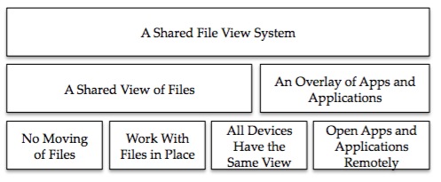
Approach and Implementation
- Idea

Slide 7
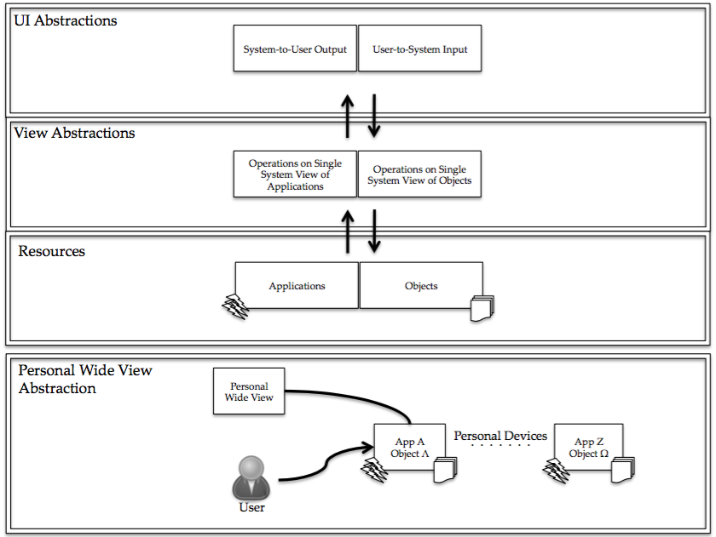
Approach and Implementation
- Architecture

Slide 8
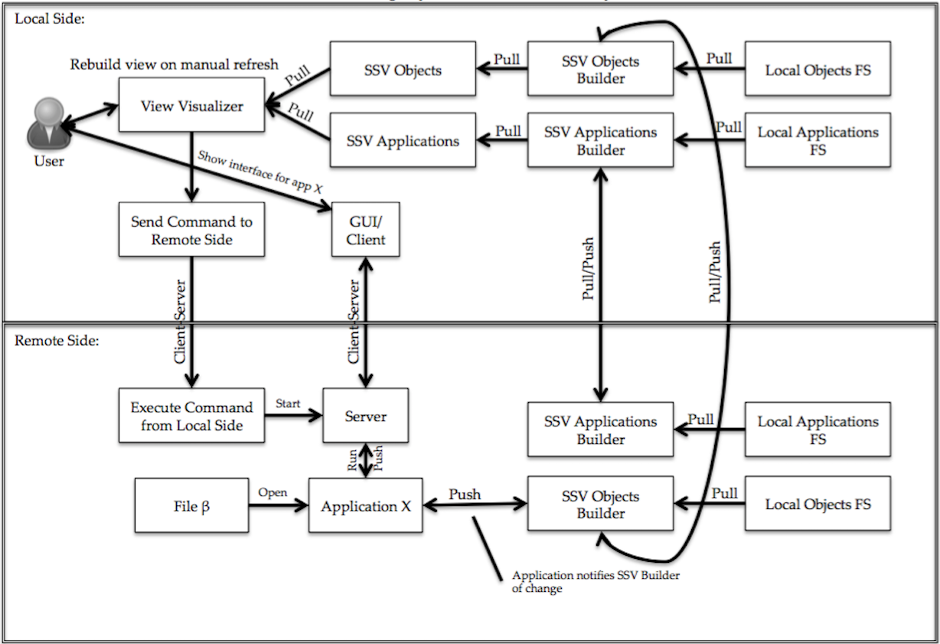
Approach and Implementation
- Design
SSV: Single System View FS: File System

Slide 9
Approach and Implementation
- Implementation: Overview (1)
Backend Go, frontend JavaScript
GUI in HTML and QML
TCP/IP, HTTP and pipes.

Slide 10
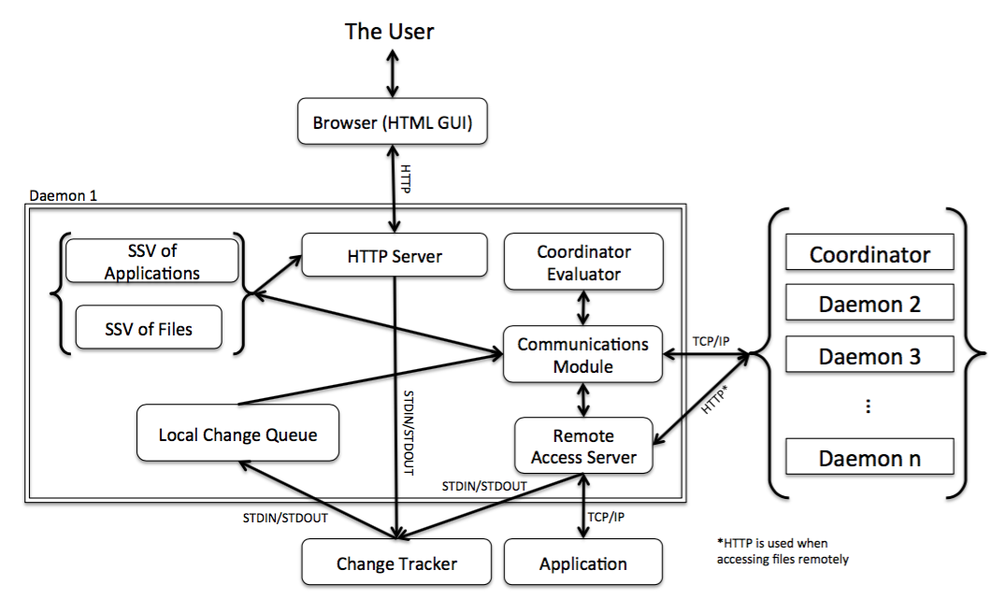
Approach and Implementation
- Implementation: Overview (2)
SSV: Single System View

Slide 11
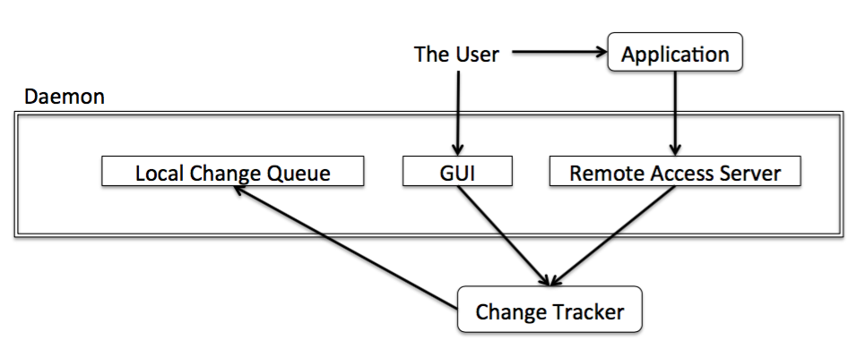
Approach and Implementation
- Implementation: Single System View of Data Files (1)

Slide 12
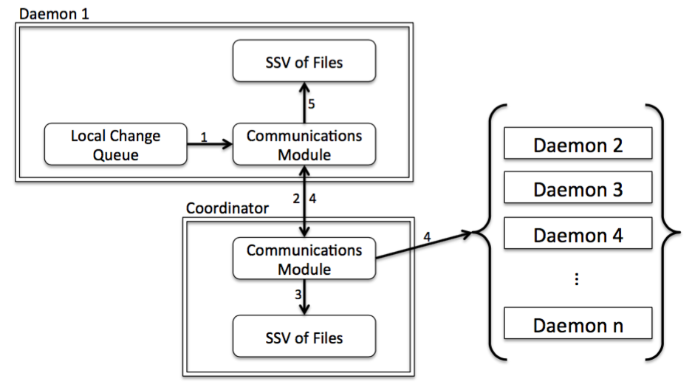
Approach and Implementation
- Implementation: Single System View of Data Files (2)

Slide 13
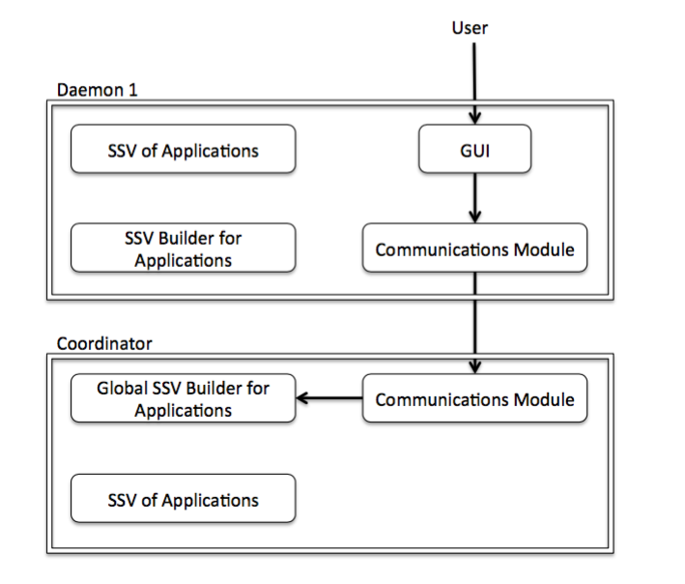
Approach and Implementation
- Implementation: Single System View of Applications (1)

Slide 14
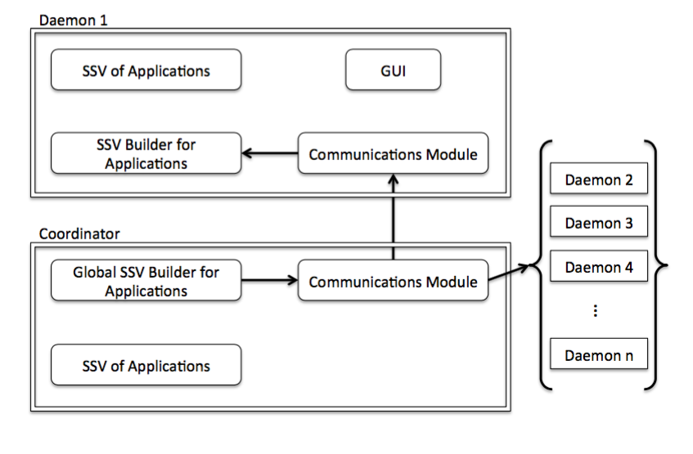
Approach and Implementation
- Implementation: Single System View of Applications (2)

Slide 15
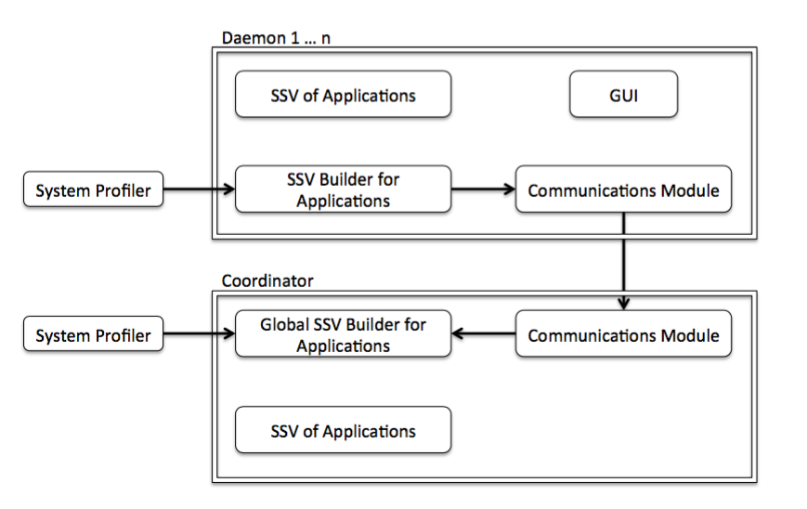
Approach and Implementation
- Implementation: Single System View of Applications (3)

Slide 16
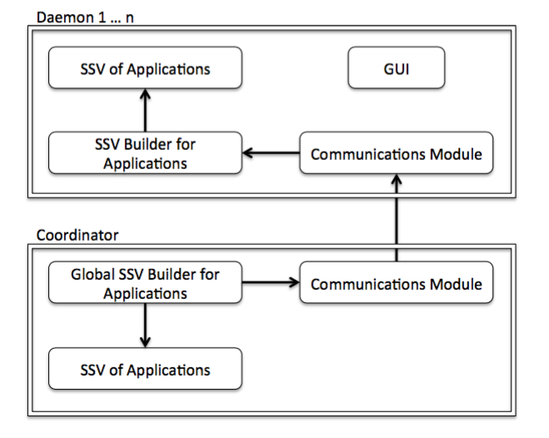
Approach and Implementation
- Implementation: Single System View of Applications (4)

Slide 17
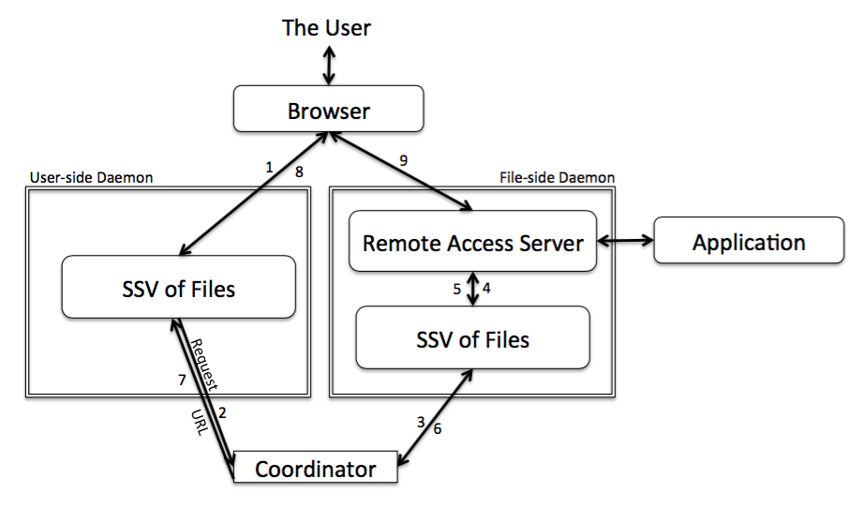
Approach and Implementation
- Implementation: Remote File Access

Slide 18
Approach and Implementation
- Implementation: Coordinator and coordinator election
Use the device with the most files
Interaction with the user
Battery percentage
Calculates a score, and compares
Lets coordinator finish tasks, queues new ones.

Slide 19
Experimentation and Evaluation
- Methodology
All “devices” running on one machine
TCP/IP loopback or route via router on LAN
Capture network traffic with Wireshark
Change network conditions with Network Link Conditioner
Log CPU and memory usage by running “top” every three seconds.

Slide 20
Experimentation and Evaluation
- Metrics
CPU usage, 400 %
Memory usage, ca. 2.5 GB
Network traffic, in theory 54 mbps
Time

Slide 21
Experimentation and Evaluation
- Environment
MacBook Air 13-inches, mid-2012 model
Intel i5 dual core (hyper-threading), 1.8GHz, 3MB L3 cache
4GB 1600MHz DD3L memory
OS X, El Capitan 10.11.4
Go v. 1.2.1 darwin/amd64
Asus RT-N56U, 5GHz wireless connection

Slide 22
Experimentation and Evaluation
- Running Idle (1)
Prototype started and left running with no interaction
No data or application files present
Tested with fixed coordinator and automatic coordinator

Slide 23
Experimentation and Evaluation
- Running Idle (2)

Slide 24
Experimentation and Evaluation
- Running Idle (3)

Slide 25
Experimentation and Evaluation
- Running Idle (4)

Slide 26
Experimentation and Evaluation
- Running Idle (5)

Slide 27
Experimentation and Evaluation
- Coordinator Selection Time (1)
Different number of files on the devices
Measured time from starting evaluation to the slowest daemon had registered the change
Device 1 | Device 2 | Device 4
8 | 11 | 1

Slide 28
Experimentation and Evaluation
- Coordinator Selection Time (2)

Slide 29
Experimentation and Evaluation
- Setup Time (1)
Time of setting up 1 to 200 ”devices”
Time from starting execution to ready to receive requests
Started 1 second apart

Slide 30
Experimentation and Evaluation
- Setup Time (2)

Slide 31
Experimentation and Evaluation
- Opening a File Remotely
Time from instigating request to the file is open
No difference in traffic
Coordinator vs. not coordinator
Word Count | Time (s)
200 | 3.50
1000 | 3.51
5000 | 3.60
Type of test | Time (s)
Non-coord to coord | 3.72
Coord to non-coord | 3.44

Slide 32
Experimentation and Evaluation
- Synchronization Time (1)
Difference if added to coordinator or not
Difference in what device is coordinator
Difference if device has files already or not
Difference if device has high or low number of files

Slide 33
Experimentation and Evaluation
- Synchronization Time (2)

Slide 34
Experimentation and Evaluation
- Synchronization Time (3)

Slide 35
Experimentation and Evaluation
- Synchronization Time (4)

Slide 36
Experimentation and Evaluation
- Application Synchronization (1)
See how number of applications affect synchronization time
Emulate system profiler
Time from the coordinator starts to all synchronization is done
Ran with 2, 10 and 20 devices

Slide 37
Experimentation and Evaluation
- Application Synchronization (2)

Slide 38
Discussion
Coordinator versus complete decentralization
OS and application interface
Automatic versus manual refresh/synchronization
Batching and caching
Remote application access
Security
Environment for the experiments

Slide 39
Conclusion

