Slide 1

Compartmentalized and Extensible Security Framework for Securing Pre-Existing Systems Dmitrii Chemodanov, Andrew Krall, Trevor Leach, Joe Chandler, Daniel Dunn, David Emily, Prasad Calyam
SEC Cyber Conference’18
https://github.com/AndreasKralj/SECMizzouCyberChallenge

Slide 2

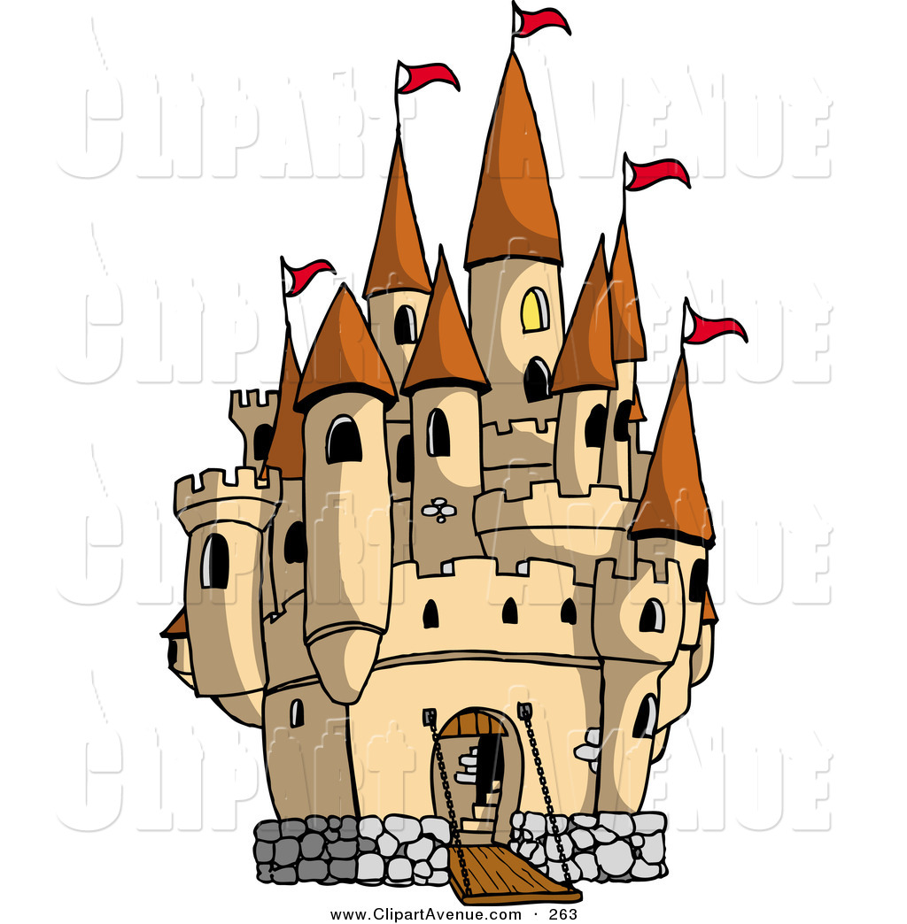

By 2020, $101.6 billion will be spent in cyber security, to build high walls and deep moats
http://fortune.com/2016/10/12/cybersecurity-global-spending/
But that won’t help if the threat is already inside!!!

Slide 3
74% of companies feel they’re vulnerable to insider threats
Companies have pre-existing, vulnerable infrastructure too costly, and time-consuming, to reinvent
We NEED compartmentalization and inner security walls/thresholds
58% percent of healthcare security breaches are due to insider threat or insider negligence; breaches that may remain undetected for years.
https://healthitsecurity.com/news/58-of-healthcare-phi-data-breaches-caused-by-insiders

Slide 4
Use Cases
Massachusetts psychiatrist created false diagnoses of drug addiction for people who were not his patients in order to submit medical insurance claims for sessions that never happened
Retired Senior Master Sergeant stealing government credit cards and personal identifying information for more than 30 service members
What if there a was a way to assess risk on user actions? How many lives would change for the better?

Slide 5



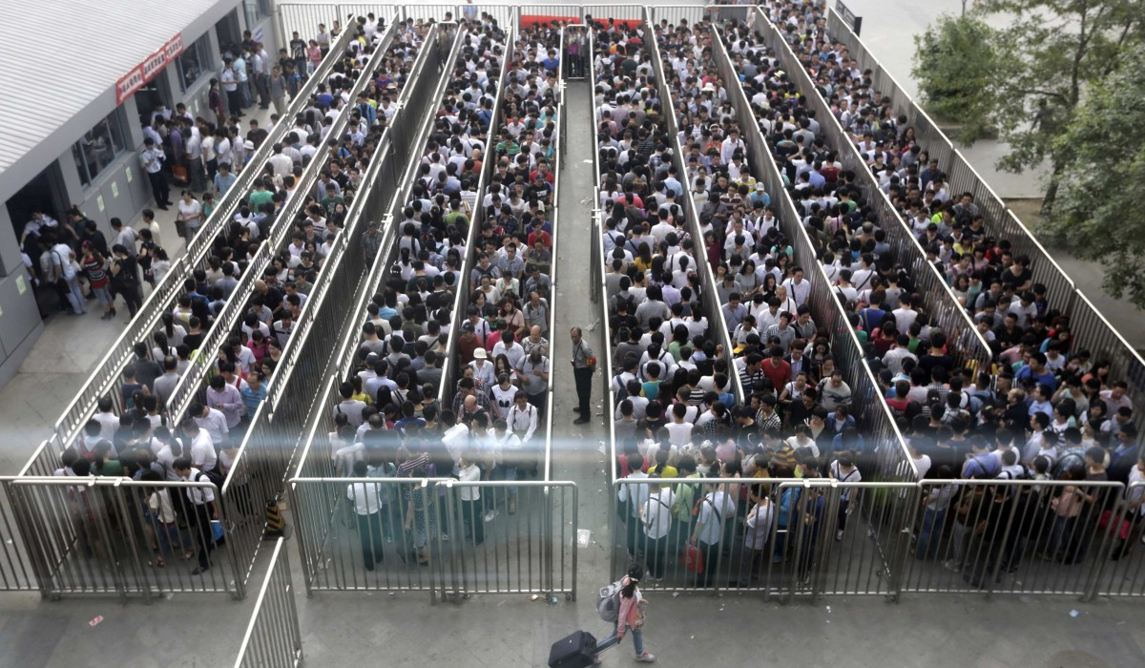
Applying all possible security tools strengths security at expense of the performance
High Walls
Deep Moats
Invincible Army
Long Access…

Slide 6
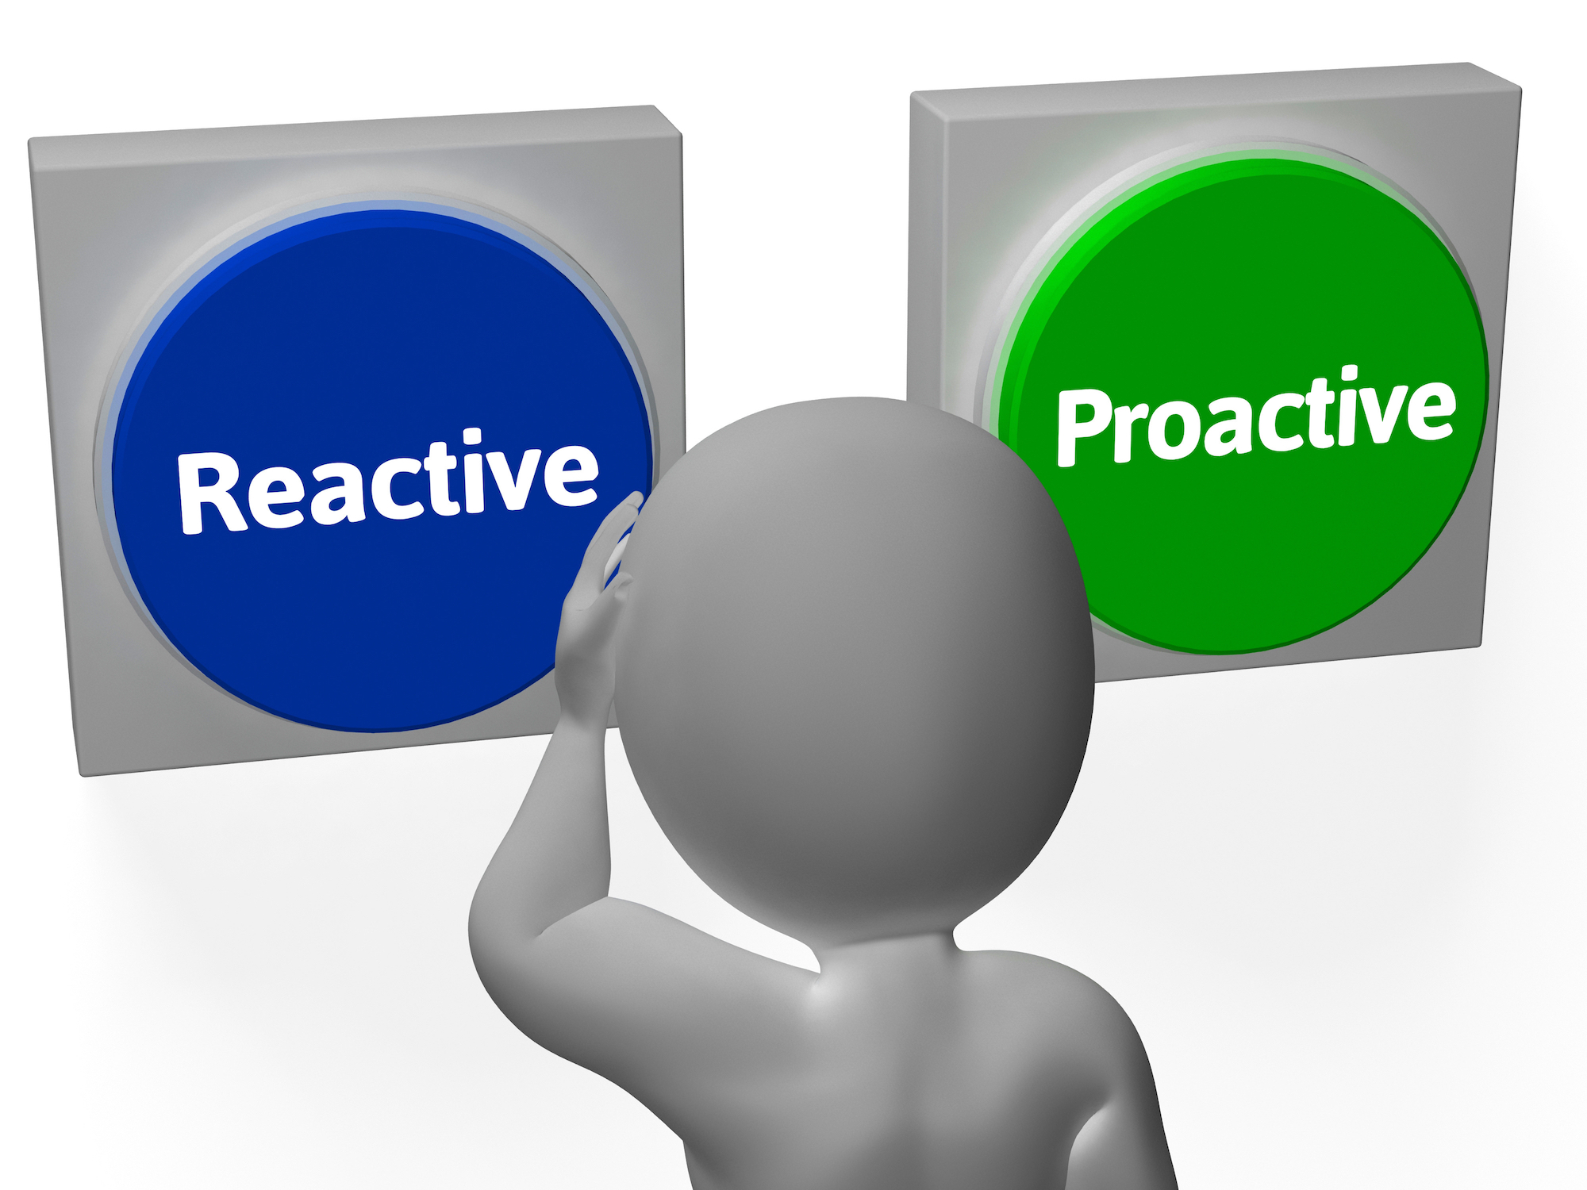
What we need
Highly customizable infrastructure
Authentication decisions defined by a policy-based configuration file
Compartmentalization
Preventative measure as well as retrospective analysis
Past & present to influence the future

Slide 7

Investing in a “Single Security” strategy doesn’t make sense
Harry Markowitz (1927- ) is a Nobel Prize winning economist
who devised the modern portfolio theory in investments

Slide 8

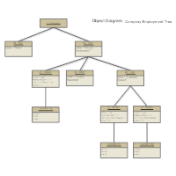
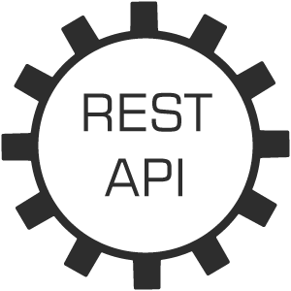
Solution Idea
We propose a generalized, blanket framework that can adhere to diverse federated data architectures
Our solution solves the problem of implementing a more robust security system, by providing a layered, non-intrusive approach, while utilizing reactive and proactive techniques to mitigate internal attack vectors
We’ve built our framework to be easily extended and utilized by other applications by exposing API features

Slide 9

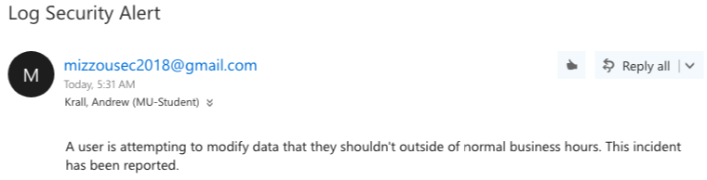
Hierarchy to protect data from malicious activity
and careless users!
Database Permissions
Email
Notifications
Time Window
Notifies group of users with an email when “insider actions are stupid”.
Group of users can be changed with configuration files...

Slide 10

Middleware Extensions (No need to refactor entire existing data systems)
Web Apps
Desktop Apps
Integration/Management Applications
Network Interface
Permission Groups
Security Levels
Available Actions
API Framework
Database
Users
Pre-existing Architecture

Slide 11
Defining the Configuration
To create an effective security policy, it’s necessary to determine the risk levels for data type and user actions
Data analysis requirements of users
Dynamic risk assessment
Loss of action opportunity analysis
Security (fat) > performance (sugar)

Slide 12
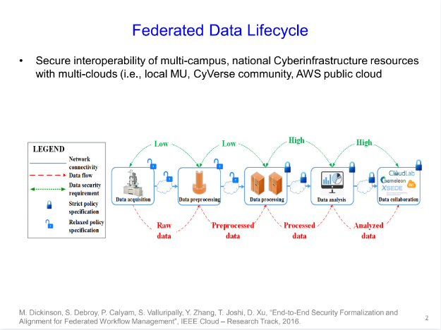

Slide 13
Applying all possible security tools strengths security at expense of the performance
High Walls
Deep Moats
Invincible Army
Long Access…

Slide 14
Using the most secure technique can be also suboptimal
Creating the invincible army takes a long time!

Slide 15
Diversified portfolio best trade-offs between the risk and the performance
Efficient Frontier
Performance
Encrypt Data
Notify Data Owner
Request Approval
to Modify Data
Security Actions
Risk

Slide 16
URL | Request Type | Parameters | Response | Description
/core/compose_actions | POST | [{"name" : String, "risk" : double, "exec_time" : double, "apply" : boolean}] | [{"name" : String, "risk" : double, "exec_time" : double, "apply" : boolean}] | Decides on applying security actions by optimally trade-off between performance and a risk using the efficient frontier
/core/update_policy | POST | ("risk_lvl" : double) | ("risk_lvl" : double) | Updates acceptable risk based on policy
 | … | … | … | …

Slide 17
DEMO

Slide 18
Future Ideas
In the future, we would want to use AI to be able to determine anomalies in user actions and subsequently act upon them
We would also aim to have a dataset of reasonable versus unreasonable levels of profile modification and act on them accordingly

Slide 19
Thank you for your attention!

Slide 20
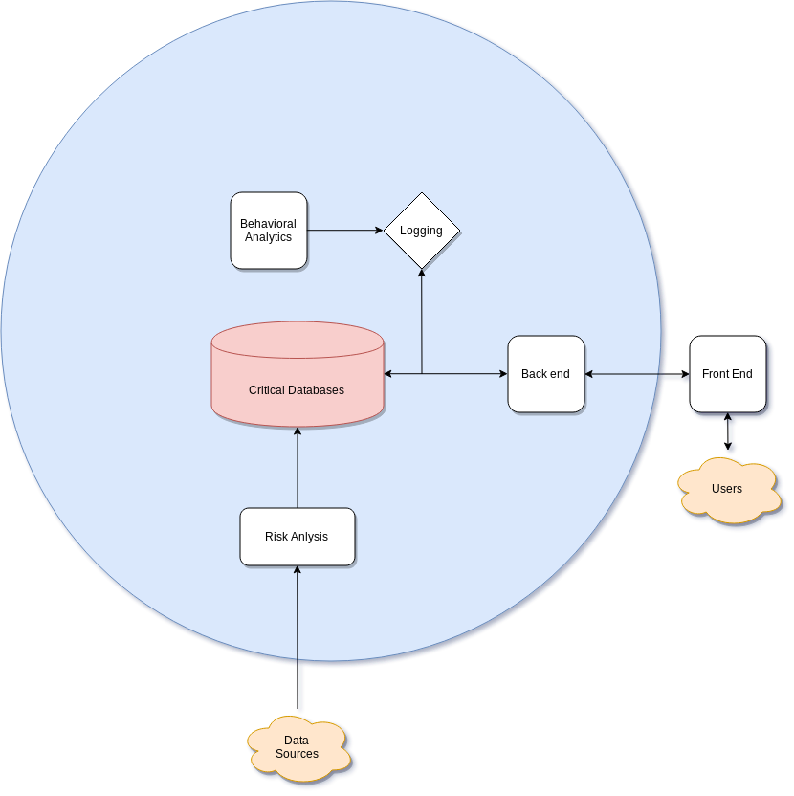
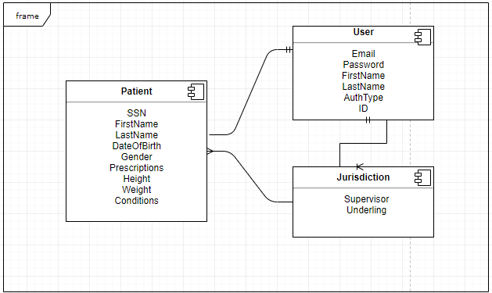
Current Healthcare System

