Slide 1
Næstved Biludlejning
Programmering
Chris, Andreas & Stine

Slide 2
Disposition
Klassediagram
EER diagram
GUI

Slide 3
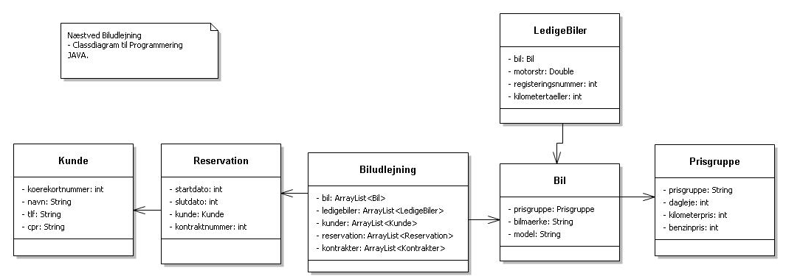
Klassediagram

Slide 4
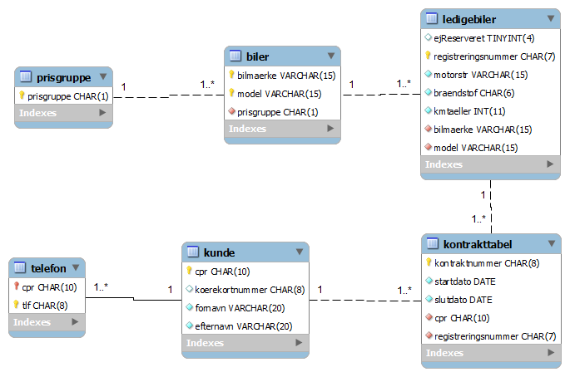
EER diagram

Slide 5
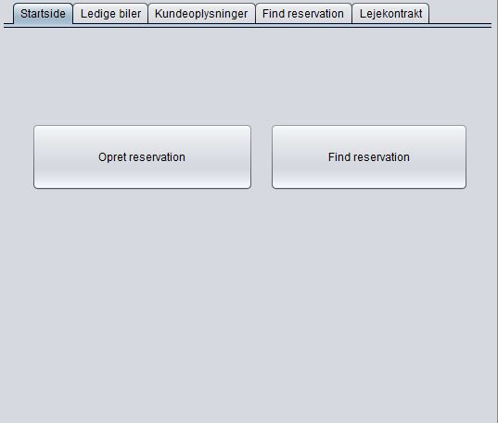
GUI

Slide 6
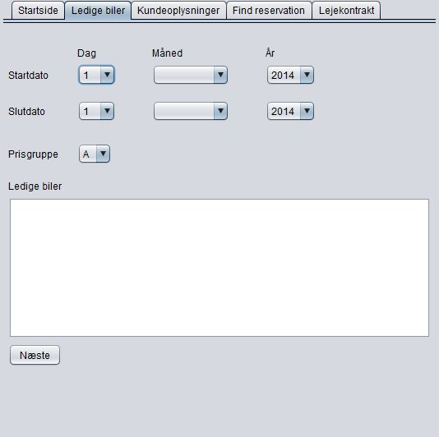
GUI

Slide 7
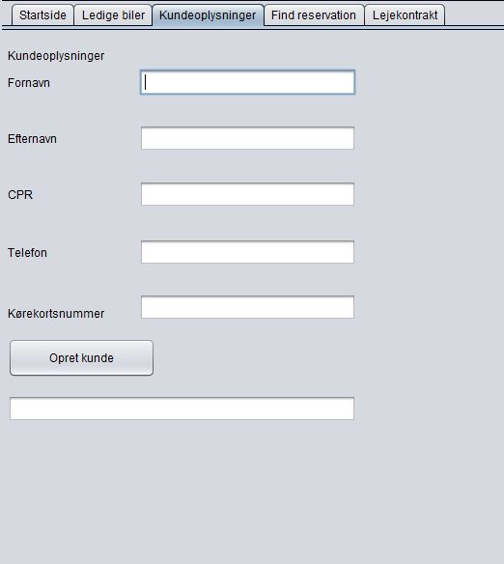
GUI

Slide 8
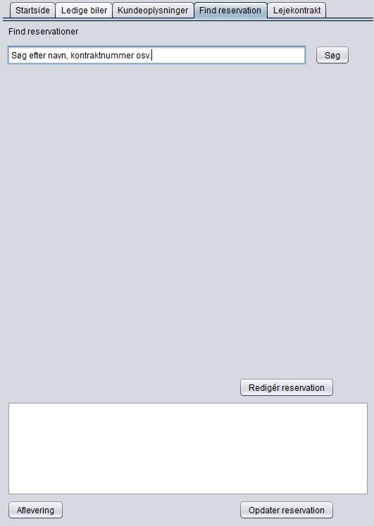
GUI

Slide 9
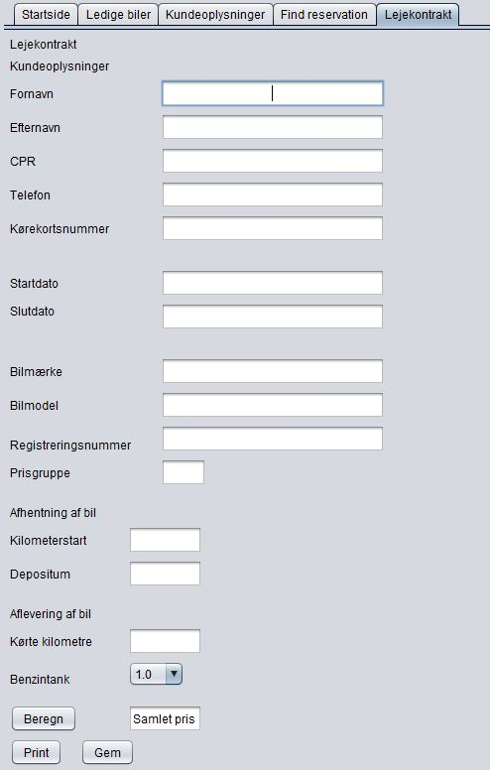
GUI

