Slide 1






Performance data
Leadership
Data aggregation
Trends, summaries
Management
Organizarional hierachy
Detailed
data
Staff

Slide 2
Typical ways to consume data
KPIs
Dashboards
Financial reports
Data aggregation
Performance data
Leadership
Trends, summaries
Organizarional hierachy
Management
Managerial reports
Ad-hoc analysis
Detailed
data
Staff
Operational reports
On-screen task data

Slide 3
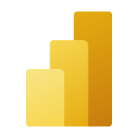

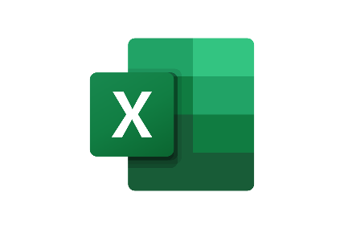
Typical ways to consume data (and tools to support it)
KPIs
Dashboards
Financial reports
Data aggregation
Performance data
Leadership
Trends, summaries
Organizarional hierachy
Management
Managerial reports
Ad-hoc analysis
Detailed
data
Staff
Operational reports
On-screen task data

