Slide 1
Integrating LiDAR Data with Cellular Automata for Wildfire Spread Prediction
Development, Calibration, and Validation
A Case Study of the 2023 Tenerife Wildfire
Andreas Paphitis
University of Amsterdam, Graduate School of Life and Earth Sciences
November 2025

Slide 2
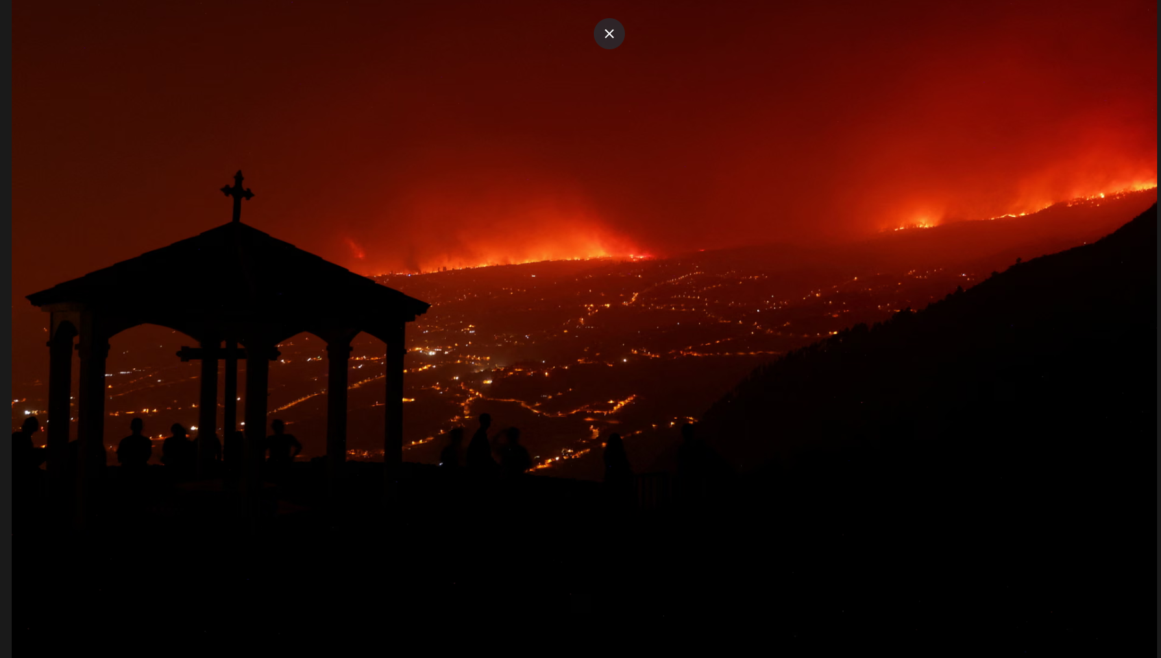
2023 Tenerife Wildfire: Background & Problem
~ 12,000 hectares burned across 12 municipalities
Event 2023 Tenerife Fire
Most severe wildfire in Canary Islands in 40 years
Duration Aug 15-Nov 10, 2023
Over 12,000 residents evacuated
Classified as 'sixth-generation' wildfire (Tedim et al., 2018)
Active Fire Spread Aug 15-26, 2023
Traditional models failed to predict extreme behavior
Existing models overlook alternative modes of fire spread beyond horizontal
Lack of integration of available LiDAR data in current modeling approaches

Slide 3
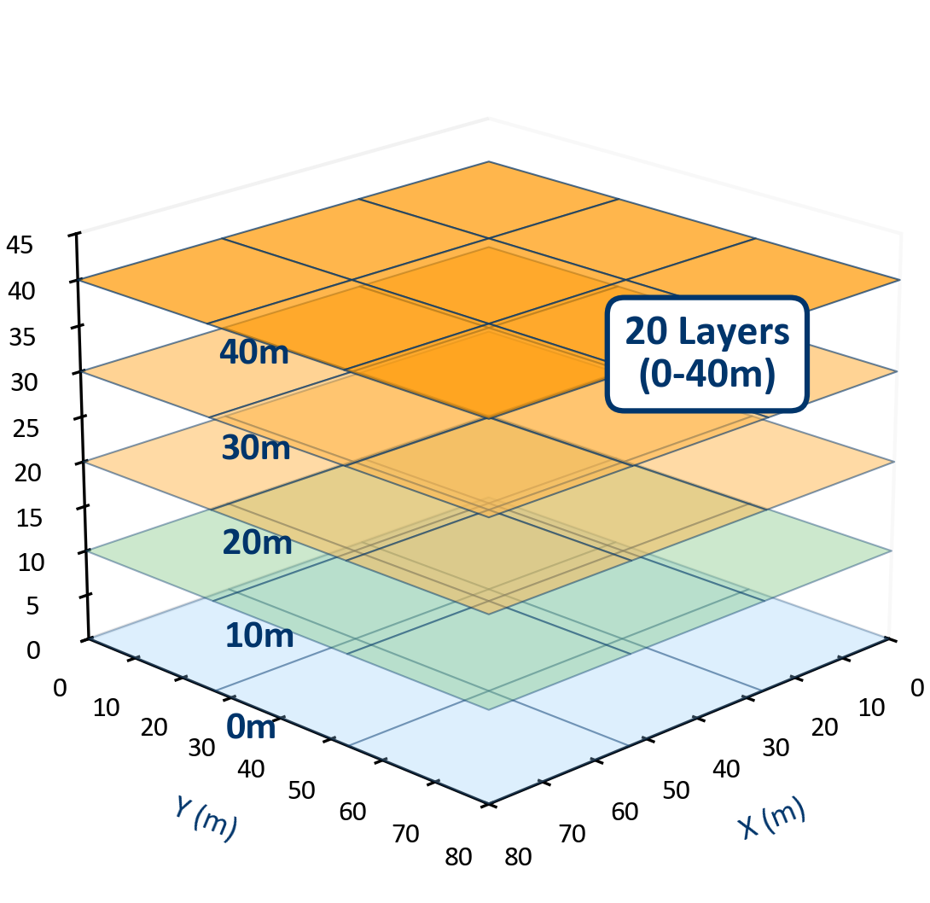
Research Objectives & Questions
Objective 1: LiDAR Integration
• Integrate high-resolution LiDAR data into CA wildfire model
• 3D fuel structure representation using Plant Area Density (PAD)
• Research Question: How effectively can LiDAR PAD represent vertical fuel connectivity?
Objective 2: Multi-Dimensional Fire Spread
• Develop framework with multiple fire spread mechanisms
• Horizontal spread, vertical spread, and ember transport
• Research Question: How do spread modes contribute to fire behavior in complex terrain?

Slide 4
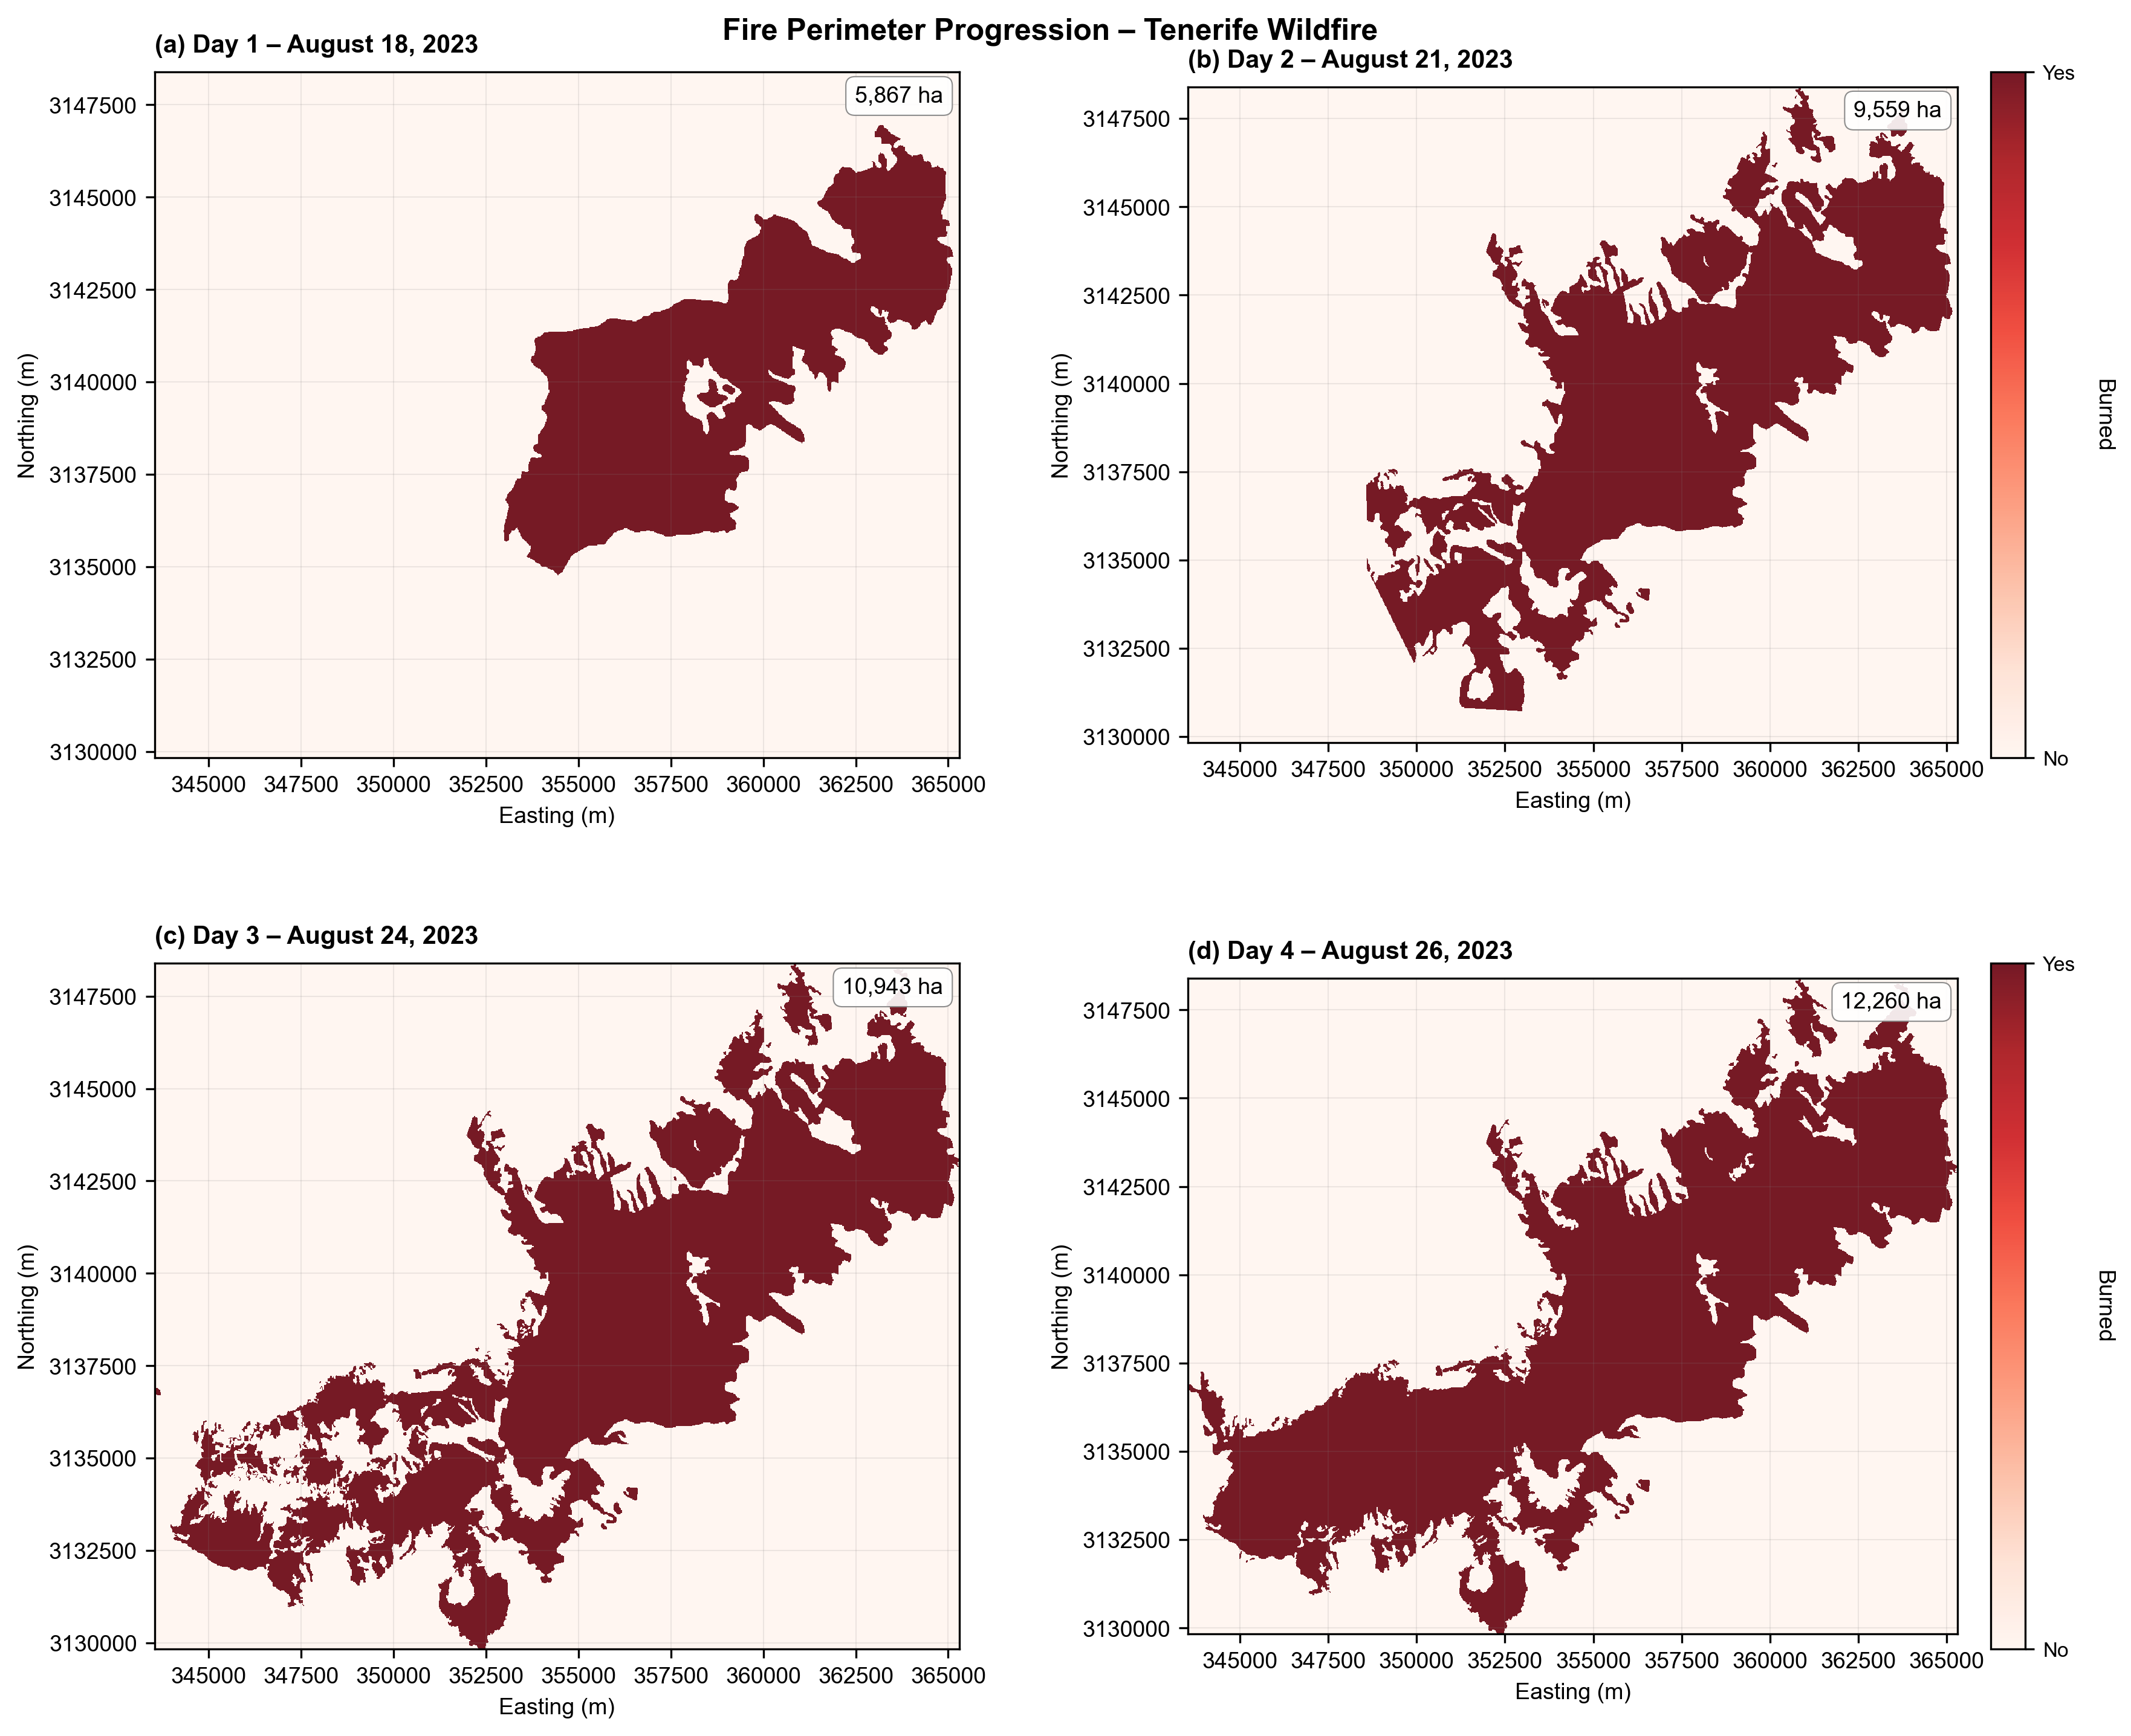
Study Area
Terrain Characteristics:
• Volcanic topography with barrancos (deep ravines)
• Elevation range: 0–2,400m vertical relief
• Steep slopes (>25°)
Vegetation:
• Canary Island Pine (Pinus canariensis) dominant species
• Pine forests feature pyrogenic adaptations (thick bark, partial cone serotiny)
Fire Event:
August 15 – November 10, 2023
• Active spread phase: August 15-26 (12 days modeled)
• Ignition: Arafo municipality (~1,000m elevation)
• Final extent: 12,000 hectares

Slide 5
Methodology Overview
Data & Model
Data Sources:
LiDAR: 5m (PNOA-IGN, Spain)
Terrain: 5m DTM (Instituto Geográfico Nacional)
Fire: EMSR-685 delineations (Copernicus EMS, Aug 2023)3D CA Model:
3D model,20m resolution, 20 layers (0-40m)
3 spread mechanisms:
Horizontal, Vertical, Ember
Objective Function
Minimize: (1 - Dice) + P
Dice = 2|A∩B| / (|A|+|B|)
P = 2(r-2)² if r>2, else P=0
Rationale:
• Balances spatial accuracy
• Prevents unrealistic spread
• Standard in wildfire validation
Calibration Framework
Two-Stage Approach:
Stage 1: Sensitivity Analysis
• 16 parameters tested
• Range-based screening
• Top 4 parameters selected
Stage 2: Grid Search
• 3 points × 4 params = 81 runs
• Modified Dice optimization
Training: Days 1-2 (Aug 18-21)
Validation
Out-of-Sample Testing:
Test Period:
Days 3-4 (Aug 24-26)
Performance Metrics:
• Day 3: Dice = 0.690
• Day 4: Dice = 0.486
• Improvement: +29.6%
Ensures model generalization to unseen fire events

Slide 6
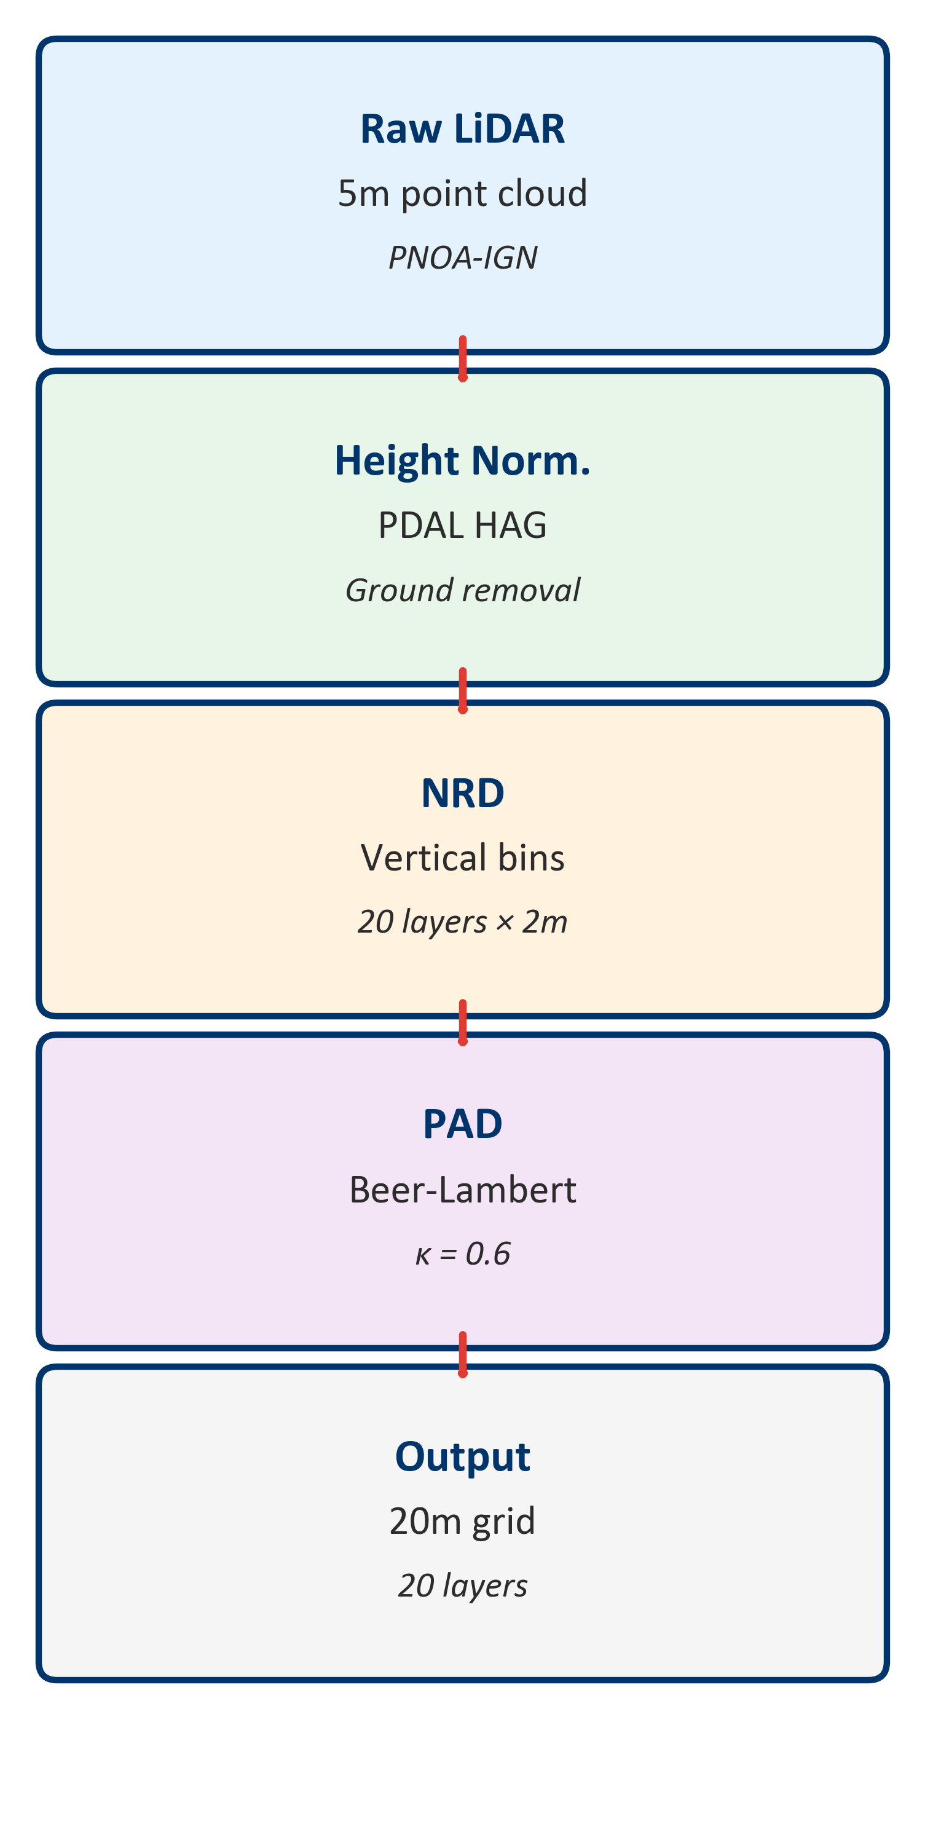
LiDAR Pre-Processing & Model Architecture
LiDAR Pre-Processing Pipeline
• Height normalization using PDAL HAG algorithm and extraction of vegetation points
(PDAL Contributors, 2023)
• Normalized Relative Density (NRD) calculation
(MacArthur & Horn, 1969)
• PAD derivation via Beer-Lambert law (κ=0.6)
(Campbell & Norman, 1998)
• 20 vertical layers at 2m intervals (0-40m)
• Resampling: 5m → 20m resolution (16× reduction)
3D CA Model Architecture
• Horizontal: Moore neighborhood, slope/wind factors (Rothermel, 1972)
• Vertical: √(fuel_lower × fuel_upper) connectivity
(Van Wagner, 1977)
• Ember: Exponential distance decay, wind-biased direction
(Albini, 1979)
• Terrain: Barranco detection and wind channeling

Slide 7
Model Structure & Computational Optimization
Why Custom 3D CA Model?
1. LiDAR Integration
FARSITE/FlamMap use 2D fuel classifications,
cannot utilize continuous 3D PAD data
2. Computational Efficiency
Sparse storage + pre-computed terrain → 85%
memory reduction, enables 100s of calibration runs
3. Region-Specific
Canary Island pine needs custom parameters
(not North American fuel models, accounts for calima)
Key Optimizations
Sparse matrix storage: 85% memory reduction vs dense arrays
Pre-computed terrain: Barranco detection, wind channeling
Large-scale grid: 609×609×20 layers (7.4M cells)

Slide 8
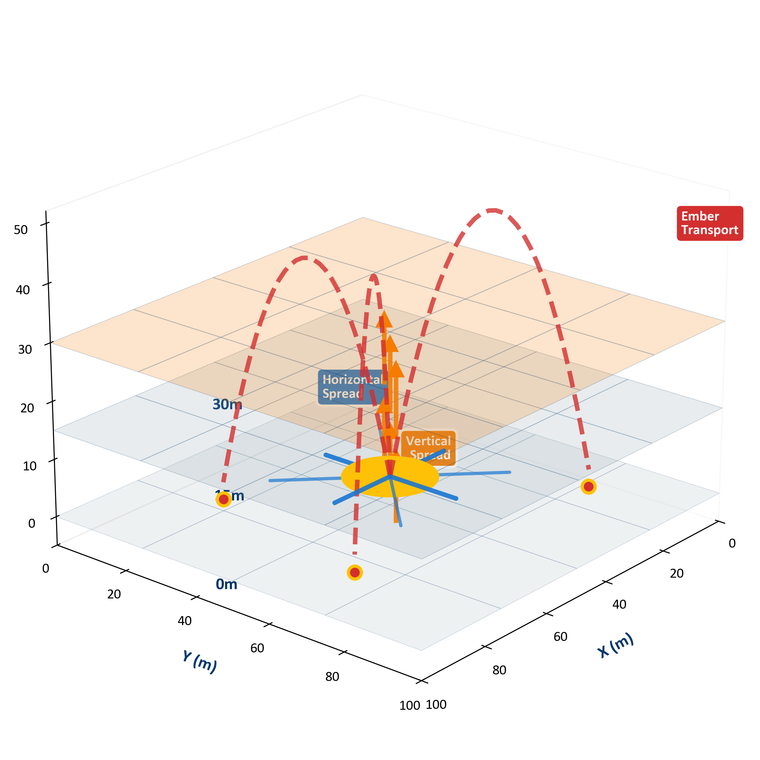
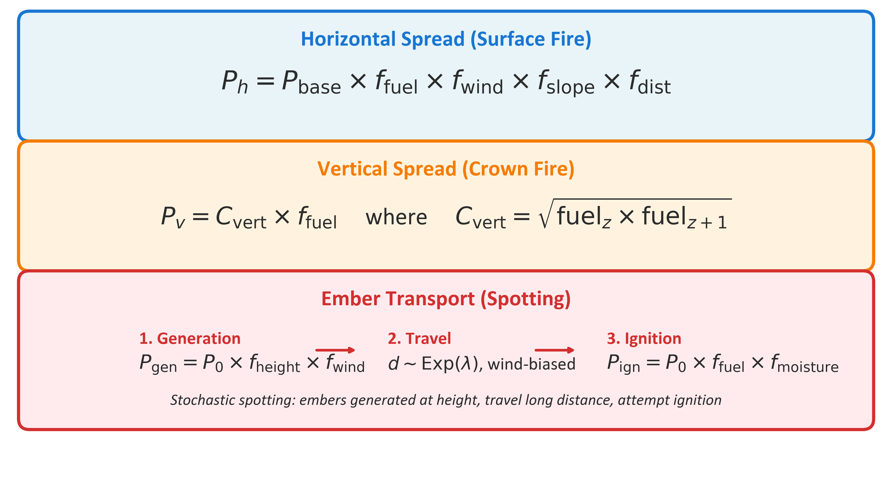
Fire Spread Mechanisms
Model implements three physically-based spread mechanisms:
Horizontal: Moore neighborhood (8-connectivity) for surface fire propagation (Slope, Fuel, Wind Direction)
Vertical: Layer-to-layer transitions through 20 vertical strata based on fuel connectivity
Ember: Stochastic long-distance spotting with wind-bias parameterization.

Slide 9
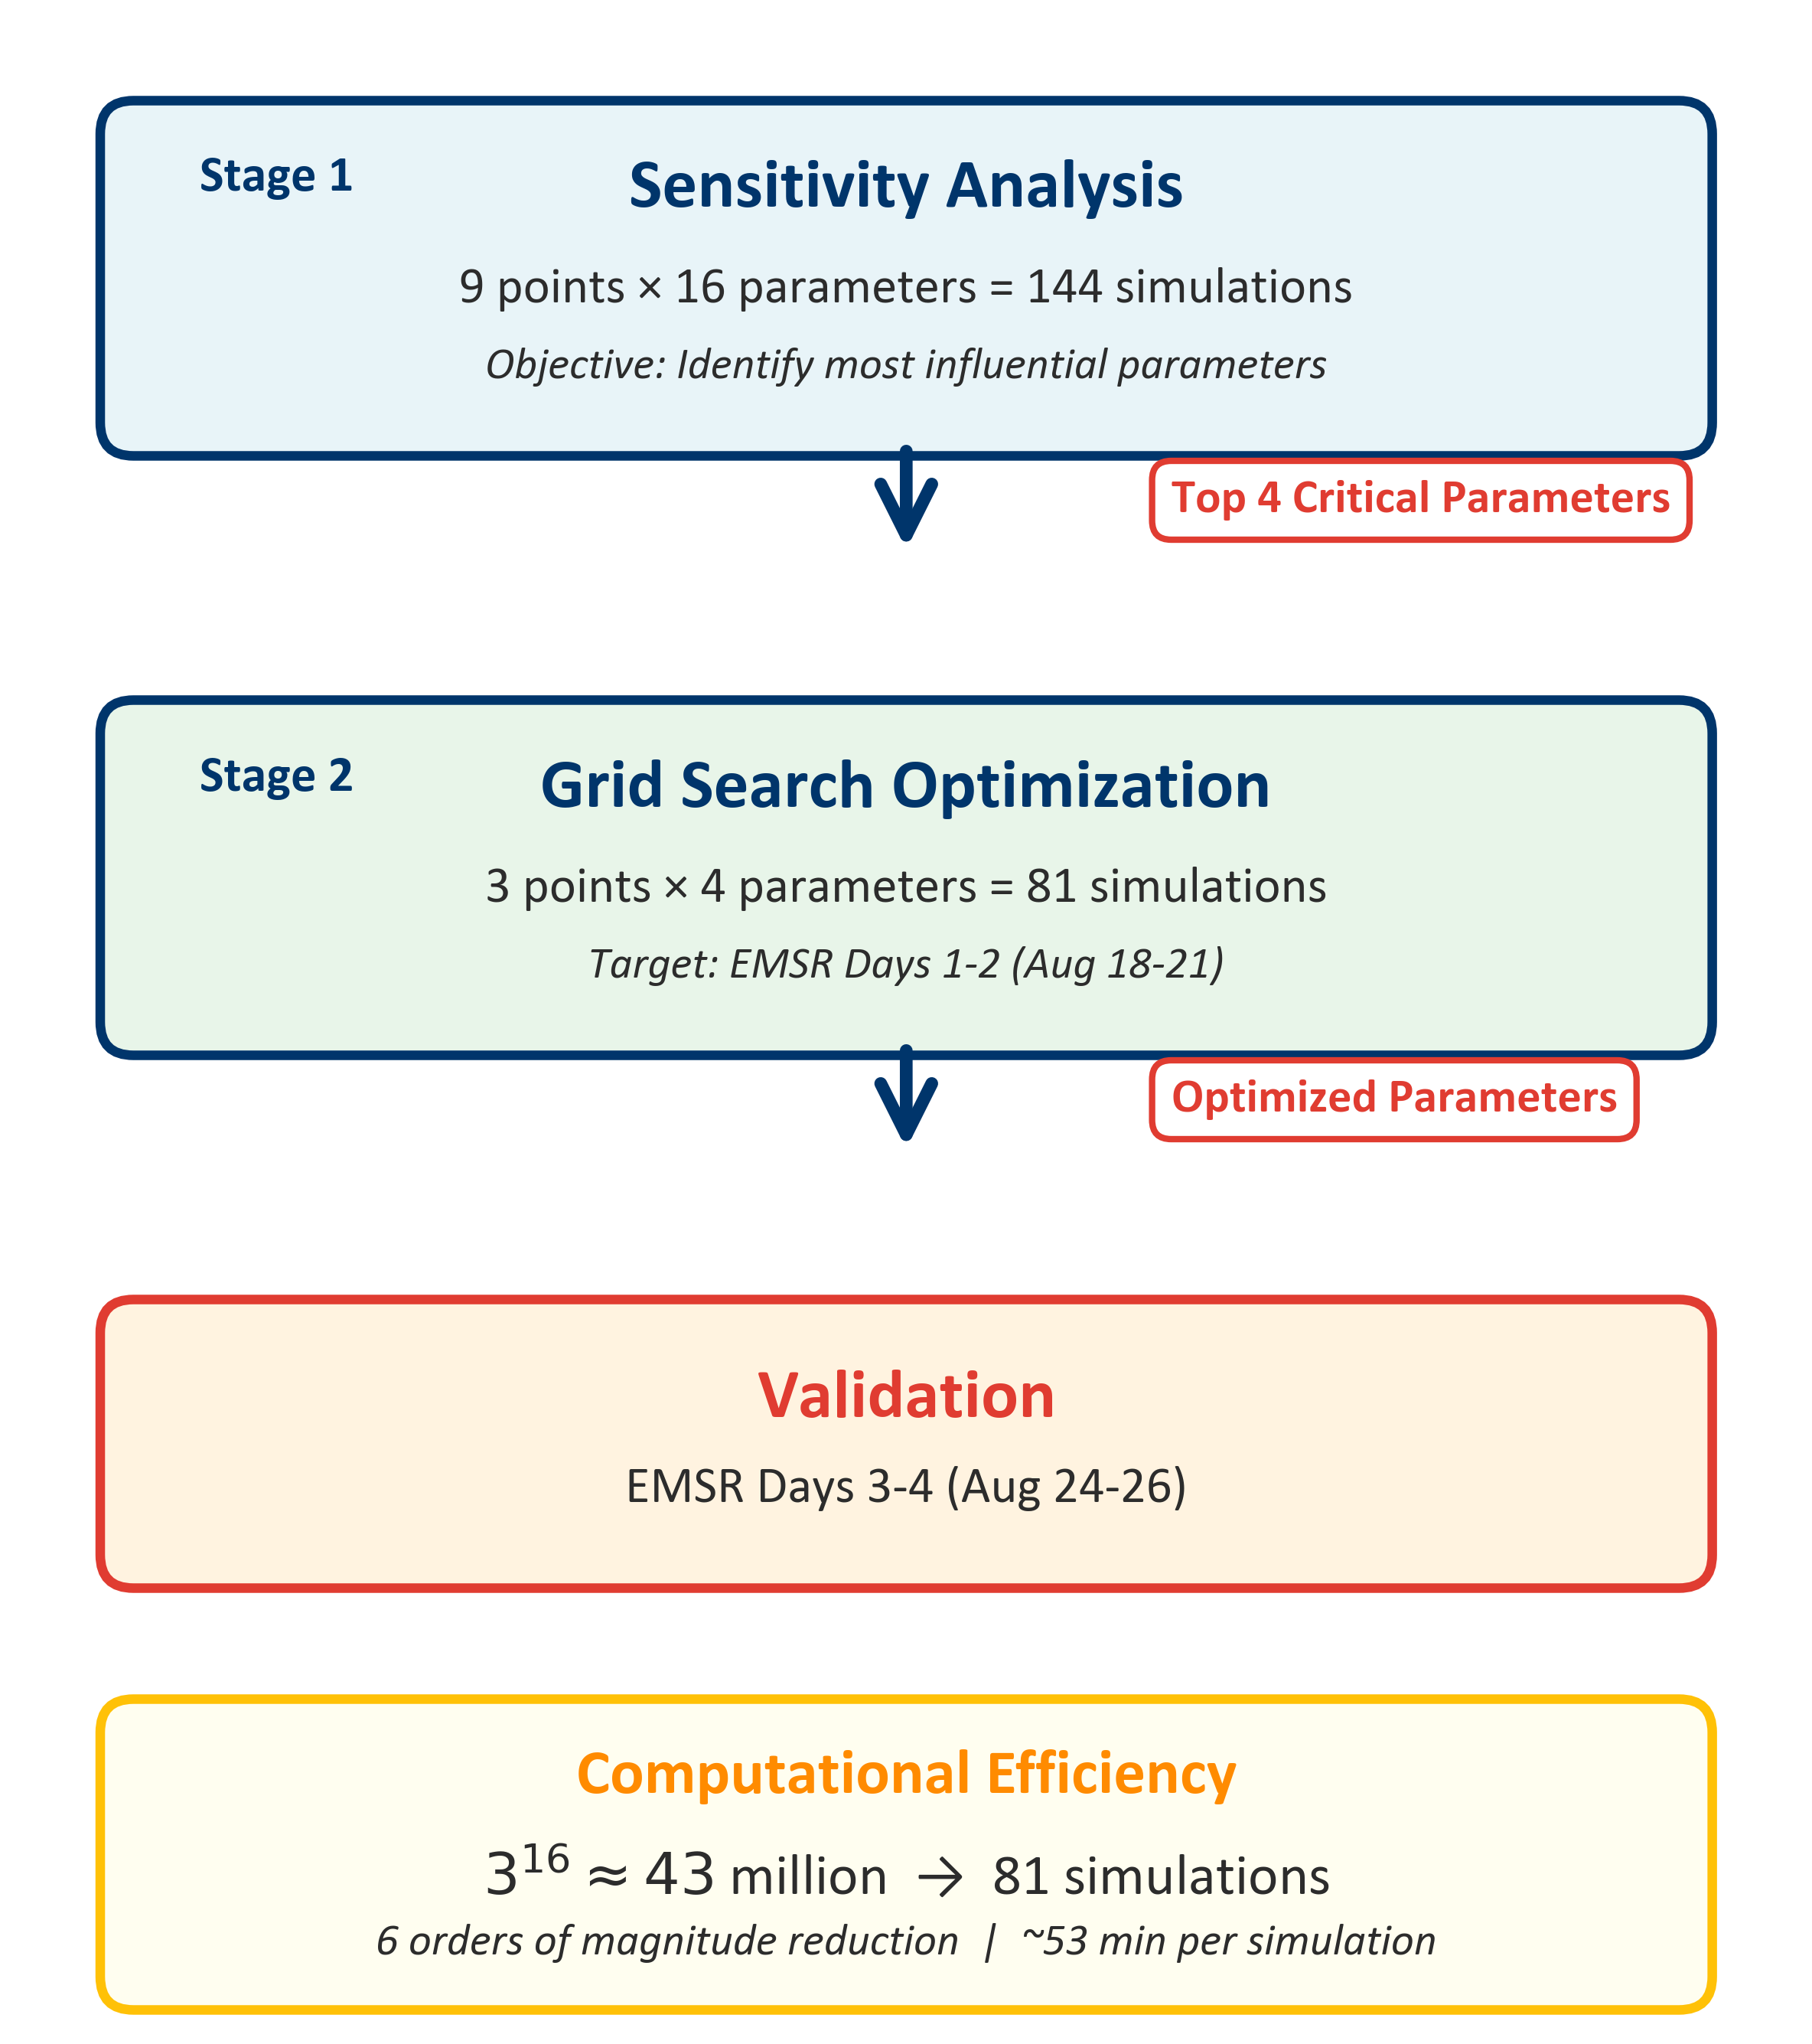
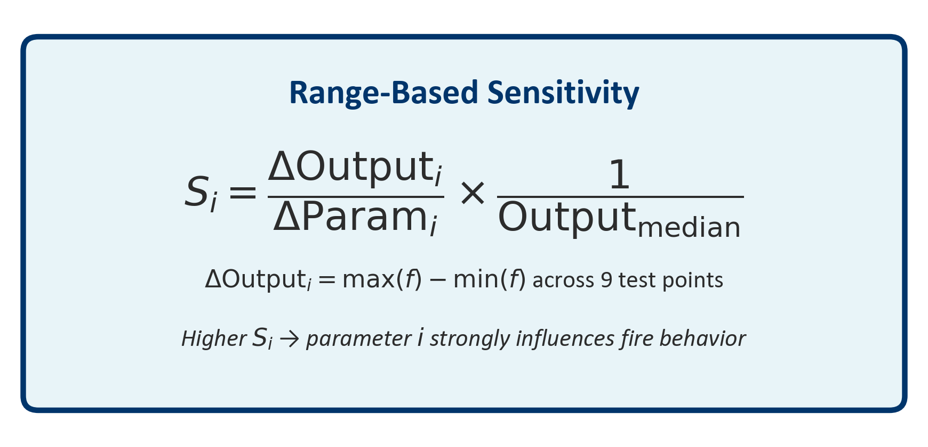
Calibration Approach
Two-Stage Calibration:
Stage 1: Sensitivity Analysis (Range-based screening)
• 9 points × 16 parameters → Identified top 4
• Metric: Composite fire behavior variability
Stage 2: Grid Search
3 points × 4 parameters = 81 simulations
Metric: Modified Dice coefficient
Training Data: Days 1-2
Test Data: Days 3-4

Slide 10
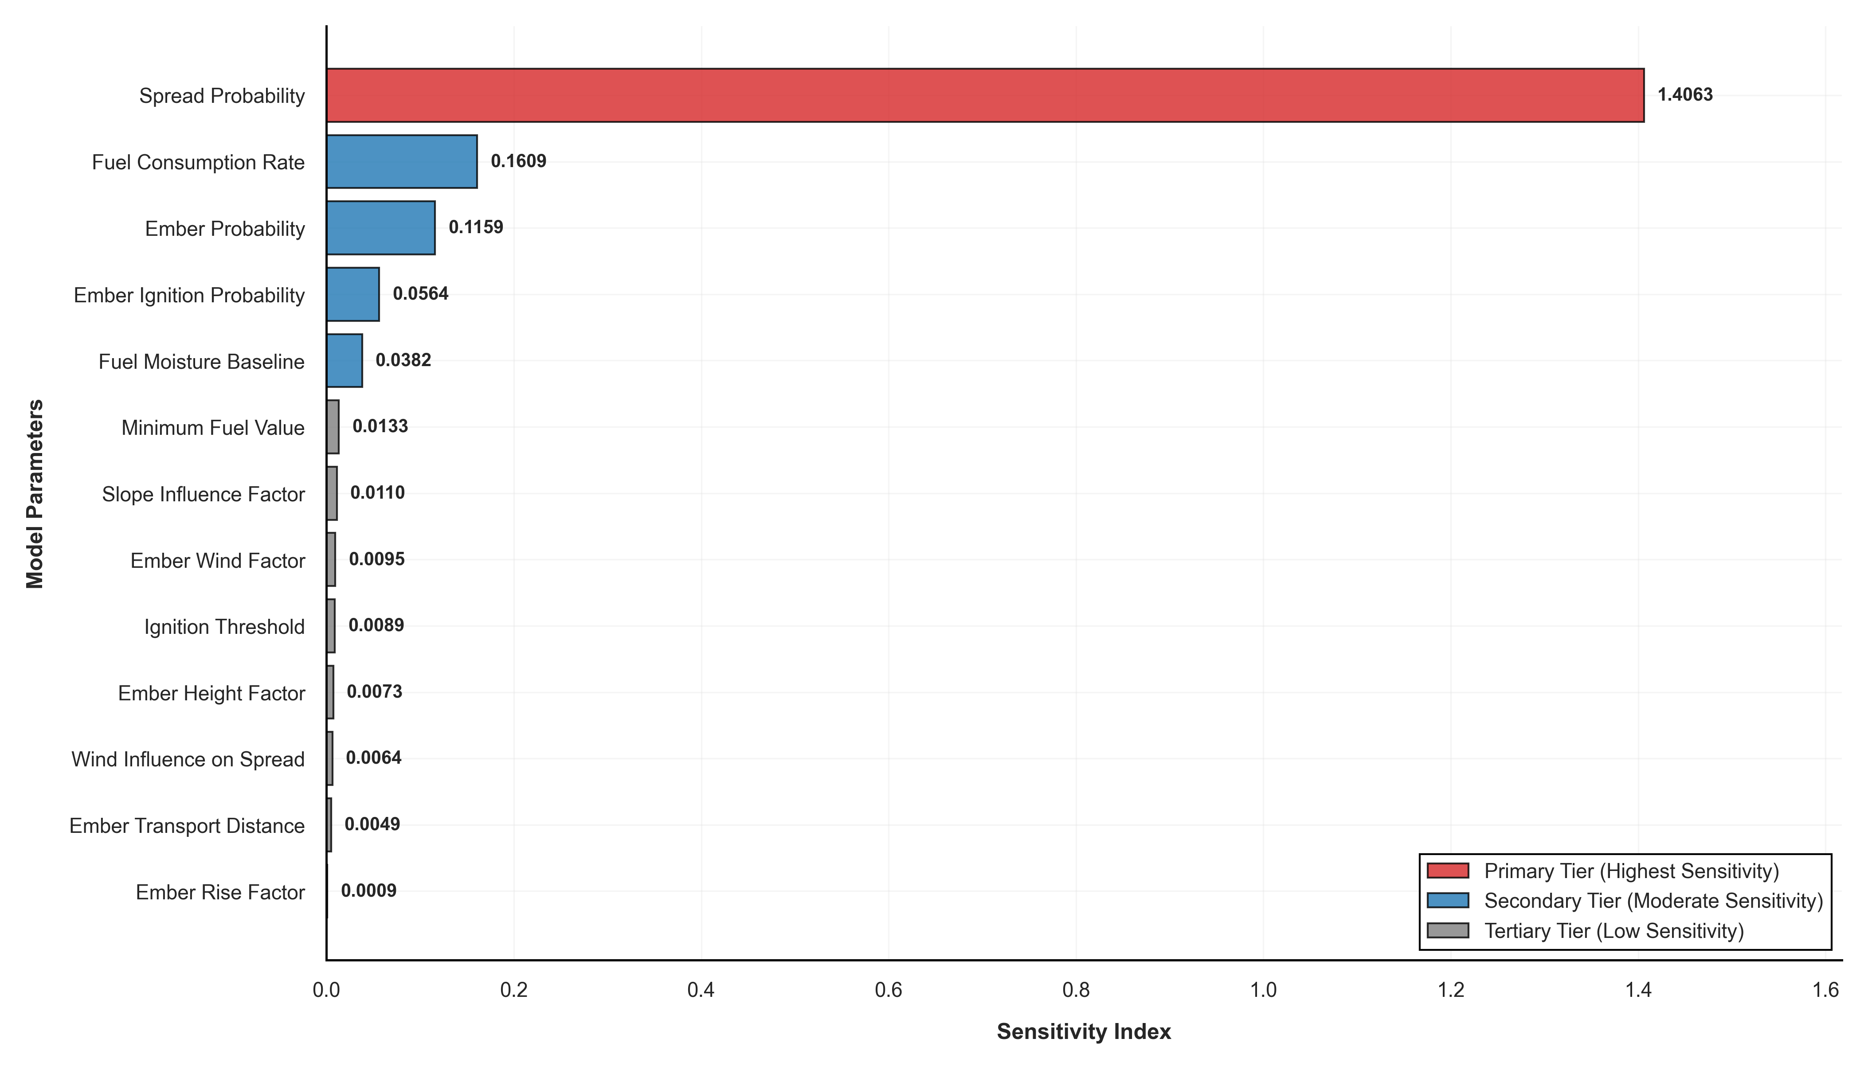
Sensitivity Analysis Results
Key Finding: 4 parameters dominate fire behavior
Top 4 Parameters (for grid search):
Spread Probability
Fuel Consumption Rate
Ember Probability
Ember Ignition
Calibration Efficiency:
• 75% reduction in parameter space
• Search space: 43 million → 81 combinations
• Focused optimization on critical parameters

Slide 11
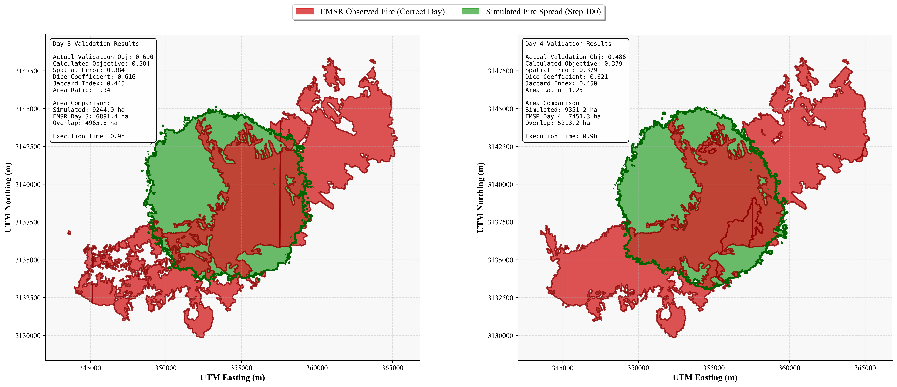
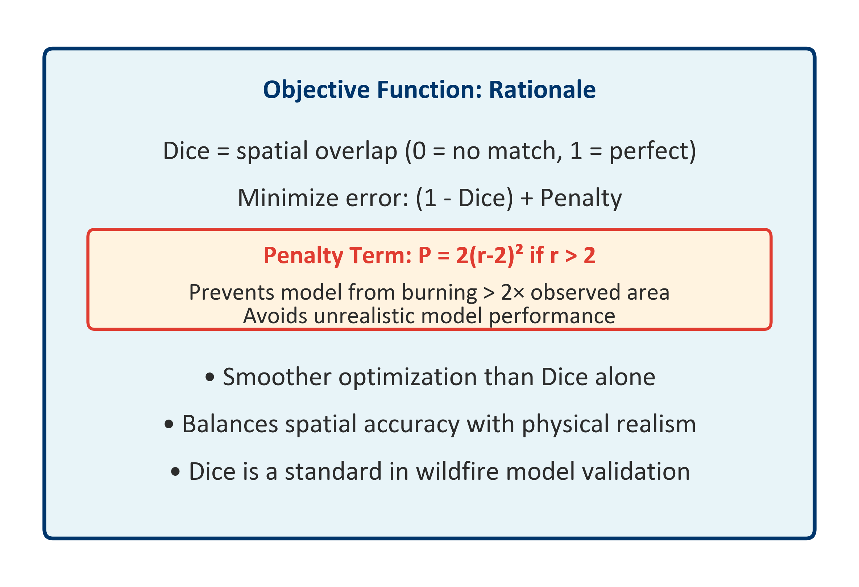
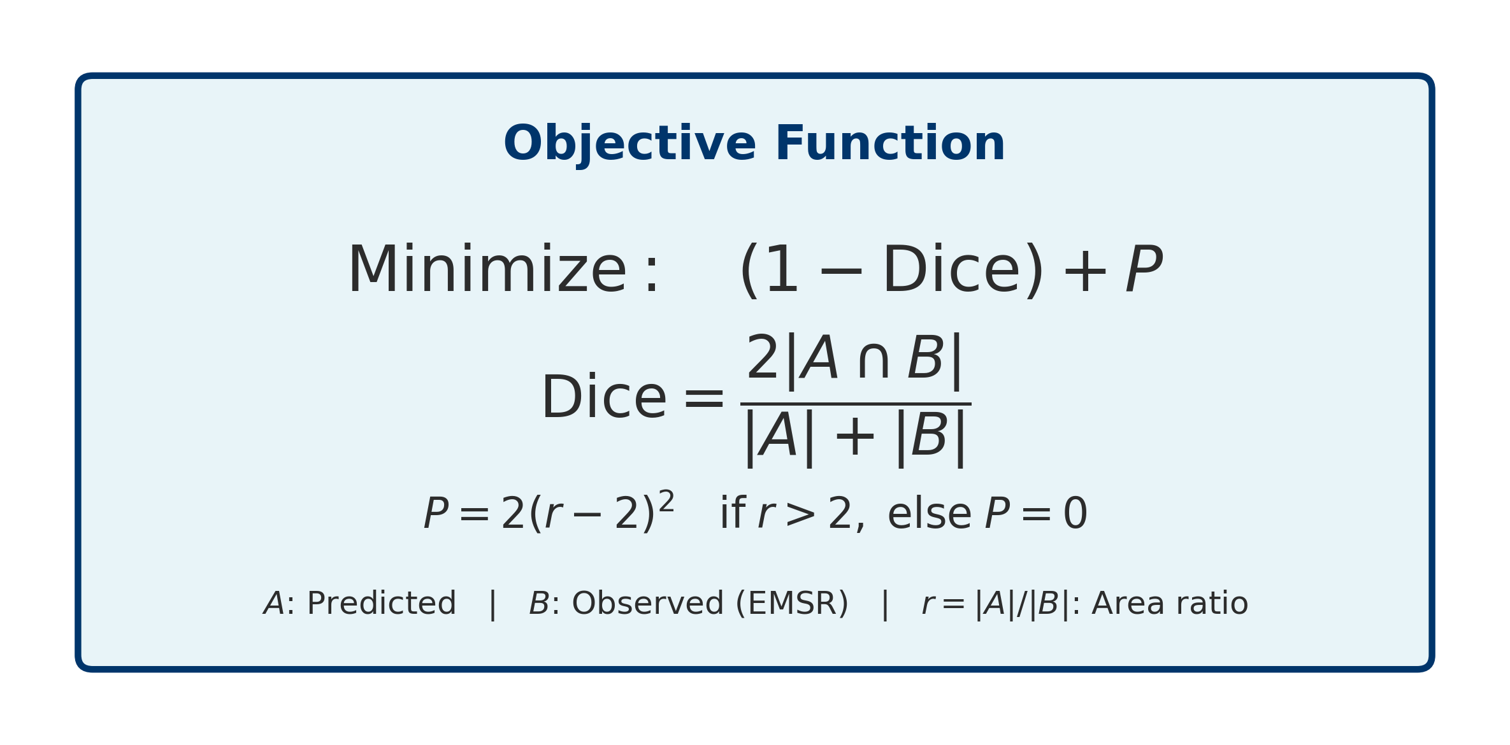
Validation Results
Optimal parameter combination found on training data and then used on test data
Validation Period:
• Day 3: Objective = 0.690
• Day 4: Objective = 0.486
• Improvement: 29.6% (Day 3 → Day 4)
• ~53 minutes per simulation (20m resolution)

Slide 12
Key Findings & Challenges
✓ Achievements
⚠ Challenges
Successful LiDAR PAD integration for 3D fuel structure
Systematic calibration framework (43M → 81 simulations)
Identified critical parameters via sensitivity analysis
Framework demonstrates feasibility of approach
Vertical spread: Only 3.8% (expected 30-50%)
Ember spread: 43.0% (expected 10-20%) Compensating errors rather than physical accuracy
Need multi-objective calibration and fuel constraints

Slide 13
Conclusions & Future Directions
1
Research Questions Addressed
Q1: LiDAR PAD successfully represents vertical fuel connectivity
→ Framework operational, requires refinement
Q2: Spread modes quantified (H:23.7%, V:3.8%, E:43.0%)
→ Ember dominance reveals need for physical constraints
2
Main Contributions
• 3D CA wildfire model with continuous LiDAR PAD integration
• Systematic two-stage calibration framework
• Quantitative analysis of fire spread mode contributions
3
Future Work
• Multi-objective calibration (spatial + mechanistic constrains)
• Fire suppression mechanisms and fuel consumption limits
• Validation against additional fire events
• Integration with weather forecasting systems

Slide 14
Acknowledgments
Supervisor: dr. A.C. Seijmonsbergen
Assessor: dr. Yifang Shi
Data Sources:
• PNOA-IGN (LiDAR point cloud data)
• Copernicus EMSR (Fire perimeter delineations)
• IGN Spain (Digital Terrain Models)
University of Amsterdam
Graduate School of Life and Earth Sciences
Institute for Biodiversity and Ecosystem Dynamics

Slide 15
Key References
[1] Cruz & Alexander (2013). Uncertainty associated with model predictions of surface and crown fire rates of spread. Environmental Modelling & Software.
[2] Sullivan (2009). Wildland surface fire spread modelling, 1990-2007. International Journal of Wildland Fire.
[3] Finney (2004). FARSITE: Fire Area Simulator—Model Development and Evaluation. USDA Forest Service Research Paper RMRS-RP-4.
[4] Finney (2006). An overview of FlamMap fire modeling capabilities. In: Andrews, P.L. & Butler, B.W. (Eds.). Fuels Management.
[5] PDAL Contributors (2023). Point Data Abstraction Library (PDAL). https://pdal.io
[6] MacArthur & Horn (1969). Foliage profile by vertical measurements. Ecology.
[7] Campbell & Norman (1998). An Introduction to Environmental Biophysics. Springer.
[8] Rothermel (1972). A mathematical model for predicting fire spread in wildland fuels. USDA Forest Service Research Paper INT-115.
[9] Van Wagner (1977). Conditions for the start and spread of crown fire. Canadian Journal of Forest Research.
[10] Albini (1979). Spot fire distance from burning trees—a predictive model. USDA Forest Service Research Paper INT-56.
Data Sources:
• PNOA-IGN: Plan Nacional de Ortofotografía Aérea, Instituto Geográfico Nacional (LiDAR)
• Copernicus EMSR706: Emergency Management Service Rapid Mapping (Fire perimeters)
• IGN España: Instituto Geográfico Nacional España (Digital Terrain Models)

Slide 16
Thank You Questions
Repository: github.com/AndreasPaphitis/Forest-Fire-Simulation
Contact: andreas.paphitis@student.uva.nl

