Slide 1
Integrating High-Resolution LiDAR Data with Cellular Automata for Wildfire Spread Prediction
Development, Calibration, and Validation
A Case Study of the 2023 Tenerife Wildfire
Andreas Paphitis
University of Amsterdam, Graduate School of Life and Earth Sciences
October 2025

Slide 2
2023 Tenerife Wildfire: Background & Problem
12,000 hectares burned across 12 municipalities
Event 2023 Tenerife Fire
Most severe wildfire in Canary Islands in 40 years
Over 12,000 residents evacuated
Duration Aug 15-26, 2023
Classified as 'sixth-generation' wildfire
Traditional models failed to predict extreme behavior
Classification 6th Generation
Models overlook vertical fire dynamics & ember transport
Operational tools underperformed in complex terrain

Slide 3
Research Objectives & Questions
Objective 1: LiDAR Integration
• Integrate high-resolution LiDAR data into CA wildfire model
• 3D fuel structure representation using Plant Area Density (PAD)
• Research Question: How effectively can LiDAR PAD represent vertical fuel connectivity?
Objective 2: Multi-Dimensional Fire Spread
• Develop framework with multiple fire spread mechanisms
• Horizontal spread, vertical spread, and ember transport
• Research Question: How do spread modes contribute to fire behavior in complex terrain?

Slide 4
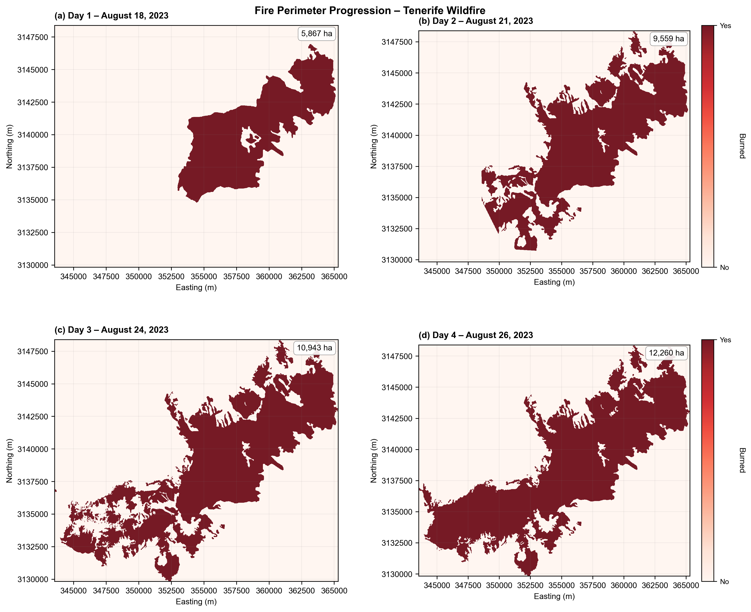
Study Area & Methodology Overview
Location: Tenerife, Canary Islands
Key Features:
• Complex terrain with barrancos (deep ravines)
• Elevation: Sea level to 2,400m+
• Canary Island Pine (Pinus canariensis) dominant
• Prone to calima (Saharan dust) events
Fire Event: August 15-26, 2023
• Start: Arafo municipality, ~1,000m elevation
• Spread: Multi-directional across 12 municipalities
• Validation periods: EMSR Days 1-4 (Aug 18, 21, 24, 26)
Methodology:
• Data: 5m LiDAR, 5m DTM, EMSR fire perimeters
• Model: 3D Cellular Automata (20m resolution)
• Calibration: Two-stage framework (sensitivity + grid search)
• Validation: Temporal split-sample approach

Slide 5
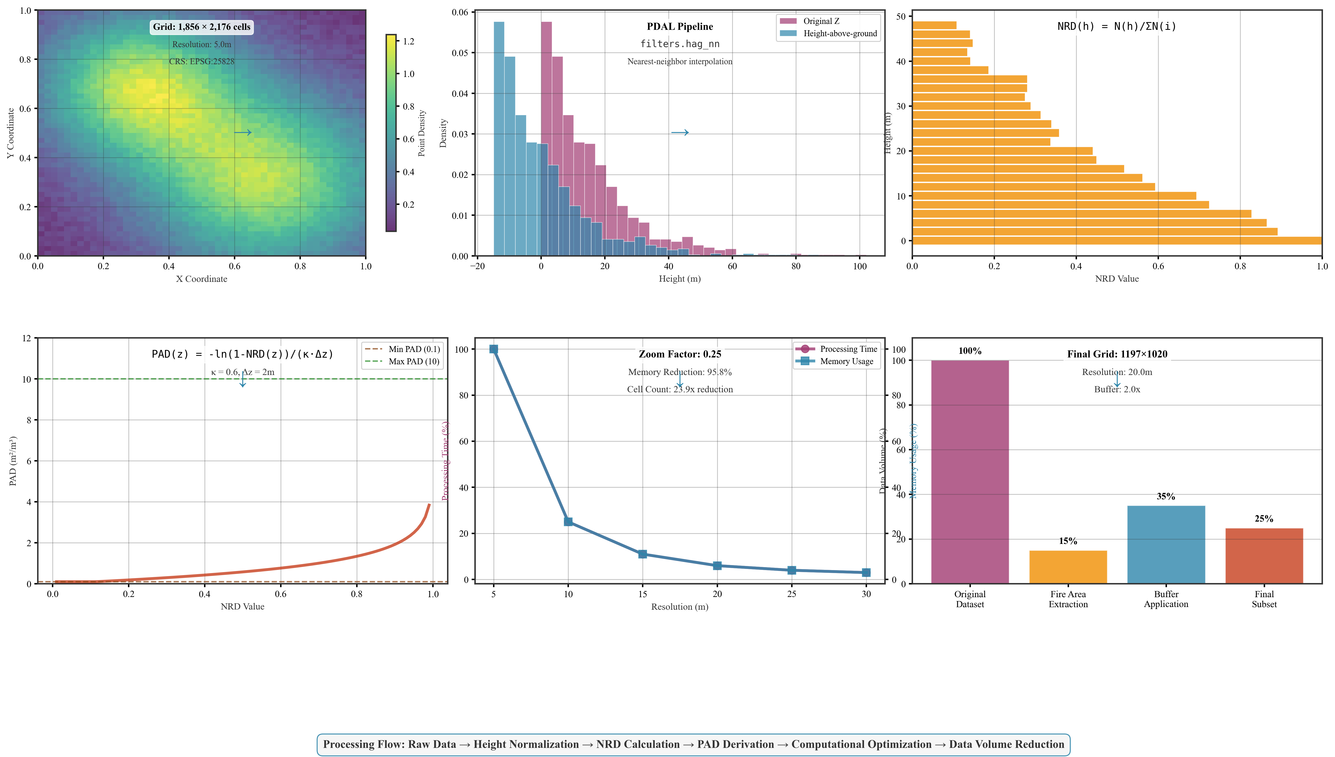
LiDAR Processing & Model Architecture
LiDAR Processing Pipeline
• Height normalization using PDAL HAG algorithm
• Normalized Relative Density (NRD) calculation
• PAD derivation via Beer-Lambert law (κ=0.6)
• 20 vertical layers at 2m intervals (0-40m)
• Resampling: 5m → 20m resolution (16× reduction)
3D CA Model Architecture
• Horizontal: Moore neighborhood, slope/wind multiplicative factors
• Vertical: √(fuel_lower × fuel_upper) connectivity
• Ember: Exponential distance decay, wind-biased direction
• Terrain: Barranco wind channeling (2.5× amplification)

Slide 6
Model Structure & Computational Optimization
Why Custom 3D CA Model?
1. LiDAR Integration: FARSITE/FlamMap/Prometheus use 2D fuel
classifications, cannot utilize continuous 3D PAD data
2. Computational Efficiency: Sparse storage + pre-computed terrain
→ 85% memory reduction, enables 100s of calibration runs
3. Region-Specific: Canary Island pine needs custom parameters
(not North American fuel models, accounts for calima events)
Key Optimizations
• Sparse matrix storage: 85% memory reduction vs dense arrays
• Pre-computed terrain: Barranco detection, wind channeling
• Resolution: 5m → 20m (16× reduction, preserves patterns)
• Memory-mapped loading: <2s init vs 30+ s runtime
• Grid: 609×609×20 layers (24.4M cells) efficiently managed

Slide 7
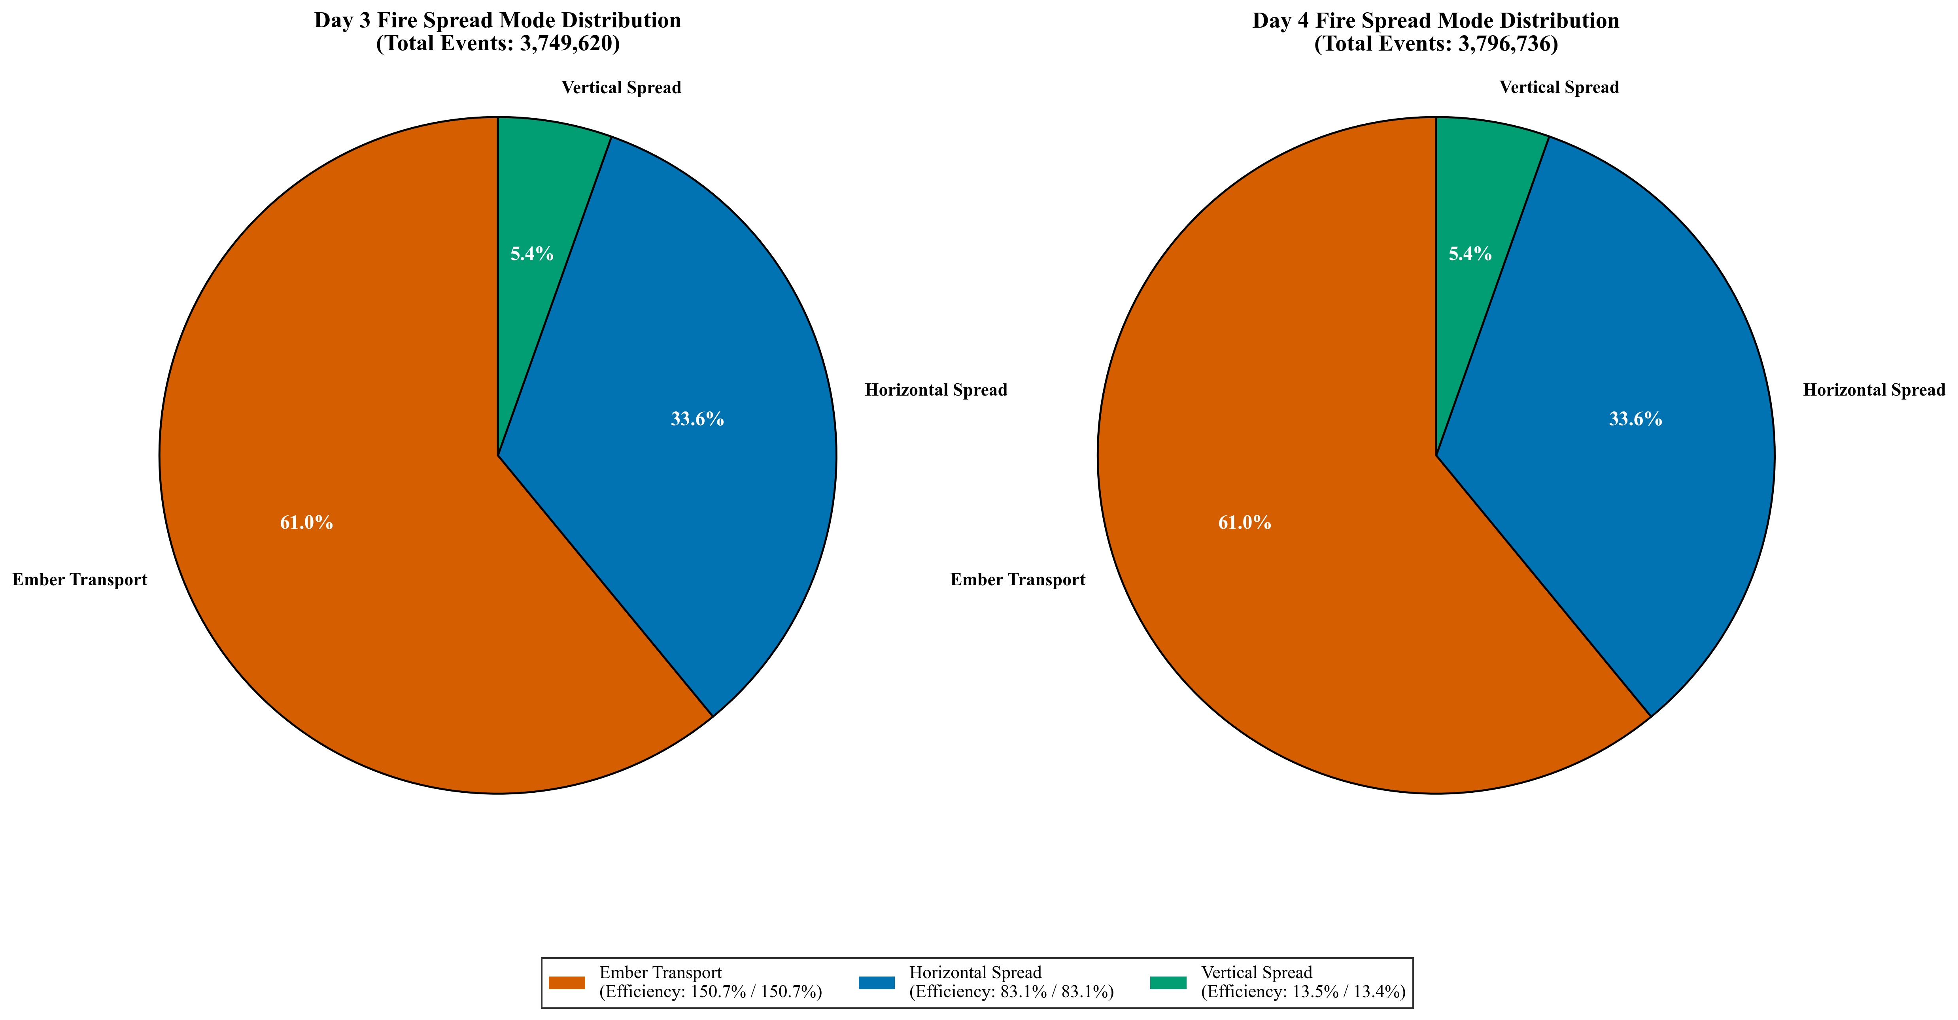
Fire Spread Mechanisms
Three Fire Spread Mechanisms:
Horizontal Spread (Surface Fire):
• 8-neighbor Moore connectivity (N, NE, E, SE, S, SW, W, NW)
• Slope multiplicative factor: exp(0.1·slope_degrees)
• Wind multiplier: Higher in wind direction
• Barranco channeling: 2.5× amplification in ravines
Vertical Spread (Crown Fire):
• Layer-to-layer geometric mean: √(PAD_lower × PAD_upper)
• 20 vertical layers at 2m intervals (0-40m)
• Fuel continuity drives vertical propagation
Ember Transport (Spotting):
• Exponential distance decay: exp(-dist/param)
• Wind-biased direction kernel
• Stochastic ignition probability
• Critical for long-distance spread across discontinuities

Slide 8
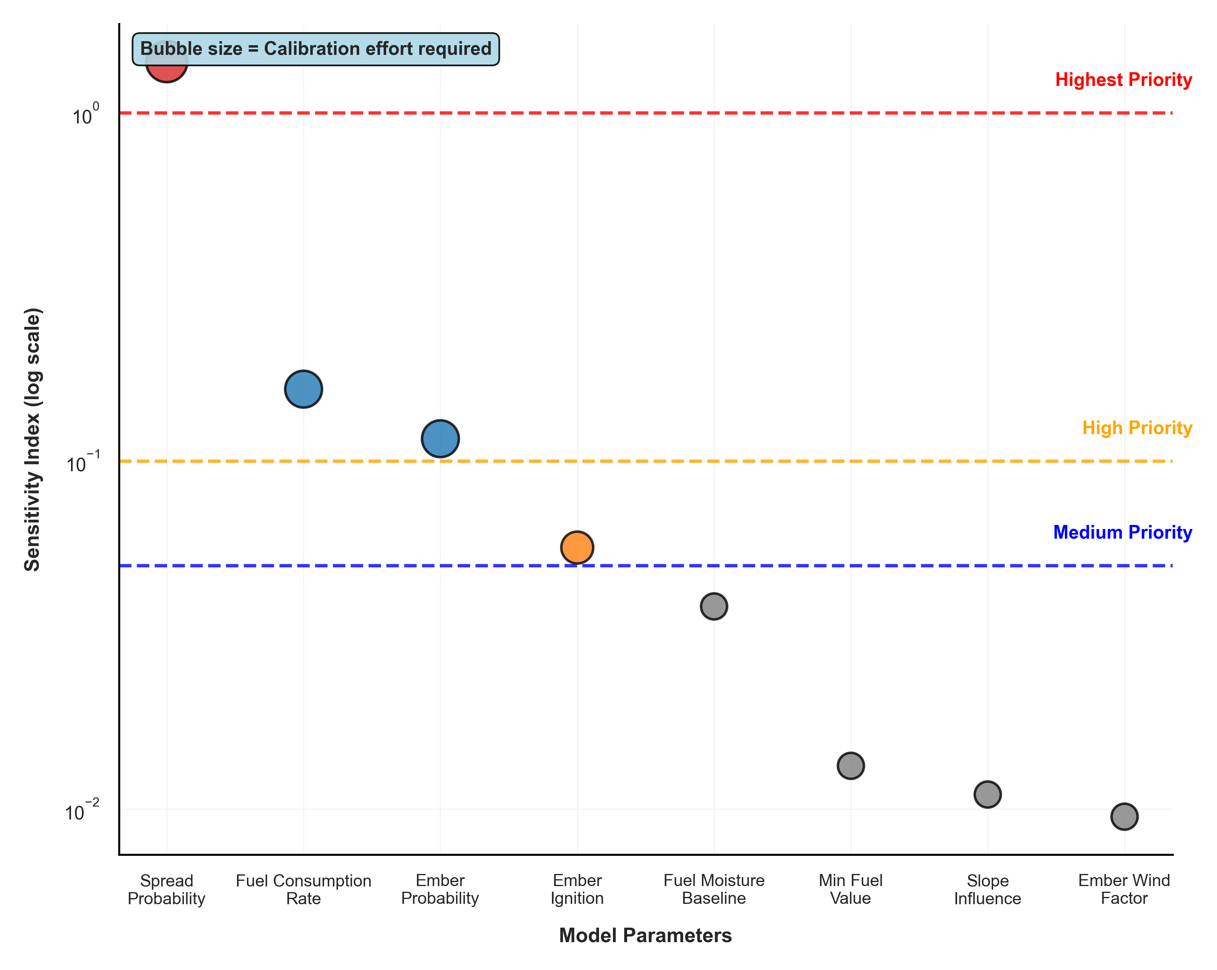
Calibration Approach
Two-Stage Calibration Framework:
Stage 1: Sensitivity Analysis
• Range-based analysis: 9 points × 16 parameters
• Objective: Modified Dice coefficient
• Result: Identified top 4 critical parameters
Stage 2: Grid Search Optimization
• Focused search: 3 points × 4 parameters = 81 combinations
• Calibration target: EMSR Days 1-2 (Aug 18-21)
• Validation target: EMSR Days 3-4 (Aug 24-26)
Computational Efficiency:
• Reduced from 3¹⁶ ≈ 43 million to 81 simulations
• 6 orders of magnitude reduction
• Execution time: ~53 minutes per simulation

Slide 9
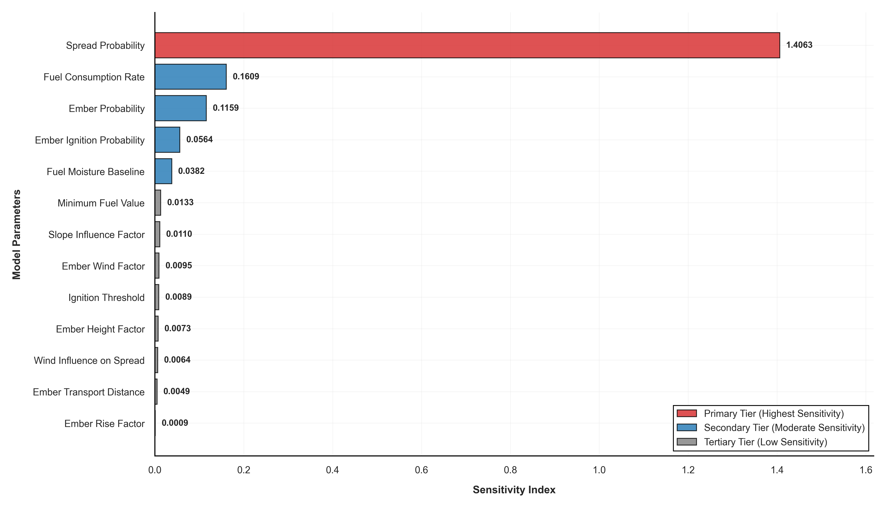
Sensitivity Analysis Results
1.406
0.161
0.172
Top Param
2nd Param
Ember Sum
Parameter Sensitivity Hierarchy:
Top 5 Most Sensitive Parameters:
1. spread_probability: 1.406 (8.7× more sensitive)
2. fuel_consumption_rate: 0.161
3. ember_probability: 0.116
4. ember_ignition: 0.056
5. fuel_moisture_baseline: 0.038
Key Insights:
• spread_probability dominates fire behavior
• Ember system parameters collectively significant (0.172)
• Clear hierarchy enables focused calibration
• Terrain and fuel parameters show secondary importance

Slide 10
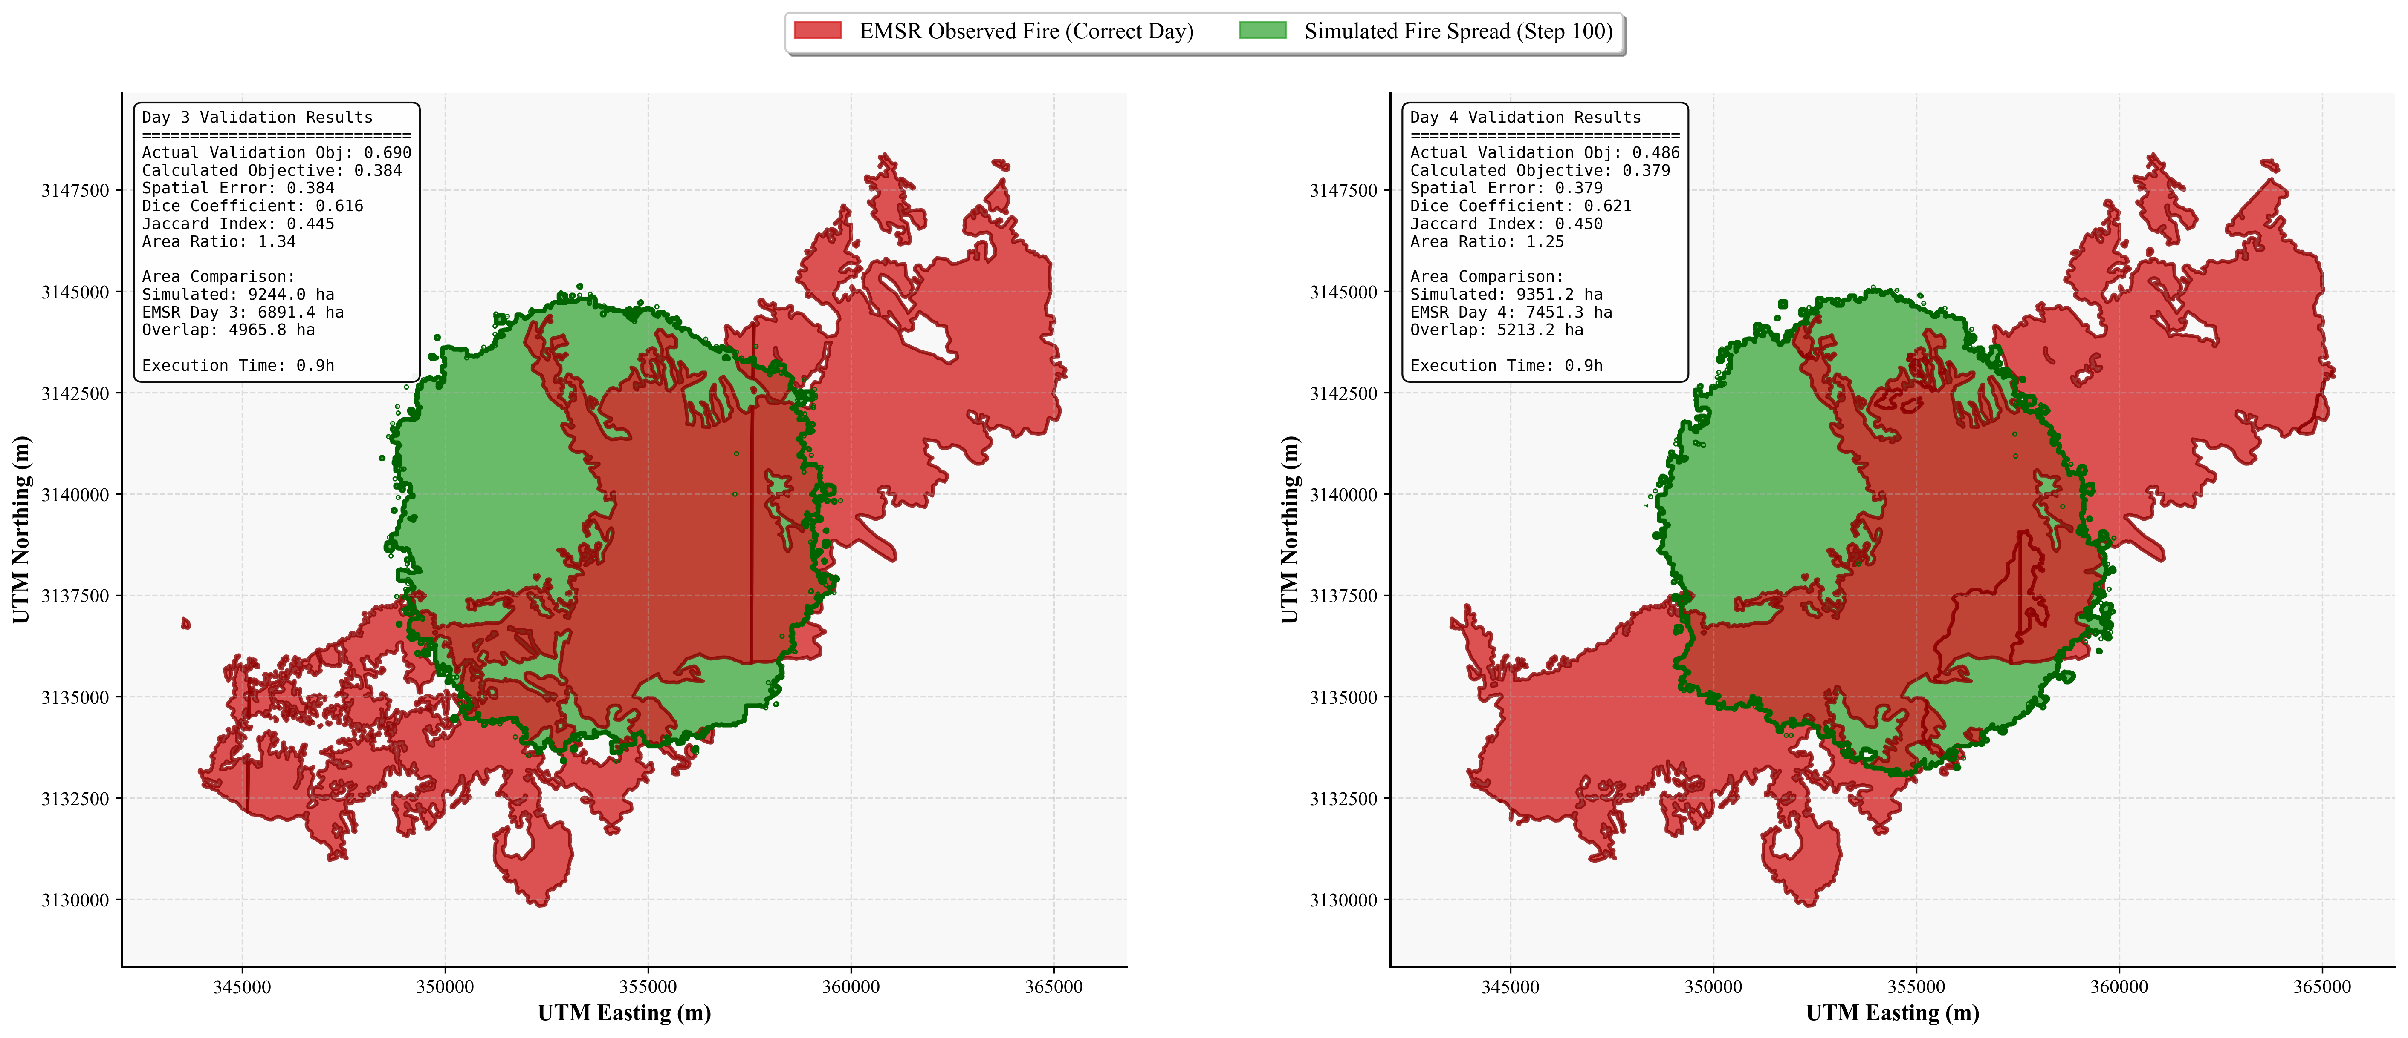
Validation Results
0.690
0.486
-29.6%
Day 3
Day 4
Δ
Spatial Performance (Rank 2 Parameters):
Calibration Period:
• Days 1-2: Objective function optimized
Validation Period:
• Day 3: Objective = 0.690
• Day 4: Objective = 0.486
• Improvement: 29.6% (Day 3 → Day 4)
Parameter Selection Rationale:
• Rank 1: Error 0.513, spread_prob = 0.95 (unrealistic)
• Rank 2: Error 0.536, spread_prob = 0.775 (selected)
• Trade-off: Slightly higher error for physical realism
Execution Time:
• ~53 minutes per simulation (20m resolution)

Slide 11
Key Findings & Limitations
✓ Achievements
⚠ Challenges
Successful LiDAR PAD integration for 3D fuel structure
Vertical spread: Only 3.8% (expected 30-50%)
Systematic calibration framework (43M → 81 simulations)
Ember spread: 43.0% (expected 10-20%)
Horizontal spread: 23.7% contribution, 83% efficiency
Ember efficiency: 150.7% indicates overfitting
Identified critical parameters via sensitivity analysis
Compensating errors rather than physical accuracy
Framework demonstrates feasibility of approach
Need multi-objective calibration + fuel constraints

Slide 12
Conclusions & Future Directions
1
Research Questions Addressed
Q1: LiDAR PAD successfully represents vertical fuel connectivity
→ Framework operational, requires parameter refinement
Q2: Spread modes quantified (H:23.7%, V:3.8%, E:43.0%)
→ Reveals need for improved suppression mechanisms
2
Main Contributions
• First 3D CA wildfire model with continuous LiDAR PAD integration
• Systematic two-stage calibration framework
• Honest validation revealing overfitting challenges
• Quantitative analysis of fire spread mode contributions
3
Future Work
• Multi-objective calibration (spatial + mechanistic constraints)
• Fire suppression mechanisms and fuel consumption limits
• Validation against additional fire events
• Integration with weather forecasting systems

Slide 13
Acknowledgments
Supervisor: dr. A.C. Seijmonsbergen
Assessor: dr. Yifang Shi
Data Sources:
• PNOA-IGN (LiDAR point cloud data)
• Copernicus EMSR (Fire perimeter delineations)
• IGN Spain (Digital Terrain Models)
University of Amsterdam
Graduate School of Life and Earth Sciences
Institute for Biodiversity and Ecosystem Dynamics

Slide 14
Thank You Questions & Discussion
Repository: github.com/AndreasPaphitis/Forest-Fire-Simulation
Contact: andreas.paphitis@student.uva.nl

