Slide 1
Integrating High-Resolution LiDAR Data with Cellular Automata for Wildfire Spread Prediction
Development, Calibration, and Validation
A Case Study of the 2023 Tenerife Wildfire
Andreas Paphitis
University of Amsterdam
October 2025

Slide 2
2023 Tenerife Wildfire
•
12,000 hectares burned across 12 municipalities
Event Date
Aug 15-26, 2023
•
Most severe in Canary Islands in 40 years
•
Over 12,000 residents evacuated
Area Burned
12,000 hectares
•
Classified as 'sixth-generation' wildfire
•
Traditional models failed predictions
Classification
6th Generation
•
Overlooked vertical fire dynamics
•
Underperformed in complex terrain

Slide 3
Research Objectives & Questions
Objective 1: LiDAR Integration
• Integrate high-resolution LiDAR data
• 3D fuel structure via PAD
• Question: How effectively can LiDAR
represent vertical fuel connectivity?
Objective 2: Multi-Dimensional Spread
• Multiple fire spread mechanisms
• Horizontal, vertical, ember transport
• Question: How do spread modes
contribute in complex terrain?

Slide 4
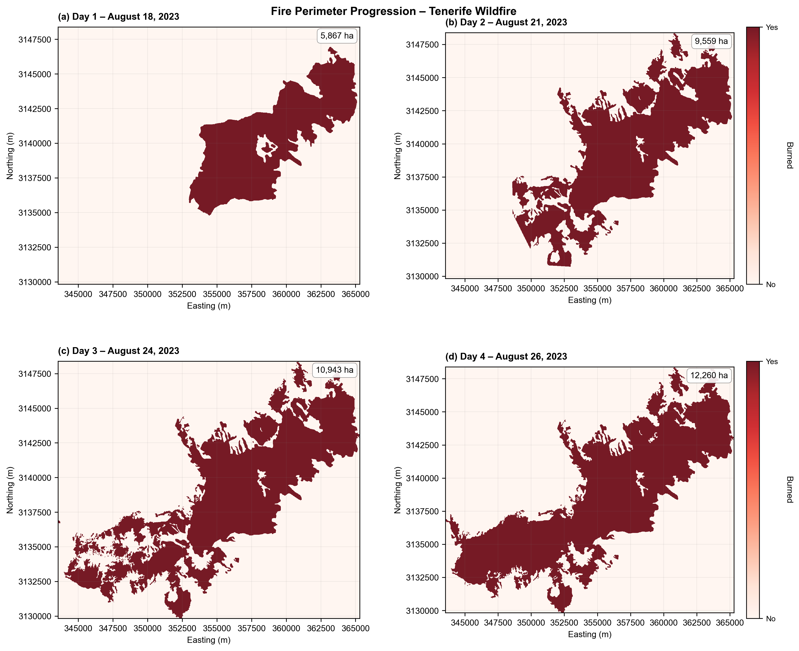
Study Area & Methodology
Location: Tenerife, Canary Islands
Key Features:
• Complex terrain with barrancos
• Elevation: Sea level to 2,400m+
• Canary Island Pine dominant
• Prone to calima (Saharan dust) events
Fire Event: August 15-26, 2023
• Start: Arafo, ~1,000m elevation
• Multi-directional spread
• 12 municipalities affected
Data & Methodology:
• 5m LiDAR, 5m DTM, EMSR perimeters
• 3D Cellular Automata (20m resolution)
• Two-stage calibration framework
• Temporal split-sample validation

Slide 5
LiDAR Processing & 3D CA Model
LiDAR Pipeline
• Height normalization (PDAL HAG)
• NRD → PAD (Beer-Lambert, κ=0.6)
• 20 vertical layers (2m intervals)
• Resampling: 5m → 20m (16× reduction)
3D CA Architecture
• Horizontal: Moore neighborhood
• Vertical: Fuel connectivity
• Ember: Wind-biased transport
• Terrain: Barranco channeling (2.5×)

Slide 6
Why Custom 3D CA Model?
1
2
3
LiDAR Integration
FARSITE/FlamMap use 2D
Need continuous 3D PAD
Custom model required
Efficiency
85% memory reduction
Enables calibration
100s of simulations
Region-Specific
Canary Island pine
Not N. American models
Accounts for calima

Slide 7
Two-Stage Calibration Framework
Stage 1: Sensitivity
• Range-based analysis
• 9 points × 16 parameters
• Modified Dice coefficient
• Result: Top 4 parameters
Stage 2: Grid Search
• 3 points × 4 params = 81
• Days 1-2 calibration
• Days 3-4 validation
• 3^16→81: 6-order reduction

Slide 8
Parameter Sensitivity Hierarchy
1. spread_probability
1.406
2. fuel_consumption
0.161
3. ember_probability
0.116
4. ember_ignition
0.056
5. fuel_moisture
0.038

Slide 9
Validation Results
Day 3
Objective
0.690
Day 4
Objective
0.486
(-29.6%)

Slide 10
Key Findings & Limitations
✓ Achievements
⚠ Challenges
✓
Successful LiDAR PAD integration for 3D fuel
!
Vertical spread: Only 3.8% (expected 30-50%)
✓
Systematic calibration (43M → 81 simulations)
!
Ember spread: 43.0% (expected 10-20%)
✓
Horizontal spread: 23.7%, 83% efficiency
!
Ember efficiency: 150.7% indicates overfitting
✓
Critical parameters identified
!
Compensating errors vs physical accuracy
✓
Framework feasibility demonstrated
!
Need multi-objective calibration + constraints

Slide 11
Conclusions & Future Directions
1. Research Questions
Q1: LiDAR PAD successfully represents connectivity
Q2: Spread modes quantified (H:23.7%, V:3.8%, E:43.0%)
2. Contributions
• First 3D CA with continuous LiDAR PAD
• Systematic two-stage calibration framework
• Honest validation revealing challenges
3. Future Work
• Multi-objective calibration
• Fire suppression mechanisms
• Validation on additional events

Slide 12
Acknowledgments
Supervisor: dr. A.C. Seijmonsbergen
Assessor: dr. Yifang Shi
Data Sources:
PNOA-IGN • Copernicus EMSR • IGN Spain
University of Amsterdam
Graduate School of Life and Earth Sciences

Slide 13
Thank You
Questions & Discussion
Repository:
github.com/AndreasPaphitis/Forest-Fire-Simulation
andreas.paphitis@student.uva.nl

