Slide 1
High-Resolution Wildfire Modelling: Integrating LiDAR-Derived 3D Fuel Structure
Master's Thesis Defense
Andreas Paphitis
University of Amsterdam
Graduate School of Life and Earth Sciences
November 2024

Slide 2
Background & Problem Statement
Climate change: Wildfire seasons extending (+18.7% longer) [Tedim et al., 2018]
Mediterranean: High-risk region for extreme fire behavior [Copernicus EMS]
+18.7% longer
Current models: Limited by 2D fuel classifications [1,2,3,4]
Fire Season
Opportunity: High-resolution LiDAR data now available
Tenerife 2023
Solution: 3D Cellular Automata with vertical fuel structure
Study Area
Challenge: Calibration complexity & overfitting risks [6]
20m, 20 layers
Resolution

Slide 3
Research Objectives
Research Question 1:
Can LiDAR-derived Plant Area Density (PAD) effectively
represent vertical fuel connectivity in fire spread models?
Research Question 2:
What are the relative contributions of horizontal, vertical,
and ember-mediated spread in 3D fire behavior?
Approach:
• Systematic two-stage calibration framework
• Temporal split-sample validation (Days 1-4)
• Quantification of spread mode contributions

Slide 4
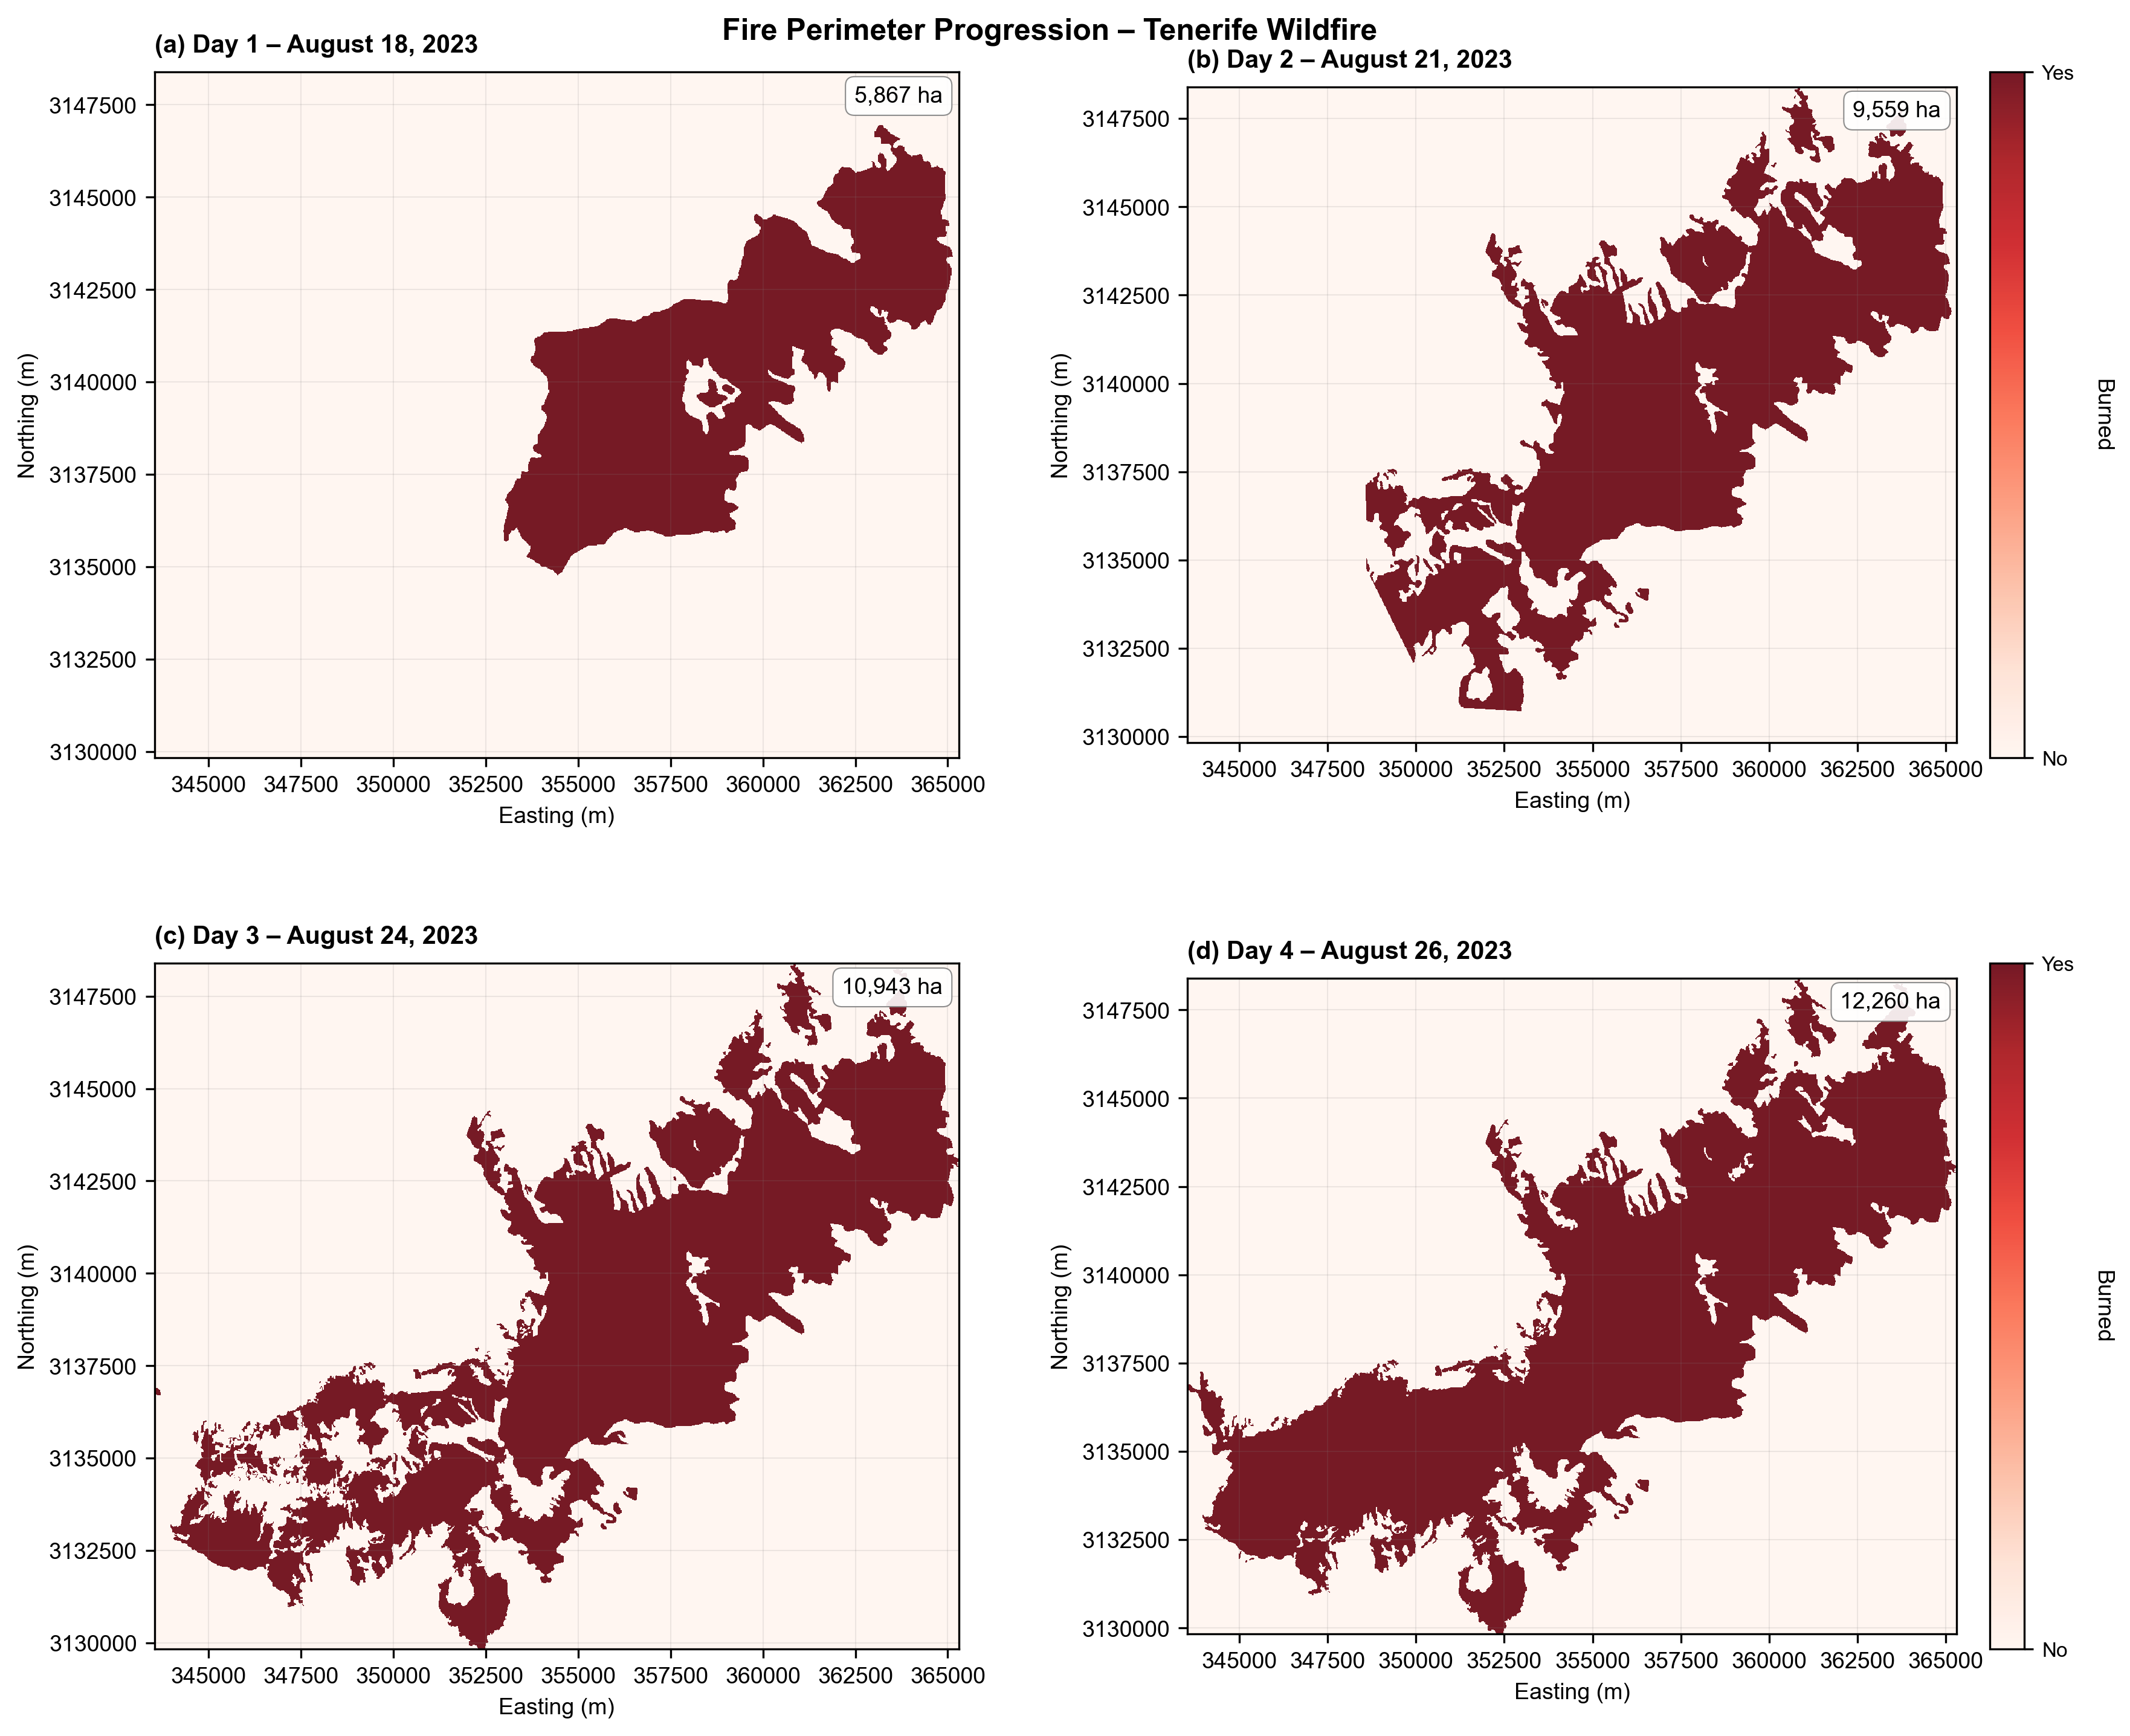
Study Area & Methodology Overview
Study Area: Tenerife, Canary Islands
Fire Event: August 15-26, 2023
• Start: Arafo municipality, ~1,000m elevation
• Spread: Multi-directional across 12 municipalities
• Validation periods: EMSR Days 1-4 (Aug 18, 21, 24, 26)
Methodology:
• Data: 5m LiDAR, 5m DTM, EMSR fire perimeters
• Model: 3D Cellular Automata (20m resolution)
• Calibration: Two-stage framework (sensitivity + grid search)
• Validation: Temporal split-sample approach

Slide 5
LiDAR Processing & Model Architecture
LiDAR Processing Pipeline:
• Height normalization using PDAL HAG algorithm [5]
• Normalized Relative Density (NRD) calculation [6]
• PAD derivation via Beer-Lambert law (κ=0.6) [7]
• 20 vertical layers at 2m intervals (0-40m)
• Resampling: 5m → 20m resolution (16× reduction)
3D CA Model Architecture:
• Horizontal: Moore neighborhood, slope/wind factors [8]
• Vertical: √(fuel_lower × fuel_upper) connectivity [9]
• Ember: Exponential decay, wind-biased direction [10]
• Terrain: Barranco wind channeling (2.5× amplification)

Slide 6
Model Structure & Computational Optimization
Why Custom 3D CA Model?
1. LiDAR Integration: FARSITE/FlamMap use 2D fuel
classifications, cannot utilize continuous 3D PAD data
2. Computational Efficiency: Sparse storage enables
100s of calibration runs (85% memory reduction)
3. Region-Specific: Canary Island pine parameters
(not North American models, accounts for calima)
Key Optimizations:
• Sparse matrix storage: 85% memory reduction
• Pre-computed terrain: Barranco detection, channeling
• Resolution: 5m → 20m (16× reduction, preserves patterns)
• Grid: 609×609×20 layers (24.4M cells) efficiently managed

Slide 7
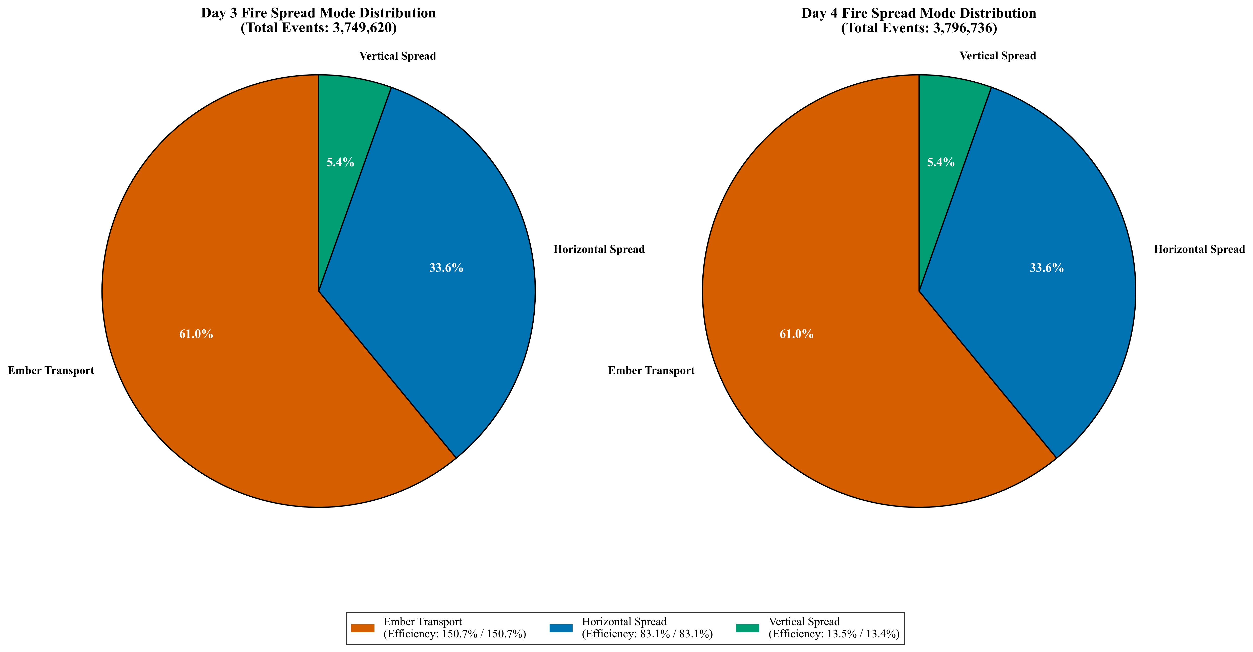
Fire Spread Mechanisms
Three Fire Spread Mechanisms:
Horizontal Spread (Surface Fire):
• 8-neighbor Moore connectivity (N, NE, E, SE, S, SW, W, NW)
• Slope multiplicative factor: exp(0.1·slope_degrees)
• Wind multiplier: Higher in wind direction
• Barranco channeling: 2.5× amplification in ravines
Vertical Spread (Crown Fire):
• Layer-to-layer geometric mean: √(PAD_lower × PAD_upper)
• 20 vertical layers at 2m intervals (0-40m)
• Fuel continuity drives vertical propagation
Ember Transport (Spotting):
• Exponential distance decay: exp(-dist/param)
• Wind-biased direction kernel
• Stochastic ignition probability
• Critical for long-distance spread across discontinuities

Slide 8
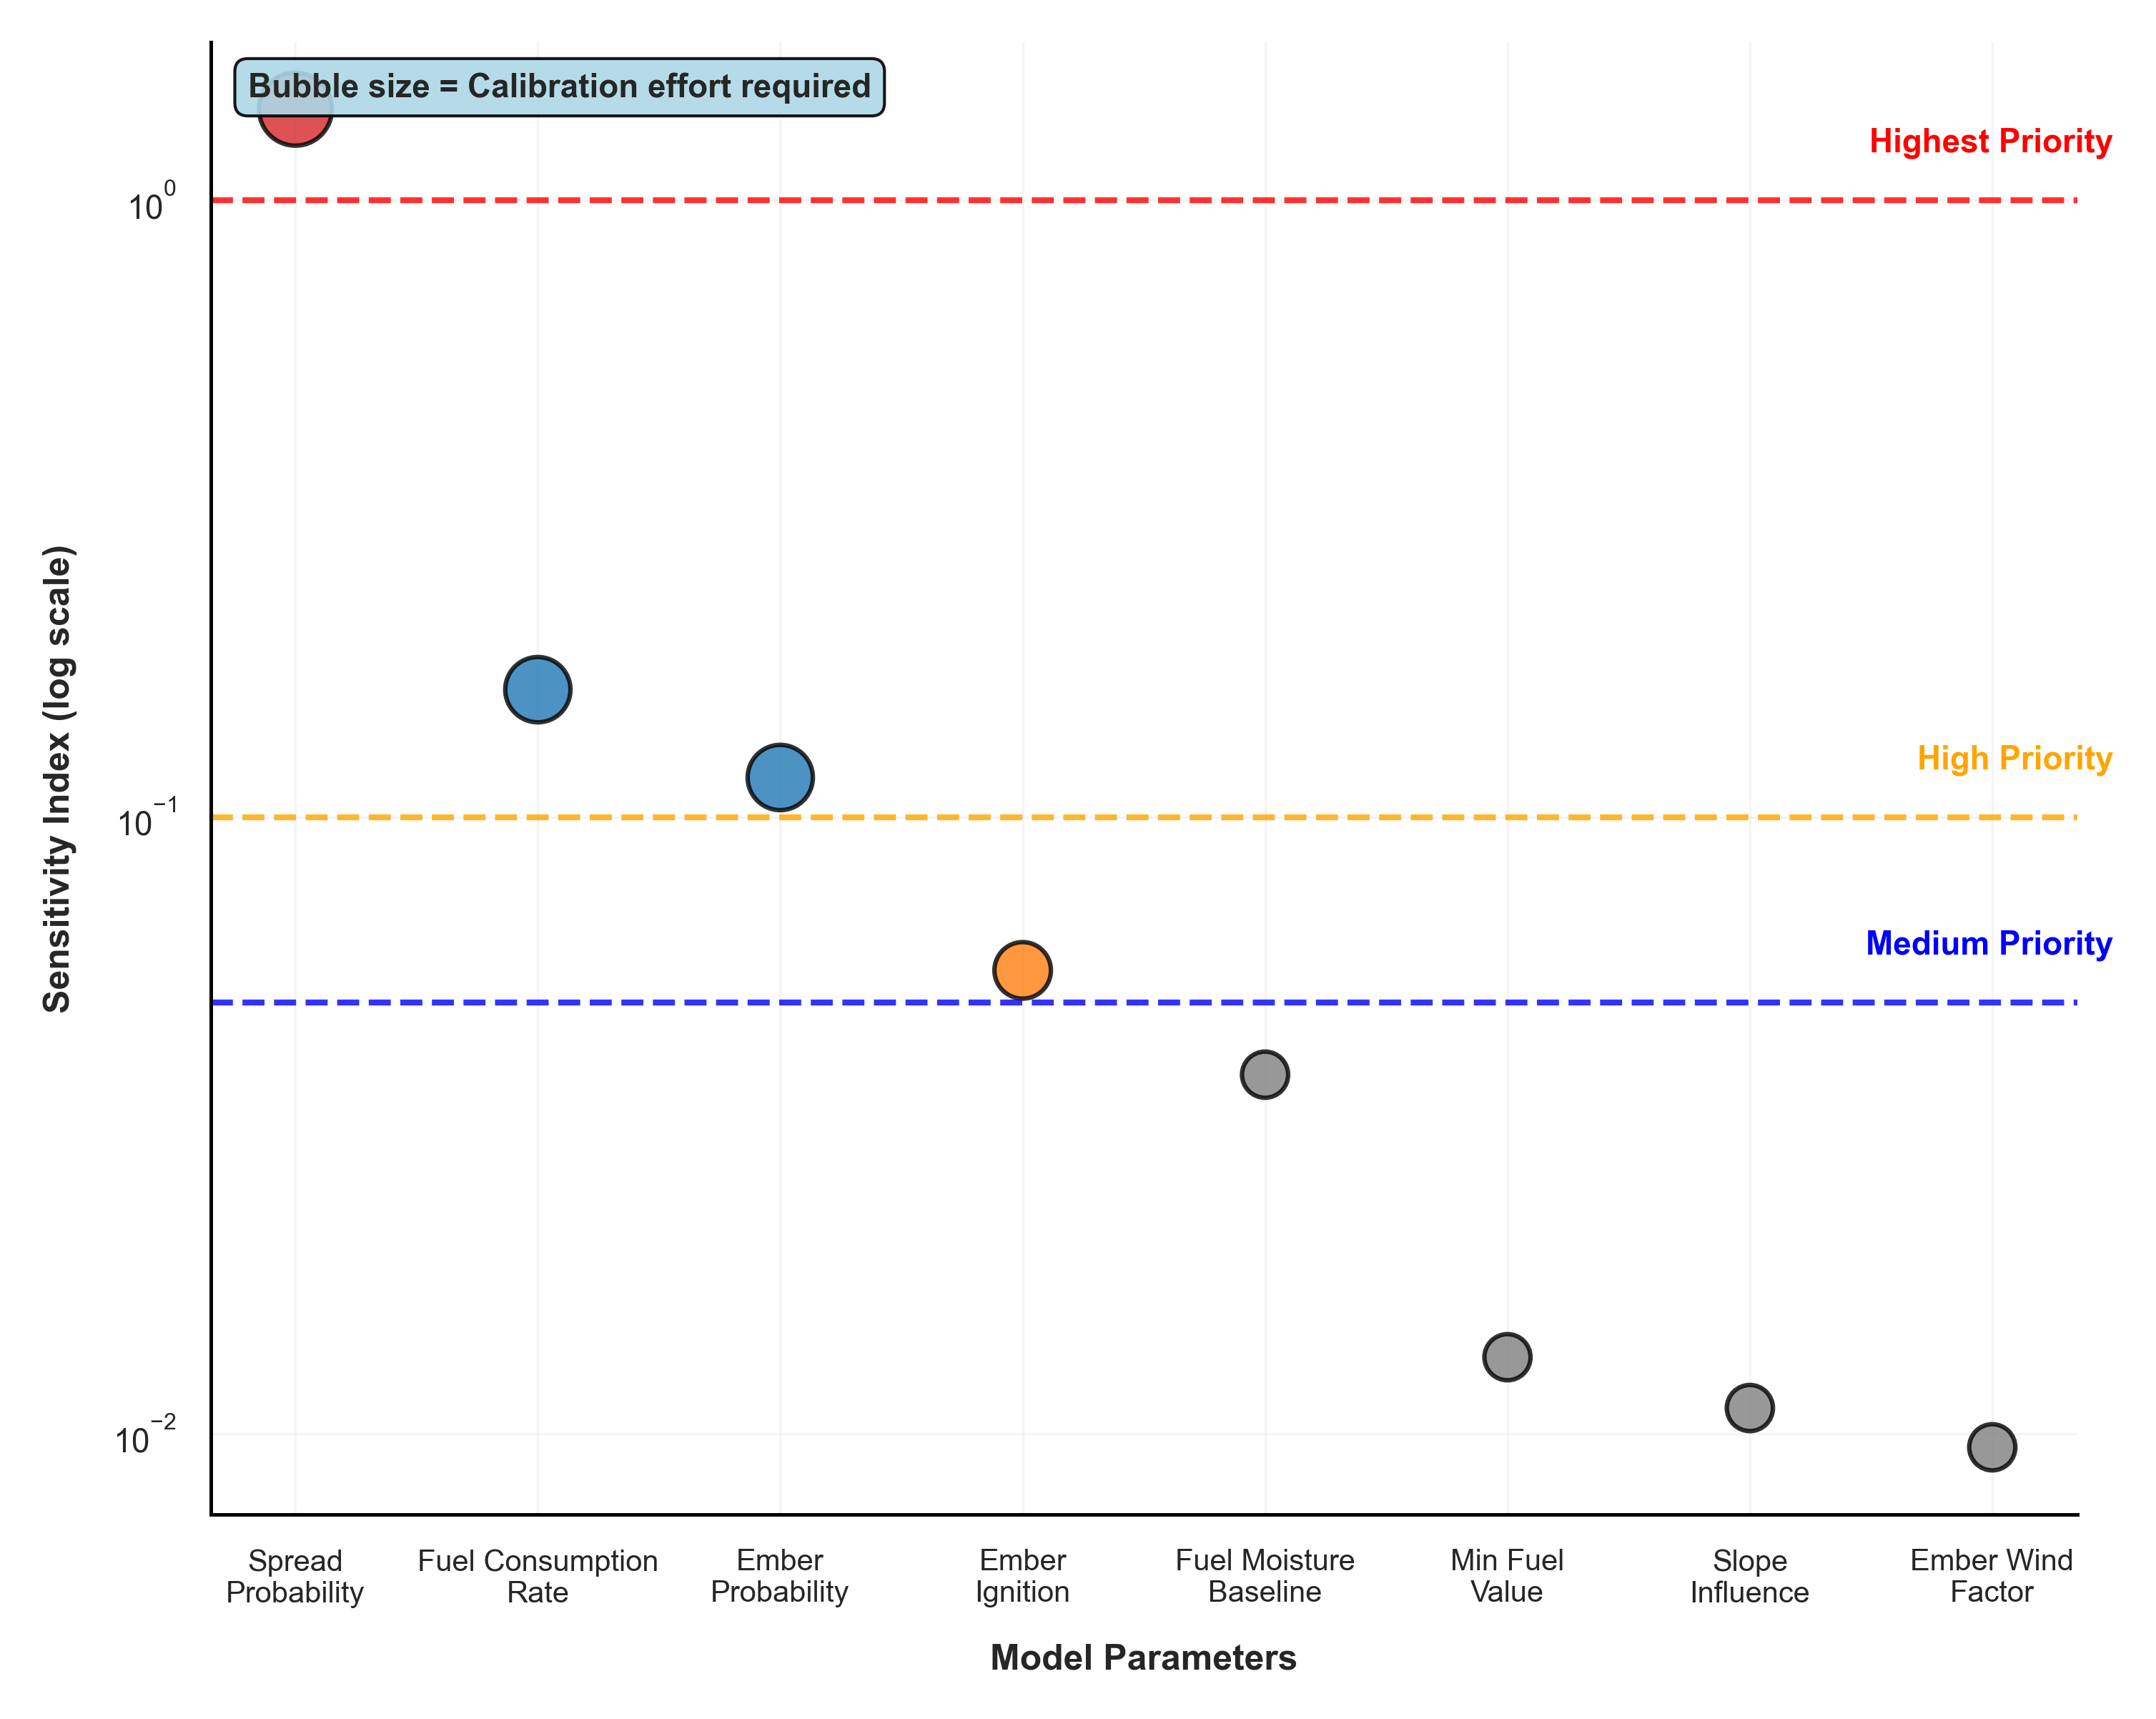
Calibration Approach
Two-Stage Calibration Framework:
Stage 1: Sensitivity Analysis
• Range-based analysis: 9 points × 16 parameters
• Objective: Modified Dice coefficient
• Result: Identified top 4 critical parameters
Stage 2: Grid Search Optimization
• 7³ = 343 combinations on top parameters
• Reduced from 3¹⁶ ≈ 43M to 81 simulations
• 6 orders of magnitude reduction
• Objective: Maximize modified Dice
• Coverage metrics: F1, intersection area
Challenge: Overfitting Risk
• Temporal splits (calibration vs validation days)
• Mechanistic metrics alongside statistical
• Trade-off: Physical realism vs empirical fit
Computational Efficiency:
• ~53 minutes per simulation
• Calibration target: EMSR Days 1-2 (Aug 18-21)
• Validation target: EMSR Days 3-4 (Aug 24-26)

Slide 9
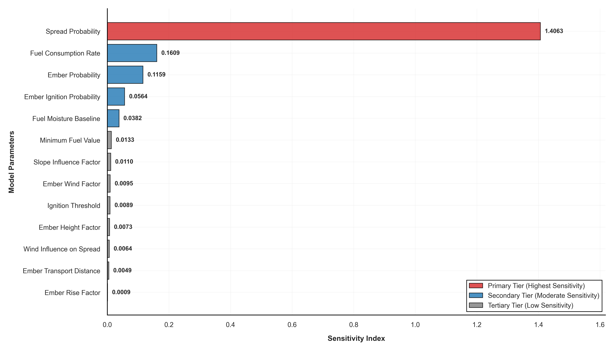
Sensitivity Analysis Results
1.406
0.161
0.172
Top Param
2nd Param
Ember Sum
Parameter Sensitivity Hierarchy:
Top 5 Most Sensitive Parameters:
1. spread_probability: 1.406 (8.7× more sensitive)
2. fuel_consumption_rate: 0.161
3. ember_probability: 0.116
4. ember_ignition: 0.056
5. fuel_moisture_baseline: 0.038
Key Insights:
• spread_probability dominates fire behavior
• Ember system parameters collectively significant (0.172)
• Clear hierarchy enables focused calibration
• Terrain and fuel parameters show secondary importance
Results:
• Identified top 4 parameters for grid search
• Reduced calibration space by 6 orders of magnitude
• Systematic approach to parameter selection

Slide 10
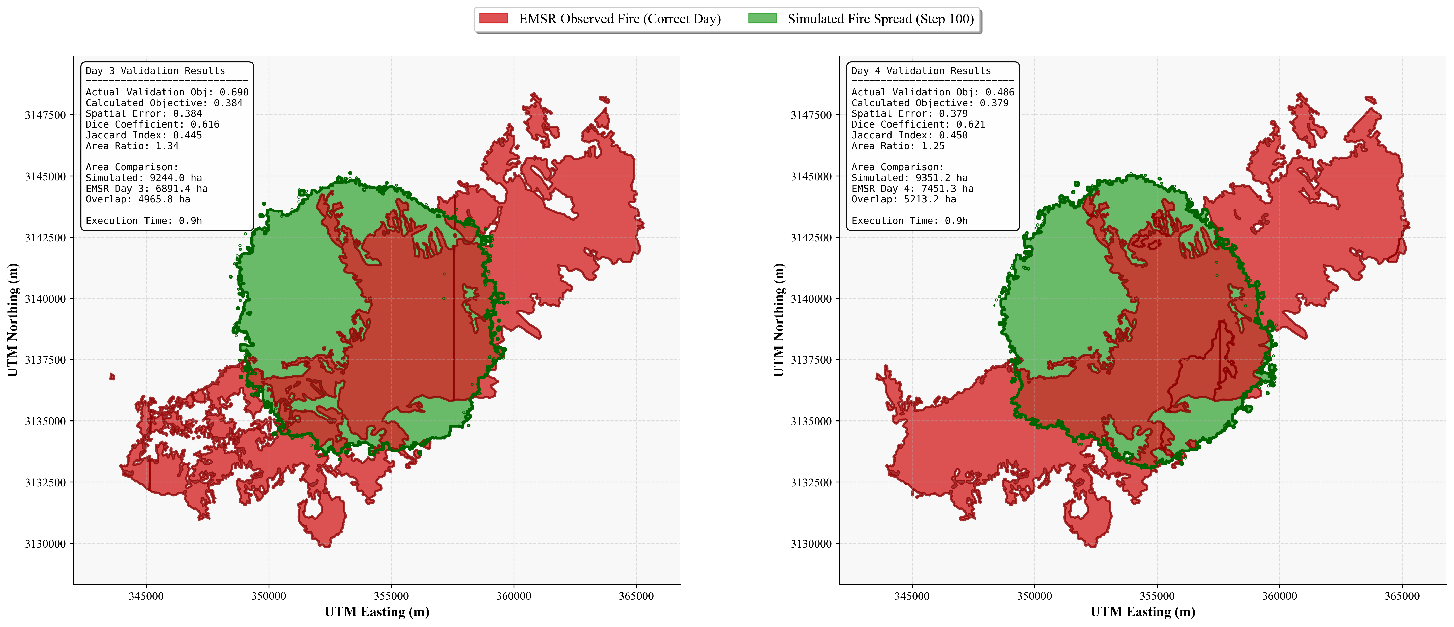
Validation Results
0.690
0.486
-29.6%
Day 3
Day 4
Δ
Spatial Performance (Rank 2 Parameters):
Calibration Period:
• Days 1-2: Objective function optimized
Validation Period:
• Day 3: Objective = 0.690
• Day 4: Objective = 0.486
• Improvement: 29.6% (Day 3 → Day 4)
Parameter Selection Rationale:
• Rank 1: Error 0.513, spread_prob = 0.95 (unrealistic)
• Rank 2: Error 0.536, spread_prob = 0.775 (selected)
• Trade-off: Slightly higher error for physical realism
Spread Mode Contributions:
• Horizontal: 23.7% (expected 40-60%)
• Vertical: 3.8% (expected 30-50%)
• Ember: 43.0% (expected 10-20%)
Execution Time:
• ~53 minutes per simulation (20m resolution)

Slide 11
Key Findings & Limitations
Achievements
Challenges
Successful LiDAR PAD integration for 3D fuel structure
Vertical spread: Only 3.8% (expected 30-50%)
Systematic calibration framework (43M → 81 simulations)
Ember spread: 43.0% (expected 10-20%)
Horizontal spread: 23.7% contribution, 83% efficiency
Ember efficiency: 150.7% indicates overfitting
Identified critical parameters via sensitivity analysis
Compensating errors rather than physical accuracy
Framework demonstrates feasibility of approach
Need multi-objective calibration + fuel constraints

Slide 12
Conclusions & Future Directions
1
Research Questions Addressed
Q1: LiDAR PAD successfully represents vertical fuel connectivity
→ Framework operational, requires parameter refinement
Q2: Spread modes quantified (H:23.7%, V:3.8%, E:43.0%)
→ Reveals need for improved suppression mechanisms
2
Key Contributions
• First LiDAR-derived 3D CA model for Mediterranean wildfires
• Systematic two-stage calibration framework
• Computational optimizations: 85% memory reduction
• Quantitative assessment of spread mode contributions
3
Future Work
• Multi-objective calibration (spatial + mechanistic constraints)
• Fire suppression mechanisms and fuel consumption limits
• Validation against additional fire events
• Integration with weather forecasting systems

Slide 13
Acknowledgments
Supervisor: dr. A.C. Seijmonsbergen
Assessor: dr. Yifang Shi
Data Sources:
• PNOA-IGN (LiDAR point cloud data)
• Copernicus EMSR (Fire perimeter delineations)
• IGN Spain (Digital Terrain Models)
University of Amsterdam
Graduate School of Life and Earth Sciences
Institute for Biodiversity and Ecosystem Dynamics

Slide 14
Key References
[1] Cruz & Alexander (2013). Uncertainty associated with model predictions of surface and crown fire rates of spread. Environmental Modelling & Software.
[2] Sullivan (2009). Wildland surface fire spread modelling, 1990-2007. International Journal of Wildland Fire.
[3] Finney (2004). FARSITE: Fire Area Simulator—Model Development and Evaluation. USDA Forest Service Research Paper RMRS-RP-4.
[4] Finney (2006). An overview of FlamMap fire modeling capabilities. In: Andrews, P.L. & Butler, B.W. (Eds.). Fuels Management.
[5] PDAL Contributors (2023). Point Data Abstraction Library (PDAL). https://pdal.io
[6] MacArthur & Horn (1969). Foliage profile by vertical measurements. Ecology.
[7] Campbell & Norman (1998). An Introduction to Environmental Biophysics. Springer.
[8] Rothermel (1972). A mathematical model for predicting fire spread in wildland fuels. USDA Forest Service Research Paper INT-115.
[9] Van Wagner (1977). Conditions for the start and spread of crown fire. Canadian Journal of Forest Research.
[10] Albini (1979). Spot fire distance from burning trees—a predictive model. USDA Forest Service Research Paper INT-56.
Data Sources:
• PNOA-IGN: Plan Nacional de Ortofotografía Aérea, Instituto Geográfico Nacional (LiDAR)
• Copernicus EMSR706: Emergency Management Service Rapid Mapping (Fire perimeters)
• IGN España: Instituto Geográfico Nacional España (Digital Terrain Models)

Slide 15
Thank You Questions & Discussion
Repository: github.com/AndreasPaphitis/Forest-Fire-Simulation
Contact: andreas.paphitis@student.uva.nl

