Slide 1

Hands-on Demo Environment (Azure)
Deploy from: github.com/rchaganti/PSConfEU2017

Slide 2
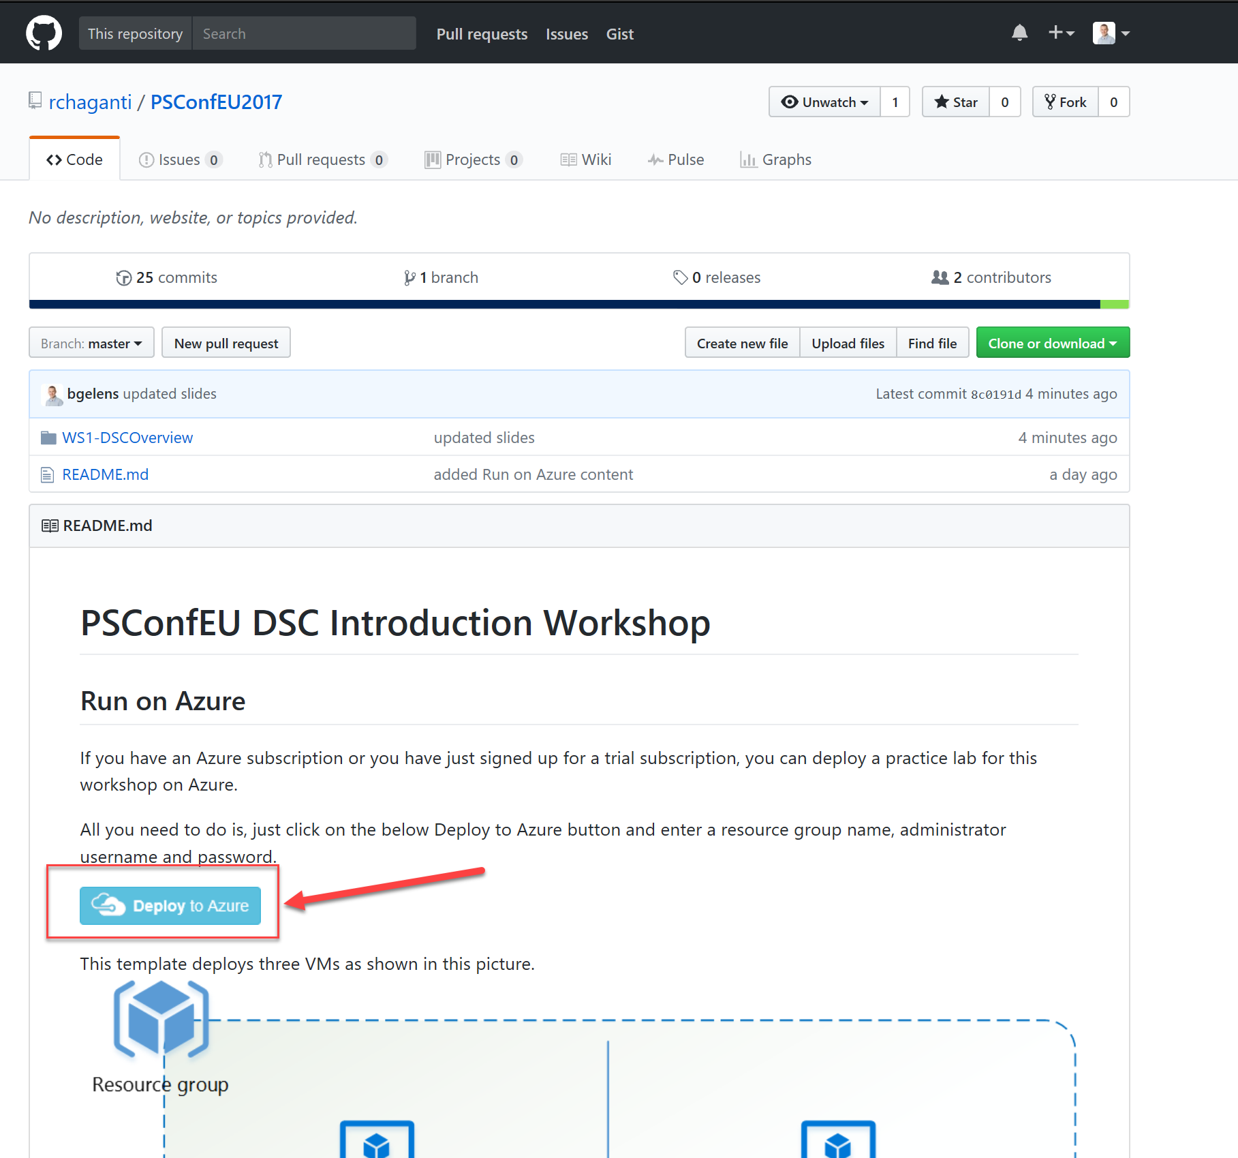

Slide 3
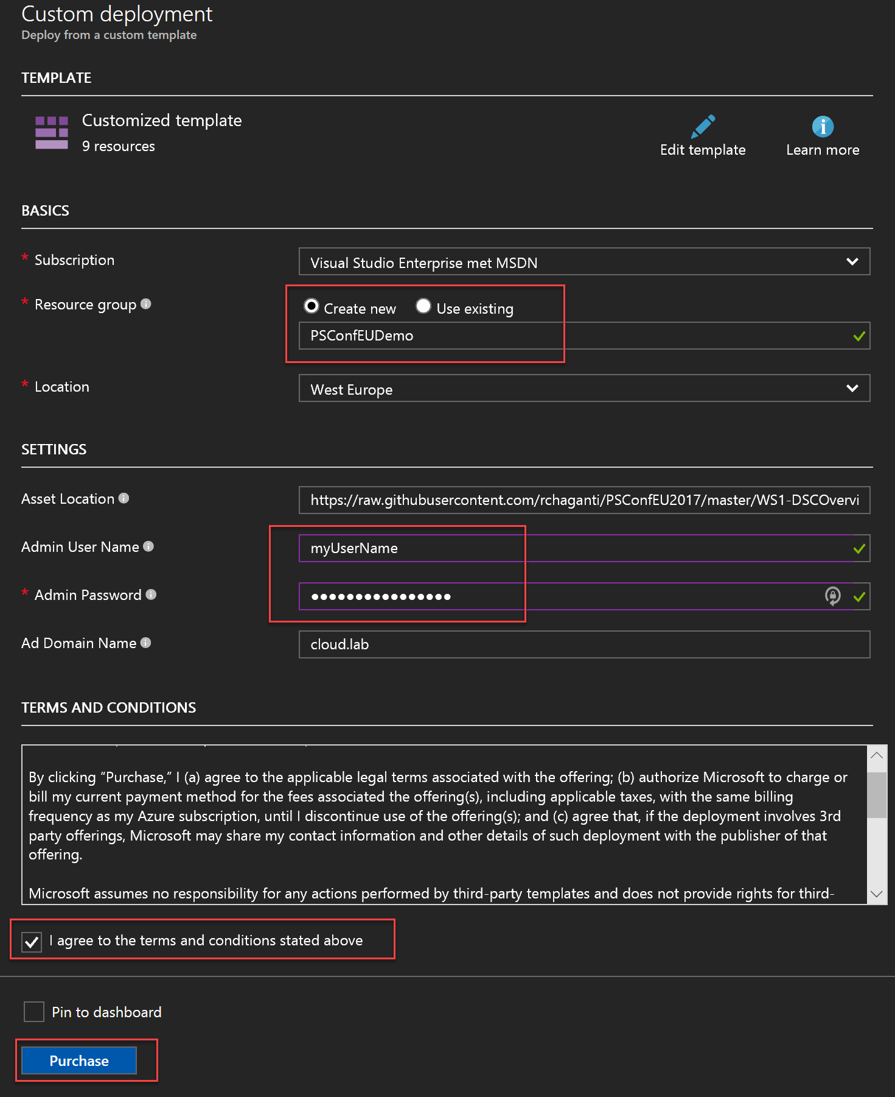

Slide 4
Hands-on Demo Environment (Local)
If you don’t have an Azure Subscription. I have prepared a solution for Hyper-V
https://github.com/rchaganti/PSConfEU2017/blob/master/README.md#run-on-hyper-v
If people downloaded these images to USB media already, please help out others!

