Slide 1
PowerShell Desired State Configuration
An Overview
Ben Gelens, MVP, @bgelens, bgelens.nl DevOps & Cloud Consultant @ InSpark

Slide 2
About_Author - Ravikanth Chaganti
Sr. Principal Engineer at Dell EMC
CDM and Azure MVP
Founder & Editor, PowerShell Magazine
Published Author
Windows PowerShell Desired State Configuration Revealed (Apress)
Pro DSC (Apress; upcoming title)
Several other self-published books!

Slide 3
About_Presenter
Name : Ben Gelens
Job : Consultant
MVP : CDM (PowerShell)
Company : InSpark
Email : ben@bgelens.nl
Twitter : @bgelens
GitHub : bgelens
Community : {Hyper-V.nu, azurestack.blog, DuPSUG}
Blogging : {bgelens.nl, Hyper-V.nu, … PowerShellMagazine.com, azurestack.blog}

Slide 4
Agenda
Why DSC?
DSC Components
Imperative vs Declarative
Writing Configurations
Resource Modules and Composite Resources
DSC Pull Service
DSC On Linux (if time permits)

Slide 5
Hands-on Demo Environment (Azure)
Deploy from: github.com/rchaganti/PSConfEU2017

Slide 6
Hands-on Demo Environment (Local)
If you don’t have an Azure Subscription. I have prepared a solution for Hyper-V
https://github.com/rchaganti/PSConfEU2017/blob/master/README.md#run-on-hyper-v
If people downloaded these images to USB media already, please help out others!

Slide 7
Why DSC?
Configuration Management is different from simple script automation
Provides a reliable way to configure -> monitor -> correct configurations
Provide an idempotent way of configuring resources

Slide 8

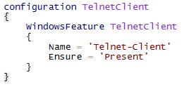
Imperative vs Declarative
Imperative:
Declarative:

Slide 9
History
Version 1.0 was released with WMF 4.0 Windows Server 2012R2 / Windows 8.1
Subsequent update as November 2014 Rollup
http://support.microsoft.com/en-us/kb/3000850
Version 2.0 was released with WMF 5.0
Updated with WMF 5.1
https://www.microsoft.com/en-us/download/details.aspx?id=54616

Slide 10
WMF 5.1 support
Windows Server 2012 R2
Windows Server 2012
Windows Server 2008 R2 SP1
Windows 8.1
Windows 7 SP1
Not applicable for Windows Server 2016
Includes WMF 5.1 level components already

Slide 11
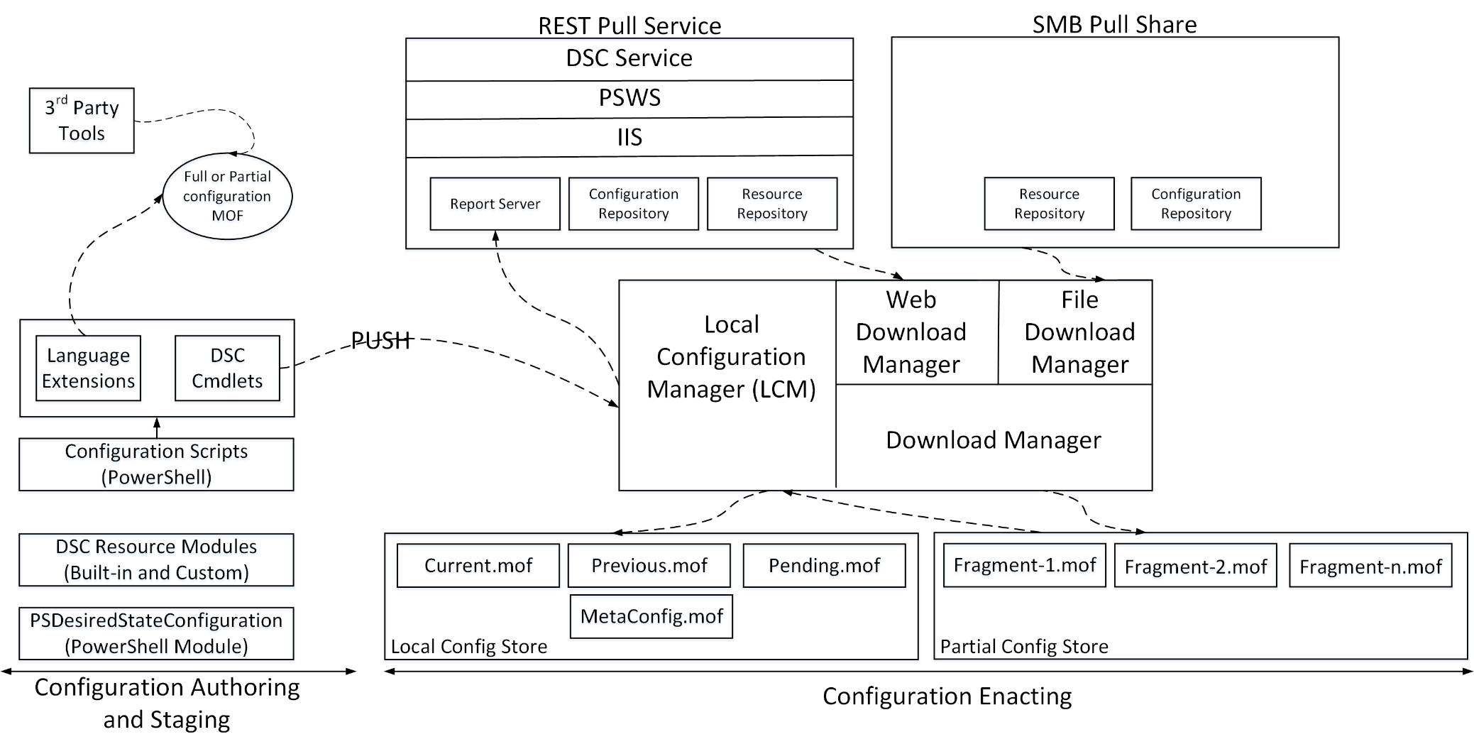
DSC Components
From Ravi’s new book: Pro DSC Available Q3

Slide 12
Language Extensions
PSDesiredStateConfiguration Module
Dynamic Keywords that enable configuration authoring
Declarative Syntax
Cmdlets to compile and manage configurations

Slide 13
Start-Demo –Item ‘LangaugeExt’
Exploring PSDesiredStateConfiguration Module and Language Extensions

Slide 14
Local Configuration Manager
The OS “agent” … sort of!
Implemented as a WMI provider.
Can be configured in a declarative manner using Meta Resources.
Ability to receive (push) or pull configurations.

Slide 15
Start-Demo –Item ‘LCMBasics’
Local Configuration Manager Overview

Slide 16
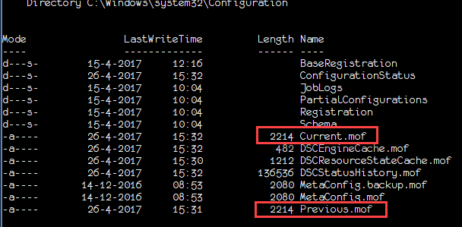
Configuration Store
Place where configurations live
Different types based on the phase
Pending
Current
Previous
Partial Configuration Store

Slide 17
Writing Configurations
Tools for the job!
Good old PowerShell ISE!
ISESteroids
Visual Studio Code

Slide 18
Configuration Anatomy
Configuration ArchiveDemo {
Node WS2016-01 {
Archive ArchiveDemo {
Path = "C:\demo\Scripts.zip"
DestinationPath = "C:\Scripts"
Ensure="Present"
}
}
}
ArchiveDemo
Can take parameters like a function
Uses WSMAN
Each Configuration document gets converted to a MOF
.PS1

Slide 19
Start-Demo –Item ‘ConfigAnatomy’
Writing basic DSC configuration documents

Slide 20
Start-Demo –Item ‘BasicConfigAuthoring’
Writing basic DSC configuration documents

Slide 21
Start-Demo –Item ‘PushConfig’
Pushing DSC configurations to target nodes

Slide 22
Start-Demo –Item ‘ReportDSCConfig’
Using the DSC status cmdlets to check configuration state

Slide 23
Start-Demo –Item ‘FindingResources’
Finding in-box and custom resources for writing configuration documents

Slide 24
Start-Demo –Item ‘ParameterizedConfigs’
Parameterized configurations for promoting re-use

Slide 25
Configuration Data
Make the configuration documents more dynamic and parameterized
Promote better re-use and conditional configuration of resources

Slide 26
Start-Demo –Item ‘ConfigDataInDSC’
Using Configuration Data to create re-usable configuration documents

Slide 27
Credentials in Configuration
Plain-text credentials not suitable for production.
Should implement certificate-based encryption/decryption of credentials.

Slide 28
Start-Demo –Item ‘PlainTextCreds’
Implementing Plain-Text Credentials in configuration documents

Slide 29
Start-Demo –Item ‘SecureCredentials’
Implementing Secure Credentials in configuration documents using certificates

Slide 30
RunAs Credentials
For some configuration items, the user context is important
Example: Registry modifications, cluster configurations, process invocation, remoting capabilities needed by the resource and so on
PSDscRunAsCredential provides this ability
Removes the need for Resource authors to build in credential support we had in v1

Slide 31
Start-Demo –Item ‘RunAsCreds’
Configuration documents with RunAs Credentials

Slide 32
Resource Dependencies
DependsOn in configuration documents is used for defining resource dependencies
Has impact on the resource configuration order

Slide 33
Start-Demo –Item ‘DependsOn’
Using DependsOn to defined resource dependencies and configuration order

Slide 34
Resource Modules
The imperative scripts behind the declarative configuration
Can be written as:
MOF-based DSC resources
Class-based DSC resources (v5 and above)
Binary
C#
MI DSC resources (low level, provider which extents for e.g. Python, Ruby, etc)

Slide 35
Resource Module Execution
Resource modules are what make DSC idempotent
Start
Run
Test-TargetResource
True
False
Run
Set-TargetResource
End

Slide 36
Start-Demo –Item ‘ResourceExecution’
Understanding how DSC resources work using the Script resource

Slide 37
Composite Resource Modules
Configuration documents can be packaged into composite resource modules for reusablity
Enable configuration blueprints

Slide 38
Start-Demo –Item ‘CompositeResources’
Creating and using DSC composite resources

Slide 39
DSC Pull Service
Enables REST-based pull service for configuration and module retrieval
REST-based pull service is a DSC feature
LCM support REST as well as SMB based pull configuration

Slide 40
Start-Demo –Item ‘DSCPullService’
configuring Rest-Baser Pull Server
Configuring LCM as a pull client

Slide 41
DSC on Linux
Open source
Available for different Linux distributions
Enables xPlatform configuration management

Slide 42
Start-Demo –Item ‘DSCOnLinux’
Using DSC on Linux

Slide 43
Summary
DSC is a configuration management platform
DSC is cross-platform
DSC is an essential skillset for any IT administrator
Your existing PowerShell skills are good to create configurations and resource modules.

Slide 44
Next Steps...
Now: Lunch break
Come back for a workshop of writing DSC resources
Ask me questions or meet me in-person afterwards

Slide 45
Questions?

