Slide 1
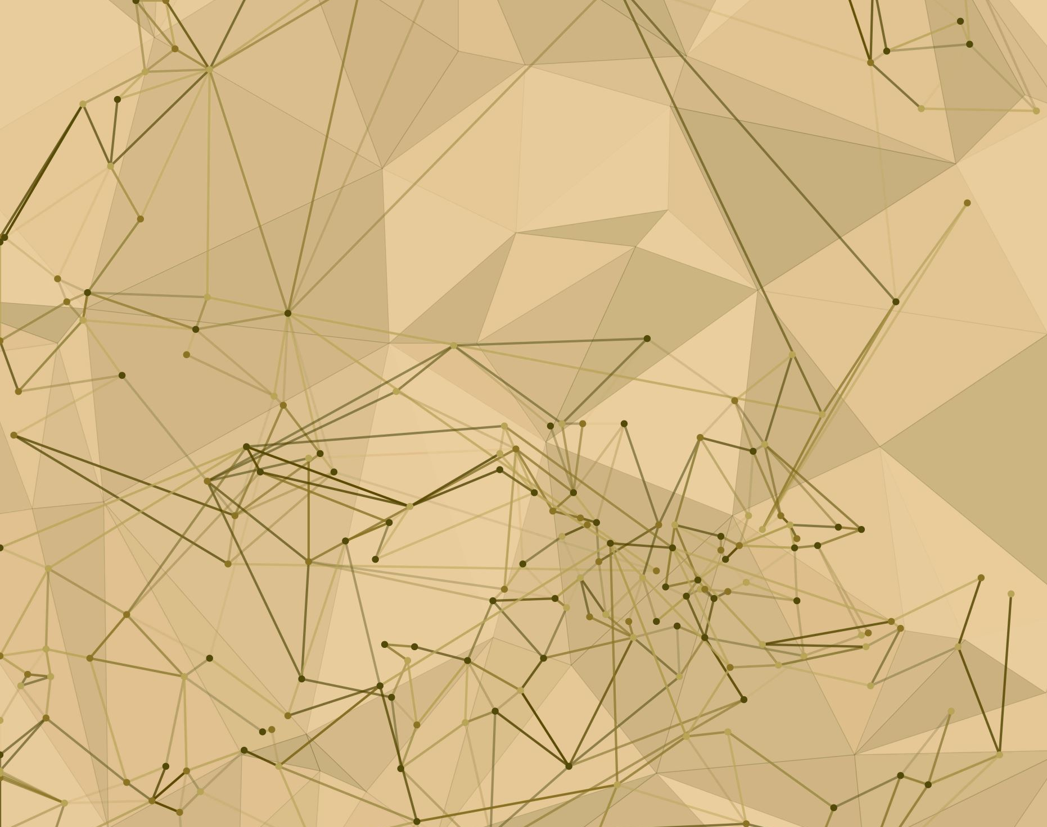
Computer Vision
Group E8
Initial idea

Slide 2
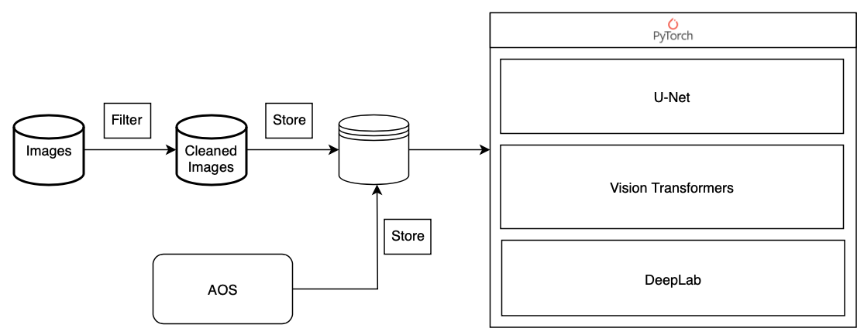
Architecture diagram
Training checkpoints

Slide 3
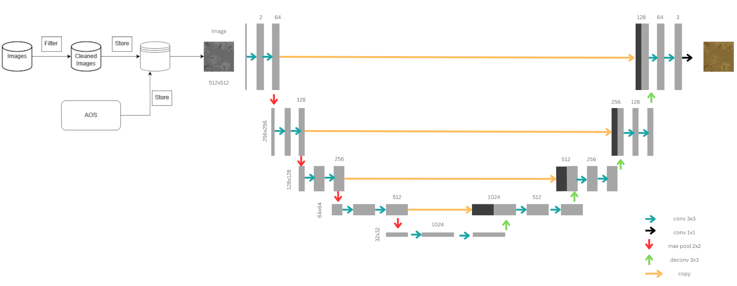
Example U-Net

Slide 4

Thank you for your attention
Feel free to ask questions

Slide 5
"From this point on, only slides from the first presentation are included, these remain hidden."

Slide 6
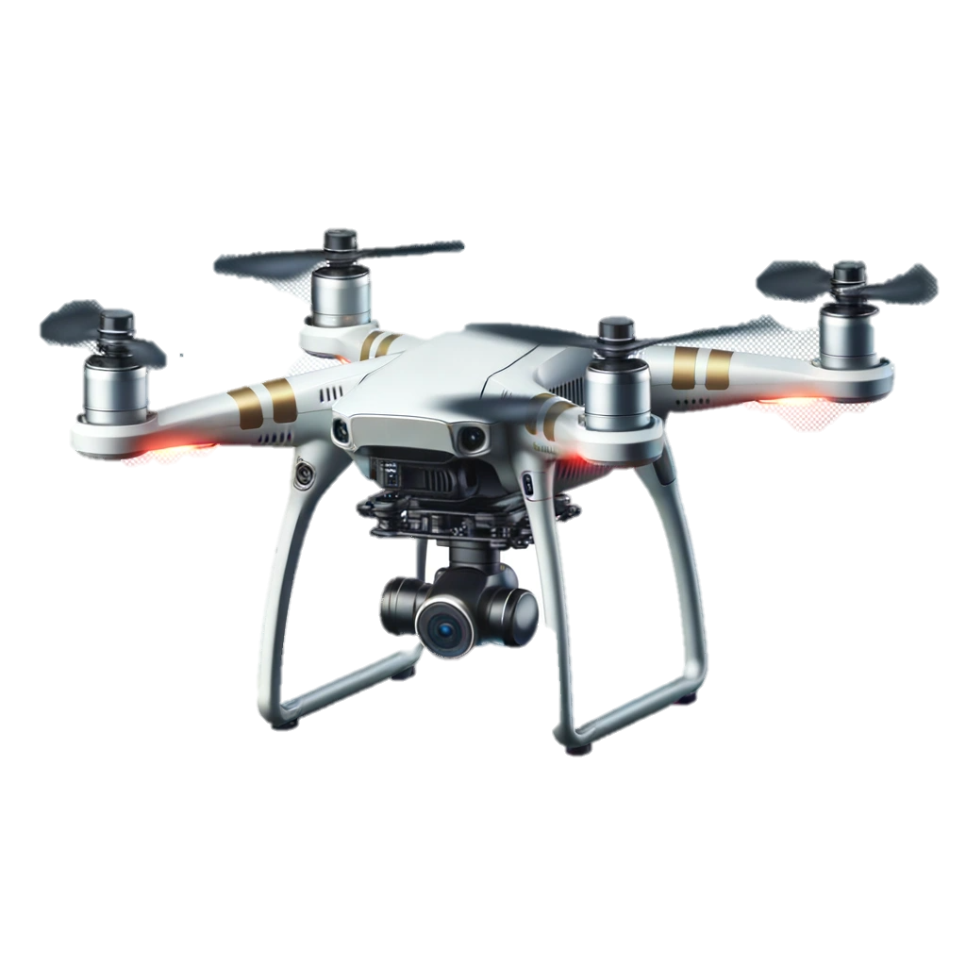
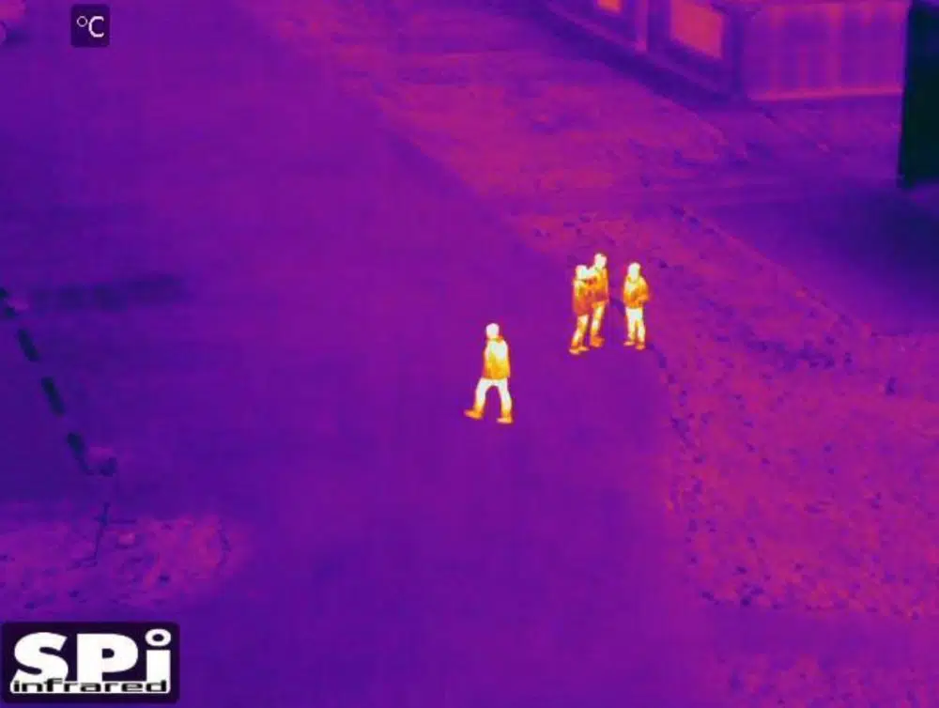
Motivation
Find humans in thermal drone images
Partial occlusion -> reconstruction necessary
Objective: Given stack of simulated thermal images, reconstruct an integrated ground truth image with pixels in (0, 1)
Image-to-Image transformation -> Can interpret as a (supervised) segmentation task

Slide 7
Architectures – Vision Transformer
Transformers are sequence-to-sequence models originally used for NLP
Vision transformers adapt the Transformer to handle images
Image is cut into a grid of smaller patches
Patches are flattened into a fixed-length vector to yield “tokens” for the transformer
In our case, we pose the problem as a “translation” task in the domain of images

Slide 8
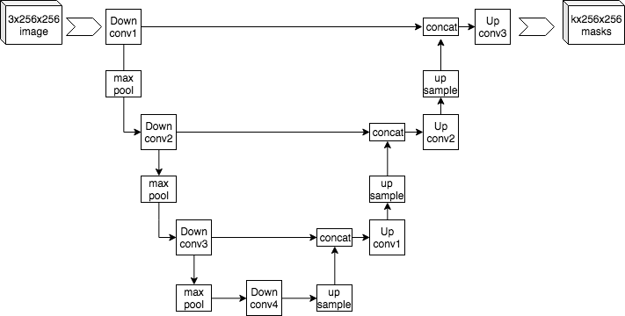
U-Net
From project basics and related work
U-Net: Multi-layered convolutional neural network
Skip connections add context at multiple layers
Up-sampling allows classification of each pixel without explosion in parameter count

Slide 9
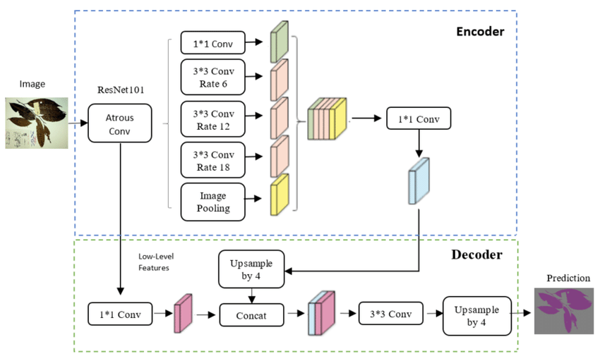
DeepLabV3
From project basics and related work
DeepLabV3 is an advanced deep learning model designed for efficient and accurate pixel-level segmentation
Key Features:
Atrous Convolution
Atrous Spatial Pyramid Pooling (ASPP)
Skip Connections
Various Backbones
Notes:
Atrous Convolution: DeepLabV3 uses atrous convolution to increase the field of view of filters, enabling the model to understand larger context without increasing the computational cost. This is crucial for capturing fine details in images while maintaining efficient computation.
Atrous Spatial Pyramid Pooling (ASPP): ASPP is a new component in DeepLabV3 that applies atrous convolution in parallel with different dilation rates. This allows the model to capture multi-scale information effectively, crucial for segmenting objects at different scales within an image.
Skip Connections: Although more prominent in its predecessors, DeepLabV3 continues the use of an encoder-decoder structure. This structure, along with skip connections, helps in refining the segmentation results by combining deep, semantic information with shallow, high-resolution information.
Various Backbones: DeepLabV3 is designed to be flexible with various backbone networks (e.g., xception, resnet, mobilenet), making it adaptable and efficient for different segmentation tasks.

Slide 10
Vision Transformers

Slide 11
Loss Functions
Want: Differentiable optimization objective for use during training
Zhao et al. 2017 examines multiple loss functions for the image restoration task:
L_2
L_1
Structural Similarity Index (SSIM)
Multi-Scale Structural Similarity Index (MS-SSIM)
Proposes a novel loss function as a combination of MS-SSIM and L_1

