Slide 1
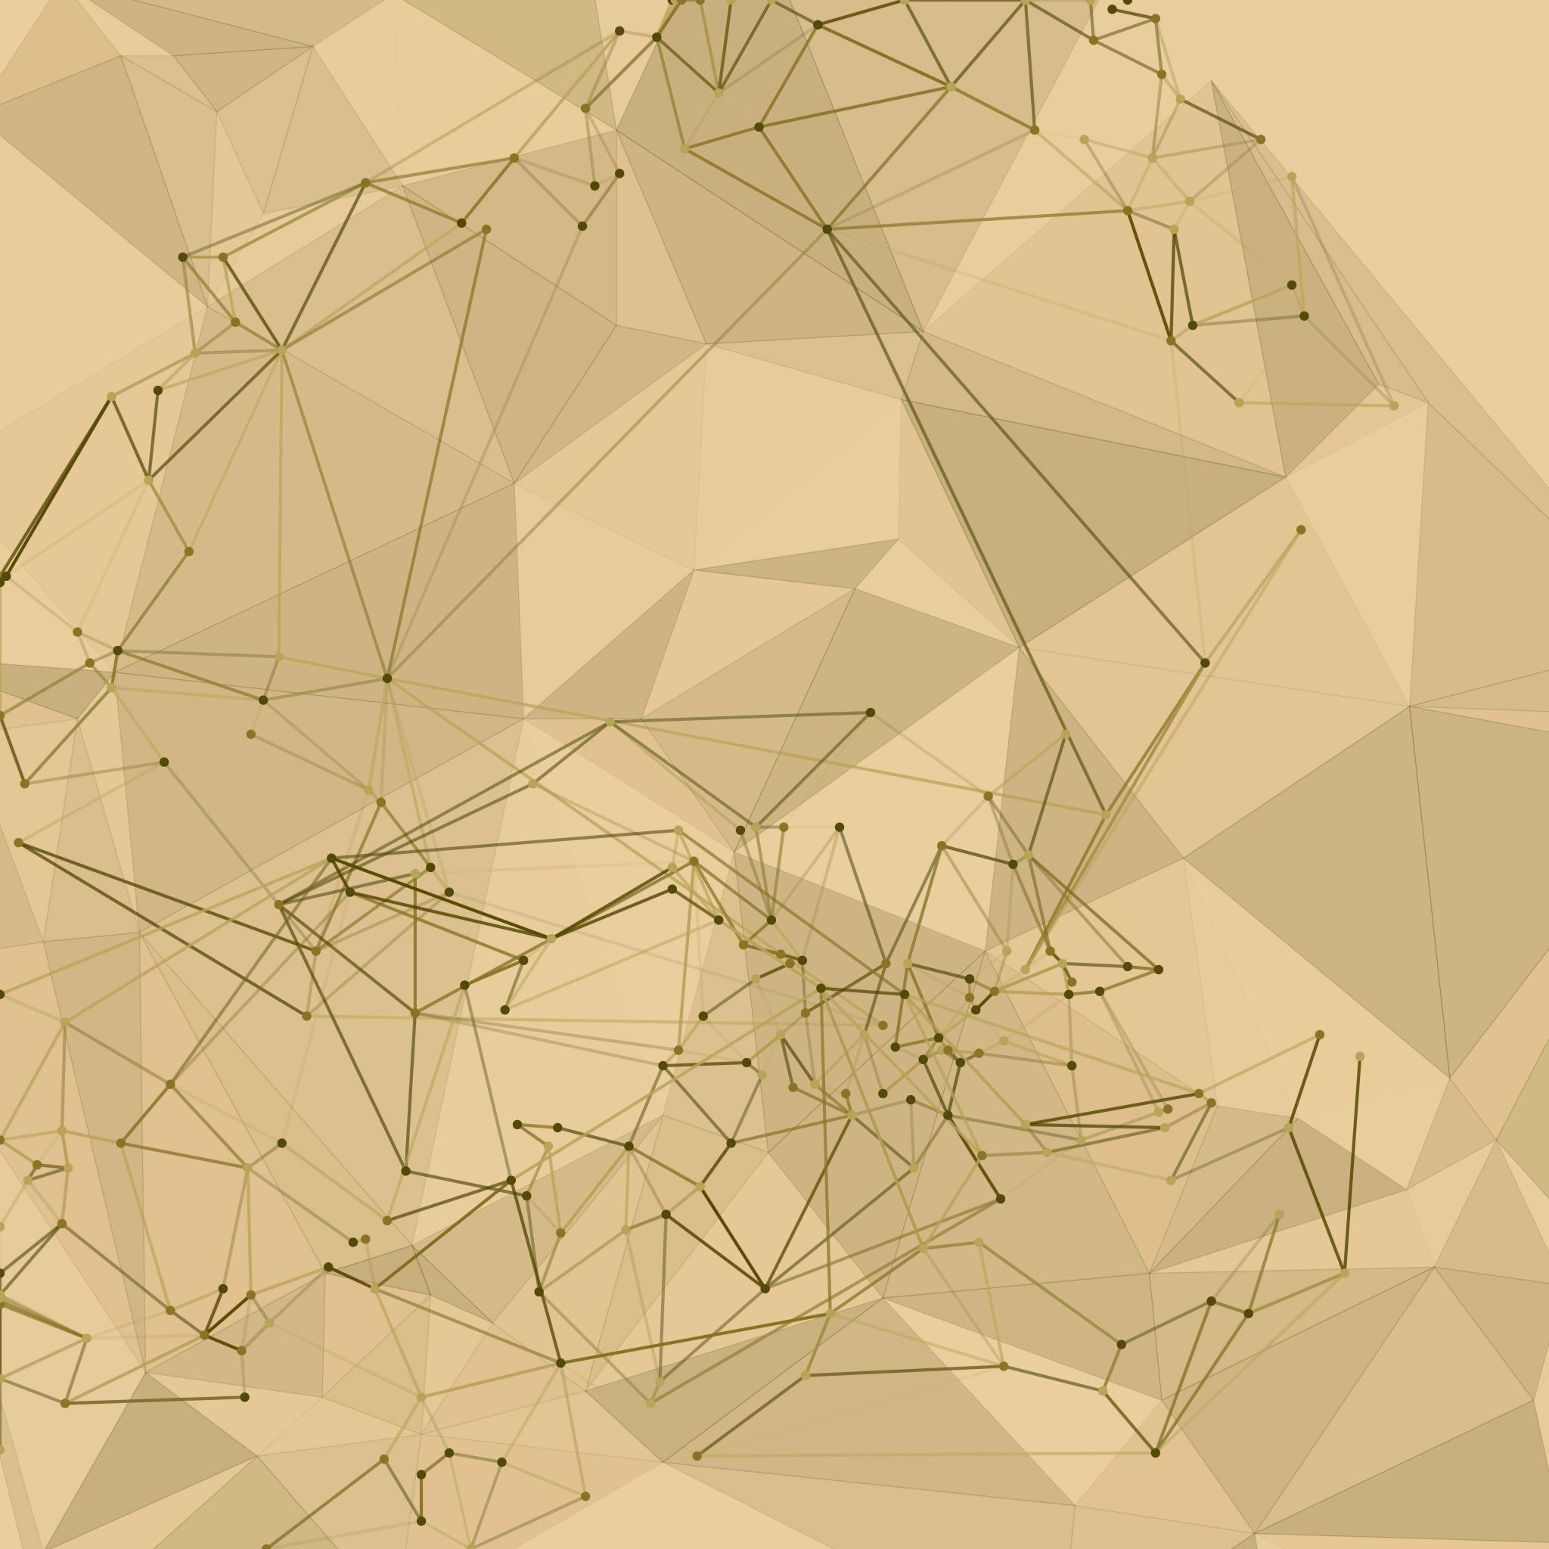
Computer Vision
Group E8
Intermediate results

Slide 2
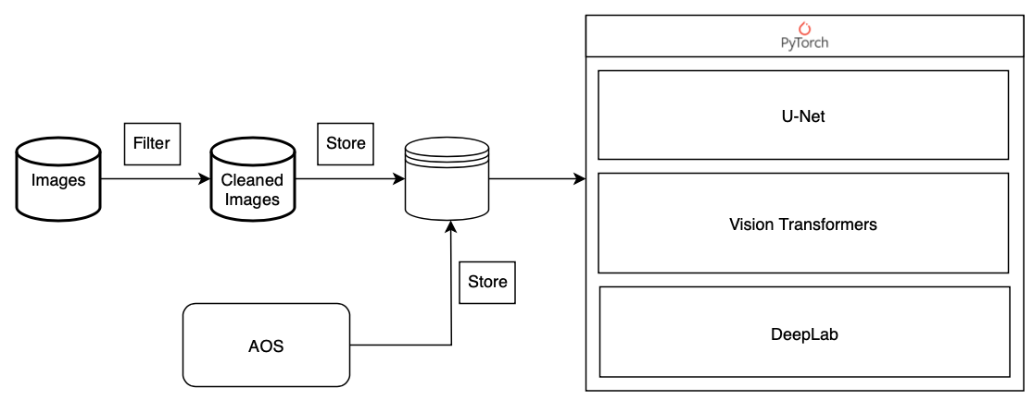
Software Pipeline
Training checkpoints
Notes:
Software Pipeline (enhance original diagram with more detail) (2 min)
Preprocessing✓
filtering✓
generation of AOS integrals✓
train/test split

Slide 3
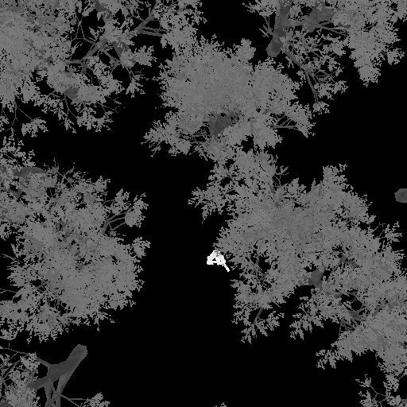
Custom data loader
Optionally resize images
Thresholds rounding for categorical outputs

Slide 4
Training
block diagram for neural net
One training loop for multiple models

Slide 5
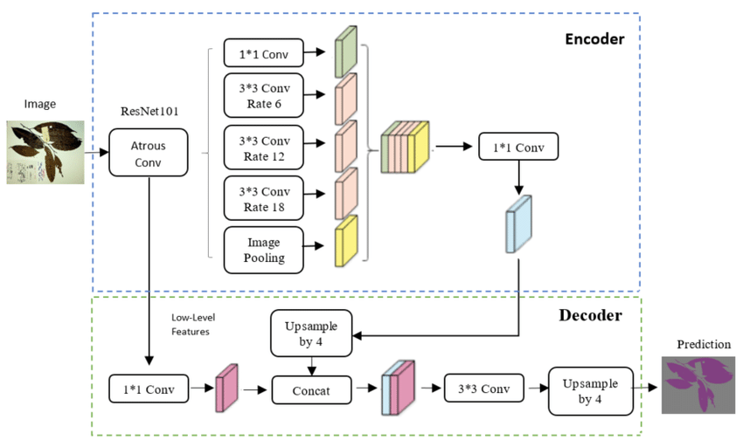
DeepLabV3
Delete what you do not need for your part!
DeepLabV3 is an advanced deep learning model designed for efficient and accurate pixel-level segmentation
Key Features:
Atrous Convolution
Atrous Spatial Pyramid Pooling (ASPP)
Skip Connections
Various Backbones
Notes:
Atrous Convolution: DeepLabV3 uses atrous convolution to increase the field of view of filters, enabling the model to understand larger context without increasing the computational cost. This is crucial for capturing fine details in images while maintaining efficient computation.
Atrous Spatial Pyramid Pooling (ASPP): ASPP is a new component in DeepLabV3 that applies atrous convolution in parallel with different dilation rates. This allows the model to capture multi-scale information effectively, crucial for segmenting objects at different scales within an image.
Skip Connections: Although more prominent in its predecessors, DeepLabV3 continues the use of an encoder-decoder structure. This structure, along with skip connections, helps in refining the segmentation results by combining deep, semantic information with shallow, high-resolution information.
Various Backbones: DeepLabV3 is designed to be flexible with various backbone networks (e.g., xception, resnet, mobilenet), making it adaptable and efficient for different segmentation tasks.

Slide 6
Training - Evaluation
accuracy (for categorical outputs)
train/test loss
accuracy
specificity

Slide 7
Training - Evaluation
precision
recall
F1 score
mean intersection over union (for categorical outputs)

Slide 8
Loss Functions
Delete what you do not need for your part!
Want: Differentiable optimization objective for use during training
Zhao et al. 2017 examines multiple loss functions for the image restoration task:
L_2
L_1
Structural Similarity Index (SSIM)
Multi-Scale Structural Similarity Index (MS-SSIM)
Proposes a novel loss function as a combination of MS-SSIM and L_1

Slide 9
Results
loss curves
sample images comparing input, output, target (use probability visualizations)
Comment on model performance

Slide 10
Outlook
Next steps
systematically compare pixel outputs to categorical outputs
examine performance with different stack sizes
Implement other architecture and compare?

Slide 11

Thank you for your attention
Feel free to ask questions

