Slide 1
Game Choice and story in games
Andreas Richardsen
”Games are a series of interesting decisions”
- Sid Meier
Notes:
Because it is simply one of the most powerful aspects of fun in gameplay, we need to look more closely at choice as an aspect of fun. What makes a choice interesting versus uninteresting? How can you design choices that are more interesting than not?
One of the most important aspects of choice is consequence. For a game to engage a player's mind, each choice must alter the course of the game. This means the decision has to have both an upside and a downside; the upside being that it advances the player one step closer to victory; and the downside being that it hurts the player's chances of winning. This concept seems simple, but you'd be surprised at how many games force the players to make choices that have no impact upon whether they win or lose.

Slide 2
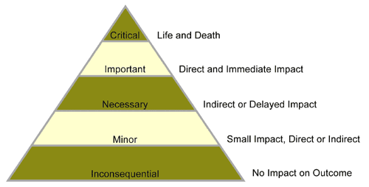
Contents
Types of decisions
Dilemmas
Puzzles
Rewards and punishments
Anticipation
Surprise
Progress
My choice
Notes:
As a designer, this is what you must strive for. But how do you make the choices in your game have significance? To start with, let's step back and analyse your game. What type of decisions are your players making? Are those decisions truly meaningful, or are they tangential to the main objective? To help analyse this, we use a tool we call the decision scale
If there are decisions in your game that seem "inconsequential" or "minor," you have a problem. Go back and rethink the choices you are giving your players. Is there a way to make those choices matter? And if there isn't, those choices need to be eliminated because they aren't adding anything to the game and are probably hurting the experience. Now take a look at the decisions higher up on the diagram. Is there a way to make some of your players' decisions fall into these categories? These are the types of decisions your players want to make.
But, unless your game is an arcade-style shooter, the decisions you ask your players to make shouldn't all be life and death. Nonstop action can get boring too--it's in the breather between waves of enemies that we can appreciate our accomplishments, anticipate the next wave, and steel ourselves for the battle ahead.
In order to create a truly engaging game, you want some peaks and valleys. Let the decisions rise and fall, and as the game progresses, ratchet up the tension by making the decisions gradually more important, until by the climax of the game, everything hangs in the balance.

Slide 3
Types of decisions
Hollow: no real consequences
Obvious: no real decision
Uninformed: an arbitrary choice
Informed: where the player has ample information
Dramatic: taps into a player’s emotional state
Weighted: a balanced decision with consequences on both sides
Immediate: has an immediate impact
Long-term: whose impact will be felt down the road

Slide 4
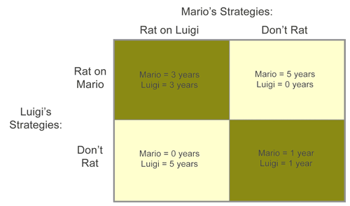
Dillemas
Game theorist John Von Neumann
Hierarchy payoff
Temptation for defection: zero years
Reward for mutual cooperation: one year each
Punishment for mutual defection: three years each
Sucker's payoff for unreciprocated cooperation: five years
Notes:
Dilemmas are the situations where players must weigh the consequences of their choices carefully, and in many cases, where there is no optimal answer. No matter what the player chooses, something will be gained and something will be lost.
Game theorist John Von Neumann used dilemmas as a framework for studying how people make choices, and how conflicts are resolved in both game-based and real world dilemmas.
To understand dilemmas, von Neumann broke them down into very simple structures, called moves. Each move was diagrammed on a matrix, showing the potential outcomes of each strategy as they pertain to each player.

Slide 5
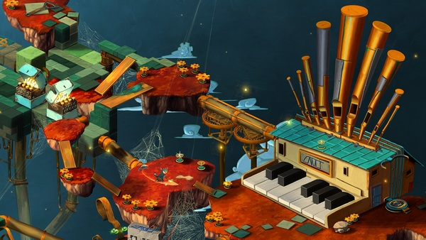
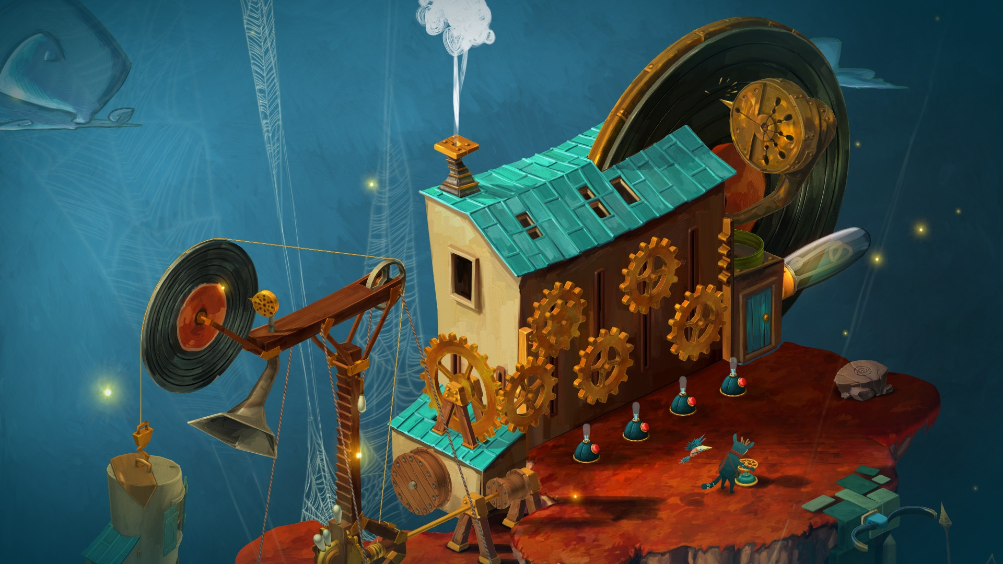
Puzzles
Solvable systems
Contextualize the choices that players make
Create conflict in single player
Not needed in multiplayer
Game designer = puzzle designer
Puzzle is a part of the game
Notes:
Another format for structuring interesting choices in your games is by incorporating puzzles. Puzzles are solvable systems. They can contextualize the choices that players make by valuing them as moving towards or away from the solution. Suddenly, the act of rifling through a treasure chest takes on new meaning if you are searching for the key to open the door to maze, rather than just looting the castle.
Puzzles are also a key element in creating conflict in almost all single-player games. There's an innate tension in solving a puzzle. If you tie this into a system of rewards for solving the puzzle and punishments for failure, the puzzle transforms into a dramatic element.
You'll notice that we keep using the qualification "single-player." This is because in multiplayer mode you don't need puzzles to provide conflict. The conflict comes from the competition with other players, whether they are human or computer-controlled. But in single-player mode, especially when you are sent on a quest or mission, puzzles play an increasingly important role. That's why every game designer should also consider herself a puzzle designer. The better your puzzle design skills, the better your game will be.
One consideration when designing puzzles in your games is to make sure that the elements of the puzzle are woven into the fabric of the game. By this we mean that it advances the player towards his overall goal. If a puzzle doesn't enable progress, it's a mere distraction and should be redone or removed. A puzzle may also advance the storyline. You can use the puzzle to tell the player something about the unfolding plot.
If you can integrate your puzzles into the gameplay and the story, they won't feel at all like "puzzles," but rather like integral, interesting choices a player must make to progress in the game as a whole.

Slide 6
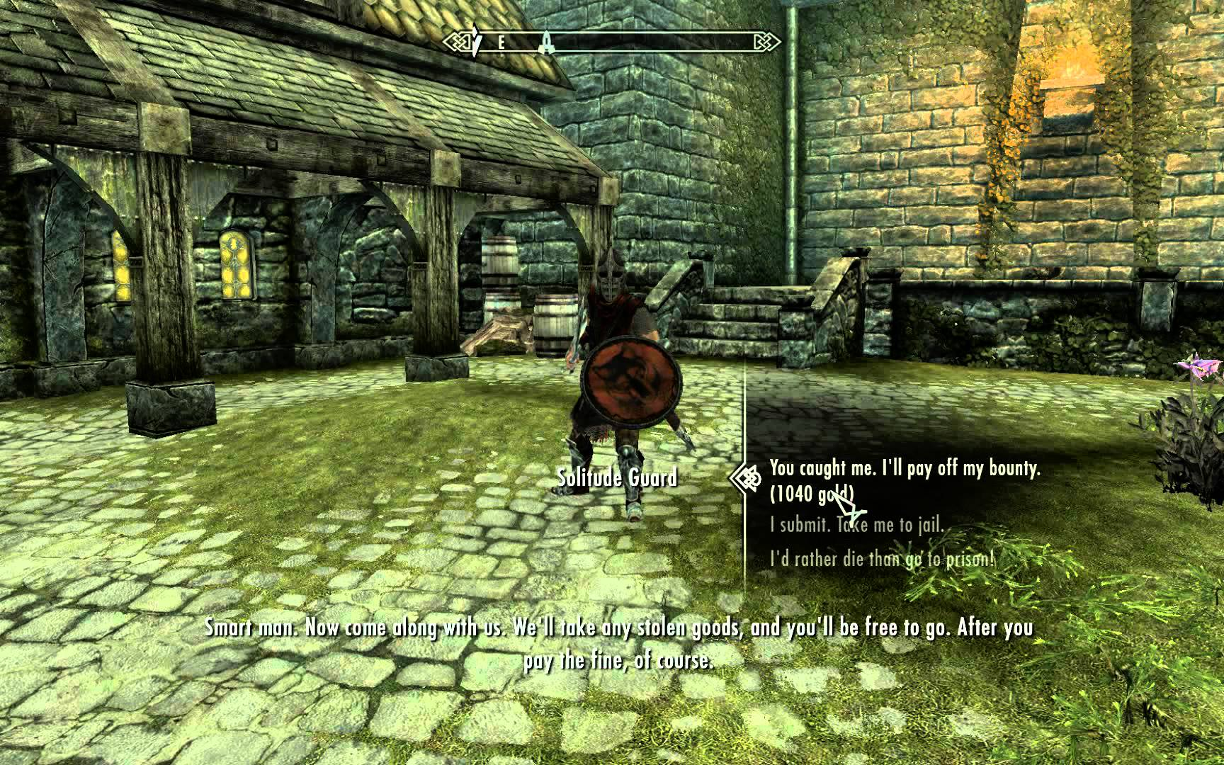

Rewards and punishments
Types of rewards
Rewards that are useful in obtaining victory carry greater weight
Rewards that have a romantic association, like magic weapons or gold, appear more valuable
Rewards that are tied into the storyline of the game have an added impact.
Operant conditioning
Skinner box
Fixed interval
Fixed ratio
Random ratio
Recognition
Notes:
The most direct consequences for player choices are rewards and punishments. Obviously, players enjoy being rewarded and dread punishments. Nothing is more natural. So when designing a game, a designer often emphasizes the rewards, while limiting the punishments. This makes sense; players aren't playing games to suffer the hardships of life. And in reality, you don't want to punish players so much that they stop playing your game. But often, the threat of punishment, if not the actual punishment itself, carries a dramatic tension that can add layers of meaning to even the most trivial choices a player makes.
Stealing in Skyrim, punished if caught, rewarded by getting the item for free if successful.
The timing and quantity of rewards is also critical. If you give a steady stream of small rewards, it can become meaningless. Players know the rewards are coming, no matter what they do and they stop caring.
Operant conditioning claims that the frequency of performing a given behaviour is directly linked to whether it is rewarded or punished. If a behaviour is rewarded, it is more likely to be repeated. If it is punished, it becomes suppressed. It is usually explained by using the example of a "Skinner Box," a glass cage equipped with levers, food pellets, and drinking tubes. Rats are placed in the cage and rewarded with a food pellet for pressing the lever, using reinforcement to shape their behaviour.

Slide 7
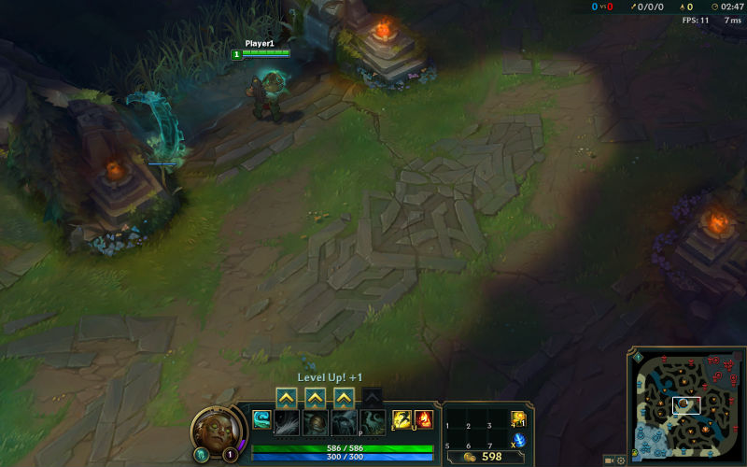
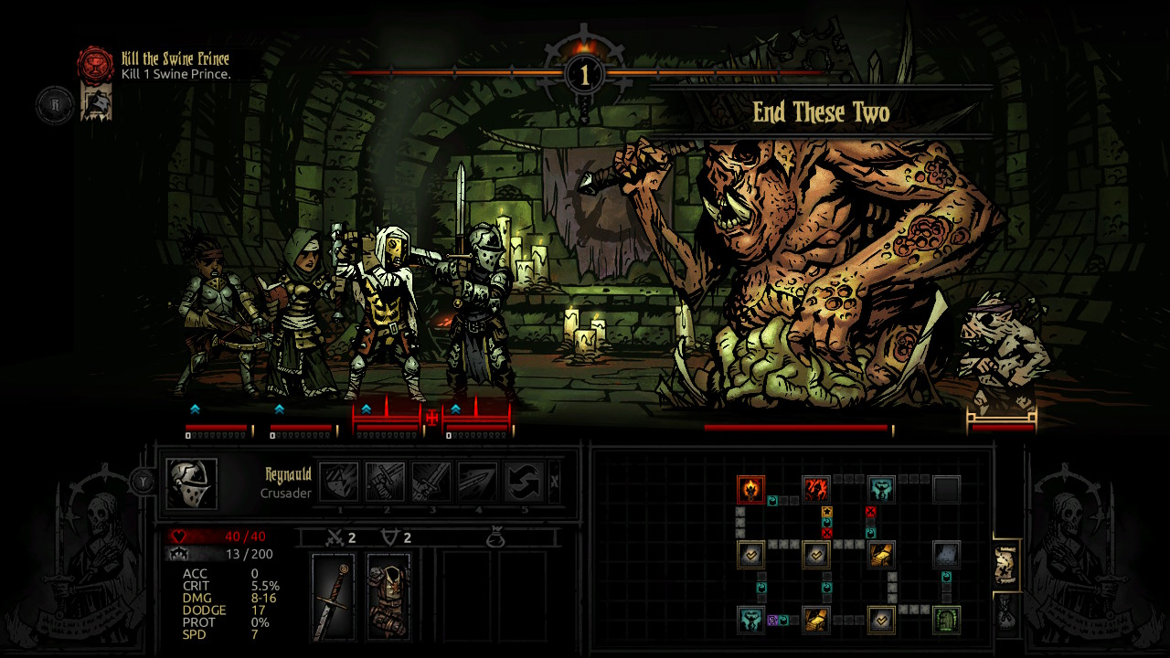
Anticipation
Chess
League Of Legends
CS:GO
Darkest dungeon
Notes:
In this example, players accept the lack of information as one of the conditions of the game and understand that their job is to maximize their position given the limited information they have available. In fact, the lack of visibility can increase a player's sense of tension. With the knowledge that the game state is in flux, players feel compelled to act swiftly to counter anticipated enemy moves. In many ways, the hiding of knowledge has added a new dramatic twist that is lacking in the completely open strategy games.

Slide 8
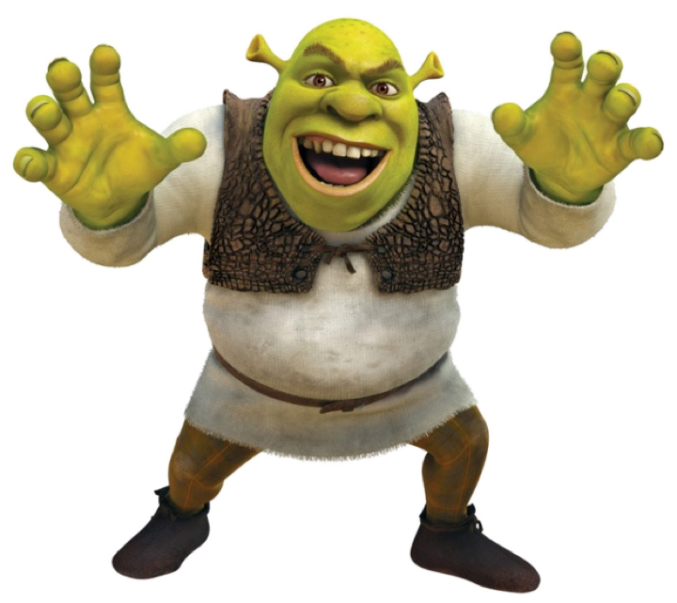
Surprise
Random but good
Send a soldier with 20%
Choice remains dominant
Notes:
Surprise is one of the most electrifying tools at a designer's disposal. People love to be surprised, especially when they feel they should have anticipated the event. Too many surprises will alienate players, however, so, how do you know when to use surprise and when to telegraph an event?
Surprises may feel random to players, but in a good way. The trick is to find the right balance between the randomness of surprise and the importance of making player choices meaningful. Take the example of a real-time strategy game, where you might send a simple foot soldier up against an ogre because he's all you've got. The foot soldier has strength of one to five, while the ogre has strength of one to 20. Odds are that the ogre will win. But there's always that chance, no matter how small, that the foot soldier will prevail.
In most well- designed games, the element of choice remains dominant. If every choice a player makes results in random effects, they will feel like their choices have no meaning. But keep surprise in mind; used judiciously, it can create a wealth of fun and excitement.

Slide 9
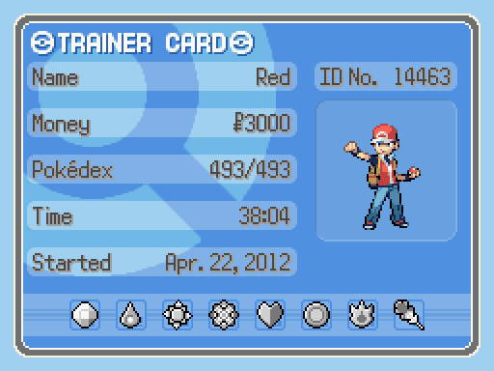
Progress
Joy from advancing
Milestones
Mini arcs
Memorable moment
“The journey, Not the destination matters…”
- T.S. Elliot
Notes:
Nothing is quite as satisfying as seeing the choices you make result in progress. It's part of human nature to derive joy from the act of advancing towards a goal. The small payoffs along the way are often sweeter than the final victory. The same is true in a game. Allowing players to feel they are moving forward is the best way to draw someone into a game and keep them engaged.
One approach for structuring progress is to design milestones for the players. These are small goals along the way to the grand goal of winning. Advertise these milestones to the players so that they know what they're striving for, and reward them after each accomplishment.
When you consider the pacing of progress that players can make in the game, you might also consider the typical amount of time a player spends with a game. Veteran game designer Rich Hilleman with Electronic Arts says that their designers plan "mini-arcs" of about one hour into the overall game progress. This is because that is what they have found the length of time the average gamer plays for in a single sitting.
At the end of each mini-arc, the designers try to make sure the player encounters a "memorable moment" of gameplay, which makes sure they will return for another play session. These mini-arcs, when aggregated, form the overall dramatic arc of the game.

Slide 10
My Choice
Types of decisions
Obvious
Informed
Weighted
Immediate
Long-term
Dilemma
Rewards and punishments

Slide 11
Future implementations
Puzzles
Surprise
progress

Slide 12
Thanks for listening

