Slide 1
Applied Machine Learning for Senior Leaders

Slide 2
Today…
Solve a prediction challenge
Explore and understand our data with Python
Think about how our data is connected, and test our theories
Use our findings to build our first model, and see how it performs
Use our model to make predictions
Tutorial: bit.ly/ml-for-board
Notes:
Purpose of today is to help you understand what is practically involved in solving a problem with AI, and give you a high level overview of the practical steps your team might be going through
run through list now
We’ll introduce you to a dataset you can explore, and start thinking about how different parts of your data might connect
We’ll test those connections, and use those to build a model
Finally, we’ll use that model to make predictions

Slide 3
Our Data, and our Challenge
We’ve built a fake dataset
Each row represents a benefit claimant, that has been suspected of fraud, over the last 12 months
Divided into:
a training dataset (270 individuals) where a human has manually verified whether fraud was commited
a test dataset (30 indivuals) where we’ll aim to predict whether or not fraud was committed
Can we build a model to predict whether claimants have comitted fraud?
Notes:
run through slide
This is a fake dataset, but the method will be similar to problems you’re all familiar with, for example:
Will pupils sucesfully graduate?
Will prisoners re-offend?
Our challenge is to predict whether those 10% will commit fraud, based on what we know about the 90%
Now open the dataset in Excel, and walk through it
Step through each column, explaining what it means in turn
So, let’s start thinking about our data, and our challenge…
Do you think any one column in our data may affect any other column? and if so, how?

Slide 4
Relationships in our data - Correlation
To make a model, we need to understand how one variable in our data is affected by the others
A good place to start is with correlation
Correlation is a statistical measure of how much two things are related to each other, whether they increase or decrease together, or if there is no relationship at all.
Notes:
start with slides run through
Remember what we’re trying to achieve here: understanding how different parts of our data connect, so we can build a model
Correlation might sound complicated, but it’s really just a mental shortcut to understand how to parts of our data relate
It starts at 1 (perfect correlation): for example, if your weight went up by 1 kilo for every 10 cms you grew
In the real world, we rarely have correlations of 1 - but we might have correlations between 0.3-0.5, described as moderate
And of course, lots of different data points have no correlation, around 0, meaning no apparent connection
And you can also have negative correlation - that’s just flipping the lines the other way around
So remember our first example? A correlation of -1 would mean mean you lost 1 kilo for every 10 cms you grew

Slide 5
Examples of Correlation
How well is a person’s age in years correlated with…
their age in months
their income
the length of their name
Notes:
let’s go through some examples
Our correlation of 1 is a perfect straight line
And our correlation of 0 is just random noise
You can have negative correlation - you just flip the lines around

Slide 6
Let’s code it!
training[['age','years_in_labour_force']].corr()
How would you interpret these coefficients?
Can you find features linked to fraud?
Notes:
So how do you do those things in code?
Here is us checking correlation between age and years in the labour force from our data
Our right correlation shows correlation between age, and years in the labour force, and you can see that’s a very strong correlation, as we’d expect
On the left, you can see the correlation between age and age…which is of course 1!
Now it’s time to get coding!
You’re going to open your notebooks, and follow the instructions until you reach our first Practical 2 - Regression
Remember what we’re trying to achieve, find features correlated - Participants should find a weak correlation between age, and years in the labour force, and weak negative correlation with years in education

Slide 7
Building our first regression
model = smf.ols(formula='years_in_labour_force ~ age', data=training) results = model.fit() results.summary()
For now, we’ll focus on our R-squared value
Notes:
Remember how easy it was to code our first correlation? Now let’s build our first model
First we’ll walk through it via slides, so don’t start yet.
Explain that we have three steps:
first we define our model - so here we want to understand how years in the labour force is affected by age, or how you could predict someone’s years in the labour force based on their age
You then fit your model - this is where your computer does the processing to fit that model
Then you ask it to see the summary of what it’s found!
Python will provide you with a range of values, but won’t worry too much about them for now - for now, we’ll focus on only one, the R-Squared

Slide 8
Understanding R-Squared
R-squared is a measure that tells us how well our data fits our model
I like thinking of it as how “good” our model is, in percentage terms
So a model with a R-squared of 1.0 fits 100% of our data, while 0.5 would fit 50%
It’s a little like correlation…but with a lot more potential!
Notes:
Walk through our bullet points
So why is this important? Because your data should represent the real world, and a model that fits the real world, is the mark of a good model!
In the real world, there are concerns around simply perfecting your fit - Laura briefly discussed over-fitting, for example - but for now, we’re focusing on improving our model

Slide 9
Regression Example - Restaurant Bills
model = smf.ols(formula='tips ~ bill', data=all_bills)
Unable to display output for mime type(s): text/html
Unable to display output for mime type(s): text/html
Notes:
To explain how this improves on correlation, here is our dataset we’ve created.
This is data around restaurant bills - showing the total bill on the horizontal axis, and the tip on the vertical axis.
At first glance, you can see this looks noisy: it looks inconsistent, and we’d expect a pretty low correlation
And sure enough, if we were to make a model like this, we’d have a poor R-squared value
but…

Slide 10
model = smf.ols(formula='tips ~ bill + gender', data=all_bills)
Unable to display output for mime type(s): text/html
How does it change when we add features?
Notes:
But the magic of regression is we aren’t limited to two different bits of data! Here, we’ve added the gender of the waiter
Notice how suddenly, our data doesn’t look so noisy!
Now, it’s turn to practise building your first regression! - Participants code until practical 3
Which was your best model?

Slide 11
Making our predictions
Now we have our model, how do we make predictions?
We just pass it our test data!
model = smf.ols(formula='committed ~ age + years_in_labour_force + years_of_further_education+', data=train) results = model.fit() predictions = results.predict(test)
Notes:
So, let’s recap. You’ve explored your data, make some intuitions about how different parts relate, and used those to build a model.
But remember the point of this exercise is to make predictions on new data
Reveal the code now
Notice how similar your code is - but instead of summarising, we ask it to predict.
And here are our two first predictions!
Notice we don’t have an actual prediction… we have a number. Youl could think about this as a percent chance… but the best way to do that is set a threshold. So let’s do that!
Give participants time to finish the noteboook

Slide 12
Notes:
So, here is a random sample of our predictions
5 random participants - we’ve now got predictions!

Slide 13
From here… to AI!
We’ve understood how our data connects, and combined it into a model
The same core methods and principles apply to both what you’ve done today, and cutting edge AI
Notes:
So, a recap. Today, you have, with code:
Approached a real problem
Understood your data, explored how it behaves, and built a model
And used that model to make predictions
What you have done today is no differnet to what data scientists in your departments are doing everyday (or fancy consultants)
Those predictions might appear simple, and the model simple, but the intuition and principles, from here to AI, are based on two differences
Scale
Shape
To illustrate that…

Slide 14
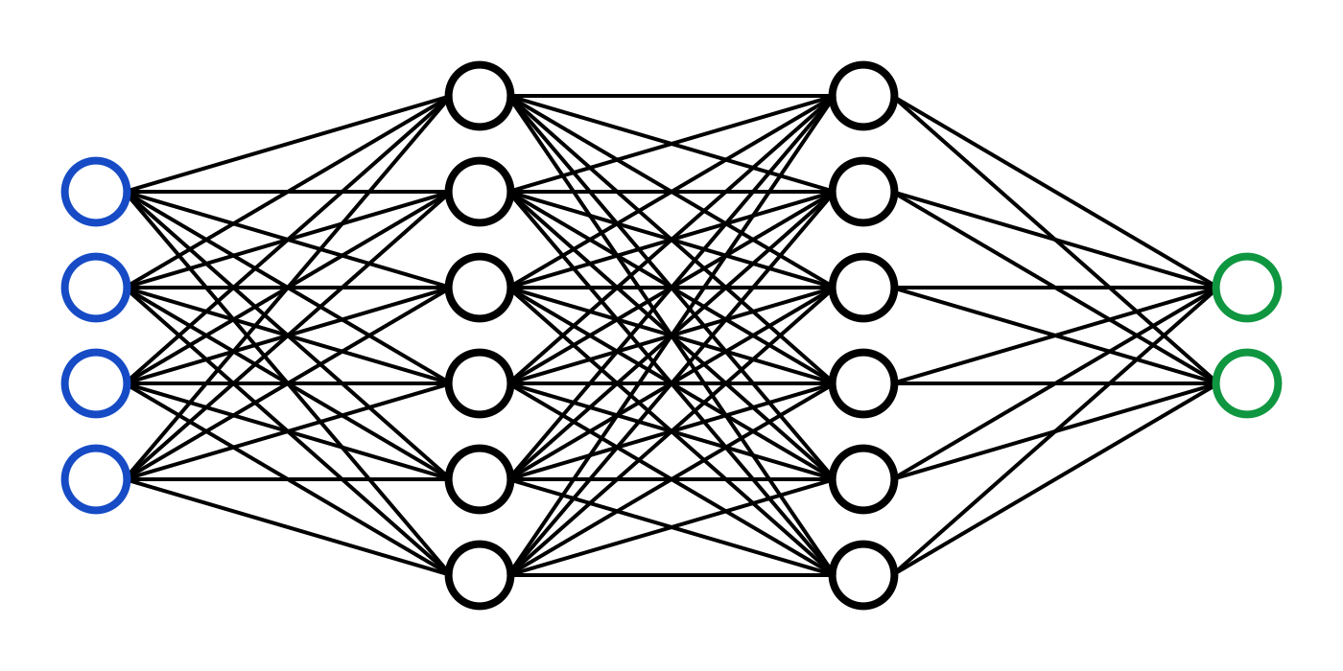
Notes:
This neural network powers models from ChatGPT to image creation
And each of those nodes, at it’s core, is a linear model
There are far more, and they’re more complex, but it’s the first step.

Slide 15
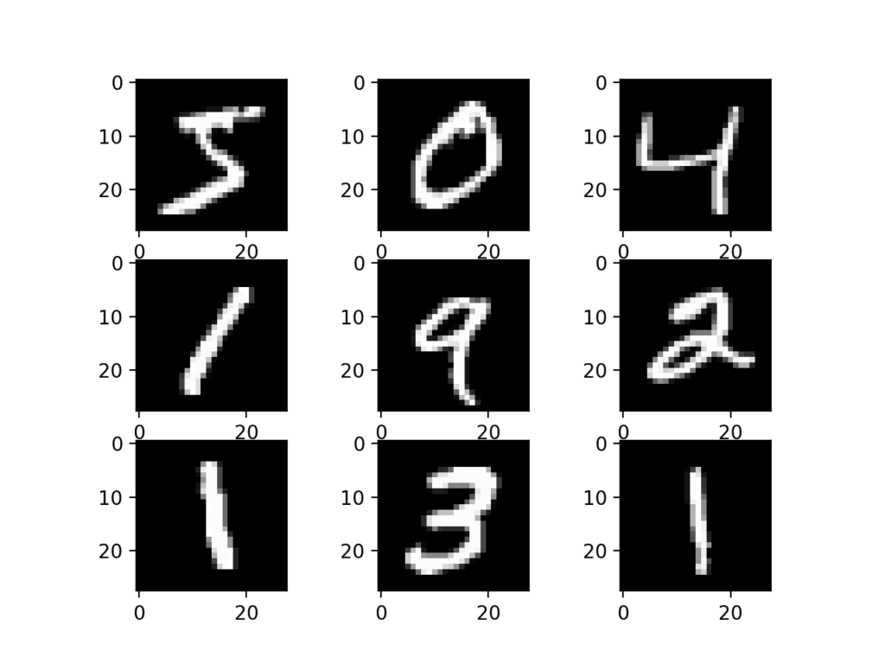

Slide 16
Notes:
To illustrate that, here is a dataset, where people predict handwritten numbers…
For example, whether something is the number two

Slide 17


Slide 18
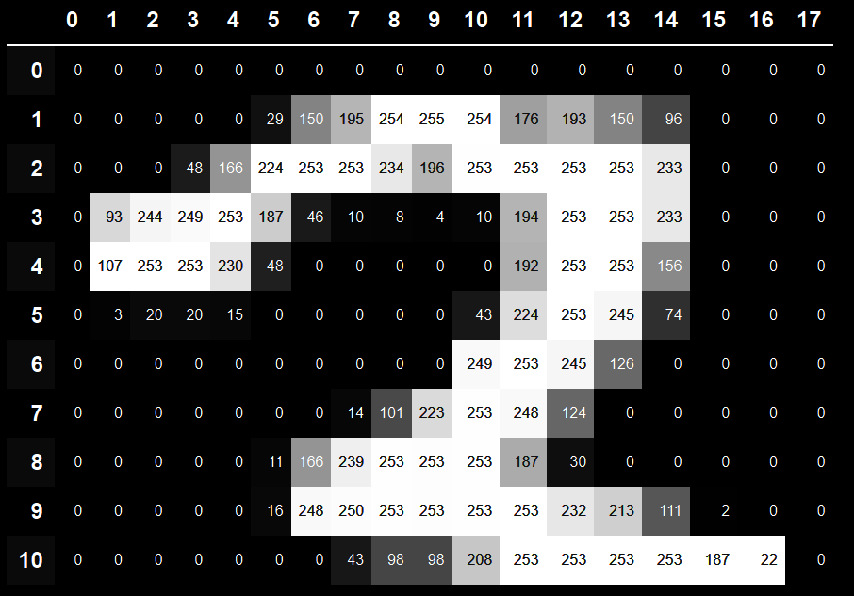
Notes:
Today, you’ve made predictions on 270 rows of data, between 0 and 1
All this two is is 170 rows of data, between 0 and 256, representing how dark pixels are

Slide 19

Thank you!
avarotsis@no10.gov.uk
Notes:
Bring to a close
By giving your staff the chance to learn explore, you build the foundations for AI
We’re keen to help - reach out with any questions, and support your staff to take part in Evidence House

