Slide 1
Icons in JGISShell
Andreas W. Bartels

Slide 2
Agenda
Motivation
Java – Framework
Code Generierung
  Datenbasis
  Ant - Task
  Fehlerhändlig
  Ergebnis
Eclipse Plugin

Slide 3
Motivation
Probleme mit Icons bei der Arbeit
  Welche Icon habe Ich zur Verfügung?
  Wie kann Ich von Wo auf vorhandene Icons zugreifen?
  Wie vermeide Ich redundance?
  Wie erhalte Ich die konsistents im Workspace?
Gutes Fortbildungsprojekt -
da Technisch Komplexes aber überschaubares Scenarium
  Java – Framework
  XML-Schema und Jaxb für XML-Reader
  Ant Task für Code Generierung
  Eclipse Plugin für Usability

Slide 4
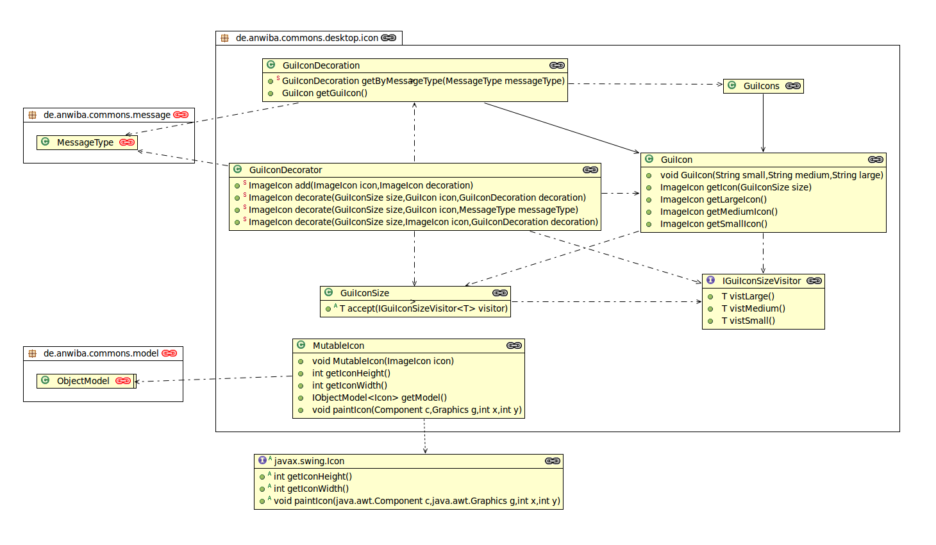
Icons - Framework

Slide 5
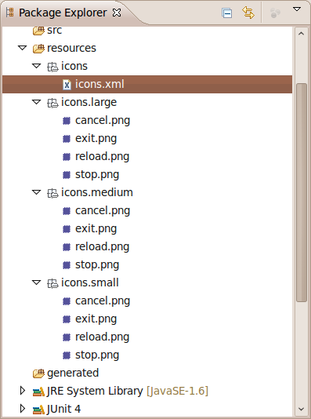
Code – Generierung - Datenbasis
<?xml version="1.0" encoding="UTF-8" standalone="yes"?>
<icons>
<class name="GuiIcons" package="de.anwiba.commons.desktop.icon" />
<icon name="CANCEL_ICON" image="cancel.png" />
<icon name="EXIT_ICON" image="exit.png" />
<icon name="RELOAD_ICON" image="reload.png" />
:
</icons>

Slide 6
Code – Generierung – Ant Task
<?xml version="1.0"?>
<project name="icons" basedir="../..">
<macrodef name="icons.generate">
<attribute name="source" default="" />
<attribute name="target" default="" />
<attribute name="force" default="on" />
<attribute name="aggregate" default="on" />
<sequential>
<icons.generator iconclass="de.anwiba.commons.desktop.icon.GuiIcon"
source="@{source}"
target="@{target}"
force="@{force}"
aggregate=”@{aggregate}” />
</sequential>
</macrodef>
<taskdef name="icons.generator"
classname="de.anwiba.tools.icons.ant.task.GuiIconsGeneratorTask">
<classpath>
<fileset dir="../ThirdParty/icons/" includes="*.jar" />
<fileset dir="../ThirdParty/xml/jaxb" includes="*.jar" />
</classpath>
</taskdef>
</project>

Slide 7
Code – Generierung - Fehlerhändling
force = on
[icons.generator] de.anwiba.commons.desktop.icon.GuiIcon
[icons.generator] search file: /home/andreas/work/JGISShell/Commons_Desktop_Core
[icons.generator] add file: /home/andreas/work/JGISShell/Commons_Desktop_Core/resources/icons/icons.xml
[icons.generator] medium image viewmag.png is not available
[icons.generator] class de.anwiba.gis.desktop.map.icon.MapGuiIcons
[icons.generator] large image move.png is not available
[icons.generator] class de.anwiba.gis.desktop.map.icon.MapGuiIcons
[icons.generator] no image table.png available
[icons.generator] class de.anwiba.commons.desktop.icon.GuiIcons
[icons.generator] conflict, multiple definition for image resource TABLE_ICON
[icons.generator] class de.anwiba.commons.desktop.icon.GuiIcons
[icons.generator] class de.anwiba.commons.desktop.icon.GuiIcons
[icons.generator] create file: /home/andreas/work/JGISShell/Build/src/de/anwiba/commons/desktop/icon/GuiIcons.java]

Slide 8
Code – Generierung - Fehlerhändling
force = off
[icons.generator] de.anwiba.commons.desktop.icon.GuiIcon
[icons.generator] search file: /home/andreas/work/JGISShell/Commons_Desktop_Core
[icons.generator] add file: /home/andreas/work/JGISShell/Commons_Desktop_Core/resources/icons/icons.xml
[icons.generator] no image table.png available
[icons.generator] class de.anwiba.commons.desktop.icon.GuiIcons
[icons.generator] java.io.IOException: no image table.png available
[icons.generator] de.anwiba.commons.desktop.icon.GuiIcon
[icons.generator] search file: /home/andreas/work/JGISShell/Commons_Desktop_Core
[icons.generator] add file: /home/andreas/work/JGISShell/Commons_Desktop_Core/resources/icons/icons.xml
[icons.generator] conflict, multiple definition for image resource TABLE_ICON
[icons.generator] class de.anwiba.commons.desktop.icon.GuiIcons
[icons.generator] class de.anwiba.commons.desktop.icon.GuiIcons
[icons.generator] java.io.IOException: conflict, multiple definition for image resource TABLE_ICON

Slide 9
Code – Generierung - Ergebnis
// Copyright (c) 2010 by Andreas W. Bartels (bartels@anwiba.de)
package de.anwiba.commons.desktop.icon;
import de.anwiba.commons.desktop.icon.GuiIcon;
public class GuiIcons {
public final static GuiIcon CANCEL_ICON = new GuiIcon("icons/small/cancel.png",
"icons/medium/cancel.png",
"icons/large/cancel.png");
public final static GuiIcon EXIT_ICON = new GuiIcon("icons/small/exit.png",
"icons/medium/exit.png",
"icons/large/exit.png");
public final static GuiIcon RELOAD_ICON = new GuiIcon("icons/small/reload.png",
"icons/medium/reload.png",
"icons/large/reload.png");
}

Slide 10
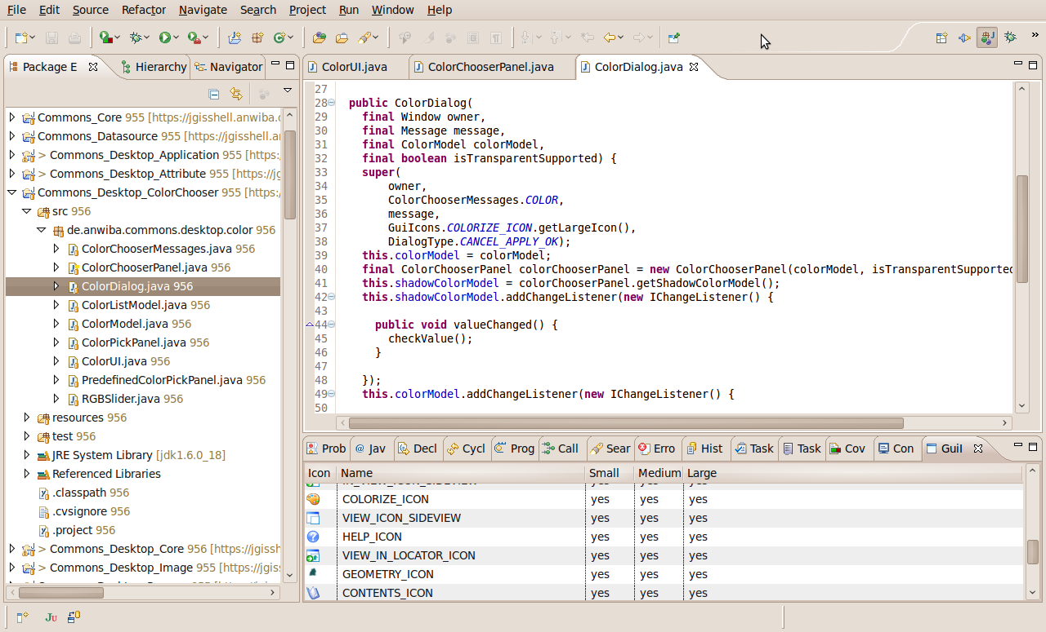
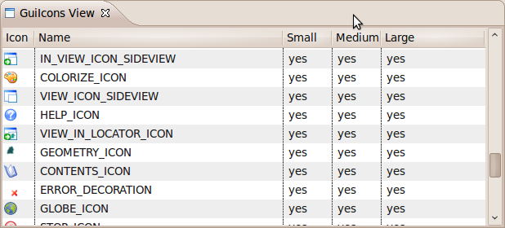
Eclipse - Plugin

Slide 11
Fazit
Welche Icon habe Ich zur Verfügung?
Jetzt Antwort über Eclipse-Plugin bzw. Metadaten
Wie kann Ich von Wo auf vorhandene Icons zugreifen?
Jetzt Antwort über Eclipse-Plugin
Wie vermeide Ich redundance?
Referenzierung von Icons
Wie erhalte Ich die konsistents im Workspace?
Überwachung bei der Code-Generierung

