Slide 1
Predicting which songs Andreas likes
FRTN65 Lab 1, Andreas Olsson, October 2026
736
labelled songs after dropping duplicates
11
methods through one protocol
0.830
cross-validated accuracy of the chosen random forest
Notes:
Ten minutes. The short version: eleven methods, one evaluation protocol written before any result, and a random forest that wins by a small but consistent margin.

Slide 2
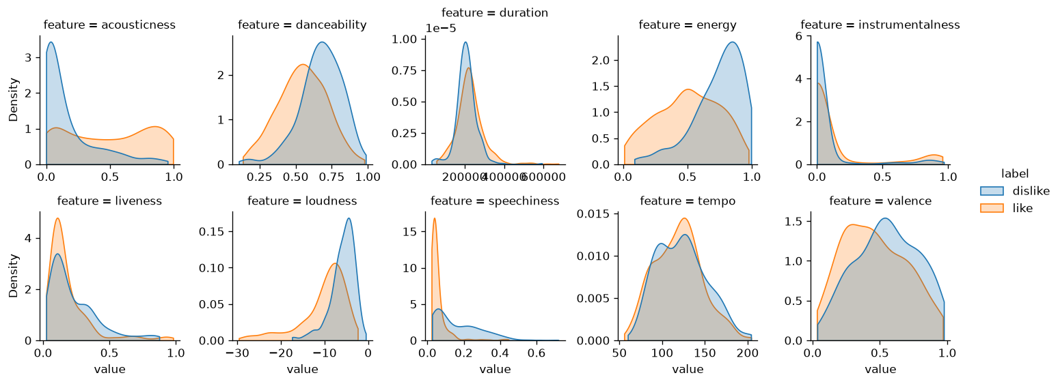
The data: one axis, loud versus acoustic
750 songs, 13 Spotify features, 60% liked, so always saying "like" scores 0.60
Liked songs are quiet, acoustic and nearly free of speech
Energy, loudness and acousticness are close to one feature (rank correlation up to 0.85)
Speechiness is the strong signal that is not that axis
Clean but not tidy: 12 songs repeated, heavy tails in duration, speechiness, instrumentalness
Notes:
Every song quieter than -20 dB is liked. 36 of the 43 songs above 0.33 speechiness, meaning rap or spoken parts, are disliked.

Slide 3
(1) The methods: lines, distances, densities
method | what it does | tuned
Logistic regression | linear log-odds, L2 shrinkage | C
LDA | Gaussian classes, one shared covariance, so a linear boundary | nothing
QDA | a covariance per class, so a quadratic boundary | shrinkage
kNN | majority vote among the k closest songs | k, weighting
Linear SVM | widest-margin hyperplane, soft margin | C
RBF SVM | the same margin in a kernel space, curved boundary | C, gamma
Notes:
The first four are the classic families from the course; the two SVMs differ only in the kernel. All share the same preprocessing.

Slide 4
(1) The methods: trees and their ensembles
method | what it does | tuned
Decision tree | recursive threshold splits, one tree | depth, leaf size
Bagging | 300 deep trees on bootstrap samples, averaged | leaf size
Random forest | bagging, but each split sees a random subset of features | features per split, leaf size
Gradient boosting | shallow trees added one by one, each fixing the last one's errors | rate, depth, rounds
AdaBoost | stumps, reweighting the songs the previous ones got wrong | rate, rounds
Dummy | always "like", the floor | nothing
Notes:
Bagging versus random forest is a controlled pair: the only difference is the random feature subsets, so their gap is what decorrelating the trees buys.

Slide 5
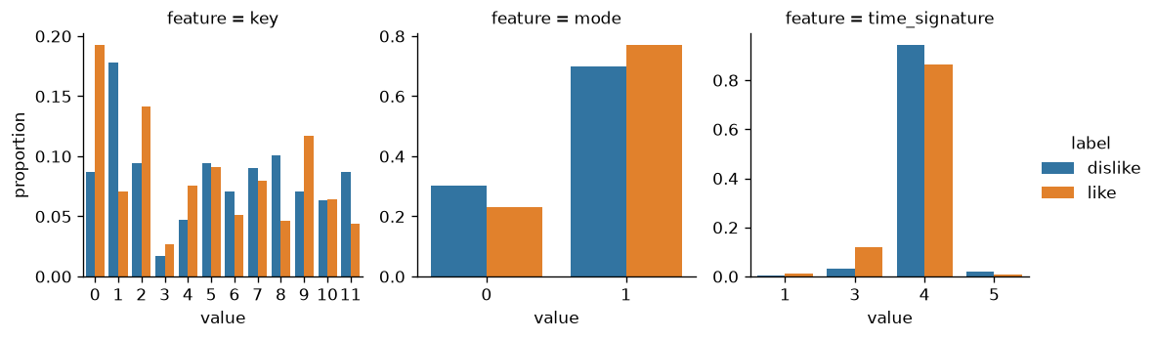
(2) How the inputs went in
All 13 features used, none dropped: the weak ones cost little and the forest ignores noise well
10 numeric features, standardised
key, mode and time_signature treated as qualitative and one-hot encoded: key 11 is not "more" than key 0, and meters are distinct, not points on a scale
14 exact duplicate rows dropped before any split, so a song cannot sit in its own validation fold
Scaling and encoding live inside each model's pipeline, learned on the training part only
Notes:
Trees do not need the scaler, but it changes no split, so every method keeps one pipeline shape.

Slide 6
(2) How parameters were tuned, and the rule written first
25
outer splits: 5-fold stratified CV, repeated 5 times, seed 65
5
inner folds: grid search inside each outer training part only
1
decision rule, committed before any model was fitted
Accuracy decides, since the leaderboard scores accuracy; balanced accuracy and ROC AUC are reported beside it
Every method sees the same 25 splits, so comparisons are paired
Errors use the Nadeau and Bengio correction, because the 25 splits share most of their data
The rule: of the methods within one corrected error of the best, take the one with the fewest tuned parameters
Notes:
Nested CV means the score of a tuned method never saw its own validation fold during tuning. Writing the rule first is what makes the choice a judgment rather than picking the biggest number after the fact.

Slide 7
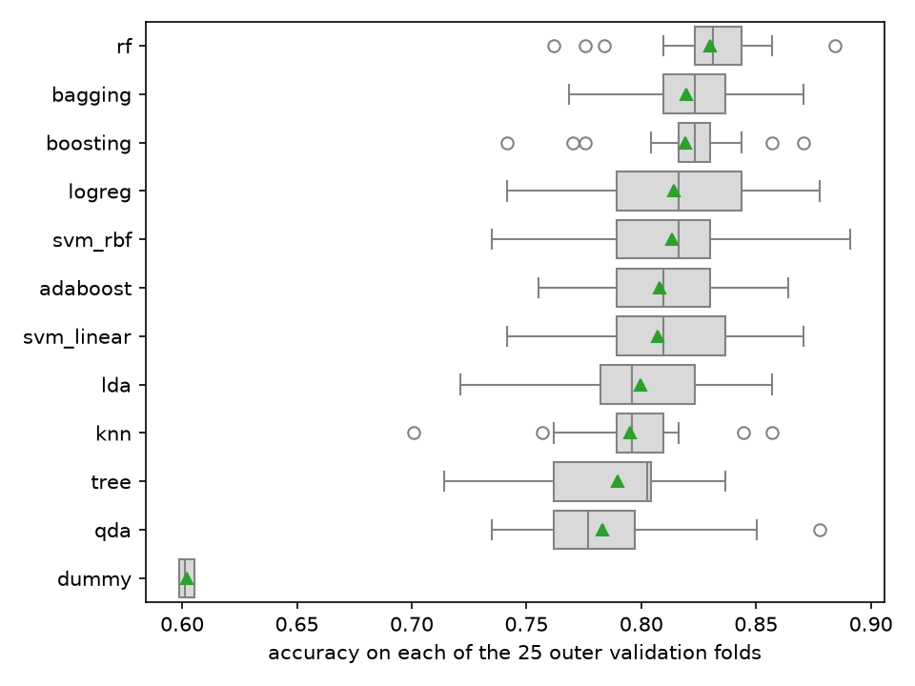
(3) Evaluation: the boxes overlap, the pairs do not
Each box is one method's 25 per-split accuracies, the triangle its mean
From rf down to LDA the boxes overlap almost entirely
Most of the spread is which songs land in a fold, and every method shares that
So methods are compared on their per-split differences, not their boxes
Notes:
This is why the comparison is paired. Read naively, everything above LDA looks the same.

Slide 8
(3) Paired against the best method
method | accuracy | gap to rf | corrected error | p | rf wins of 25
Random forest | 0.830
Bagging | 0.820 | -0.011 | 0.007 | 0.15 | 18
Gradient boosting | 0.819 | -0.011 | 0.009 | 0.24 | 19
Logistic regression | 0.814 | -0.016 | 0.015 | 0.29 | 18
RBF SVM | 0.813 | -0.017 | 0.015 | 0.28 | 17
LDA | 0.799 | -0.031 | 0.014 | 0.04 | 19
kNN | 0.795 | -0.035 | 0.014 | 0.02 | 22
Decision tree | 0.790 | -0.041 | 0.017 | 0.03 | 22
QDA | 0.783 | -0.047 | 0.020 | 0.02 | 22
Notes:
p is the corrected resampled t-test. AdaBoost (0.808) and linear SVM (0.807) sit between RBF SVM and LDA and are left off for space; the full table is in results/03-sweep.md. Four methods miss the one-error band by a hair.

Slide 9
(4) Conclusion: the random forest, read as bias and variance
0.830
random forest, ± 0.014 over 25 splits
A line captures the main axis; logistic regression reaches 0.814 with heavy shrinkage
What a line misses are thresholds and interactions (every song under -20 dB is liked), which trees find
One tree finds them but pays in variance (0.790); averaging 300 trees keeps the low bias and pays the variance down (bagging 0.820)
Random feature subsets decorrelate the trees and add one more point (0.830)
kNN and QDA were last: distances mixed with one-hot columns, and too many covariance parameters for 240 dislikes
Notes:
Boosting reaches the same place from the other side: low-variance learners, bias removed step by step. It ties with bagging.

Slide 10
(4) How sure: a small edge, honestly sized
~3
songs in 200: the forest's expected edge over logistic regression
0.80 to 0.86
what to expect on the 200 hidden songs
Only the forest falls inside the one-error band, so the rule picks it outright
A looser rule, "not significantly worse at 5%", would hold seven methods and pick logistic regression
The strictness was fixed before the numbers, which is what makes this a choice and not a sweep
First on accuracy, balanced accuracy and AUC alike, so the win is not bought by leaning on "like"
Notes:
If I had to defend logistic regression instead, I could: it is within noise. The protocol said in advance which end of that trade-off I would take.

Slide 11
Production: one refit, one read of the test file
200
songs predicted, 123 liked
Refit on all 736 songs with the same grid search: 300 trees, 25% of features per split, at least 3 songs per leaf
The inner search scored that setting at 0.837; the setting barely matters, the grid's surface was flat across the sweep
songs_to_classify.csv read once, by this model, after the decision
The string is in results/submission-2026-10-01.txt, one character per test song in file order
4 test songs also appear in the training file; the forest predicts their known labels
Notes:
make predict reproduces the string byte for byte.

Slide 12
The code: a small package, thin notebooks
src/songtaste/ holds the mechanism as one module per stage (data contract, features, protocol, comparison, prediction), each standing on scikit-learn, pandera and seaborn rather than code of my own, and tests/ checks the contract, the protocol, the rule and the string.
The notebooks are where I looked at things and results/ is where every number in these slides is written down, so uv sync && make data && make test && make sweep && make predict reproduces all of it.
AI use, per the lab's policy: the package, tests and first drafts of the written results and these slides were produced with Claude (Anthropic) coding agents, working from a plan and a design I set and approved.
Notes:
The sweep takes about 36 minutes on four cores; everything else runs in a minute or two.

