Slide 1
Predicting which songs Andreas likes
736 songs, 51 variants of 12 methods through one protocol, chosen method: <name> at <acc> ± <se>
FRTN65 Lab 1 · Andreas Olsson · October 2026
Notes:
Say the result, then say in words what the rule did: the four ensembles are equivalent, the rule picked the simplest of them.

Slide 2
The data runs along one axis: quiet, acoustic, wordless songs are liked
Densities normalised within class. Liked songs are quiet, acoustic and nearly free of speech; the discrete columns barely separate.
Notes:
From initial_exploration: single_feature_plots cropped to speechiness, loudness, acousticness, energy and one discrete column. Mention the 14 duplicate rows dropped before any split.

Slide 3
Feature pairs carry more than their parts
energy + speechiness, acousticness + speechiness: about +0.08
small gains sit inside the null
so a model that can bend along pairs should gain
Gain = pair ROC AUC minus the better single, depth-4 trees under cross validation.
Notes:
From initial_exploration: the pair gain bars and the energy + speechiness plot. The gain survives equal depth, repeated folds and a shuffled-copy null, which never exceeds +0.02.

Slide 4
(1) Twelve methods, what each does and what is tuned
xgboost is outside the course list, kept as a check on the boosting implementation.
Notes:
From METHODS and the SIMPLICITY comments: two columns, what it does, what is tuned. Twelve rows including dummy.

Slide 5
(2) How the inputs went in
all 13 features; 10 numeric standardised
key, mode, time_signature one-hot: key 11 is not more than key 0
spiky four (duration, speechiness, instrumentalness, liveness): log1p, robust and quantile scaling tried as variants
14 exact duplicates dropped before any split
scaling and encoding live inside the pipeline, fit on the training part only
With the defaults, 28 columns reach the model: 10 scaled numeric, 18 one-hot.
Notes:
From make_preprocessor and the Data cell. Say why key/mode/time_signature are qualitative, what was tried on the spiky four, and that preprocessing is fit inside each fold.

Slide 6
(2) The protocol, written before any number
metric: accuracy (the leaderboard); balanced accuracy and AUC reported beside
5-fold stratified, repeated 5 times, one seed: 25 paired outer splits
tuning: grid search inside each outer training part (5 inner folds)
error bars: std · sqrt(1/k + n_val/n_train), the Nadeau-Bengio correction
rule: within one corrected error of the best, take the fewest tuned hyperparameters
screen variants at 2 repeats; promote to 5 only if a variant beats its base by more than the error of the gap
Every method is scored on the same 25 splits, so every comparison is paired.
Notes:
Lift the Decisions markdown cell: accuracy primary because the leaderboard scores it, 5x5 stratified outer splits, grid search inside each outer training part, Nadeau-Bengio corrected errors, the decision rule, screen (2 repeats) versus full (5) and the promotion rule. Have the nested-loop pseudocode ready.

Slide 7
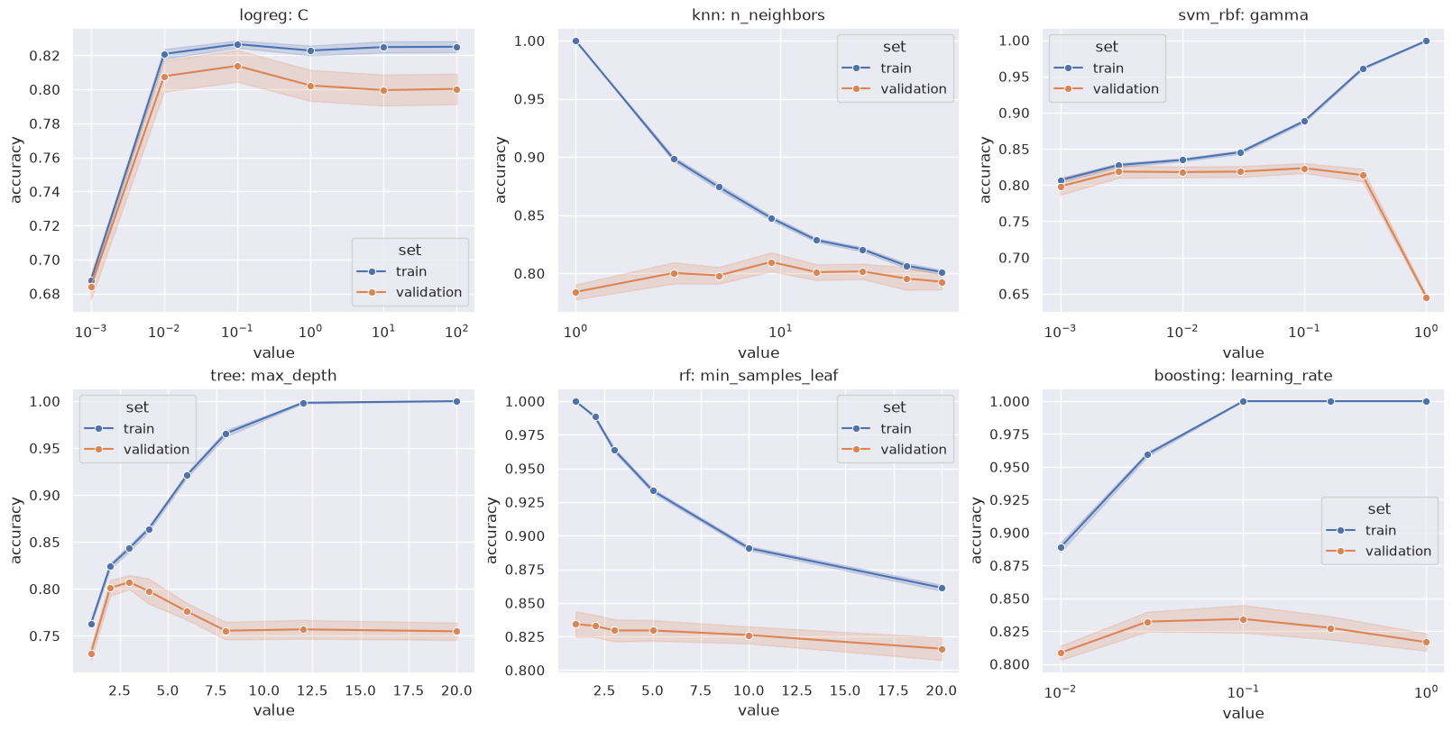
(2) What the searches chose, and why
Linear models want heavy shrinkage (C = 0.01); kNN's validation line is flat; the RBF kernel falls off a cliff at gamma = 1.
Notes:
Table of modal hyperparameters from the params column beside this figure, or on a build. logreg C=0.01 on 13/25, svm_linear C=0.01 on 19/25, tree depth 2, bagging leaf 3, rf max_features 0.25.

Slide 8
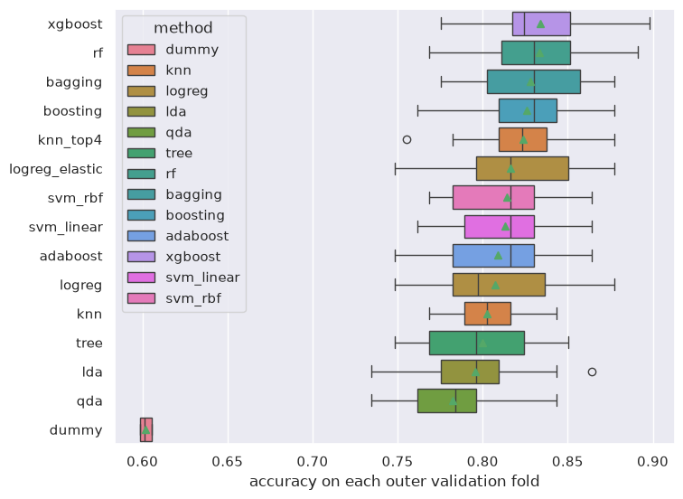
(3) Every method on the same 25 splits
Each box is one method's 25 validation accuracies; from xgboost down to logistic regression the boxes overlap, so the comparison has to be paired.
Notes:
The five-repeat summarize table goes on a build or the next slide: mean ± corrected error, balanced accuracy, AUC.

Slide 9
(3) Paired against the best, and the rule applied
Inside one corrected error: xgboost, rf, bagging, boosting, knn_top4. Fewest tuned hyperparameters among them: bagging. Best mean alone would pick xgboost.
Notes:
From paired_vs_best and decide: gap, se, p, best-wins. Say the strictness was fixed in advance and what two errors or best-mean would have chosen. Rerun after the SVM top4 / numeric variants get their full run.

Slide 10
(3) What the variants taught
kNN on the four strong features gains two points over kNN on all 13: the one-hot axes drown the distance
L1 and elastic net gain about two points over L2; L1 keeps the same few features
robust scaling costs kNN and the RBF SVM four points: a tiny IQR blows the tails up
scaling changes nothing for trees: tree_noscale equals tree split for split
Screen numbers (2 repeats), named as such.
Notes:
From the screen table. Each bullet is one motivation the rubric asks for, with a number.

Slide 11
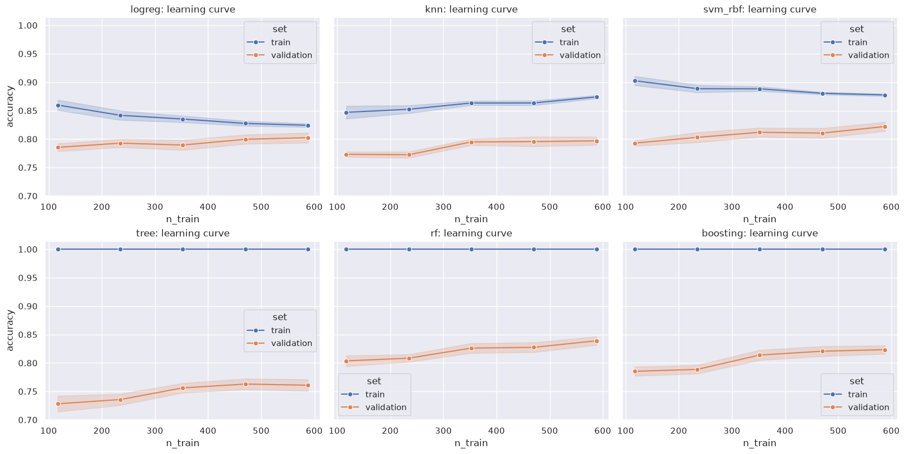
(3) Why: bias on the left, variance on the right
logreg: lines have met, bias limited
tree: biggest gap, variance limited
rf: still climbing at 590 songs
every method leans on speechiness first; key, mode, meter are zero
Training accuracy of the tree family is 1.0 at the defaults because they fit until pure; read the validation line.
Notes:
Learning curves left, permutation heatmap in the text column or on a build. Logistic regression bias limited (lines met), the lone tree variance limited, the forest still climbing at 590 songs. Speechiness is the one feature every method leans on; key, mode and time_signature are zero for all.

Slide 12
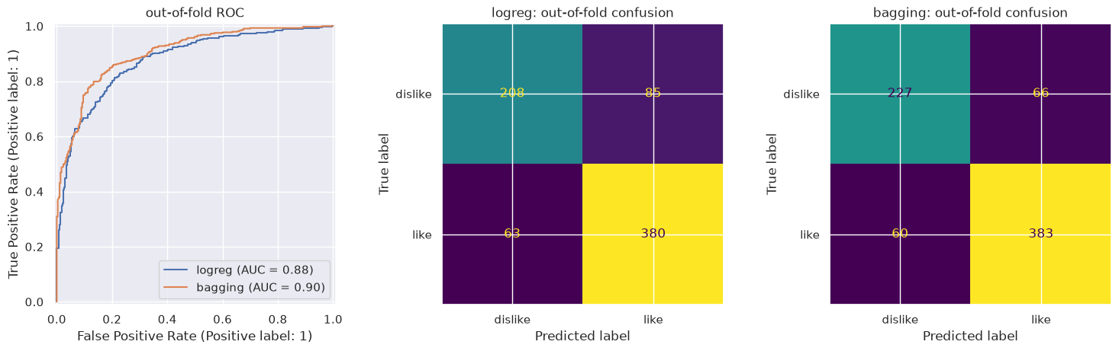
(4) Conclusion: <chosen method>, refit once, 200 songs predicted
Out-of-fold confusion: the gain over logistic regression is mostly on disliked songs (227 vs 208 right). Expect 0.80 to 0.86 on the 200 songs.
Notes:
Refit setting, the submission file, the honest range, and one line on the code: two notebooks, definitions up top, every number regenerable from the seed and the results CSV.

